Slide 1


Where Is My Money
WIMM
PROJECT BY EMIR AVCI
30866

Slide 2

HYPOTHESIS
By analyzing my bank account transaction data, I can identify significant spending patterns and develop personalized saving tips to reduce unnecessary expenses and improve financial management.

Slide 3





DATAS AND OVERALL PROCESS
Collecting Past Datas from Bank
Visualizing Datas
Analizing Data
In
I turn them into Pie Chart
I analized pie charts
I used my Akbank bank
statement for past 4 month:
September
October
November
December

Slide 4
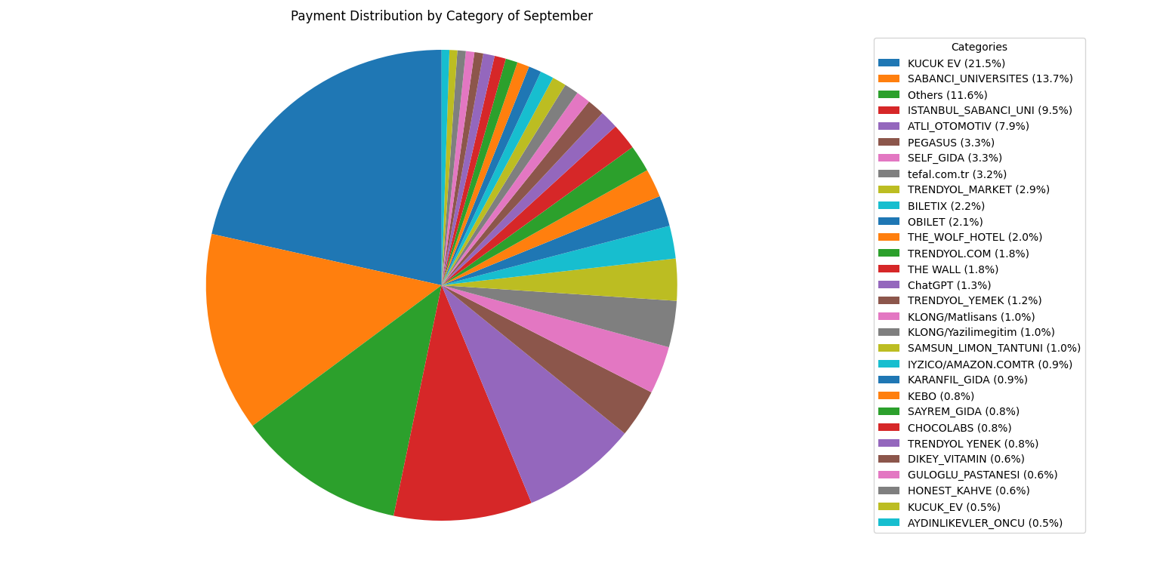
SEPTEMBER

Slide 5

SEPTEMBER:
Top Expenses:
01
KÜÇÜK EV (21.5%)
02
SABANCI ÜNIVERSITES (13.7%)
03
OTHERS (11.6%)
OBSERVATION:
Significant spending on Küçük Ev

Slide 6
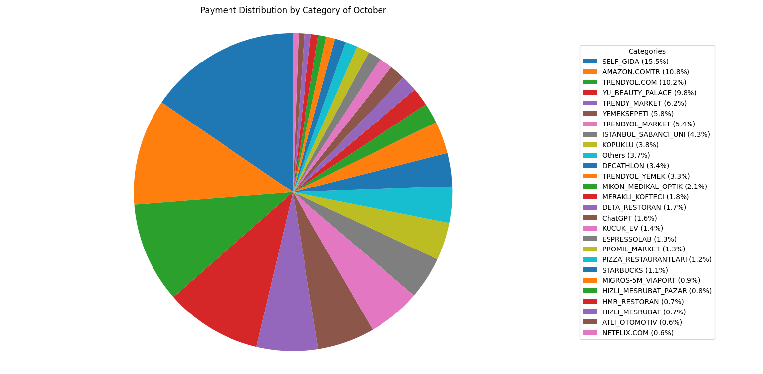

OCTOBER:

Slide 7
OCTOBER:
Top Expenses:
01
SELF GIDA (15.5%)
02
AMAZON.COM.TR (10.8%)
03
TRENDYOL.COM (10.2%)
OBSERVATION:
ONLINE SHOPPING PLATFORMS LIKE AMAZON AND TRENDYOL BEGIN TO DOMINATE SPENDING. FOOD SPENDING IS STILL PROMINENT.

Slide 8
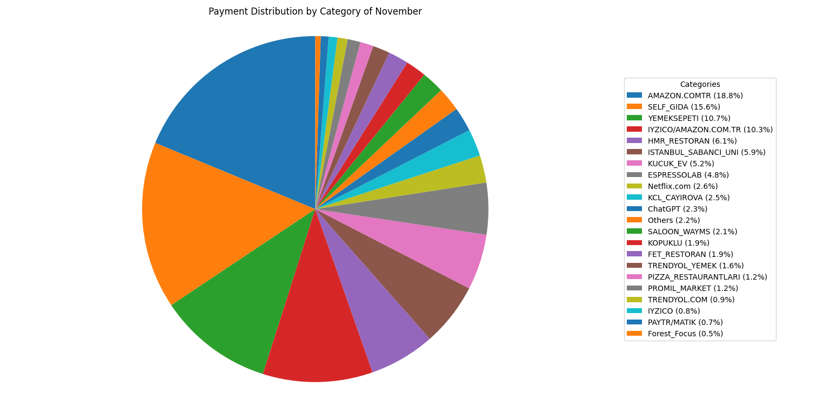
NOVEMBER:

Slide 9
NOVEMBER:
Top Expenses:
01
AMAZON.COM.TR (18.8%)
02
SELF GIDA (15.6%)
03
YEMEKSEPETI (10.7%)
OBSERVATION:
Amazon purchases represent a noticeable peak this month, indicating possible clothing or shoes. Food expenses (Self Gıda, Yemeksepeti) remain high.

Slide 10
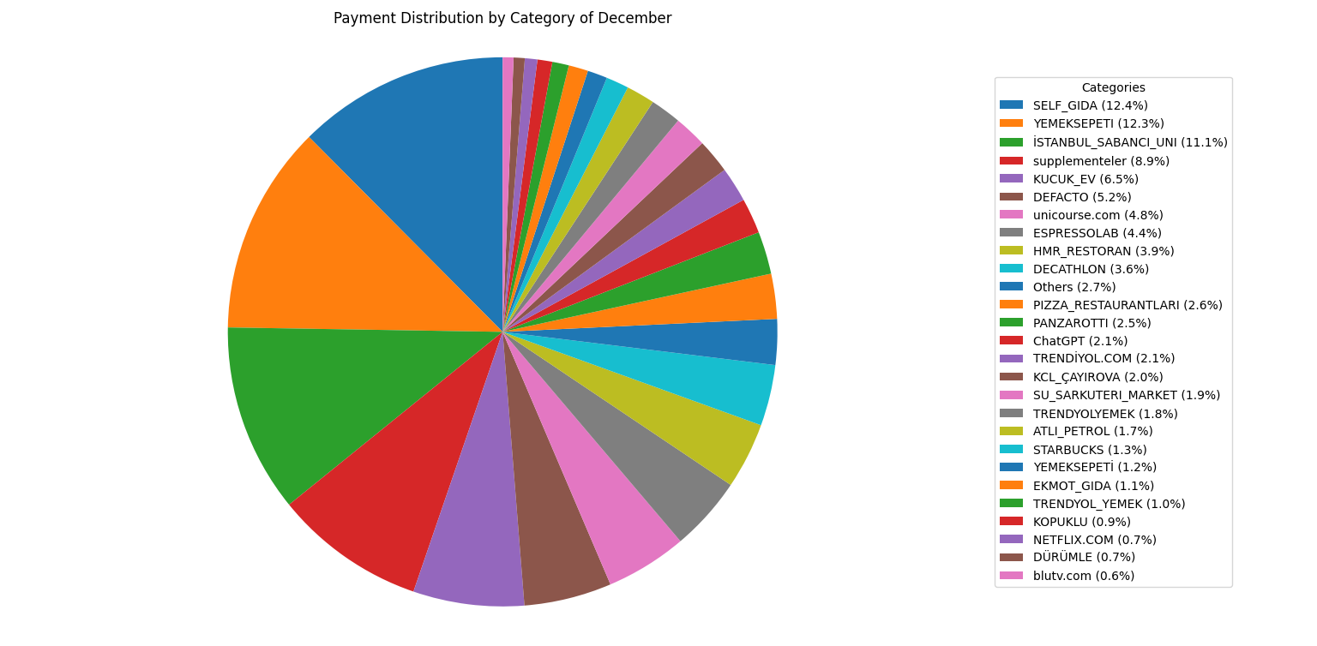

DECEMBER:
PROJECT 1

Slide 11
DECEMBER:
Top Expenses:
01
SELF GIDA (12.4%)
02
YEMEKSEPETI (12.3%)
03
İSTANBUL SABANCI UNI (11.1%)
OBSERVATION:
A significant portion of my expenses is food-related (Self Gıda,Yemeksepeti).
This is related to the sports I do and the amount of food my body requires.

Slide 12
MONTHLY TRENDS
SELF GIDA AND YEMEKSEPETI ARE CONSISTENT
TOP CATEGORIES ACROSS ALL MONTHS.
SEPTEMBER SHOWS UNIQUE EXPENSES ON KÜÇÜK EV,
WHILE NOVEMBER HIGHLIGHTS AMAZON.COM.TR AS A SIGNIFICANT
CONTRIBUTOR,
INDICATING POSSIBLY ONE-OFF PURCHASES.

Slide 13

SAVING STRATEGIES
FOOD SPENDING:
ONLINE SHOPPING:
Food Spending:
Insight: Food expenses are consistently high. Limiting online food orders and shifting to home-cooked meals could significantly reduce costs.
Tip: Set a weekly budget for groceries and dining out to control expens
Online Shopping:
Insight: Amazon and Trendyol-related expenses in November and October may indicate impulse buying during sales or promotional periods.
Tip: Adopt a 24-hour rule before making non-essential purchases online.

Slide 14

THANK'S FOR YOUR TIME

