Slide 1
Some important prerequisites
You are acquainted with x86 architecture
You can execute Linux/UNIX commands
You know how to use a text-editing tool
You can write programs in the C language
You can print out a program’s source-file

Slide 2
Typical C layout
Basic structure of a C program:
  Comment-banner (showing title and abstract)
  Preprocessor directives (e.g., for header-files)
  Global data-declarations (if they are needed)
  Required ‘main()’ function (as the entry-point)
  Can invoke ‘printf()’ (for ‘formatted’ output)
  Optionally may define some other functions

Slide 3
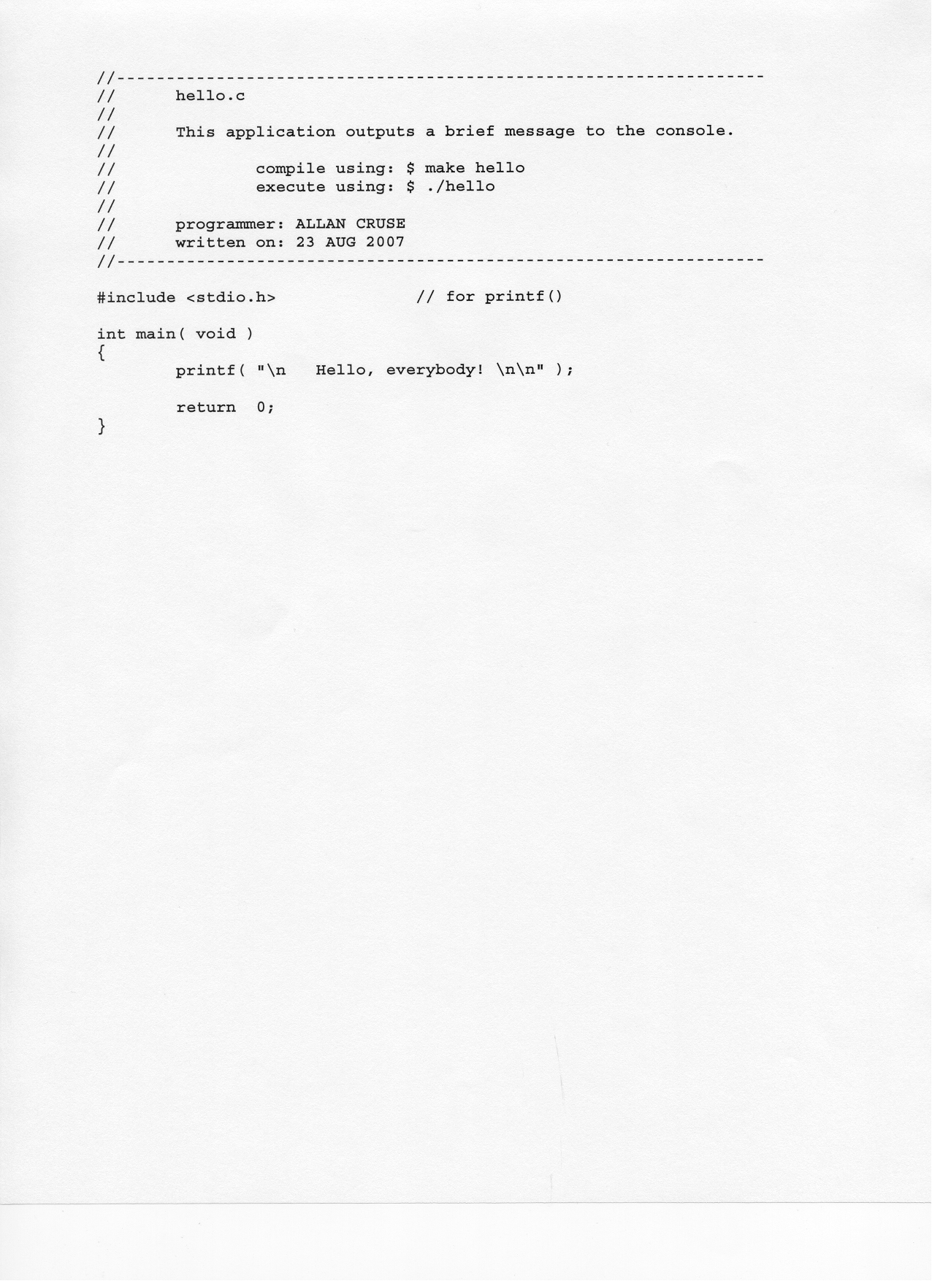
Example program in C

Slide 4
‘Extensibility’
A modern OS needs the ability to evolve
  Will need to support new devices
  Will need to allow ‘bugs’ to be fixed
  Will need to permit performance gains
Else OS may suffer early obsolescence!

Slide 5
Extensibility with Linux
Two mechanisms for ‘extensibility’:
‘Open Source’ development
‘Loadable’ kernel modules (LKMs)

Slide 6
Loadable Kernel Modules
Convenient technique for OS ‘extensibility’
Also allows us to study how kernel works
Kernel can be modified while it’s running
No need to recompile and then reboot
But inherently unsafe: any ‘bug’ can cause a system malfunction -- or complete crash!

Slide 7
‘Superuser’ privileges
Modifying a running kernel is ‘risky’
Only authorized ‘system administrators’
are allowed to install kernel modules
But our classroom workstations will allow us some (limited) administrator privileges

Slide 8
‘insmod’ and ‘rmmod’
We’re allowed to ‘install’ kernel objects:
$ /sbin/insmod myLKM.ko
We’re allowed to ‘remove’ kernel objects:
$ /sbin/rmmod myLKM
Anyone is allowed to ‘list’ kernel objects:
$ /sbin/lsmod

Slide 9
Creating a new LKM
You can use any text-editor (e.g., ‘vi’ or ‘emacs’) to create source-code (in the C language) for a Linux kernel module (i.e., an LKM)
But a kernel module differs from a normal C application program (e.g., no ‘main()’ function)
A kernel module cannot call any of the familiar functions from the standard C runtime libraries
For any LKM, two entry-points are mandatory (one for ‘initialization’, and one for ‘cleanup’)

Slide 10
Normal LKM structure
Resembles normal layout of C programs
but
Two ‘module administration’ functions [these are required]
plus
Appropriate ‘module service’ functions [these are optional]

Slide 11
Other LKM differences
Module uses ‘printk()’ instead of ‘printf()’
Includes the <linux/module.h> header-file
Specifies a legal software license (“GPL”)
Compilation requires a special ‘Makefile’
Execution is “passive” (it’s a ‘side-effect’)
Module has no restriction on ‘privileges’

Slide 12
Required module functions
int init_module( void );
// this gets called during module installation
void cleanup_module( void );
// this gets called during module removal
A newer syntax allows memory-efficiency:
  module_init(my_init);
  module_exit(my_exit);

Slide 13
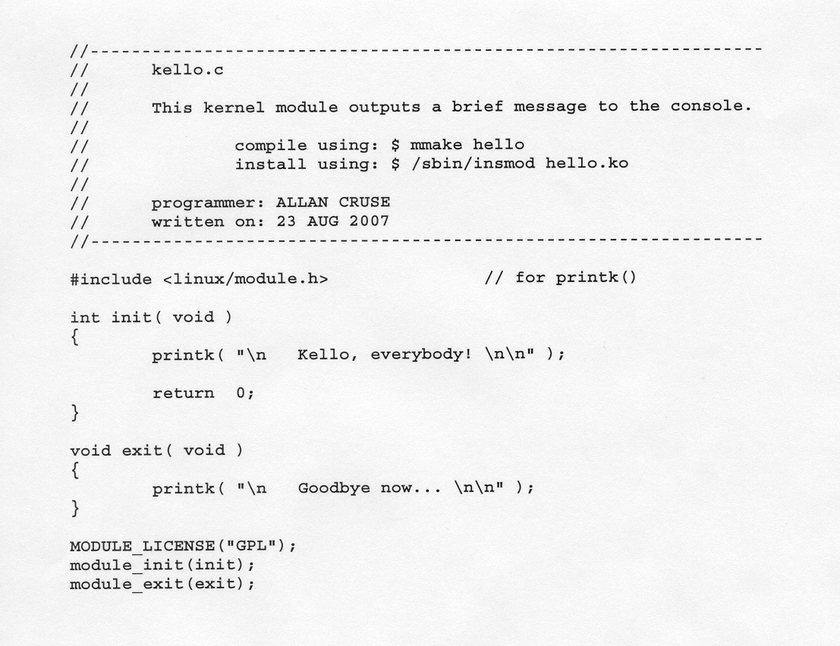
Kernel module written in C
(Courtesy: Allan Cruse’s demo programs)

Slide 14
Format of the ‘Makefile’
ifneq ($(KERNELRELEASE),)
obj-m := mymod.o
else
KERNELDIR := /lib/modules/$(shell uname –r)/build
PWD := $(shell pwd)
default:
$(MAKE) -C $(KERNELDIR) M=$(PWD) modules
endif

Slide 15
Inconveniences
That ‘Makefile’ has to be edited every time you create another new module! ☹
Then, when you compile the new module, like this: $ make
there are more than a half-dozen files that get created (some of them are ‘hidden’) in your current directory, but just one is the ‘.ko’ (kernel object) that you really wanted

Slide 16
In-class exercise #1
Compile it with ‘make’ (or alternatively use: $ g++ name.c –o mmake )
Type the ‘kello.c’ source-file from the slide, and compile it
Add the ‘kello.ko’ kernel-object to Linux using the Linux ‘/sbin/insmod’ command
Use ‘dmesg’ to view the kernel’s log-file
Remove ‘kello’ (with ‘/sbin/rmmod kello’)

Slide 17
Showing kernel messages
You can modify the ‘printk()’ text-string so its message will be sure to be displayed – -- it will be output to the graphical desktop
Here’s how you can do it:
  printk( “<0> Hello, everybody! \n” );
This log-level indicates a ‘kernel emergency’

Slide 18
In-class exercise #2
Modify the ‘kello.c’ source-file so that the messages will be visible in a window on the graphical desktop (in addition to being written to the kernel’s log-file)
You can switch from graphics-mode to a text-mode console with <CTRL><ALT>F1
You can switch back to graphics mode by typing <CTRL><ALT>F7

Slide 19
Summary
Compile kello.c
Install ‘kello.ko’ (and see printk-message)
Remove ‘kello’ (to see another message)
Modify the ‘printk()’ statements in kello.c
Recompile and reinstall to view new info

