Slide 1
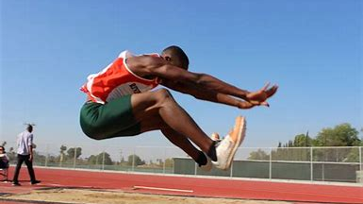
Sample case study: To jump or not to jump with a target line.

Slide 2
Structure
1.0 Introduction
- Background
2.0 Methodology
- Classlist and Planning
- Measurements
- Sampling Method (Random, Systematic, Stratified)
3.0 Data Collection
- 30 samples, 10 reserves
4.0 Data Analysis
- Frequency Table
- Graphs (Line, Bar, Boxplots)
- Statistics (Measures of centrality (mean), Measures of spread (variance))
- Confidence interval
5.0 Conclusion
6.0 Recommendation
Intro | Methodology | Data Collection | Analysis | Recommendation
Notes:
Planning
Data Collection
Methodology
Analysis
Conclusion and recommendation

Slide 3



What are we measuring?
Start
To prove that
$$μ_{B}>μ_{A}$$
the average length of jumping towards a target is always greater than the average length of jumping without a target
Research question: Do students jump further when aiming for a specific target compared to jumping without a target?
A
Target
Start
B
Intro | Methodology | Data Collection | Analysis | Recommendation
Notes:
Obesity is a medical condition that entails excessive body fat. When body fat is accumulated to such an extent where it is too much, or the person is too heavy
It can lead to negative health effects that not only affect you physically but mentally you too
such as type 2 diabetes, cardiovascular diseases , sleep apnea, depression and so forth
Planning
Data Collection
Methodology
Analysis
Conclusion and recommendation

Slide 4
1.0 Intro
Do students jump further when aiming for a target?
Hypothesized question **** Most important part!!
Purpose: This paper sets out to investigate whether *hypothesis* to gather insight into the relationship between setting goals and producing higher outcomes.
Link to methodology
Intro | Methodology | Data Collection | Analysis | Recommendation
Notes:
Tonga’s obesity rate of 48.2% is amongst the highest in the world. The negative impacts of obesity can lead to greater health complications such as cardiovascular diseases, type II diabetes, types of cancer and from a psychologoical point of view: can cause depression. Therefore, it is so important to make substantial effort to reduce these effects early while there is time to prevent it. This study sets out to investigate, using form 6 tongan students as the target population, whether the average student in this cohort is obese. An experiment will be conducted that utilizes the BMI scores of students in Form 6 to analyze the hypothesis that the average student in Tonga is not obese.

Slide 5
Which sampling method should we pick and why?
Method | Pros | Cons | Best to use
1) Random | - Simple - Removes bias | - May fail to capture and represent key groups due to randomness | If the sample is random
2) Systematic | Simple Fast | Patterns in list can create bias | No major subgroups exist
3) Stratified | - Captures key information in sub groups | More complex Requires prior knowledge of sub groups in the data | Sub-group comparison is important
Random generator
Every 5th person on the list
Dividing by class, and taking an even split of males and females
Intro | Methodology | Data Collection | Analysis | Recommendation
Notes:
Planning
Data Collection
Methodology
Analysis
Conclusion and recommendation

Slide 6
2.0 Methodology
Clearly outline experiment steps
What are you measuring?
What variables are you observing?
What tools did you use?
- Outline clear steps.
Sampling method
Random | Systematic | Stratified
Why did you use this sampling method?
Intro | Methodology | Data Collection | Analysis | Recommendation
Notes:
Tonga’s obesity rate of 48.2% is amongst the highest in the world. The negative impacts of obesity can lead to greater health complications such as cardiovascular diseases, type II diabetes, types of cancer and from a psychologoical point of view: can cause depression. Therefore, it is so important to make substantial effort to reduce these effects early while there is time to prevent it. This study sets out to investigate, using form 6 tongan students as the target population, whether the average student in this cohort is obese. An experiment will be conducted that utilizes the BMI scores of students in Form 6 to analyze the hypothesis that the average student in Tonga is not obese.

Slide 7
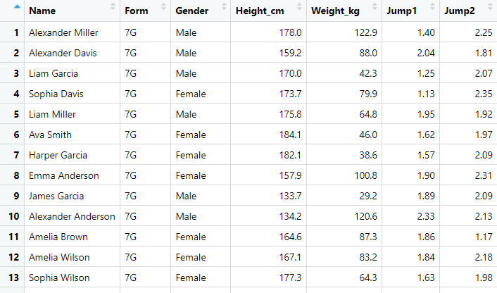
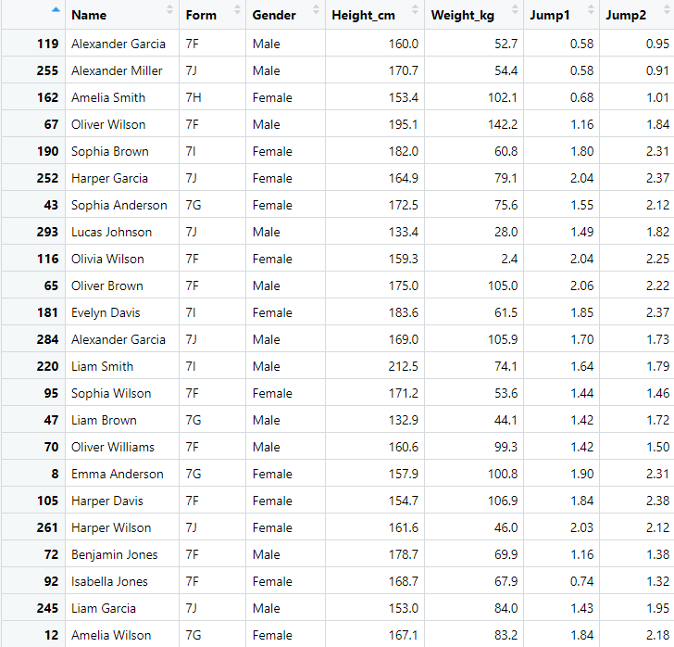

Given a list of 300 students
Full list (300)
Sample (30 students, 10 reserves)
Intro | Methodology | Data Collection | Analysis | Recommendation
Notes:
Planning
Data Collection
Methodology
Analysis
Conclusion and recommendation

Slide 8
Summary statistic table
Intro | Methodology | Data Collection | Analysis | Recommendation
Notes:
Planning
Data Collection
Methodology
Analysis
Conclusion and recommendation

Slide 9
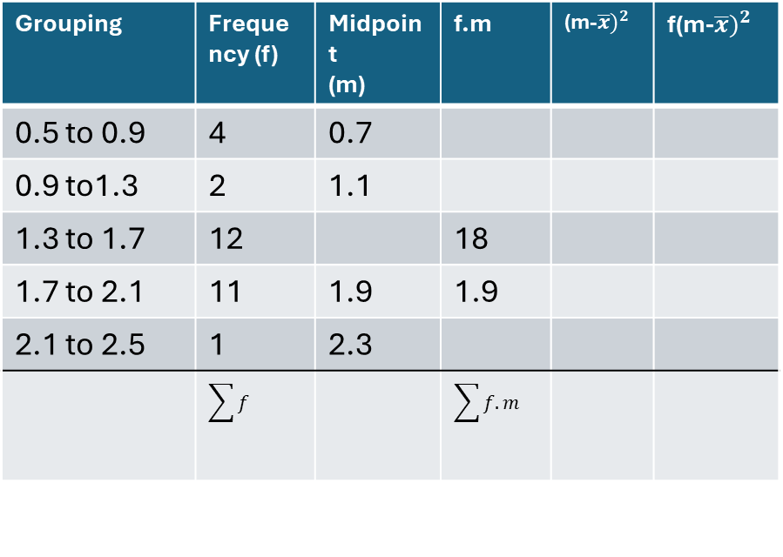
How to construct a grouped frequency table
Grouping | Frequency (f) | Midpoint (m) | f.m | (m-$\overline{x})^{2}$ | f(m-$\overline{x})^{2}$
0.5 to 0.9 | 4 | 0.7
0.9 to1.3 | 2 | 1.1
1.3 to 1.7 | 12 |  | 18
1.7 to 2.1 | 11 | 1.9 | 1.9
2.1 to 2.5 | 1 | 2.3
 | $$\sum{f}$$ |  | $$\sum{f.m}$$
Mean =1.54
Average distance jumped by students is 1.54m without a target
Median = 1.54
50% of students reached a distance of 1.54m without a target
Mode = the most frequent class is 1.3 to 1.7
0.58 0.58 0.68 0.74 1.16 1.16 1.42 1.42 1.43 1.44 1.49 1.51 1.53 1.55 1.55 1.64 1.68 1.70 1.80 1.82 1.84 1.84 1.85 1.90 1.95 2.03 2.04 2.04 2.06 2.37
Intro | Methodology | Data Collection | Analysis | Recommendation
Notes:
1.53 +

Slide 10
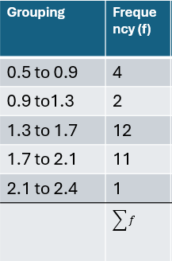
Drawing a histogram
Intro | Methodology | Data Collection | Analysis | Recommendation
Notes:
Estimated mean

Slide 11
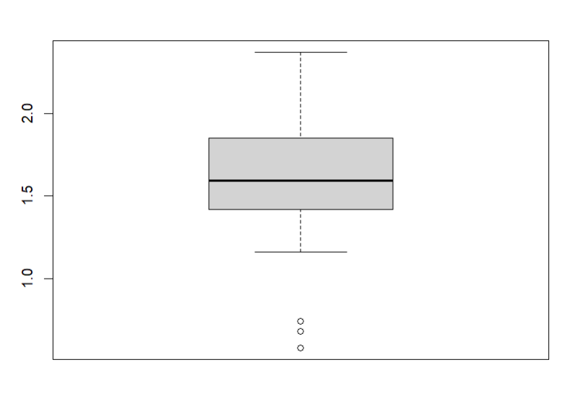
Constructing a boxplot
Median = 1.54
Lower quartile: (25%)
= 1.29
Upper Quartile: (75%)
= 1.81
Interquartile (1.81 – 1.29) = 0.52
Intro | Methodology | Data Collection | Analysis | Recommendation
Notes:
Estimated mean

Slide 12
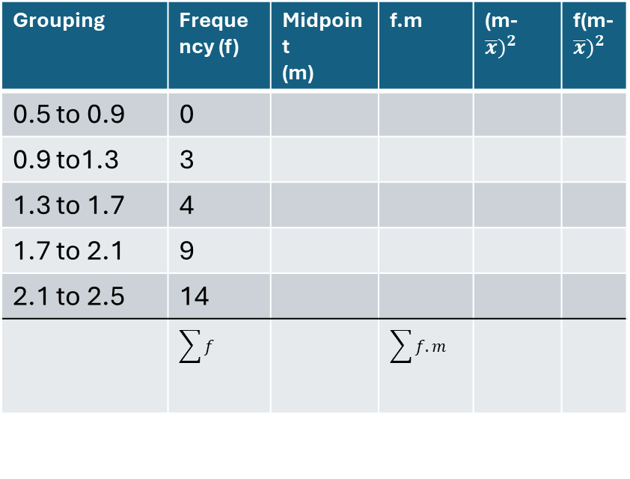
How to construct a grouped frequency table
Grouping | Frequency (f) | Midpoint (m) | f.m | (m-$\overline{x})^{2}$ | f(m-$\overline{x})^{2}$
0.5 to 0.9 | 0
0.9 to1.3 | 3
1.3 to 1.7 | 4
1.7 to 2.1 | 9
2.1 to 2.5 | 14
 | $$\sum{f}$$ |  | $$\sum{f.m}$$
Mean =1.95
Average distance jumped by students is 1.95m with a target
Median = 1.995
50% of students reached a distance of 1.995m with a target
Mode = the most frequent occurring is in 2.1
0.91 0.95 1.01 1.32 1.38 1.46 1.50 1.72 1.73 1.75 1.79 1.82 1.84 1.90 1.95 2.04 2.12 2.12 2.12 2.18 2.22 2.24 2.25 2.31 2.31 2.33 2.37 2.37 2.38 2.39
Intro | Methodology | Data Collection | Analysis | Recommendation
Notes:
1.53 +

Slide 13
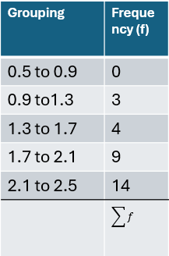
Drawing a histogram
Intro | Methodology | Data Collection | Analysis | Recommendation
Notes:
Estimated mean

Slide 14
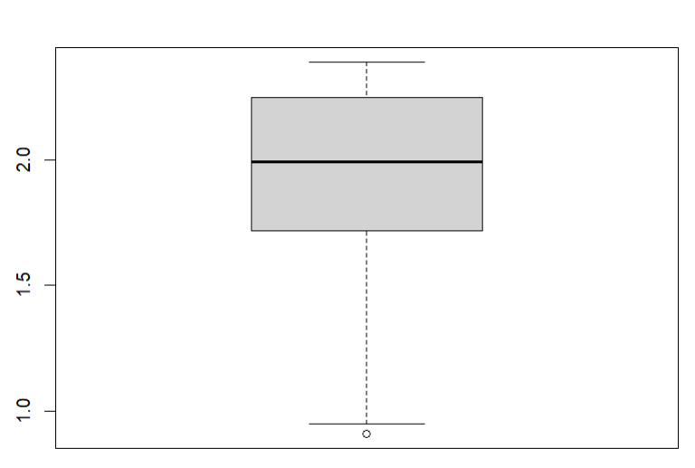
Constructing a boxplot
Median = 1.95
Lower quartile: (25%)
= 1.61
Upper Quartile: (75%)
= 2.245
Interquartile (1.81 – 1.29) = 0.635
Intro | Methodology | Data Collection | Analysis | Recommendation
Notes:
Estimated mean

Slide 15

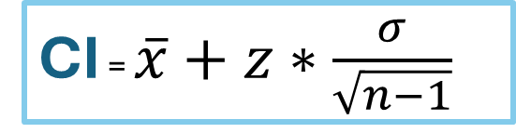






Confidence interval
CI = $\overline{x}+z∗\frac{σ}{\sqrt{n−1}}$
$$\overline{x}=$$
z $=$
$$\overline{x}=$$
$σ$ $=$
z $=$
$σ$ $=$
$$\overline{x}−z∗\frac{σ}{\sqrt{n−1}}<μ<\overline{x}+z∗\frac{σ}{\sqrt{n−1}}$$
Intro | Methodology | Data Collection | Analysis | Recommendation
Notes:
Estimated mean

Slide 16
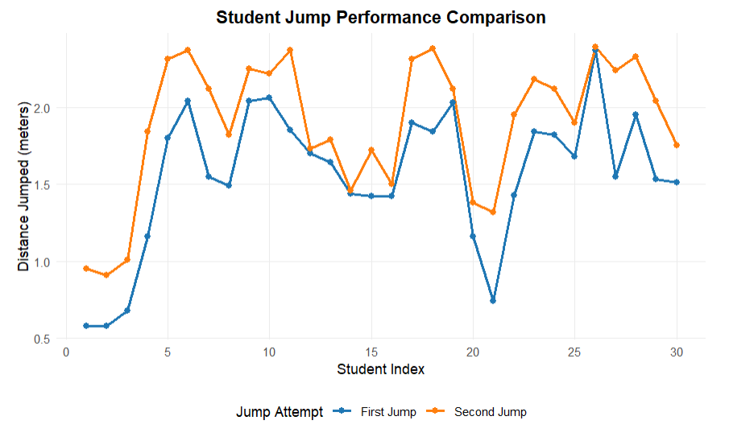
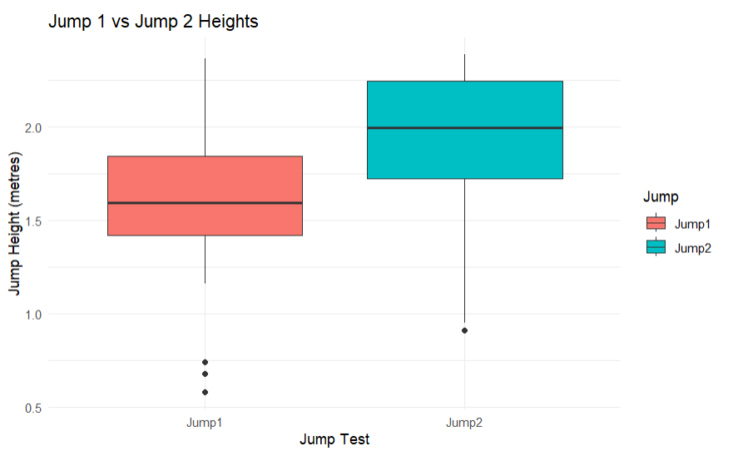
Line graph & Boxplot
We can see the higher trends of jump 2
A clear understanding of the ranges of both jump attempts
Compare the means of Jump1 and Jump 2
Intro | Methodology | Data Collection | Analysis | Recommendation

Slide 17
Other analysis
“Do students jump further when aiming for a target?”
$$μ_{B}>μ_{A}$$
Recommendation:
Intro | Methodology | Data Collection | Analysis | Recommendation
Notes:
Planning
Data Collection
Methodology
Analysis
Conclusion and recommendation

