Slide 1

Sample case study: Who (F6) wants to be a mathematician?
Notes:
Why can’t we calculate the exact mean
For a grouped frequency table? For a grouped frequency table?

Slide 2
Structure
1.0 Introduction
- Background and hypothesis question
2.0 Methodology
- Measuring math interest?
- Classlist
- Sampling Method (Random, Systematic, Stratified)
3.0 Data Collection
- 30 samples, 10 reserves
4.0 Data Analysis
- Frequency Table
- Graphs (Line, Bar, Boxplots)
- Statistics (Measures of centrality (mean), Measures of spread (variance))
- Commentary!
5.0 Conclusion
6.0 Recommendation
Intro | Methodology | Data Collection | Analysis | Recommendation
Notes:
Planning
Data Collection
Methodology
Analysis
Conclusion and recommendation

Slide 3
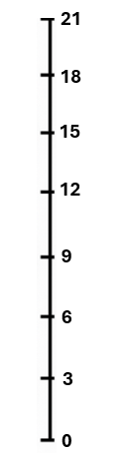
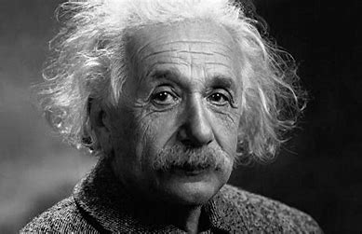

Measuring math interest!
Hours studying math in a week
How many hours in your week do you study math?
15 hours
5 hours
Intro | Methodology | Data Collection | Analysis | Recommendation
Notes:
Obesity is a medical condition that entails excessive body fat.
When body fat is accumulated to such an extent where it is too much, or the person is too heavy
It can lead to negative health effects that not only affect you physically but mentally you too
such as type 2 diabetes, cardiovascular diseases , sleep apnea, depression and so forth
Planning
Data Collection
Methodology
Analysis
Conclusion and recommendation

Slide 4
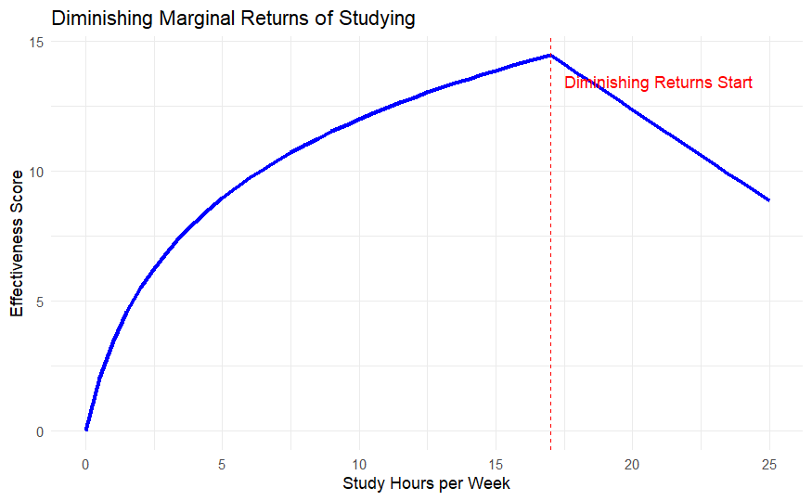
Measuring math interest!
Hours studying math in a week
How many hours in your week do you study math?
15 hours
5 hours
Intro | Methodology | Data Collection | Analysis | Recommendation
Notes:
Obesity is a medical condition that entails excessive body fat.
When body fat is accumulated to such an extent where it is too much, or the person is too heavy
It can lead to negative health effects that not only affect you physically but mentally you too
such as type 2 diabetes, cardiovascular diseases , sleep apnea, depression and so forth
Planning
Data Collection
Methodology
Analysis
Conclusion and recommendation

Slide 5
1.0 Intro
Introduction = Background + Hypothesis
Do F6 students study math for at least 5 hrs a week?
Hook sentence:
Hypothesized question **** Most important part!!
Purpose: This paper sets out to investigate whether *hypothesis* to gather insight for the reduction of obesity rates in younger adults.
Link to methodology
Intro | Methodology | Data Collection | Analysis | Recommendation
Notes:
Tonga’s obesity rate of 48.2% is amongst the highest in the world. The negative impacts of obesity can lead to greater health complications such as cardiovascular diseases, type II diabetes, types of cancer and from a psychologoical point of view: can cause depression. Therefore, it is so important to make substantial effort to reduce these effects early while there is time to prevent it. This study sets out to investigate, using form 6 tongan students as the target population, whether the average student in this cohort is obese. An experiment will be conducted that utilizes the BMI scores of students in Form 6 to analyze the hypothesis that the average student in Tonga is not obese.

Slide 6
Which sampling method should we pick and why?
Method | Pros | Cons | Best to use
1) Random | - Simple - Removes bias | - May fail to capture and represent key groups due to randomness | Applicable in all cases
2) Systematic | Simple Fast | Patterns in list can create bias | No major subgroups exist
3) Stratified | - Captures key information in sub groups | More complex Requires prior knowledge of sub groups in the data | Sub-group comparison is important
Example
Random generator
Every 5th person on the list
Dividing by class, and taking an even split of males and females
Intro | Methodology | Data Collection | Analysis | Recommendation
Notes:
Planning
Data Collection
Methodology
Analysis
Conclusion and recommendation

Slide 7
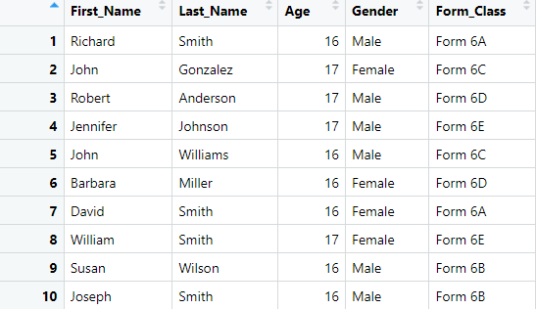
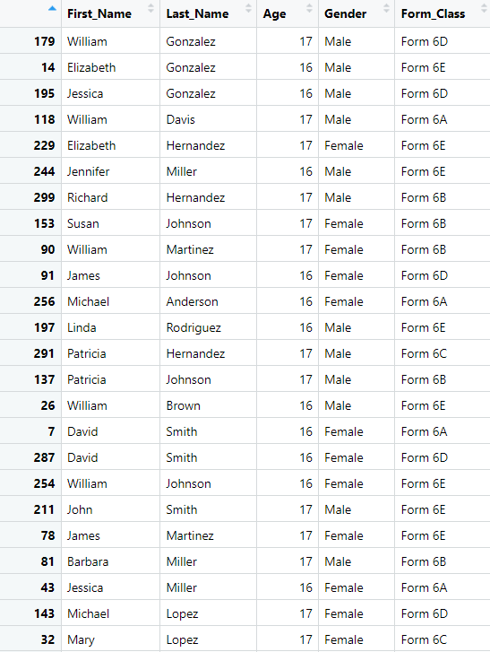

Given a list of 300 students
Full list (300)
Sample (30 students, 10 reserves)
Intro | Methodology | Data Collection | Analysis | Recommendation
Notes:
Planning
Data Collection
Methodology
Analysis
Conclusion and recommendation

Slide 8
2.0 Methodology
Clearly outline experiment steps
      How did you measure mathematics?
      What did you use to measure people’s interest in maths
      Sampling method
      Where did you get your target population list from?
      Random | Systematic | Stratified
      Why did you use this sampling method?
      On the data collection day, how did you divide the tasks amongst your group?
Intro | Methodology | Data Collection | Analysis | Recommendation
Notes:
Tonga’s obesity rate of 48.2% is amongst the highest in the world. The negative impacts of obesity can lead to greater health complications such as cardiovascular diseases, type II diabetes, types of cancer and from a psychologoical point of view: can cause depression. Therefore, it is so important to make substantial effort to reduce these effects early while there is time to prevent it. This study sets out to investigate, using form 6 tongan students as the target population, whether the average student in this cohort is obese. An experiment will be conducted that utilizes the BMI scores of students in Form 6 to analyze the hypothesis that the average student in Tonga is not obese.

Slide 9

Data collection day
Students were divided into groups of 4
- Interviewer, Data Recorder, Number cruncher
- Will you divide the sample up or do it all together?
Have a structured approach
- Purpose of interview
- Ready questions
Only 27 out of the sample of 30 were available.
Can’t get a scale?
Interest
Intro | Methodology | Data Collection | Analysis | Recommendation
Notes:
Planning
Data Collection
Methodology
Analysis
Conclusion and recommendation

Slide 10
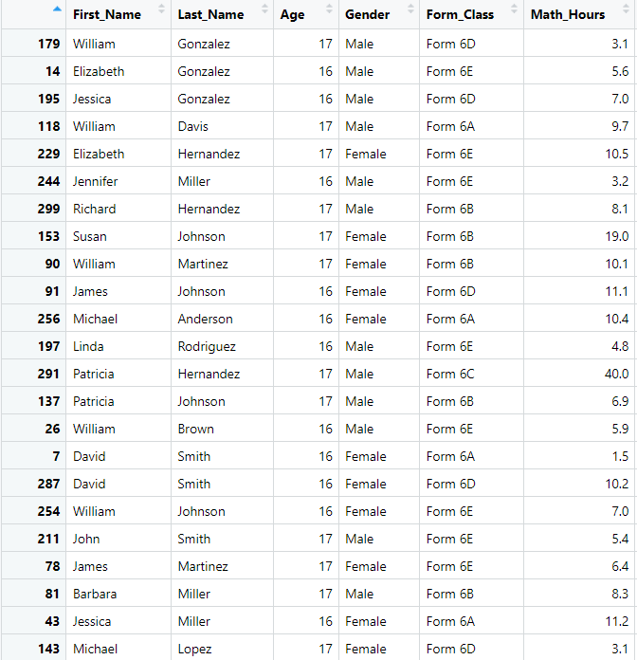
Summary statistic table
Intro | Methodology | Data Collection | Analysis | Recommendation
Notes:
Planning
Data Collection
Methodology
Analysis
Conclusion and recommendation

Slide 11
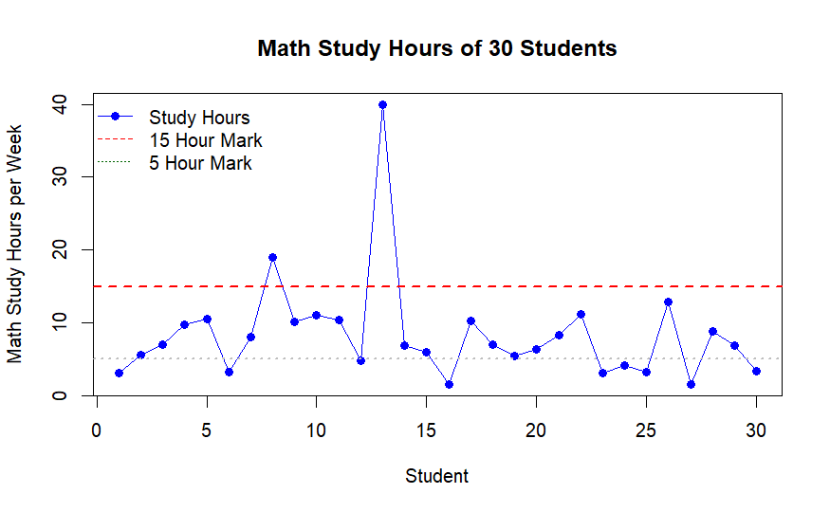
What does our data look like?
Which observations stand out to you?
Are there any particular trends?
Intro | Methodology | Data Collection | Analysis | Recommendation
Notes:
Planning
Data Collection
Methodology
Analysis
Conclusion and recommendation

Slide 12
Dealing with outliers
Method | Purpose | When to use
✨Leave it as it is✨ | Retains original value | If the entry is real (not an error) eg Math Olympiad
Remove outlier ❌ | Exclude from analysis | If its an error, and not representative of the target population and you want to exclude it
Mean imputation 🔍 | Replace with mean | If you believe it is a mistake and want to include it
Transformation 🐦‍🔥 | Apply log or sqrt transformation | If you want to dampen the effect but still include it
Intro | Methodology | Data Collection | Analysis | Recommendation
Notes:
Planning
Data Collection
Methodology
Analysis
Conclusion and recommendation

Slide 13

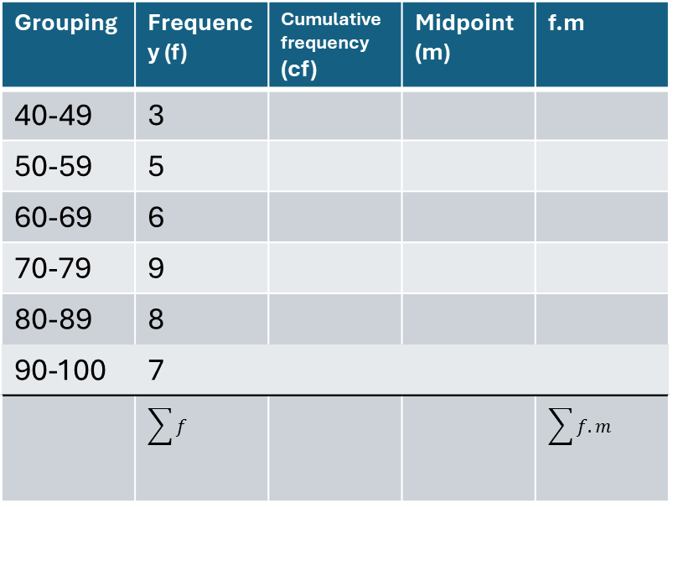
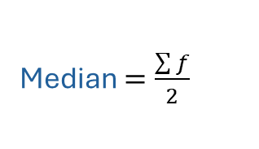

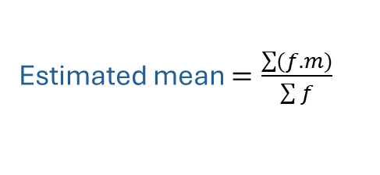

How to construct a grouped frequency table
Grouping | Frequency (f) | Cumulative frequency (cf) | Midpoint (m) | f.m
40-49 | 3
50-59 | 5
60-69 | 6
70-79 | 9
80-89 | 8
90-100 | 7
 | $$\sum{f}$$ |  |  | $$\sum{f.m}$$
$$\overline{x}=\frac{sum of data}{Total number}$$
Estimated mean $=\frac{\sum{(f.m)}}{\sum{f}}$
midpoint $=\frac{lower+upper}{2}$
Median $=\frac{\sum{f}}{2}$
Mode $=highest frequency$
Mean =
Median =
Mode =
Range =
Intro | Methodology | Data Collection | Analysis | Recommendation
Notes:
Estimated mean

Slide 14
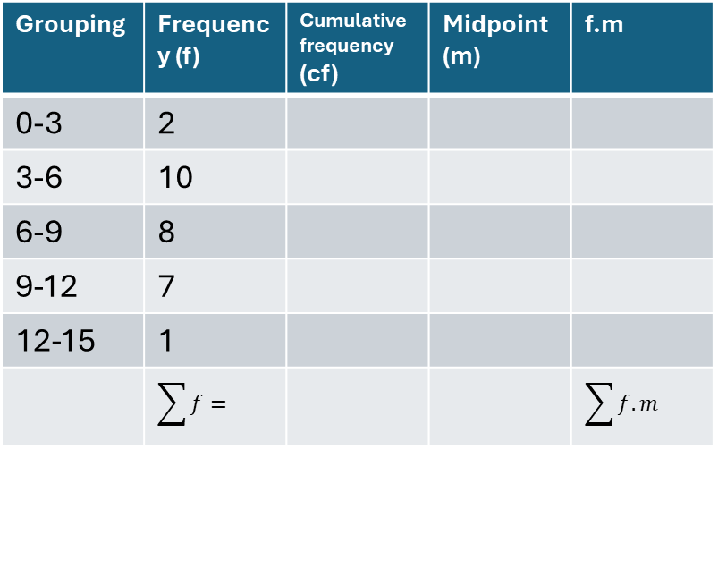
How to construct a grouped frequency table
Grouping | Frequency (f) | Cumulative frequency (cf) | Midpoint (m) | f.m
0-3 | 2
3-6 | 10
6-9 | 8
9-12 | 7
12-15 | 1
 | $$\sum{f}=$$ |  |  | $$\sum{f.m}$$
$$\overline{x}=\frac{sum of data}{Total number}$$
Estimated mean $=\frac{\sum{(f.m)}}{\sum{f}}$
midpoint $=\frac{lower+upper}{2}$
Median $=\frac{\sum{f}}{2}$
Mean
Median
Mode
Mode $=highest frequency$
Intro | Methodology | Data Collection | Analysis | Recommendation

Slide 15
Measures of Centrality & Spread
Measures of Centrality
What does this tell me?
The average hour spent studying math for form 6 is 7 hours
The median time is between 6-9 hours
3 – 6 hrs is the most frequent occurring class
Mean = 7.05 hours
Median = between 6-9 hrs
Mode class = 3 < x < 6
Measures of Spread
Range = 15 hours
Lower quartile = 4 hours
Upper quartile = 10 hours
Interquartile = 6 hours
What does this tell me?
Given the range of 15 hrs, there are extreme students who are studying a lot and those who are studying very little
Most students study a reasonable amount (4-10 hours)
Intro | Methodology | Data Collection | Analysis | Recommendation
Notes:
Planning
Data Collection
Methodology
Analysis
Conclusion and recommendation

Slide 16
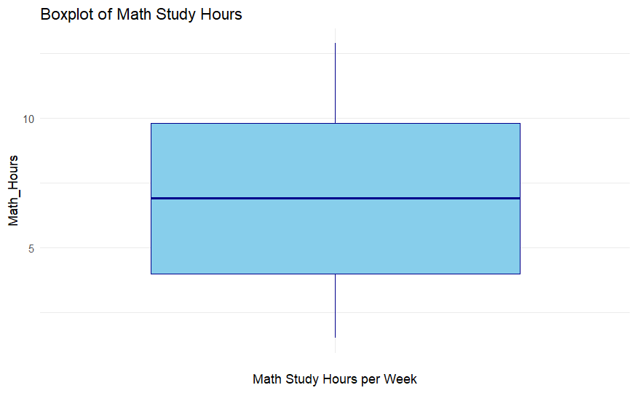
Measures of Centrality & Spread
Measures of Centrality
Mean = 7.05 hours
Median = between 6-9 hrs
Mode class = 3 < x < 6
Measures of Spread
Range = 15 hours
Lower quartile = 4 hours
Upper quartile = 10 hours
Interquartile = 6 hours
Intro | Methodology | Data Collection | Analysis | Recommendation
Notes:
Planning
Data Collection
Methodology
Analysis
Conclusion and recommendation

Slide 17
Conclusion and recommend
“Do F6 students study more than 5 hours of math
In a week?”
.
Since the mean was calculated at 7 hours. It can be concluded that students are studying more than 5 hours in a week.
Recommendation:
Maintain or further promote these study habits
      Greater incentives (Prizes, workshops, proof conferences).
Increase awareness of the pathways of mathematics
Establish study groups
Intro | Methodology | Data Collection | Analysis | Recommendation

