Slide 1
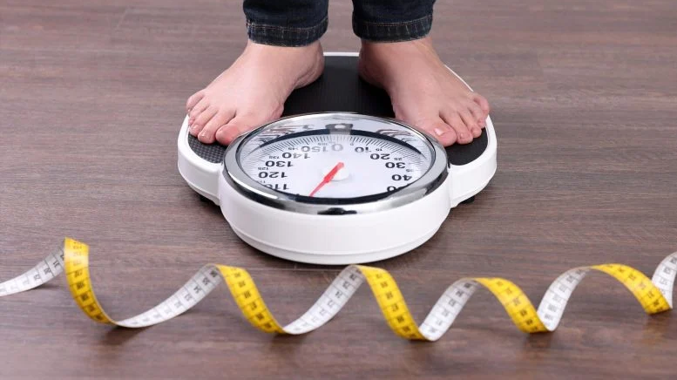
Sample case study: Obesity rates of students in Tonga

Slide 2
Structure
1.0 Introduction
- Background
2.0 Methodology
- Classlist and Planning
- Measurements
- Sampling Method (Random, Systematic, Stratified)
3.0 Data Collection
- 30 samples, 10 reserves
4.0 Data Analysis
- Frequency Table
- Graphs (Line, Bar, Boxplots)
- Statistics (Measures of centrality (mean), Measures of spread (variance))
- Commentary!
5.0 Conclusion
6.0 Recommendation
Intro | Methodology | Data Collection | Analysis | Recommendation
Notes:
Planning
Data Collection
Methodology
Analysis
Conclusion and recommendation

Slide 3
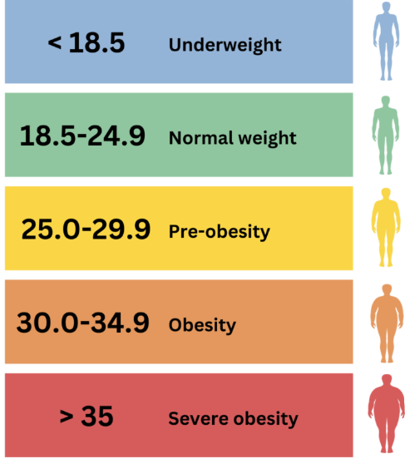
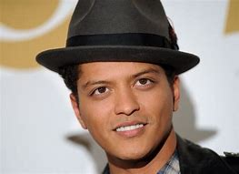





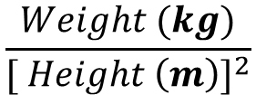

How do we measure obesity rates in students ?
Body Mass Index
$$\frac{Weight (kg)}{{[ Height \left(m\right)]}^{2}}$$
$$BMI=$$
Example calculation
Overweight
Person A
Person B
Weight= 67kg Height= 1.65m
Weight= 73kg Height= 1.45m
$$=\frac{67}{{[ 1.65]}^{2}}$$
$$=\frac{73}{{[ 1.45]}^{2}}$$
$$=24.60973$$
$$=34.72$$
Intro | Methodology | Data Collection | Analysis | Recommendation
Notes:
Obesity is a medical condition that entails excessive body fat.
When body fat is accumulated to such an extent where it is too much, or the person is too heavy
It can lead to negative health effects that not only affect you physically but mentally you too
such as type 2 diabetes, cardiovascular diseases , sleep apnea, depression and so forth
Planning
Data Collection
Methodology
Analysis
Conclusion and recommendation

Slide 4

Underweight
< 18.5
Normal
18.5 – 24.9
Overweight
25 – 29.9
Obese
30 – 34.9
Obese II
$≥$35

Slide 5
1.0 Intro
Is the average student obese?
Are males more obese than women?
Hook sentence: Tonga’s obesity rate of 48.2% is among the highest in the world
Hypothesized question **** Most important part!!
Purpose: This paper sets out to investigate whether *hypothesis* to gather insight for the reduction of obesity rates in younger adults.
Link to methodology
Intro | Methodology | Data Collection | Analysis | Recommendation
Notes:
Tonga’s obesity rate of 48.2% is amongst the highest in the world. The negative impacts of obesity can lead to greater health complications such as cardiovascular diseases, type II diabetes, types of cancer and from a psychologoical point of view: can cause depression. Therefore, it is so important to make substantial effort to reduce these effects early while there is time to prevent it. This study sets out to investigate, using form 6 tongan students as the target population, whether the average student in this cohort is obese. An experiment will be conducted that utilizes the BMI scores of students in Form 6 to analyze the hypothesis that the average student in Tonga is not obese.

Slide 6
Which sampling method should we pick and why?
Method | Pros | Cons | Best to use
1) Random | - Simple - Removes bias | - May fail to capture and represent key groups due to randomness | If the sample is random
2) Systematic | Simple Fast | Patterns in list can create bias | No major subgroups exist
3) Stratified | - Captures key information in sub groups | More complex Requires prior knowledge of sub groups in the data | Sub-group comparison is important
Random generator
Every 5th person on the list
Dividing by class, and taking an even split of males and females
Intro | Methodology | Data Collection | Analysis | Recommendation
Notes:
Planning
Data Collection
Methodology
Analysis
Conclusion and recommendation

Slide 7
2.0 Methodology
Clearly outline experiment steps
      How did you measure obesity?
      On the data collection day, how did you divide the tasks amongst your group?
      What did you use to measure people’s heights and weight?
      Did you have interview questions?
Sampling method
      Random | Systematic | Stratified
      Why did you use this sampling method?
Intro | Methodology | Data Collection | Analysis | Recommendation
Notes:
Tonga’s obesity rate of 48.2% is amongst the highest in the world. The negative impacts of obesity can lead to greater health complications such as cardiovascular diseases, type II diabetes, types of cancer and from a psychologoical point of view: can cause depression. Therefore, it is so important to make substantial effort to reduce these effects early while there is time to prevent it. This study sets out to investigate, using form 6 tongan students as the target population, whether the average student in this cohort is obese. An experiment will be conducted that utilizes the BMI scores of students in Form 6 to analyze the hypothesis that the average student in Tonga is not obese.

Slide 8
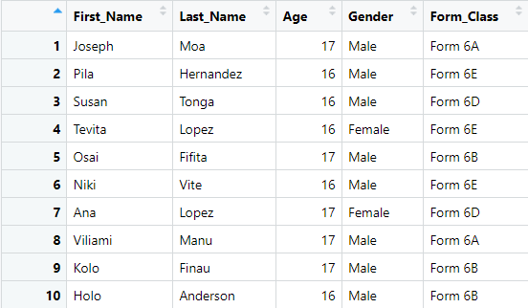
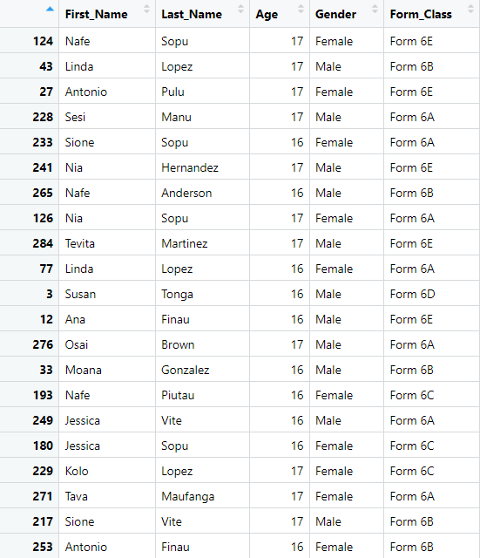

Given a list of 300 students
Full list (300)
Sample (30 students, 10 reserves)
Intro | Methodology | Data Collection | Analysis | Recommendation
Notes:
Planning
Data Collection
Methodology
Analysis
Conclusion and recommendation

Slide 9
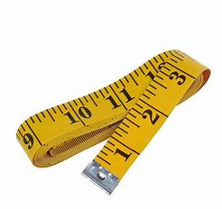
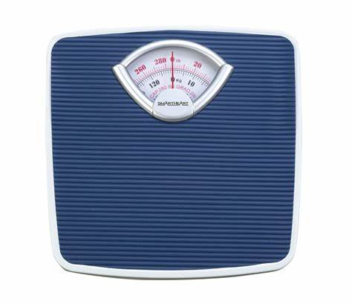

Data collection day
Students were divided into groups of 4
- Interviewer, Data Recorder, Number cruncher
- Will you divide the sample up or do it all together?
Have a structured approach
- Purpose of interview
- Ready questions
Only 27 out of the sample of 30 were available.
Can’t get a scale?
Height
Weight
Intro | Methodology | Data Collection | Analysis | Recommendation
Notes:
Planning
Data Collection
Methodology
Analysis
Conclusion and recommendation

Slide 10
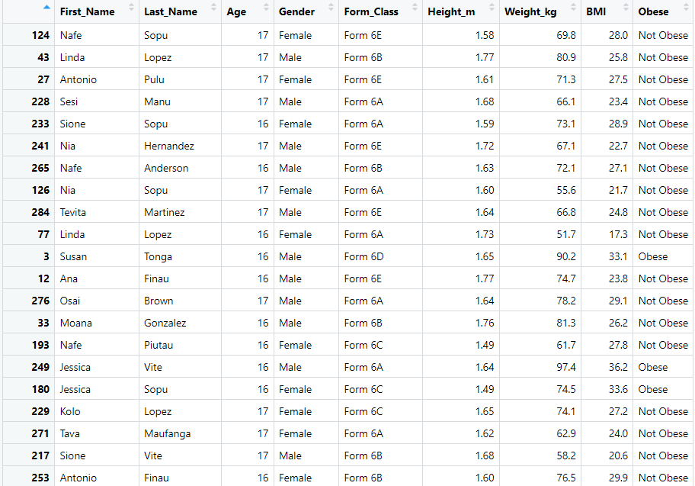
Summary statistic table
Intro | Methodology | Data Collection | Analysis | Recommendation
Notes:
Planning
Data Collection
Methodology
Analysis
Conclusion and recommendation

Slide 11

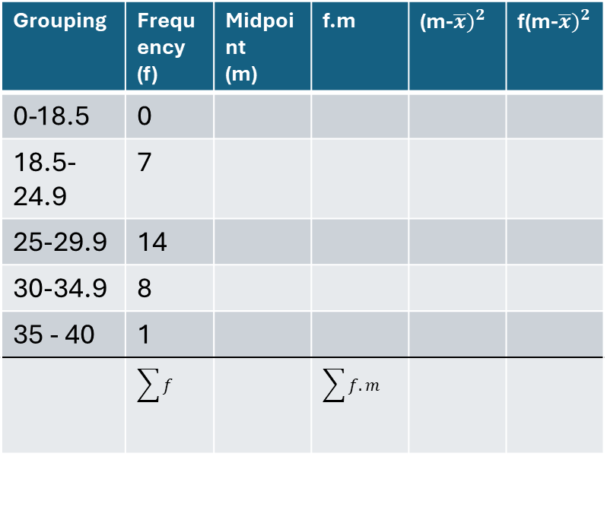
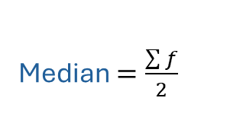

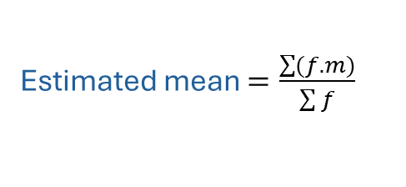



How to construct a grouped frequency table
Grouping | Frequency (f) | Midpoint (m) | f.m | (m-$\overline{x})^{2}$ | f(m-$\overline{x})^{2}$
0-18.5 | 0
18.5-24.9 | 7
25-29.9 | 14
30-34.9 | 8
35 - 40 | 1
 | $$\sum{f}$$ |  | $$\sum{f.m}$$
$$\overline{x}=\frac{sum of data}{Total number}$$
Estimated mean $=\frac{\sum{(f.m)}}{\sum{f}}$
midpoint $=\frac{lower+upper}{2}$
Median $=\frac{\sum{f}}{2}$
Mode $=highest frequency$
Mean =
Median =
Mode =
Range =
Standard deviation ($σ)=$
$σ$ $=\sqrt{\frac{f(m−\overline{x})^{2}}{n−1}}$
Intro | Methodology | Data Collection | Analysis | Recommendation
Notes:
Estimated mean

Slide 12
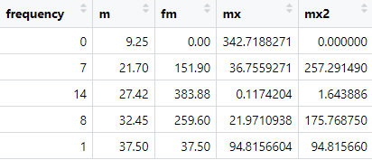

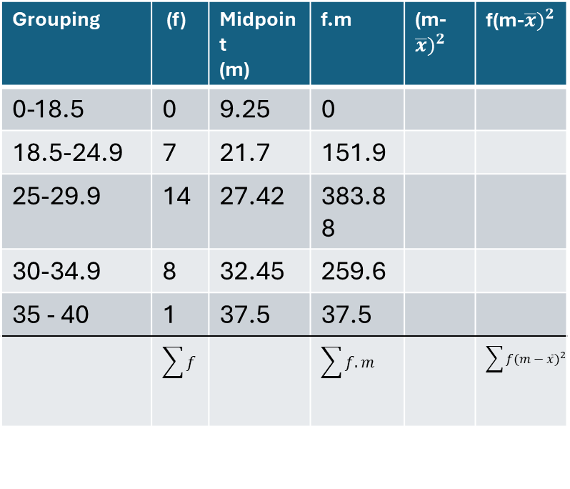
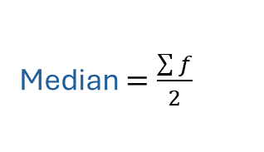


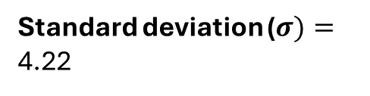


How to construct a grouped frequency table
Grouping | (f) | Midpoint (m) | f.m | (m-$\overline{x})^{2}$ | f(m-$\overline{x})^{2}$
0-18.5 | 0 | 9.25 | 0
18.5-24.9 | 7 | 21.7 | 151.9
25-29.9 | 14 | 27.42 | 383.88
30-34.9 | 8 | 32.45 | 259.6
35 - 40 | 1 | 37.5 | 37.5
 | $$\sum{f}$$ |  | $$\sum{f.m}$$ |  | $$\sum{f(m−\overline{x})^{2}}$$
$$\overline{x}=\frac{sum of data}{Total number}$$
Estimated mean $=\frac{\sum{(f.m)}}{\sum{f}}$
midpoint $=\frac{lower+upper}{2}$
Median $=\frac{\sum{f}}{2}$
Mode $=highest frequency$
Mean =27.76
Median = 25 – 29.9 group
Mode = 25-29.9 group
Range = (39-23)=16
Standard deviation ($σ)=$ 4.22
$σ$ $=\sqrt{\frac{f(m−\overline{x})^{2}}{n−1}}$
Intro | Methodology | Data Collection | Analysis | Recommendation
Notes:
Estimated mean

Slide 13
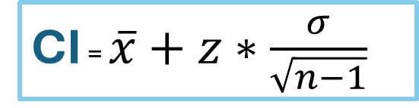

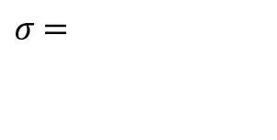
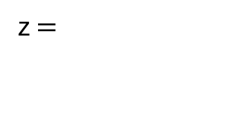
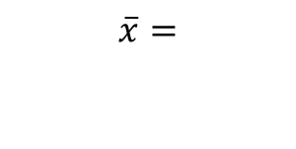
Confidence interval
CI = $\overline{x}+z∗\frac{σ}{\sqrt{n−1}}$
$$\overline{x}=$$
z $=$
With 95% confidence, the true mean BMI of the student population lies between 26.17316 and 29.22684. This reinforces that the average BMI likely falls within the overweight range (25–29.9), indicating a potential public health concern.
$σ$ $=$
$$\overline{x}−z∗\frac{σ}{\sqrt{n−1}}<μ<\overline{x}+z∗\frac{σ}{\sqrt{n−1}}$$
(27.7) – 1.96*0.779 < $μ$ < (27.7) + 1.96*0.779
26.17316 < $μ$ < 29.226
Intro | Methodology | Data Collection | Analysis | Recommendation
Notes:
Estimated mean

Slide 14
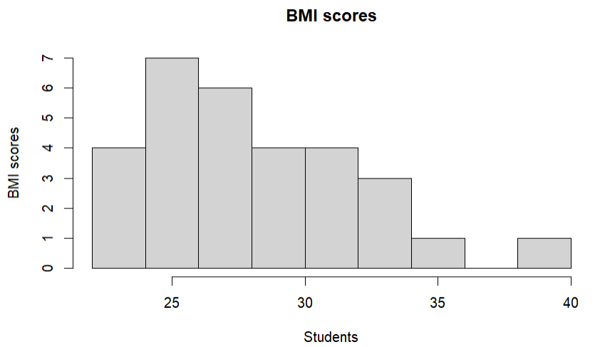
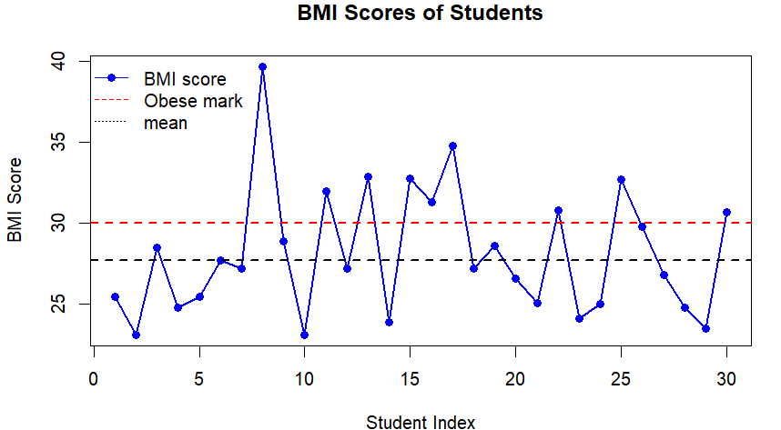
Line graph & Histogram
Helps us spot outliers and trends (if any)
We can easily note which observations:
    Obesity mark
    Mean
The histogram gives a better overview of group patterns. We note that this histogram is right skewed.
Modal class is 18.5 – 24.5
It supports the idea that most students do not fall in the severely obese range, but a significant number are overweight or mildy obese
Intro | Methodology | Data Collection | Analysis | Recommendation

Slide 15
Other analysis
“Are form 6 students obese on average?”
Our measures of centrality tell us that the mean BMI is 27.7 and our measures of spread identify _________. From our CI we are 95% confident the population mean is 26 and 29.
Recommendation:
Encourage active lifestyles
Promote healthy diets
Increase sample size
Intro | Methodology | Data Collection | Analysis | Recommendation
Notes:
Planning
Data Collection
Methodology
Analysis
Conclusion and recommendation

