Slide 1
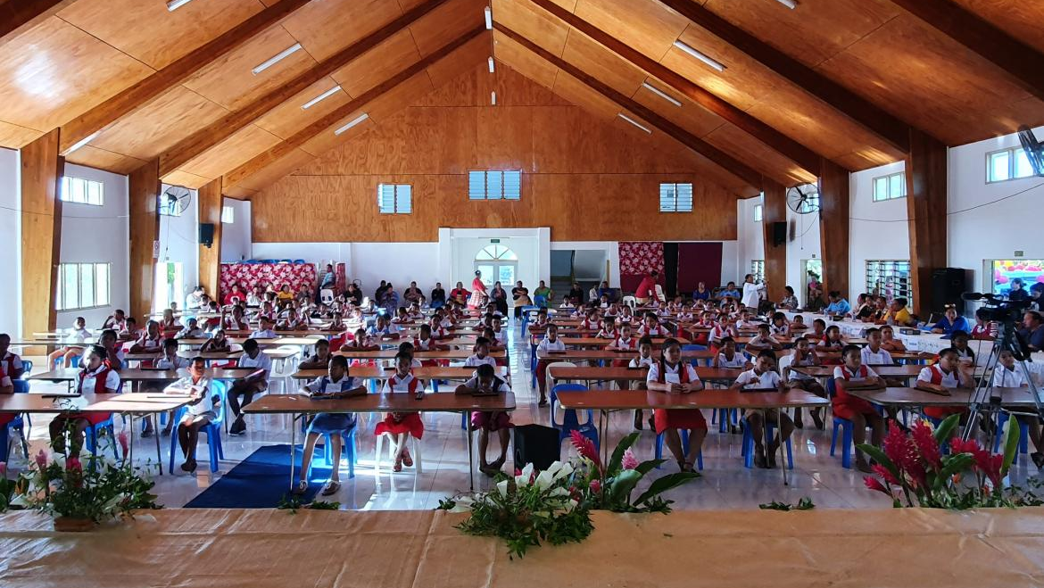
Education Sector (At a Glance)
EFPD

Slide 2




Tonga’s education analysis highlights these key problems.
Improving education for all with a focus on addressing drop-outs, gender equality, building safer schools, and increasing employable trainings for both local and overseas opportunity.
GPA 4
Quality & Accessible Education
Vulnerabilities and Gender Disparities
Safer Schools
Themes
Higher pass rates in science and mathematics
A school within access per village.
Converge Secondary GPI to 1.0
Aid vulnerable families with tuition
Address attitude towards the value of education
Safer and more resilient infrastructures
X x x x x x x
Impact
Mission | Snapshot | Enrolments | Challenges | Outlook

Slide 3


The Ministry of Education has undergone significant change
MET in 2024
New Policies and Reforms
Education quality
Revised Curriculum & Assessment for Class 1 – Form 2 (WB) & Form 3 to Form 7: GPE – 2025 System Transformation Grant
Education Management Information System (EMIS) – quality data and better-informed decision based on data – (In progress under TSRS Project)
Removal of TSC (Reinstated by Education Minister 2025) | Free education up to Form 5 (Reinstated)
Vulnerabilities (Accessibility)
Extension of Primary School to Form 2 and moving SEE to Form 2
Increase Grant to Non Govt Schools to address Equity
ECE – $200 NG | $50 G
C1-F2 $50, $110 NG
Secondary $770
TVET $1320
Safer Schools
THS Phase 2. (Completed) AND handover completed.
Building of more resilient classrooms (Through Tonga Safer Resilient School Project, WB)
MET’s mandate is to ensure the provision of quality education that is inclusive, equitable, relevant, and sustainable.
1343 Staff
70.6 million
(2024/25)
12% decrease
15% of public expenditure
Staff Transfer Policy (2022) from MET to TNU
Vision to attain funding up to 20% of public expenditure.
Mission | Snapshot | Enrolments | Challenges | Outlook
Notes:
The STG grant (4 year duration) is provided by the Global Partnership for Education (GPE)and focuses on *Developing classroom libraries, national reading in –service programs. Home reading journals, introducing school counsellors.
ECE – $200 FOR NON GOVT SCHOOLS & $50 FOR GOVT SCHOOLS
Tonga Primary School Subsidy - $50 for Class 1-Class 6 (both Govt and Non Govt Primary Schools) & $110 for Forms 1 & 2 (Non Govt Schools only)
Tonga Secondary School Subsidy – Increased from $700 to $770 per head (increase by 10% in the current FY)
TVET Subsidy – Increased from $1200 per head to $1320 per head in this financial year (increase by 10%)
The government has allocated 1.4million for primary school fees (2025)
*******BUDGET CONSULTATION*****************
Staffing proposal ( MET has their own staff board , linked to PM?)
Tuutuuni cabinet or parliament law ? ( x > y ?) y seems contextually more important. Container of milk to be distributed
TNU (cheques and fakamatala paanga) ready with MET.
MET should fakalele langa and then hand to health? MET says budget money isn’t enough.
(nursing school!). Nursing school is under TNU.
Payment account returned back to MOF.
CP (planning presentation)
Format and structured adhered to well by MET
Activities by division and organizational and national outcomes clearly outlined
New initiatives (6) – lacking detailed budget breakdown for these initiatives (current update: ongoing)
Recommendation: KPI needs to be more clear
Recurrrent budget
It was identified that budgeting for scholarships was inadequate
Major spending was on category #10 which is vahe
Trigger is scholarship and subsidy (1m deficit)
1001 (salary) , 1005 (OT)
Breakdown for TNU expenses need to be expounded on
Post conflict : Removing vacant posts? Attaching the wage level to the person (eg principal grade 1/2/3/4 etc)
Structure needs to have staffing that fits everyone into it.
Post should retain original salary and the previous post they occupied should be removed if they carry the current wage level
Top up need
Move the body with the wage, and the vacancy remains is creating extra deficits
Matching the rate oku I ai. 40+ were asked for which were mainly teaching for F1-F2, and some new ECE teachers
No posts, but there is a need in the classrooms (solution: daily paid) but new financial year would be requested to create a post for them
Vacancy should be advertised to daily paid people
TUT? Or DUD?
Daily paid pool?
140 | 80 |
Length of daily paid: ???? (dynamics from substituting maternity leaves)
List of HR incongruent with list from MET
Differences in lists is because MOF isn’t informed of the processes from met (not live updated)
List of resignation for MET is showing an increasing trend (PALM scheme is the cause)
Atele budget to be revised
FORM 5 exams reinstated yet examination feees not going up
Non govvt schools are opting out of the examination fees
Sale of publications (over printing)
Maintenance of indoor is 10k per month
Question: Provision for MET minister from now til July (since budget accounts for post July) – from land ministry
Senior IA post reports to Minister not CEO - was In conjunction with Procurement officer (pls consider PO)
Another question : TNQAB – tomui mai e budget 1.4m now they are asking for 1.7m (+300)
TNU qualifications want more because of higher qualified team
Next contract with TNU to clarify revenue contribution from TNU to MET
NEW BUDGET 74,040,400
Question to CEO: TSDF III where is research atm?
Research educational is usually referred to TIHE
No research body
Tonga misses potential revenue from research
Fakahu e research into education
The name exists in MET, but no designated body in MET to conduct research on key areas
Emphasize research body (NCD issues is a great example that needs to be studied)
Research council exists by taunikina but resides in TNU
Faiako (staff list) ke toe sio ki ai and Atele ration and duty teachers as well as THS maintenance costs
Chinese university , palau and livestock. (Atele ration)
4000 per week, tangai suka/mahoa’a
There are no OT for the teachers who look after boarding students should be given compensation / PM didn’t answer

Slide 4



Snapshot of the education sector
Performance Indicators for Tonga
Gender Parity Index ( GPI )
ECE and Primary GPI is between 0.87 and 1.0
Secondary and Higher education GPI is 2.16 and 2.42 respectively
Conversion Rates
Form 2 to Form 3 (Secondary Exam): 82.7%
Form 6 to Form 7 (TFSC): 72.7%
Form 7 to University (TNFSC): ξ (low)
Teacher Qualifications
Minimum Qualifications: [ 54.5% ECE | 97.9% Primary | 86.2 % Secondary]
Student-Teacher ratio: [13 ECE | 20 Primary | 12 Secondary]
Mission | Snapshot | Enrolments | Challenges | Outlook
Notes:
Gender parity index
Even though Tonga’s population has more boys than girls, the GPI rises during secondary school until 2F:M. Men drop out due to economic pressure to work, poor academic outcomes and poor attitudes to the value of education they receive
Benchmark - <1 favors men | >1 favors women | =1 shows equality In ECE:Year6 = GPI is around .87 – 1 | TOTAL GPI was .94 for primary level
However,
In secondary, the GPI in form 1 is 0.86. But as we move towards upper secondary levels, like form 5 form 6, the GPI is >2 Indicating the ratio of females to male is twice as many girls than there are boys. And you can see this statistic reflected if you
Attend any high school assembly.
TVET: 2022 GPI was 0.52
Higher education: 2022 GPI was 2.42
Completion rates:
ECE : 97%
Primary: 98%
Lower Secondary: (93% female | 91% male)
Upper secondary: (56% female | 45% male)
The MICS survey in 2019 found strong primary and lower secondary completion rates but poor upper secondary completion rates, especially for male students
In summary, the lower secondary is a bottleneck for both genders but the impact on male students is more serious. Male student’s educational progress becomes stalled in secondary school. Young women have a 20% point higher adjusted net attendance rate in upper secondary, rising to 27% points in rural areas.
Conversion rates => Tertiary = (# of people in tertiary)/(#of people in form 7) * 100
NEET rate (youth) (26.7% Male | 32.8% Female | Total 29.9%) 2021
Student teacher ratios
Teacher qualifications (Teacher registration policy (2021)
Literacy rate
Drop out rates
Completion rates

Slide 5
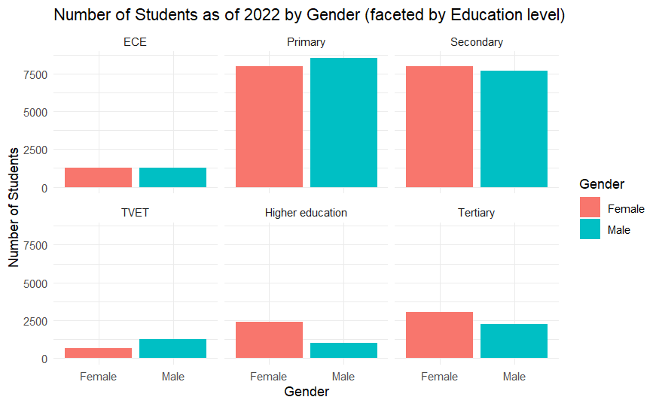
Enrolment data highlights gender disparity and low post-secondary conversion rate
By education level, it is noted that male enrolments drop particularly in upper- and post-secondary levels. This is mainly due to:
economic pressure to work
poor academic outcomes
poor attitudes to the value of education
The transition rate from Form 7 to university is also very low (No data on first year entry) to calculate statistic but it can be approximated from 2022 to be __.
Males dominate TVET due to lower academic entry requirements.
Source: ESA 2022
Mission | Snapshot | Enrolments | Challenges | Outlook
Notes:
The calculation for transition rate to university
is (1st yr uni enrolments)/(total_F7_enrolments)*100 but uni enrolment data is not available
There

Slide 6
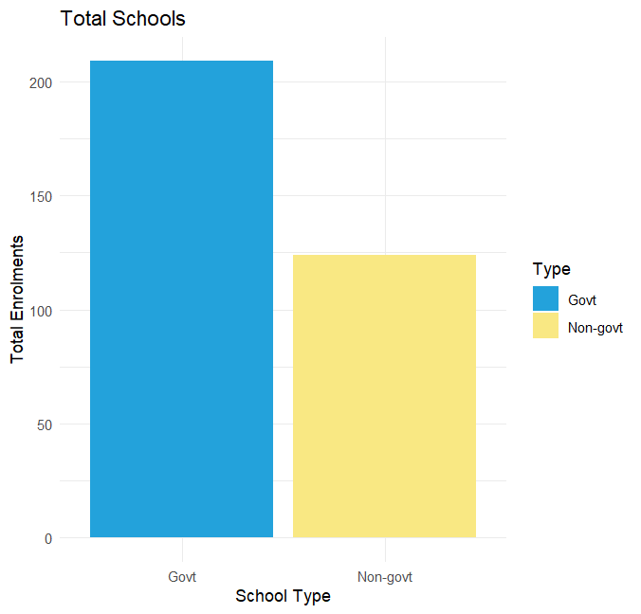
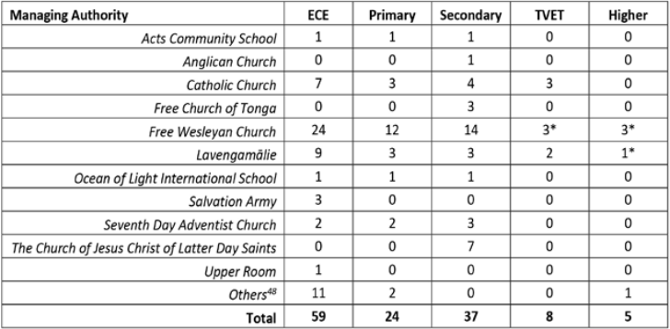
Government schools hold larger enrolments
The distribution of student enrolments shows a larger concentration (58.8%) in government schools. On the other hand, we are seeing a growing number of non-government schools
A further breakdown by education gives an important insight into inequity in educational journey from differences in gov and non-gov school enrolments.
Source: MET National Summit 2024
Mission | Snapshot | Enrolments | Challenges | Outlook

Slide 7
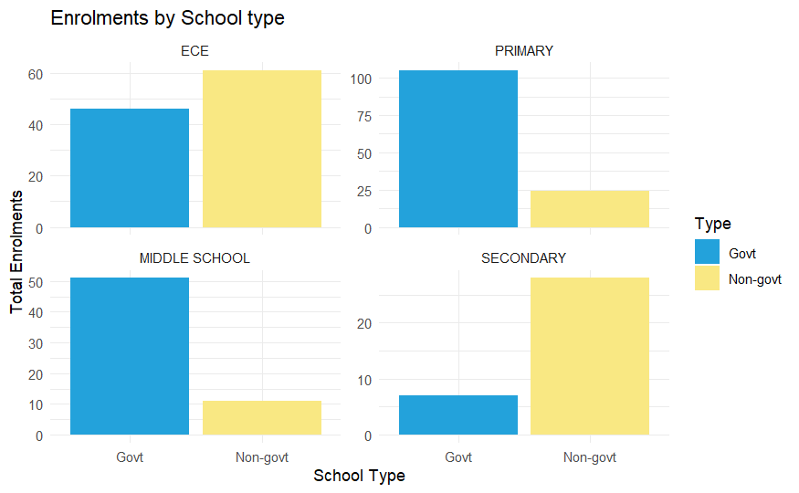
Non-Government schools hold important years of schooling
Despite government schools holding higher enrolments, the distribution by education level reveals that non-government schools hold a higher concentration of ECE and secondary level enrolments.
The implication from this is that students enter non-govt schools during ECE and Secondary level:
- Inequities in quality, access and affordability of education due to systemic differences of govt and non-govt schools.
-
Source: MET National Summit 2024
Mission | Snapshot | Enrolments | Challenges | Outlook
Notes:
Government schools dominate Primary education
but rely heavily on non-government actors (like churches or private institutions) to deliver ECE and Secondary schooling.
There may be limited government investment or infrastructure in those levels, causing non-government providers to step in.
This may create inequities in access, quality, and affordability:
Non-government schools may charge fees or have different entry criteria.
Students from lower-income households might face barriers to accessing early or later stages of education.
It can also mean less oversight or consistency in educational standards, curricula, or teacher training, especially in ECE.
1. Government Responsibility and Planning:
The government may be under-investing in crucial developmental stages (ECE and Secondary), even though they are critical for long-term human capital development.
This insight signals a need for the government to:
Expand its role in delivering or supporting ECE and Secondary education.
Collaborate with non-government providers to ensure quality and equity.
Create a clear policy framework to guide public-private partnerships in education.
Human Capital and Economic Growth:
ECE lays the foundation for lifelong learning, social behaviour, and productivity, whilst secondary education is key for developing skilled labor and preparing students for higher education or the workforce. Underdevelopment or inconsistency in these stages can undermine national productivity, reduce youth employability, and increase inequality.
Equity and Access:
If ECE and Secondary education are mainly available through non-government schools, there may be inequitable access based on geography or income.
Government policy needs to level the playing field—for instance, through subsidies, regulation, or even expanding public school offerings at these levels.
Policy Implications:
Reassess funding allocation to ensure ECE and Secondary levels are adequately supported.
Introduce teacher training programs that include non-government educators.
Create a national framework for ECE development.
Implement monitoring and accountability mechanisms for all education providers.
The concentration of ECE and Secondary enrolments in non-government schools suggests a gap in public service provision. For policymakers, this insight underscores the need to invest strategically in these stages, support equitable access, and recognize the economic importance of building strong human capital pipelines through education.

Slide 8

Non-Government schools hold important years of schooling
Challenges
Limited Resources
Outer island lacks access to Technology.
Shortage of textbooks and teaching resources
Student with disabilities need special resources
Funding constraints
4. Infrastructure and Facilities
Poor school Infrastructure
Natural Disaster prone – TSRS project (WB)
6
2
Complexity to resolve
2. Teacher Recruitments and Retention
Shortage of teachers (Science & Maths)
Teachers easily leave for better paying jobs
Salary gap between govt and non-govt teachers
5. Data Availability
The availability of data needs to be strengthened
No official website
3
1
4
5
Gender Inequality
More girls completing high school than boys
Drop out rate is more apparent in boy students.
Political Change
- Changing government initiatives may have different values and priorities from previous government
Impact
Mission | Snapshot | Enrolments | Challenges | Outlook
Notes:
Teacher Recruitments and Retention
Shortage of teachers in key subjects such as Mathematics and Science
Teachers tend to easily leave teaching for better paid jobs and also to join the Seasonal Employment abroad.
Salary Gap between Government and Non Government Teachers
4. Infrastructure and Facilities
Poor school infrastructure
Natural Disaster – We try to build back better and more resilient classrooms/buildings to with stand natural disaster – Safer & Resilient School Project (WB)
DATA AVAILABILITY – Need to strengthen data collection and dissemination
POLITICAL CHANGE

Slide 9
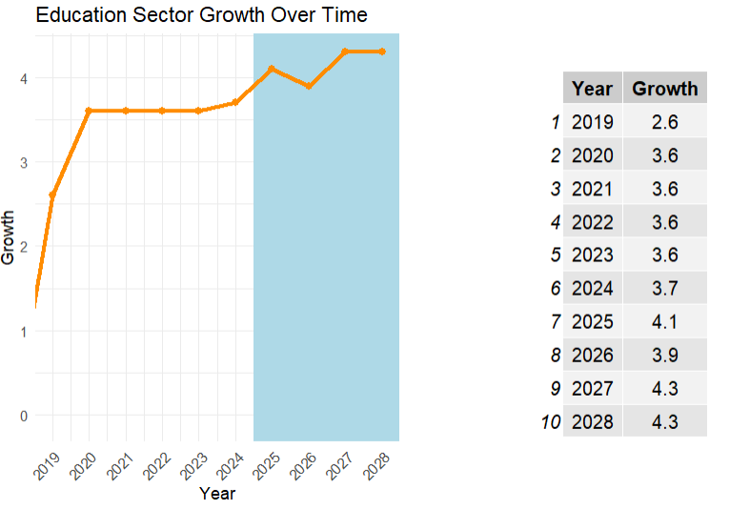
Forecasting Education GDP
Key events
Establishment of TNU in 2022 bringing level 7 (Bachelor) qualifications to local tertiary schools.
Removal of selective exams (2023) and government imbursements for vulnerable groups – encouraging higher enrolments
Slight moderation of growth post 2025 due to revised initiatives (reinstating F5 exams, removing breakfast program) to reduce government expenditure.
STG signed in 2025 to improve education quality
Allocated $1.4 budget 2025 to reinvest in primary education
Mission | Snapshot | Enrolments | Challenges | Outlook

