Slide 1
Service Sector

Slide 2
Total Service Sector Growth (%)
Forecast

Slide 3
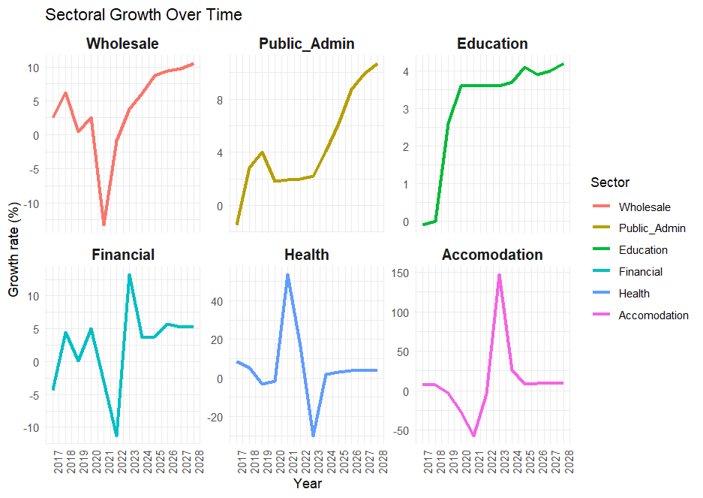
Services Sector - GDP Forecasting Performance

Slide 4
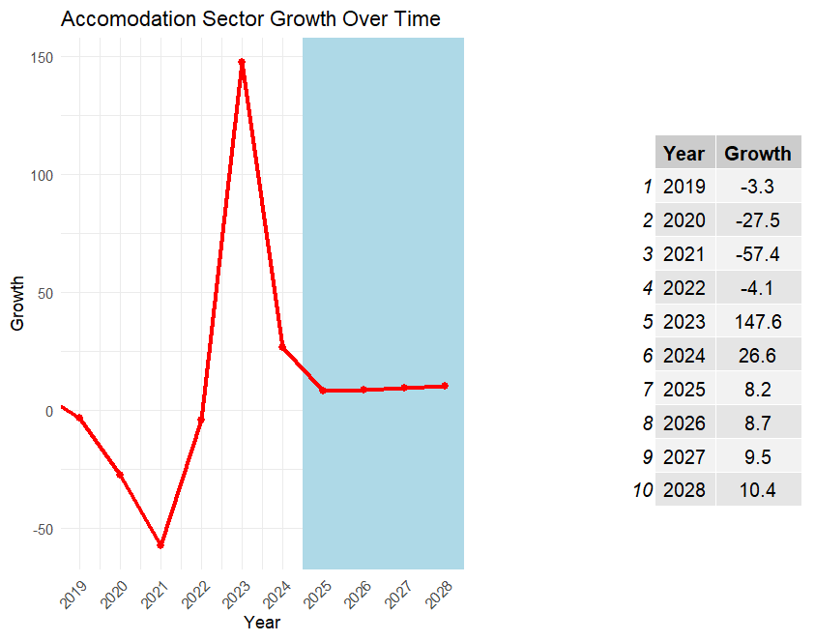
Accommodation Sector
2023/24
growth of 26.6%, sector growth decreased compared to 147.6% in 2022/2023.
although overall growth is declining, the accommodation and food services sector is increasing, with earnings rising from $22.9 million to $29.0 million and total air visitors’ arrival increased by 46.6% (from 40,665 to 59,633).
2024/25
Growth recorded at 8.2% compared to 26.6% in 2023/24
although overall growth is declining, the accommodation and food services sector is increasing, with earnings rising from $29.0 million to $31 million and total air visitors’ arrival increased by 5% (from 59,633 to 62,615).
2025/26
Growth recorded at 8.7% compared to 8.2% in 2024/25
Both growth and earnings are increasing. Earnings increased by $2.7 million to $34.12 million.
Increase activities under each tourism subsector such as airlines, Tours & travel, transportation (land & sea), accommodation, restaurant, bars & entertainment and events & activities, and handicrafts. Activities under these subsectors Heilala festivals, Pacific Festival of Arts, cruise ships, Royal Agriculture, Fisheries, Tourism and Consumer & Trade Shows locally and internationally, the local beautification program to boost the cleanliness in Tonga via infrastructure development, village clean-up campaign.
foreign investors to increase the development of 5-star accommodations (FUA’AMOTU 5 STAR HOTEL) - increasing number of visitors coming to the Kingdom.
His Majesty’s Cabinet approved on the 7th of February 2025 the acquisition of the Tonga National Museum. We will continue to monitor the construction of the new museum building in the coming years.
Cruise Ships Schedule 2025 (travel receipts increases by 15.4%)
Jan – May = 17 cruise ships & 3 was cancelled.
September – December = 16 Cruise Ships.
Notes:
TNU performance – iniatiatives? (more degrees,
Budget to see investment into education to reveal new government iniatives

Slide 5
Accommodation Sector
Ministry of Tourism New Initiatives
Tonga Festival
Mafana Festival
Tourism Rebranding Project Phase 2
Increase travel trade activities
Improve Digital Marketing efforts
Museum Touring Exhibition
Revival of the Tonga National Cultural Centre (TNCC)
Establishing a national baseline data for Heritage Sites
Number of Accommodations this year
Tongatapu:84(operating) + 15 (renovated) + 2 (new) = 101 Vava’u 37 (operating) + 6 (renovated) = 43 Ha’apai: 15 (operating) = 15 Eua: 15 (operating) + 2 (renovated) = 17 - Total for 2025: 176 accommodations
Whale watching operators
2025 - currently 48 licensed whale-watching operators throughout Tonga however, there is a possibility that these numbers will be reduced.
2026: This number is expected to decrease to focus on sustainable tourism practices.
2026/27 & 2027/2028
Growth of 9.5% for 2026/27 and 10.4% for 2027/28.
Average growth for outer years is 9.5%.
The number of accommodations is expected to remain stable, with potential for new boutique accommodations to open.
Tourism Roadmap for 2018-2023 now extend to 2023-2028. This plan focuses on the implementation of practical and systematic measures to build a stronger and sustainable tourism sector. The plan includes initiatives such as beautification projects & upgrading of tourist sites, tourism infrastructure and product development, tourism activities, industry empowerment, and the safeguarding of our culture and heritage.

Slide 6
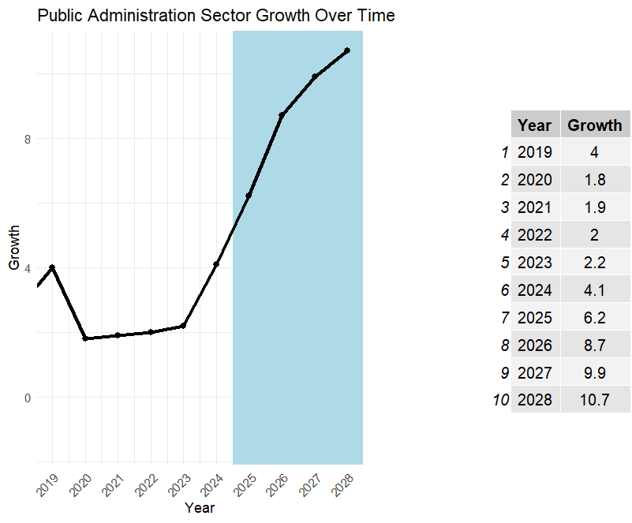
Public Administration Sector
2023/24 (growth of 4.1%, sector growth increased compared to 1.0% in 2022/2023.)
increased growth rate in salaries and wages following the COLA increases and PMS.
number of civil servants (employees) decreases by 193 posts (from 3601 to 3408) – excluding Health & Education. (vacant post of 868)
Although the no. of post decreases but the Salaries increase by $5.68 mil
Critical post committee vet post proposed from MDAs
Lower posts were merged to create higher posts.
Civil servants (64) leave for labor mobility scheme.
2024/25 (Growth recorded at 6.2% compared to 4.1% in 2023/24)
increased growth rate in salaries following PMS of FY 2023/24.
$1.8m budget for Public Sector Reform under PMO & MOF budget.
number of civil servants (employees) increases by 187 (from 3408 to 3595) – excluding Health & Education.
Increased number of vacant posts filled especially higher posts including CEO.
Staff turnover increases across MDAs
2025/26 (Growth recorded at 8.7% compared to 6.2% in 2024/25)
increased growth rate in salaries following PMS of FY 2024/25
increase Government Budget by 25% from $452.m to $603m.
$152.3 million new initiatives that will cover from the Government Recurrent Budget (new initiatives for FY 2026)
$20million to Fanga’uta Bridge (one of the big projects forecast to finish by 2027/28.
2026/27 & 2027/2028 (Growth of 9.9% for 2026/27 and 10.7% for 2027/28)
Average growth for outer years is 9.7%.
The number of employees and salaries are expected to increase on the medium term given the scholarship student are expected to finish studies and vacant post are expected to be filled.
Government are expected to increased in the medium given the huge project expected to finish by 2027/28 – eg Vava’u Hospital and Fanga’uta Bridge.
Notes:
Reflect new public growth data

Slide 7
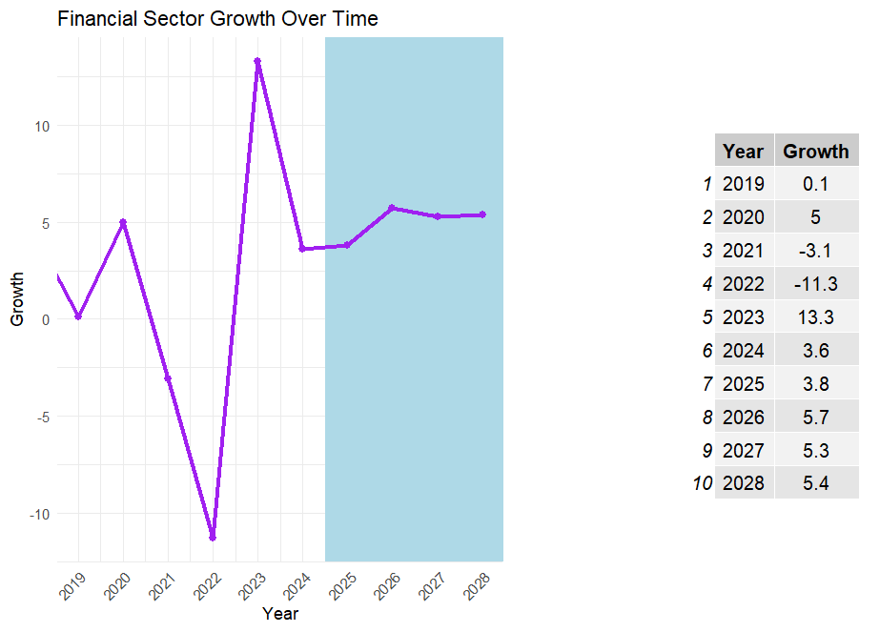
Financial Sector Growth
Key Trends
Growth rebounded to 13.3% in 2023 after pandemic/economic shocks in 2021-22.
Moderate growth of 3.6-5.7% projected for 2024-2028.
Sector contributes ~5-7% of GDP; highly liquid and capitalized.
Growth Drivers
Remittances (35% of GDP) boost liquidity and household demand.
Loan & Deposit Growth: Loans +4%, Deposits +7% in 2024.
Gov't & Donor Support: Recovery grants + TOP 56.4m GDL forsector.
Digital Financial Services: Expanding mobile and card payments.
Challenges
NPLs remain elevated, esp. in agri and SME sectors.
Climate Risk & Shocks: Natural disasters disrupt recovery cycles.
Skilled Labor Drain: Worker migration affects banking workforce.
Financial Inclusion Gap: Rural and outer islands underserved.
Opportunities
Scale up financial literacy & fintech.
Expand access via GDL programs.
Strengthen credit risk management & non-bank oversight.
Notes:
TNU performance – iniatiatives? (more degrees,
Budget to see investment into education to reveal new government iniatives

Slide 8
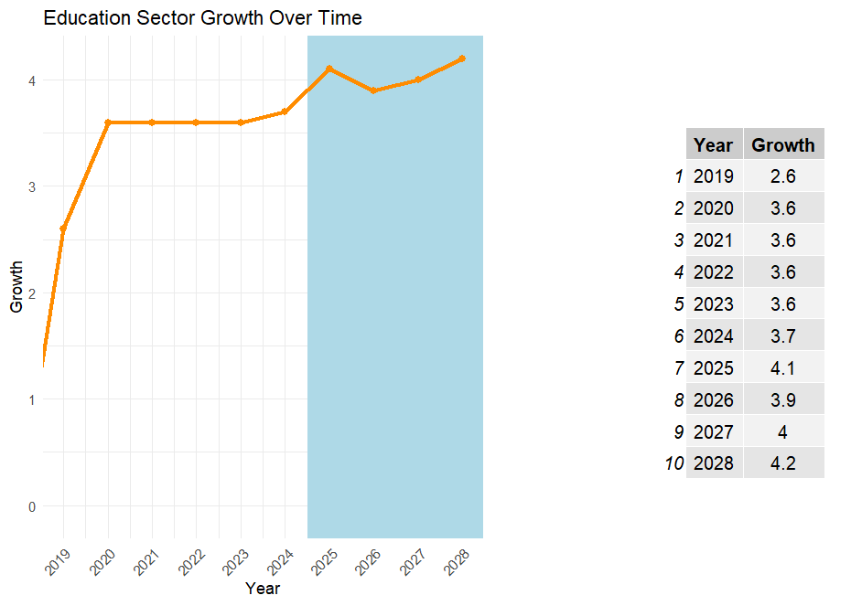
Education Sector
Key events
Establishment of TNU in 2022 bringing level 7 (Bachelor) qualifications to local tertiary schools.
Removal of selective exams (2023)
government imbursements for vulnerable groups – encouraging higher enrolments
FY 2024 (3.7%)
Feedback effect from from retention of level 7-8 students in Tonga (from TNU establishment)
Tongan national syllabus gaining credibility with NZ.
Free education (GMS – extended to F2) and vulnerable assistance schemes to improve education continuity
FY 2025 (4.1% growth)
increased subsidy to schools for better equity (eg increased to $770/head secondary, 1320 tertiary)
reinstating F5 exams (perceived negative effect which will reduce enrolment numbers)
47 ECE schools established by government.
GDL contributions ($4.5m for student loans and $10m for non-gov schools) – perceived long term positive effect due to better opportunity to study
STG ($2.2m) signed in 2025 to improve education quality (perceived positive effect due to better resources)
FY 2026 (3.9%)
Student loan roll out process is better established
ECE school growth
STG progress
Indicators: Staff List, Enrolments, Government Expenditure
Notes:
The contributional share to the services sector for education is 11%
Updated data:
Educations staff list was 1500 (up 100+ from previous year)
Total enrolment in 2024 was 33,895 (2.5% decline from previous year)
Total recurrent budget was $74.8m (from $70m in previous year | around 15% of government expenditure).
Free education act (2025)
2025 points
The increased subsidies for schools is in favor of Non-government schools in the levels of ECE and C1-F2. (positive)
ECE ($200 for non-gov, $50 for gov).
C1-F2 ($110 for non-gov, $50 for gov)
Reintroducing high-stakes exams could increase drop-out rates at that level, which runs counter to the retention gains you saw when the exams were removed in 2023 (negative)
Student loans available for tertiary students (4.5m) and 10m given for non-gov schools will help educational accessibility in the coming years (financing is one of Tongas biggest barriers post-secondary
Global Partnership for Education (GPE) gave a STG grant ($2.2m) to improve Tonga’s education system in 2025 (4 year duration), this aims to develop classroom libraries and a national reading in-service program + Home reading journals to encourage literacy at home and appoint school counsellors to support student well-being

Slide 9
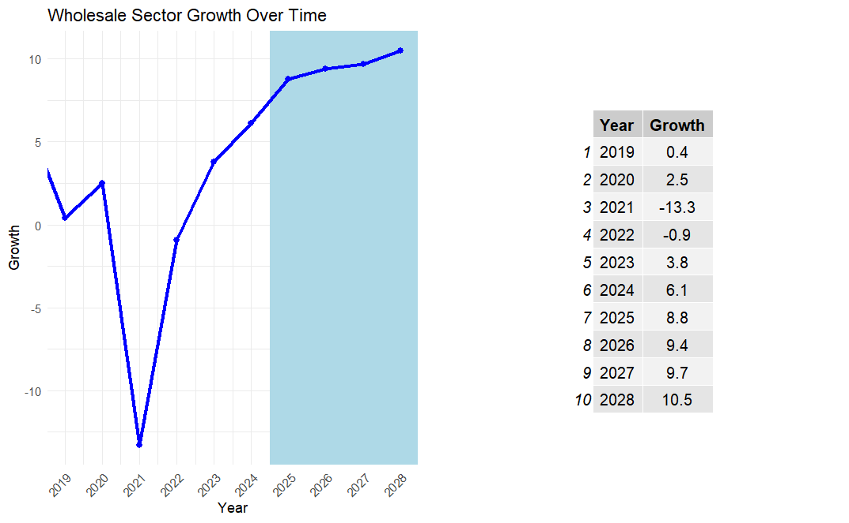
Wholesale Sector
2023/24: Strengthening Growth (+6.1% GDP Forecast)
Sector growth is forecast at 6.1%, supported by:
99 additional ESRS-adopted branches, expanding CT collection points.
CT revenue rose by 3%, with a 75% increase in collection compared to 2022/23.
February 2024 recorded the highest monthly collection at $655,171.23
MoRC collected 179% of estimated CT revenue
Awareness campaigns by the Revenue Division helped improve public understanding of tax obligations, leading to more CT registrations
These efforts collectively broadened the CT base and formalized more wholesale and retail activity.
2024/25: Momentum Building (+8.8% GDP Projection)
The sector is projected to grow by 8.8%, reflecting:
5.4% rise in import payments, signaling strong restocking and higher consumer demand.
16 more ESRS-registered branches, further widening CT compliance.
Continued shift from import duties to CT as a primary tax instrument for goods, reinforcing retail-level accountability.
Ongoing public engagement and tax education campaigns sustaining positive behavioral shifts in tax compliance.
2025/26 – 2027/28: Sustained Growth (Avg. 9.6% Nominal Growth | 3% Real GDP Contribution)
Looking ahead, the sector is expected to maintain high nominal growth, averaging 9.6%, and contribute around 3% to real GDP annually, underpinned by:
Rising imports of key goods | Growing remittances and COLA wage
Expanding ESRS coverage and CT education, cementing the formalization of the sector.
Notes:
2022/23: Recovery Phase (+3.8% GDP Growth)
The sector grew by 3.8%, led by:
A 16% increase in total imports, especially in consumer goods, food, and fuel.
Early impact of the ESRS rollout, enhancing formal sector visibility.
Rebound in remittances and tourism, boosting household consumption.
Tax exemptions on some customs duties redirected the revenue focus toward CT collections, gradually shifting more responsibility to the retail end

Slide 10
Key Takeaways for Tertiary Sector Growth
The Tertiary sector is mainly driven by growths in Wholesale and the Public administration sector
This is in line with strengthened revenue administration
large-scale ESRS adoptions across Tonga generating 179% revenue against CT estimates
The growing size (and high-end salary positions) of the public sector
Growth in COLA and PMS movements
Staff turnover increases across MDAs
GDL scheme is instrumental in the growth of key sectors, namely:
Education: School loans ($4.5m)and non-government investments ($10m)
Financial: Opportunity to give greater access eg Microfinancing ($1.2m) and credit access
Wholesale: 4.3% GDL allocation offering loans with a maximum of $50,000 and a 2-year repayment period

