Slide 1
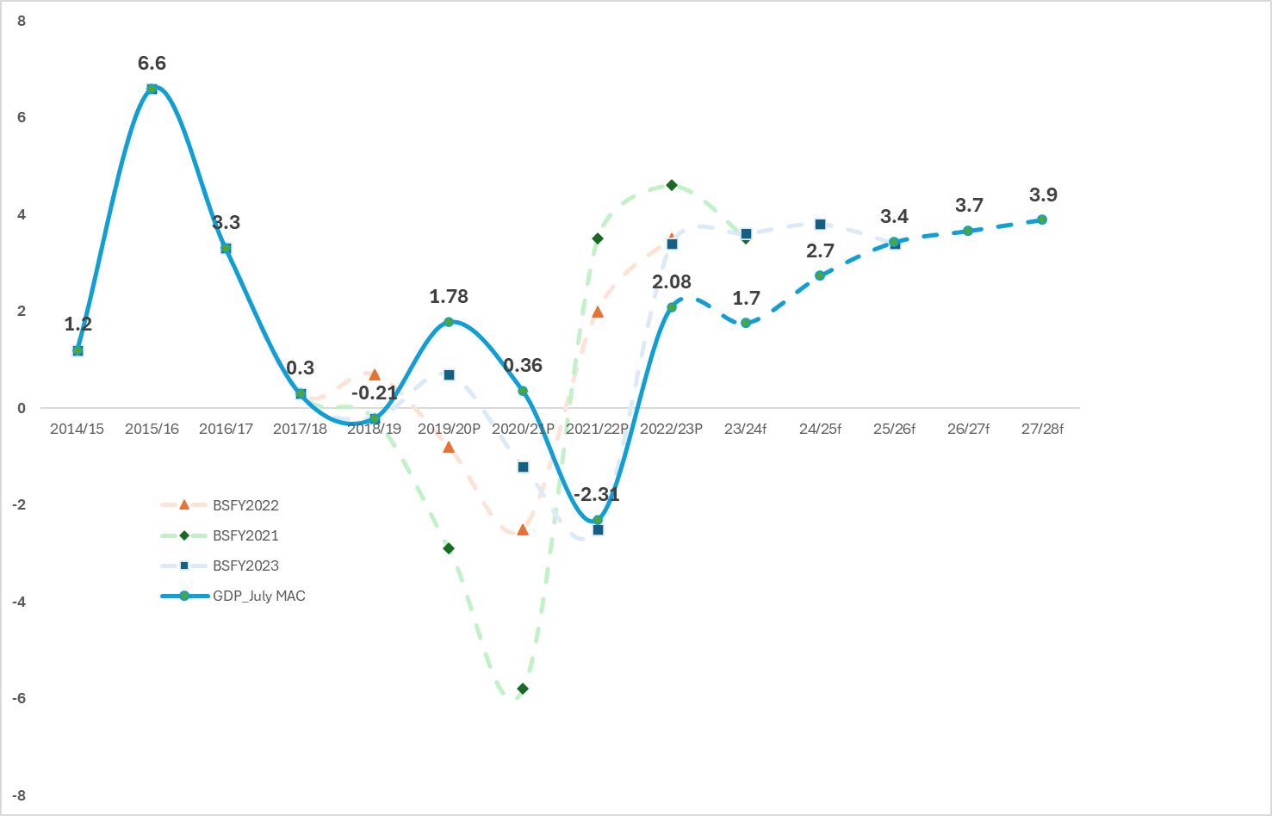
Forecast deviation
General notes
The MAC GDP revisions (2025) is in blue with forecast years marked by striped lines.
Previous year forecasts (Budget statement 2021-2023) are marked in faded colors to compare against (blue) actual data
Earlier year fo(recasts (eg FY2019 projections) deviate most from the actual data,
but this estimate is brought closer to the actual figure each successive year (2020, 2021,2022) through revisions
We can focus on 3 regions on forecasts
1) Pessimistic forecasts in 2019-2022
2) Optimistic forecasts in 2022-2023
3) Outer year forecasts 2025-2028
 | 2014/15 | 2015/16 | 2016/17 | 2017/18 | 2018/19 | 2019/20P | 2020/21P | 2021/22P | 2022/23P
BSFY2021 | 1.2 | 6.6 | 3.3 | 0.3 | -0.21 | -2.9 | -5.8 | 3.5 | 4.6
BSFY2022 | 1.2 | 6.6 | 3.3 | 0.3 | 0.7 | -0.8 | -2.5 | 2 | 3.5
BSFY2023 | 1.2 | 6.6 | 3.3 | 0.3 | -0.21 | 0.7 | -1.2 | -2.5 | 3.4
GDP_July MAC 2025 | 1.2 | 6.6 | 3.3 | 0.3 | -0.21 | 1.78 | 0.36 | -2.31 | 2.08
actual
provisional
forecast

Slide 2
Forecast deviation
Pessimistic forecasts (FY2019-FY2021)
1
2
3
1
Tonga 2019/20
Negative growth projections taking into account the impacts from COVID-19 pandemic and TC Harold (April 2020) on key sectors
Actual figures (1.78) reflects the major construction projects including TC Gita reconstruction activities and sector recovery
Tonga 2020/21
Negative growth projections from prolonged impacts of COVID-19, recovery from Tropical Cyclones (TC) GITA and TC Harold
Actual figures (0.36) driven by ongoing reconstruction and recovery works especially during a very challenging time.
Optimistic forecasts (FY2022-FY23)
2
Tonga 2021/22
High forecast projections surmises strong recovery expected from reconstruction actvities, travel bubble with NZ and Aus and $60m Gov Economic and Social Stimulus package
Actual data (-2.31) driven by pessimistic expectations from the double shock from HTHH and covid pandemic as well as increased dependency on external aid.
Tonga 2022/23
Higher projections came from extended socio-economic support to business FY2022, construction recovery works, and normalizing of demand post covid
Actual data (2.08) shows catalyst broad-based growth from recovery and reconstruction activities and stronger remittance and tax revenue inflows
3
Moderation of growth in outer years in medium term (FY2025-FY2028) consider:
Major construction projects (Fangauta Bridge (US$102m), Fuaamotu Resort ($US56m)Tonga Museum ($16.7m), Queen Salote nursing, Vava’u hospital $15m, GRID Project $16m)
Strengthened revenue administration through ESRS adoptions across Tonga generating 179% revenue against CT estimates
Global uncertainty affecting supply and trade dynamics (Ukraine War)
Potentially stalled projects from caretaking mode in upcoming elections

