Slide 1
Government Priority Areas
1. Climate & Disaster Resilience
2. Combat Illicit Drugs
3. Poverty Reduction & Vulnerable Groups
4. Quality Education
6. Economic Growth
7. Public Sector Efficiency
5. Quality & Affordable Healthcare
  Government Priority Areas
3 Objectives
National resilience
Social sector development
Economic & Public sector
Development
GPA
Notes:
The 7 Government Priority Areas fall under 3 broad themes.

Slide 2
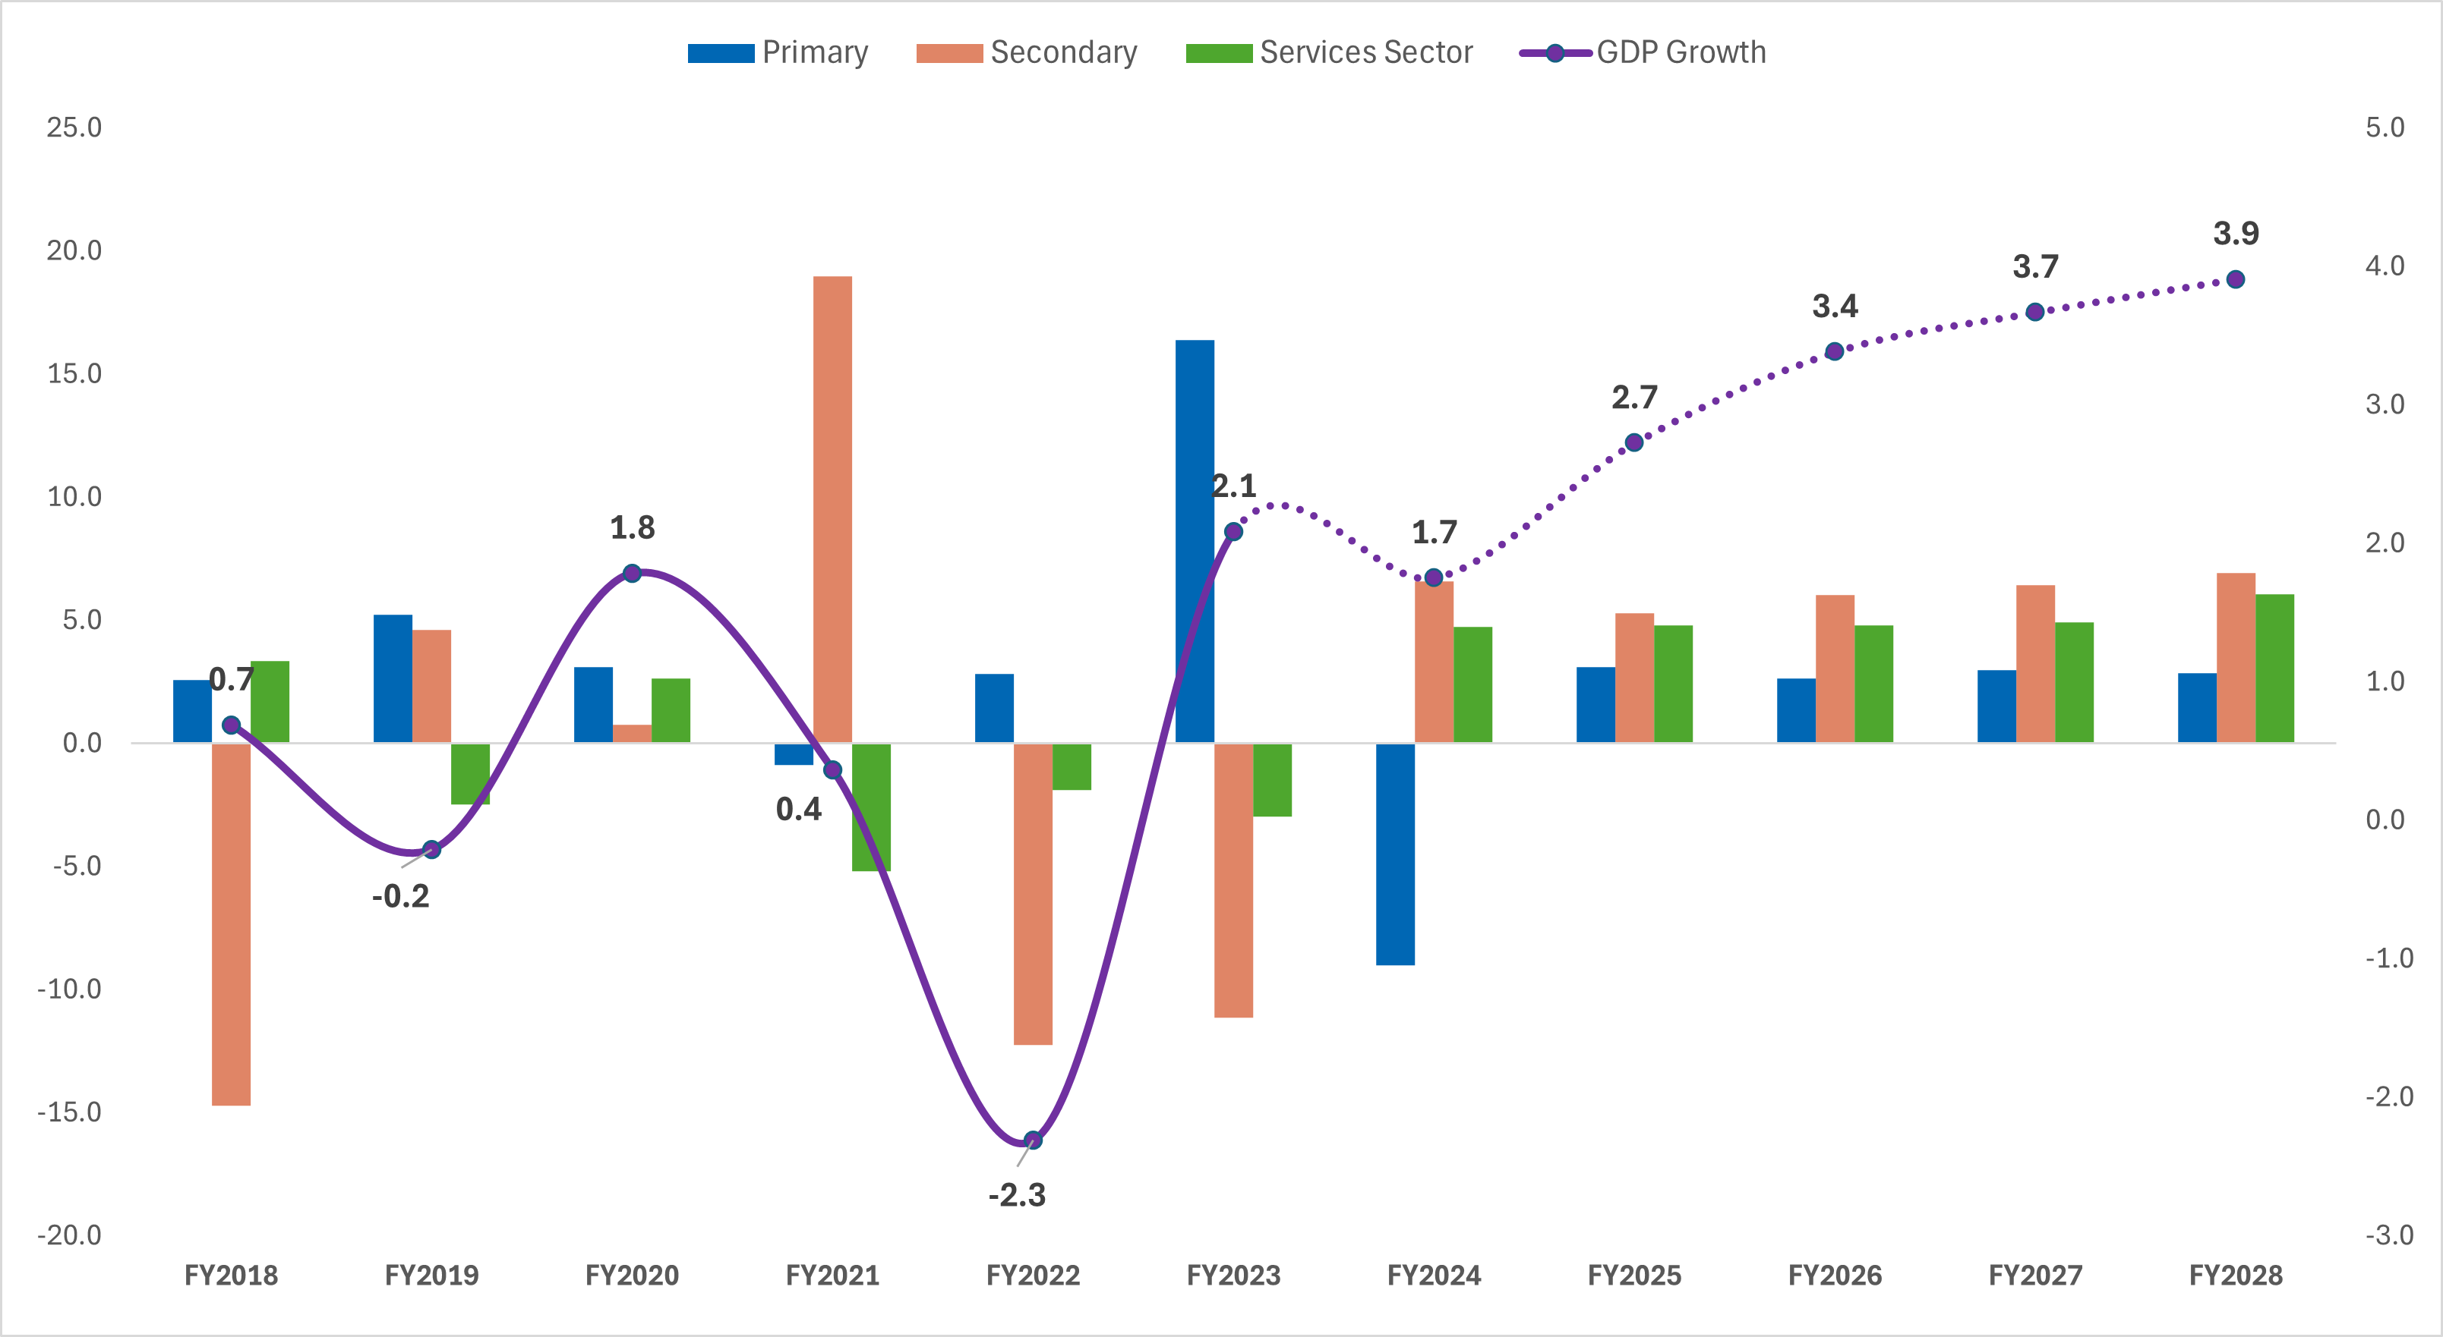
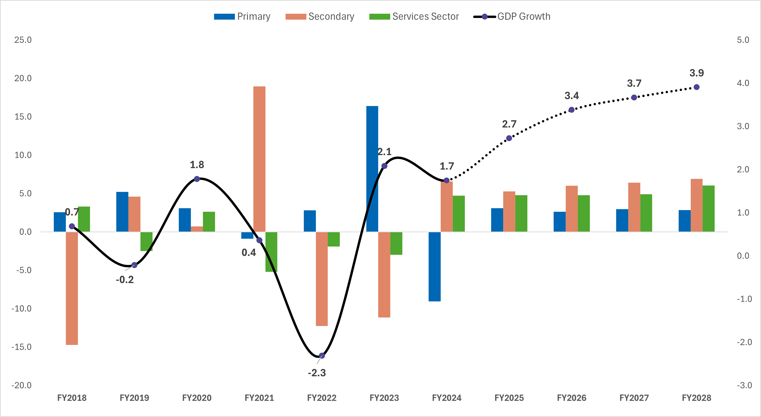
Domestic Economy
Tonga saw a moderation of growth in FY24 to 1.7% (actual) due to a fall in agricultural output (compared to FY23) - despite consistent remittance flows and continued tourism recovery.
The economy expanded by 2.7% in FY25, supported by robust reconstruction activity, strong remittance inflows, a rebound in tourism, and stronger-than-expected grants inflows.
Outlook: Projections are optimistic in the medium term mainly due to major construction projects such as
  Major construction projects (Fangauta Bridge (US$102m), Fuaamotu Resort ($US56m), Tonga Museum ($16.7m), Queen Salote nursing, Vava’u hospital $15m, GRID Project $16m)
  Improved Tourism
  Strengthened revenue administration through ESRS adoptions across Tonga generating 179% revenue against CT estimates

Slide 3
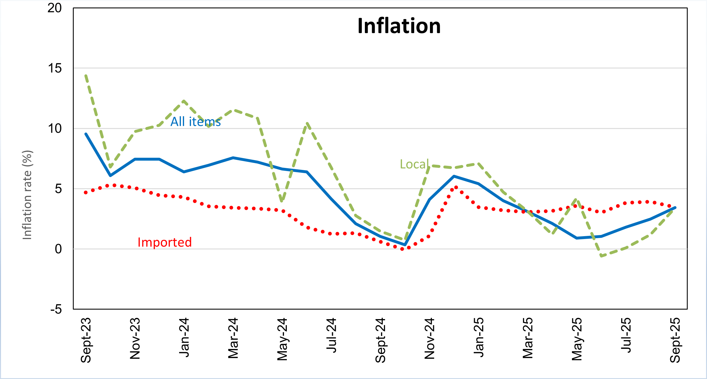
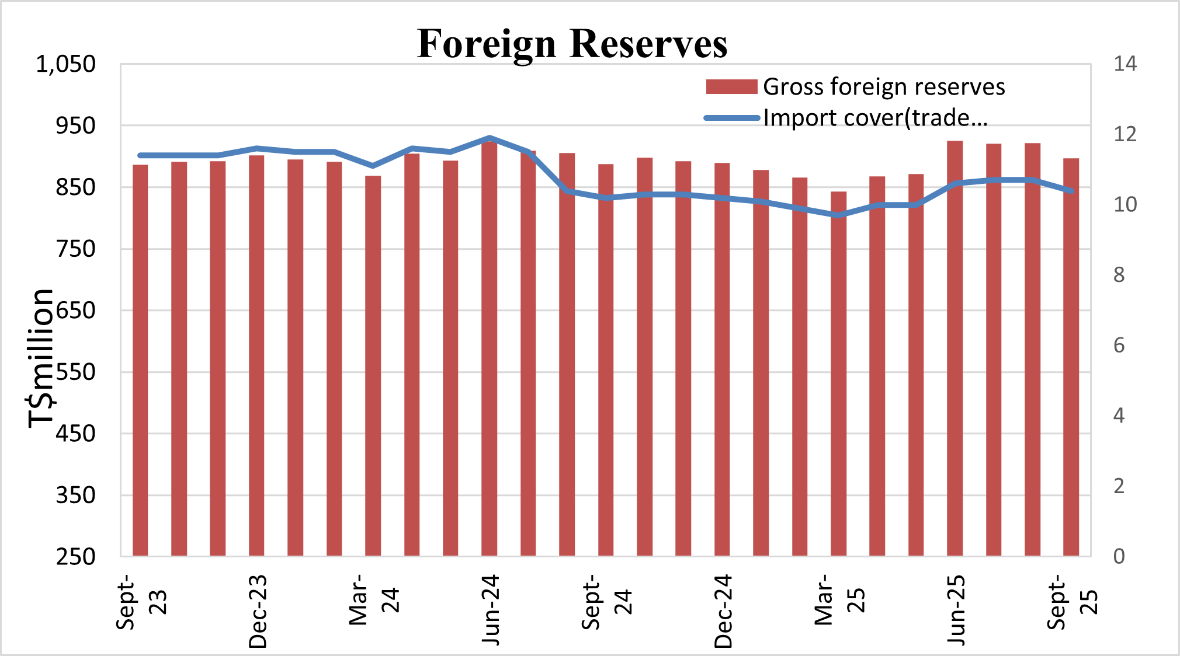
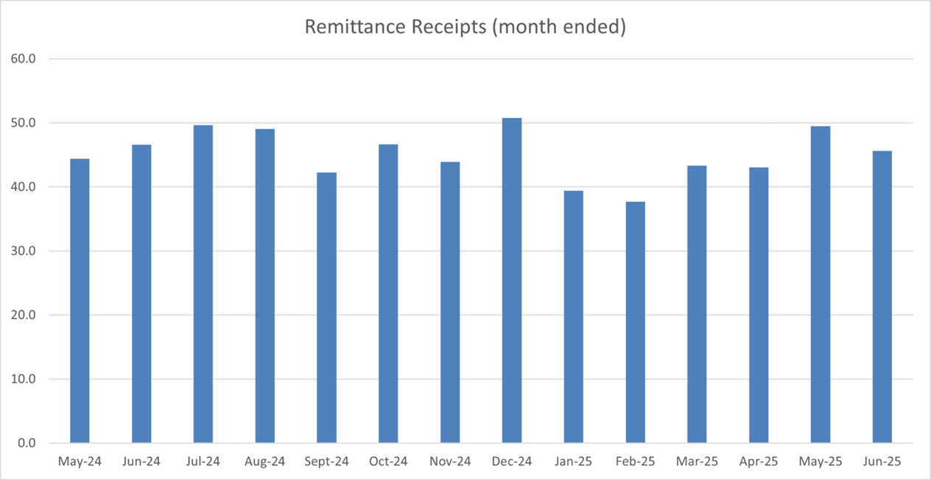
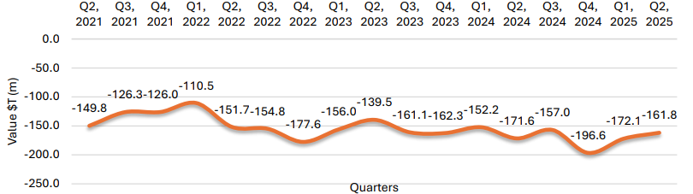
Economic Indicators
Inflation
Headline inflation rose to 3.4% in September (from 2.5% in August). There upward trend in inflation has persisted since May – but has been managed below the NRBT reference rate of 5.0%
Foreign Reserves
Foreign reserves sit at a comfortable level of $921 million as of Sept 2025, equivalent to 10.7 months of import coverage, well above IMF’s recommended 7.5-month threshold
Remittances
Remittance rose by $52.2 million for the month of August. This was mainly from higher private transfers, employee compensation, and social benefits.
Imports and Exports
Tonga recorded a trade deficit of T$161.1m in Q2 of 2025 – which is a T$10m decline from the previous quarter. This was due to a reduction of imports (by 4.6%) and an increase in exports (by 40.9%). The main import goods are Prepared food stuff, Tobacco and spirits (worth T$27m) whilst the main exports were vegetable products (worth T$3.3m).

Slide 4
Social Protection Programs
  Social Welfare Scheme (SWS)
Beneficiary Group | Current FY2026
Elderly (67-79 yrs) | $100/month
Elderly (80+ yrs) | $120/month
  Supports 5,600+ elderly individuals across Tonga
  Expansion of Eligibility:
    Current : Age eligibility reduced to 66 years (FY 2026)
  Eligibility & Application Process:
    Members become eligible upon reaching the official age.
    Lodge application with NRFB using form and valid ID
  ii. Disability Welfare Scheme (DWS)
Beneficiary Group | Current FY2026
Disabled (1 form) | $70/month
Disabled (2 forms) | $100/month
Disabled (3 forms) | $120/month
  Assists approximately 4,100+ persons with disabilities
  Monthly support based on severity (1, 2, or 3 forms of disability)
  Eligibility & Application Process :
    Submit application form to MIA for verification, in collaboration with relevant authorities.

