Slide 1

Data Storage Solutions for Data Analytics
Luis Alberto Castaneda Avila & Seember Naomi Shausu

Slide 2
Introduction
Data-driven decision making is essential for modern businesses
Data warehouses enable analysis of large historical datasets
Project builds a sales data warehouse using Northwind dataset

Slide 3
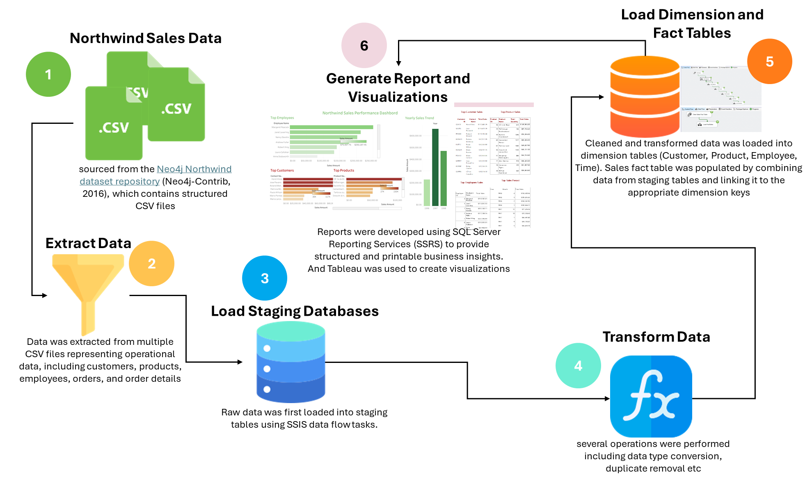
Problem & Objective
Raw data is fragmented and not suitable for analytics
Need a centralized system for insights
Objectives
  Build a dimensional data warehouse
  Enable reporting and visualization

Slide 4
Business Requirements
Identify
Identify top customers
Analyze
Analyze product performance
Evaluate
Evaluate employee sales
Track
Track sales trends over time

Slide 5
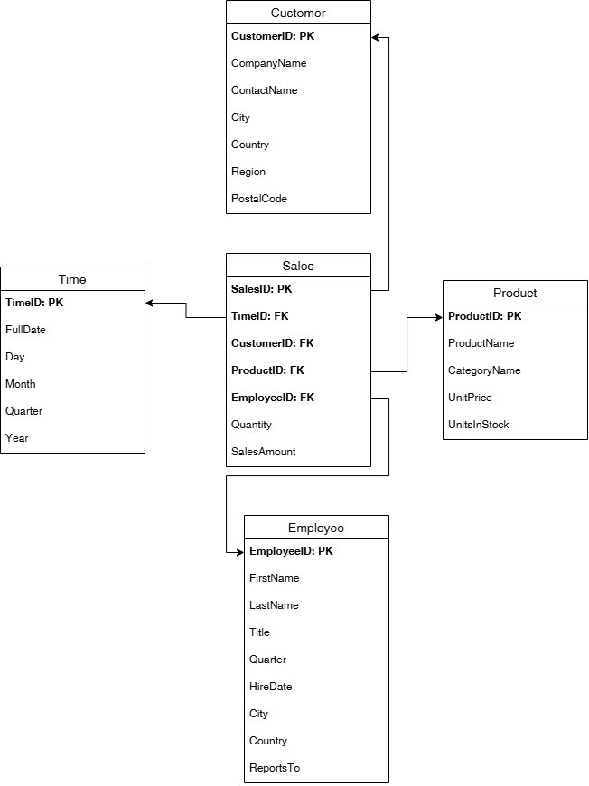
Data Warehouse Design
Star Schema used
Fact Table: Sales
Dimensions:
  Customer
  Product
  Employee
  Time

Slide 6
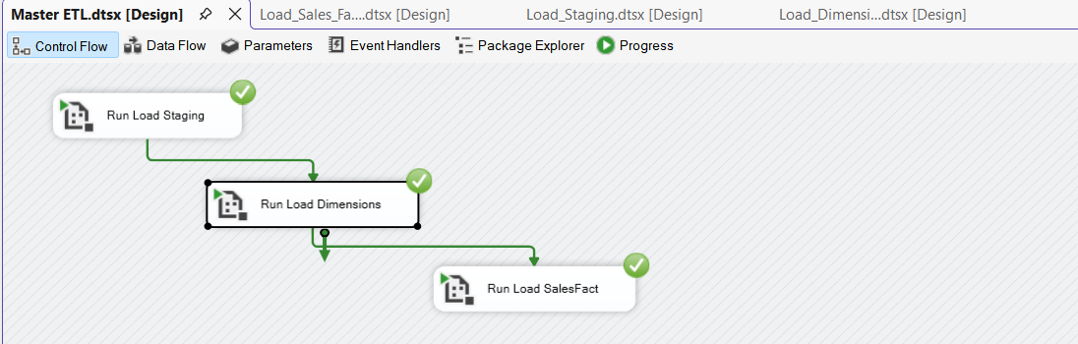
ETL Process
Tool: SSIS
Steps:
Extract data from CSV files
Transform (clean, convert, deduplicate)
Load:
  Staging → Dimensions → Fact

Slide 7
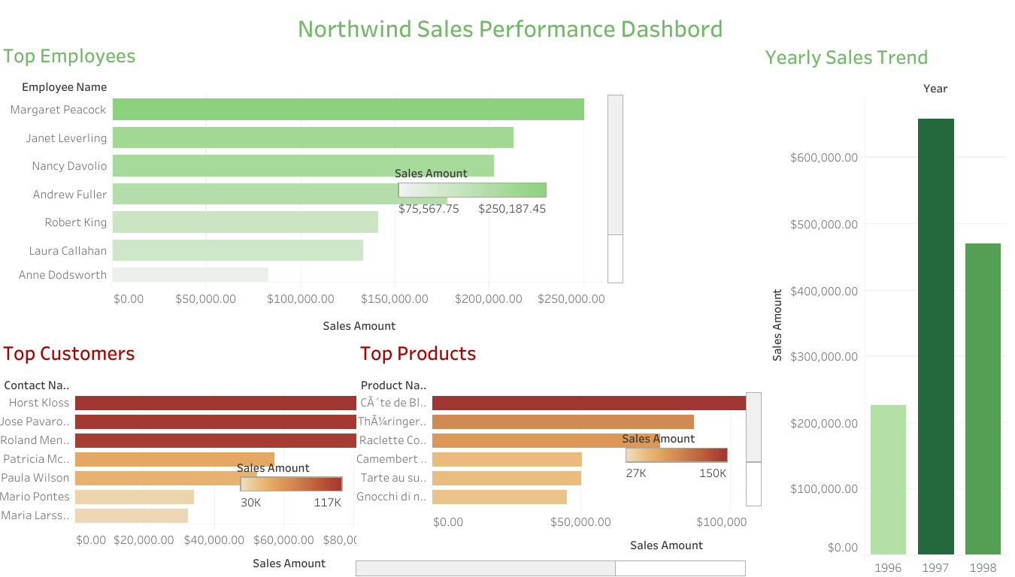
Visualizations (Tableau)
Top Customers by Sales
Top Products
Total Sales by Year
Employee Performance

Slide 8
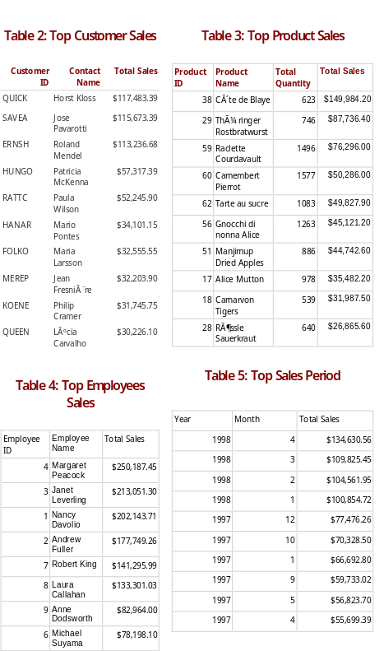
Reports (SSRS)
Top Customer Sales
Top Product Sales
Top Sales Period
Employee Performance

Slide 9
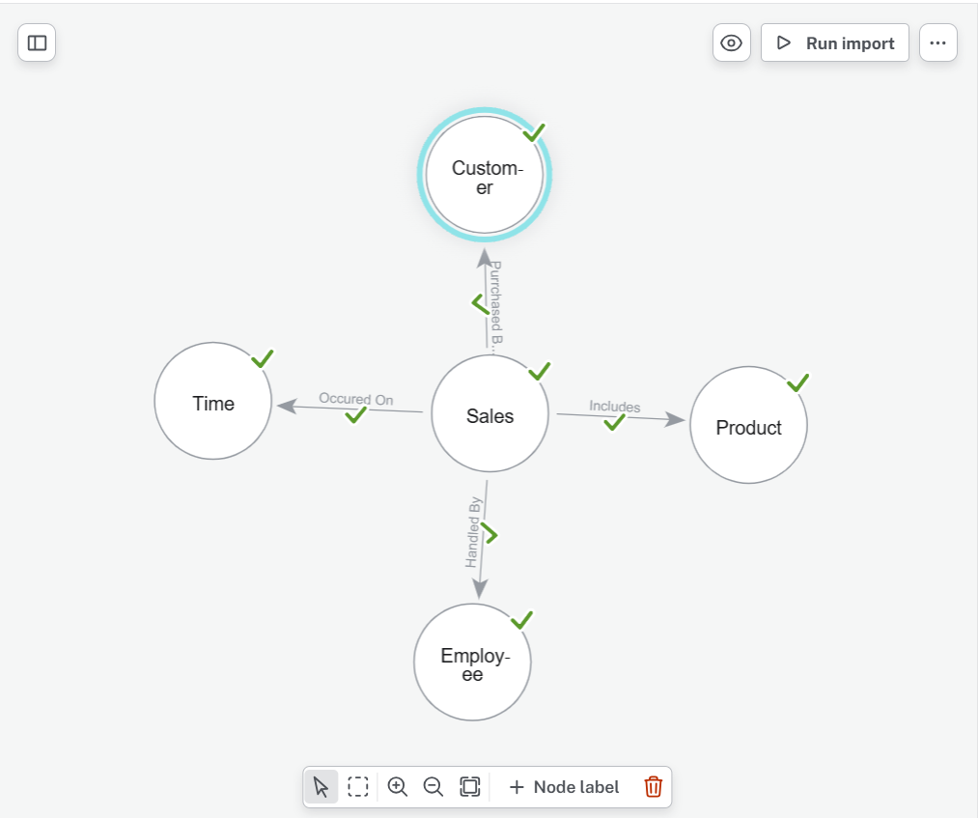
Graph Database (Neo4j)
Data modeled as nodes and relationships
Relationships:
Customer → PURCHASED → Sales
Sales → INCLUDES → Product
Insights:
Customer similarity
Products bought together
Relationship paths

Slide 10

Questions?

