Slide 1
Who am I?
Hello, I am Māris Ločmelis.
I have 14+ years of experience in software development.

Slide 2
Explain basics of Java
OOP
Vendors
VM
JDK

Slide 3
Java pros and cons
OOP Language.
VM required.
JDK.
Vendors.

Slide 4
What is Spaghetti.
Code that is hard to read.
Code that is hard to maintain.
Code that is hard to restructurize.
Code that is best for that guy, and everyone hates this guy.

Slide 5
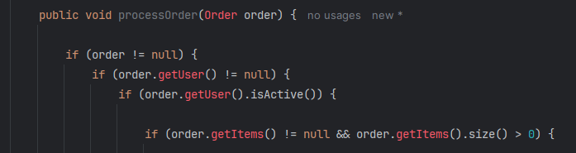
Java spaghetti code example

Slide 6
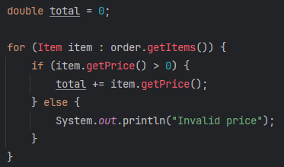

Slide 7
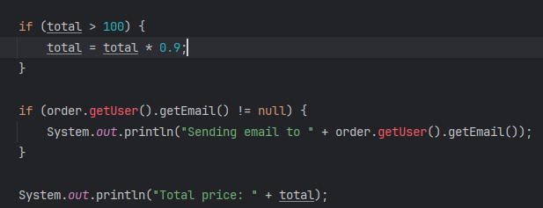

Slide 8
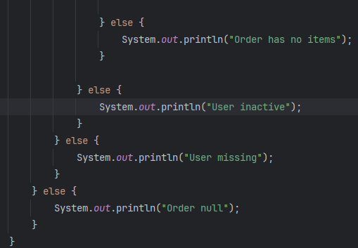

Slide 9
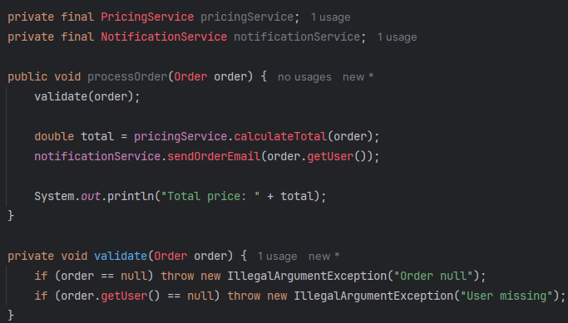
Same but Clean

Slide 10
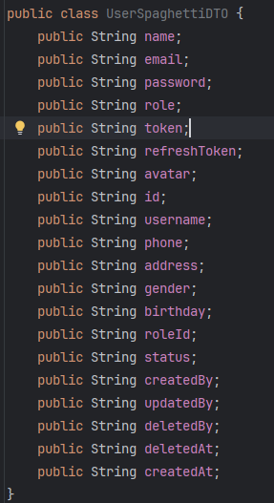
Spaghetti Object

Slide 11
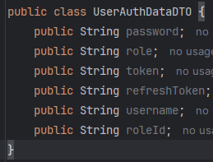
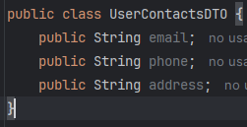
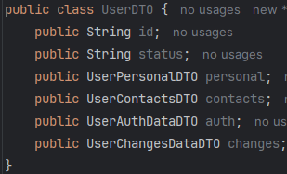
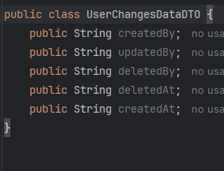
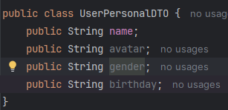
Reworked Object

Slide 12
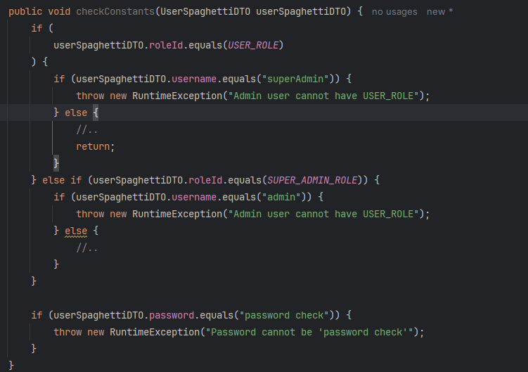
Some Complex Spaghetti

Slide 13
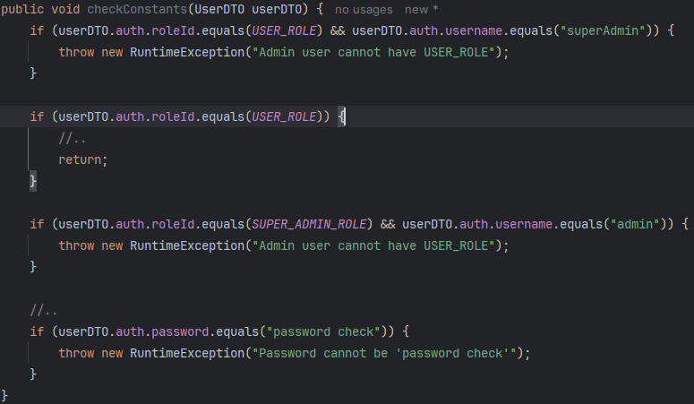
Complex better

Slide 14
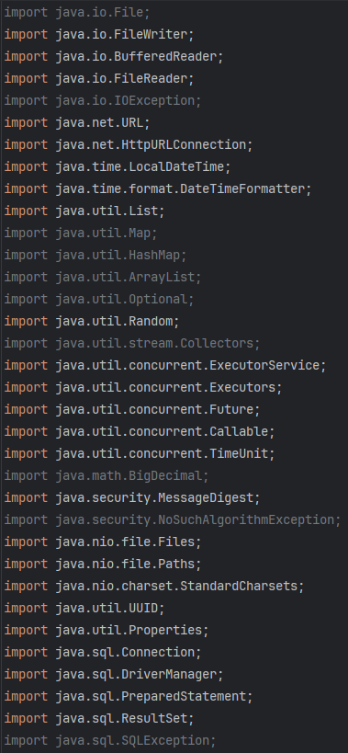
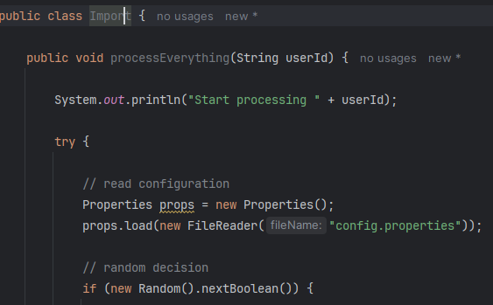
Import Hell

Slide 15
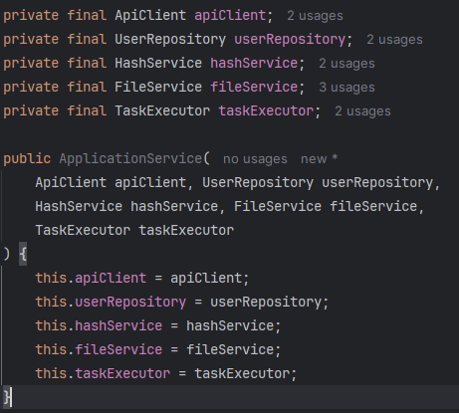
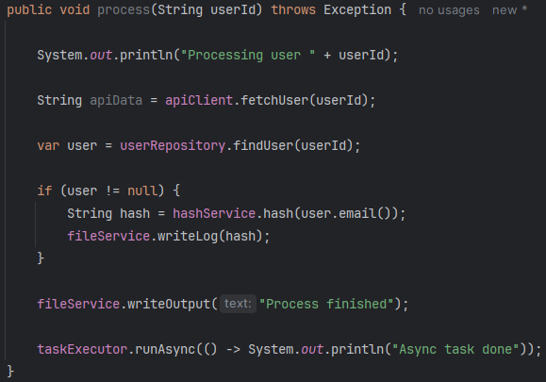
Imports optimized

Slide 16
Importance of Constructor
Shows dependencies used in class
Minimizes random object creation
Makes tests easier
Can see all class dependencies.

Slide 17
Vendor Management
Gradle (functional styled)
Maven (xml styled)

Slide 18
IntelIJ Maven tool
IntelIJ have built in tools.
Tool for Maven.
Tool for Gradle.

Slide 19
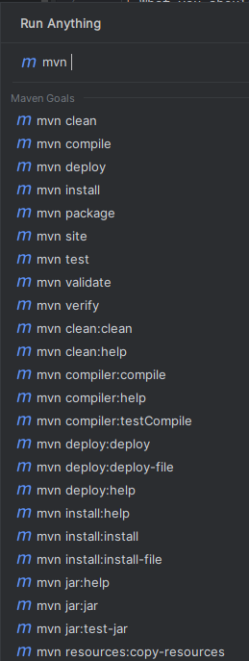

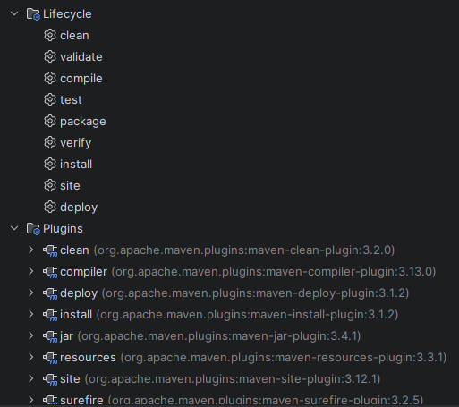

Slide 20
Dependency Hell
100? dependencies listed in vendor manager
Related dependencies have conflicts
mvn dependency:tree output is to huge to read.

Slide 21
Avoid dependency hell
Evade new dependencies.
Confirm subvendors.
Specify and validate versions compatibility.
Choose clear path.

Slide 22
Cool common dependencies
Lombook
SL4J
Junit
Mockito
Spring
Jackson

Slide 23
Any Questions ?
Questions are welcome (eng, lv or ru).
Critics are welcome to.
Materialshttps://github.com/Neznajki/devclub-almost-java-materials
Linked-in https://www.linkedin.com/in/ml-698627181/
Email me: neznajki@gmail.com

