Slide 1
Pattern and Anomaly Based Detection of Potential Money Laundering Transactions and Entities
Nathan fleming

Slide 2
Related Work
data preparation, data transformation, and data analytics techniques(Chen, Z., Van Khoa, L.D., Teoh, E.N. et al., “Machine learning techniques for anti-money laundering (AML) solutions in suspicious transaction detection”)
Advantages of graph theory over traditional SQL(K. Plaksiy, A. Nikiforov and N. Miloslavskaya, "Applying Big Data Technologies to Detect Cases of Money Laundering and Counter Financing of Terrorism”)
typical patterns used to detect ML(R. I. T. Jensen and A. Iosifidis, "Fighting Money Laundering With Statistics and Machine Learning”)

Slide 3
Background
Anti Money Laundering(AML) laws have become more complex
Increased volume of transactions
Perpetrators become more sophisticated
Simplistic SQL data query's have become obsolete

Slide 4
Dataset
Transaction Database – DataBricks
14,532 rows
12 columns
Entities Database – DataBricks
10,108 rows
7 columns

Slide 5
Methodology
Libraries
Graphframes(https://github.com/graphframes/graphframes)
Torch(https://pytorch.org)
Splink(https://github.com/mojanalytical-service/splink)

Slide 6
Methodology-continued
Types of money laundering schemes detected with their solution
Synthetic Identity’s (graph theory with correlation values)15 entities
Structuring and Smurfing( entity graph mining ) 3884 fraudulent schemes
Round Tripping( entity graph mining ) 4 detected transaction sets
Slightly Modified Identities (splink entity comparisons) 2 flagged entities

Slide 7
Evaluation
Challenges
Data contains no ground truth
It is impossible with real data to determine false positives or negatives
Solution
Compare the entities found
Compare the time needed to compute result

Slide 8
evaluation
To reduce the computation time needed to find money launder I adapted the solution until I found two ways to improve the models.
Pruned the entity graph more aggressively before running calculations
Created and used more simplistic motifs to find smurfing/structuring

Slide 9
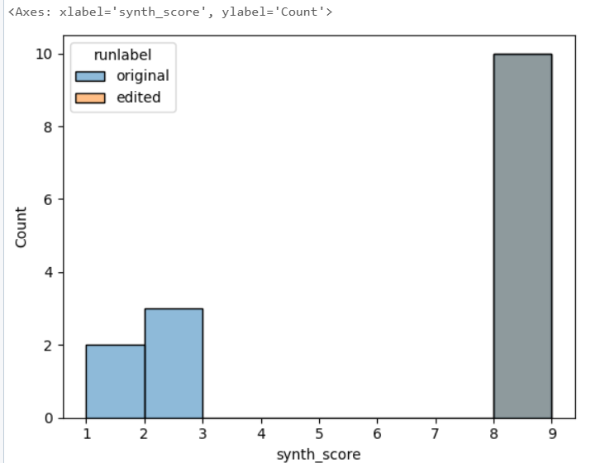
Results-Pruning
All entities with a syth score of three and more are detected
Computation times on all 20 trials were faster

Slide 10
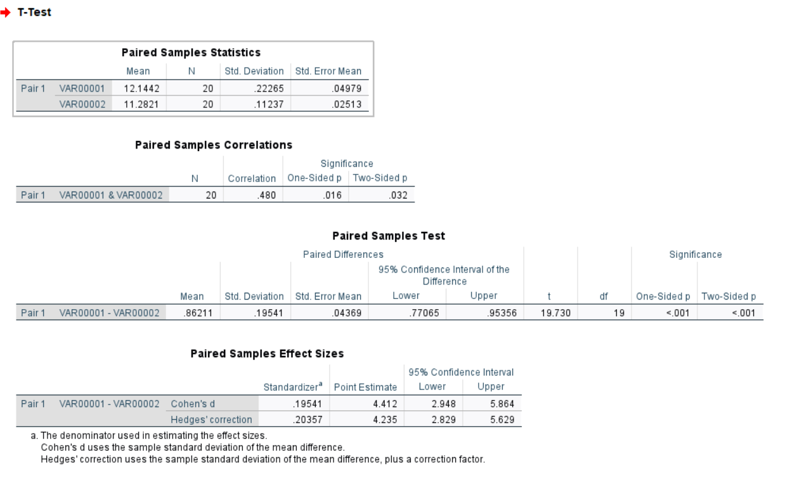
Results-Pruning

Slide 11
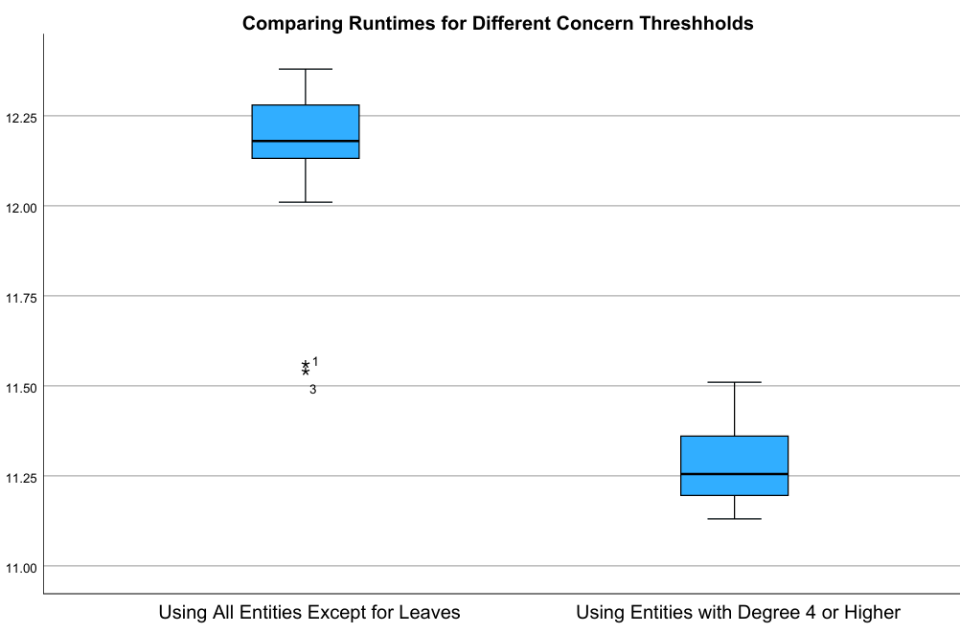
Results Pruning

Slide 12
Evaluation-Pruning
In conclusion as you can see a dependent samples t-test was conducted to examine the difference in run time of the larger entity graph (mean 12.1442 Standard Deviation .22265) and the smaller(mean 11.2821 Standard Deviation .11237). for a sample of 20 runs. The analysis revealed a significant decrease in run time . t(19) = 19.73, p < .001. The coins d effect size is 4.412 indicating a substantial difference in run time. This shows that being more selective in the connectedness of the graph we create can help increase run time of analysis. This may not seem significant but because of the large volume of transactions and entities a speed increase with this small of a data set shows that with a larger set a substantial amount of time could be saved.

Slide 13
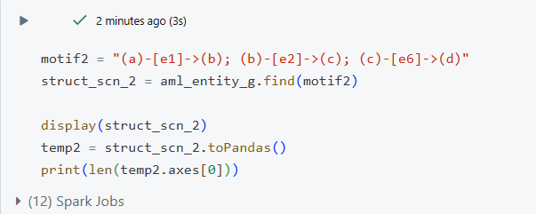
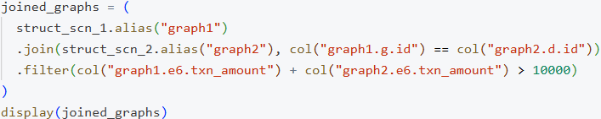
Evaluation-SmallerMotifs

Slide 14
Evaluation-SmallerMotifs
All graph patterns caught by larger motif were caught by the smaller motif
Smaller motifs reduce the run time but also the amount of information

Slide 15
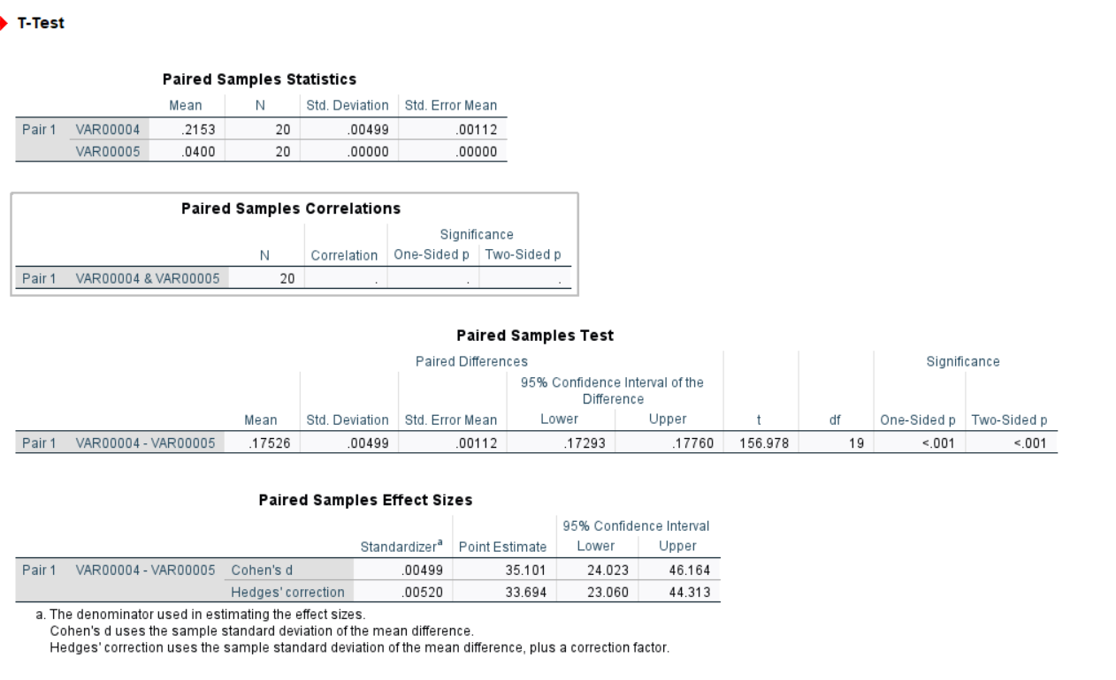
Evaluation-SmallerMotifs

Slide 16
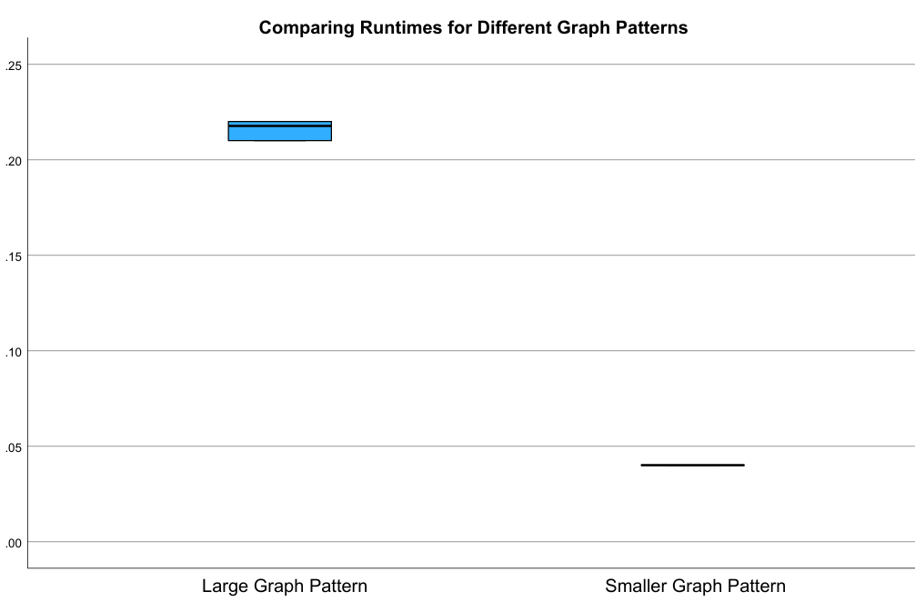
Evaluation-SmallerMotifs

Slide 17
Evaluation-SmallerMotifs
In conclusion a dependent samples t-test was conducted to examine the difference in in run time of the larger motif(mean .2153 Standard Deviation .004) and the smaller motif (mean .04 Standard Deviation 0). for a sample of 20 runs. The analysis revealed a significant decrease in run time . t(19) = 156.98, p < .001. The coins d effect size is 35.101 indicating a substantial difference in run time. The increased number of suspicious schemes found, and the time decrease of the computation gives credence to the hypothesis that a smaller search motif decreases run time. One disadvantage to a smaller search motif is that the number of entities found as a part of the scheme decreases. This gives investigators less information to go off, but these entities can be quickly found once we only have suspicious entities.

