Slide 1
RECURSION
PROGRAMMING TECHNIQUES
ADVISOR: Trương Toàn Thịnh

Slide 2
CONTENTS
Introduction
Categories
Some applications
Alternative method
Extended problems

Slide 3
INTRODUCTION
Have a big significance in computer science
Suitable for problem with recursive nature
Limitations
  Low speed
  Need a large amount of memory
For example: recursively defining a natural number
  Zero (0) is a natural number
  n is a natural number if n – 1 is a natural number

Slide 4
INTRODUCTION
Example: recursively defining the factorial
  0! = 1
  n! = n * (n – 1)!
Program
  long GT(int n){
    long ret;
    if(n == 0) ret = 1;
    else ret = n * GT(n – 1);
    return ret;
  }

Slide 5
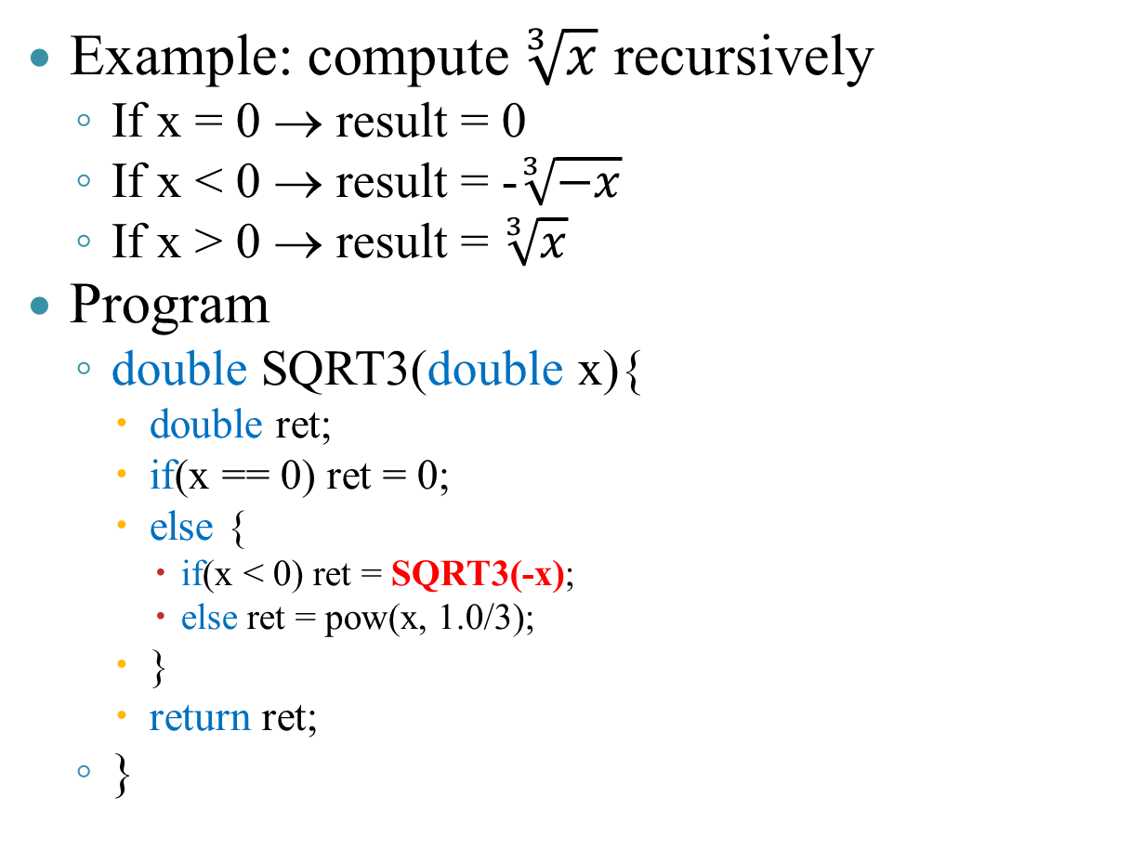
INTRODUCTION
Example: compute $\sqrt[3]{x}$ recursively
  If x = 0 → result = 0
  If x < 0 → result = -$\sqrt[3]{−x}$
  If x > 0 → result = $\sqrt[3]{x}$
Program
  double SQRT3(double x){
    double ret;
    if(x == 0) ret = 0;
    else {
      if(x < 0) ret = SQRT3(-x);
      else ret = pow(x, 1.0/3);
    }
    return ret;
  }

Slide 6
INTRODUCTION
Example: recursively report an error
  If len(string-to-print) > 50 → print error-string
  Else print string-to-print
Program
  void printString(char* s){
    if(strlen(s) <= 50) cout << s << endl;
    else printError();
  }
  void printError(){
    printString(“String exceeding limited length”);
  }

Slide 7
INTRODUCTION
Stop condition
  At ex1: at base step n = 0 → result is 1
  At ex2:
    At base step x = 0 → result is 1
    At recursive step x > 0 → compute normally
  At ex3:
    Error-string obeys the limited length
What if stop condition is wrong
  Loop forever
  Stack overflown

Slide 8
CATEGORIES
Linear recursion
  In the function’s body, there is only one function-call to itselt directly
  General form
    <Function-name & parameters list>{
      if(<stop-condition>)
        /*Return a value or stop working*/
      else{
        /*Do something*/
        /*Call recursively*/
      }
    }

Slide 9
CATEGORIES
Linear recursion
  Example: Consider {a_{n}}, n ≥ 0 with following rule
    If n = 0 then a₀ = 1
    If n even then a_{n} = (n/2)*a_{n/2}
    If n odd then a_{n} = (3n + 1)*a_{n – 1}
  Program
    int A(int n){
      if(n <= 0) return 1;
      else if(n % 2 == 0)
        return (n/2)*A(n/2);
      else
        return (3*n + 1)*A(n – 1);
    }
    void main(){
      cout << A(4) << endl;
    }
n
0
1
<128>
A
4
(3* +1)*
n
1
A
<120>
2
n
( /2)*
<112>
A
4
8
n
( /2)*
<104>
A
<100>
main

Slide 10
CATEGORIES
Linear recursion
  The last call (tail call): When function g() call function f(), we say f() is a tail-call if the f()’s termination is the termination of g()
  Tail-call does not mean it is at the last-line of the function’s body
float CalcAB(float t){ | float Calc(float t){
float y = FuncA(t); | float y = FuncA(t);
float x = FuncB(t); | float x = FuncB(t);
return Max(t*x, t*y); | if(x > y) return FuncA(x – y);
} | return (y – x)*Max(t*x, t*y);
 | }

Slide 11
CATEGORIES
Linear recursion
  Tail recursion is linear recursion, and have a recursive call which is a tail-call
  Example: NOT tail-recursion program
    void main(){
      cout << GT(3) << endl;
    }
    long GT(int n){
      if(n == 0) return 1;
      return n * GT(n – 1);
    }
n
0
1
<128>
GT
n
1
×
<120>
GT
n
2
×
2
<112>
GT
n
3
×
6
<104>
GT
<100>
main

Slide 12
CATEGORIES
Linear recursion
  Tail recursion is linear recursion, and have a recursive call which is a tail-call
  Example: tail-recursion program
    void main(){
      cout << GT(3) << endl;
    }
    long GT(int n, long ret = 1){
      if(n == 0) return ret;
      return GT(n – 1, ret * n);
    }
ret
6
n
0
<140>
GT
ret
6
n
1
<128>
GT
ret
3
n
2
<116>
GT
ret
1
n
3
<104>
GT
<100>
main

Slide 13
CATEGORIES
Binary recursion
  In the function’s body, there are exact 2 recursive call directly
  General form
    <Function name and parameters list>{
      if(<stop condition>)
        /*Return value or stop working*/
      else{
        /*Do something*/
        /*Recursively call (1) to solve the smaller problems*/
        /*Recursively call (2) to solve the remaining problems*/
      }
    }

Slide 14
CATEGORIES
Binary recursion
  Ex: Consider Fibonaci {F_{n}}, n ≥ 2
    If n = 0 ∨ n = 1 then F₀ = F₁ = 1
    If n ≥ 2 then F_{n} = F_{n – 1} + F_{n – 2}
  Program
    long F(int n){
      long ret, fn_1, fn_2;
      if(n <= 1) ret = 1;
      else{
        fn_1 = F(n – 1);
        fn_2 = F(n – 2);
        ret = fn_1 + fn_2;
      }
      return ret;
    }
    void main(){
      cout << F(4) << endl;
    }
fn_2
fn_1
1
ret
1
1
n
0
<164>
F
fn_2
Main
fn_1
2
1
1
ret
1
F(4)
0
2
1
n
1
<144>
F
F(3)
F(2)
fn_2
fn_1
3
ret
2
3
F(2)
F(1)
F(1)
F(0)
n
2
<124>
F
fn_2
F(1)
fn_1
ret
5
F(0)
n
4
<104>
F
<100>
main

Slide 15
CATEGORIES
fn_2
fn_1
<172>
fn
<152>
n
1
Binary recursion
  Ex: Consider Fibonaci {F_{n}}, n ≥ 2
    If n = 0 ∨ n = 1 then F₀ = F₁ = 1
    If n ≥ 2 then F_{n} = F_{n – 1} + F_{n – 2}
  Program improved
    void F(int n, long* fn_1, long* fn){
      long fn_2;
      if(n <= 1) *fn_1 = *fn = 1;
      else{
        F(n – 1, &fn_2, &(*fn_1));
        *fn = *fn_1 + fn_2;
      }
    }
    void main(){
      long F, Fnext;
      cout << F(4, &F, &Fnext) << endl;
    }
<176>
F
<172>
fn_2
1
<168>
fn_1
<152>
<164>
fn
<132>
n
2
<156>
F
Main
<152>
fn_2
1
<148>
fn_1
<132>
F(4)
<144>
fn
<112>
F₃, F₂
n
3
F(3)
<136>
F
F₂, F₁
<132>
fn_2
2
<128>
fn_1
<112>
F(2)
<124>
fn
<108>
F₁, F₀
n
4
F(1)
<116>
F
<112>
F
3
<108>
Fnext
5
n
4
<100>
main

Slide 16
CATEGORIES
Binary recursion
  Ex: Consider Fibonaci {F_{n}}, n ≥ 2
    If n = 0 ∨ n = 1 then F₀ = F₁ = 1
    If n ≥ 2 then F_{n} = F_{n – 1} + F_{n – 2}
  Program tail-recursion
    long F(int n, long fn_1 = 1, long fn = 1){
      if(n <= 1)
        return fn;
      else
        return F(n – 1, fn, fn_1 + fn);
    }
    void main(){
      cout << F(4) << endl;
    }
fn
5
fn_1
3
n
1
Main
<148>
F
fn
3
F(4)
fn_1
2
F₀ + F₁
n
2
F(3)
<132>
F
F₁ + F₀ + F₁
(F₁ + F₂)
fn
2
fn_1
1
F(2)
n
3
F₀ + F₁ + F₁ + F₀ + F₁
( F₂ + F₃)
<116>
F
F(1)
fn
1
fn_1
1
n
4
<104>
F
<100>
main

Slide 17
CATEGORIES
Non-linear recursion
  Recursively call is in a loop. It can be said that non-linear recursion is a general form of binary recursion
  General form
    <Function name and parameters list>{
      if(<stop-condition>)
        /*Return a value or stop working*/
      else{
        loop {
          /*Do something*/
          /*Recursively call to solve the smaller problems*/
        }
      }
    }

Slide 18
CATEGORIES
Non-linear recursion (nesting recursion)
  Example:
    C₁ = 1 when n = 1
    C_{n} = C₁ + C₂ + … + C_{n – 1} when n > 1
  Program
    unsigned long C(int n){
      unsigned long ret;
      if(n == 1) ret = 1;
      else{
        ret = 0;
        for(int i = 1; i < n; i++)
          ret += C(i);
      }
      return ret;
    }
    void main(){
      cout << C(4) << endl;
    }
ret
1
n
1
C(1)
<152>
C
2
i
1
ret
1
0
C(4)
C(2)
C(1)
1
n
1
2
C(3)
C(1)
<136>
C
2
3
i
1
2
0
C(2)
C(1)
ret
1
n
2
3
1
<120>
C
4
2
3
i
1
2
0
ret
4
n
4
<104>
C
<100>
main

Slide 19
CATEGORIES
Mutual recursion
  Indirectly recursive call is through another different function
  May change to different form of recursion
  General form
    <1st function name and parameters list>{
      if(<stop-condition>)
        /*Return a value or stop working*/
      else{
          /*Do something*/
          /*Call to 2nd function*/
        }
      }
    }
    <2nd function name and parameters list>{
      if(<stop-condition>)
        /*Return a value or stop working*/
      else{
          /*Do something*/
          /*Call to 1st function*/
        }
      }
    }

Slide 20
CATEGORIES
Mutual recursion
  Example:
    X₀ = Y₀ = 0;
    X_{n} = X_{n – 1} + Y_{n} – ₁;
    Y_{n} = n² × X_{n} – ₁ + Y_{n} – ₁
  Program
    long X(int n){
      long ret;
      if(n <= 0) ret = 1;
      else ret = X(n – 1) + Y(n – 1);
      return ret;
    }
    long Y(int n){
      long ret;
      if(n <= 0) ret = 1;
      else ret = n*n*X(n – 1) + Y(n – 1);
      return ret;
    }
    void main(){ cout << X(4) << endl; }
1
1
1
1
1
1
1
1
1
1
1
1
1
1
1
ret
1
n
0
Y
<152>
X
Y
<152>
2
2
2
2
2
2
2
ret
2
n
1
<140>
X
Y
8
8
10
10
4
ret
4
n
2
<128>
X
Y
36
46
ret
14
n
3
<116>
X
Y
ret
60
n
4
<104>
X
<100>
main

Slide 21
SOME APPLICATIONS
Can use recursion to solve some problems
In some cases, recursion is a simple and easy-to-understand method
This method consumes time and memory very much
Carefully pay attention to stop-condition
Some problems: Ha-Noi tower, recurrence formula, combination, permutation, find the biggest/smallest, sort

Slide 22
SOME APPLICATIONS
Ha Noi tower with 3 column (n = 3 disc)
  Description:
    Have three columns (1, 2, 3)
    At first, 1st column has 3 disc
    Move disc from 1st column to 3rd column (2nd column is intermerdiate), such that bigger disc is under smaller one and move only one disc at one time
  Recursive method
    Move upper n – 1 disc from 1st column to 2nd column
    Move the last disc from 1st column to 3rd column
    Move n – 1 disc from 2nd column to 3rd column
(1)
(2)
(3)

Slide 23
SOME APPLICATIONS
Ha Noi tower with 3 column (n = 3 disc)
  Pseudo-code
    // Using Tower to move n disc from col1 to col3 (mid col2)
    Tower(n, col1, col2, col3){
      If(n = 1) Then MoveDisc(col1, col3);
      Else{
        //Move n – 1 disc from col1 to col2 (mid col3)
        Tower(n – 1, col1, col3, col2)
        //Move disc n^{th} from col1 to col3
        MoveDisc(col1, col3);
        //Move n – 1 disc from col2 to col3 (mid col1)
        Tower(n – 1, col2, col1, col3)
      }
    }
(1)
(2)
(3)
T(3, c1, c2, c3)
T(2, c1, c3, c2)
MD(c1, c2)
T(1, c1, c2, c3)
T(1, c3, c1, c2)
MD(c2, c3)
T(2, c2, c1, c3)
MD(c1, c3)
T(1, c1, c2, c3)
T(1, c2, c3, c1)

Slide 24
SOME APPLICATIONS
Recurrence formula
  Usually in mathematics and approximate computation
  May directly change induction formula to recursive program
  Example 1:
    Virus doubles the amount after one hour. How many viruses are there after h hours
      V₀ = 2 (At first there are 2 viruses)
      V_{h} = 2 × V_{h – 1}
    Program
      long ComputeVirus(int h){
        if(h == 0) return 2;
        return 2 * ComputeVirus(h – 1);
      }
  Example 2:
    Bank rate is 14%/year. At first, a sender sends 1000000, How many sum of the money is there after n years
      T₀ = 1000000
      T_{n} = T_{n – 1} + 14% × T_{n – 1} = 1.14 × T_{n – 1}
    Program
      double ComputeMoney(int n){
        if(n == 0) return 1000000;
        return 1.14*ComputeMoney(n – 1);
      }

Slide 25
SOME APPLICATIONS
Combination / Permutation
  Example: we have Ω = {1, 2, 3}
    There are six permutations: 123, 132, 213, 231, 312, 321
    There are six 2-permutation of 3: 12, 13, 21, 31, 23, 32
  Formula: _{n}P_{n} = n! và _{n}P_{k} = n!/(n - k)!
Program
  long P(char *a, int n, int k, int m = 0){
    long c = 0;
    for (int i = m; i <= (n - 1); i++){
      swap(a[m], a[i]);
      if(m < k - 1) c += P(a, n, k, m + 1);
      else{
        for(int t = 0; t < k; t++) cout << a[t];
        cout << endl;
        c++;
      }
      swap(a[m], a[i]);
    }
    return c;
  }
  void main(){cout << P(“123”, 3, 2);}
n = 3, k = 2, m = 0
1
2
3
c = 0
c = 6
c = 2
c = 4
n = 3, k = 2, m = 1
n = 3, k = 2, m = 1
n = 3, k = 2, m = 1
1
2
3
2
1
3
3
2
1
c = 1
c = 2
c = 2
c = 0
c = 0
c = 0
c = 1
c = 2
c = 1
12
13
21
23
32
31

Slide 26
SOME APPLICATIONS
Combination
  Consider Ω = {1, 2, 3}, there’re three 2-combination of 3: 12, 13, 23
  Formula: _{n}C_{n} = 1 và _{n}C_{k} = n!/(k! × (n - k)!)
  Program (demo slide 27)
    long C(char *a, char* kq, int n, int k, int m = 0, int idx = 0){
      long c = 0;
      for (int i = m; i < n; i++){
        kq[idx] = a[i];
        if(idx < k - 1)
          c += C(a, kq, n, k, i + 1, idx + 1);
        else{
          cout << kq << endl;
          c++;
        }
      }
      return c;
    }
    void main(){ cout << C(“1234”, “xxx”, 4, 3); }

Slide 27
SOME APPLICATIONS
c = 4
m = 0, idx = 0
m = 0, idx = 0
m = 0, idx = 0
m = 0, idx = 0
m = 0, idx = 0
4
4
4
4
2
2
4
4
3
4
4
x
4
4
1
4
4
3
1
x
x
c = 4, i = 1
c = 4, i = 4
c = 0, i = 0
c = 3, i = 1
c = 4, i = 3
c = 3, i = 0
c = 4, i = 2
m = 1, idx = 1
m = 1, idx = 1
m = 1, idx = 1
m = 1, idx = 1
m = 4, idx = 1
1
3
4
4
4
4
4
4
1
x
x
3
4
4
1
2
4
1
2
c = 0, i = 1
c = 2, i = 2
c = 3, i = 3
c = 3, i = 4
c = 0, i = 4
c = 2, i = 1
c = 3, i = 2
m = 2, idx = 1
m = 2, idx = 1
m = 2, idx = 1
m = 3, idx = 1
m = 3, idx = 1
3
4
3
4
4
4
2
4
4
4
2
3
4
3
4
2
4
4
c = 0, i = 2
c = 1, i = 3
c = 1, i = 4
c = 0, i = 3
c = 0, i = 4
c = 1, i = 2
m = 3, idx = 2
m = 3, idx = 2
m = 4, idx = 2
m = 4, idx = 2
2
3
4
4
2
3
4
2
4
4
3
4
4
c = 0, i = 3
c = 1, i = 4
c = 0, i = 4
c = 1, i = 3
c = 0, i = 4
m = 2, idx = 2
m = 2, idx = 2
m = 2, idx = 2
m = 3, idx = 2
m = 3, idx = 2
m = 4, idx = 2
2
3
4
1
x
1
2
3
1
2
4
1
3
4
1
3
4
1
4
4
4
c = 1, i = 2
c = 2, i = 3
c = 0, i = 4
c = 0, i = 2
c = 1, i = 3
c = 2, i = 4
c = 1, i = 3
c = 1, i = 4
c = 0, i = 3

Slide 28
SOME APPLICATIONS
Find the biggest/smallest element
  Ex: a = {-1, 4, 2, 7, 9, -9, 3}. Find the position of the max number.
  Idea:
    If the array is empty then return -1
    If the array have one element, then return
    Else
      Find the position of the biggest element among n – 2 members
      Compare that position with n – 1 to determine which is the most suitable one
  Program
    int csmax(int a[], int n){
      if(n <= 0) return -1;
      else if (n == 1) return 0;
      else{
        int i = csmax(a, n - 1);
        if(a[i] < a[n - 1]) return n – 1;
        return i;
      }
    }
    void main(){
      int a[] = {-1, 4, 2, 7, 9, -9, 3};
      cout << csmax(a, 7) << endl;
    }
n = 1
n = 2
n = 3
n = 4
n = 5
n = 6
n = 7
-1
4
2
7
9
-9
3
main
i = 0
i = 1
i = 1
i = 3
i = 4
i = 4
4

Slide 29
SOME APPLICATIONS
Recursively sort (brute-force)
  Example: Sort a = {-1, 4, 2, 7, 9, -9, 3} with increasing order.
  Idea
    If length of the array is greater than one
      Sort n – 1 members with increasing order
      Compare the last member with penultimate one of the sub-array just sorted
      If the last member < penultimate one
        Swap them
        Re-sort the sub-array
  Program
    void sxTang(int a[], int n){
      if(n > 1){
        sxTang(a, n - 1);
        if(a[n - 1] < a[n - 2]){
          swap(a[n - 1], a[n - 2]);
          sxTang(a, n - 1);
        }
      }
    }
    void main(){
      int a[] = {-1, 4, 2, 7, 9, -9, 3};
      sxTang(a, 7);
    }
n = 1
n = 2
n = 3
n = 4
n = 5
n = 6
n = 7
-1
4
2
7
9
-9
3

Slide 30
SOME APPLICATIONS
Recursively sort with csmax (brute-force)
  Example: Sort a = {-1, 4, 2, 7, 9, -9, 3} with increasing order.
  Idea
    If length of the array is greater than one
      Find the max position of n – 1 member
      Compare the a[n – 1] with a[csmax] to swap if necessary
      Re-sort the sub-array with n – 1 members
  Program
    void sxTang(int a[], int n){
      if(n > 1){
        int cs = csmax(a, n - 1);
        if(a[n - 1] < a[cs]) swap(a[n - 1], a[cs]);
        sxTang(a, n - 1);
      }
    }
    void main(){
      int a[] = {-1, 4, 2, 7, 9, -9, 3};
      sxTang(a, 7);
    }
n = 1
n = 2
n = 3
n = 4
n = 5
n = 6
n = 7
-1
4
2
7
9
-9
3
cs = 0
cs = 1
cs = 3
cs = 4

Slide 31
SOME APPLICATIONS
Quick sort
  Example: Sort a = {-1, 4, 2, 7, 9, -9, 3} with increasing order.
  Idea
    Choose the pivot (any position)
    Process such that the left elements of pivot are smaller than pivot
    Process such that the right elements of pivot are greater than pivot
    Recursively process for 2 sub-array (exclude pivot)
  Program
    void QSort(int a[], int le, int ri){
      if(l >= r) return;
      int k = le;
      for(int i = le; i < ri; i++){
        if(a[i] <= a[ri]){
          swap(a[i], a[k]); k++;
        }
      }
      swap(a[k], a[ri]);
      QSort(a, le, k - 1);
      QSort(a, k + 1, ri);
    }
    void main(){
      int a[] = {-1, 4, 2, 7, 9, -9, 3};
      QSort(a, 0, 6);
    }
k = 0
k = 1
k = 2
k = 3
pv
-1
4
2
7
9
-9
3
i = 0
i = 1
i = 2
i = 3
i = 4
i = 5
i = 6
k = 0
pv
k = 0
k = 1
pv
-1
2
-9
9
4
7
i = 0
i = 1
i = 2
i = 0
i = 1
i = 2
k = 0
pv
2
-1
4
9
i = 0
i = 1

Slide 32
SOME APPLICATIONS
Knight's tour (board size 6 × 6)
  Description: Starting from cell (2, 2), let’s find the path (follow knight’s rule) to pass all the cells in board
  There are 2 kinds of solutions: closed path and normal path
  Board size and starting cell affect the amount of solutions (paths)
15 | 36 | 27 | 2 | 17 | 8
26 | 19 | 16 | 9 | 28 | 3
35 | 14 | 1 | 18 | 7 | 10
22 | 25 | 20 | 31 | 4 | 29
13 | 34 | 23 | 6 | 11 | 32
24 | 21 | 12 | 33 | 30 | 5
17 | 34 | 13 | 2 | 23 | 36
12 | 25 | 16 | 35 | 14 | 3
33 | 18 | 1 | 24 | 29 | 22
26 | 11 | 28 | 15 | 4 | 7
19 | 32 | 9 | 6 | 21 | 30
10 | 27 | 20 | 31 | 8 | 5

Slide 33
SOME APPLICATIONS
Knight's tour
  Hint:
    #define SIZE 5
    int dd[] = {-2, -1, 1, 2, 2, 1, -1, -2};
    int dc[] = {1, 2, 2, 1, -1, -2, -2, -1};
    int Bc[SIZE][SIZE] ={0};
    void NuocDi(int n, int d, int c){
      Bc[d][c] = n;
      if(n == MAX * MAX) xuatBc();
      for(int i = 0; i < 8; i++){
        int dmoi = d + dd[i], cmoi = c + dc[i];
        if(dmoi >= 0 && dmoi < MAX && cmoi >= 0 && cmoi < MAX && Bc[dmoi][cmoi] == 0)
          NuocDi(n + 1, dmoi, cmoi);
      }
      Bc[d][c] = 0;
    }
    void main(){ NuocDi(1, 0, 0); }
 | -2, -1 |  | -2,1
-1, -2 |  |  |  | -1, 2
 |  | d,c
1, -2 |  |  |  | 1, 2
 | 2, -1 |  | 2, 1
column
row

Slide 34
SOME APPLICATIONS
Eight queens puzzle
  Description: Need to put 8 queens into 8 × 8 board such that no queen can win the others (follow Chess’s rule)
  Note:
    Name 8 queens as follows: 0, 1, 2, 3, 4, 5 ,6 ,7
    Surely 8 queens is in 8 different rows ⇒ putting 0th queen in the 0th row
    Need to find column indexes corresponding 0th row
    Pay attention to main/sub diagonal after choosing row and column

Slide 35

SOME APPLICATIONS
Eight queens puzzle
  Example of one solution

Slide 36
SOME APPLICATIONS
Eight queens puzzle (program)
  Hint:
    Create array of columns, main/sub diagonal:
      int ct[8] = {1, 1, 1, 1, 1, 1 ,1, 1};
      int cxt[15] = { 1, 1, 1, 1, 1, 1 ,1, 1, 1, 1, 1, 1, 1, 1, 1 };
      int cnt[15] = { 1, 1, 1, 1, 1, 1 ,1, 1, 1, 1, 1, 1, 1, 1, 1 };
    Create array of solutions int lg[8]. It means that the i^{th} queen is at i^{th} row and lg[i]^{th} column
0
1
2
3
4
5
6
7
0
0
1
1
2
2
3
3
4
4
5
5
6
6
7
7
14
13
12
11
10
9
8
8
9
10
11
12
13
14

Slide 37
SOME APPLICATIONS
Eight queens puzzle (program)
  Hint:
    Need determining the indexes of main/sub diagonals corresponding to row/col (i, j)’s (e.g., i = 3 & j = 1)
0
1
2
3
4
5
6
7
0
1
Main diagonal 9 = 3 – 1 + 8 – 1
2
Sub diagonal 4 = 3 + 1
3
4
5
6
đcx = d – c + SIZE – 1
7
đcn = d + c

Slide 38
SOME APPLICATIONS
Eight queens puzzle
  Program:
    void QH(int i){ // Put i^{th} queen into i^{th} row
      for(int j = 0; j < 8; j++){
        if(ct[j] && cxt[j - i + 8 - 1] && cnt[i + j]){
          lg[i] = j;
          ct[j] = cxt[j - i + 8 - 1] = cnt[i + j] = FALSE;
          if(i == 8 - 1) //print array lg
          else QH(i + 1);
          ct[j] = TRUE;
          cxt[j - i + 8 - 1] = TRUE;
          cnt[i + j] = TRUE;
        }
      }
    }
    void main(){
      QH(0);
    }
0
1
2
3
4
5
6
7
0
x
x
x
x
x
x
1
x
x
x
x
x
x
x
2
x
x
x
x
x
x
x
3
x
x
x
x
x
x
x
4
x
x
x
x
x
x
x
5
x
x
x
x
x
x
x
x
6
x
x
x
x
x
x
x
x
7
x
x
x
x
x
x
x
x
x

Slide 39
SOME APPLICATIONS
Compute
  Sum of the all members in array
    long sum(int a[], int n){
      if(n < 1) return 0;
      return sum(a, n - 1) + a[n – 1];
    }
  Power
    Note: x⁷ = x³ × x³ × x, x⁶ = x³ * x³, x⁻³ = 1/x³.
    float LT(float x, int n){
      float ret, xlast;
      if(n < 0) ret = 1/LT(x, -n);
      else if (n == 0) ret = 1;
      else if (n == 1) ret = x;
      else {
        if(n % 2 == 0) { xlast = LT(x, n/2); ret = xlast * xlast; }
        else { xlast = LT(x, (n – 1)/2); ret = xlast * xlast * x;}
      }
      return ret;
    }

Slide 40


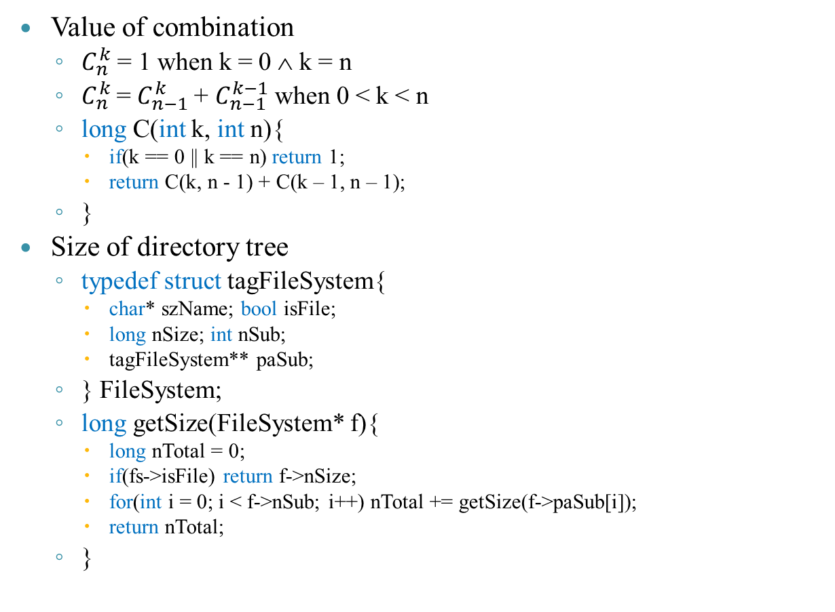
SOME APPLICATIONS
Value of combination
  $C_{n}^{k}$ = 1 when k = 0 ∧ k = n
  $C_{n}^{k}$= $C_{n−1}^{k}$+ $C_{n−1}^{k−1}$when 0 < k < n
  long C(int k, int n){
    if(k == 0 || k == n) return 1;
    return C(k, n - 1) + C(k – 1, n – 1);
  }
Size of directory tree
  typedef struct tagFileSystem{
    char* szName; bool isFile;
    long nSize; int nSub;
    tagFileSystem** paSub;
  } FileSystem;
  long getSize(FileSystem* f){
    long nTotal = 0;
    if(fs->isFile) return f->nSize;
    for(int i = 0; i < f->nSub; i++) nTotal += getSize(f->paSub[i]);
    return nTotal;
  }

Slide 41
ALTERNATIVE METHOD
There are 2 way of replacing recursion: loop and (stack+loop)
Example: QuickSort with (stack+ loop)
  typedef struct {int L, R; } Pair;
  void QSort(int a[], int le, int ri){
    stack<Pair> s;
    Pair p = {le, ri};
    s.push(p);
    while(!s.empty()) {
      p = s.top(); s.pop();
      int k = p.L;
      for(int i = p.L; i < p.R; i++){
        if(a[i] <= a[p.R]){
          swap(a[i], a[k]); k++;
        }
      }
      swap(a[k], a[p.R]);
      if(p.L < k – 1) s.push({p.L, k - 1});
      if(p.R > k + 1) s.push({k + 1, p.R});
    }
  }
  void main(){ int a[] = {-1, 4, 2, 7, 9, -9, 3}; QSort(a, 0, 6); }
0 6
-1
4
2
7
9
-9
3
0 2
4 6
-1
2
-9
3
9
4
7
1 2
4 6
-9
2
-1
4
7
9
0 6
0 2
1 2
-1
2

Slide 42
EXTENDED PROBLEMS
The algorithm’s complexity
  Space: memory is computed with the depth of the recursive tree (exclude nodes with the same level)
  Time: count the operations in the recursive tree
Example: Ha-Noi tower
    Tower(n, col1, col2, col3){
      If(n = 1) Then MoveDisc(col1, col3);
      Else{
        Tower(n – 1, col1, col3, col2)
        MoveDisc(col1, col3);
        Tower(n – 1, col2, col1, col3)
      }
    }
T(3, c₁, c₂, c₃)
Depth = 3
(storage unit)
T(2, c₁, c₃, c₂)
T(2, c₂, c₁, c₃)
2³ – 1 times
of disc moving
T(1, c₁, c₂, c₃)
T(1, c₃, c₁, c₂)
T(1, c₂, c₃, c₁)
T(1, c₁, c₂, c₃)

Slide 43
EXTENDED PROBLEMS
Replacing recursion
  Recursion algorithm consume memory and time very much
  In some case, recursion algorithm is simple and easy-to-understand
  Completely convert a recursive algorithm to non-recursive one with loop and stack
  Using stack is more efficient time and space than recursive algorithm

Slide 44
EXTENDED PROBLEMS
Non-recursive algorithm for Ha-Noi tower
  Tower(n, col1, col2, col3){
    Stack s;
    Push(s, kq←{n , col1, col2, col3});
    Do{
      kq ← pop(s);
      If(kq.n = 1) MoveDisc(kq.col1, kq.col3);
      Else{
        Push(s, kq←{n – 1, col2, col1, col3});
        Push(s, kq←{1, col1, col2, col3});
        Push(s, kq←{n - 1}, col1, col3, col2});
      }
    }Until(!empty(s));
  }
T(3, c₁, c₂, c₃)
T(2, c₁, c₃, c₂)
T(2, c₂, c₁, c₃)
T(1, c₁, c₂, c₃)
T(1, c₃, c₁, c₂)
T(1, c₂, c₃, c₁)
T(1, c₁, c₂, c₃)
s
(1, c₁, c₂, c₃)
(1, c₁, c₂, c₃)
(1, c₁, c₂, c₃)
(2, c₁, c₃, c₂)
(1, c₃, c₁, c₂)
(1, c₃, c₁, c₂)
(1, c₃, c₁, c₂)
(1, c₂, c₃, c₁)
(1, c₁, c₂, c₃)
(1, c₁, c₂, c₃)
(1, c₁, c₂, c₃)
(1, c₁, c₂, c₃)
(1, c₁, c₂, c₃)
(1, c₁, c₂, c₃)
(1, c₁, c₂, c₃)
(3, c₁, c₂, c₃)
(2, c₂, c₁, c₃)
(2, c₂, c₁, c₃)
(2, c₂, c₁, c₃)
(2, c₂, c₁, c₃)
(2, c₂, c₁, c₃)
(2, c₂, c₁, c₃)
(1, c₁, c₂, c₃)
(1, c₁, c₂, c₃)
(1, c₁, c₂, c₃)
t
t₀
t₀
t₁
t₂
t₃
t₄
t₅
t₆
t₇
t₈
t₉

Slide 45
EXTENDED PROBLEMS
The correctness of recursive algorithm
  Prove the output of recursive program is right
  Use induction to prove
    Example n! = 1(n = 0) and n!= n*(n – 1)! (n > 0)
    Program
      GT(n){
        if n = 0 then kq = 1
        else kq = n * GT(n – 1)
      }
    Proof: GT(n) = n!
      If n = 0 then kq ← 1 (Definition)
      Assume the program is right with n = k, so GT(k) = k!
      Need to prove GT(k + 1) = (k + 1)!
        Easy GT(k + 1) = (k + 1)*GT(k)
        We have GT(k) = k!
        So GT(k + 1) = (k + 1)*k! = (k + 1)! (complete the proof)

Slide 46
EXTENDED PROBLEMS
The correctness of recursive algorithm
  Prove the output of recursive program is right
  Use induction to prove
    Example: GCD(a, b) (a, b > 0)
    Program
      GCD(a, b){
        if a = b then d = a // kq = b
        else
          if a > b then d = GCD(a – b, b)
          else d = GCD(a, b – a)
      }
    Proof GCD(a, b) = d (d|a ∧ d|b ∧ ∄c: c|a ∧ c|b ∧ d<c)
      If a = b then d ← a (Right)
      If a ≠ b:
        If a > b: because d | a & d | b so (a/d) – (b/d) = (a – b)/d ∈ ℕ ⇒ d | a – b. So d is the common divisor of a – b and b
        If b > a: because d | a & d | b so (b/d) – (a/d) = (b – a)/d ∈ ℕ ⇒ d | b – a. So d is the common divisor of b – a and a
        So the process continues: the bigger subtracts the smaller until a – b = 0 or b – a = 0. When a = b then the algorithm stops

