Slide 1
HandGestureRecognition
Dung cd chi tay de tao dieu khien video: Play/stop, tang, giam am luting, tua lai, tua nhanh, md full-screen
Mo hinh hoc may
I.Chuan bi dd lieu vdi Tensowflow Dataset API
• •
Pretrained
Data: Dtf lieu cat tfr webcam vdi cd chi tay ttiting dng 6 dieu khien
Dtia Data ve kieu TFRecord:TFRecord la dinh dang van ban de ltiu trd mot chuoi cac ban ghi nhi phan. Chuyen doi sang TFRecord co mot so ltii the sau:
1: Luu tr& hieu qua: d& lieu TFRecord co the chiem it dung luong hon d& lieu goc; no cung co the duoc phan d& lieu thanh nhieu tep. Khi save duoi dang nhi phan, ta se tiet kiem nhieu dung luong.
2: I/O nhanh: dinh dang TFRecord co the duoc doc song song, rat h&u ich khi train tren TPU hoac nhieu may chu.
Tep doc lap: d& lieu TFRecord co the duoc doc td mot nguon duy nhat. Vi du nhu data anh ta se co anh nhieu folder, label va cac chu thich cua anh (annotation) d noi khac. TFRecord se tom tat lai d& lieu ve mot cho.
Update Config
2. Dung Labellmg cho Label sign language
item
name:'Play/Pause'
id:1
name:'Volume Up'

Slide 2
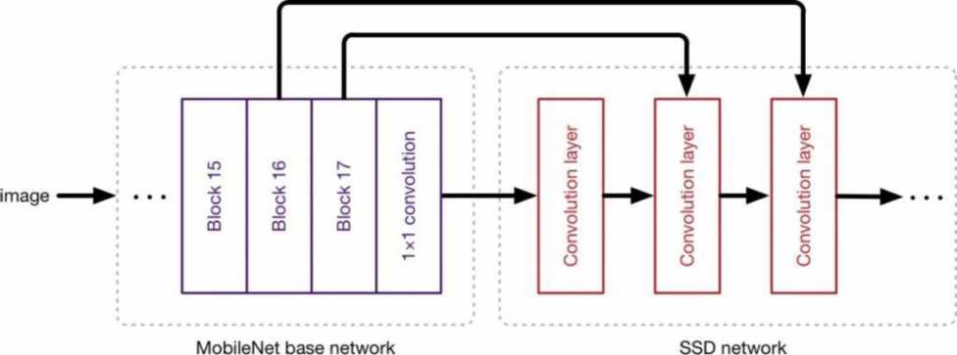
id:2
name:'Volume Down' id:3
name:'Fast_Forward'
id:4
name:'Rewind'
id:5
name:'Full_Screen'
id:6
3. Cai dat Tensorflow Object Detection pipeline configuration Model: ssd mobnet
Mo hinh SSD drfdc chia lam hai giai doan:
-Trich xuat feature map de tang hieu qua trong viec phat hien. 6 day su” dung MobileNet.
-Ap dung cac bo loc tich chap de co the detect du^c cac doi tuong
Config
pipeline_config.model.ssd.num_classes = 6 pipeline_config.train_config.batch_size = 4 pipeline_config.train_config.fine_tune_checkpoint = PRETRAINED_MODEL_PATH+'/ssd_mobilenet_v2_fpnlite_320x320_coco17_tpu-8/checkpoint/ckpt-0'
pipeline_config.train_config.fine_tune_checkpoint_type = "detection"
4.Train mo hinh

Slide 3
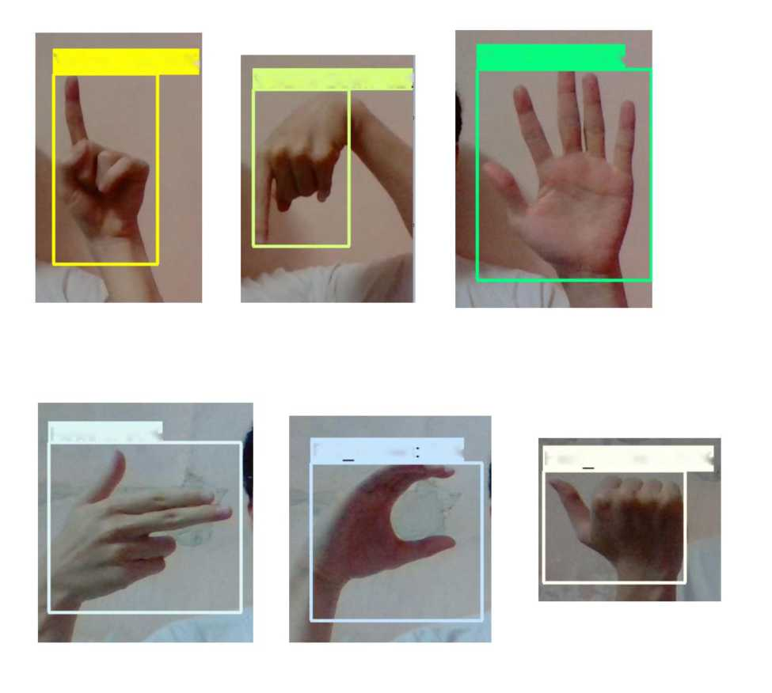
# Load pipeline config and build a detection model
configs = config_util.get_configs_from_pipeline_file(CONFIG_PATH) detection_model = model_builder.build(model_config=configs['model'], is_training=False)
Load Train Model From Checkpoint
# Restore checkpoint
ckpt = tf.compat.v2.train.Checkpoint(model=detection_model) ckpt.restore(os.path.join(CHECKPOINT_PATH, 'ckpt-6')).expect_partial()
5. Nhan dang cu* chi tay trong thdi gian thtfc
Volume Up: 95%
Volume Down: 92^{c}
Play/Pause: 99%
Rewind: 90%
Full
Screen
73%
Fast Forward: 84%
*Python: Dung thu vien opencv

Slide 4
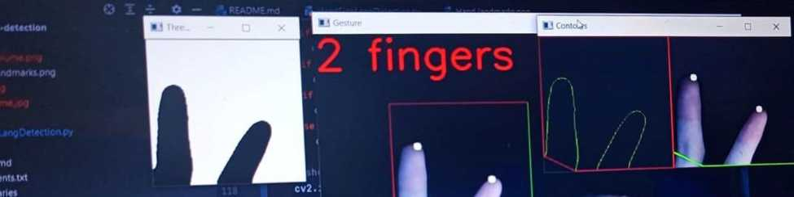
Dem so lrftfng ngon tay
Dung bo loc Gaussian
#applying gaussian blur value = (35, 35)
blurred = cv2.GaussianBlur(grey, value, 0)
Thresholdin: Otsu's Binarization method
Tach ngrfdng v6i Otsu's method. 6 dang ddn gian nhat, thuat toan tra ve mot ngrfdng crfdng do duy nhat giup
tach cac pixel thanh hai l6p nen trang va nen den de thtfc hien brfdc sau la contours.
_, thresh1 = cv2.threshold(blurred, 127, 255,
cv2.THRESH_BINARY_INV + cv2.THRESH_OTSU)
Show thresholded image
cv2.imshow('Thresholded', threshl)
Find contour with max area
De tim contour chinh xac, chung ta can phai nhj phan hoa btfc anh. Trong opencv, viec tim mot contour la viec tim mot doi tUOng co mau trang tren nen den
cnt = max(contours, key=lambda x: cv2.contourArea(x))
Create bounding rectangle around the contour (can skip below two lines)

Slide 5
x, y, w, h = cv2.boundingRect(cnt)
cv2.rectangle(crop_img, (x, y), (x + w, y + h), (0, 0, 255), 0)
Finding convex hull
hull = cv2.convexHull(cnt)
defects = cv2.convexityDefects(cnt, hull)
count_defects = 0
sub_counter = 0
Drawing contours
drawing = np.zeros(crop_img.shape, np.uint8) cv2.drawContours(drawing, [cnt], 0, (0, 255, 0), 0) cv2.drawContours(drawing, [hull], 0, (0, 0, 255), 0)
Tim goc gitfa cac ngon tay de xac djnh hinh dang cua ban tay tUOng tfng vdi 6 cu* chi tay dieu khien
for i in range(defects.shape[0]): if angle <= 134:
count_defects += 1
cv2.circle(crop_img, far, 5, [255, 255, 255], -1)
elif 146.5 < angle <= 150: sub counter = 1

