Slide 1
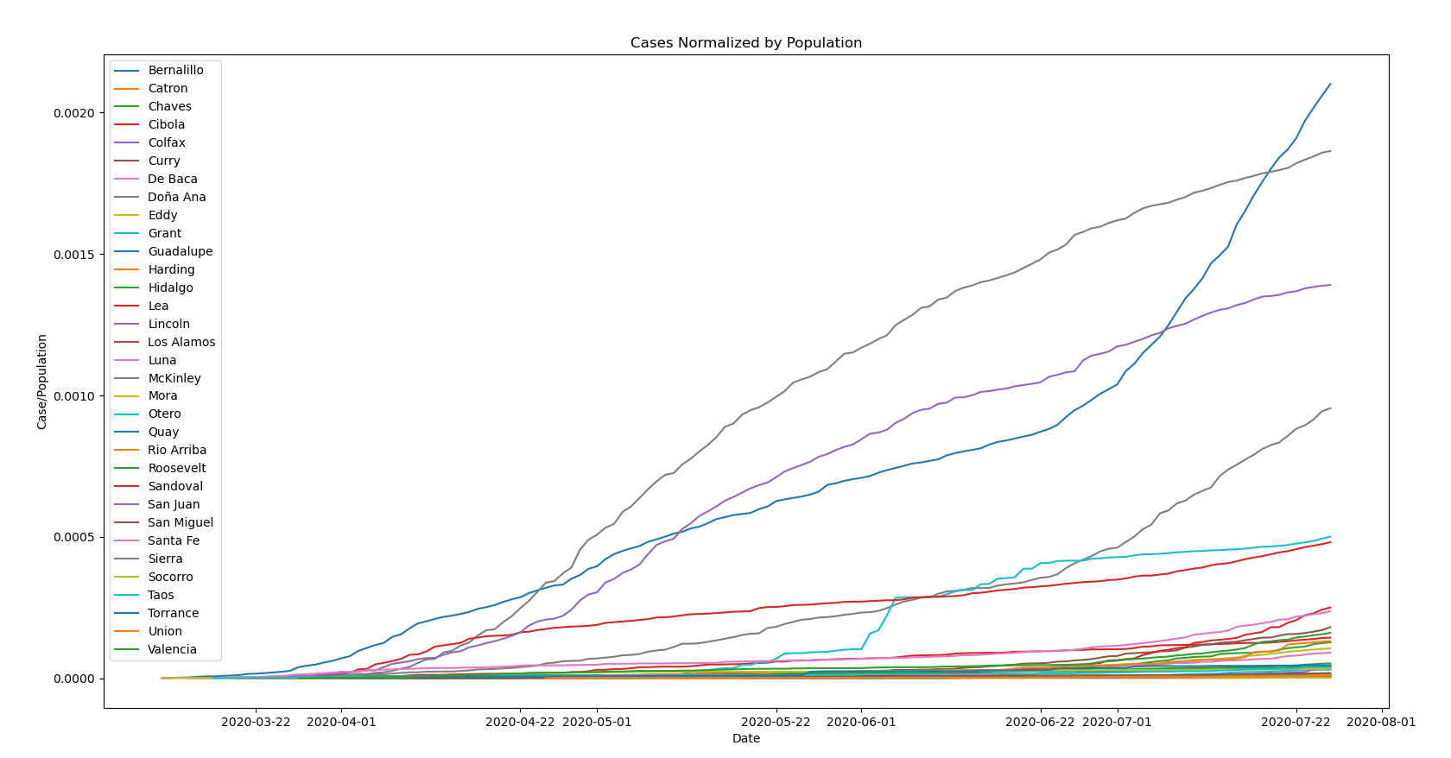
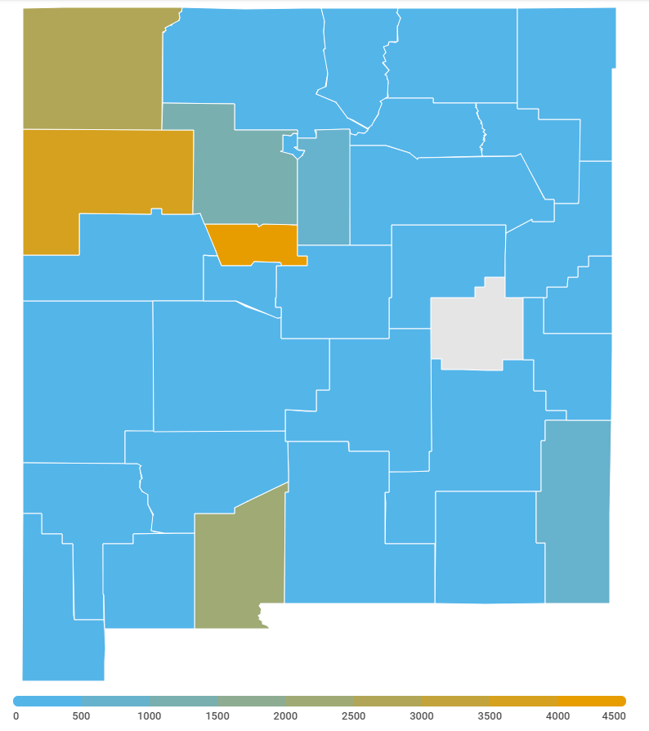

Comparing Factors to the Spread of Coronavirus in New Mexico Counties
John Ng, University of New Mexico, Computer Science (B.S. Expected: May 2021), jng15@unm.edu
Mentor: Tyler Morrow, Adjunct Professor, Department of Computer Science, University of New Mexico
Introduction
Coronavirus is a mild to severe illness that spreads through respiratory particles. Population, population density, income per capita, wealth, and population age were compared against the spread of coronavirus, to determine which factors played larger roles.
Results
Methodology
Used Python to grab up to date cases on each New Mexico County.
Normalized cases by population to confirm or deny higher population lead to higher cases.
Used US Census information to compare population density to rising cases.
Compared county average age to show how age factors. Analyzed peaks with policy changes, such as reopening.
Population density was taken from the census and plotted in a tree map. Counties with more dense populations have larger areas on the map.
Income per capita was compared to growths in total cases between counties to determine whether wealth played in role in the spread.
This graph shows the total cases normalized by the county’s respective population.
Bernalillo, McKinley, San Juan, Doña Ana, and Otero have the highest number of cases.
Compared against wealth and population, analysis showed that the counties with the highest cases were not wealthier. Population did not impact as highly as population density. As you can see above, even when normalized by population, densely populated counties suffered the most cases. Counties like Santa Fe County have high population, but their number of cases were roughly ten times smaller than Bernalillo yet having 1/5 the population.
New Mexico County Heat map of confirmed cases. Here we can see hot spots in the state. Counties with high population density and lower average population age.
Acknowledgments
National Security Studies Program and Critical Technology Studies Program
Conclusion
Living in a wealthier county does not slow down the spread of the coronavirus. Living in a county that is densely populated will increase your chance of getting the disease. Counties with younger generations will likely see higher cases. This all comes down to percentage. To prevent spreading the disease we need to lower the chance of it spreading by staying at home or social distancing when possible, wearing a mask, and having access to sanitation.
Further Information
Please email me at jng15@unm.com
References
KOAT 7 Coronavirus Heat Map of New Mexico Counties

