Slide 1
CDS4004 – Lecture 2 Introduction to CSS

Slide 2
Lesson objectives
Overview of CSS
What is CSS ?
Basic syntax of CSS rules
CSS Selectors
Classes vs Ids
What is the difference? When would you use one over the other?
CSS Cascading
More on CSS
CSS Specificity and inheritance
Document Object Model (DOM) and Contextual Selector
Layout with Box Model and Flex

Slide 3
Overview of CSS

Slide 4
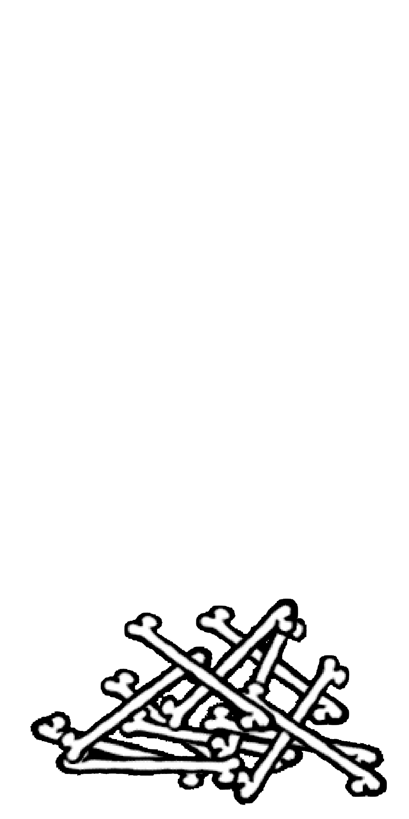
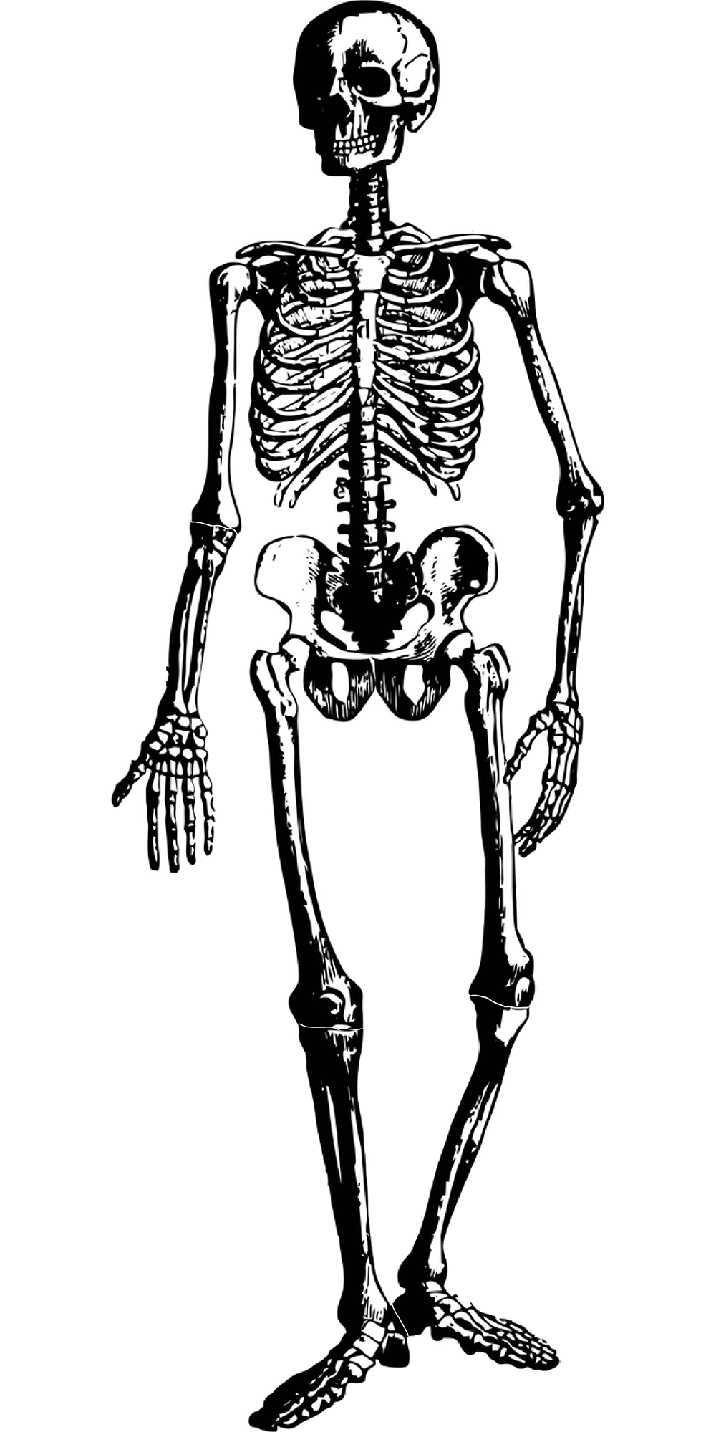
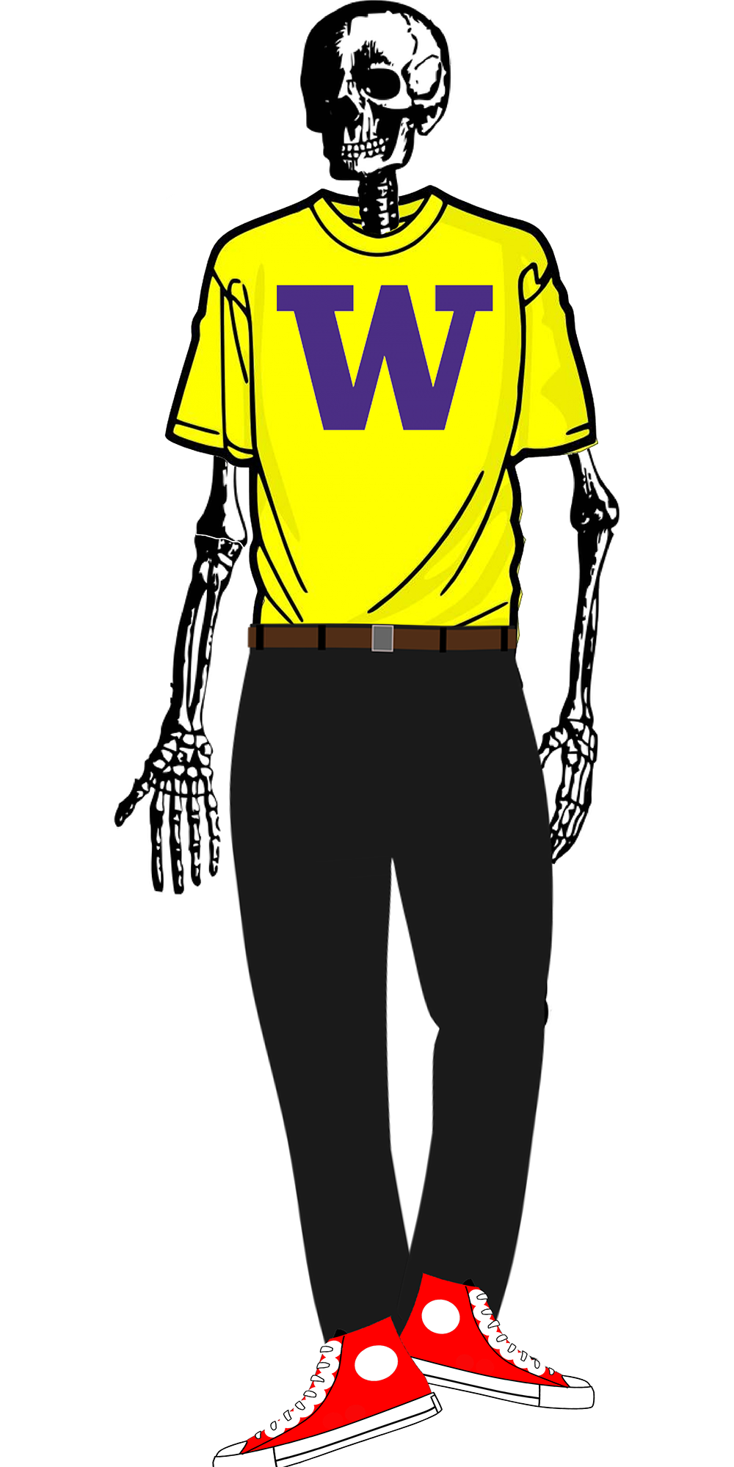
Terminology
Content
Structure
Style
Words + Images
HTML
CSS

Slide 5
Cascading Style Sheets (CSS): <link>
<head>
...
<link href="filename" rel="stylesheet">
...
</head>
html
CSS controls the appearance of the content on HTML pages.
Can be embedded in HTML (bad) or placed into separate .css file (much better)
It is not HTML.
It is a separate code that enhances the abilities of HTML by allowing authors to redefine the way that existing tags display their contents.

Slide 6

Basic Syntax of a CSS Rule
A CSS rule specifics the HTML to which a style definition applies, and then defines the style.
Selector
It starts each rule, appearing before the left curly brace.
Declaration
It is surrounded by curly braces.
It is made up of a pair of property (to identify the style that is being defined) and value (to define its nature).

Slide 7
Basic Syntax of a CSS Rule
selector {
property: value;
property: value;
...
property: value;
}
p {
color: red;
text-decoration: underline;
font-family: sans-serif;
}
template
css
A CSS file consists of one or more rulesets containing one or more rules
Each property (RHS of a rule) has a set of values that can be chosen
There are currently over 200 possible style properties to choose from use the Chrome inspector for useful autocomplete of property values!
Together, a selector and the list of properties that follows is a rule.

Slide 8
Type selector
div {
background-color: #AED581;
font-size: 14px;
}
html
Selects a HTML element.
The example above:
To apply a style to all divs of the pages that the CSS file is linked to.

Slide 9
CSS Pseudo-classes
a:link { color: #FF0000; } /* unvisited link */
a:visited { color: #00FF00; } /* visited link */
a:hover { /* mouse over link */
color: #FF00FF;
cursor: pointer; /* can set new pointer icon, usually a "hand" */
}
css
Class | Description
:hover | An element that has the mouse over it
:visited | A link that has already been visited
:first-child | An element that is the first one to appear inside another
:nth-child(N) | Applies to every Nth child of a given parent
There are many more, but the above tend to be the most common
For more information, please refer to https://www.w3schools.com/css/css_pseudo_classes.asp

Slide 10
Group Selector
section, p, h3 {
color: green;
font-size: 14pt;
}
p {
text-decoration: underline;
}
css
Allows us to reduce redundancy by grouping together rules into rulesets to style multiples types of elements with common styles.
Q: What will the <p> tag look like here?

Slide 11
Consider the following situation...
What CSS selector would allow you to style the contents of only the 6th <p> tag without changing the HTML?
What CSS selector would allow you to style the contents of the 3rd and 5th <p> tags without changing the HTML?
<article>
<p>hello CDS4004 students</p>
<p>week 2, woohoo!</p>
<p>can you just style me?</p>
<p>but not me, haha!</p>
<p>don’t forget me</p>
<p>I need my own styles</p>
<section>
<p>hello from inside the section</p>
</section>
</article>

Slide 12
id and class
id
Unique identifier for an element
Each unique id can only appear once per page
Each element can only have one id
class
Non-unique grouping attribute to share with many elements
Many elements (even of different types) can share the same class
Each element can have many different classes

Slide 13
Consider this situation...
<article>
<p>hello CDS4004 students</p>
<p>week 2, woohoo!</p>
<p class=”demo2”>can you just style me?</p>
<p>but not me, haha!</p>
<p class=”demo2”>don’t forget me</p>
<p id=”demo1”>I need my own styles</p>
<section>
<p>hello from inside the section</p>
</section>
</article>
Uses the # to indicate demo1 is an id
#demo1 {
...
}
Uses the . to indicate demo2 is a class
.demo2 {
...
}

Slide 14
CSS Selectors: Simple selectors
Classification | Description | Example
Type selector | Selects an element type | p
Class selector | Selects all elements with the given class attribute value | .koala-face
ID selector | Selects the element with the unique id attribute value | #scientific-name

Slide 15
The Bad Way to Produce Styles
Tags such as b, i, u and font are discouraged in strict HTML
They are bad because of:
Accessibility
Code organization
Changing style easily
<p>
<font face="Arial">Welcome to Greasy Joe's.</font>
You will <b>never</b>, <i>ever</i>, <u>EVER</u> beat
<font size="+4" color="red">OUR</font> prices!
</p>
Welcome to Greasy Joe's. You will never, ever, EVER beat OUR prices!

Slide 16
Why use classes and ids when we can select by the tag name?

Slide 17
Where to put CSS rules ?
Inline Style (Poor style !!)
Embedded Style
External / Linked Style

Slide 18
Where to put CSS rules ?
Use a <div> tag to break up a page into divisions
and apply styles to an entire chunk at once
Use <span> to name smaller chunks of text or other
inline elements in order to apply styles to them

Slide 19
Where to put CSS rules ?
Embedded Style
It puts rules in the <head> section.
It uses the <style> tag to enclose the rules.
It uses to define rules for an entire web page.
Style tag
Style type
Media type
CSS Rule
<style type="text/css“ media=“all”>
<!--
selector { property: value }
-->
</style>

Slide 20
Where to put CSS rules?

Slide 21
Where to put CSS rules?
External / Linked Style
Rules go in a separate file, which can be used with any number of HTML files.
The rules go in a file with a .css extension.
A link to the file goes in the <head> section.
Advantages
Ease of maintenance
Use less disk space
Increase accessibility

Slide 22
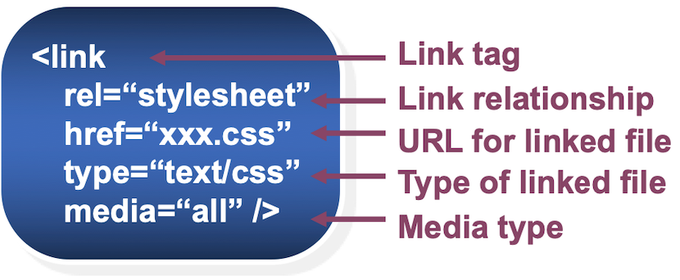
Where to put CSS rules?
Linking to a Style Sheet
External style sheet files can be used with any html file through the <link> tag.
It affects the document in the same way as embedded style rules in the head of the document.

Slide 23
Where to put CSS rules?

Slide 24
"Conflicting" Rulesets?
Given the HTML & CSS , what color will the <p> be?
<p>
Very pretty, very stylish
</p>
html
p {
color: blue;
}
p {
color: red;
}
css

Slide 25
The “Cascade” of CSS
All styles "cascade" from the top of the sheet to the bottom
When you add a second file, conflicting rules are overwritten
Take care not to override styles if possible
If you have styles specific to a page, use a second sheet (usually linked after the shared one)
Styles cascade* together when there are conflicting selectors but different properties.
* The term "cascade" comes from waterfalls:
At the top of a waterfall, every drop of water is at the same height. As the water "cascades" down, some of those drops reach the bottom earlier (or later) than others.

Slide 26
"Conflicting" Rulesets?
This is a big part of the "cascade" in CSS:
Like water falling off an edge, it all ends up in a pool at the bottom, but some drops of water get there before others.
<p>
Very pretty, very stylish
</p>
html
p {
color: blue;
}
p {
text-decoration: underline;
}
css

Slide 27
But what if the selector is different?
There are two other important concepts here:
Specificity
Inheritance

Slide 28
Specificity and Inheritance

Slide 29
CSS Specificity
Given an element, and two (or more) different selectors that would "select" it, which rules would actually apply?
The answer is to determine “Which one is more specific ?”
As the browser reads through your CSS code, it calculates a score for each selector
The browser gathers all the selectors that might apply, sorts by their specificity score, and applies some style in order
<p id="text">
Very pretty, very stylish
</p>
html
#text {
color: blue;
}
p {
color: red;
}
css
What will "Hello World!" look like now?

Slide 30
Specificity Scores
Example Selector | Inline style=“” | Ids | Classes, attributes, pseudo-classes | Elements, pseudo-elements | Total Score
h1 | 0 | 0 | 0 | 1 | 0001
h1 + p::first-letter | 0 | 0 | 0 | 3 | 0003
li > .form > input[value="name"] | 0 | 0 | 2 | 2 | 0022
#text | 0 | 1 | 0 | 0 | 0100
style="" attribute | 1 | 0 | 0 | 0 | 1000
CSS Specificity Calculator: https://specificity.keegan.st/

Slide 31
Inheritance of Styles
Inheritance means that subordinate elements inherit properties from their parent element.
body { color: blue; } #pageContent { font-size: 1em; } h3 { text-transform: uppercase; }
css

Slide 32
Inheritance of Styles
Some properties, like color, are inheritable.
If there's no conflict, an element will inherit the value for that property from its parent.
What will the text “Hello World!” look like now?
<div>
<p id="text">
Very pretty, very stylish
</p>
</div>
#text {
color: blue;
}
div {
color: red;
font-size: 16px;
}
html
css

Slide 33
Inheritance of Styles
Parent, child and descendant
Some properties don’t have inheritance
Property values to override inheritance
!important (override anything)
Cascade order
How to determine the order?
specificity of selector
specified order of CSS rules

Slide 34
The Document Object Model (DOM)
How the browser represents the hierarchy of a page. Very useful when thinking about selectors!
For example:
Every HTML tag (<p>, <img>, <body>, etc.) is part of the DOM, and has a place in a tree hierarchy.
They all have a parent (<body>'s is <html>) and almost always have a child (<title> is a child of <head>).
You don't build a DOM, but the browser does, which allows you to access it.

Slide 35
Contextual Selector
Document Tree
html
html
html
html
Parent
body
Child
body
body
body
body
Parent
h1
h1
h1
h1
h2
h2
h2
h2
div
div
div
h1
h2
div
div
Children
Siblings
h3
Descendants of <body>
h3
h3
p
p
p
a
a
a
Ancestors of <a>

Slide 36
Descendent Combinators
General Format | A B
Description | Selects all B elements located anywhere inside of A
Examples | div section section p div section h2
<div>
<section>
<h2>hello</h2>
<section>
<p>this is a paragraph</p>
</section>
</section>
<section>
<p>here is another paragraph</p>
</section>
<p>and another one</p>
</div>
html

Slide 37
Child Combinators
General Format | A > B
Description | Selects all B descendants directly inside A elements
Examples | section > p div > p div section > h2
<div>
<section>
<h2>hello</h2>
<section>
<p>this is a paragraph</p>
</section>
</section>
<section>
<p>here is another paragraph</p>
</section>
<p>and another one</p>
</div>
html

Slide 38
Adjacent Siblings
General Format | A + B
Description | Selects B only if it shares a parent with A and is immediately after it in the DOM.
Examples | section + section h2 + section
<div>
<section>
<h2>hello</h2>
<section>
<p>this is a paragraph</p>
</section>
</section>
<section>
<p>here is another paragraph</p>
</section>
<section>
<p>here is another paragraph</p>
</section>
<p>and another one</p>
</div>
html

Slide 39
General Siblings
General Format | A ~ B
Description | Selects all B elements that share a parent with A and appear after A in the DOM.
Examples | section ~ section h2 ~ section
<div>
<section>
<h2>hello</h2>
<section>
<p>this is a paragraph</p>
</section>
</section>
<section>
<p>here is another paragraph</p>
</section>
<section>
<p>here is another paragraph</p>
</section>
<p>and another one</p>
</div>
html

Slide 40
Combinator Selector Exercise
<section>
<p>no pressure, no diamonds</p>
<p>impossible is for the unwilling</p>
<article>
<p>try, try again</p>
<p>hakuna matata</p>
<p>take the risk or lose the chance</p>
<div>
<p>that’s enough</p>
</div>
</article>
</section>
What selector would select all the <p> tags?
What selector would select the <p> tags highlighted in red?
What selector would select the <p> tags highlighted in blue?
What selector would select the <p> tag highlighted in pink?

Slide 41
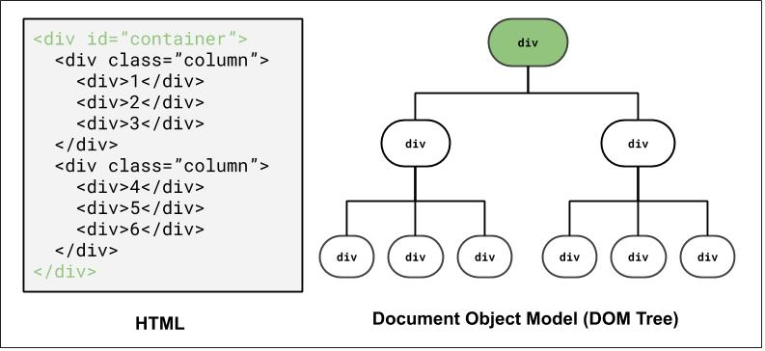
DOM and Selectors Exercise
How to select the highlighted elements?
using ID selector: #container

Slide 42
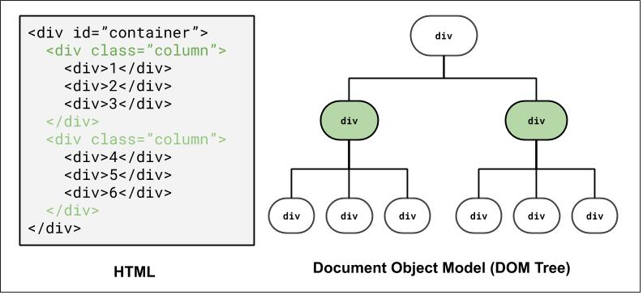
DOM and Selectors Exercise
How to select the highlighted elements?
using class selector: .column
using combinator selector: #container > div

Slide 43
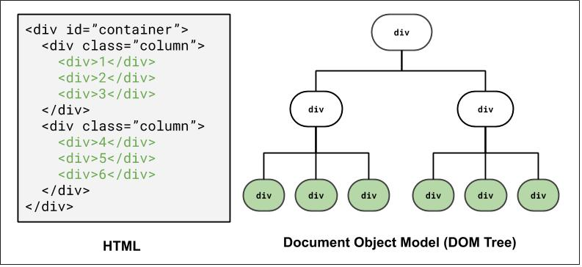
DOM and Selectors Exercise
How to select the highlighted elements?
using class and descender combinator selector: .column > div
using a class and child combinator selector: #container > div > div

Slide 44
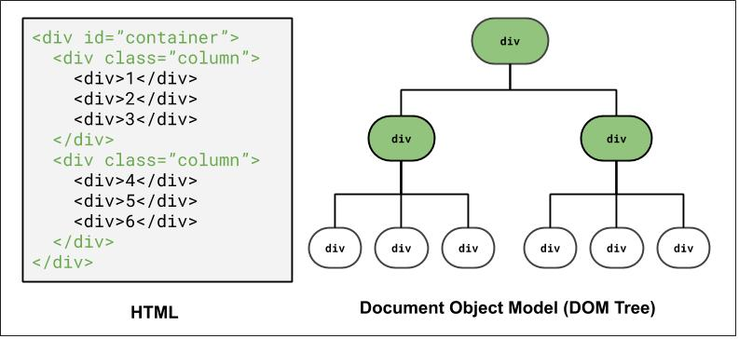
DOM and Selectors Exercise
How to select the highlighted elements?
using Grouping elements: #container, .column

Slide 45
Layout with Box Model and Flex

Slide 46
Why page layout is important
Example: Click here for an example of poor HTML tags, layout, and accessibility (try resizing the page).
The “old days” of layout.
Inspect?
table, table, table, table…
As a user, have you ever left a website (that may be useful) because of the layout or accessibility?

Slide 47
Layout Techniques in CSS
Block vs. Inline and nesting in HTML
Box Model (margin/padding/border)
Flex
Positioning
Float (less common today, but still good to know about)
Note that Positioning and Float will not be covered in this course.

Slide 48
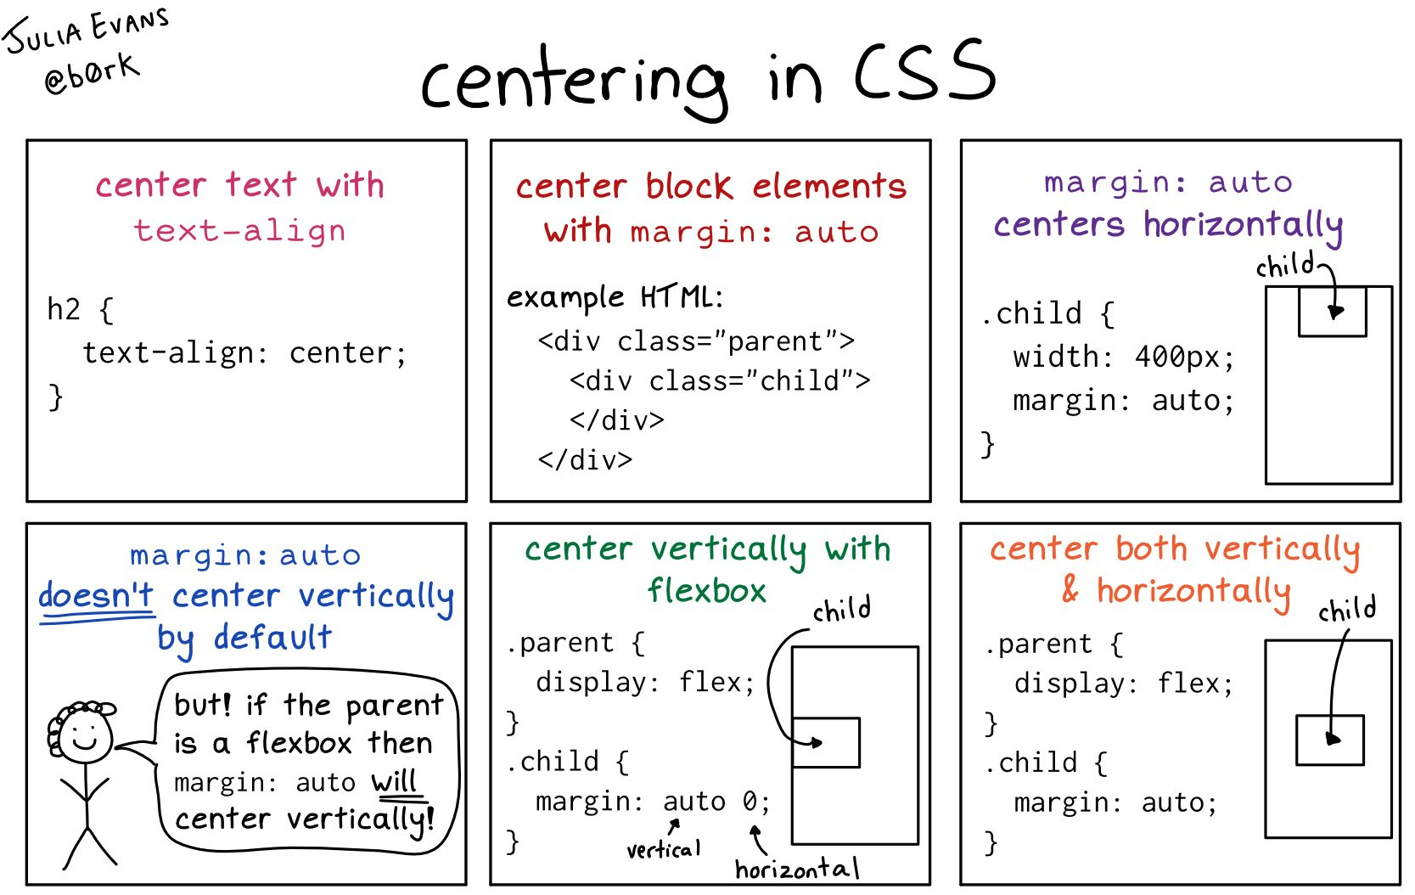
Aligning Text Within a Block Element
CSS property to control this is text-align
Sets the horizontal alignment of the inline content (the text)

Slide 49

Starting with Building Blocks
Question: What does this look like on a browser by default?
<body>
<div>1</div>
<div>2</div>
<div>3</div>
<div>4</div>
<div>5</div>
<div>6</div>
</body>
div {
background-color: red;
color: white;
font-size: 14px;
}
css
html

Slide 50
Default Dimensions of Block and Inline Elements
Height:
Both block and inline elements normally have the height of their content
Width:
Inline elements have the width of their content
Block elements have a width that spans the width of their parent and generally cause a line-break
<p id="css">
CSS is <strong>really</strong> great!
</p>
<p id="html">HTML is pretty cool too.<p>
#css { background-color: lightblue; }
#html { background-color: lightgreen; }
strong { background-color: white; }
html
css

Slide 51
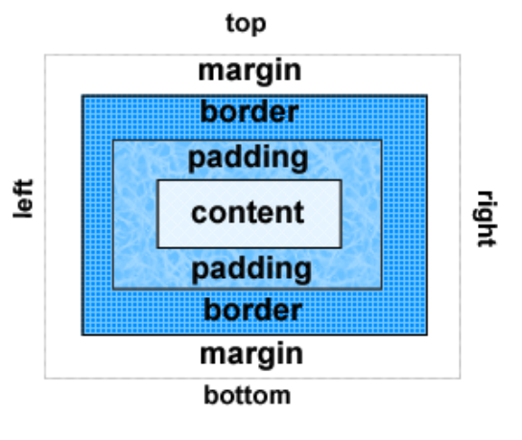
Box Model
Content: Text & web page elements in the container
Padding: Area between the content and the border
Border: between the padding and the margin
Margin: Determines the empty space between the element and adjacent elements

Slide 52

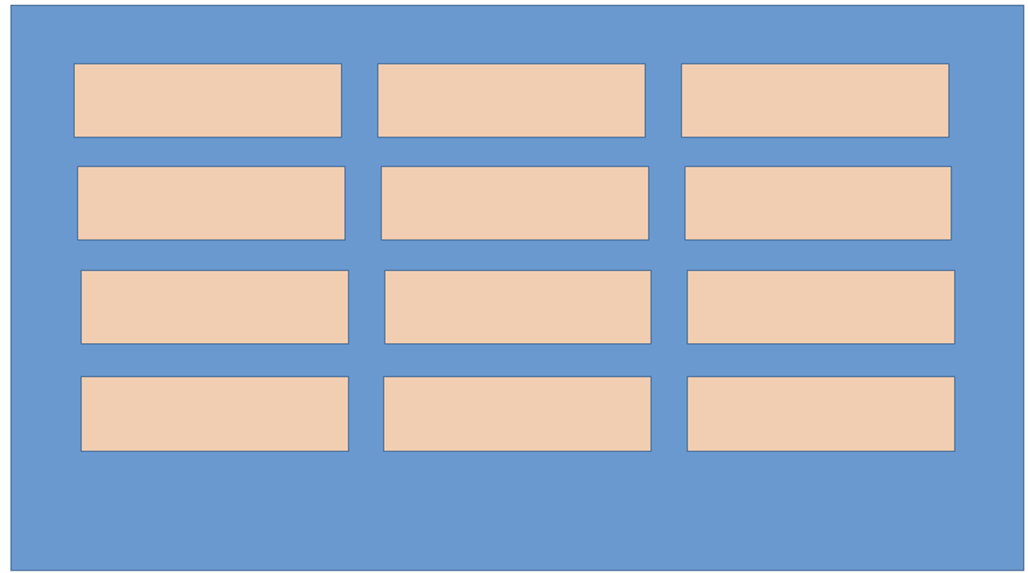
Distributing Boxes Evenly in a Container
How could we distribute boxes across box container evenly (equal space between each box)?
What should we do about the margins of the boxes?
What value do we put?
How many screen sizes will we try on?

Slide 53
Flexbox Basics
Flexbox is a set of CSS properties for aligning block level content.
Flexbox defines two types of content - "containers" and "items".
Container (sometimes referred to as the flex parent):
the direct parent element of the HTML elements whose position you would like to control
Items (sometimes referred to as the flex children):
the directly nested elements inside the parent container whose position you are controlling.
Most properties on the container can be set to determine how its items are laid out.
Some properties can be directly applied to the flex items.

Slide 54
Containers vs Items
If we wanted to control the position of these images using flex then.
Flex container: <section>
Flex items: <img>
<section>
<img src=”1.jpg”>
<img src=”2.jpg”>
<img src=”3.jpg”>
<img src=”4.jpg”>
</section>
1.jpg
2.jpg
3.jpg
4.jpg
section {
display: flex;
}
Flex container
(Defined with the CSS property display: flex)
Flex items
(Defined implicitly because their parent is a flex container)
To label the container (<section>) as a flex container we use the CSS display property.

Slide 55
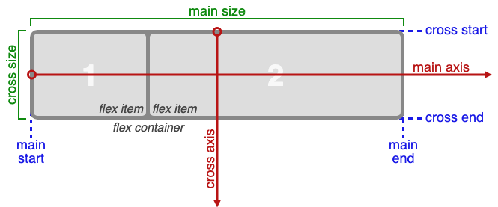
Alignment of items along the main axis always controlled by justify-content property
<section>
<p>1</p>
<p>2</p>
</section>
Alignment of items along the cross axis always controlled by align-items property

Slide 56
Basic properties applied to the flex container
display: flex;
makes an element a "flex container", items inside automatically become "items" - by default, starts as a row
justify-content: flex-end; (flex-start, space-around,...)
indicates how to space the items inside the container along the main axis
align-items: flex-end; (flex-start, center, baseline,...)
indicates how to space the items inside the container along the cross axis
flex-direction: row; (column)
indicates whether the container flows horizontally or vertically (default row)
flex-wrap: wrap; (no-wrap, ...)
indicates whether the container's children should wrap on new lines

Slide 57
Basic properties for flex items
There are also cases when you will need to apply flex properties to flex items rather than the flex container
align-self: flex-end; (flex-start, center, stretch,...)
indicates where to place this specific item along the cross axis
flex-grow: <number>
Defines a proportional value to determine whether a flex items can grow (what amount of the available space inside the container it should take up).
flex-basis: 20%; (3em, 50px,...)
indicates the default size of an element before the extra space is distributed among the items

Slide 58
flex-direction
Define flow of the flex items placed in flex container.
The default flex-direction is row. If you change the flex-direction to column you are changing the orientation of the axes.
The properties arranging elements along each axis does not change
Example: justify-content still controls items along the main axis. The main axis is just vertical now

Slide 59


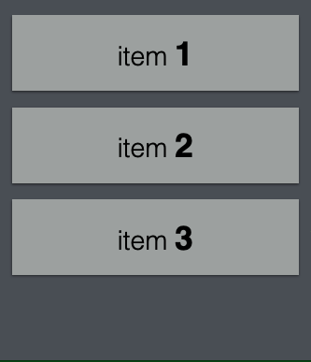
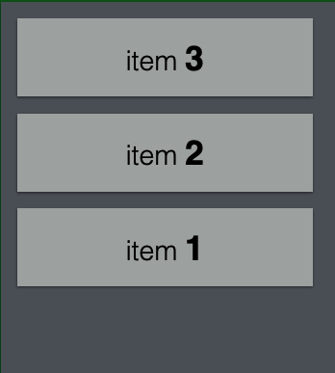
flex-direction
row
row-reverse
column
column-reverse

Slide 60

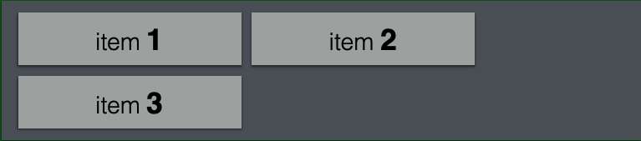
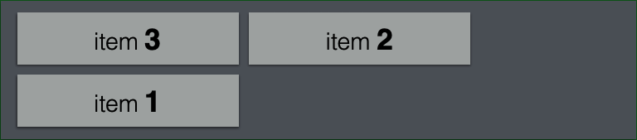
flex-wrap
nowrap
wrap
wrap-reverse

Slide 61



justify-content
Determine align of flex items in the main-axis (horizontal lines)
flex-start
flex-end
center

Slide 62
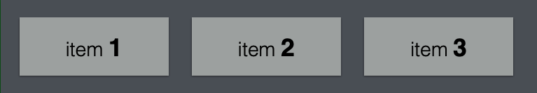

justify-content
Determine align of flex items in the main-axis (horizontal lines)
space-around
space-between

Slide 63
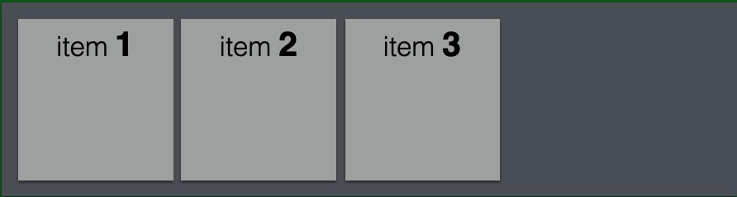
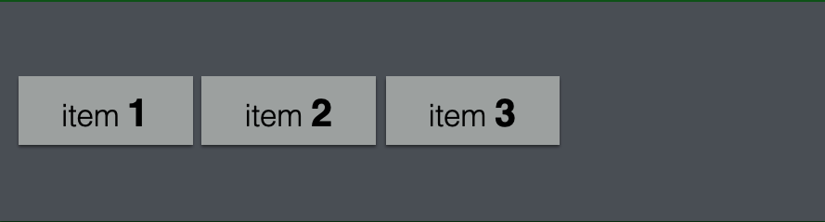
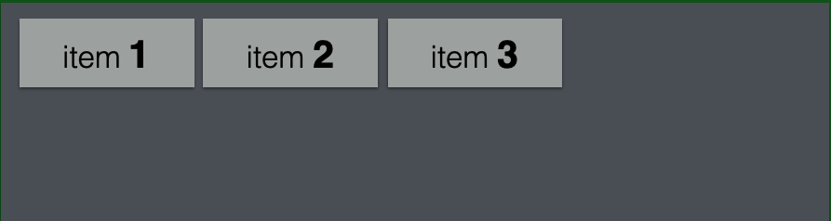

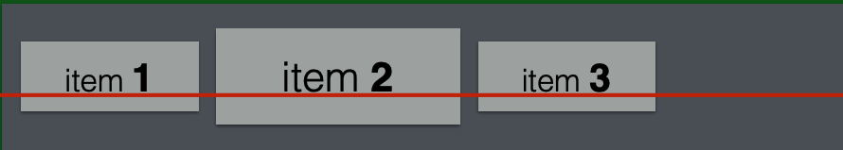
align-items
Determine align of flex items in cross-axis (Vertical line).
stretch
center
flex-start
flex-end
baseline

Slide 64
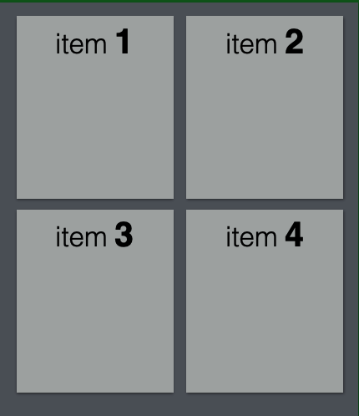
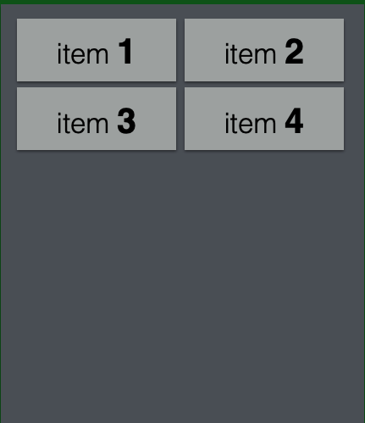
align-content
Align flex items with extra space on the cross-axis, within the flex container when have multiple lines.
stretch
center

Slide 65
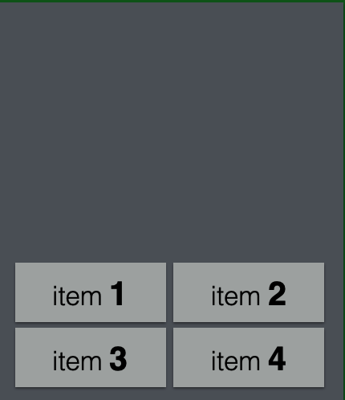
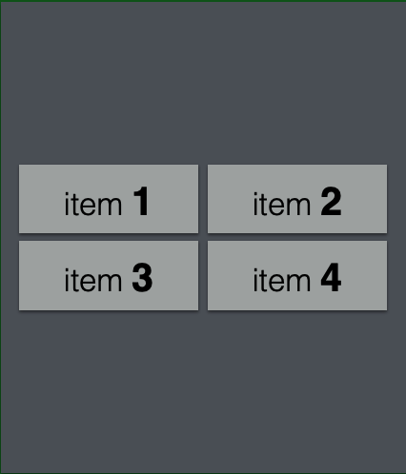
align-content
flex-end
center

Slide 66
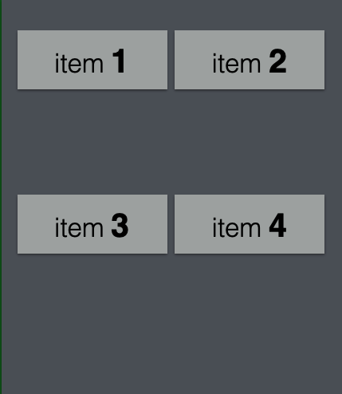
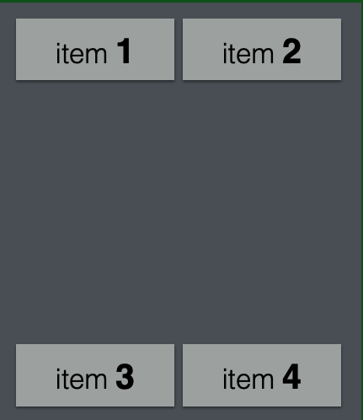
align-content
Space-around
Space-between

Slide 67
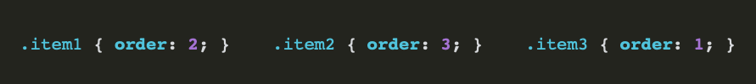
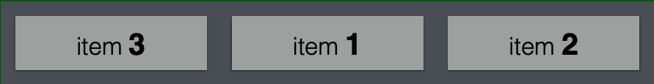
order

Slide 68

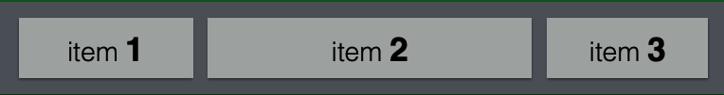
flex-grow
Define how much the item will take of available space. - The value serves as a proportion. - If all elements have 1 of value, all elements will have same width. - If one element have 2 of value, that element will have the double of size.

Slide 69


flex-shrink
Define how much the item will shrink.

Slide 70



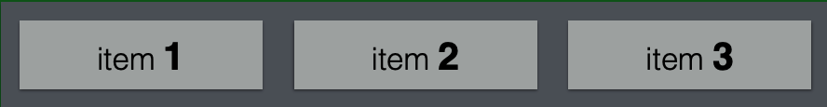
flex-basis
Define the width of elements. This is works like max-width.

Slide 71
Flex Items can ALSO be Containers
Makes the section a flex container
<section>
<p>1</p>
<p>2</p>
<p>3</p>
<div>
<p>4</p>
<p>5</p>
</div>
</section>
section {
display: flex;
justify-content: center;
align-items: center
}
div {
display: flex;
justify-content: center;
align-items: center
}
Flex rules assigned to the parent that control the flex items (direct children) of that parent
Makes the div a flex container (this div is ALSO a flex child of the section)
Flex rules assigned to the parent that control the flex items (direct children) of that parent

Slide 72
More on Flex box
The flexbox guide
A mini-game help you master the flex box !

Slide 73
Any questions?

