Slide 1
CDS4004 – Lecture 11 Network Constructions

Slide 2
Network Constructions

Slide 3
Network Construction
Specification
Node meaning
Edge meaning
Directed or not
Weighted or not
Construction
Data collection (web scraping)
Construct edge list out of the web data
Load network from edge list
Inspection
Appearance of the network, measuring the network

Slide 4
Is Web Scraping Python Legal?
Not all web scraping acts are considered legal. Web scraping extract publicly available data is legal.
Web Scraping Rules
Check the Terms and Conditions of the website before we scrape it. The Legal Use of Data section will have the information about data that we all can use.
Keep the pace low. If we request for data from the website too aggressively with our bot or our program, it might be considered as spamming. Add wait time in between to make the program behave like a human.
Use public content only.

Slide 5
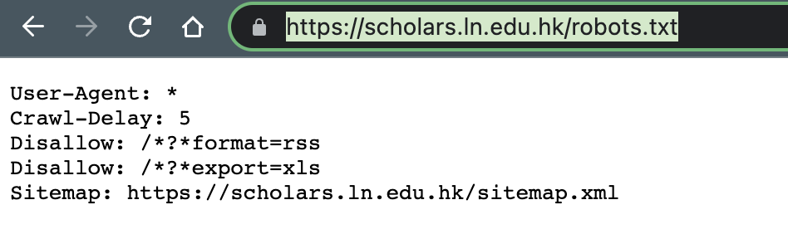
Robots.txt
Common directives
User-Agent: * kind of bots or browsers
Disallow: / paths that are not allowed for robots
Crawl-Delay: 5 delay in seconds of consecutive requests
Sitemap: xxx organization of links of a website
Notes:
A sitemap is a list of pages of a web site within a domain.

Slide 6
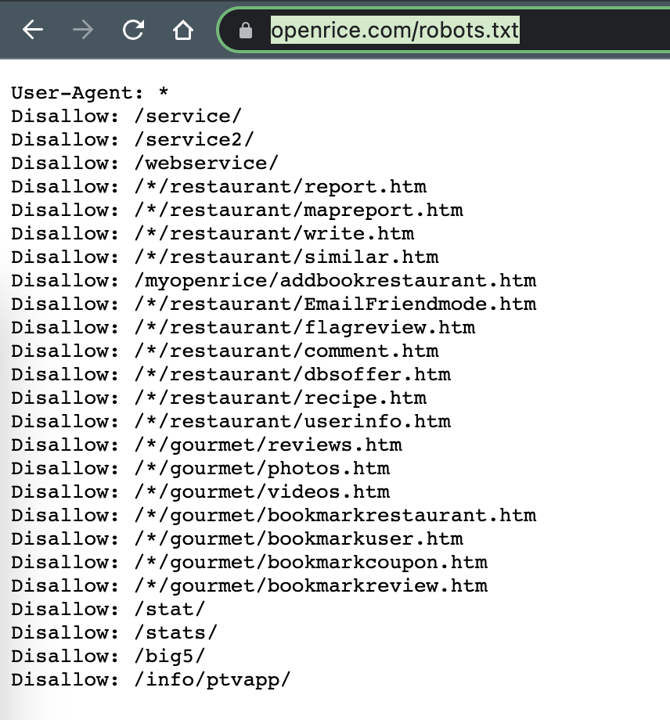
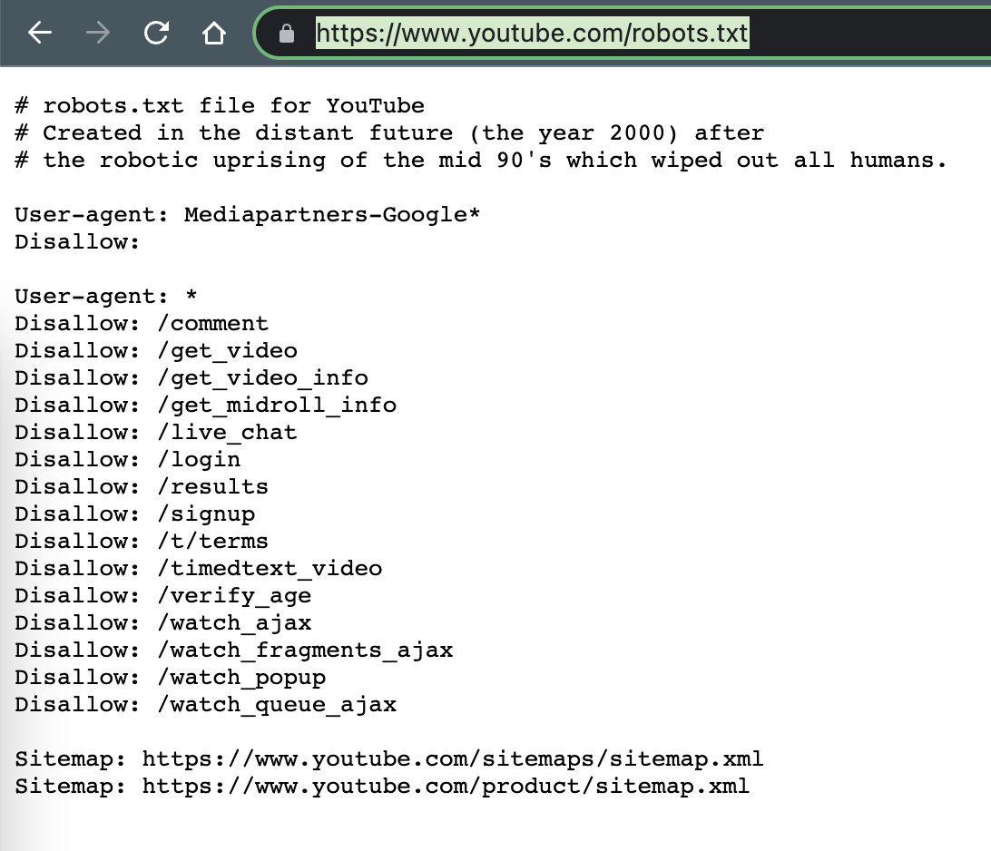
Robots.txt

Slide 7
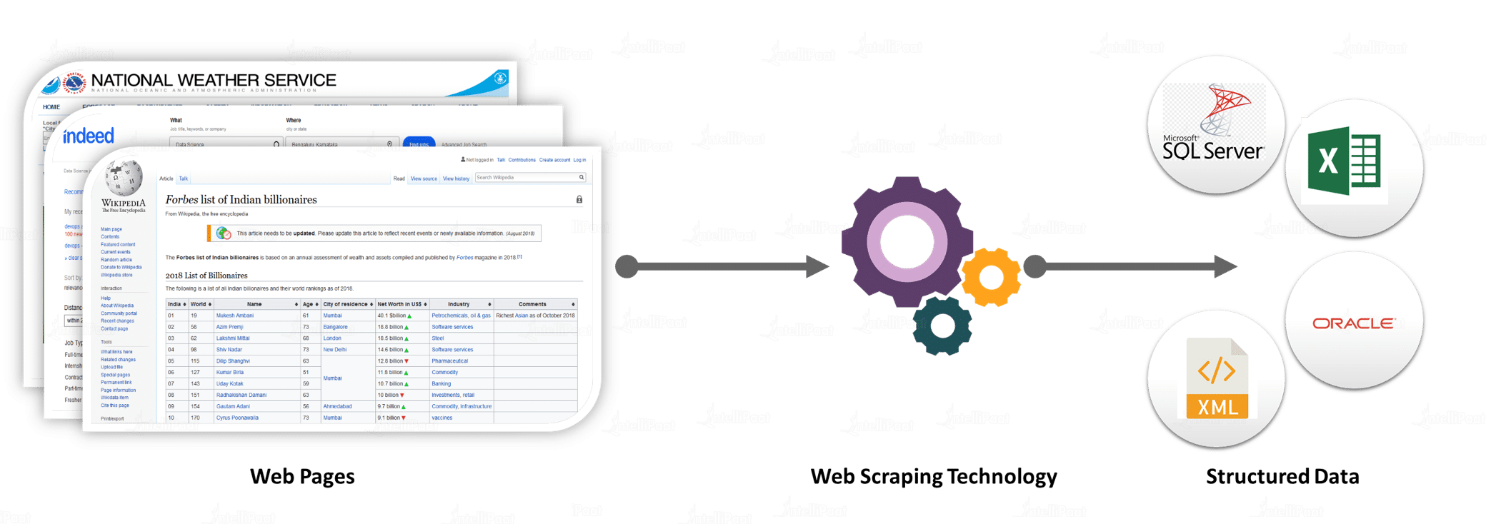
Web Scraping Workflow
Python Web scraping is the process of collecting data from the web. Web scraping in Python involves automating the process of fetching data from the web.
In order to fetch the web data, all we need is the URL or the web address that we want to scrape from.
Transform the data in unstructured form into a structured form.
Store the data for further processing.

Slide 8
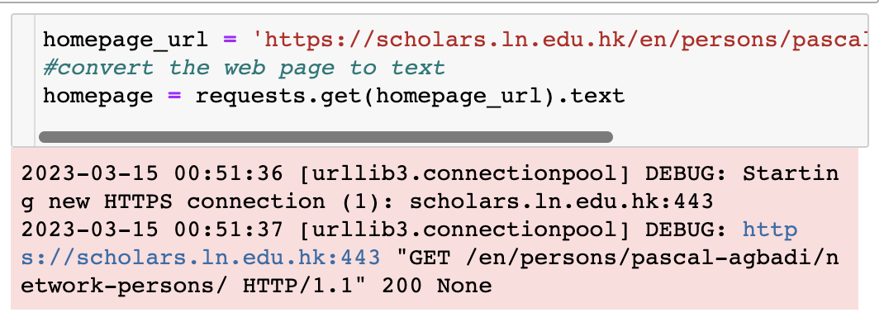
Python Libs for Web Scraping
For performing HTTP requests: Import Python requests
For handling all of the HTML processing: Import BeautifulSoup from bs4

Slide 9
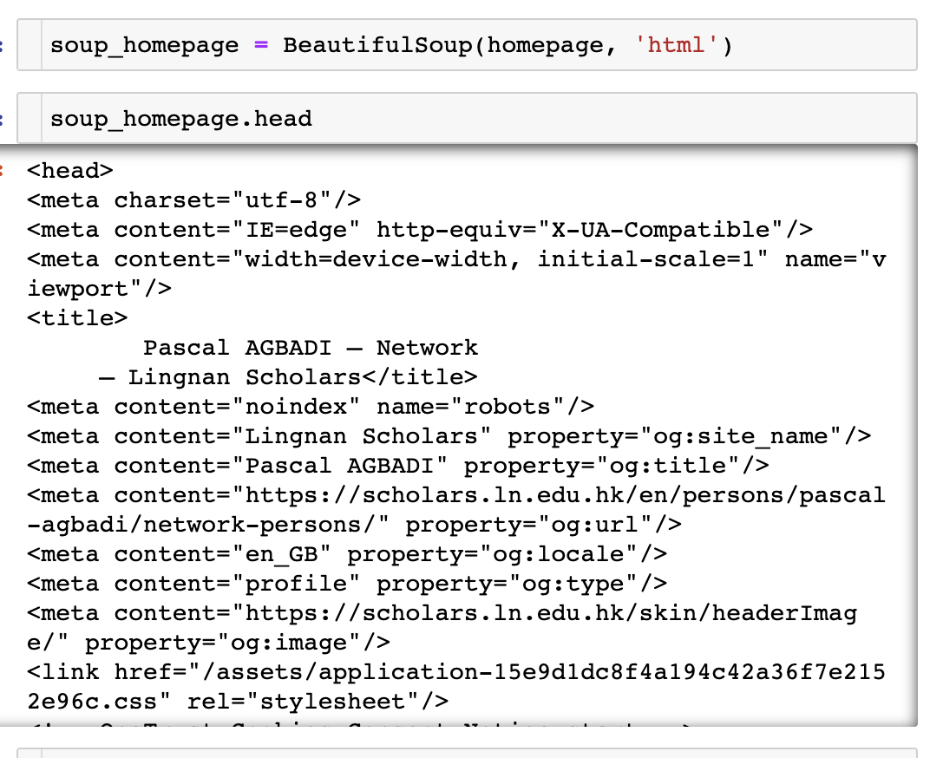
Python Libs for Web Scraping

Slide 10
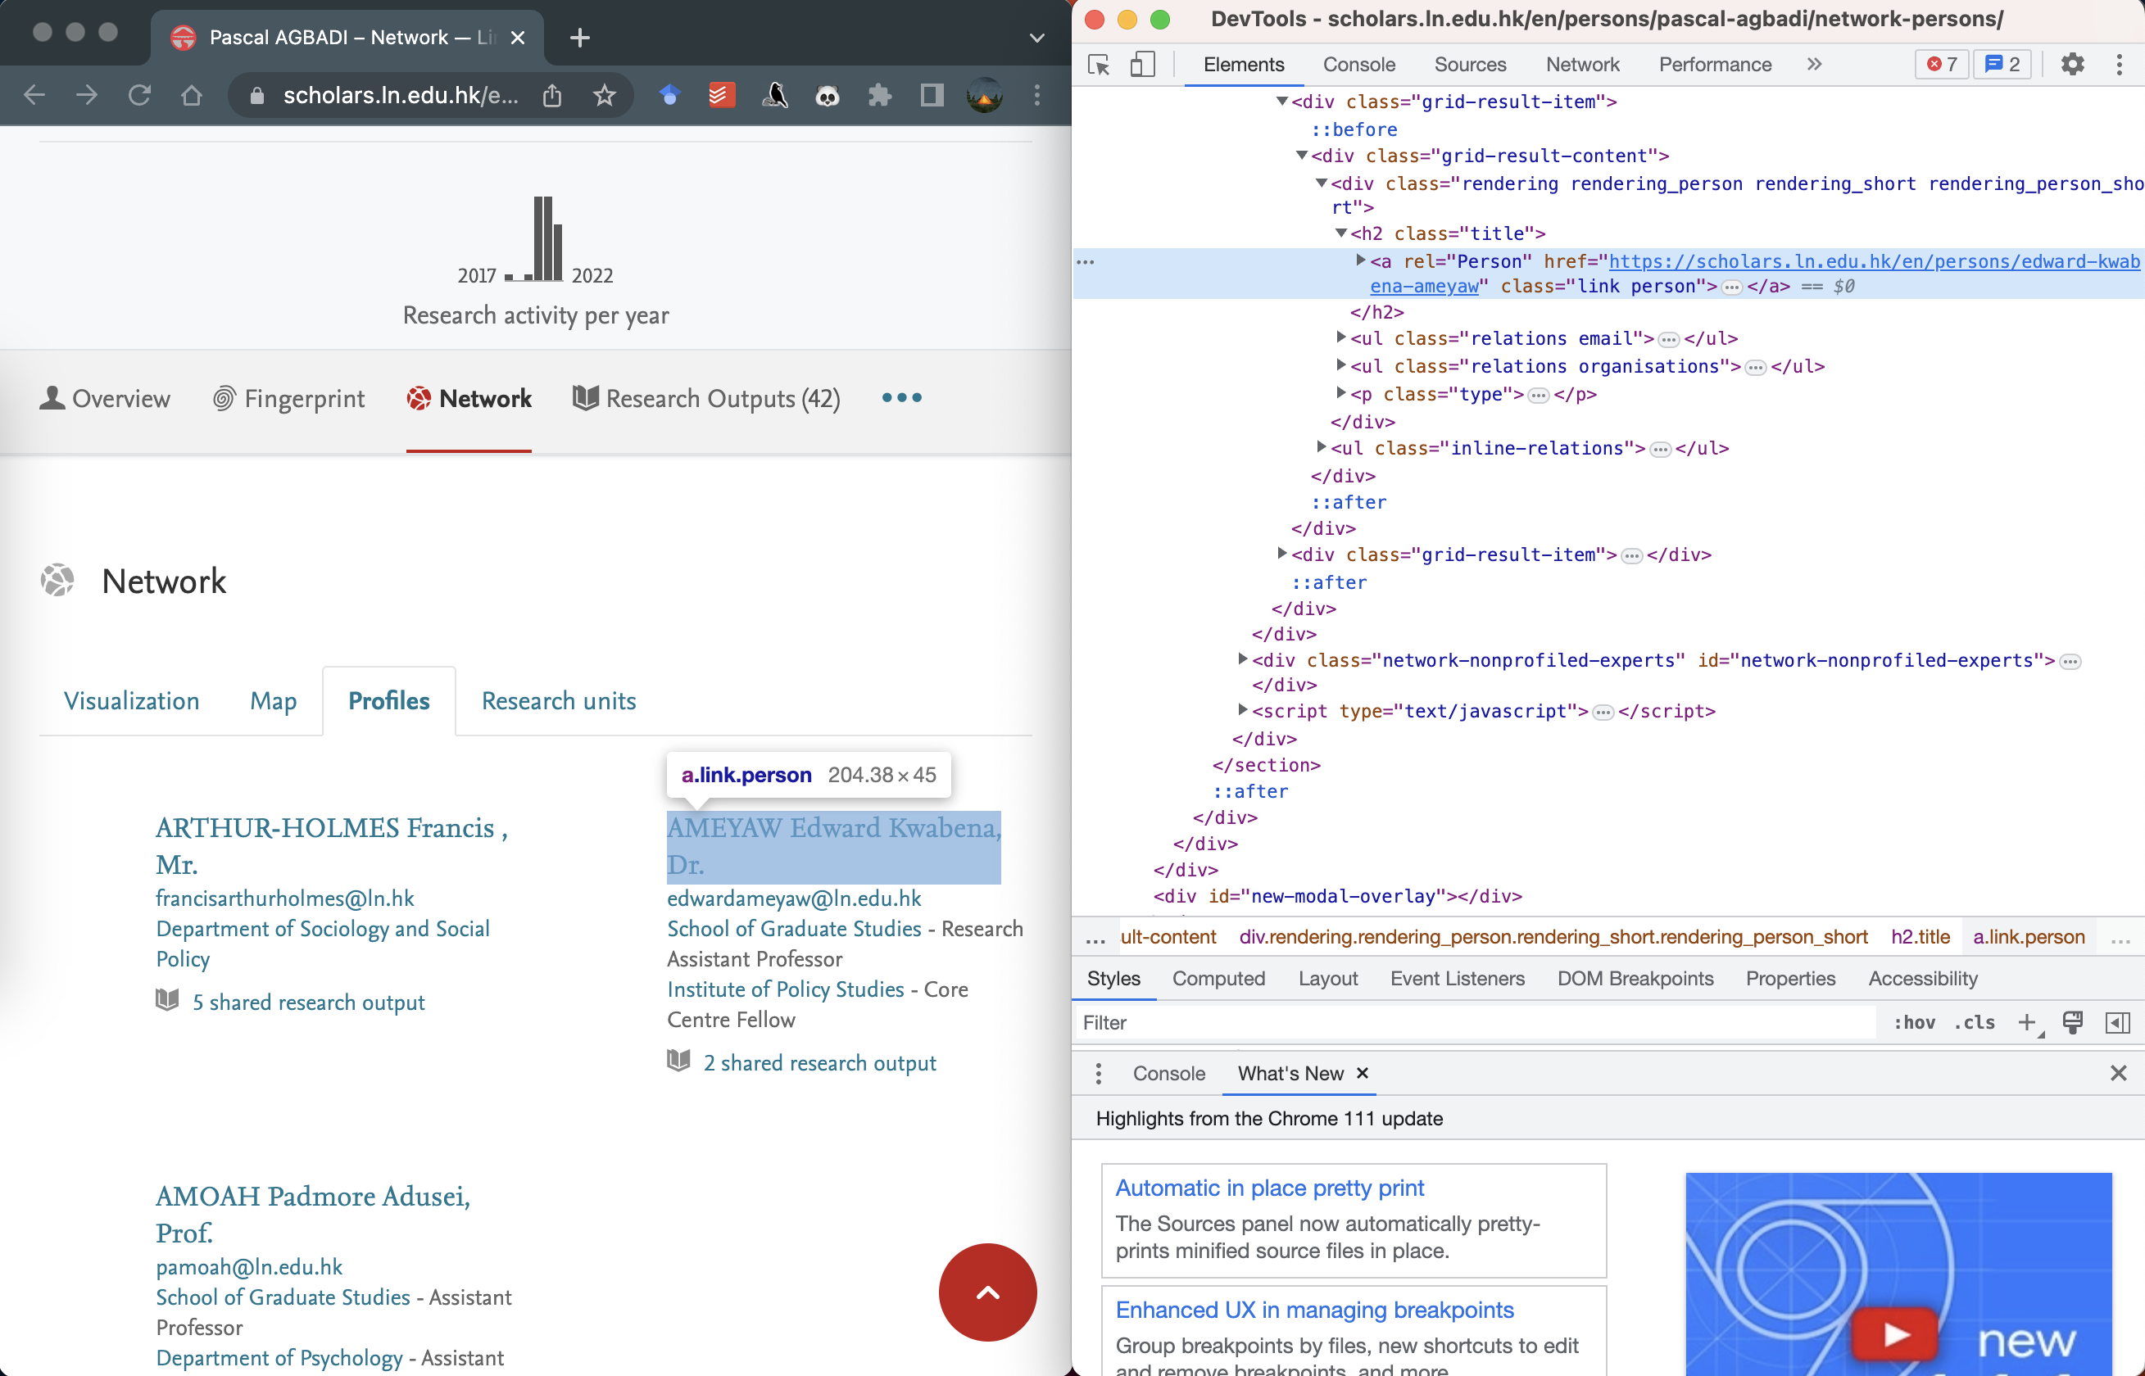
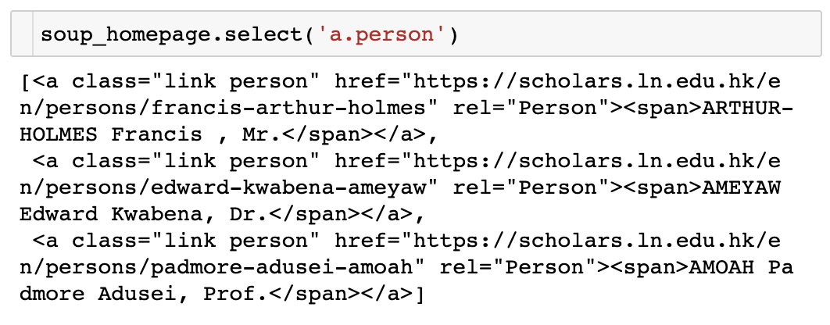
Python Libs for Web Scraping

Slide 11
Any questions?

