Slide 1
CDS4004 – Lecture 9 Node Importance Analysis II

Slide 2
Lesson objectives
Understand the importance of node importance
Apply degree and geometric centrality to analyze networks
Understand centrality and connectivity-based centrality
Understand limitations of centrality

Slide 3




Exercise: Closeness Centrality
$$C_{close}\left(g\right)=\frac{10}{\left(1\right)\left(1\right)+\left(2\right)\left(3\right)+\left(3\right)\left(2\right)+\left(4\right)\left(1\right)+\left(5\right)\left(3\right)}=0.3125$$
$$C_{close}\left(a\right)=\frac{10}{\left(1\right)\left(4\right)+\left(2\right)\left(3\right)+\left(3\right)\left(3\right)}=0.5263157895$$
$$C_{close}\left(b\right)=\frac{10}{\left(1\right)\left(2\right)+\left(2\right)\left(6\right)+\left(3\right)\left(2\right)}=0.5$$
Notes:
a, b , g

Slide 4

Exercise: Harmonic Centrality
$$C_{harm}\left(g\right)=\frac{1}{1}+\frac{1}{2}\left(3\right)+\frac{1}{3}\left(2\right)+\frac{1}{4}+\frac{1}{5}\left(3\right)=4.01666666667$$
$$C_{harm}\left(b\right)=\frac{1}{1}\left(2\right)+\frac{1}{2}\left(6\right)+\frac{1}{3}\left(2\right)=5.6666666667$$
Notes:
b , g
B: 1+1+1/2 * 6 + 1/3*2 =

Slide 5
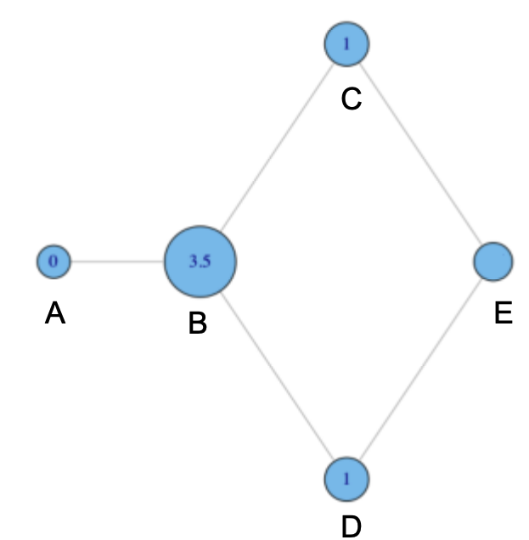
Exercise: Betweenness Centrality
Why do C and D each have betweenness of 1 ?
Why B has betweenness of 3.5 ?
What is the betweenness of node E ?

Slide 6
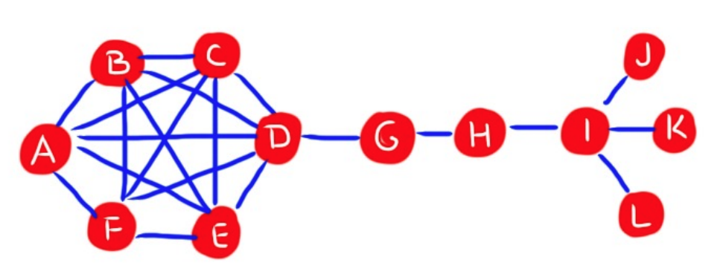
Exercise: Betweenness Centrality
Find a node:
that has high betweenness but low degree
that has high betweenness but high degree

Slide 7




Exercise: Betweenness Centrality
$$C_{bet}\left(g\right)= ?$$
$$C_{bet}\left(d\right)= ?$$
$$C_{bet}\left(a\right)=?$$
$$C_{bet}(b)= ?$$
Notes:
a: 5 * 1 + 5 * 4 + 1 * 4
D: 1 * 9 + 7 /2

Slide 8

Exercise: Betweenness Centrality
$$C_{bet}\left(g\right)=0$$
$$C_{bet}\left(d\right)= ?$$
$$C_{bet}\left(a\right)=?$$
$$C_{bet}(b)= ?$$
Notes:
a: 5 * 1 + 5 * 4 + 1 * 4
D: 1 * 9 + 7 /2

Slide 9
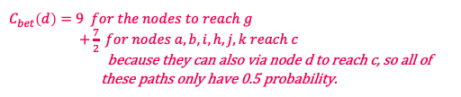
Exercise: Betweenness Centrality
$$C_{bet}\left(g\right)=0$$
$$C_{bet}\left(d\right)=9 for the nodes to reach g$$ $+\frac{7}{2} for nodes a, b, i,h,j,k reach c$ because they can also via node d to reach c, so all of these paths only have 0.5 probability.
$$C_{bet}\left(a\right)=?$$
$$C_{bet}(b)= ?$$
Notes:
a: 5 * 1 + 5 * 4 + 1 * 4
D: 1 * 9 + 7 /2

Slide 10



Exercise: Betweenness Centrality
$$C_{bet}\left(g\right)=0$$
$$C_{bet}\left(d\right)=12.5$$
$$C_{bet}\left(a\right)=5 ∗5 for \left\{b,i,h,j,k\right\} to reach \left\{ g,d,c,e,f\right\}$$ $+4 for f to reach \{g,d,c,e\}$
$$C_{bet}(b)= ?$$
Notes:
a: 5 * 1 + 5 * 4 + 1 * 4
D: 1 * 9 + 7 /2

Slide 11

Exercise: Betweenness Centrality
$$C_{bet}\left(g\right)=0$$
$$C_{bet}\left(d\right)=12.5$$
$$C_{bet}\left(a\right)=29$$
$$C_{bet}\left(b\right)=4∗6$$
Notes:
a: 5 * 1 + 5 * 4 + 1 * 4
D: 1 * 9 + 7 /2

Slide 12
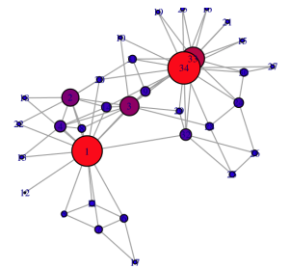
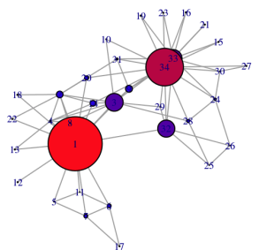
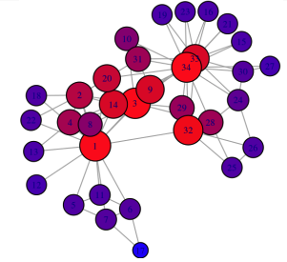
Comparing Centrality Measures
Degree Centrality
Closeness Centrality
Betweenness Centrality

Slide 13
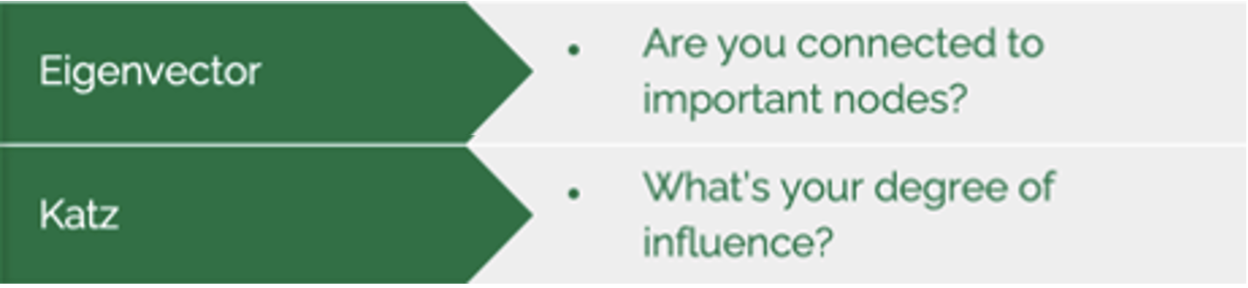
Types of Centrality Measures
Connectivity-based Measures
Based on the eigen-structure of some graph-related matrix.

Slide 14
Connectivity-based Measures
Intuition: A node’s centrality is a function of the centrality of its neighbors.
Nodes connected to central nodes has a larger centrality score than those connected to non-central nodes.
Eigenvector Centrality
Katz’s Index

Slide 15
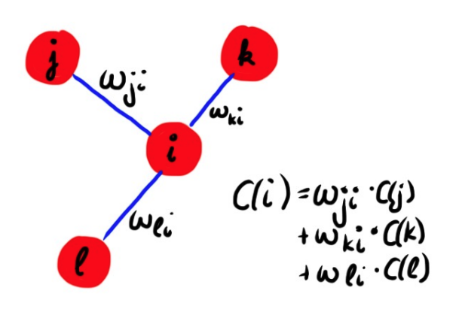
Eigenvector Centrality
Your centrality depends on the centralities of your neighbors.

Slide 16
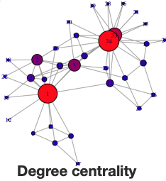
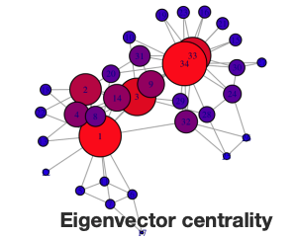
Degree Centrality vs Eigenvector Centrality

Slide 17

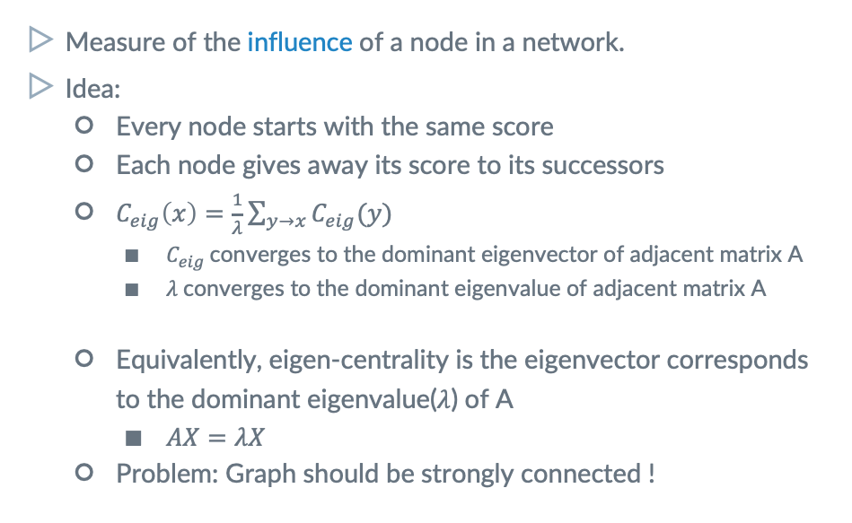
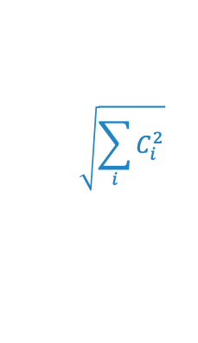
Eigenvector Centrality
Measure of the influence of a node in a network.
Idea:
Every node starts with the same score
Each node gives away its score to its successors
$C_{eig}\left(x\right)=\frac{1}{λ}\sum_{y→x}{C_{eig}(y)}$
$C_{eig}$converges to the dominant eigenvector of adjacent matrix A
$λ$converges to the dominant eigenvalue of adjacent matrix A
Equivalently, eigen-centrality is the eigenvector corresponds to the dominant eigenvalue($λ$) of A
$AX=λX$
Problem: Graph should be strongly connected !
$$\sqrt{\sum_{i}{C_{i}^{2}}}$$
where $λ=$Normalization constant

Slide 18
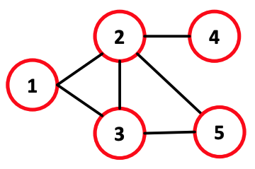
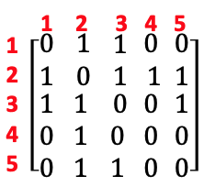


How to compute?
Power Iteration:
Step 1: Set c(0) = 1, k = 1
Step 2: $c^{(k)} = Ac\left(k−1\right)$
Step 3: $c^{(k)} =c^{\left(k\right)}/{\left|\left|c^{\left(k\right)}\right|\right|}_{2}$
Step 4 if $\left|\left|c^{\left(k\right)}−C^{\left(k−1\right)}\right|\right|>ε:$ $k=k+1;Go to step 2$
A =
C⁽⁰⁾ =

Slide 19


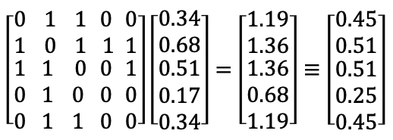
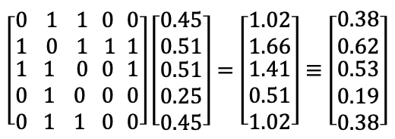
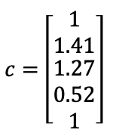
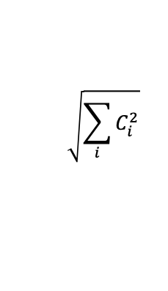
How to compute?
Power Iteration:
Iteration 1
$$\sqrt{\sum_{i}{C_{i}^{2}}}$$
A
c⁽⁰⁾
c⁽¹⁾ = Ac⁽⁰⁾
c⁽¹⁾ = c⁽¹⁾/||c⁽¹⁾||₂
Iteration 2
Iteration 3
Iteration k

Slide 20
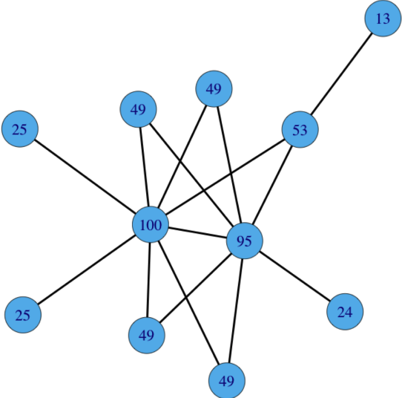
Eigencentrality Example

Slide 21
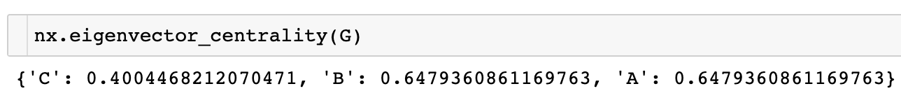
Connectivity-based Centralities
Eigenvector centrality (also called eigencentrality) is a measure of the influence of a node in a network.
It assigns relative scores to all nodes in the network based on the concept that connections to high-scoring nodes contribute more to the score of the node in question than equal connections to low-scoring nodes.
Google's PageRank and the Katz centrality are variants of the eigenvector centrality.
Notes:
卡茨

Slide 22
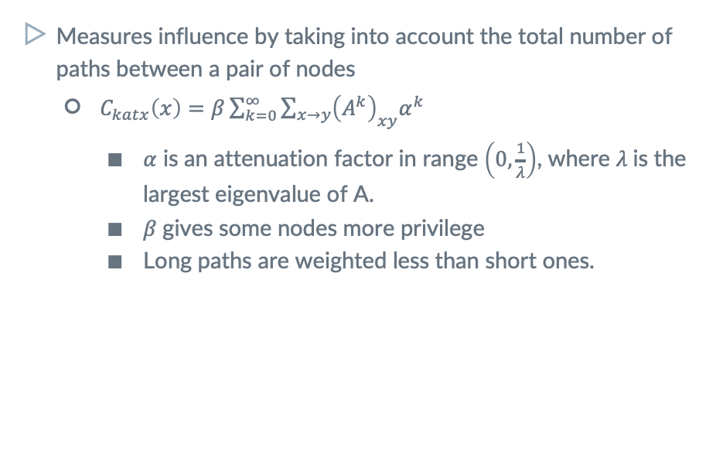
Katz’s Index
Measures influence by taking into account the total number of paths between a pair of nodes
$C_{katx}\left(x\right)=β\sum_{k=0}^{∞}{\sum_{x→y}{{\left(A^{k}\right)}_{xy}α^{k}}}$
$α$ is an attenuation factor in range $\left(0,\frac{1}{λ}\right)$, where $λ$is the largest eigenvalue of A.
$β$gives some nodes more privilege
Long paths are weighted less than short ones.
Total number of paths of length k between x and y

Slide 23
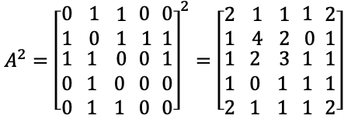
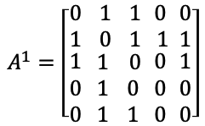
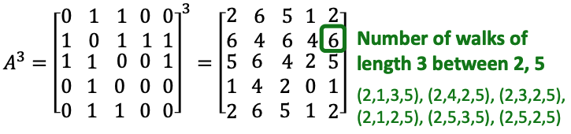


Katz’s Index
Measures influence by taking into account the total number of paths between a pair of nodes
$C_{katx}\left(x\right)=β\sum_{k=0}^{∞}{\sum_{x→y}{{\left(A^{k}\right)}_{xy}α^{k}}}$
$α < 1$: Long paths are weighted less
Total number of paths of length k between x and y

Slide 24
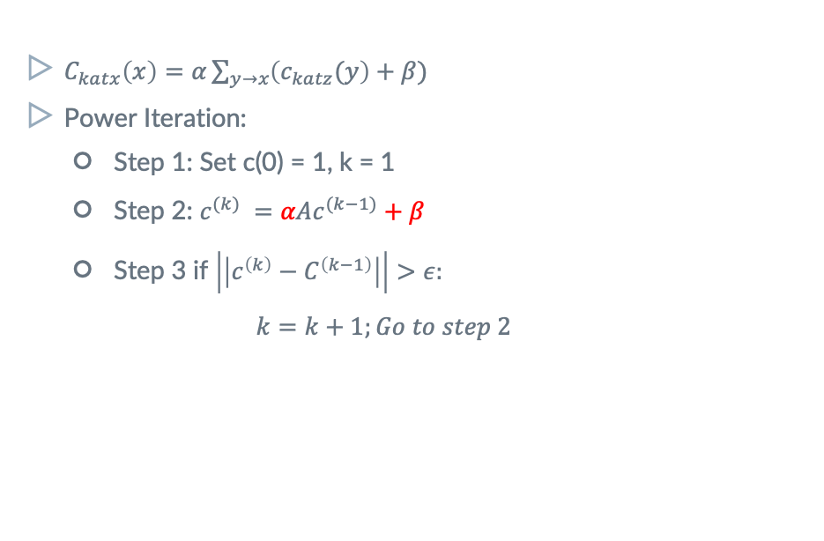
Katz’s Index
$C_{katx}\left(x\right)=α\sum_{y→x}{\left(c_{katz}(y\right)+β)}$
Power Iteration:
Step 1: Set c(0) = 1, k = 1
Step 2: $c^{(k)} =αAc^{(k−1)}+β$
Step 3 if $\left|\left|c^{\left(k\right)}−C^{\left(k−1\right)}\right|\right|>ε:$ $k=k+1;Go to step 2$

Slide 25
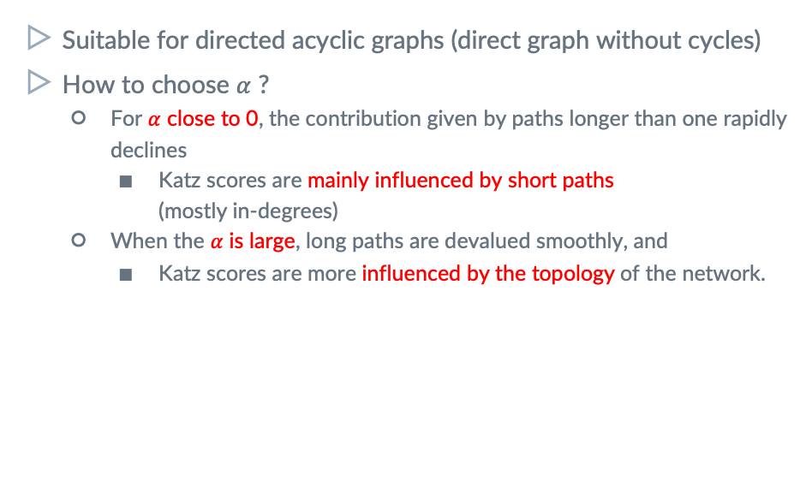
Katz’s Index
Suitable for directed acyclic graphs (direct graph without cycles)
How to choose $α$ ?
For $α$ close to 0, the contribution given by paths longer than one rapidly declines
Katz scores are mainly influenced by short paths (mostly in-degrees)
When the $α$ is large, long paths are devalued smoothly, and
Katz scores are more influenced by the topology of the network.

Slide 26
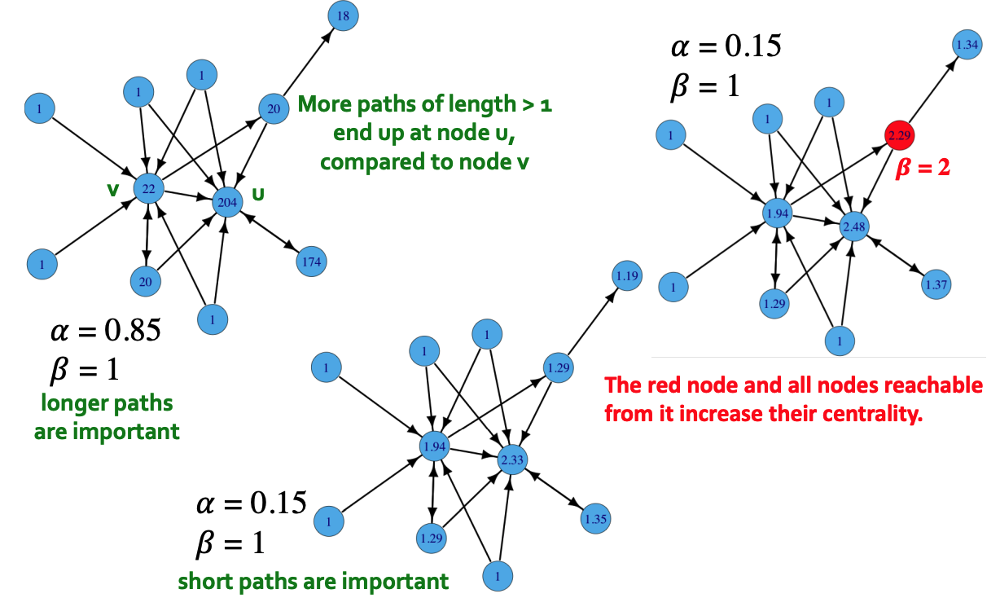
Example of Katz’s Index

Slide 27
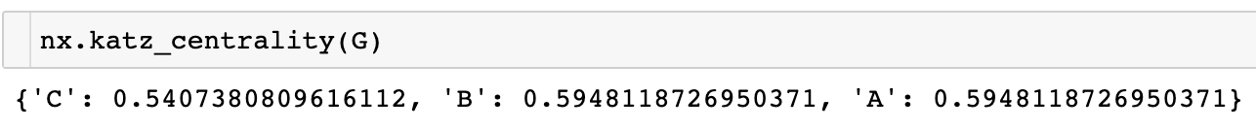
Connectivity-based Centralities
Katz centrality is a generalization of degree centrality.
Degree centrality measures the number of direct neighbors, and Katz centrality measures the number of all nodes that can be connected through a path, while the contributions of distant nodes are penalized.
Notes:
卡茨

Slide 28
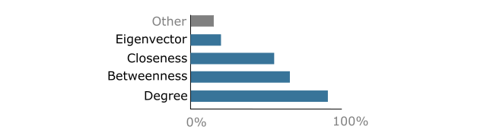
Which Centrality is the Best?
No one is the best!
Share of network centrality measurements in 63 studies
Vignery, K., & Laurier, W. (2020). A methodology and theoretical taxonomy for centrality measures: What are the best centrality indicators for student networks?. PLoS One, 15(12), e0244377.

Slide 29
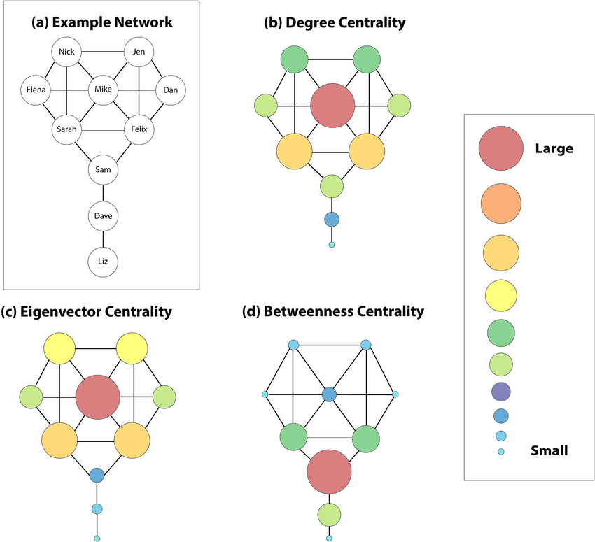
Limitations of Centrality
The obvious limitation is that
a centrality which is optimal for one application is often sub-optimal for a different application.
An illustration of this phenomenon is provided by the Krackhardt kite graph, for which three different notions of centrality give three different choices of the node centrality.

Slide 30
Limitations of Centrality
Centrality are not designed to measure the influence of nodes in general.
A ranking only orders vertices by importance, it does not quantify the difference in importance between different levels of the ranking
The features which (correctly) identify the most important vertices in a given network/application do not necessarily generalize to the remaining vertices
Notes:
[美: ˈfæləsi] [英: ˈfæləsi]
For the majority of other network nodes the rankings may be meaningless.^{[14][15][16][17]} This explains why, for example, only the first few results of a Google image search appear in a reasonable order. The pagerank is a highly unstable measure, showing frequent rank reversals after small adjustments of the jump parameter.^{[18]}

