Slide 1
CSC2003 Group A4
Communications
Members:
Abdullah(2100972)
Nicole(2102552)
Amiir(2101526)

Slide 2
Overview
Web app to display data retrieved from PICO
Wheel velocity (Left & Right)
Barcode data
Coordinate of the Barcode
Map of the maze
Distance from obstacles in maze
Height of hump
Coordinate of hump

Slide 3
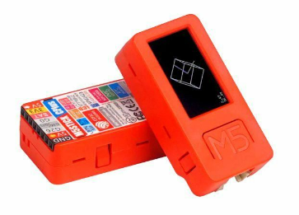

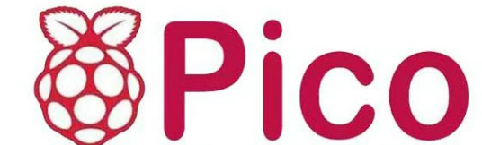
Communication Protocols
UART
MQTT
Socket.IO
Baud Rate: 115200
Data bits: 8
Parity: None Stop bit: 1
UART_TX_PIN: 0
UART_RX_PIN: 1
Connect to MQTT Broker (broker.emqx.io)
Publish data to different MQTT topics
Subscribe to MQTT Topics
Display data

Slide 4
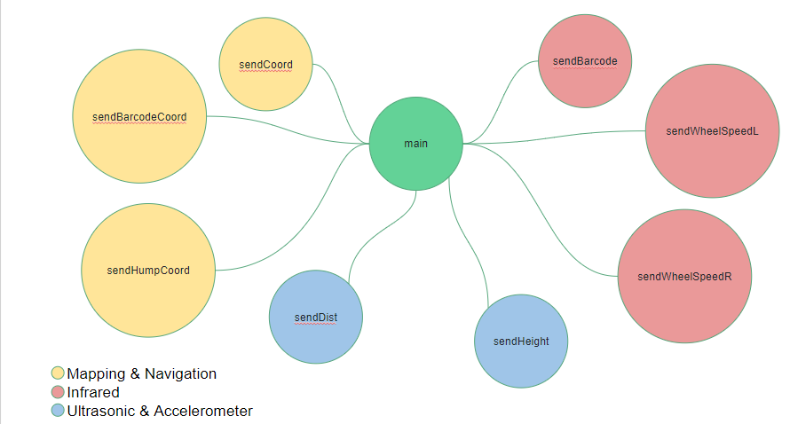
Call Graph

Slide 5
sendCoord
sendBarcode
sendBarcodeCoord
sendWheelSpeedL
main
sendHumpCoord
sendWheelSpeedR
sendDist
sendHeight
Mapping & Navigation
Infrared
Ultrasonic & Accelerometer

Slide 6
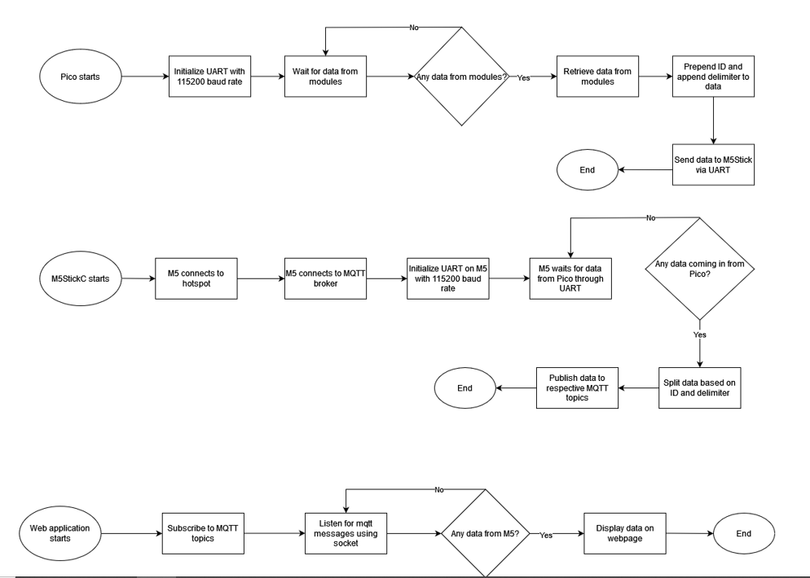
Pico - M5 stick - Flask flowchart

Slide 7
Comparisons
 | HC-05 | M5StickC Plus(ESP32)
Module Used | Bluetooth V2.0 | Wi-Fi (2.4Ghz)
Baud Rate Supported | 9600 (default), 19200,38400, 57600, 115200, 230400, 46080,1382400 | 1200 ~115200, 250K, 500K, 750K, 1500K
Speed | Asynchronous: 2.1Mbps(Max) / 160 kbps, Synchronous: 1Mbps/1Mbps. | Ideal scenario 30Mbps
Range | 10M | 20-100M
Power | 3.3v | 3.3v

Slide 8
Latency
Time Delay when sending character from Pico/MSP to M5/HC05
For Wi-Fi, we are able to ping to find out the latency.
However for bluetooth, it is very hard to tell as we are unable to verify that both clocks start at the same time(in the smallest time unit) which may skew our results, therefore we cannot accurately conclude the latency.
Average latency for bluetooth is 100-300ms
Latency for WiFi Hotspot 293 ms

Slide 9
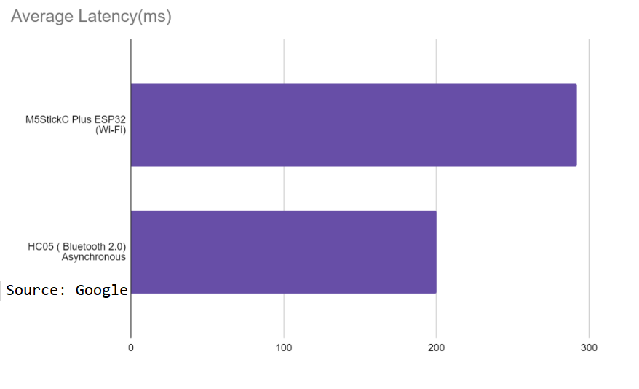

Slide 10
Throughput
Rate of message delivery
Amount of data sent/time taken

Slide 11
Reasons for M5StickC
Easier to debug due to LCD Screen
Bigger Range (Depends on hotspot)
Supports WiFi and accelerometer
Can code in UIflow and micropython

Slide 12
White Box
Black Box
Tested individual components by increasing the rate that data is being transmitted/ the amount of interrupts
Generated dummy input from pico to website to check reliability of data transmission.
Used buttons and coordinates entry to see if map is displaying as intended
Notes:
Testing on Pico/ m5/ web???
I think black box is just u put input see if correct output come out anot
White box i think is the algo

Slide 13
Video Demo (Main)
Pico -> M5StickC Plus -> Flask Web App

Slide 14
Video Demo of Alternative Configurations
HC-05 + PICO
VS
M5StickC Plus + MSP432

