Slide 1

What’s new in Angular?
@ziaziosk
Ziazios Konstantinos
developer

Slide 2


Slide 3
Contents
Quick Intro
What is all about
Angular 8
What is new
Angular 9
What is coming
Demo
A simple progressive app
ngThess
Discussion

Slide 4

Quick intro
Angular is a full featured framework created and maintained by Google and used for building applications.
Main features:
Develop Across Platforms ( mostly web and mobile )
Speed & performance
Incredible tooling
Very popular in large enterprise

Slide 5
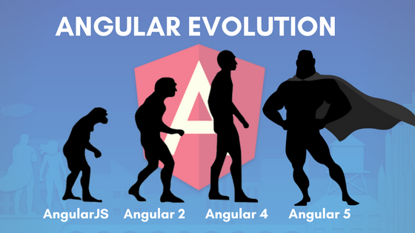
Angular Versions
Angular JS 1.x
AngularJS usually referred to as “Angular.js” or Angular 1.x
Very different !!
Angular2+ → Angular
Semantic versioning e.q. 7.2.11
Beta, rc and next
Release schedule
6-ish Months release cycles
6 mo. active support and 12 Months LTS
October/November 9.0.0
May 2020 10.0.0

Slide 6
Angular Versions
Angular 2
September 2016 First Version With Typescript
Angular 3
Skipped!
Angular 4
March 2017
Fixes / Faster compilation / Reduce in size

Slide 7
Angular Versions
Angular 5
November 2017 Universal State Transfer API / HttpClient changes
Angular 6
May 2018
Angular Elements / CDK / Angular Material
Angular 7
October 20178
Virtual scrolling / Drag and drop

Slide 8
BENEFITS
Organized front-end structures
Powerful and full featured
All-in-one solution (routing, http, RxJS, etc)
Build powerful SPA apps
MVC
Typescript
Fantastic CLI

Slide 9
rerquisites
JavaScript Fundamentals (Object, Arrays, Conditionals)
Good to Know:
Typescript
Classes
Observables
MVC Pattern

Slide 10
Thinking in angular
Use Typescript and static types (variables, functions, params)
Component based
Use “services” to share/data/functionality
Concept of modules
Use RxJS “observables” for async operations

Slide 11
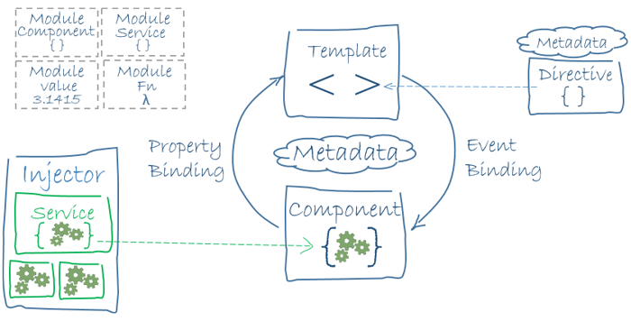
Explain me!

Slide 12

Anatomy of a component
import {Component, OnInit} from '@angular/core';
import {Router} from '@angular/router';
import {Todo} from '../../model/todo';
import {TodoService} from '../../services/todo.service';
@Component({
selector: 'app-todo-list',
templateUrl: './todo-list.component.html',
styleUrls: ['./todo-list.component.scss']
})
export class TodoListComponent implements OnInit {
public todos: Todo[] = [];
constructor(private router: Router , private todoService: TodoService ) { }
ngOnInit() {
// logic
}
}

Slide 13
Show me
npm install -g @angular/cli
ng new todoapp
cd todoapp
ng serve -o

Slide 14
Angular 8

Slide 15
Angular 8 features
Differential Loading By Default
Route Configuration use Dynamic Imports
Web Workers
Ivy , almost ready for production
Bazel experimental not fully tested
BREAKING CHANGES

Slide 16
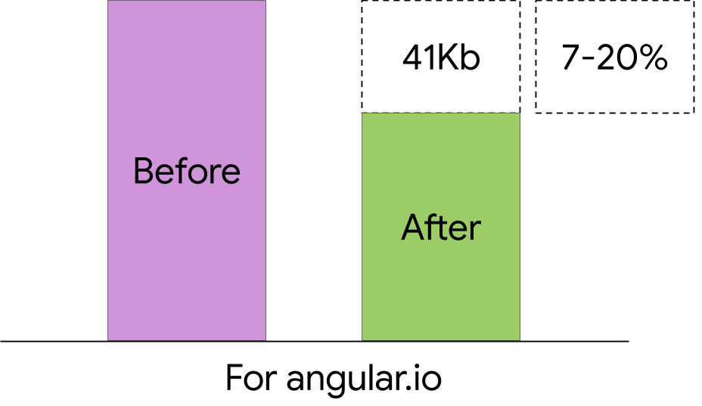
DIFFERENTIAL LOADING
Angular CLI understands browsers support range from browserslist configuration.
If the application needs to support ES5 browsers and TypeScript target is higher than es5, the CLI automatically makes additional bundles for compatibility.
browserslist is the single source of truth, so es5BrowserSupport will be deprecated.

Slide 17
How to enable
{
"compilerOptions": {
"target": "es2015",
...
}
}
Configure browserlist

Slide 18
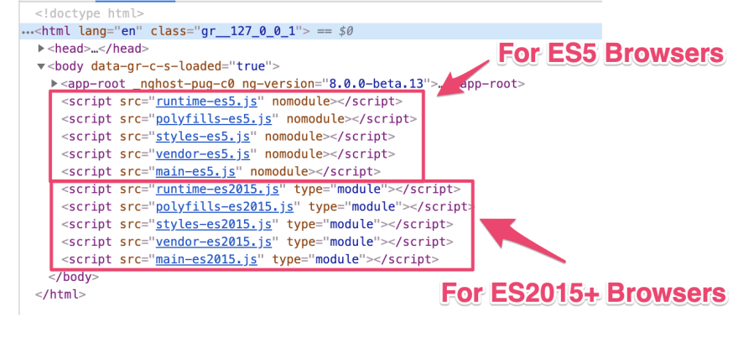
result

Slide 19

iVY
🚀reach better build times (with a more incremental compilation)
🔥 reach better build sizes (with a generated code more compatible with tree-shaking)
🔓 unlock new potential features (metaprogramming or higher order components, lazy loading of component instead of modules, a new change detection system not based on zone.js…)
94% ready
https://is-angular-ivy-ready.firebaseapp.com/#/status

Slide 20
Ivy – opt-in
ng new shiny-ivy-app --enable-ivy
{
"compilerOptions": { ... },
"angularCompilerOptions": {
"enableIvy": true
}
}

Slide 21

BAZEL
The key advantages of Bazel are:
the possibility of building your backends and frontends with the same tool
the incremental build and tests
the possibility to have remote builds (and cache) on a build farm

Slide 22
bazel
npm i -g @angular/bazel
ng new bazel-project --defaults --collection=@angular/bazel
ng build --leaveBazelFilesOnDisk
ng add @angular/bazel

Slide 23

WEB WORKERS
Web Workers are awesome and Angular CLI now supports them natively.
ng generate web-worker

Slide 24
Route configuration
const routes: Routes = [
{
path: 'lazy',
loadChildren: './lazy/lazy.module#LazyModule', // use this syntax for non-ivy or Angular 7 and below
loadChildren : () => import('./lazy/lazy.module').then(m => m.LazyModule), // new dynamic import method
}
];

Slide 25
Angular 9
Performance / size
Bazel & Ivy
New Ivy API
No zone? No modules?

Slide 26
Progressive apps demo
ng new pwa-app ng add @angular/pwa
ng build --prod

Slide 27
Tips and tricks (adv)

Slide 28
subsink
import {Subscription} from 'rxjs’;
…
subs: Subscription;
constructor() { this.subs = someObservable.subscribe ( ... ); }/** * Lifecycle hook that unsubscribes all subscriptions when the component gets destroyed */ ngOnDestroy(): void { this.subs.unsubscribe(); }

Slide 29
subsink
export class SomeComponent implements OnDestroy {
private subs = new SubSink();
this.subs.sink = observable$.subscribe(...); // easy syntax
this.subs.add(observable$.subscribe(...)); // if you insist
this.subs.add( // can add multiple subcriptions
observable$.subscribe(...),
anotherObservable$.subscribe(...)
);
// Unsubscribe when the component dies
ngOnDestroy() {
this.subs.unsubscribe();
}
}

Slide 30
Ngrx data
import { EntityMetadataMap } from '@ngrx/data';
const entityMetadata: EntityMetadataMap = {
Hero: {},
Villain: {}
};
// because the plural of "hero" is not "heros"
const pluralNames = { Hero: 'Heroes' };
export const entityConfig = {
entityMetadata,
pluralNames
};

Slide 31
Ng deploy
npm install -g @angular/cli
ng new hello-world --defaults
cd hello-world
ng add @azure/ng-deploy
ng run hello-world:deploy

Slide 32
*NGTHESS MEETUP
IDEAS :
ANGULAR MATERIAL
NGRX
ANGULAR ELEMENT
NESTJS
SSR
WORKSHOPS:
TYPESCRIPT
ANGULAR FUNDAMENTALS
Let’s discuss over drink @ΓΡΑΔΑ

Slide 33

THANKS
ziaziosk@gmail.com

