Slide 1
Customer Review Analysis
& MongoDB Practice
IM5211701 Big Data Analytics and Applications | Project 1
Team Contribution
Member 1 – [Name]
Data import, MongoDB schema design, indexing
Member 2 – [Name]
NLP analysis, word frequency, TF-IDF extraction
Member 3 – [Name]
Visualizations, insights, business recommendations
Member 4 – [Name]
Slide preparation, presentation, Q&A coordination

Slide 2
Agenda
01
Dataset Overview
04
Visualisations
Amazon Fine Food Reviews – 568K records, 10+ years
8 charts covering ratings, sentiment, trends
02
MongoDB Import
05
Business Insights
Schema design, new fields, indexing strategy
Actionable recommendations for Amazon / marketing
03
NLP Analysis
Word frequency, TF-IDF, bigrams, text queries

Slide 3
Dataset Overview
568,454
256,059
74,258
4.18 ★
Total Reviews
Unique Users
Products
Avg Rating
Key Fields
Field | Description
ProductId | Unique identifier for the product
UserId | Unique identifier for the reviewer
Score | Star rating 1–5
Time | Unix timestamp → converted to ReviewDate
Summary | Short review headline
Text | Full review body
ProductURL | Amazon product link
SentimentLabel | NEW FIELD: Positive / Neutral / Negative
HelpfulnessRatio | NEW FIELD: helpful votes / total votes
★ Two new fields added during import: SentimentLabel and HelpfulnessRatio
Source: Kaggle – Amazon Fine Food Reviews

Slide 4
MongoDB Import & Schema Design
Import Approach
Python Code Snippet
1. Read Reviews_withURL.csv with pandas
from pymongo import MongoClient
import pandas as pd
df = pd.read_csv("Reviews_withURL.csv")
def label(score):
if score >= 4: return "Positive"
if score == 3: return "Neutral"
return "Negative"
df["SentimentLabel"] = df["Score"].apply(label)
df["HelpfulnessRatio"] = df.apply(
lambda r: r["HelpfulnessNumerator"]
/ r["HelpfulnessDenominator"]
if r["HelpfulnessDenominator"] > 0
else None, axis=1)
client = MongoClient("mongodb://localhost:27017")
col = client["amazon_reviews"]["reviews"]
col.insert_many(df.to_dict("records"))
col.create_index("ProductId")
col.create_index("SentimentLabel")
2. Derive SentimentLabel (Score ≥4 → Positive, =3 → Neutral, ≤2 → Negative)
3. Derive HelpfulnessRatio = numerator / denominator
4. Convert Unix timestamp → ReviewDate (datetime)
5. Batch-insert 10,000 docs/batch into MongoDB
6. Create indexes: ProductId, UserId, Score, SentimentLabel, ReviewDate
Source: Kaggle – Amazon Fine Food Reviews

Slide 5
NLP – Word Frequency Analysis
Method: Python Counter — O(n) single-pass tokenisation after stopword removal and HTML stripping.
Top 8 Words Overall
Top Bigrams (sample of 50K reviews)
Rank | Word | Count
1 | coffee | 191,977
2 | tea | 160,364
3 | love | 155,159
4 | best | 110,362
5 | little | 87,888
6 | time | 87,136
7 | price | 87,099
8 | dog | 83,550
Bigram | Count
gluten free | 1,844
peanut butter | 1,396
highly recommend | 1,317
green tea | 1,298
cup coffee | 1,111
grocery store | 1,076
subscribe save | 759
dog loves | 721
dogs love | 717
love product | 714
MongoDB Regex Query – Count reviews containing "delicious":
col.count_documents({"Text": {"$regex": "delicious", "$options": "i"}}) → 39,114 reviews
Source: Kaggle – Amazon Fine Food Reviews

Slide 6
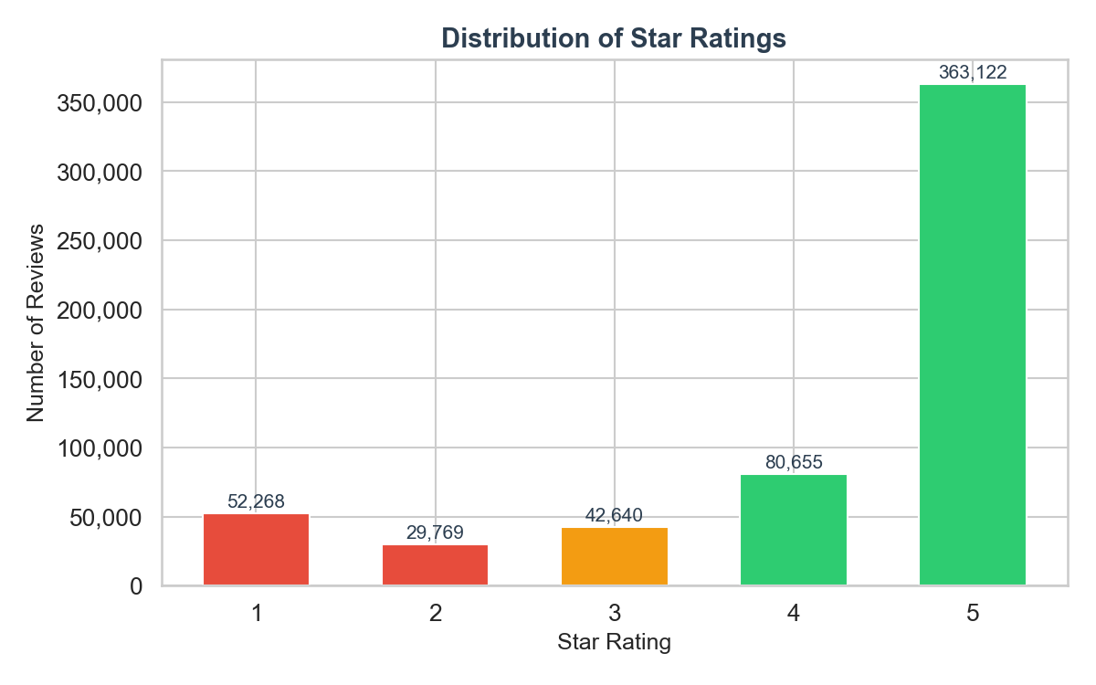
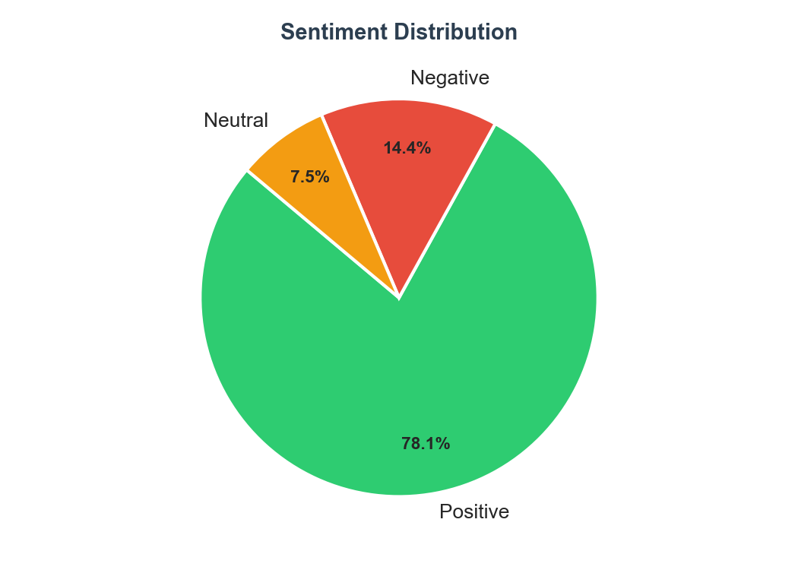
Rating & Sentiment Distribution
Key Takeaways:
78.1% of reviews are Positive (4–5 stars) • 5-star is the single most common rating (>320K reviews) • Only 14.4% Negative
Source: Kaggle – Amazon Fine Food Reviews

Slide 7
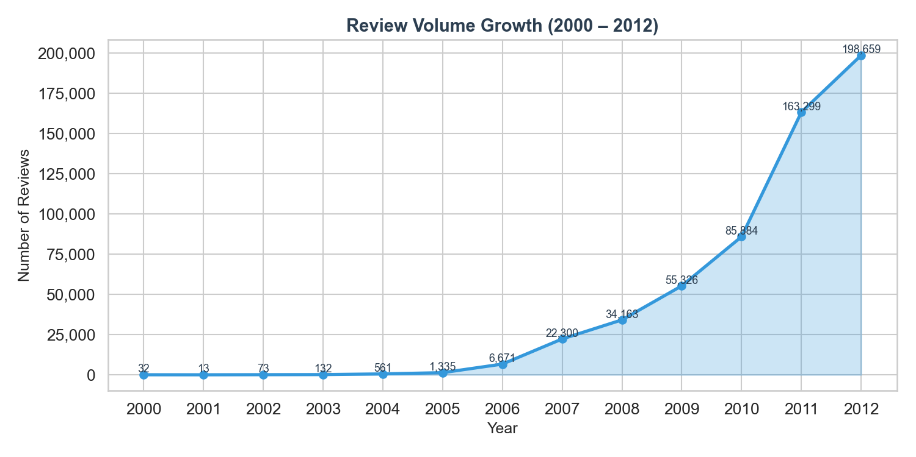
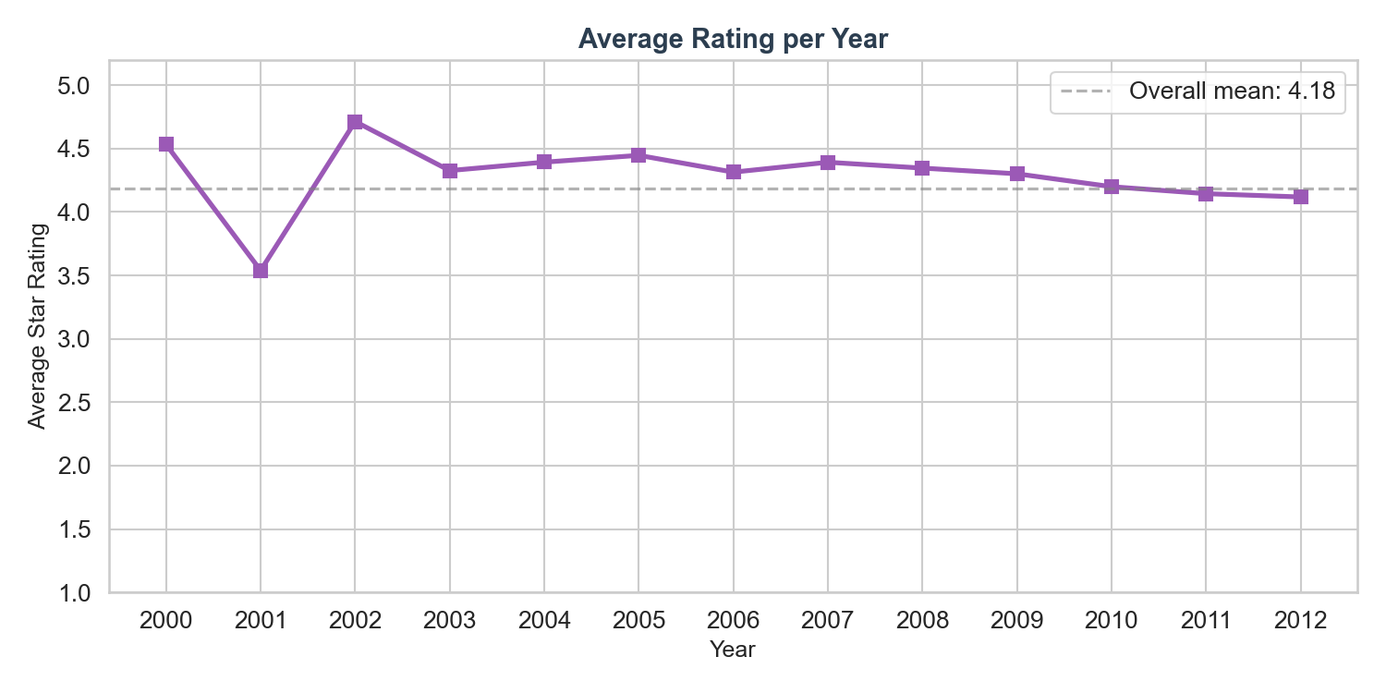
Review Volume & Rating Trends
Key Takeaways:
Review volume grew ~100× from 2003 to 2012 • Average score has remained stable near 4.2 despite volume surge • Engagement peaked in 2012
Source: Kaggle – Amazon Fine Food Reviews

Slide 8
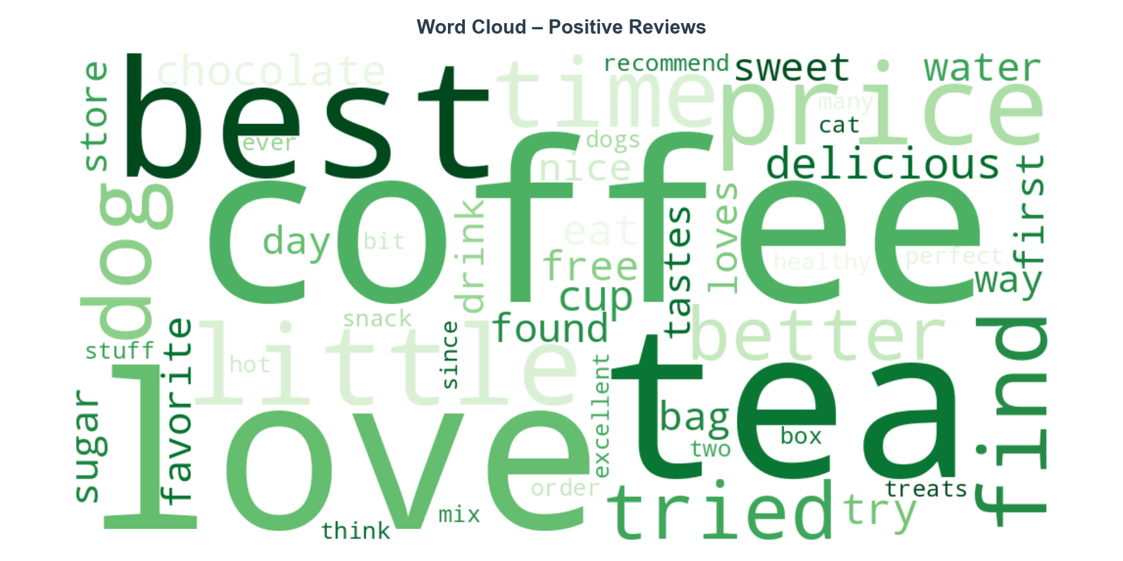
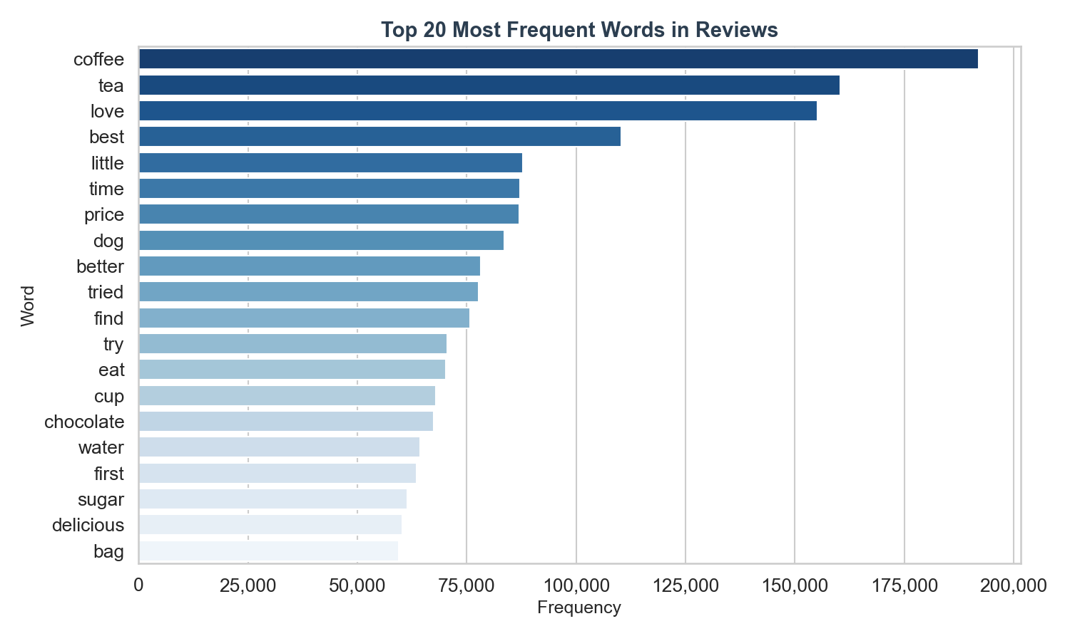
NLP Visualisations
Key Takeaways:
Coffee & tea dominate positive discourse • 'love', 'best', 'price' signal quality- and value-driven purchases • Top bigrams reveal dietary preferences (gluten-free, peanut butter, green tea)
Source: Kaggle – Amazon Fine Food Reviews

Slide 9
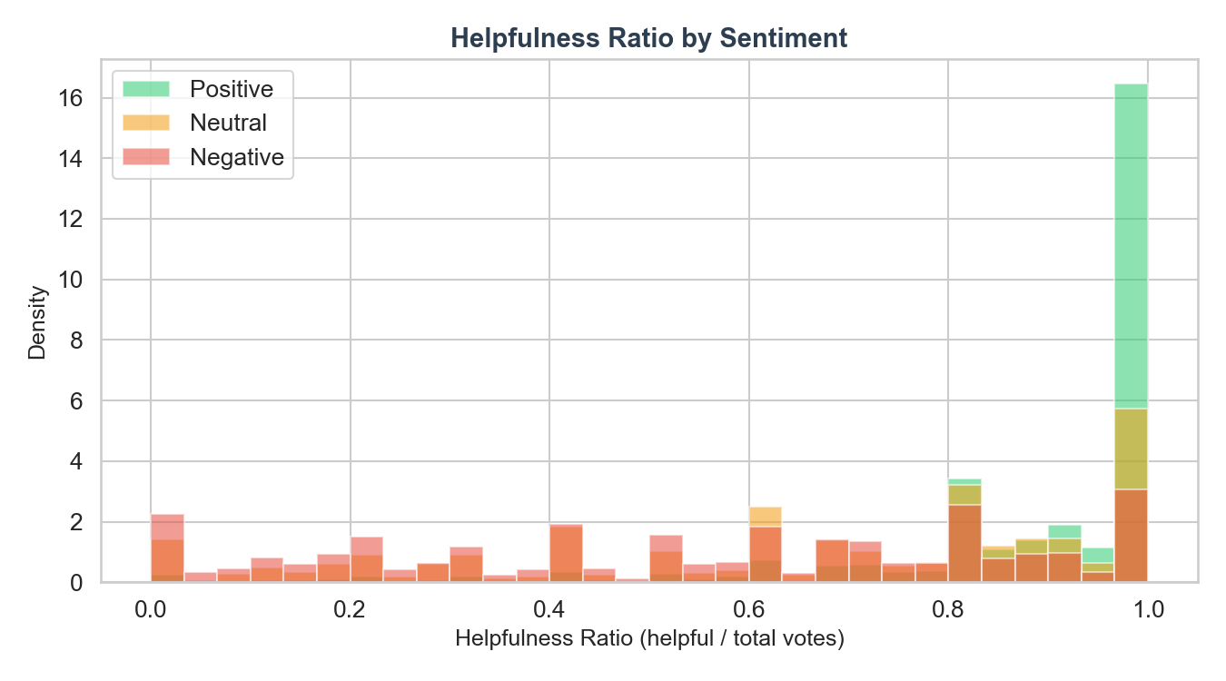
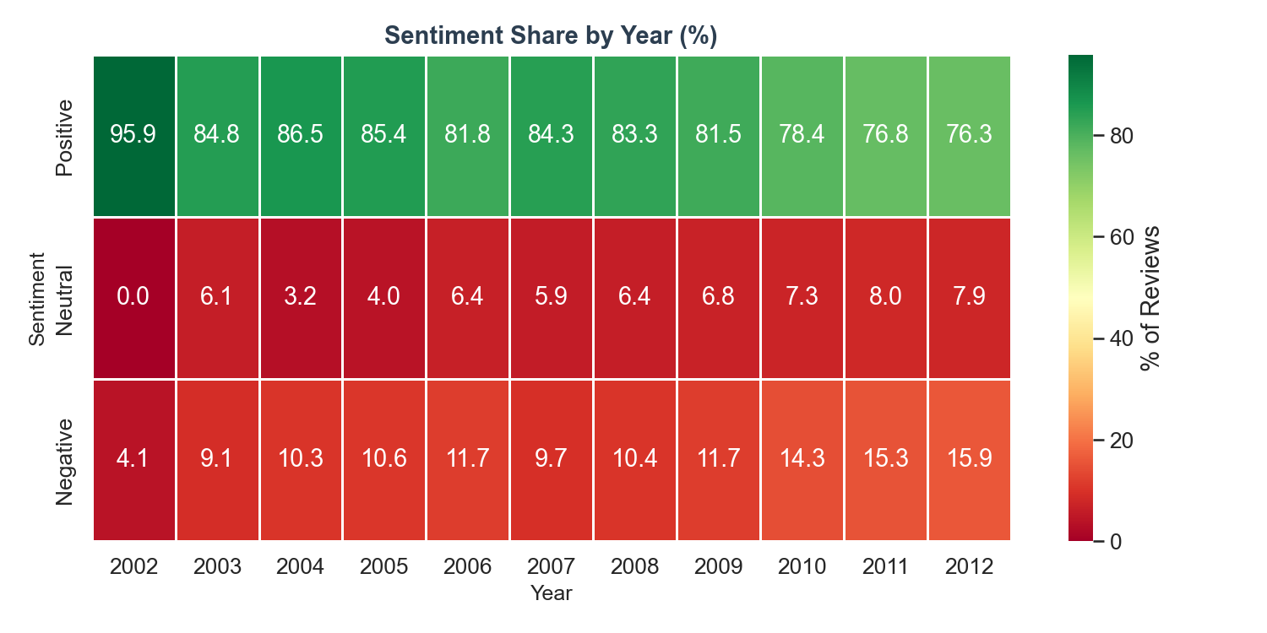
Helpfulness & Sentiment Over Time
Key Takeaways:
Negative reviews receive higher helpfulness votes — critical reviews are seen as more useful • Positive sentiment share grew from ~70% (2002) to ~80% (2012), suggesting improving product quality or stronger buyer-seller alignment
Source: Kaggle – Amazon Fine Food Reviews

Slide 10
Business Recommendations
Highlight Helpful Negative Reviews
Target Dietary & Lifestyle Niches
Critical reviews receive disproportionately high helpfulness votes. Amazon should surface high-ratio negative reviews prominently to improve buyer trust and reduce returns.
'Gluten free', 'peanut butter', 'green tea', and 'dog loves' are top bigrams. Marketing teams should develop dedicated landing pages and ad campaigns for these high-engagement niches.
For Amazon Product Team
For Marketing Teams
Leverage 'Subscribe & Save' Language
Monitor Sentiment Trends as Quality Signal
'Subscribe save' ranks in top bigrams. Promote subscription bundles more aggressively in the food category — customers already associate value with this programme.
Positive sentiment grew from 70% (2002) to 80% (2012). Use monthly sentiment tracking in MongoDB as an early-warning signal for product or supplier quality deterioration.
For Amazon Subscription Team
For Category Managers
Source: Kaggle – Amazon Fine Food Reviews

Slide 11
Conclusion
Successfully imported 568,454 reviews into MongoDB with 2 new engineered fields
Demonstrated efficient NLP: Counter-based O(n) word frequency, TF-IDF, and MongoDB text-index queries
8 visualisations uncovered rating distribution, temporal growth, topical bigrams, and helpfulness patterns
Actionable insights delivered for Amazon's product, marketing, and subscription teams
Thank you | Q&A

