Slide 1
Research:
Stream and ParallelStream,
Generate and Iterate
Nguyễn Trọng Thuận
Phạm Thị Kim Hiền

Slide 2
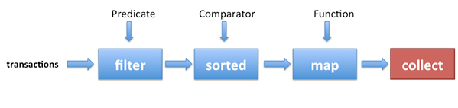

Stream
Picture demo for Stream

Slide 3
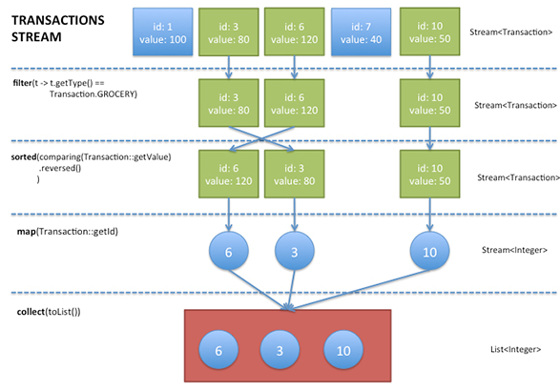
Stream
Transaction Stream

Slide 4
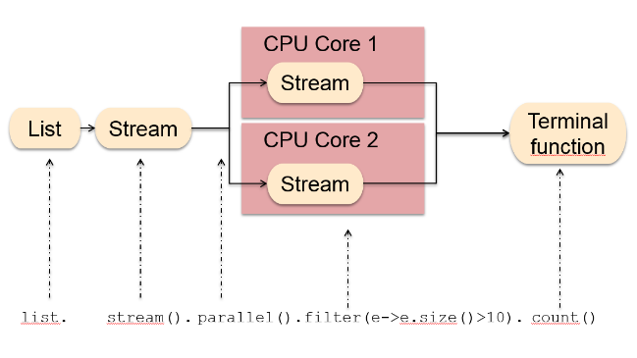
Parallel Stream
Picture demo for Parallel Stream
Paralel processing implement in filter : part of processor will check e.size > 10 then return result forTermianal function.

Slide 5
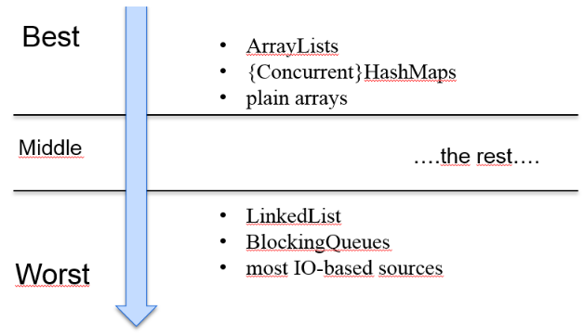
Parallel Stream
When use Parallel Stream ?

Slide 6
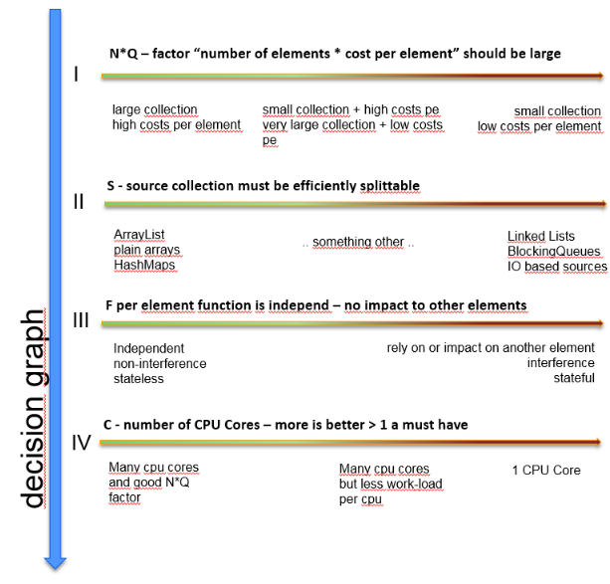
Parallel Stream
Decision graph

Slide 7

Different between generate and iterate
The following two static methods from Stream interface generates an infinite stream from a function.
iterate() method creates a sequential ordered stream.
generate() method creates a sequential unordered stream.
IntStream, LongStream, and DoubleStream contain iterate() and generate() methods that take parameters specific to their primitive types and generate values.

Slide 8
Different between generate and iterate
Stream.iterate():
The iterate() method takes two arguments: a seed and a function.
A seed is the first element of the stream. The second element is generated by applying the function to the first element. The third element is generated by applying the function on the second element.
Therefore the elements are: seed, f(seed), f(f(seed)), f(f(f(seed)))

Slide 9
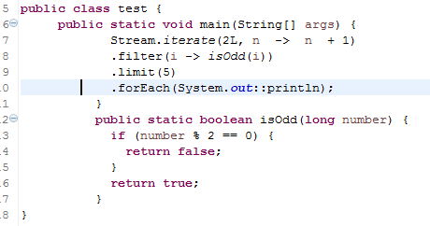
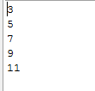
Different between generate and iterate
Stream.iterate():
Example: Result:

Slide 10
Different between generate and iterate
Stream.generate():
generate(Supplier<T> s) uses Supplier to generate an infinite sequential unordered stream.

Slide 11
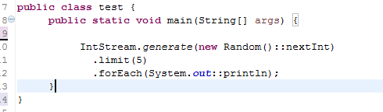
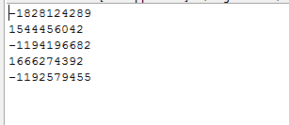
Different between generate and iterate
Stream.generate():
Example:
Result:

Slide 12
Tài liệu tham khảo
http://www.java2s.com/Tutorials/Java/Java_Stream/0050__Java_Stream_From_Functions.htm
http://www.oracle.com/technetwork/articles/java/ma14-java-se-8-streams-2177646.html

