Slide 1

JAVA VIRTUAL MACHINE
Thực hiện:
Lê Phương Thanh
Nguyễn TrọngThuận

Slide 2

Nội dung
JVM là gì ?
Kiến trúc của JVM
Classloader
Class (method) Area
Heap
Stack
Program Counter Register
Native Method Stack
Execution Engine

Slide 3
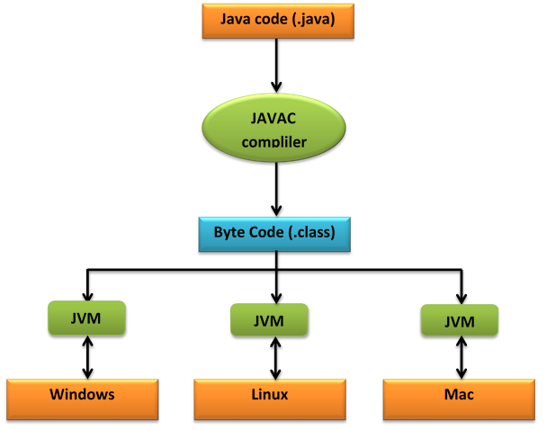

JVM (Java Virtual Machine) là gì?
JVM ?

Slide 4
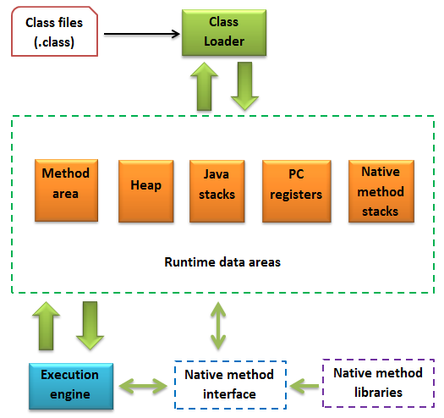
Kiến trúc của JVM
Tổng quan kiến trúc của JVM

Slide 5
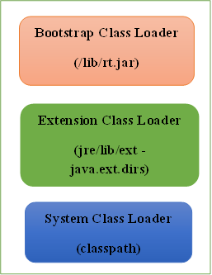

Class Loader
Thành phần của Class Loader

Slide 6
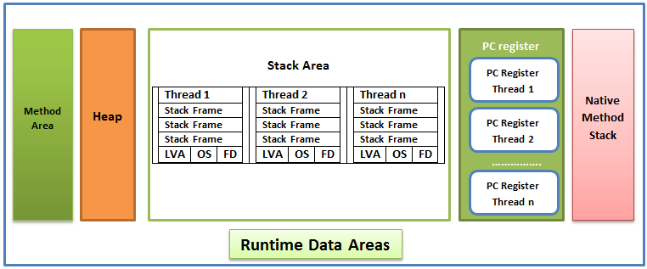
Runtime Data Areas
Các thành phần của Runtime Data Areas

Slide 7
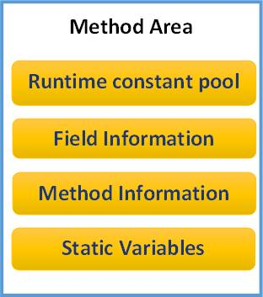
Class (method) Area
Các thành phần của Method Class

Slide 8
Heap
Object
Object
Object

Slide 9
GC-Garbage Collection
Object
Object
Survivor spaces
Object
Object
Eden
S0
S1
Tenured
Permanent
Young generation
Old generation
Permanent generation
Notes:
where garbage collector places objects that are still in use (survivor spaces)
1) Java Heap is divided into three generation for the sake of garbage collection. These are a young generation, tenured or old generation, and Perm area. 2) New objects are created by young generation and subsequently moved to the old generation. 3) String pool is created in PermGen area of Heap, garbage collection can occur in perm space but depends upon JVM to JVM. By the way from JDK 1.7 update, String pool is moved to heap area where objects are created. 4) Minor garbage collection is used to move an object from Eden space to survivor 1 and survivor 2 space and major collection is used to move an object from young to tenured generation. 5) Whenever Major garbage collection occurs application threads stop during that period which will reduce application’s performance and throughput. 6) There are few performance improvements has been applied in garbage collection in java 6 and we usually use JRE 1.6.20 for running our application. 7) JVM command line options –Xmx and -Xms is used to setup starting and max size for Java Heap. The ideal ratio of this parameter is either 1:1 or 1:1.5 based on my experience, for example, you can have either both –Xmx and –Xms as 1GB or –Xms 1.2 GB and 1.8 GB. 8) There is no manual way of doing garbage collection in Java, but you can use various reference classes e.g. WeakReference or SoftReference to assist garbage collector.
Read more: http://javarevisited.blogspot.com/2011/04/garbage-collection-in-java.html#ixzz4LXYYq9Ke

Slide 10
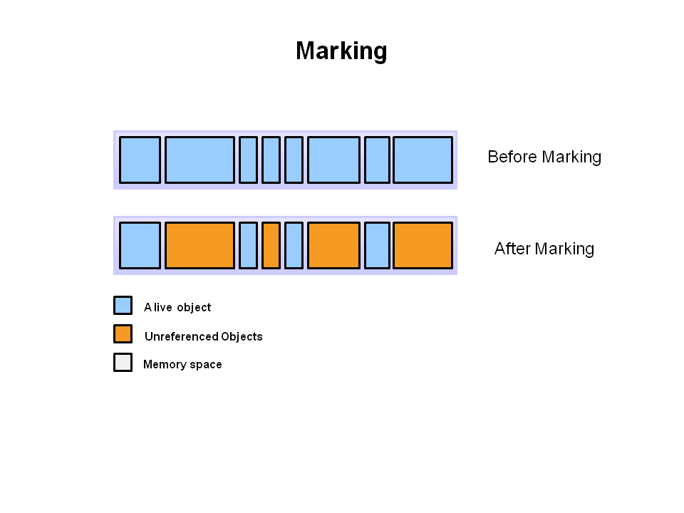

GC-Garbage Collection
Object -> Null
Object -> Weak References
Notes:
1) All references to that object explicitly set to null e.g. object = null 2) The object is created inside a block and reference goes out scope once control exit that block. 3) Parent object set to null if an object holds the reference to another object and when you set container object's reference null, child or contained object automatically becomes eligible for garbage collection. 4) If an object has only lived weak references via WeakHashMap it will be eligible for garbage collection. Read more: http://javarevisited.blogspot.com/2011/04/garbage-collection-in-java.html#ixzz4LXjsTyiq
Garbage Collection in Java is carried by a daemon thread called Garbage Collector. Read more: http://javarevisited.blogspot.com/2011/04/garbage-collection-in-java.html#ixzz4LXh2hAZZ

Slide 11

Heap
Heap | Code | File
public class Person {
public boolean hungry;
public void eat(int food){
…………………………………
}
public void wasteTime(){
…………………………………
}
}
Person.java
public class Word{
public static void main(String[] args){
Person Tom=new Person();
Person Emily =new Person();
Tom.hungry=true;
Tom.eat(10);
Emily.wasteTime();
Emily.hungry=false;
boolean h= Emily.hungry;
}
}
Word.java

Slide 12
Heap
Heap | Code | File
public class Person {
public boolean hungry;
public void eat(int food){
…………………………………
}
public void wasteTime(){
…………………………………
}
}
Tom
Boolean hungry
void eat (int food)
void wasteTime()
Person.java
public class Word{
public static void main(String[] args){
Person Tom=new Person();
Person Emily =new Person();
Tom.hungry=true;
Tom.eat(10);
Emily.wasteTime();
Emily.hungry=false;
boolean h= Emily.hungry;
}
}
Word.java

Slide 13
Heap
Heap | Code | File
public class Person {
public boolean hungry;
public void eat(int food){
…………………………………
}
public void wasteTime(){
…………………………………
}
}
Tom
Boolean hungry
void eat (int food)
void wasteTime()
Person.java
Emily
public class Word{
public static void main(String[] args){
Person Tom=new Person();
Person Emily =new Person();
Tom.hungry=true;
Tom.eat(10);
Emily.wasteTime();
Emily.hungry=false;
boolean h= Emily.hungry;
}
}
Boolean hungry
void eat (int food)
void wasteTime()
Word.java

Slide 14
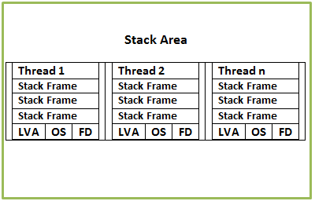

Stack
Stack
Frame
Local Variable Array
Operand Stack
Frame Data
Cấu trúc của Stack
Run-time contant pool

Slide 15
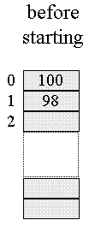

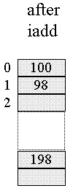

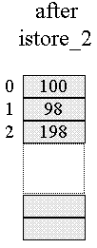
Ví dụ demo của stack
Hàm tính tổng hai số: public static calSum(int a, int b){
return a + b;
}
Gọi hàm: calSum(100, 98);
Local variable Array
Operand stack

Slide 16
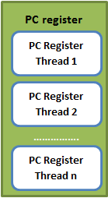
Program counter (PC) register

Slide 17
Native Method Stack
Là vùng nhớ chứa mã bycode của các ngôn ngữ khác không phải Java (ví dụ C/C++). Mã C/C++ được gọi thông qua JNI (Java Native Interface).

Slide 18
Mở rộng: Native Method
Happy.java
class Happy {
public native void printText ();
static {
System.loadLibrary ("happy");
}
public static void main (String[] args) { Happy happy = new Happy ();
happy.printText ();
}
}
Compile Java code: javac Happy.java

Slide 19
Mở rộng: Native Method
Tạo file header của C: javah Happy
Tạo C stubs file: javah –stubs Happy
Viết code C:
#include &ltStubPreamble.h>
#include "Happy.h"
#include &ltstdio.h>
void Happy_printText (struct HHappy *this) {
puts ("Happy New Year!!!");
}

Slide 20
Mở rộng: Native Method
Tạo thư viện chia sẻ code C:
gcc -I/usr/local/java/include -I/usr/local/java/include/genunix -fPIC -c Happy.c HappyImp.c
gcc -shared -Wl,-soname,libhappy.so.1 -o libhappy.so.1.0 Happy.o HappyImp.o
cp libhappy.so.1.0 libhappy.so
export LD_LIBRARY_PATH=`pwd`:$LD_LIBRARY_PATH
Kết quả chạy chương trình:
Happy New Year!!!

Slide 21
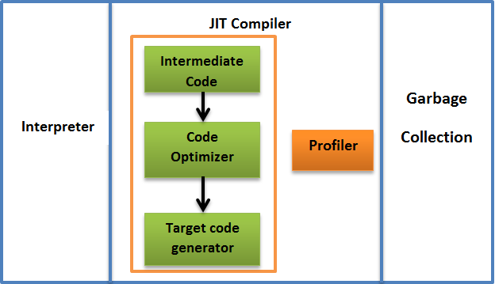
Execution Engine
Thành phần của Execution Engine

Slide 22
Native Method Interface (Java Native Interface – JNI), Native Method Library
JNI - Java Native Interface sẽ tương tác với Native Method Libraries và cung cấp Native Libraries cần thiết cho Execution Engine.

Slide 23
Tài liệu tham khảo
[1] https://dzone.com/articles/understanding-jvm-internals
[2] http://www.artima.com/insidejvm/ed2/jvmP.html
[3] https://docs.oracle.com/javase/specs/jvms/se7/html/jvms-2.html

Slide 24


