Slide 1
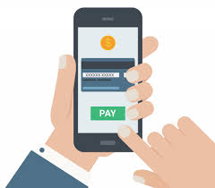
Consumer attitudes toward mobile payment

Slide 2
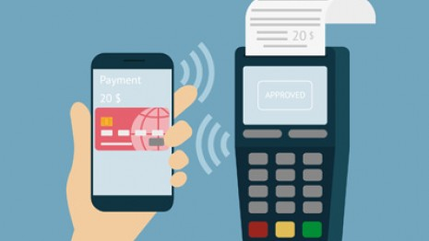
“Mobile “
Able to move or be moved freely or easily

Slide 3
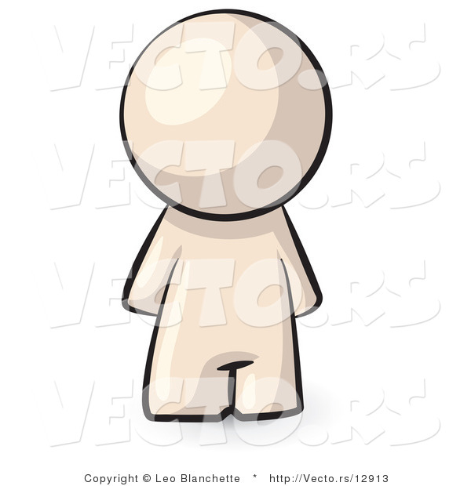
A type of payment transaction processing in the course within an electronic
Pousttchi and Wiedemann

Slide 4
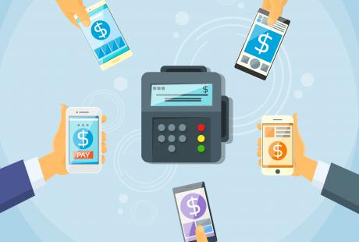
Payments for goods, services and bills with a mobile device
Dahlberg et al. (2008)

Slide 5
Consumer attitudes toward mobile payment are a composite of a consumer’s beliefs about, feelings about, and behavioral intentions toward mobile payment.
Marketing Encyclopedia

Slide 6
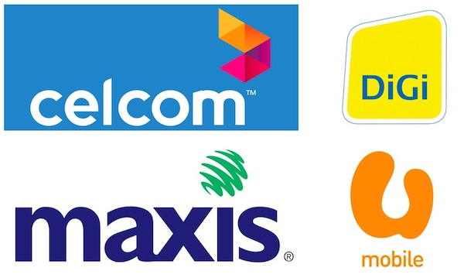
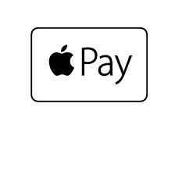



Types of mobile payment

Slide 7
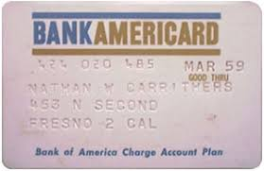
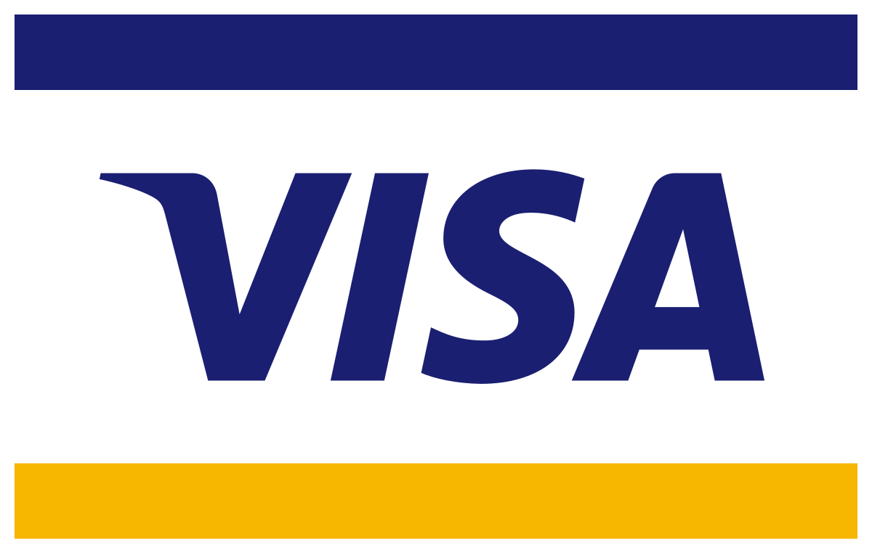

History of mobile payment
The first charge card (1921)
The BankAmericard (1958)
Visa (1977)
Online banking and bill pay
Mobile web payment (WAP)
1994
1997

Slide 8
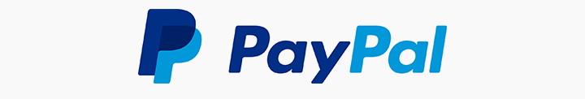
Problem Statement
With recent advances in mobile technologies, mobile commerce is having an increasingly profound impact on our daily lives and beginning to offer interesting and advantageous new services.
For instance, PayPal mobile payment is a fast-growing payment method serves as an alternative method for the traditional payment system.
However, the adoption intention of this mobile payment is low in Malaysia even through it has brought many benefits to the consumers

Slide 9
RESEARCH QUESTIONS
1. How the consumers act while start using mobile payment services ?
2. Why consumers intent to use mobile payment services ?

Slide 10
OBJECTIVES
To understand consumers’ attitudes on start using mobile payment services
To examine factors influencing consumers intention to use mobile payment services

Slide 11
Scope
30 consumer
Age between 15 to 60
Reference
LOW KOK HAU ( Aug 2016 ) FACTOR AFFECTING CONSUMER RESISTANCE TO PAYPAL MOBILE PAYMENT ADOPTION: A STUDY OF GENERATION X CONSUMERS IN MALAYSIA
The Ninh Nguyen1,2, Tuan Khanh Cao1 , Phuong Linh Dang1 & Hien Anh Nguyen ( January 28, 2016 ) Predicting Consumer Intention to Use Mobile Payment Services: Empirical Evidence from Vietnam
Niklas Arvidsson ( 22 September 2013 ) Consumer attitudes on mobile payment services – results from a proof of concept test
Rakhi Thakur & Mala Srivastava ( 29 August 2013 ) Adoption readiness, personal innovativeness, perceived risk and usage intention across customer groups for mobile payment services in India
Agnieszka Zmijewska & Dr Elaine Lawrence & Dr Robert Steele (2007) TOWARDS UNDERSTANDING OF FACTORS INFLUENCING USER ACCEPTANCE OF MOBILE PAYMENT SYSTEMS

