Slide 1
DLSG Week 4 Deep L-Network
Do Thi Ngan
August 2019

Slide 2












Deep Neural Network
Shallow neural network include 1 or 2 layer networks
Deep L-layer neural network include L layer networks, L = 5, hidden layer = 4
$x_{1}$
$x$
$x_{2}$
$$\hat{y}$$
â
$$ω$$
z =$ω^{T}x+b$
$\hat{y}$=$σ\left(ω^{T}x+b\right)$
$x_{3}$
$$b$$
$x_{1}$
$x_{2}$
$$\hat{y}$$
$x_{3}$
Input layer
L1
L2
L3
L4

Slide 3


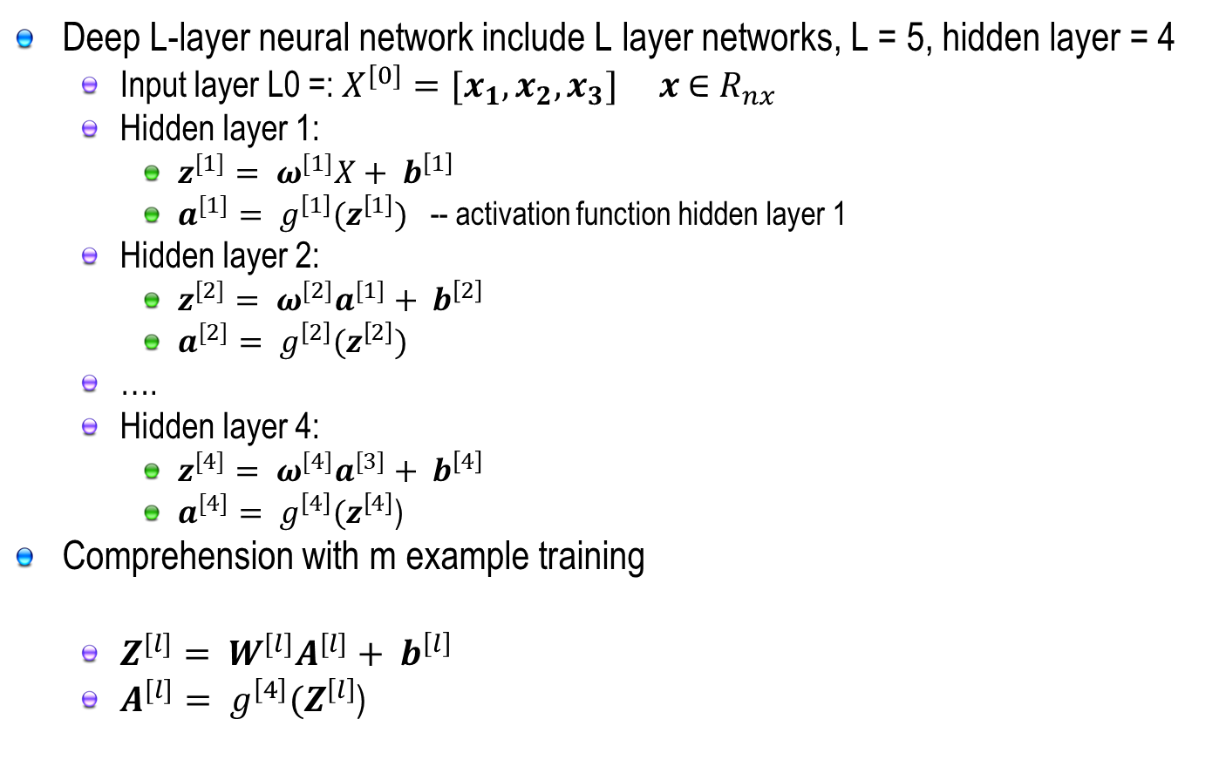



Propagation in Deep Neural Network
Deep L-layer neural network include L layer networks, L = 5, hidden layer = 4
Input layer L0 =: $X^{[0]}={[x}_{1}, x_{2}, x_{3}]$ $x$ $∈$ $R_{nx}$
Hidden layer 1:
$z^{[1]}= ω^{[1]}X+ b^{\left[1\right]}$
$a^{[1]}= g^{\left[1\right]}(z^{\left[1\right]})$ -- activation function hidden layer 1
Hidden layer 2:
$z^{[2]}= ω^{[2]}a^{[1]}+ b^{\left[2\right]}$
$a^{[2]}= g^{\left[2\right]}(z^{\left[2\right]})$
….
Hidden layer 4:
$z^{[4]}= ω^{[4]}a^{[3]}+ b^{\left[4\right]}$
$a^{[4]}= g^{\left[4\right]}(z^{\left[4\right]}$)
Comprehension with m example training
$Z^{[l]}= W^{[l]}A^{[l]}+ b^{\left[l\right]}$
$A^{[l]}= g^{\left[4\right]}(Z^{\left[l\right]}$)
$$Z^{\left[l\right]}=\left[\begin{aligned} \\ \\ \\ \\ \end{aligned} \right]$$
$$z^{\left[l\right][1]}$$
$$z^{\left[l\right][2]}$$
$$⋯$$
$$z^{\left[l\right][m]}$$

Slide 4
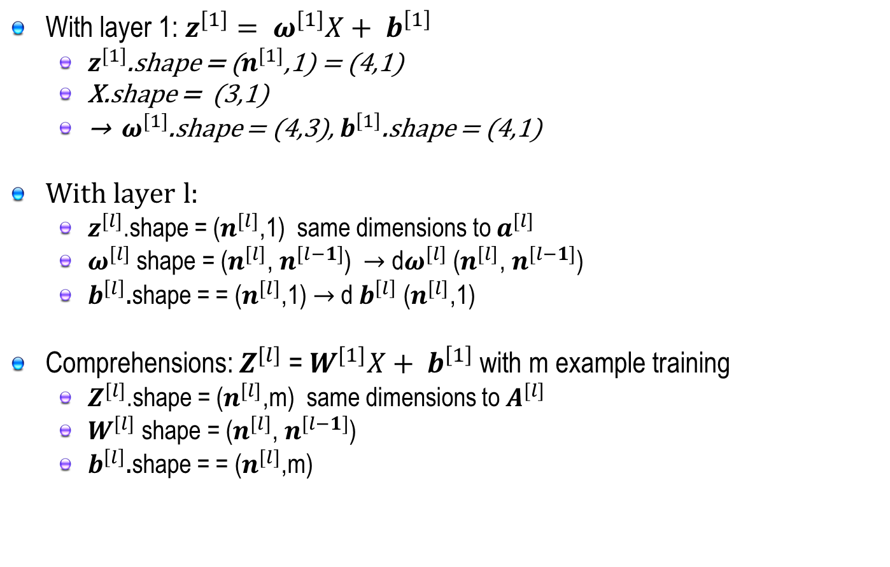
Metrix Demensions
With layer 1: $z^{[1]}= ω^{[1]}X+ b^{\left[1\right]}$
$z^{[1]}$.shape = ($n^{[1]}$,1) = (4,1)
X.shape = (3,1)
→ $ω^{[1]}$.shape = (4,3), $b^{\left[1\right]}$.shape = (4,1)
With layer l:
$z^{[l]}$.shape = ($n^{[l]}$,1) same dimensions to $a^{[l]}$
$ω^{[l]}$shape = ($n^{[l]}$, $n^{[l−1]}$) $→$ d$ω^{[l]}$ ($n^{[l]}$, $n^{[l−1]}$)
$b^{\left[l\right]}$.shape = = ($n^{[l]}$,1) $→$ d $b^{\left[l\right]}$ ($n^{[l]}$,1)
Comprehensions: $Z^{[l]}$ = $W^{[1]}X+ b^{\left[1\right]}$ with m example training
$Z^{[l]}$.shape = ($n^{[l]}$,m) same dimensions to $A^{[l]}$
$W^{[l]}$shape = ($n^{[l]}$, $n^{[l−1]}$)
$b^{\left[l\right]}$.shape = = ($n^{[l]}$,m)

Slide 5








Blocks of Neural Networks
A block of in deep neural networks
Layer l
Forward {
Input $a^{[l−1]}$
$$ω^{[l]}, b^{[l]}$$
Output $a^{[l]}$
Cache $z^{[l]}$
Backward {
Output $a^{[l−1]}$
$$ω^{[l]}, b^{[l]}$$
$${dz}^{[l]}$$
Input ${da}^{[l]}$
d$ω^{[l]}$, ${db}^{[l]}$

Slide 6




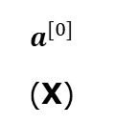

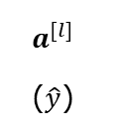






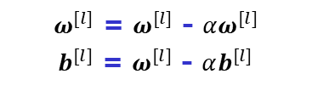















Forward and Backward Propagation
Forward and Backward process with l layer neural networks
$$a^{[0]}$$
(X)
$ω^{[1]}$, $b^{[1]}$
$a^{[1]}$
$ω^{[2]}$, $b^{[2]}$
$ω^{[2]}$, $b^{[3]}$
$a^{[3]}$
…
$ω^{[l]}$, $b^{[l]}$
$$a^{[l]}$$
($\hat{y}$)
$a^{[2]}$
$a^{[l−1]}$
$z^{[1]}$
$z^{[2]}$
$z^{[3]}$
$z^{[l]}$
$ω^{[1]}$, $b^{[1]},$
$${dz}^{[1]}$$
$da^{[1]}$
$ω^{[2]}$, $b^{[2]},$
$${dz}^{[2]}$$
${da}^{[2]}$
$ω^{[3]}$, $b^{[3]},$
$${dz}^{[3]}$$
$ω^{[l]}$, $b^{[l]},$
$${dz}^{[l]}$$
${da}^{[3]}$
…
${da}^{[l−1]}$
$${da}^{[l]}$$
${dω}^{[1]}$, ${db}^{[1]}$
${dω}^{[2]}$, ${db}^{[2]}$
${dω}^{[3]}$, ${db}^{[3]}$
…
${dω}^{[l]}$, ${db}^{[l]}$
=>
$ω^{[l]}$ = $ω^{[l]}$ - $αω^{[l]}$
$b^{[l]}$ = $ω^{[l]}$ - $αb^{[l]}$

Slide 7

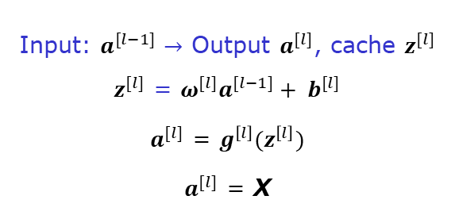


Forward and Backward Propagation
Forward
Backward
Input: $a^{[l−1]}$ $→$ Output $a^{[l]}$, cache $z^{[l]}$
$z^{[l]}$ = $ω^{[l]}a^{[l−1]}+ b^{[l]}$
$a^{[l]}$ = $g^{\left[l\right]}(z^{\left[l\right]})$
$a^{[l]}$ = X
$Z^{[l]}$ = $W^{[l]}A^{[l−1]}+ b^{[l]}$
$A^{[l]}$ = $g^{\left[l\right]}(Z^{\left[l\right]})$
$A^{[0]}$ = X
Input: ${da}^{[l]}$ $→$ Output${ da}^{[l]},{dω}^{[l]}$, ${db}^{[l]}$
${dz}^{[l]}$ = ${da}^{[l]}g^{\left[l\right]}(z^{\left[l\right]})$
${dω}^{[l]}$ = ${dz}^{[l]}$ $a^{[l−1]}$
${db}^{[l]}$ = ${dz}^{[l]}$
${da}^{[l−1]}$ = $ω^{\left[l\right]T}$ ${dz}^{[l]}$
=> ${dz}^{[l]}$ = $ω^{\left[l+1\right]T}$ ${dz}^{[l]}$* $g^{\left[l\right]}(z^{\left[l\right]})$
${dZ}^{[l]}$ = ${dA}^{[l]}g^{\left[l\right]}(Z^{\left[l\right]})$
${dW}^{[l]}$ = $\frac{1}{m}$ ${dZ}^{[l]}$ $A^{\left[l−1\right]T}$
${db}^{[l]}$ = $\frac{1}{m}$ np.sum(${dZ}^{[l]}$, axis=1, keepdims = True)
${dA}^{[l−1]}$ = $W^{\left[l\right]T}$ ${dZ}^{[l]}$

