Slide 1
DLSG – Week 2 Neural Network Basic
Do Thi Ngan
July 2019

Slide 2

Binary Classification
Pair(x,y) – Single training example
Input x: dimensional feature vector
Output y: label value 0 or 1
nx = 28*35*3 = 2940 dimensions
28
1 (dog) or 0 (not dog)
35
Feature vector X
Input x
Ouput y

Slide 3

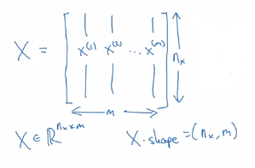
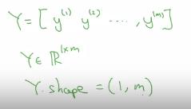
Binary Classification
M pair (x,y) – Multiple training example
M = 2
M train = {(x1,y1), (x2,y2), ..., (xm,ym)}
Testing set
1 (dog) or 0 (not dog)
1 (cat) or 0 (not cat)
Input X
Output Y

Slide 4
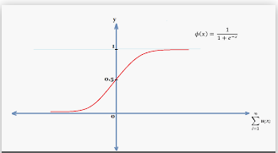
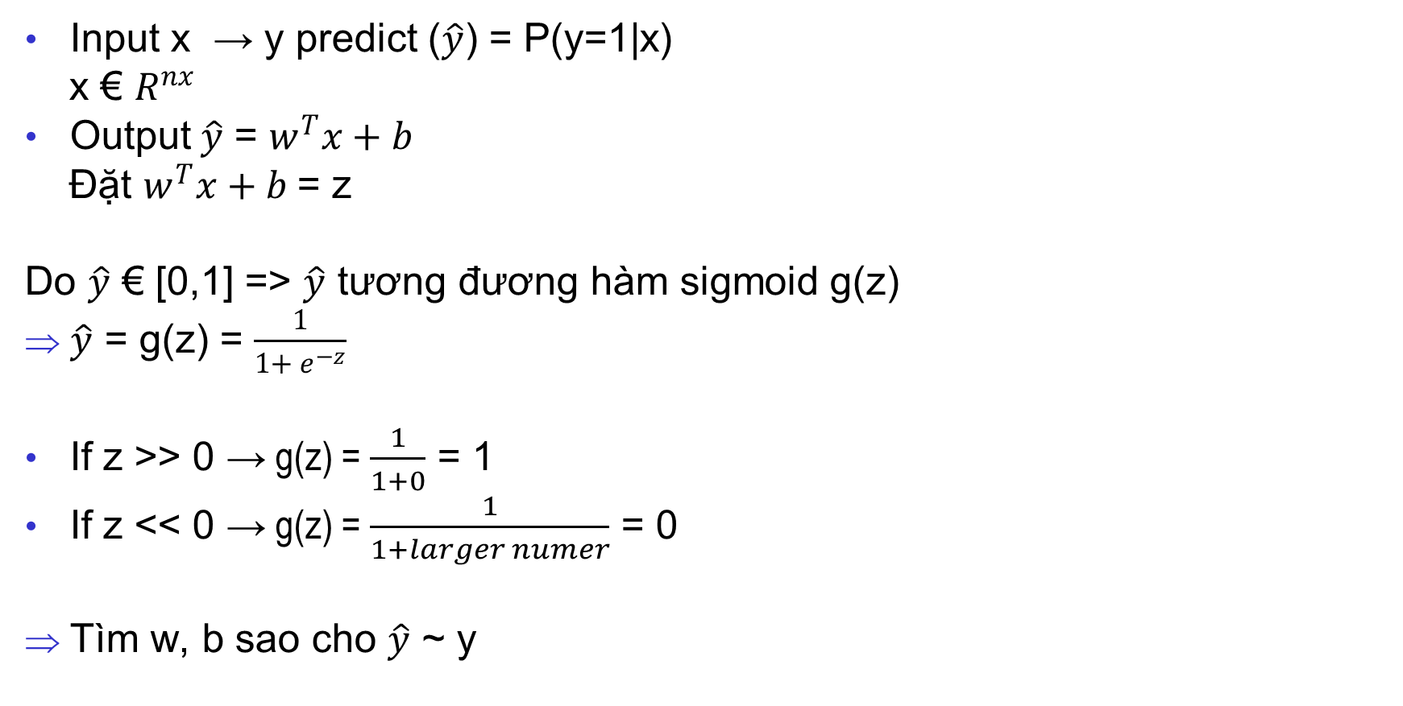
Logistic Regression
Input x → y predict ($\hat{y}$) = P(y=1|x)
x € $R^{nx}$
Output$\hat{y}$ = $w^{T}x+b$
Đặt $w^{T}x+b$= z
Do $\hat{y}$ € [0,1] => $\hat{y}$ tương đương hàm sigmoid g(z)
$\hat{y}$ = g(z) = $\frac{1}{1+ e^{−z}}$
If z >> 0 → g(z) = $\frac{1}{1+0}$ = 1
If z << 0 → g(z) = $\frac{1}{1+larger numer}$ = 0
Tìm w, b sao cho $\hat{y}$ ~ y

Slide 5

Logistic Regress Cost Function
Lost function: error for a single training example
£($\hat{y}$,y) = $\frac{1}{2}$($\hat{y}−$y )²
= - (ylog$\hat{y}+\left(1−y\right)$log(1-$\hat{y}$)
Cost function: average of the lost function of m training examples
J(w,b) = - $\frac{1}{m}$ $\sum_{i=1}^{m}{\text{£(}\hat{y}\text{i}\text{,}\text{yi}\text{ )}}$
= - $\frac{1}{m}$ $\sum_{i=1}^{m}{[\text{y}\text{i}\text{log}\hat{yi}+\left(1−yi\right)\text{log}\text{(1-}\hat{yi}\text{)}]}$

Slide 6

Gradient Descent
Recap:
Lost function: error for a single training example
£($\hat{y}$,y ) = $\frac{1}{2}$($\hat{y}−$y )²
= - (ylog$\hat{y}+\left(1−y\right)$log(1-$\hat{y}$)
Cost function: average of the lost function of m training examples
J(w,b) = - $\frac{1}{m}$ $\sum_{i=1}^{m}{\text{£(}\hat{y}\text{i}\text{,}\text{yi}\text{ )}}$
= - $\frac{1}{m}$ $\sum_{i=1}^{m}{[\text{y}\text{i}\text{log}\hat{yi}+\left(1−yi\right)\text{log}\text{(1-}\hat{yi}\text{)}]}$

Slide 7
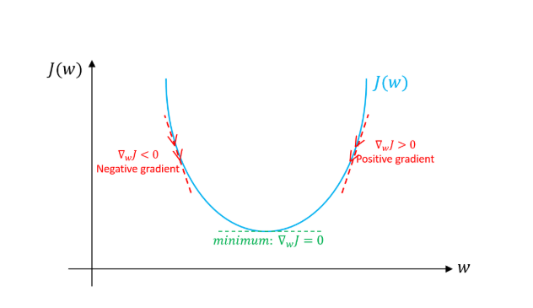

Gradient Descent
Gradient descent is do moving point (w,b) for algorithm converges to minimum value rate
dw = $\frac{dJ(w,b)}{dw}$
Algorithm implement repeat like graph beside:
w := w – α $\frac{dJ(w,b)}{dw}$
b := b – α $\frac{dJ(w,b)}{db}$
α is learning rate

Slide 8


Derivative
Derivative is the sl o to ope of fuction
Different point on function → different slope
Examples:
??? What is slope applied in Neural Network and Deep learning
f(a) = a²
f(a) = ln(a)
f(2) = 2² = 4
f(2.001) = 4.0004
Slope = $\frac{f\left(2.001\right)−f(2)}{2.001 − 2 }$ = 4
f’(2) = 2a = 4
=> Slope of f(a) = 4 at a = 2
f(2) = ln(2) = 0.69315
f(2.001) = 0.69365
Slope = $\frac{f\left(2.001\right)−f(2)}{2.001 − 2 }$ = 0.5
f’(2) = $1/a$ = 0.5
=> Slope of f(a) = 0.5 at a = 2

Slide 9
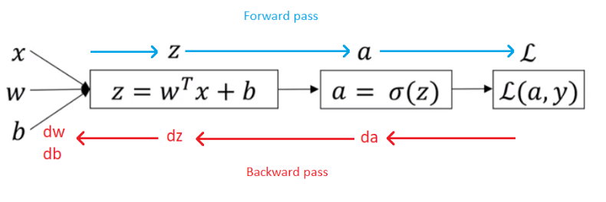
Derivative with a Computation Graph
Computation graph is flow to implement an calculation express
Base on computation graph, we can analysis follow 2 way:
Forward: right to left → calculate derivative
Backward: left to right → determine affection of each variable to derivative
Examples:

Slide 10
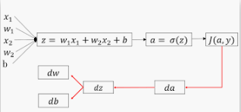
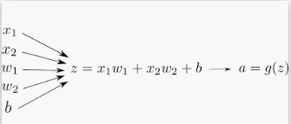

Logistic Regression Gradient Descent
Logistic Regression recap:
z = $w^{T}x+b$
$\hat{y}$ = a = sigmoid(z)
£($\hat{y}$,y ) = = - (yloga$+\left(1−y\right)$log(1-a)
Forward flow:
→ ??? w, b to minimize £($\hat{y}$,y )

Slide 11
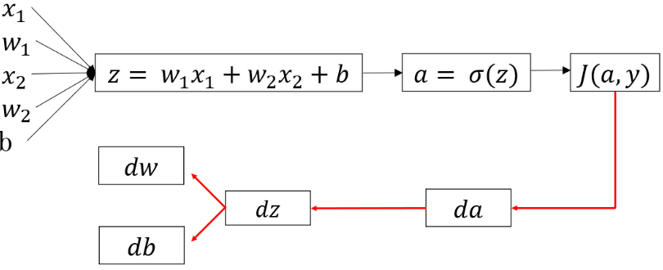
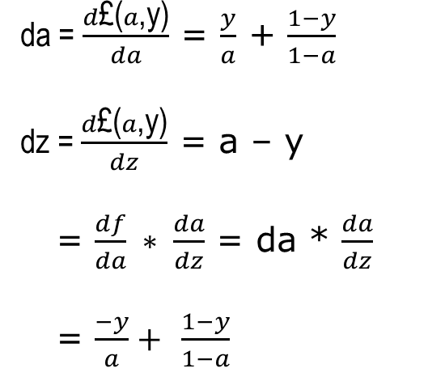

Logistic Regression Gradient Descent
Forward flow:
da = $\frac{d\text{£(}a\text{,}\text{y}\text{)}}{da}$ = $\frac{y}{a}$ + $\frac{1−y}{1−a}$
dz = $\frac{d\text{£(}a\text{,}\text{y}\text{)}}{dz}$ = a – y
= $\frac{df}{da} ∗ \frac{da}{dz}$ = da * $\frac{da}{dz}$
= $\frac{−y}{a}+$ $\frac{1−y}{1−a}$
$\frac{∂£}{∂w1}$ = dw1 = x1dz
$\frac{∂£}{∂w2}$ = dw2 = x2dz
$db$ = dz

