Slide 1
Convolution Neural Networks
Ngan Do Thi
August, 2019

Slide 2
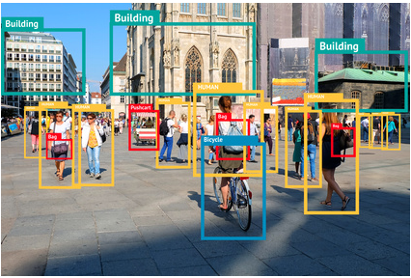
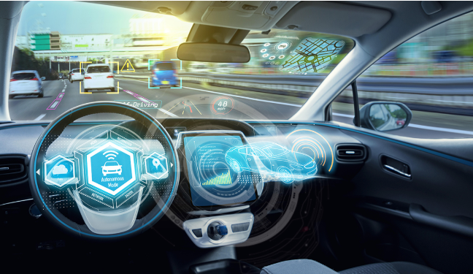
Computer Vision
Computer vision is an interdisciplinary scientific field that deals with how computers can be made to gain high-level understanding from digital images or video
Object detection
Self driving car
https://en.wikipedia.org/wiki/Computer_vision

Slide 3
Egde Detection
Vertical edge detection: extract edge from right to left
Time the matrix of image to filter below matrix
Horizontal edge detection: extract edge from top to buttom
Time the matrix of image to filter below matrix
Each time we implement edge detect is one time we do convolution operation
1 | 0 | -1
1 | 0 | -1
1 | 0 | -1
1 | 1 | 1
0 | 0 | 0
-1 | -1 | -1

Slide 4
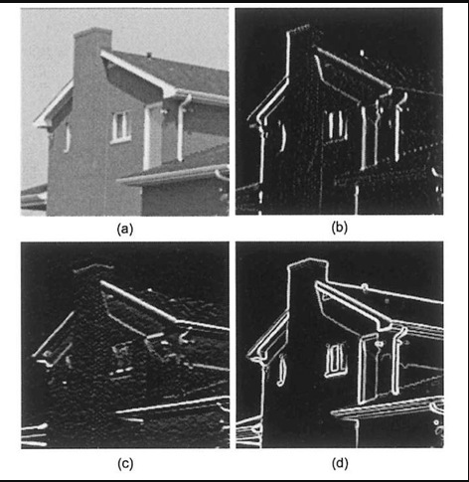
Edge Detection
Example
Vertical edge detection
Horizontal edge detection
Combinations

Slide 5

Padding
Padding is extract size of input matrix by zero values around original matrix to get the same size of input and output matrix after implement convolution operation
The number of padding:
$$p= \frac{f−1}{2}$$
With f is usually odd number
*
=
6x6
(n*n)
3x3
(f*f)
4x4
((n-f+1)*(n-f+1))

Slide 6

Strided Convolution
Strided is step jumping when implement convolution operation
Summary
*
=
($\frac{n+2p −f}{s}$ + 1)*($\frac{n+2p −f}{s}$ + 1)
nxn image
fxf filter
Padding p
Stride s

Slide 7
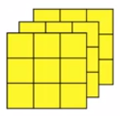
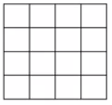
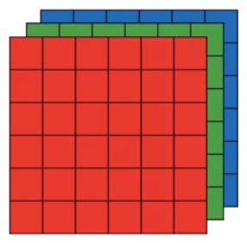
Convolution over volumes
Multiple filter with number of filter = 2
Filter 1
*
3x3x3
4x4
Filter 2
*
4x4x2
6x6x3
3x3x3
4x4
Summary:
Input (n*n*n(channel)) * (f*f*n(channel)) = (c-f+1)*(n-f+1)*n(channel)

Slide 8
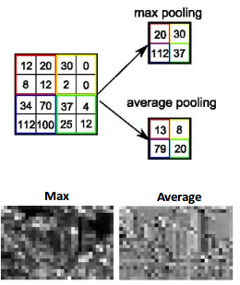
Pooling layer
Max pooling and Average pooling layer
Get important features
Sometimes can not get important features
https://www.quora.com/What-is-the-benefit-of-using-average-pooling-rather-than-max-pooling

Slide 9
Why convolutions?
Why convolutions are so when you include them in your neural networks. There are two reasons:
feature that's useful in one part of the image is probably useful in another part of
the image
The sparsity of connections

