Slide 1
Types of APIs
Building Secure, Scalable, Fault-Tolerant and Low-Latency APIs with Java & Spring Boot
Ngane Emmanuel

Slide 2
Types of APIs
Different systems have different needs:
Performance requirements
Data complexity
Real-time communication
Scalability
Ease of development
Compatibility with existing tools
No single API style solves all problems perfectly.

Slide 3
Public APIs (Open APIs)
Exposed to external developers.
Used by third-party applications.
Usually secured with API keys, OAuth, or tokens.
Examples:
- Payment gateways, Weather services, Maps services, Social media APIs
Characteristics:
- High security requirements, Strong documentation, Rate limiting, Monitoring

Slide 4
Private APIs (Internal APIs)
Private APIs (Internal APIs)
Used only inside an organization.
Connect internal services and systems.
Often power microservices architectures.
Characteristics:
- Faster evolution - Controlled access - Less public documentation - Optimized for internal performance

Slide 5
Partner APIs
Partner APIs
Shared with selected partners.
Access is restricted and governed by contracts.
Used in B2B integrations.
Examples:
- Logistics integrations - Banking integrations - Enterprise data sharing

Slide 6
API Styles (Architectural Styles)
REST (Representational State Transfer)
Most common API style on the web.
Key characteristics:
Uses HTTP methods (GET, POST, PUT, DELETE)
Stateless communication
Resources identified by URLs
Uses JSON or XML payloads
Example:
GET /api/products/10

Slide 7
API Styles (Architectural Styles)
Benefits:
Simple - Scalable - Cacheable - Widely supported
Limitations:
Can over-fetch or under-fetch data - Multiple calls may be required

Slide 8
API Styles (Architectural Styles)​
GraphQL
Client specifies exactly what data it needs.
Example query:
{
user(id: 1) {
name
email
}
}

Slide 9
API Styles (Architectural Styles)​
GraphQL
Benefits:
  Precise data fetching
  Fewer network calls
  Strong schema validation
Limitations:
  More complex infrastructure
  Caching is harder
  Learning curve

Slide 10
API Styles (Architectural Styles)​
gRPC
High-performance binary protocol.
Characteristics:
  Uses Protocol Buffers
  Strong typing
  Very fast serialization
  Ideal for microservices

Slide 11
API Styles (Architectural Styles)​
gRPC
Benefits:
  Extremely fast
  Efficient network usage
Limitations:
  Not human-readable
  Browser support is limited
  Harder debugging

Slide 12
API Styles (Architectural Styles)​
WebSockets
Real-time bidirectional communication.
Use cases:
  Chat applications
  Live dashboards
  Multiplayer games
  Real-time monitoring

Slide 13
API Styles (Architectural Styles)​
WebSockets
Benefits:
  Low latency
  Continuous connection
Limitations:
  More complex scaling
  Connection management overhead

Slide 14
API Styles (Architectural Styles)​
When to Use What?
REST → Most web and mobile APIs
GraphQL → Complex data requirements
gRPC → High-performance internal services
WebSockets → Real-time systems
There is no universal best choice.

Slide 15
API Architecture
Important Clarification
An API is not just controllers. An API is a full system composed of multiple layers working together.
Most production APIs follow a Layered Architecture.

Slide 16
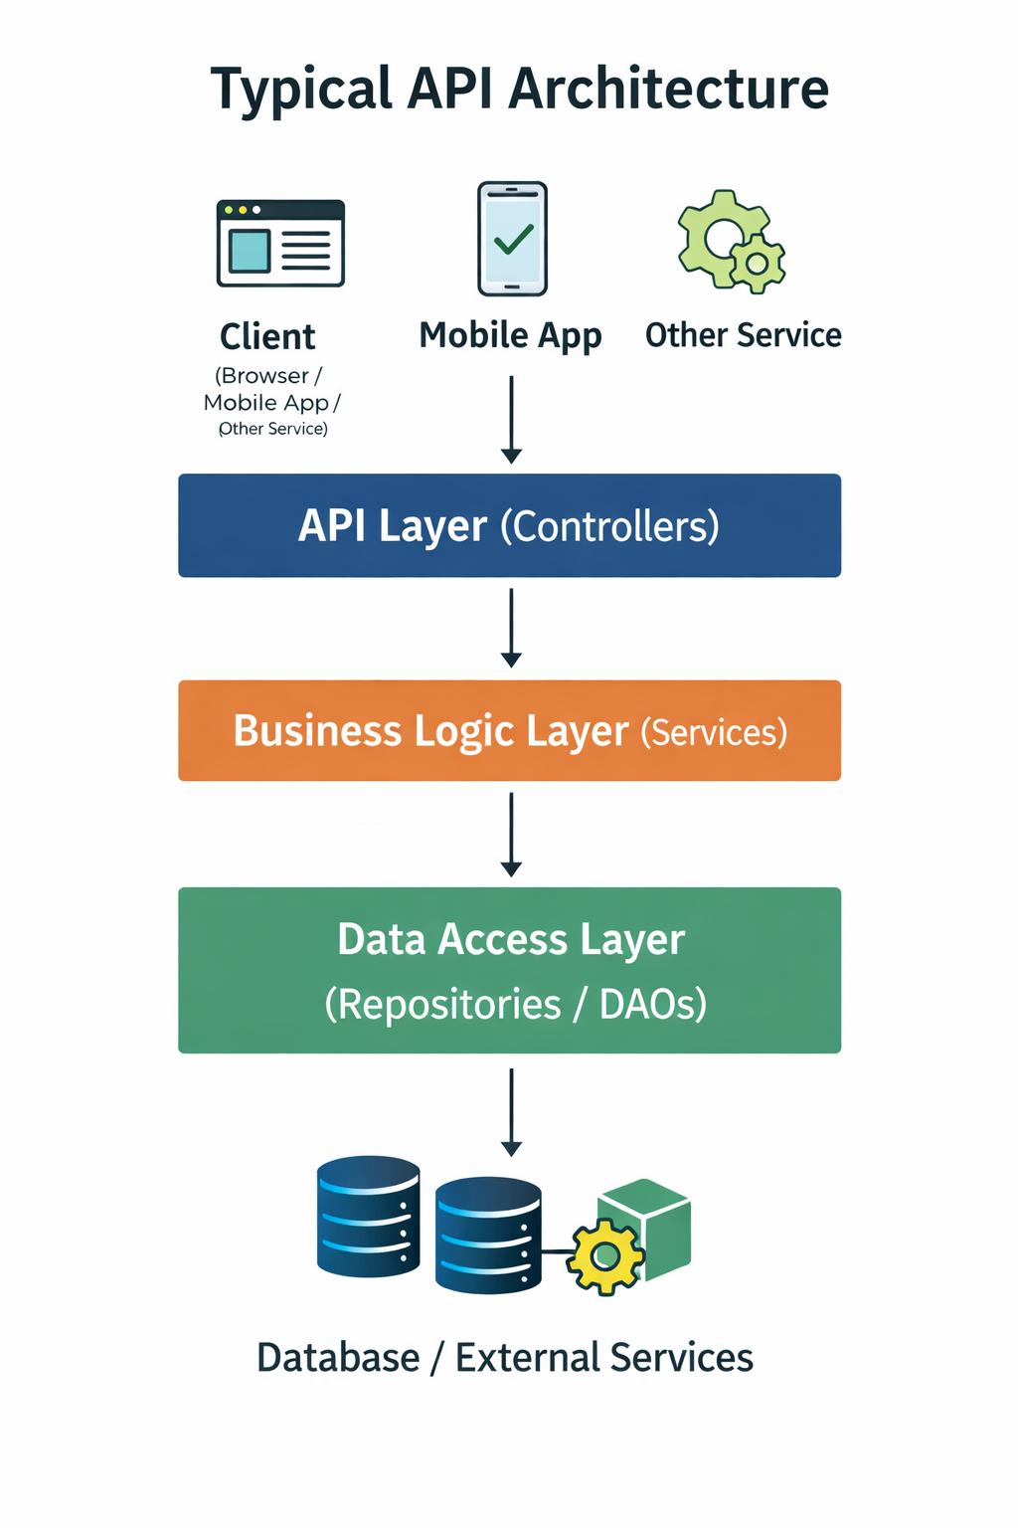
API Architecture
Typical Layered Architecture
Each Layer has a clear responsibility

Slide 17
API Architecture
API Layer (Controller Layer)
Responsibilities:
Receives HTTP requests
Validates input
Maps requests to business logic
Returns HTTP responses
Handles status codes and errors
In Spring Boot:
Annotated with @RestController
Defines endpoints
This layer should be thin.

Slide 18
API Architecture
Business Logic Layer (Service Layer)
Responsibilities:
Core business rules
Validation logic
Transactions
Orchestration of multiple repositories or services
Security checks (sometimes)
In Spring Boot:
Annotated with @Service
This is where most application logic lives.

Slide 19
API Architecture
Data Access Layer (Repository Layer)
Responsibilities:
Interacts with the database
Executes queries
Maps entities to tables
Handles persistence
In Spring Boot:
Annotated with @Repository
Uses JPA, JDBC, or other persistence tools

Slide 20
API Architecture
External Dependencies
APIs often integrate with:
Databases
Message brokers
Caches
Third-party services
Authentication providers
These dependencies must be handled carefully for reliability and performance.

Slide 21
MVC vs Layered Architecture
What Is MVC?
MVC stands for:
Model
View
Controller
It is mainly used for UI-based web applications.

Slide 22
MVC vs Layered Architecture
Why MVC Is Not a Perfect Fit for APIs
APIs usually do not return views.
APIs return data (JSON/XML).
The “View” concept does not really apply.
Business logic should not live in controllers.

Slide 23
MVC vs Layered Architecture
How APIs Actually Use MVC Concepts
Controller → API Layer
Model → Data objects (DTOs, Entities)
View → Not applicable in pure APIs
Most APIs evolve into Layered Architecture, not pure MVC.

Slide 24
Layered Architecture
Correct Mental Model
Think in layers, not screens:
API Layer
Business Layer
Data Layer
Infrastructure Layer
This improves maintainability and scalability.

Slide 25
Common Misconception: Endpoints vs API
What Many People Think
“The API is just the endpoints.”
Example:
GET /users
POST /users

Slide 26
Common Misconception: Endpoints vs API
What the API Actually Is
The API includes:
Endpoints
Validation rules
Business logic
Data models
Error handling
Security mechanisms
Documentation
Performance behavior
Reliability behavior
Endpoints are just the entry point.

Slide 27
Common Misconception: Endpoints vs API
Why This Matters
If you only focus on endpoints:
Security becomes weak
Performance suffers
Scalability breaks
Faults propagate easily
Real engineering happens behind the endpoints.

Slide 28
Key Takeaways
APIs come in multiple styles for different needs.
REST is common, but not the only choice.
APIs use layered architecture.
MVC is not the same as API architecture.
Endpoints are only part of an API.

Slide 29
What Comes Next
Next video:
Designing a very basic API
Understanding controllers, services, repositories
Creating a minimal Spring Boot project
Seeing how layers interact

