Slide 1
RFM Analysis
Author: Nguyen Thien Ngan

Slide 2
01
Analyze and segment customers

Slide 3
Approach
RFM, also known as RFM analysis, is a type of customer segmentation used to help businesses rank and segment customers based on the recency, frequency, and monetary value of a transaction.
For this dataset, the provided information can be widthrawn into necessary information to conduct an RFM analysis, allowing for effective customer segmentation.
Metrics used:
Recency: the amount of time since a customer’s last interaction
Frequency: the number of times a customer has made a purchase with your brand during a particular period of time
Monetary: total amount a customer has spent purchasing products and services from your brand over a particular period of time

Slide 4
RFM analysis
For each unique user_id, calculate the 3 metrics Recency, Frequency and Monetary. Then assign a score to each metric, ranging from 1 to 4, where 1 represents the least favorable outcome and 4 represents the most favorable. This scoring is achieved by dividing the data into quartiles, thereby segmenting the data into four groups.
Calculate metrics:
Recency: finding the number of days between the user's most recent purchase and the current date (assuming the latest date in the dataset is the current date).
Frequency: sum of total_trans of each unique user_id
Monetary: sum of the amount spent by each user. Amount = sku_price * total_trans
Assign score:
Recency: 4 for x <= Q1, 3 for Q1 < x <= Q2, 2 for Q2 < x <= Q3 and 1 for x > Q3
Frecency: 1 for x <= Q1, 2 for Q1 < x <= Q2, 3 for Q2 < x <= Q3 and 4 for x > Q3
Monetary: 1 for x <= Q1, 2 for Q1 < x <= Q2, 3 for Q2 < x <= Q3 and 4 for x > Q3

Slide 5
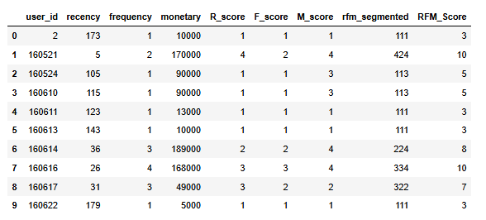
RFM table
The first 10 rows of FRM scoring table

Slide 6
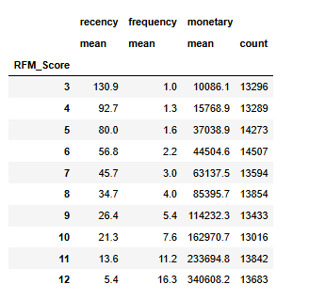
RFM segmentation
Based on the results table displayed, we have segmented customers into 10 distinct groups according to their RFM scores. The higher the RFM score, the more valuable the customer group. For example, the group with the maximum RFM score of 12 represents our best customers who spend the most, purchase frequently, and have recently interacted with our company. Conversely, the group with an RFM score of 3 represents the least valuable customers who spend the least and are least engaged.

Slide 7
RFM segmentation
While 10 groups provide detailed segmentation, we can simplify this into 4 broader categories:
1. Lost: Customers with an RFM score of 4 or less.
2. At Risk: Customers with an RFM score between 5 and 6.
2. Potential: Customers with an RFM score between 7 and 10.
3. Best: Customers with an RFM score of 11 or higher.

Slide 8
RFM segmentation
The above customer segmentation approach provides a general overview of each group. However, by summing up the scores, it does not distinguish between whether a customer is a big spender or a frequent buyer. For a more detailed analysis of each aspect of RFM, we can use the R_score, F_score, and M_score separately. Alternatively, we can use the rfm_segmented column (RFM table), which combines the three scores, to define customer groups based on specific attributes.
For instance, those customers having rfm_segmented = 144, 143, 133, 114 are customers who have not returned for a long time and have made regular purchases with a very large shopping cart value. Businesses can lose these customers if they do not take actions to stimulate them to come back.
Further analysis can be performed by adjusting the weights of the three factors—recency, frequency, and monetary—depending on the nature of the business. In a retail business with low-priced products, recency and frequency might be given more importance than monetary value. Consequently, the RFM score can be recalculated by assigning greater weight to the R and F scores compared to the M score.

Slide 9
K-means clustering
Another approach to customer segmentation is to apply the K-means clustering method using the RFM data to group users into distinct segments. The optimal number of groups is determined by the Elbow method.
Steps to perform K-means clustering:
Check skewness
Normalize data
Determine optimal K (Elbow method)
Perform K-means clustering
Find the characteristic of each clusters
Interpret the segmentation result
(Within the scope of this slide, only results are presented. For detailed information on data preprocessing and the execution of the K-means algorithm, please refer to the accompanying Jupyter notebook)

Slide 10
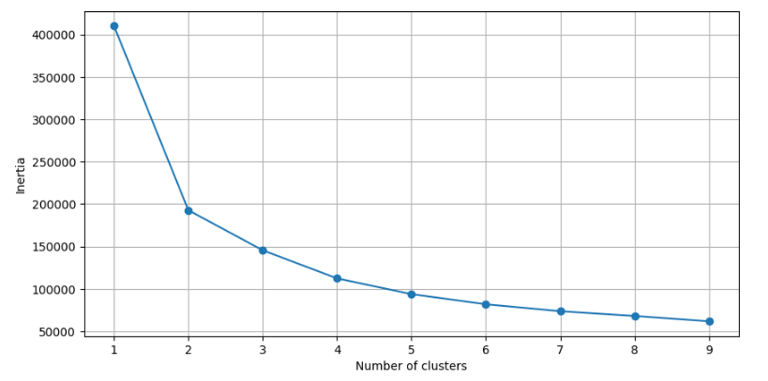
Elbow method
Based on the graph, the optimal number of clusters appears to be 4, as the inertia does not decrease significantly beyond this point. Also segmenting into 4 groups is a relatively reasonable choice, so we will proceed with 4 clusters (k = 4)

Slide 11
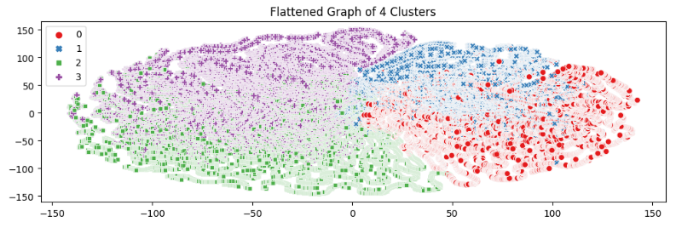
Flattened graph

Slide 12
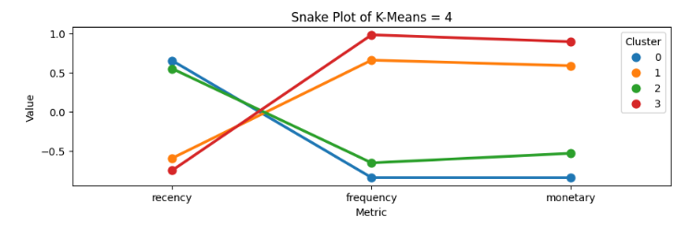
Snake graph

Slide 13
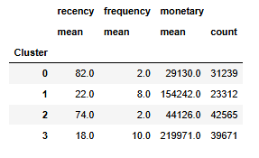
Cluster characteristic
After applying the K-means clustering algorithm, we have identified four customer groups (clusters 0 to 3).
What does each cluster represent?
Cluster 0: This group has the highest mean recency, the lowest mean frequency, and the lowest mean monetary value, indicating they are lost customers.
Cluster 1: This group exhibits decent recency, frequency, and monetary values, categorizing them as potential customers.
Cluster 2: Characterized by a relatively long time since the last interaction and moderate monetary value, this group represents at-risk customers.
Cluster 3: With the lowest recency, highest frequency, and exceptional monetary value, this group comprises our best customers.

Slide 14
Proposal to retain customers
Group | Characteristics | Retention strategies
Best customers | Highest recency, lowest frequency, lowest monetary | Personalized Offers: Send personalized offers based on their purchase history and preferences Premium Customer Service: Provide dedicated customer service lines and priority support, early access to new products, and special discounts
Potential customers | Decent recency, frequency, and monetary values | Targeted Promotions: Offer promotions and discounts on products they are likely to purchase based on their past behavior Customer Feedback: Solicit feedback to understand their needs better and adapt offerings accordingly.
At-risk customers | Relatively long time since last interaction, moderate monetary value | Win-Back Campaigns: Launch win-back campaigns with special offers and discounts to re-engage them Reminder Emails: Send reminder emails about items they have shown interest based on the past data Re-Engagement Surveys: Conduct surveys to understand why they have reduced their engagement and address their concerns
Lost customers | Highest recency, lowest frequency, lowest monetary | Content Marketing: Share valuable content that might interest them, such as how-to guides, product tutorials, or industry news, to rekindle their interest Exit Surveys: Conduct exit surveys to understand why they stopped engaging with the brand

Slide 15
Proposal to attract new customers
To expand ZaloPay’s customer base, it is crucial to implement a multifaceted approach that leverages various marketing channels, strategic partnerships, and innovative product features. Below are some proposal to attract new customers:
Digital Marketing Campaigns: SEO, Social Media Marketing, collaborate with influencers to promote ZaloPay through authentic content and endorsements.
Referral Programs: Implement a referral program where existing users can earn rewards for referring new customers to ZaloPay.
Promotional Offers and Discounts: Provide special introductory offers for new users, such as bonus credits, discounts on first transactions.
Product Innovations and Enhancements: Continuously improve the user interface to ensure it is intuitive and easy to navigate for new users.
Strategic Partnerships: Partner with major telecommunication providers, E-commerce Platforms to get exclusive discounts on purchases made through ZaloPay. Collaborate with universities and colleges to provide special offers and promotions for students

Slide 16
02
Customer development ideas

Slide 17
Proposals for company
Student Discounts and Cashback:
Provide special discounts and cashback offers on mobile top-ups, data packages, and phone card purchases for students. Collaborate with universities to verify student status and offer these deals.
Partnerships with Universities:
Establish a campus ambassador program where students promote company’s products within their universities. Offer incentives such as free data packages or bonuses for ambassadors who sign up new users.
Sponsor university events and provide exclusive offers for attendees who use company’s products for their transactions.
Bundled Services:
Education and Telecommunication Bundles: Create bundles that include educational resources (like online course subscriptions) along with data/combo packages at a discounted rate.
Subscription Models: Offer monthly subscription models for students that include a set amount of data, voice minutes, and SMS at a reduced rate, encouraging regular use of company’s products.

Slide 18
Proposals for company
Gamification and Loyalty Programs:
Implement a points system where students earn points for every transaction they make, which can be redeemed for telecommunication services or other rewards.
Encourage students to refer their peers to company’s products by offering both the referrer and the referee bonuses in the form of discounts or free data.
Collaborations with Telecommunication Providers:
Partner with major telecommunication providers to offer joint promotions that provide benefits for using company’s products for mobile top-ups and data purchases.
Work with providers to create exclusive data packages that are only available through company’s products , offering better value for students.
Tiktok marketing:
Collaborate with influencers who are popular among students to create interesting marketing content that easily reaches the student customer segment.

Slide 19
Thanks!

