Slide 1
INVESTOR WEBINAR · WEDNESDAY 19 AUGUST 2026
Don’t let August cash leave your portfolio.
Kenya’s domestic debt redemptions this month are almost double July’s. Put maturities and coupons back to work — in a Money Market Fund or a Fixed Income Fund.
Illustrative briefing for investors · Not a solicitation for any named fund

Slide 2
What we will cover
01
August’s cash calendar
Which bonds are redeeming, which coupons land, and why the month is unusually large.
02
The cost of spending it
A compounding picture of KES 1,000,000 spent vs reinvested over 5, 10 and 15 years.
03
Two natural homes for the cash
When a Money Market Fund is the right parking bay — and when a Fixed Income Fund should do the work.
04
What to do this week
A simple decision path before proceeds hit the linked bank account and disappear into spending.
August 2026 · Reinvesting Bond Maturities & Coupons · For discussion with investors
2 / 16

Slide 3
August is a cash-flow month, not a quiet month
KES 294bn
17 August
Coupons + bills
Domestic debt maturing in August 2026
Two government papers redeem
Interest and T-bills land all month
Almost double July’s KES 152bn of T-bill and T-bond redemptions. (SIB, citing CBK)
FXD1/2016/010 matures in full. IFB1/2020/011 sits on CBK’s 17 Aug redemption calendar (scheduled amortisation).
Feb/August coupon bonds pay this month. Weekly T-bills redeem on 17, 24 and 31 August.
August 2026 · Reinvesting Bond Maturities & Coupons · For discussion with investors
3 / 16

Slide 4
Bonds on the August redemption calendar
Source: CBK redemption calendar and original prospectuses. Outstanding amounts vary after switches and reopenings.
Issue
Type
What happens
Coupon
Tax
FXD1/2016/010
10-year Treasury bond
Matures in full — 17 Aug 2026
15.039%
10% WHT
IFB1/2020/011
11-year Infrastructure bond
On CBK’s 17 Aug redemption list (typical 50% year-6 amortisation; original final maturity 2031)
10.90%
Tax-exempt
Weekly T-bills
91 / 182 / 364-day
Redemptions 17, 24 and 31 August 2026
Discount
15% WHT
FXD1/2012/015 + 3 T-bills
Switch offer
Optional switch into FXD4/2019/010 — bids by 24 Aug, settles 26 Aug
11.00% source
10% WHT
August 2026 · Reinvesting Bond Maturities & Coupons · For discussion with investors
4 / 16

Slide 5
Coupons landing in August — even if your bond is not maturing
Kenya Treasury bonds pay interest twice a year. Papers issued on a February / August cycle credit coupons this month. That cash is easy to treat as “extra” and spend. It is still capital that can compound.
10 August
FXD1/2021/020
13.444% coupon · 10% WHT · matures July 2041
17 August
FXD1/2016/010
Final coupon + 100% principal · 15.039%
Feb / Aug cycle
Several FXD and IFB issues
Holders receive semi-annual interest into DhowCSD / the linked bank
August 2026 · Reinvesting Bond Maturities & Coupons · For discussion with investors
5 / 16

Slide 6
What usually happens to the money
1
Credit
2
The quiet leak
CBK pays principal and coupons into DhowCSD. Cash is then available to the linked bank account.
Once it sits in a transactional account it looks like income. School fees, a trip, a new car — all reasonable, all terminal for compounding.
3
Inflation
4
The better default
At 6.5% inflation (July 2026), cash that earns ~0–2% loses purchasing power every month it waits.
Treat every redemption as a reinvestment event first. Spend only what you planned to spend — from a budget, not from a maturity.
August 2026 · Reinvesting Bond Maturities & Coupons · For discussion with investors
6 / 16

Slide 7
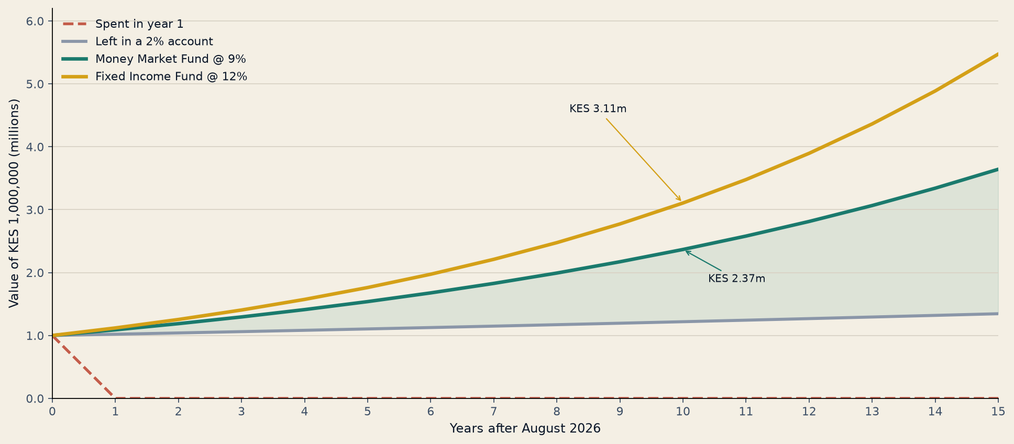
KES 1,000,000 received this August — four paths
Illustrative only. 9% and 12% are round numbers near recent MMF / fixed-income industry averages, not a promise.
August 2026 · Reinvesting Bond Maturities & Coupons · For discussion with investors
7 / 16

Slide 8
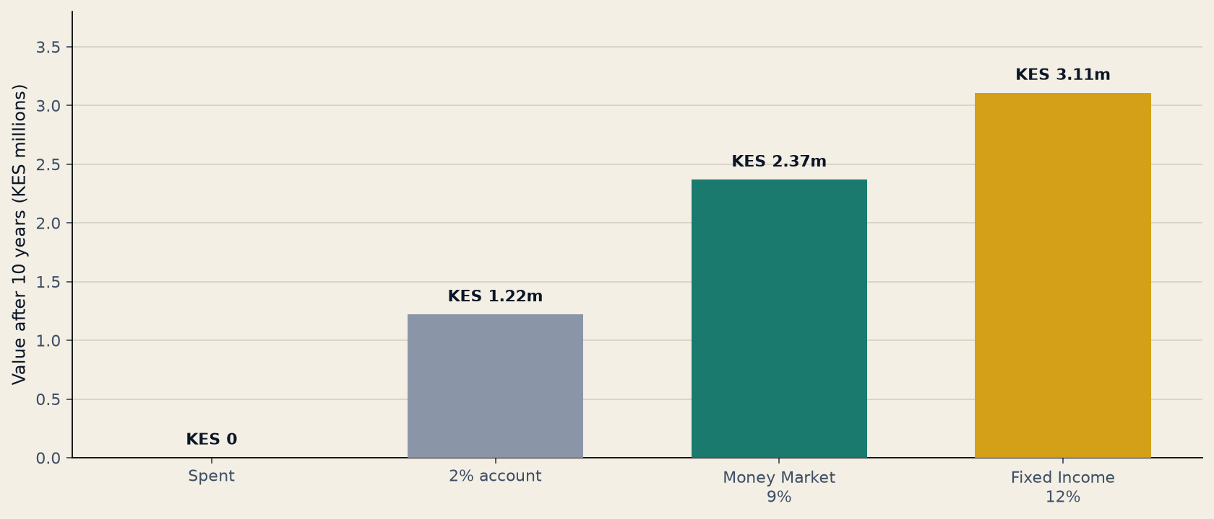
Same shilling. Three futures. One empty pocket.
Horizon
2% account
MMF 9%
FIF 12%
Gap vs spending
5 years
1.10m
1.54m
1.76m
1.76m
10 years
1.22m
2.37m
3.11m
3.11m
15 years
1.35m
3.64m
5.47m
5.47m
August 2026 · Reinvesting Bond Maturities & Coupons · For discussion with investors
8 / 16

Slide 9
Why reinvest instead of spend
Maturity is not a bonus
Coupons are easy to hide
Cash is taxed by inflation
The principal was already yours. Spending it shrinks the machine that was paying you 10–15% coupons.
A few hundred thousand shillings of interest does not feel like a decision. Repeated twice a year, it is the whole return.
6.5% inflation vs a 2% account is a 4.5% real loss. A ~9% MMF still compounds in real terms.
You cannot recapture skipped years
Liquidity is already built in
Replace the expired contract
The steep part of the compounding curve is later. Ten idle years cannot be ‘caught up’ with one good year.
You do not need to spend the bond to stay liquid. An MMF is typically T+2 to T+4 with a KES 1,000 minimum.
FXD1/2016/010 paid 15.039%. That contract ends on 17 August. A fund puts you back into a diversified book of bills and bonds the next day.
August 2026 · Reinvesting Bond Maturities & Coupons · For discussion with investors
9 / 16

Slide 10
Two CMA-licensed homes for the proceeds
Money Market Fund
Fixed Income Fund
Park it. Stay liquid. Beat the current account.
Put duration back to work. Replace the expired bond.
▸ Holds T-bills, short bonds, call and fixed deposits
▸ Typical industry yield ~9% gross / ~7.6% net (H1 2026 avg.)
▸ Interest is calculated daily, paid after 15% WHT
▸ Access usually within 2–4 working days
▸ Best when the money may be needed inside 12 months
▸ KES 442bn of industry MMF AUM as of March 2026
▸ Holds a ladder of Treasury and quality corporate bonds
▸ Category average ~11.9% gross / ~10.1% net (June 2026)
▸ More yield than an MMF; more price movement too
▸ Sensible holding period: 12 months and beyond
▸ ~250 bps extra vs the MMF average in mid-2026
▸ A closer substitute for the bond that just matured
August 2026 · Reinvesting Bond Maturities & Coupons · For discussion with investors
10 / 16

Slide 11
The case for the Money Market Fund
Use it when the August cash is a bridge — school fees in January, a property completion, or ‘I have not decided yet’.
Beats idle cash immediately
No need to pick a bond
You stay in control
91-day T-bills are ~8.8%. A decent MMF often matches or beats that, with daily compounding and no auction paperwork.
You do not have to bid the 24 August switch or the next IFB. The manager already holds a book of bills and short paper.
Units can usually be withdrawn in a few days. That is the point: the money is working, but it is not locked.
A disciplined default
Professional cash management
USD option exists
Standing instruction: every DhowCSD credit → MMF. Spending then requires a conscious withdrawal, not an accident.
Custodian + trustee + CMA licence. This is not a Sacco promise or a WhatsApp ‘investment’.
If the proceeds are dollar-linked (or you want a USD sleeve), dollar MMFs returned ~4.3% net in H1 2026.
August 2026 · Reinvesting Bond Maturities & Coupons · For discussion with investors
11 / 16

Slide 12
The case for the Fixed Income Fund
Use it when the August cash was long-term capital — the 10-year bond that just matured should not become a 91-day afterthought.
Replace the expired coupon engine
You get a ladder, not a single name
The extra 2–3 points compound
FXD1/2016/010 paid 15%. New 10-year FXD paper is around 12.8%. A bond fund keeps you in that market without timing one auction.
One matured issue becomes a diversified book — several tenors, reopenings, and (in some funds) quality corporates.
On KES 1m, 250 bps extra vs an MMF is ~KES 25,000 a year at the start — and more as the base grows.
Yields are still historically useful
Tax-aware IFB exposure
Stay invested through the switch
CBR is 8.75%. Long bonds still clear ~12–14%. Locking duration now is how you keep income if policy rates drift lower.
Infrastructure bonds pay coupons with no WHT. Funds that hold IFBs pass through some of that tax advantage.
You do not have to decide by 24 August whether to switch FXD1/2012/015. The fund can hold duration for you.
August 2026 · Reinvesting Bond Maturities & Coupons · For discussion with investors
12 / 16

Slide 13
How to choose — a 60-second test
If this is true…
Then use
I may need this money within 12 months (fees, construction drawdown, emergency reserve).
Money Market Fund
I have not decided yet, and I refuse to leave it in the current account over the weekend.
Money Market Fund (default)
This was a 5–10 year bond. I still want income, and I can leave it for a year or more.
Fixed Income Fund
I want both: spend nothing, keep 30–40% liquid, put the rest back into duration.
Split: MMF + Fixed Income
I am sitting on FXD1/2012/015 and the T-bills in the 26 August switch.
Switch and/or Fixed Income Fund
Dollar liabilities (school fees abroad, import invoice).
USD Money Market sleeve
August 2026 · Reinvesting Bond Maturities & Coupons · For discussion with investors
13 / 16

Slide 14
This week’s action list
Mon–Tue
Open DhowCSD. Note every August credit — maturity, amortisation, coupon, T-bill.
Before 17 Aug
If FXD1/2016/010 or IFB1/2020/011 is paying you, decide MMF vs FIF before the money hits the bank.
By 24 Aug, 10:00
Holders of FXD1/2012/015 and the three source T-bills: accept or ignore the switch into FXD4/2019/010.
Same day as credit
Move the amount you will not spend in 90 days. Standing order into the fund beats willpower.
Split if unsure
Example: 40% MMF (near cash) + 60% Fixed Income (replace the bond). Review in 90 days.
Do not wait for ‘the next auction’
Funds subscribe for you. Cash that waits for a perfect bond often becomes a school-fees withdrawal.
August 2026 · Reinvesting Bond Maturities & Coupons · For discussion with investors
14 / 16

Slide 15
If you remember only five things
01
August 2026 is a redemption month — KES 294bn of domestic paper is rolling off.
02
FXD1/2016/010 matures 17 August. Coupons on the Feb/August cycle land too.
03
Spending the principal ends the compounding. A 2% account is a slow version of the same mistake.
04
Default: Money Market Fund if the horizon is short. Fixed Income Fund if you are replacing a long bond.
05
Move the money the day it arrives. The decision is this week, not ‘after the holidays’.
August 2026 · Reinvesting Bond Maturities & Coupons · For discussion with investors
15 / 16

Slide 16
QUESTIONS · NEXT STEPS
We can open the fund the same week the bond pays.
Bring your DhowCSD statement. We will map each August credit to either a Money Market Fund, a Fixed Income Fund, or a planned withdrawal.
Disclaimer: This briefing is educational. It is not a prospectus, not tax advice, and not a recommendation of any named unit trust. Yields cited are industry snapshots (CBK, CMA-licensed fund tables, SIB weekly) and will change. Past returns do not predict future returns. Invest only in CMA-licensed funds. Confirm fact sheets, fees, WHT and redemption timelines with the manager before you subscribe.

