Slide 1
G2M CASE STUDY
Exploratory Data Analysis for Cab services

Slide 2
BACKGROUND
XYZ is a private firm in US. Due to remarkable growth in the Cab Industry in last few years and multiple key players in the market, it is planning for an investment in Cab industry and as per their Go-to-Market(G2M) strategy they want to understand the market before taking final decision.
The presentation below is an analysis of data

Slide 3
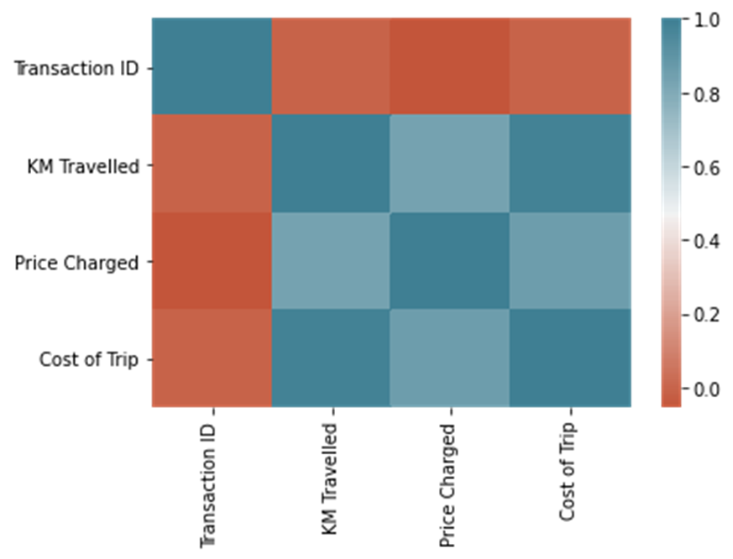
Correlation Matrix
The correlation matrix shows the relationship between various fields, with cost of trip and price charged being the most correlated.

Slide 4
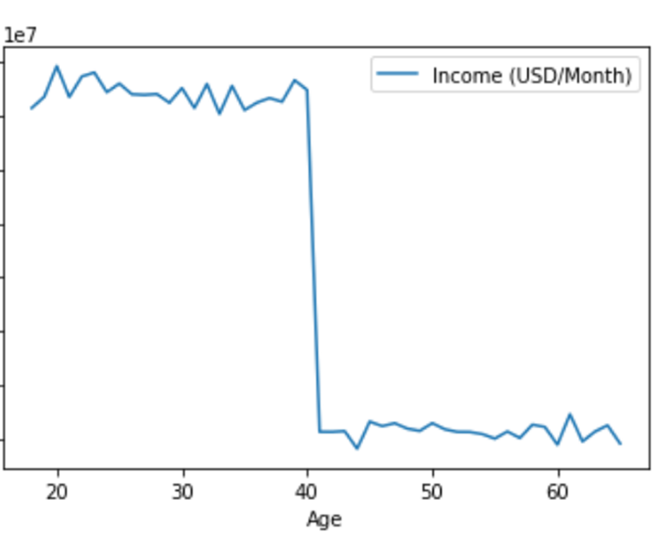
Income by Age
The illustration shows that income is high before the age of 40 with a steep descent after 40. the income is averagely low from 40 to 60 years.

Slide 5
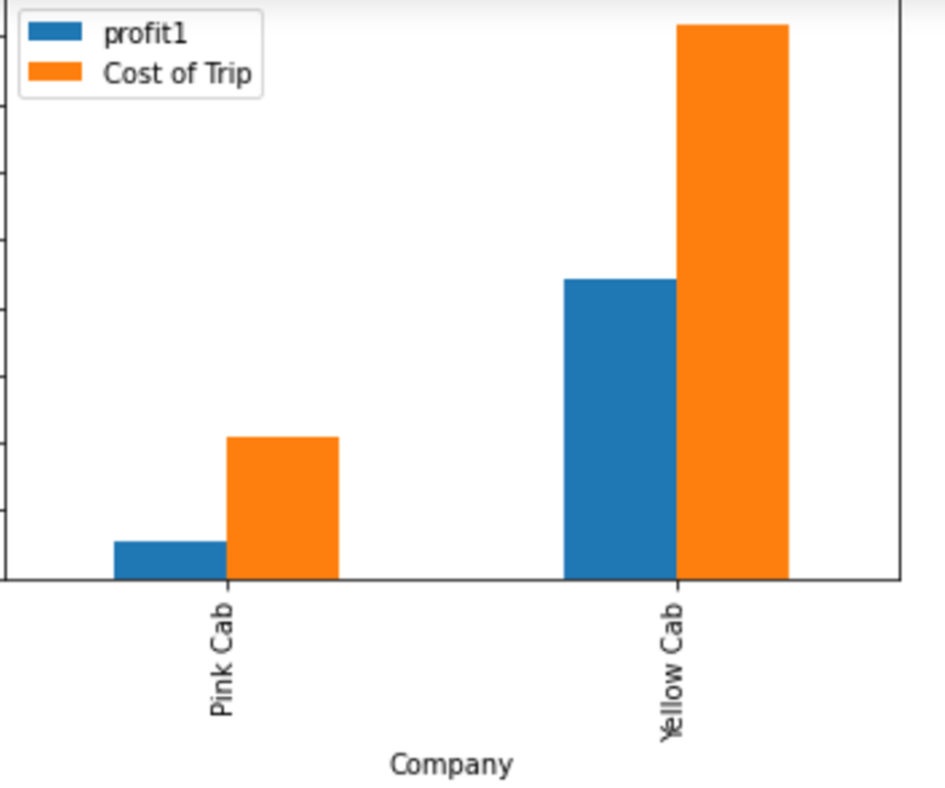
Proft & Cost of Trip per Company
The profit for both companies is relatively low as compared to its costs of trips. This means that both companies are operating as losses

Slide 6
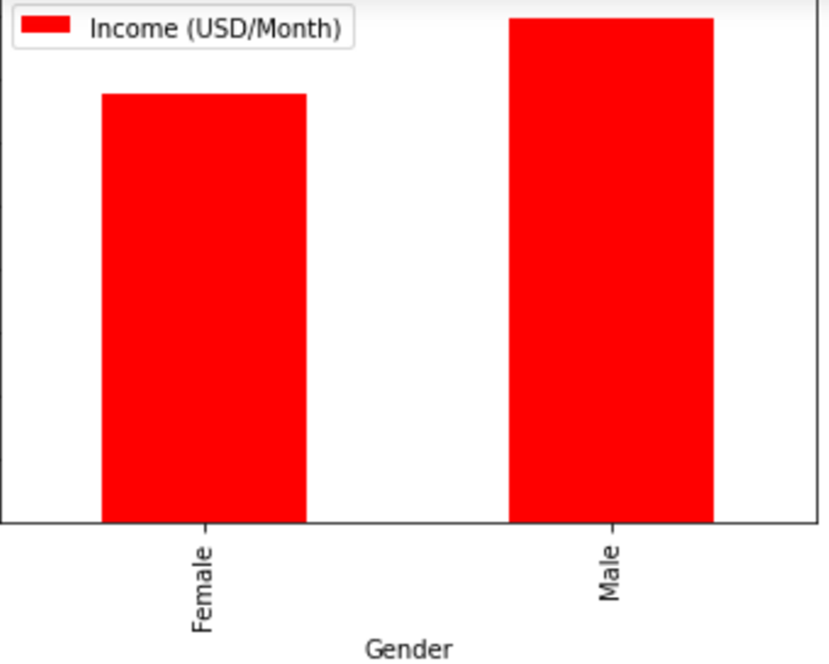
Income by gender
The customers’ income varies according to gender. The male gender is reported to have higher income than the female gender.

Slide 7
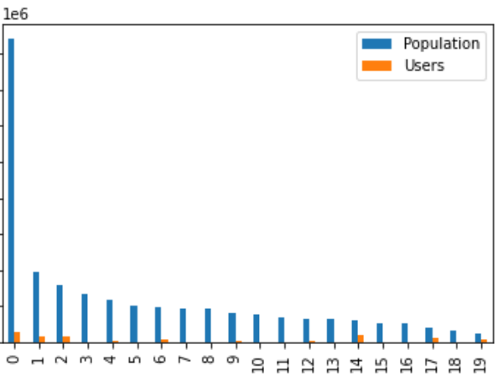
Population and cab users by city
Less than 25% of all population in every city use cabs. Three cities have no users of cab rides at all.

Slide 8
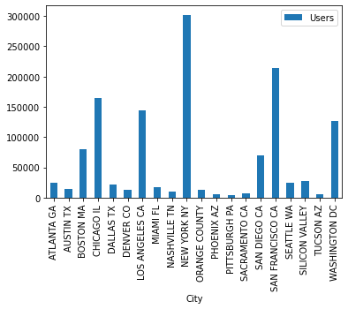
Cab users per city
New York City has the majority of cab users which is close to 300,000 users. This is followed by San Francisco whose users are close to 200,000. the city with least cab users is Pittsburg whose users are less than 50,000.

Slide 9
END

