Slide 1

Shoulder Muscle Recovery Games
Start now

Slide 2
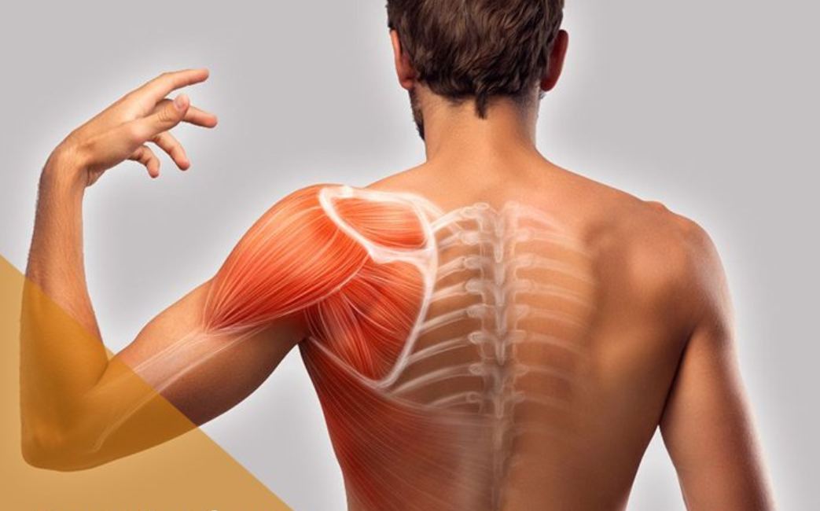

Shoulder Muscle Recover Topic: 22223DT108
Play
Result Statistics

Slide 3

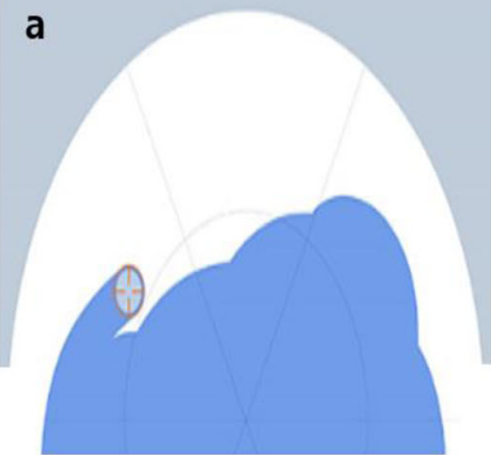
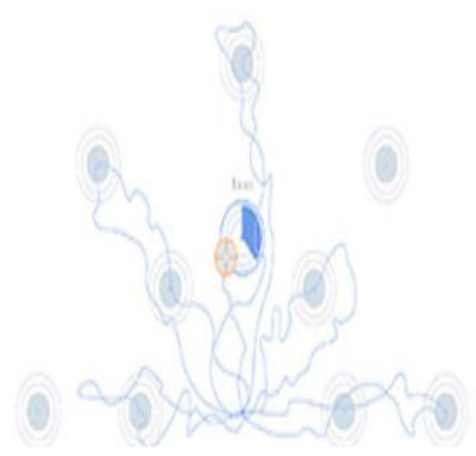
Select Games
Circle-Drawing
Free Exploration
Point-to-Point
Start
Start
Start

Slide 4
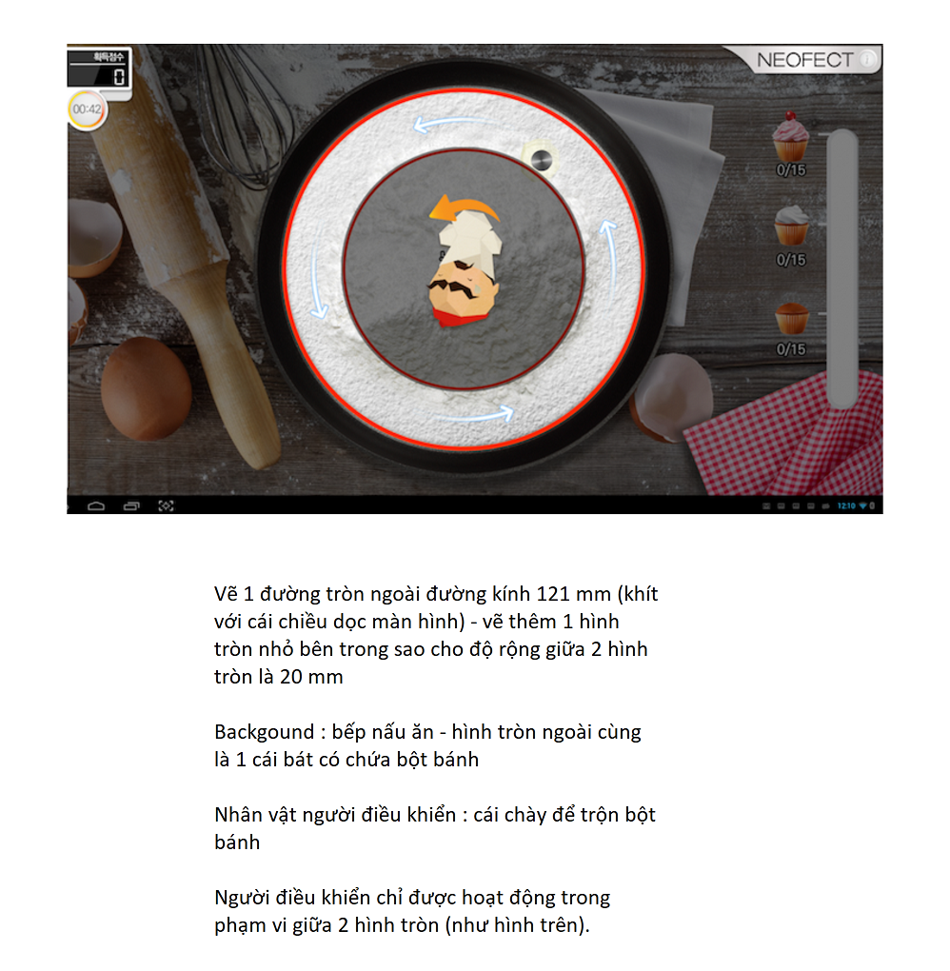


Circle Drawing - Bakery game Topic: 22223DT108
Lời giải thích cách chơi game
Time: second
Completed: %

Slide 5
Note ý tưởng game 3 :

Slide 6
Point to Point - My Pet game Topic: 22223DT108
Time: second
Completed: %

Slide 7
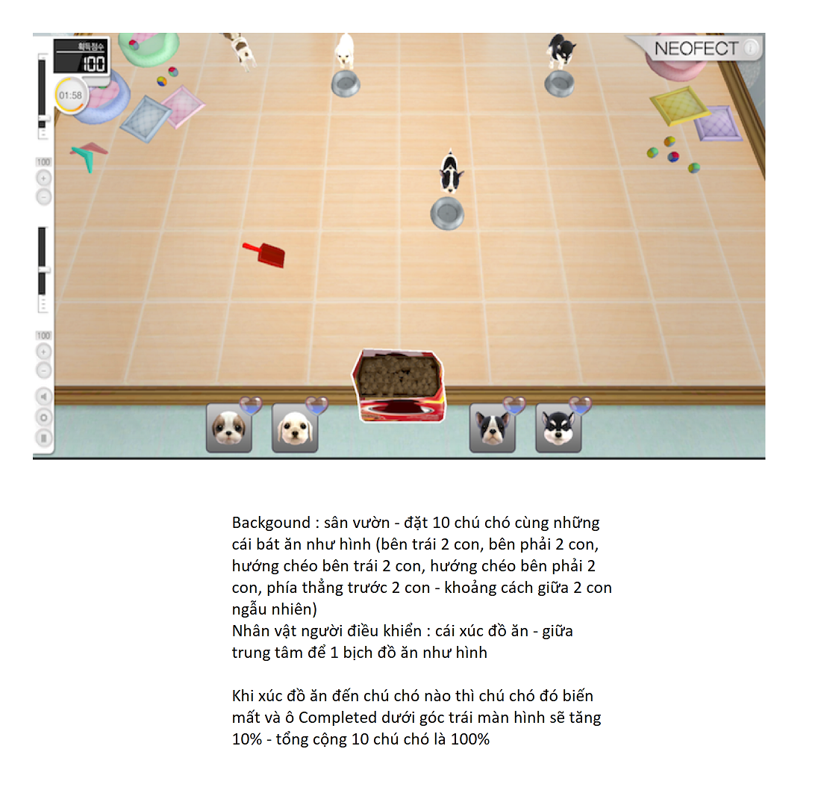
Note ý tưởng game 2 :

Slide 8
Free Exploration – Pacman game Topic: 22223DT108
Time: second
Completed: %

Slide 9
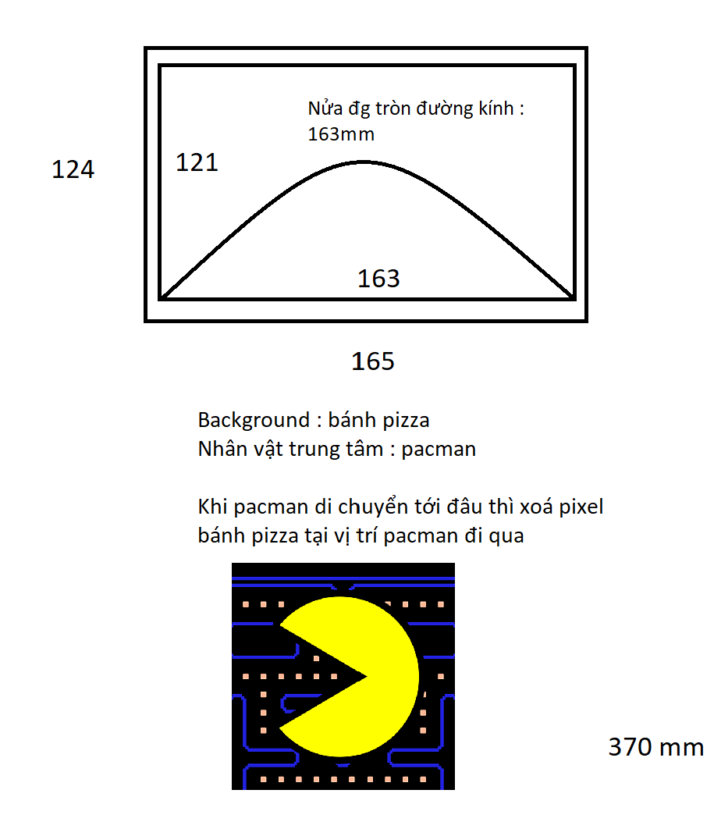
Note ý tưởng game 1 :

Slide 10
History
Date
Time
Result
13/05/2023
170/180 second
100%
Detail
12/05/2023
180/180 second
100%
Detail
11/05/2023
180/180 second
100%
Detail

Slide 11
Detail
Games | Result | Time
Free Exploration | % | second
Point to Point | % | second
Circle Drawing | % | second

