Slide 1
R语言回归分析

Slide 2
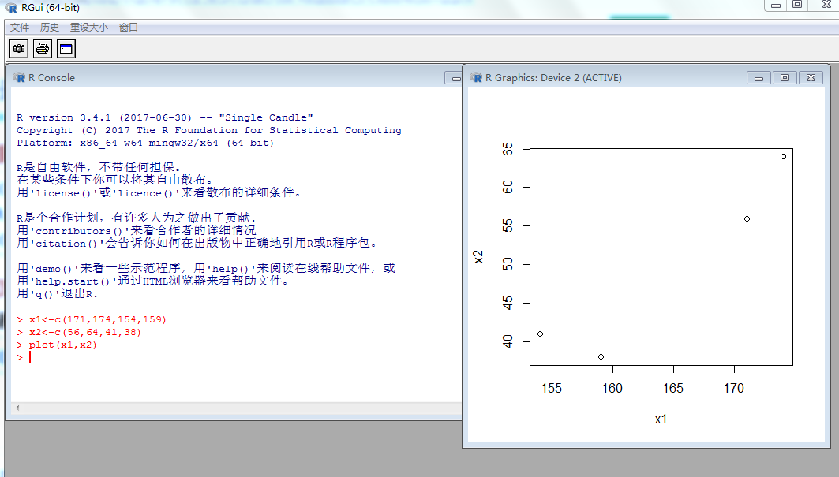
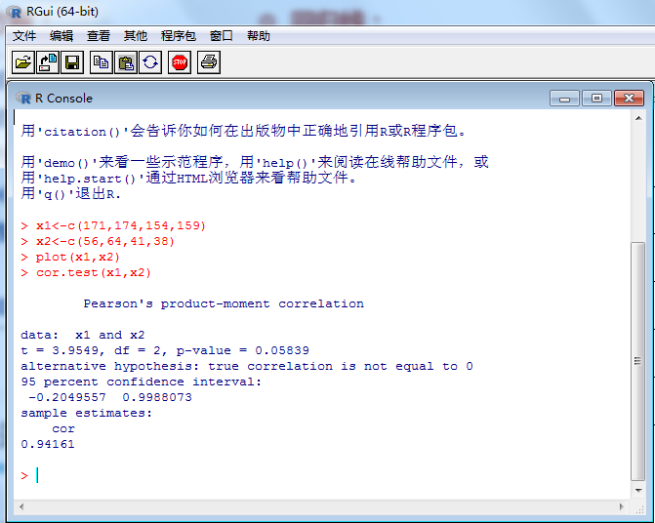
数据输入
相关系数

Slide 3
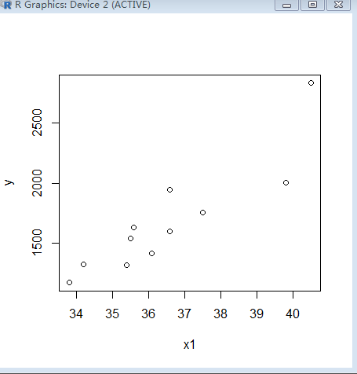
excel中，选中数据copy到剪切板——读取数据——回归分析-绘制散点图
x1 | x2 | x3 | y
40.5 | 1170.80 | 48.25 | 2835.57
36.6 | 1707.20 | 193.72 | 1947.97
35.5 | 1908.80 | 413.94 | 1538.10
37.5 | 2072.40 | 358.60 | 1756.79
35.4 | 2136.40 | 615.04 | 1317.64
33.8 | 930.80 | 752.42 | 1167.44
35.6 | 2025.10 | 435.43 | 1632.93
36.6 | 1397.80 | 238.55 | 1594.28
39.8 | 1477.20 | 87.85 | 2005.45
36.1 | 1517.20 | 316.00 | 1410.15
34.2 | 1410.00 | 503.73 | 1318.59
> yx=read.table("clipboard",header=T)
> fm=lm(y~x1+x2+x3,data=yx)
建立多元线性回归方程
> fm
Call:
lm(formula = y ~ x1 + x2 + x3, data = yx)
Coefficients:
(Intercept) x1 x2 x3
-4.007e+03 1.637e+02 -9.316e-02 -3.761e-01
> plot(y~x1,data=yx)

Slide 4
模型的方差分析(ANOVA)
> anova(fm)
Analysis of Variance Table
Response: y
Df Sum Sq Mean Sq F value Pr(>F)
x1 1 1731998 1731998 31.5044 0.000805 ***
x2 1 14045 14045 0.2555 0.628772
x3 1 15061 15061 0.2740 0.616846
Residuals 7 384835 54976
---
Signif. codes: 0 ‘***’ 0.001 ‘**’ 0.01 ‘*’ 0.05 ‘.’ 0.1 ‘ ’ 1
>

Slide 5
回归系数t检验
> summary(fm)
Call:
lm(formula = y ~ x1 + x2 + x3, data = yx)
Residuals:
Min 1Q Median 3Q Max
-332.6 -109.0 10.7 115.5 339.5
Coefficients:
Estimate Std. Error t value Pr(>|t|)
(Intercept) -4.007e+03 2.952e+03 -1.357 0.2168
x1 1.637e+02 7.403e+01 2.211 0.0627 .
x2 -9.316e-02 1.905e-01 -0.489 0.6397
x3 -3.761e-01 7.186e-01 -0.523 0.6168
---
Signif. codes: 0 ‘***’ 0.001 ‘**’ 0.01 ‘*’ 0.05 ‘.’ 0.1 ‘ ’ 1
Residual standard error: 234.5 on 7 degrees of freedom
Multiple R-squared: 0.8207, Adjusted R-squared: 0.7438
F-statistic: 10.68 on 3 and 7 DF, p-value: 0.005274

Slide 6
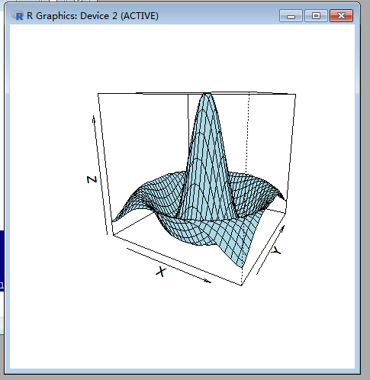
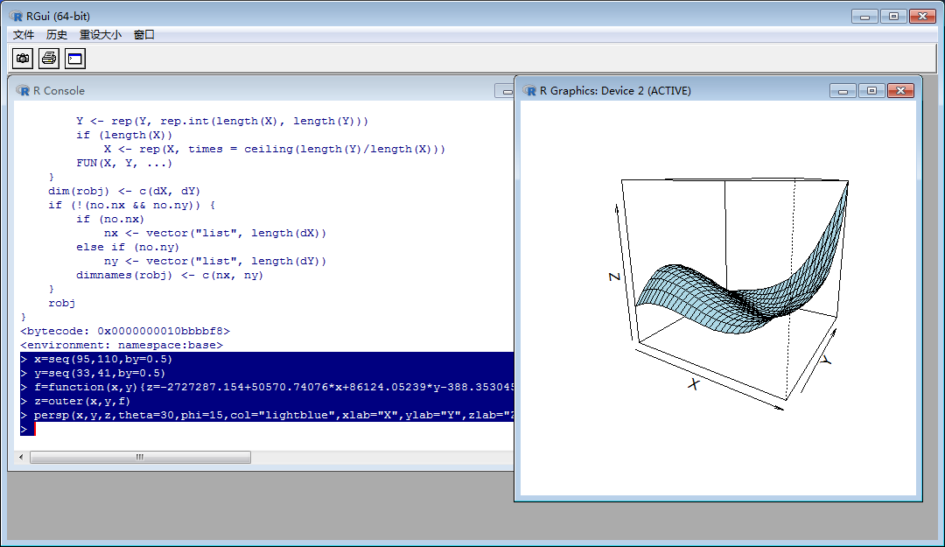
> x=seq(-7.5,7.5,by=0.5)
> y=seq(-7.5,7.5,by=0.5)
> f=function(x,y){z=sin(sqrt(x^2+y^2))/sqrt(x^2+y^2)}
> z=outer(x,y,f)
> persp(x,y,z,theta=30,phi=15,col="lightblue",xlab="X",ylab="Y",zlab="Z")
>
> x=seq(95,110,by=0.5)
> y=seq(33,41,by=0.5)
> f=function(x,y){z=-2727287.154+50570.74076*x+86124.05239*y-388.3530457*x*x-1457.42849*y*y-651.3849152*x*y+1.147742472*x*x*x+7.977018791*y*y*y+1.20961094*x*x*y+5.651203992*x*y*y}
> z=outer(x,y,f)
> persp(x,y,z,theta=30,phi=15,col="lightblue",xlab="X",ylab="Y",zlab="Z")
>

