Slide 1
系统聚类
d=dist(scale(X),method="euclidean") #默认是欧式距离
hc1=hclust(d,method="complete")
plot(hc1,hang=-1,main="聚类谱系图——最长距离法")
“single” 最短距离法
“complete” 最长距离法
“median” 中间距离法
“average” 类平均法
“centroid” 重心法*
“ward” 离差平方和法*
hang表示谱系图中各类所在的位置，取负值时，从底部画起

Slide 2
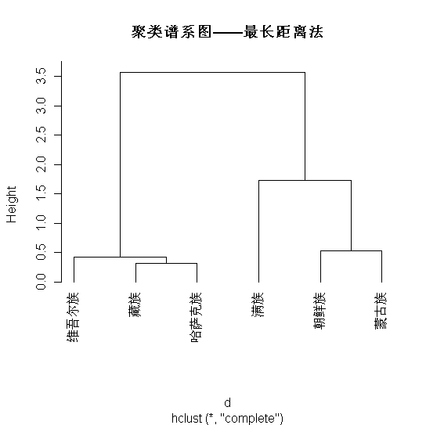

Slide 3
注意： “median” 中间距离法；“centroid” 重心法；“ward” 离差平方和法这三种应以欧式距离的平方矩阵为递推矩阵。
d=dist(scale(X) )
hc1=hclust(d^2,method="centroid")
hc1$height=sqrt(hc1$height)
cbind(hc1$merge,hc1$height)
plot(hc1,hang=-1,main="聚类谱系图——重心法")

Slide 4
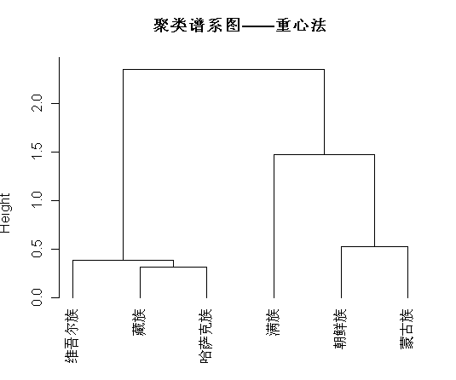

Slide 5
和谱系图有关的还有
as.dendrogram(x,type=c(“rectangle“, “triangle“),horiz=FALSE)
d=dist(c(1,2,6,8,11,13,15))
hc1=hclust(d)
dend1=as.dendrogram(hc1)
par(mfrow=c(2,2))
plot(dend1)
plot(dend1,type="t",nodePar=list(pch=c(1,NA)))
plot(dend1,horiz=T)
plot(dend1,edgePar=list(col="gray", lwd=2),nodePar=list(col=3:2, cex=c(2.0, 0.75), pch= 21:22,bg= c("light blue", "pink")))

Slide 6
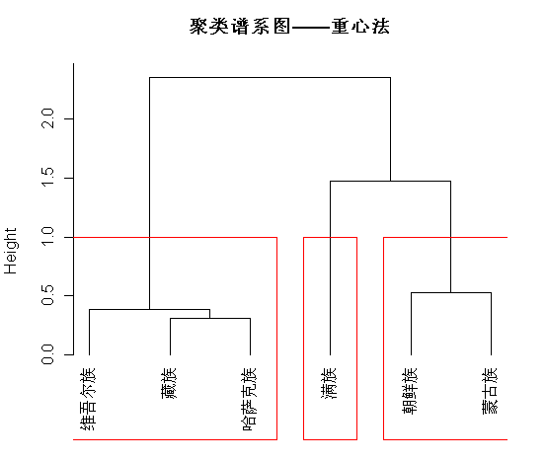
根据系统聚类划分为若干个类
cutree(hc1,3)
或者rect.hclust(hc1,k=3,border='red')

Slide 7
变量聚类
d=as.dist(sqrt(1-cor(X)^2)) #将相关系数转化为距离矩阵
hc1=hclust(d,method="single")
plot(hc1,hang=-1)

Slide 8
快速聚类（k均值聚类）
kmeans(x, centers) #centers为聚类个数

Slide 9
 | 平均寿命 | 识字率 | 综合入学率 | 人均GDP | 面积 | 人口
Afghanistan | 44.637 | 32.69196 | 54.07206 | 1419.003 | 652300 | 22000
Cambodia | 62.168 | 78.2879 | 58.07544 | 1952.26 | 181035 | 11430
China | 73.474 | 94.2301 | 68.005 | 7206.118 | 9600000 | 1295330
India | 64.352 | 68.2926 | 62.60772 | 3354.394 | 2974700 | 1020000
Indonesia | 71.493 | 93.78223 | 74.51548 | 4394.326 | 1904443 | 210000
Iran | 71.91 | 85.23285 | 74.03589 | 11891.32 | 1645000 | 63900
Korea | 79.8 | 99 | 99.84531 | 29325.77 | 99600 | 48022
Japan | 83.166 | 99 | 87.29832 | 33648.66 | 377800 | 127310
Jordan | 73.107 | 93.10328 | 78.26715 | 5700.399 | 89340 | 5040
Kazakhstan | 65.364 | 99 | 90.93078 | 11927.25 | 2717300 | 14821
Nepal | 67.459 | 60.3039 | 57.47862 | 1189.24 | 147181 | 23000
Oman | 76.142 | 86.2734 | 66.16027 | 26258.11 | 30950 | 2325
Pakistan | 67.164 | 57.83466 | 41.53325 | 2624.715 | 11500 | 8797
VietNam | 74.908 | 92.13669 | 63.71198 | 3096.957 | 329556 | 77680
Philippines | 72.339 | 93.6732 | 78.02884 | 3600.9 | 300000 | 80080
Malaysia | 74.732 | 92.898 | 69.76717 | 14410.43 | 329735 | 23275
SaudiArabia | 73.305 | 86.746 | 80.16356 | 24208.17 | 2250000 | 22760
Israel | 81.153 | 98.42512 | 90.86705 | 28291.88 | 14900 | 6458
Turkey | 72.23 | 90.03958 | 74.26163 | 13359.24 | 779450 | 66500
Qatar | 75.966 | 94.34211 | 60.97165 | 77177.68 | 11437 | 580

