Slide 1
Informed search algorithms
Lecture 3
Chapter 4

Slide 2
References
http://www.comp.nus.edu.sg/~kanmy/courses/3243_2010/syllabus.html

Slide 3
Material
Sechtions 3.5, 4.1
Excludes memory-bounded heuristic search (3.5)

Slide 4
Outline
Best-first search
Greedy best-first search
A* search
Heuristics
Local search algorithms
Online search problems

Slide 5
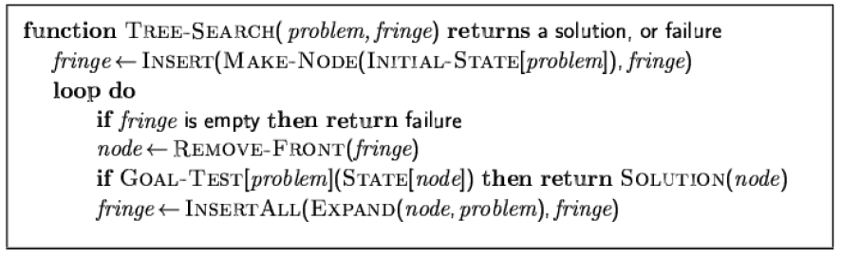
Review: Tree search
A search strategy is defined by picking the order of node expansion

Slide 6
Best-first search
Idea: use an evaluation function f(n) for each node
estimate of "desirability"
-> Expand most desirable unexpanded node
Implementation:
Order the nodes in fringe in decreasing order of desirability
Special cases:
greedy best-first search
A* search

Slide 7
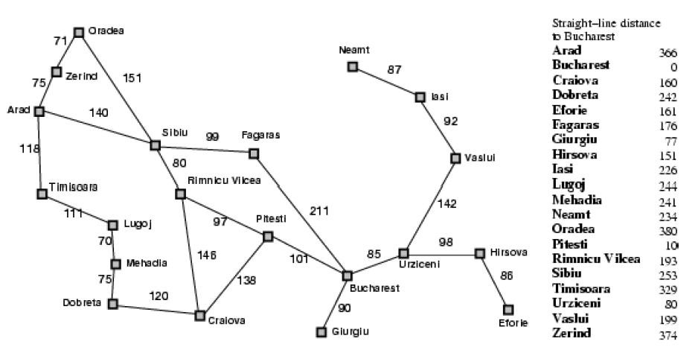
Romania with step costs in km

Slide 8
Greedy best-first search
Evaluation function f(n) = h(n) (heuristic)
= estimate of cost from n to goal
e.g., hSLD(n) = straight-line distance from n to Bucharest
Greedy best-first search expands the node that appears to be closest to goal

Slide 9

Greedy best-first search example

Slide 10
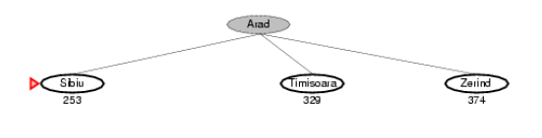
Greedy best-first search example

Slide 11
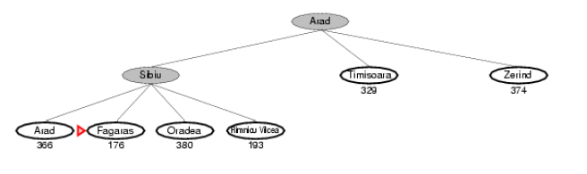
Greedy best-first search example

Slide 12
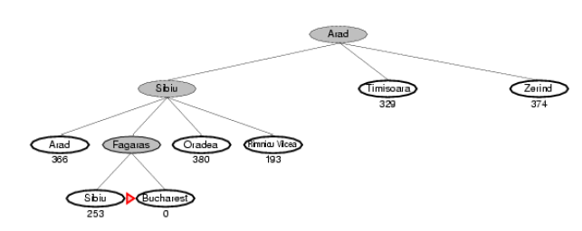
Greedy best-first search example

Slide 13
Properties of Greedy best-first search
Complete?
Time?
Space?
Optimal?

Slide 14
A* search
Idea: avoid expanding paths that are already expensive
Evaluation function f(n) = g(n) + h(n)
g(n) = cost so far to reach n
h(n) = estimated cost from n to goal
f(n) = estimated total cost of path through n to goal

Slide 15

A* search example

Slide 16
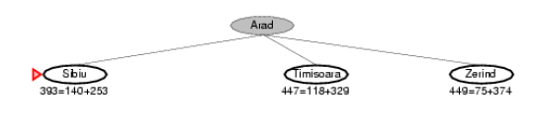
A* search example

Slide 17
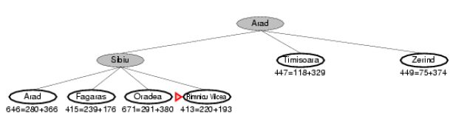
A* search example

Slide 18
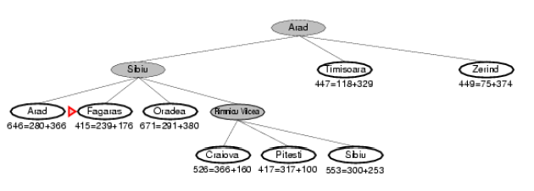
A* search example

Slide 19
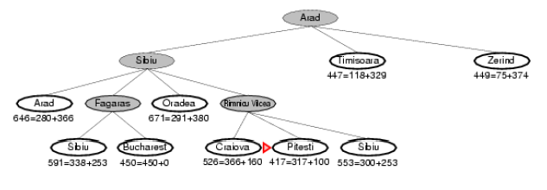
A* search example

Slide 20
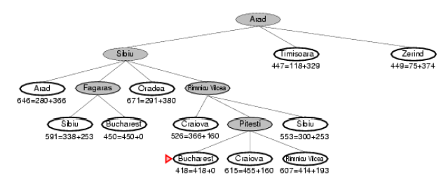
A* search example

Slide 21
Admissible heuristics
A heuristic h(n) is admissible if for every node n, h(n) ≤ h*(n), where h*(n) is the true cost to reach the goal state from n.
An admissible heuristic never overestimates the cost to reach the goal, i.e., it is optimistic
Example: hSLD(n) (never overestimates the actual road distance)
Theorem: If h(n) is admissible, A* using TREE-SEARCH is optimal

Slide 22
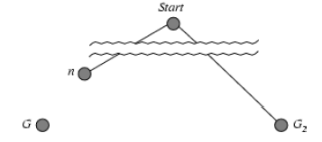
Optimality of A* (proof)
Suppose some suboptimal goal G2 has been generated and is in the fringe. Let n be an unexpanded node in the fringe such that n is on a shortest path to an optimal goal G.
f(G2) = g(G2) since h(G2) = 0
g(G2) > g(G) since G2 is suboptimal
f(G) = g(G) since h(G) = 0
f(G2) > f(G) from above

Slide 23
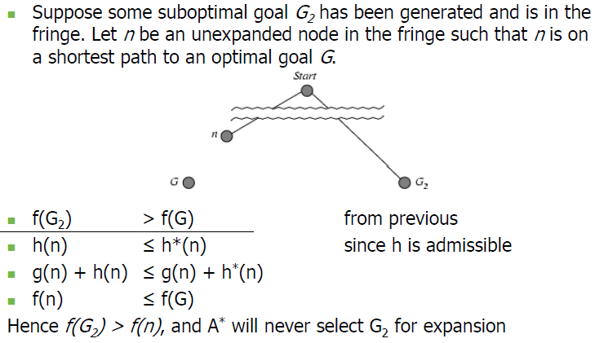
Optimality of A* (proof)

Slide 24
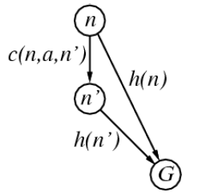
Consistent heuristics
A heuristic is consistent if for every node n, every successor n' of n generated by any action a,
h(n) ≤ c(n,a,n') + h(n')
If h is consistent, we have
f(n') = g(n') + h(n')
= g(n) + c(n,a,n') + h(n')
≥ g(n) + h(n) = f(n)
i.e., f(n) is non-decreasing along any path.
Theorem: If h(n) is consistent A* using GRAPH SEARCH is optimal

Slide 25
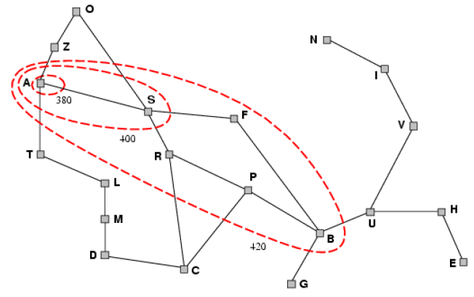
Optimality of A*
A* expands nodes in order of increasing f value
Gradually adds "f-contours" of nodes
Contour i has all nodes with f=fi, where fi < fi+1

Slide 26
Properties of A*
Complete?
Time?
Space?
Optimal?

Slide 27
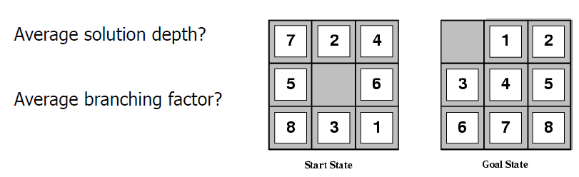
Admissible heuristics
E.g., for the 8-puzzle:

Slide 28
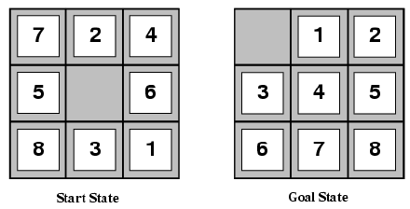
Admissible heuristics
E.g., for the 8-puzzle:
h1(n) = number of misplaced tiles
h2(n) = total Manhattan distance
(i.e., no. of squares from desired location of each tile)
h1(S) = ?
h2(S) = ?

Slide 29
Admissible heuristics
E.g., for the 8-puzzle:
h1(n) = number of misplaced tiles
h2(n) = total Manhattan distance
(i.e., no. of squares from desired location of each tile)
h1(S) = ? 8
h2(S) = ? 3+1+2+2+2+3+3+2 = 18

Slide 30
Dominance
If h2(n) ≥ h1(n) for all n (both admissible)
then h2 dominates h1
h2 is better for search
Typical search costs (average number of nodes expanded):
d=12 IDS = 3,644,035 nodes
A*(h1) = 227 nodes
A*(h2) = 73 nodes
d=24 IDS = too many nodes
A*(h1) = 39,135 nodes
A*(h2) = 1,641 nodes

Slide 31
Relaxed problems
A problem with fewer restrictions on the actions is called a relaxed problem
The cost of an optimal solution to a relaxed problem is an admissible heuristic for the original problem
If the rules of the 8-puzzle are relaxed so that a tile can move anywhere, then h1(n) gives the shortest solution
If the rules are relaxed so that a tile can move to any adjacent square, then h2(n) gives the shortest solution

Slide 32
Beyond classical search
Local search
Searching with non-determinism
Searching with partial observations
Online and exploratory search

Slide 33
Local search algorithms
In many optimization problems, the path to the goal is irrelevant; the goal state itself is the solution
State space = set of "complete" configurations
Find configuration satisfying constraints, e.g., nqueens
In such cases, we can use local search algorithms keep a single "current" state, try to improve it

Slide 34
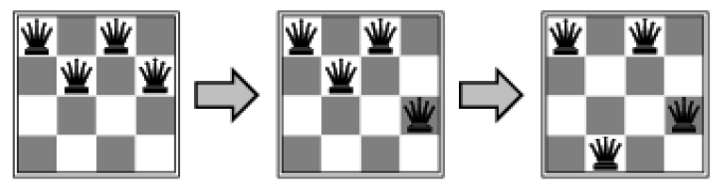
Example: n-queens
Put n queens on an n × n board with no two queens on the same row, column, or diagonal

Slide 35
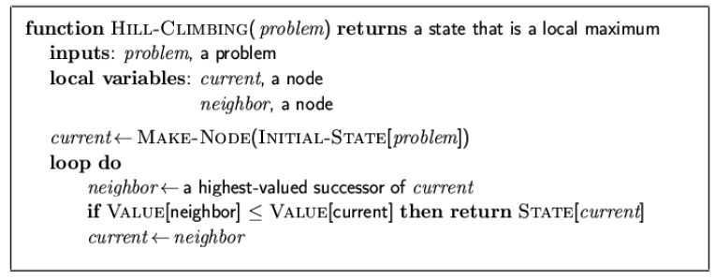
Hill-climbing search
"Like climbing Everest in thick fog with amnesia"

Slide 36
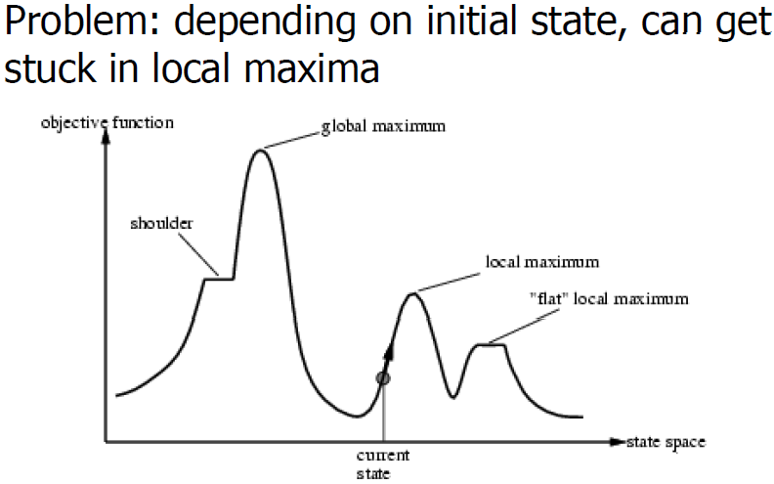
Hi-climbing search

Slide 37
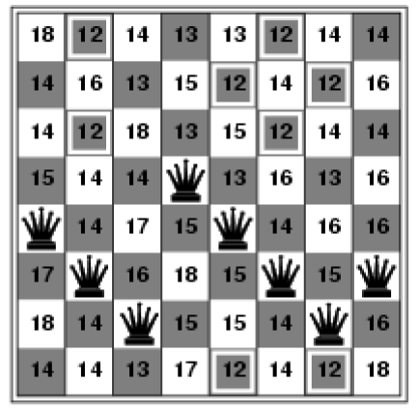
Hill-climbing search: 8-queens problem
h = number of pairs of queens that are attacking each other, either directly or indirectly
h = 17 for the above state

Slide 38
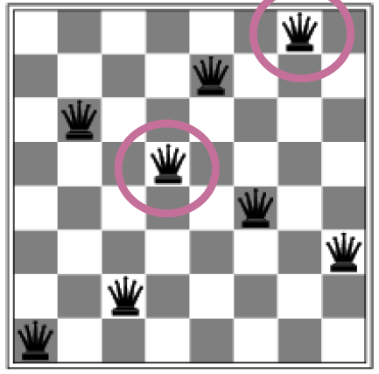
Hill-climbing search:8-queens problem
A local minimum with
h = 1

Slide 39
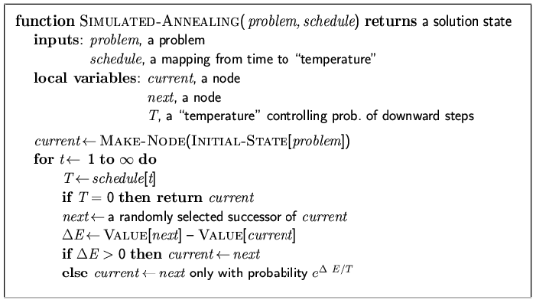
Simulated annealing search
Idea: escape local maxima by allowing some "bad“ moves but gradually decrease their frequency

Slide 40
Properties of simulated annealing search
One can prove: If T decreases slowly enough, then simulated annealing search will find a global optimum with probability approaching 1
Widely used in VLSI layout, airline scheduling, etc

Slide 41
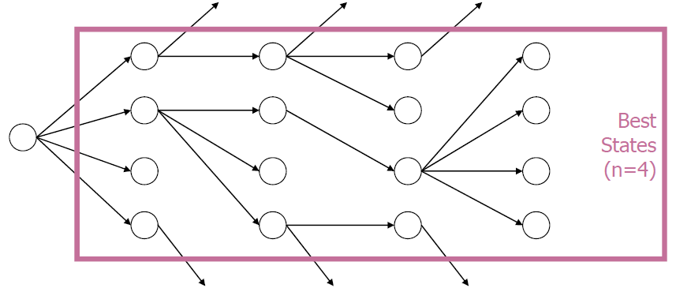
Local Beam search
Why keep just one best state?
Can be used with randomization

Slide 42
Genetic algorithms
A successor state is generated by combining two parent states
Start with k randomly generated states (population)
A state is represented as a string over a finite alphabet (often a string of 0s and 1s)
Evaluation function (fitness function). Higher values for better states
Produce the next generation of states by selection, and mutation

Slide 43
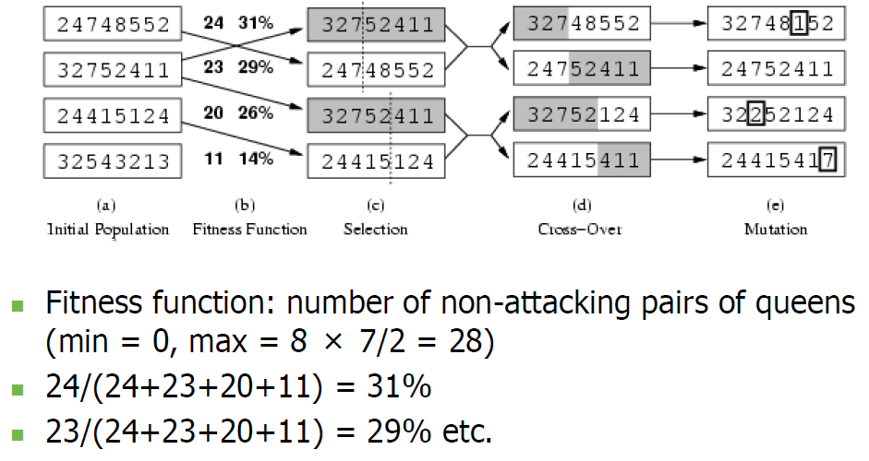
Genetic algorithms

Slide 44
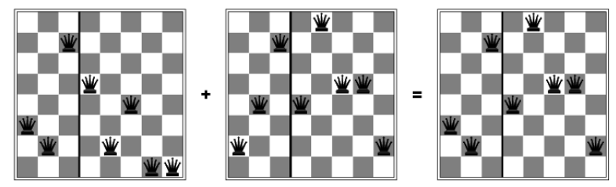
Genetic algorithms

Slide 45
Search w/ non-determinism
Fully observable, deterministic environments
Sensors, precepts no use
Consider erratic actuators
Action leads to a set of possible states
Plan will not be a set sequence, may have loops contingencies (if-then-else)

Slide 46
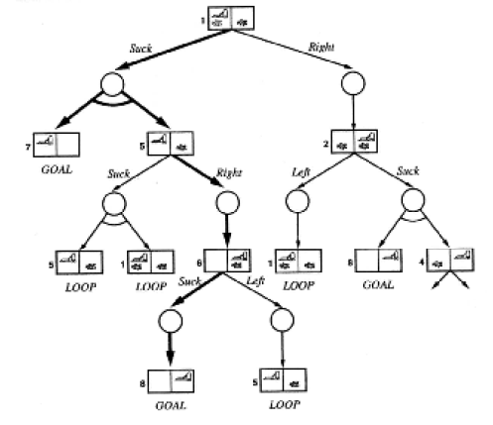
And-Or Search Tree
What does the “LOOP” label mean here?

Slide 47
Search w/ partial observations
Conformant problem – no observations
Useful! Solutions are independent of initial state
Coerce the state space into a subset of possible

Slide 48
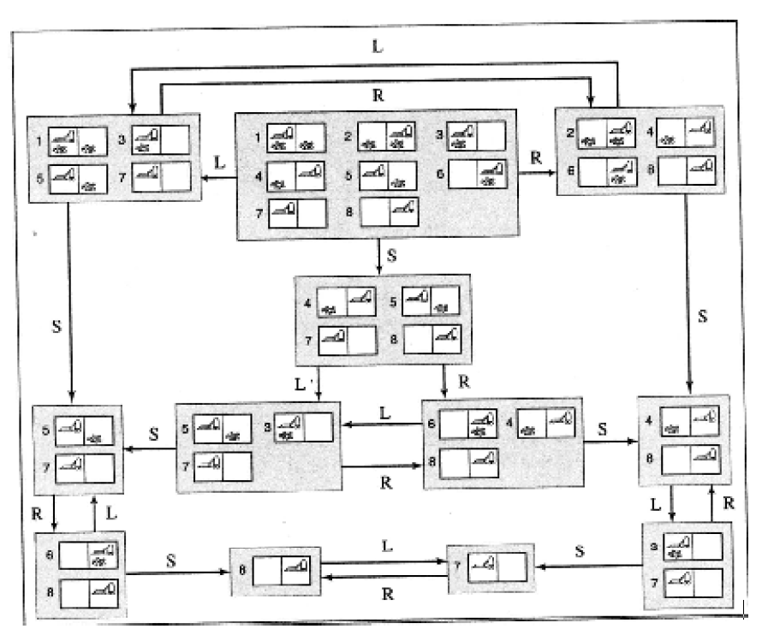

Slide 49
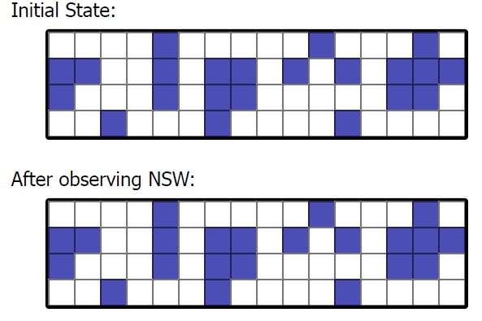
Localization
What about a really big set of initial?

Slide 50
Online search and exploration
Many problems are offline
Do search for action and then perform action
Online search interleave search & execution
Necessary for exploration problems
New observations only possible after acting

Slide 51
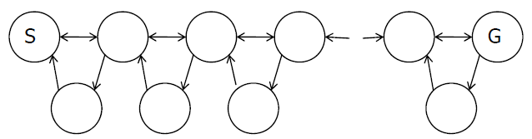
Exploratory Search
In an unknown state space, how to pick an action?
Any random action will do … but
Favor those that allow more exploration of the search space
Graph-search to track of states previously seen

Slide 52
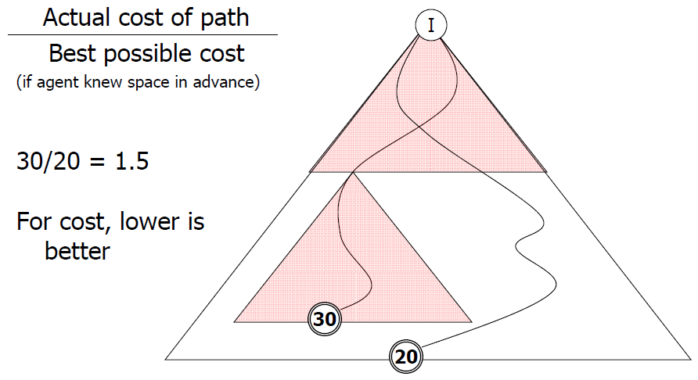
Assessing Online Agents: Competitive Ratio

Slide 53
Exploration problems
Exploration problems: agent physically in some part of the state space.
e.g. solving a maze using an agent with local wall sensors
Sensible to expand states easily accessible to agent (i.e. local states)
Local search algorithms apply (e.g., hill-climbing)

Slide 54
Assignment
Build a game player
Restricted by time per move (5 real-time secs)
Interact with the game driver through the command line
Each turn, we will run your program, providing the board state as input.
Your output will be the pair of coordinates indicating the piece to move and its destination.

