Slide 1
Adversarial Search
Lecture 4
Chapter 5

Slide 2
References
http://www.comp.nus.edu.sg/~kanmy/courses/3243_2010/syllabus.html

Slide 3
Outline
Last time: Heuristic, Informed search
h(x): utility function
Optimal decisions
α-β pruning
Imperfect, real-time decisions

Slide 4
Games vs. Search problems
“Unpredictable” opponent -> specifying a
move for every possible opponent reply
Time limits -> unlikely to find goal, must
Approximate
Hmm: Is Ataxx a game or a search problem
by this definition?

Slide 5

Two player games
Max always moves first.
Min is the opponent.
We have
An initial state.
A set of operators.
A terminal test (which tells us when the game is over).
A utility function (evaluation function).
The utility function is like the heuristic function we have seen in the past, except it evaluates a node in terms of how good it is for each player. Positive values indicate states advantageous for Max, negative values indicate states advantageous for Min.
Max Vs Min

Slide 6
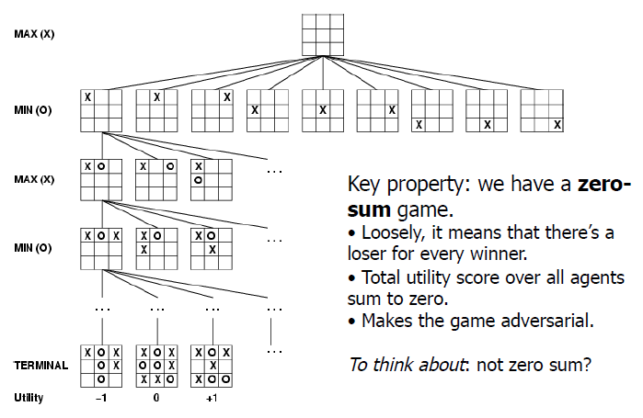
Game tree (2-player, deterministic, turns)

Slide 7
A simple abstract game.
Max makes a move, then Min replies.
A1
A2
A3
A11
A12
A13
A21
A22
A23
A31
A32
A33
3
12
8
2
4
6
14
5
2
An action by one player is called a ply, two ply (a action and a counter action) is called a move.

Slide 8
The Minimax Algorithm
Generate the game tree down to the terminal nodes.
Apply the utility function to the terminal nodes.
For a S set of sibling nodes, pass up to the parent…
the lowest value in S if the siblings are
the largest value in S if the siblings are
Recursively do the above, until the backed-up values reach the initial state.
The value of the initial state is the minimum score for Max.

Slide 9
3
A1
A2
A3
3
2
2
A11
A12
A13
A21
A22
A23
A31
A32
A33
3
12
8
2
4
6
14
5
2
In this game Max’s best move is A1, because he is guaranteed a score of at least 3.

Slide 10
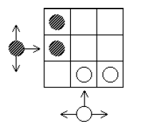
Example: Dodgen game

Slide 11
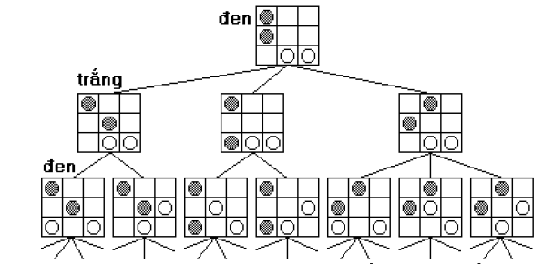
Example: Dodgen game

Slide 12
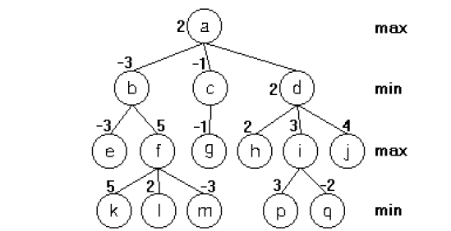
Example: Dodgen game

Slide 13
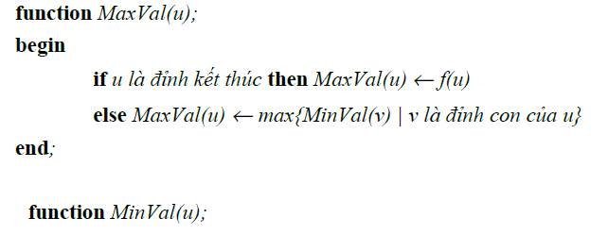
Evaluation Function
?

Slide 14
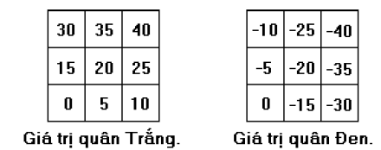
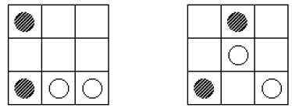
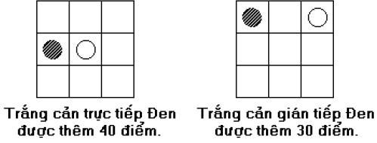
Evaluation Function
Eval(u)
Eval(u) > 0 : prefer Max
Eval(v) < 0 : prefer Min
?
?

Slide 15
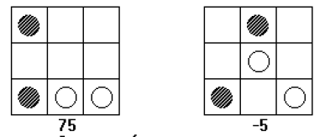
Evaluation Function

Slide 16
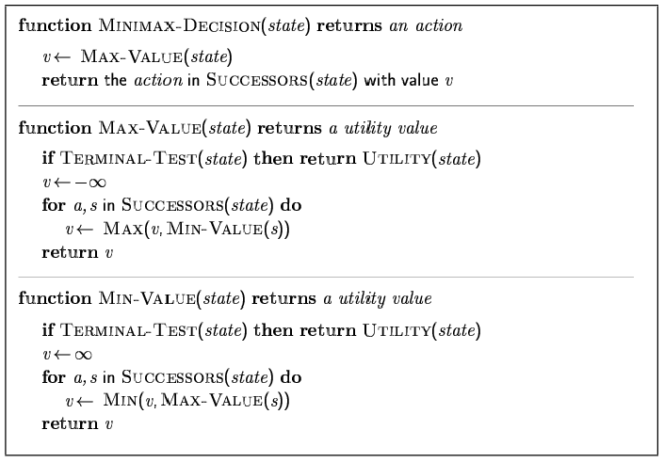
Minimax Algorithm

Slide 17
Properties of Minimax
Complete? Yes (if tree is finite)
Optimal? Yes (against an optimal opponent)
Time complexity? O(b^{m}), where b is the effective branching factor and m is the depth of the terminal states.
Space complexity? O(b^{m}) (depth-first exploration)
For chess, b ≈ 35, m ≈ 100 for “reasonable” games
-> exact solution completely infeasible
What can we do? PRUNING!

Slide 18
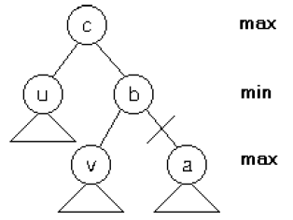
α-β Pruning
Prunning sub-tree a if Eval(u) > Eval(v)

Slide 19
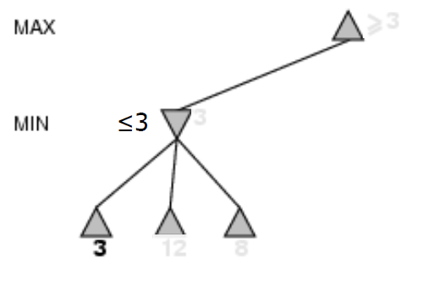
α-β Pruning example

Slide 20
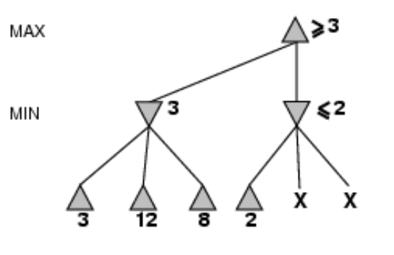
α-β Pruning example

Slide 21
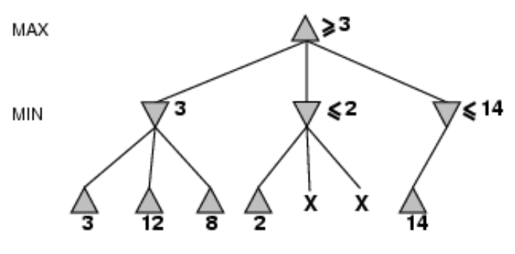
α-β Pruning example

Slide 22
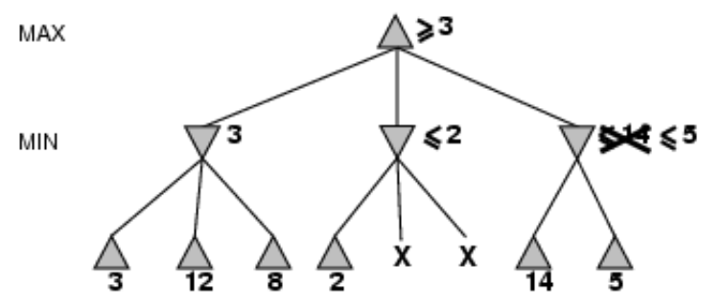
α-β Pruning example

Slide 23
α-β Pruning example

Slide 24
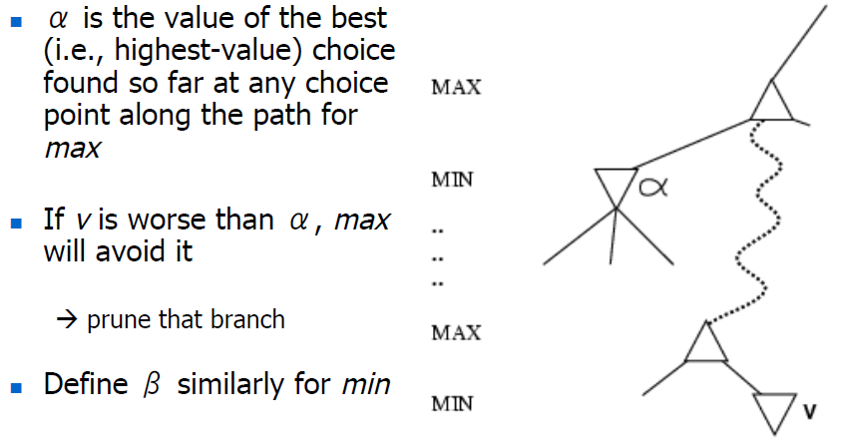
Why is it called α-β

Slide 25
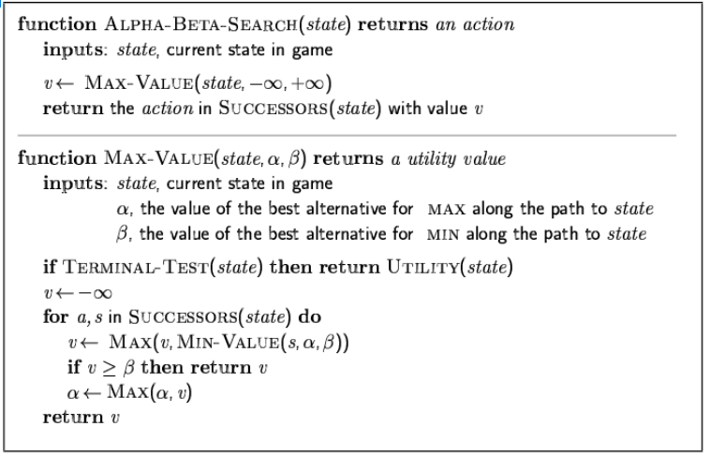
The α-β Algorithm

Slide 26
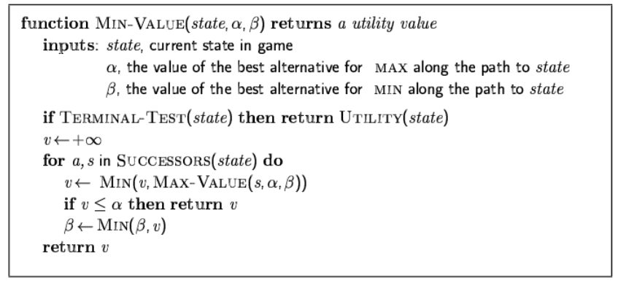
The α-β Algorithm

Slide 27
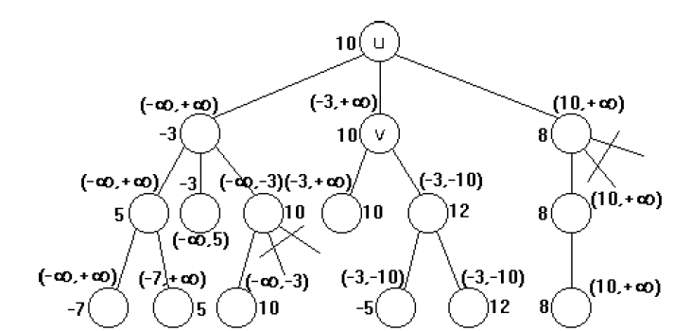
The α-β Algorithm: example

Slide 28
Resource Limits
The big problem is that the search space in typical games is very large.
Suppose we have 100 secs, explore 104 nodes/sec -> 106 nodes per move
Standard approach:
cutoff test:
e.g., depth limit
evaluation function
= estimated desirability of position

Slide 29
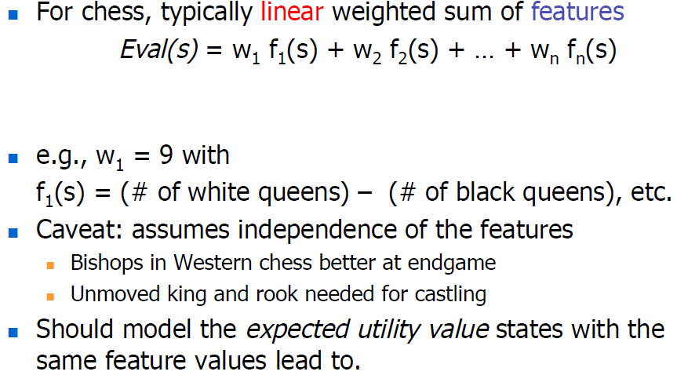
Evaluation functions

Slide 30
Other problems
Applying utility functions on end game scenarios may not solve the game
Use a policy or lookup table (taken from previous game history)
Stochastic games
Calculate the expected value of a position

Slide 31
What do you need to do
Implement Minimax
Implement Pruning (optional)
Implement an evaluation function
Input: board, selected grid location
Output: continuous value
(really optional) use state

Slide 32
Summary
Games are fun to work on!
They illustrate several important points about AI
Perfection is unattainable -> must
approximate
Good idea to think about what to think about

