Slide 1
Constraint Satisfaction Problem
Chapter 6

Slide 2
References
http://www.comp.nus.edu.sg/~kanmy/courses/3243_2010/syllabus.html

Slide 3
Outline
Constraint satisfaction problems?
Backtracking
Variable ordering and value selection
Forward checking
Constraint propagation
Iterative min-conflicts

Slide 4
Constraint satisfaction problems (CSPs)
Standard search problem:
state is a “black box” – any data structure that supports successor function, heuristic function, and goal test
CSP:
state is defined by variables Xi with values from domain Di
goal test is a set of constraints specifying allowable combinations of values for subsets of variables
Simple example of a formal representation language
Allows useful general-purpose algorithms with more power than standard search algorithms

Slide 5
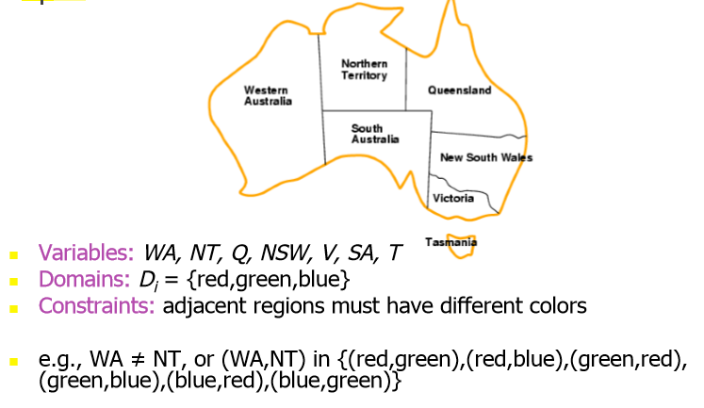
Example: Map-Coloring

Slide 6
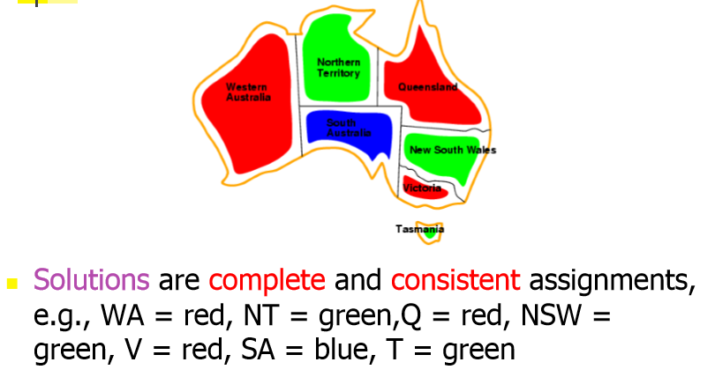
Example: Map-Coloring

Slide 7
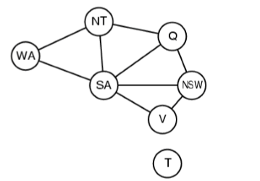
Constraint graph
Binary CSP: each constraint relates two variables
Constraint graph: nodes are variables, arcs are constraints

Slide 8
Varieties on the CSP formalism
Discrete variables
finite domains:
n variables, domain size d -> O(d^{n} ) complete assignments
e.g., Boolean CSPs, incl.~Boolean satisfiability (NP-complete)
infinite domains:
integers, strings, etc.
e.g., job scheduling, variables are start/end days for each job
need a constraint language, e.g., StartJob 1 + 5 ≤ StartJob 3
Continuous variables
e.g., start/end times for Hubble Space Telescope observations
linear constraints solvable in polynomial time by linear programming

Slide 9
Varieties of constraints
Unary constraints involve a single variable,
e.g., SA ≠ green
Binary constraints involve pairs of variables,
e.g., SA ≠ WA
Higher-order constraints involve 3 or more variables,
e.g., cryptarithmetic column constraints

Slide 10
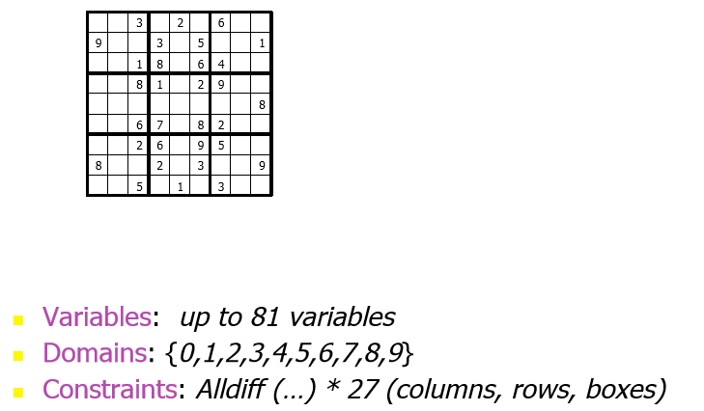
Example: Sudoku

Slide 11
Real-world CSPs
Assignment problems
e.g., who teaches what class
Timetabling problems
e.g., which class is offered when and where?
Transportation scheduling
Factory scheduling
Many real-world problems involve real-valued variables
Many problems also feature preferences (I don’t want to on Monday morning)

Slide 12
Standard search formulation (incremental)
Let's start with the straightforward approach, then fix it
States are defined by the values assigned so far
Initial state: the empty assignment { }
Successor function: assign a value to an unassigned variable that does not conflict with current assignment->fail if no legal assignments
Goal test: the current assignment is complete
This is the same for all CSPs 2. Every solution appears at depth n with n variables -> use depth-first search
Path is irrelevant, so can also use complete-state formulation

Slide 13
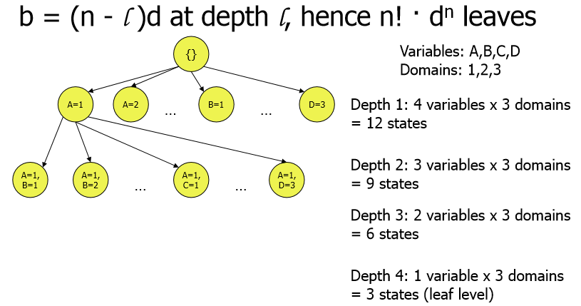
CSP Search tree size

Slide 14
Backtracking search
Variable assignments are commutative, i.e.,
[ WA = red then NT = green ] same as [ NT = green then WA = red ]
Only need to consider assignments to a single variable at each node
Fix an order in which we’ll examine the variables
-> b = d and there are d^{n} leaves
Depth-first search for CSPs with single-variable assignments is called backtracking search
Is the basic uninformed algorithm for CSPs
Can solve n-quens for n ~ 25

Slide 15
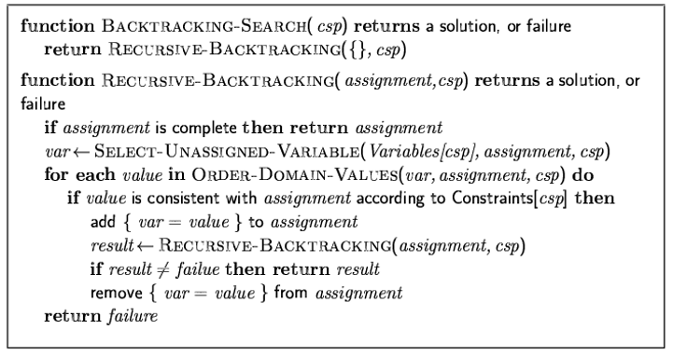
Backtracking search

Slide 16

Backtracking example

Slide 17
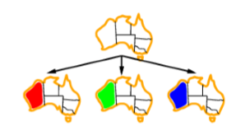
Backtracking example

Slide 18
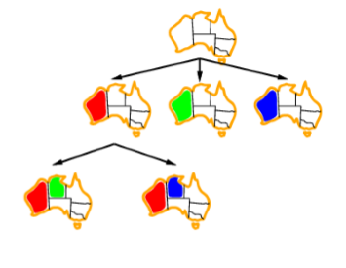
Backtracking example

Slide 19
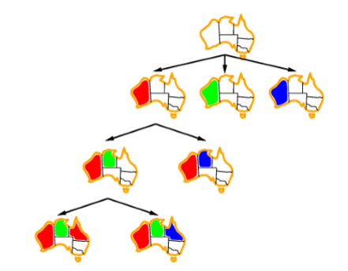
Backtracking example

Slide 20
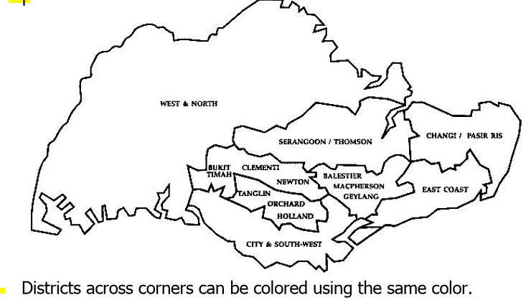
Exercise - paint the town

Slide 21
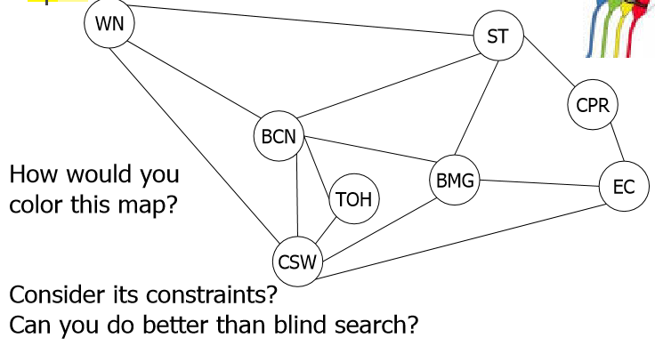
Constraint Graph

Slide 22
Improving backtracking efficiency
General-purpose methods can yield significant gains in speed:
Which variable should be assigned next?
In what order should its values be tried?
Can we detect inevitable failure early?

Slide 23
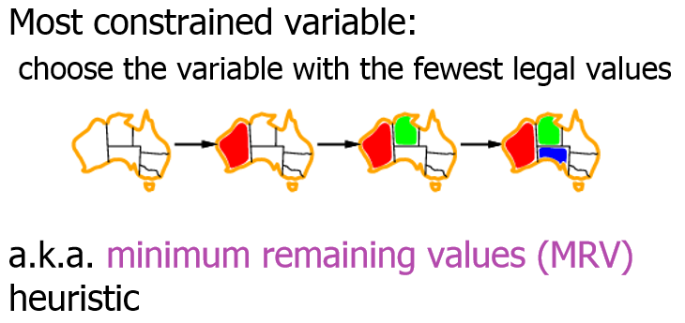
Most constrained variable

Slide 24
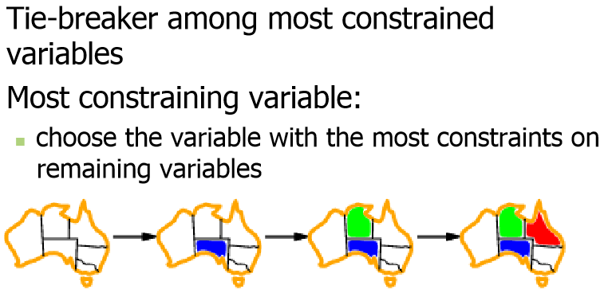
Most constraining variable

Slide 25
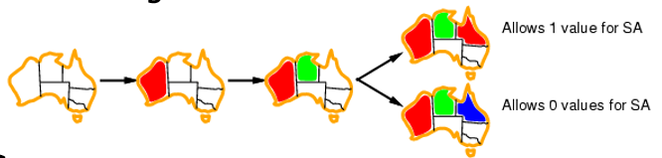
Least constraining value
Given a variable, choose the least constraining value:
the one that rules out the fewest values in the remaining variables
Combining these heuristics makes 1000 queens feasible

Slide 26
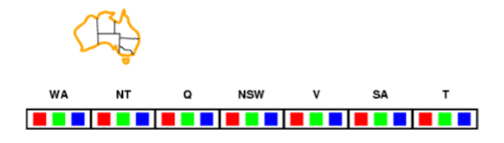
Forward checking
Idea:
Keep track of remaining legal values for unassigned variables
Terminate search when any variable has no legal values

Slide 27
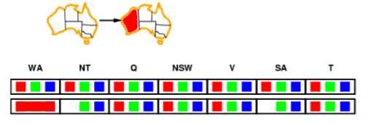
Forward checking
Idea:
Keep track of remaining legal values for unassigned variables
Terminate search when any variable has no legal values

Slide 28
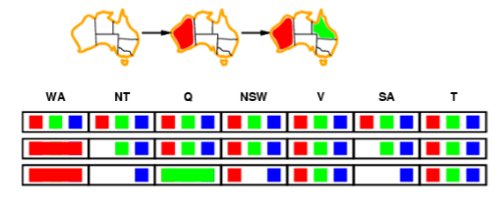
Forward checking
Idea:
Keep track of remaining legal values for unassigned variables
Terminate search when any variable has no legal values

Slide 29
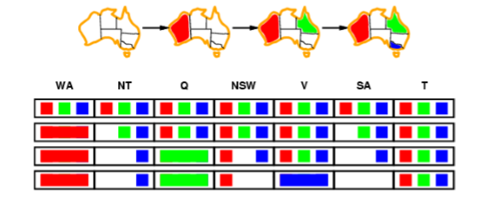
Forward checking
Idea:
Keep track of remaining legal values for unassigned variables
Terminate search when any variable has no legal values

Slide 30
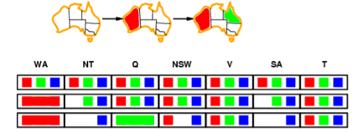
Constraint propagation
Forward checking propagates information from assigned to unassigned variables, but doesn't provide early detection for all failures:
NT and SA cannot both be blue!
Constraint propagation repeatedly enforces constraints locally

Slide 31
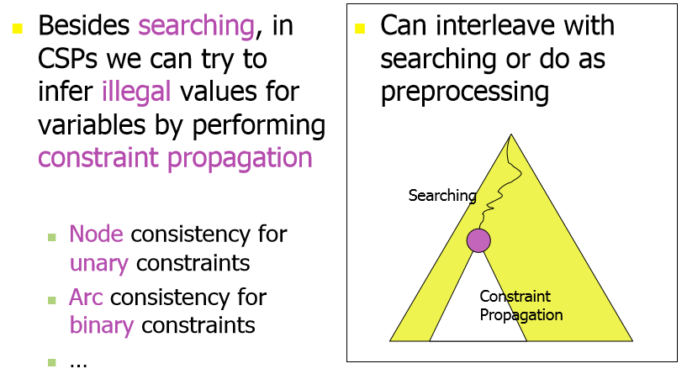
Inference in CSPs

Slide 32
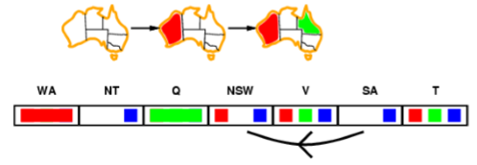
Arc consistency
Simplest form of propagation makes each arc consistent
X -> Y is consistent iff for every value x of X there is some allowed y

Slide 33
More on arc consistency
Arc consistency is based on a very simple concept
if we can look at just one constraint and see that x=v is impossible …
obviously we can remove the value x=v from consideration
How do we know a value is impossible?
If the constraint provides no support for the value
e.g. if Dx = {1,4,5} and Dy = {1, 2, 3}
then the constraint x > y provides no support for x=1
we can remove x=1 from Dx

Slide 34
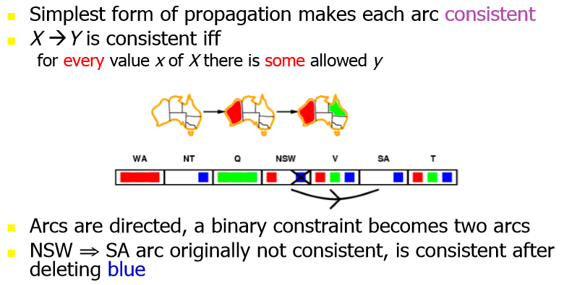
Arc consistency

Slide 35
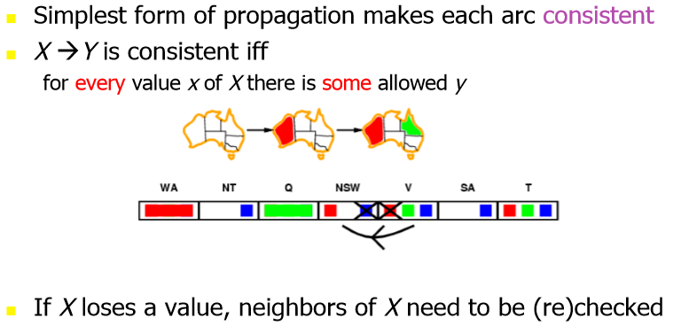
Arc consistency

Slide 36
Arc consistency propagation
When we remove a value from Dx, we may get new removals because of it
E.g. Dx = {1,4,5}, Dy = {1, 2, 3}, Dz= {2, 3, 4, 5}
x > y, z > x
As before we can remove 1 from Dx, so Dx = {4,5}
But now there is no support for Dz = 2,3,4
So we can remove those values, Dz = {5}, so z=5
Before AC applied to y-x, we could not change Dz
This can cause a chain reaction

Slide 37
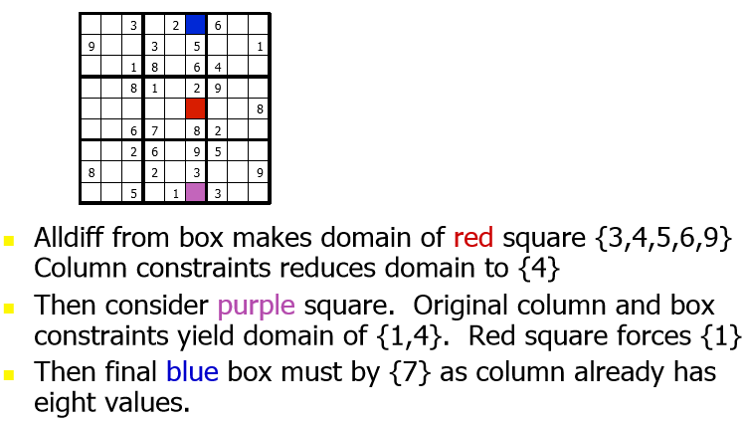
Sudoku Chain Reaction

Slide 38
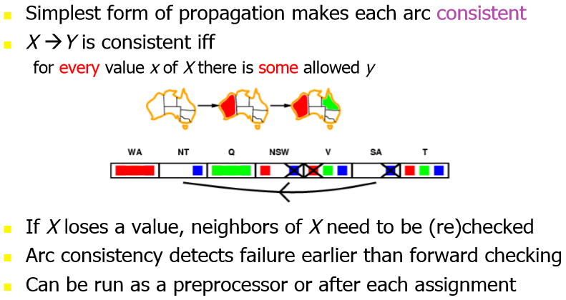
Arc consistency

Slide 39
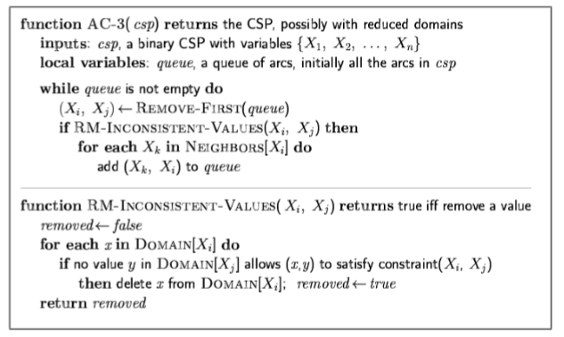
Arc consistency algorithm AC-3
Time complexity: O(n²d³)

Slide 40
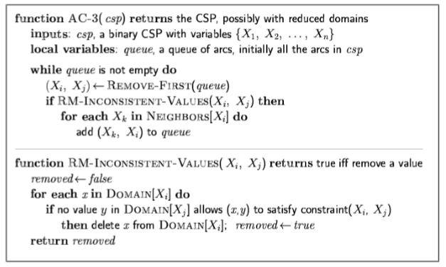
Time complexity of AC-3
CSP has n² directed arcs
Each arc X_{i},X_{j} has d possible values.
For each value we can reinsert the neighboring arc X_{k},X_{i} at most d times because X_{i} has d values
Checking an arc requires at most d² time
■ O(n² * d * d²) = O(n²d³)

Slide 41
Maintaining AC (MAC)
We can use AC in search
i.e. search proceeds as follows:
establish AC at the root
when AC3 terminates, choose a new variable/value
re-establish AC given the new variable choice (i.e. maintain AC) repeat;
backtrack if AC gives domain wipe out
The hard part of implementation is undoing effects of AC

Slide 42
Special kinds of Consistency
Some kinds of constraint lend themselves to special kinds of arc-consistency
Consider the all-different constraint
the named variables must all take different values
not a binary constraint
can be expressed as n(n-1)/2 not-equals constraints
We can apply (e.g.) AC3 as usual
But there is a much better option

Slide 43
All Different
Suppose Dx = {2,3} = Dy, Dz = {1,2,3}
All the constraints x≠y, y≠z, z≠x are all arc consistent
e.g. x=2 supports the value z = 3
The single ternary constraint AllDifferent(x,y,z) is not!
We must set z = 1
A special purpose algorithm exists for All-Different to establish GAC in efficient time
Special purpose propagation algorithms are vital

Slide 44
K-consistency
Arc Consistency (2-consistency) can be extended to kconsistency
3-consistency (path consistency): any pair of adjacent variables can always be extended to a third neighbor.
Catches problem with Dx, Dy and Dz, as assignment of Dz = 2 and Dx = 3 will lead to domain wipe out.
But is expensive, exponential time
n -consistency means the problem is solvable in linear time
As any selection of variables would lead to a solution
In general, need to strike a balance between consistency and search.
This is usually done by experimentation.

Slide 45
Local search for CSPs
Hill-climbing, simulated annealing typically work with "complete" states, i.e., all variables assigned
To apply to CSPs:
allow states with unsatisfied constraints
operators re-assign variable values
Variable selection: randomly select any conflicted variable
Value selection by min-conflicts heuristic:
choose value that violates the fewest constraints
i.e., hill-climb with h(n) = total number of violated constraints

Slide 46
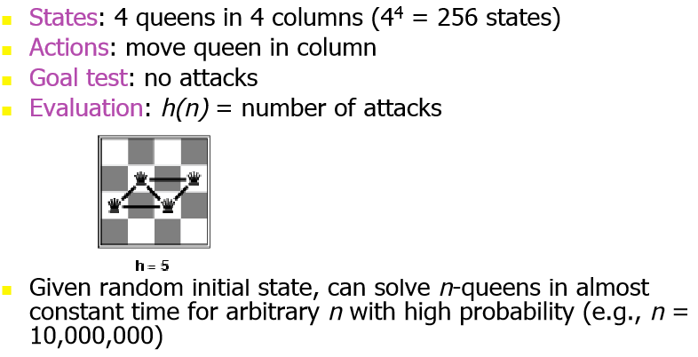
Example: 4-Queens

Slide 47
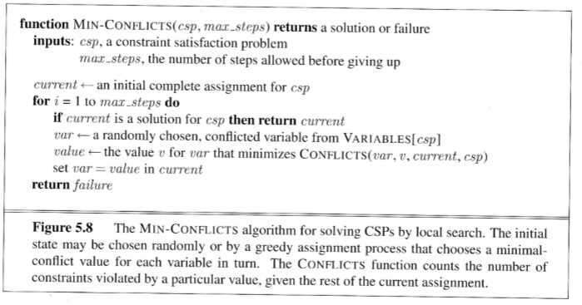
Min-conflicts

Slide 48
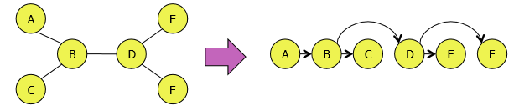
The structure of problems
Independent subproblems = unconnected components
(Return to this point after midterm)
Tree based CSPs can be solved by topological sort
Pick a root and “dangle” other nodes by it
Will have n-1 arcs, can make arc consistent in O( n )
O( nd² )

Slide 49
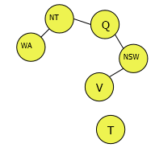
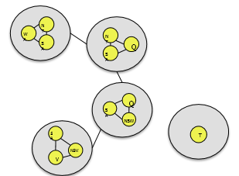
Reducing CSP Trees
Reduce other problems to trees, to use Tree-CSP-Solver, which yields solutions without backtracking. Aim to reduce to many small subproblems.
Two approaches:
Remove nodes from CSP graph to make a tree
Assign values to removed nodes and remove used domains from tree nodes
Tree decomposition: make tree CSP with nodes as subproblems

Slide 50
Summary
CSPs are a special kind of problem:
states defined by values of a fixed set of variables
goal test defined by constraints on variable values
Backtracking = depth-first search with one variable assigned per node
Variable ordering and value selection heuristics help significantly
Forward checking prevents assignments that guarantee later failure
Constraint propagation (e.g., arc consistency) does additional work to constrain values and detect inconsistencies
Iterative min-conflicts is usually effective in practice

