Slide 1
Logical Agents
Chapter 7

Slide 2
References
http://www.comp.nus.edu.sg/~kanmy/courses/3243_2010/syllabus.html

Slide 3
Outline
Knowledge-based agents
Logic: models and entailment
A simple Logic: propositional (Boolean) logic
Inference rules and theorem proving
Forward chaining
Backward chaining
resolution

Slide 4
Knowledge based agents
Knowledge base (KB) = set of sentences in a formal language
Declarative (as opposed to procedural) approach to build an agent:
Tell it what it needs to know
Then it can Ask itself what to do - answers should follow from the KB
Agents can be viewed at the knowledge level
i.e., what they know, regardless of how implemented
Or at the implementation level  i.e., data structures in KB and algorithms that manipulate them

Slide 5
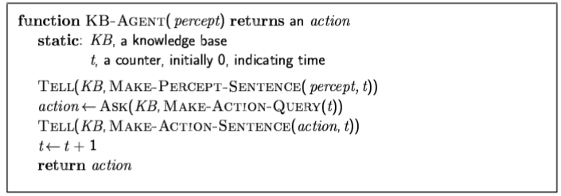
A simple knowledge-based agent
The agent must be able to:
Represent states, actions, etc.
Incorporate new percepts
Update internal representations of the world
Deduce hidden properties of the world
Deduce appropriate actions

Slide 6
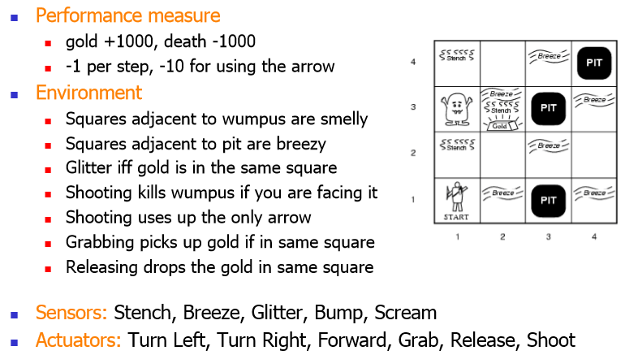
Wumpus World PEAS description

Slide 7
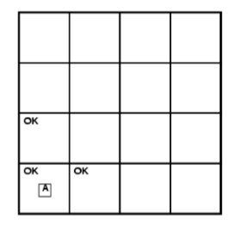
Exploring a wumpus world

Slide 8
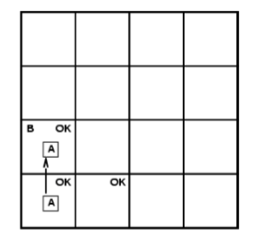
Exploring a wumpus world

Slide 9
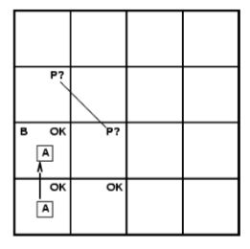
Exploring a wumpus world

Slide 10
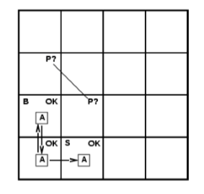
Exploring a wumpus world

Slide 11
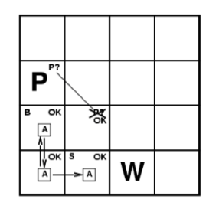
Exploring a wumpus world

Slide 12
Logics
Logics are formal languages for representing information such that conclusions can be drawn
Syntax defines the sentences in the language
Semantics define the "meaning" of sentences;
i.e., define truth of a sentence in a world
E.g., the language of arithmetic
X+2 ≥ y is a sentence; x2+y > {} is not a sentence
x+2 ≥ y is true iff the number x+2 is no less than the number y
x+2 ≥ y is true in a world where x = 7, y = 1
x+2 ≥ y is false in a world where x = 0, y = 6

Slide 13
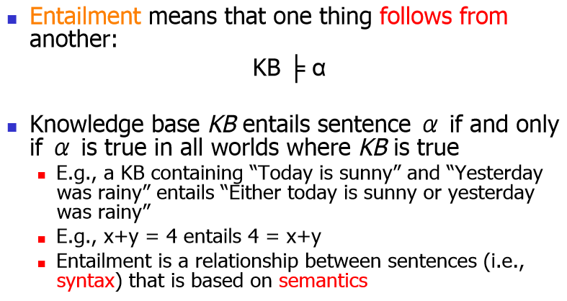
Entailment

Slide 14
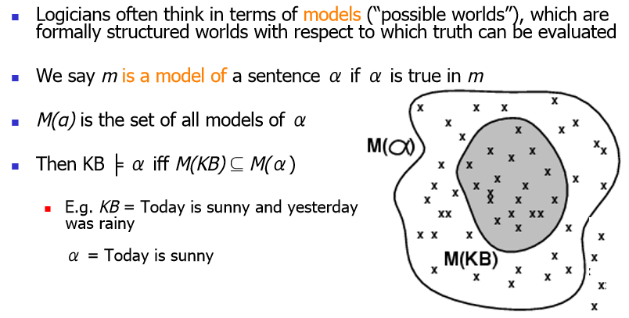
Models

Slide 15
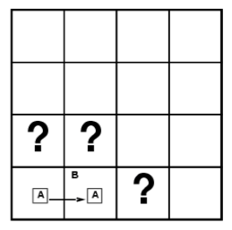
Entailment in the wumpus world
Situation after detecting nothing in [1,1], moving right, breeze in [2,1]
Consider possible models for KB assuming only pits
3 Boolean choices ⇒ 8 possible models

Slide 16
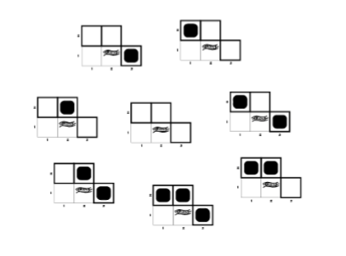
Wumpus world models

Slide 17
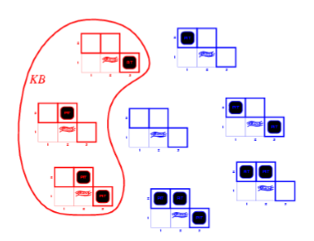
Wumpus models
KB = wumpus-world rules + observations

Slide 18
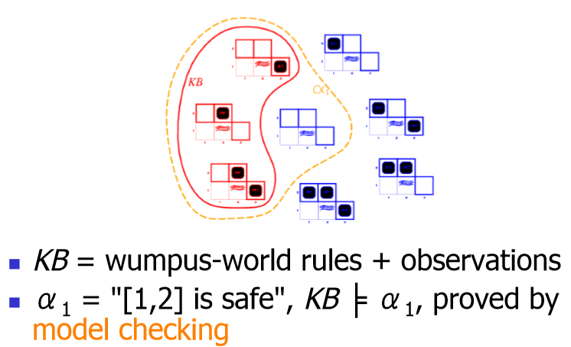
Wumpus models

Slide 19
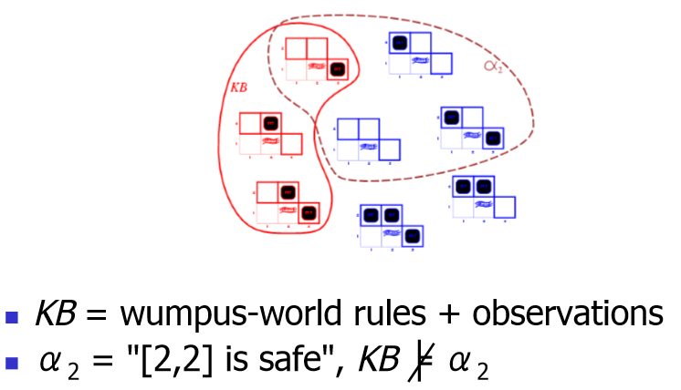
Wumpus models

Slide 20
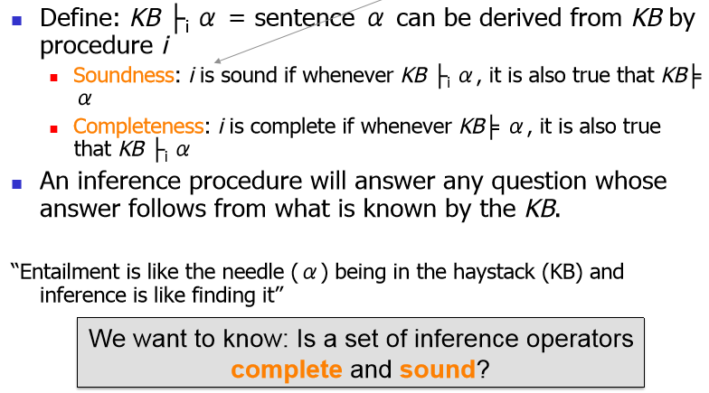
Inference

Slide 21
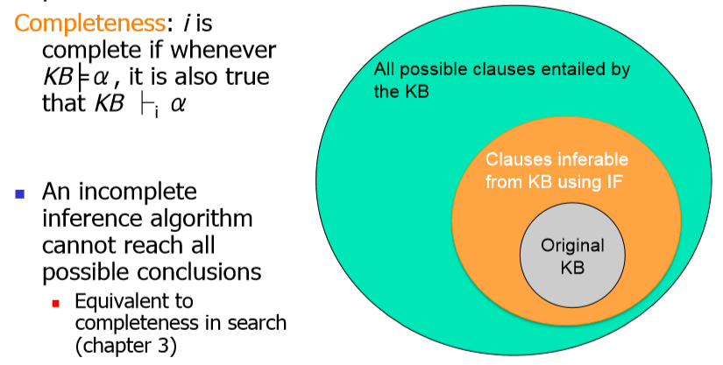
Completeness

Slide 22
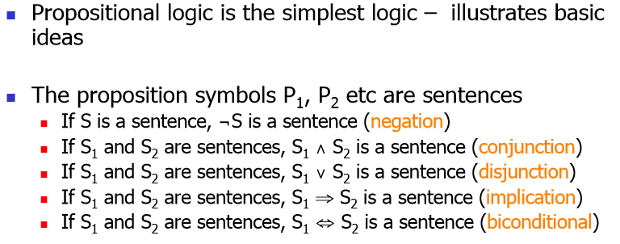
Propositional logic: Syntax

Slide 23
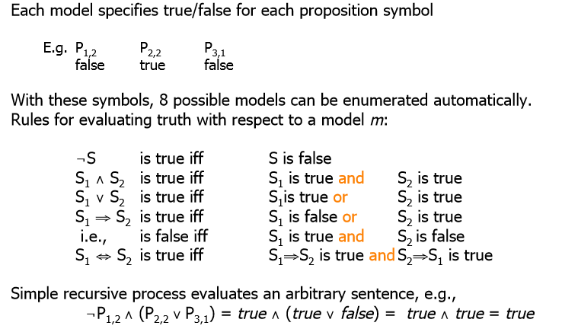
Propositional logic: Semantics

Slide 24
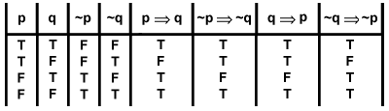
Truth tables for connectives

Slide 25
Wumpus world sentences
Let P_{i,j} be true if there is a pit in [i, j].
Let B_{i,j} be true if there is a breeze in [i, j].
¬P_{1,1}
¬B_{1,1}
B_{2,1}
How do we translate "Pits cause breezes in adjacent squares”?

Slide 26
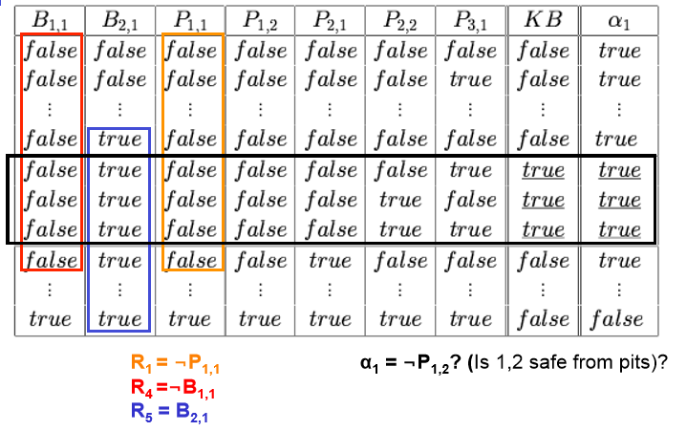
Truth tables for inference

Slide 27
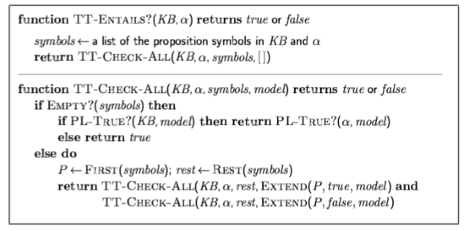
Inference by enumeration
Depth-first enumeration of all models is sound and complete
For n symbols, time complexity is O(2^{n} ) , space complexity is O(n)

Slide 28
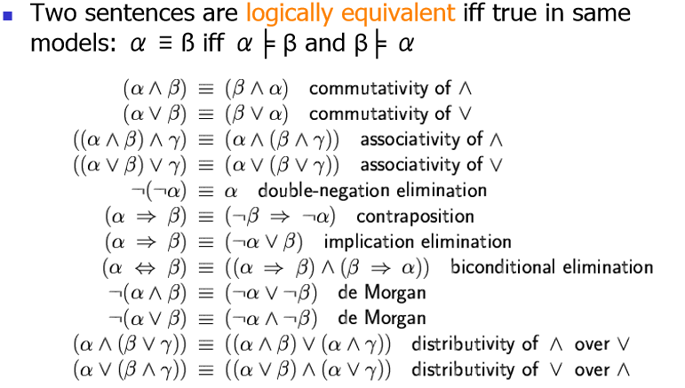
Logical equivalence

Slide 29
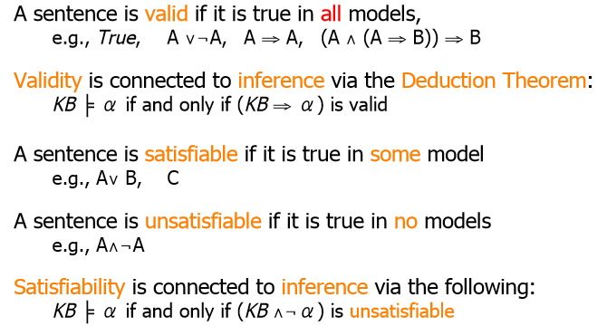
Validity and satisfiability Validity and satisfiability

Slide 30
Proof methods
Proof methods divide into (roughly) two kinds:
Application of inference rules
Legitimate (sound) generation of new sentences from old
Proof = a sequence of inference rule applications Can use inference rules as operators in a standard search algorithm
Typically require transformation of sentences into a normal form
Model checking
truth table enumeration (always exponential in n )
improved backtracking, e.g., Davis-Putnam-Logemann-Loveland (DPLL)
heuristic search in model space (sound but incomplete)
e.g., min-conflicts like hill-climbing algorithms

Slide 31
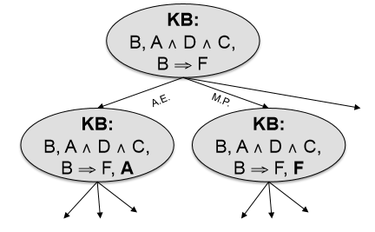
Applying inference rules
Equivalent to a search problem
KB state = node
Inference rule application = edge

Slide 32
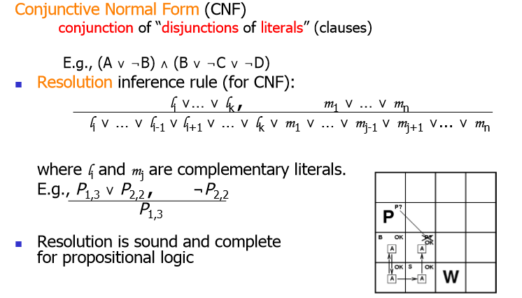
Resolution

Slide 33
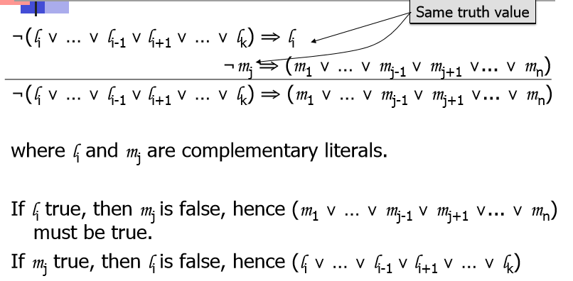
Soundness of Resolution

Slide 34
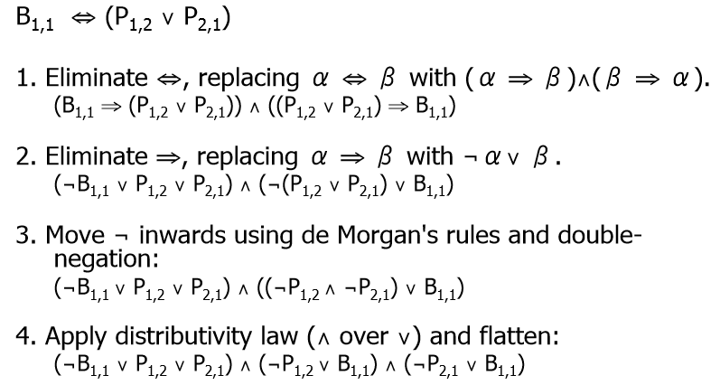
Conversion to CNF

Slide 35
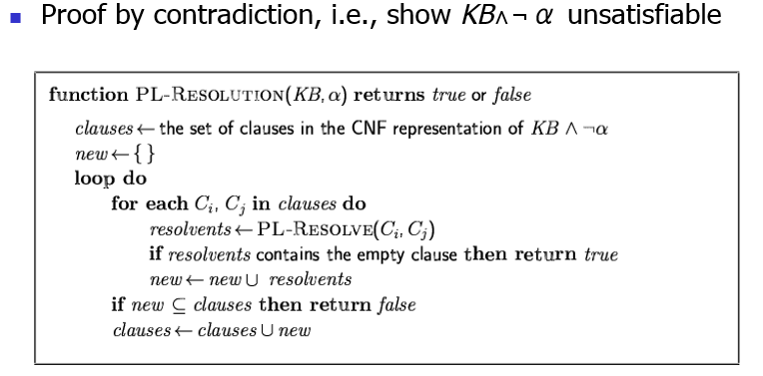
Resolution algorithm

Slide 36
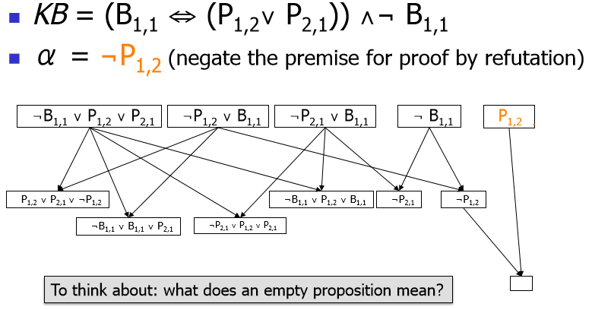
Resolution example

Slide 37
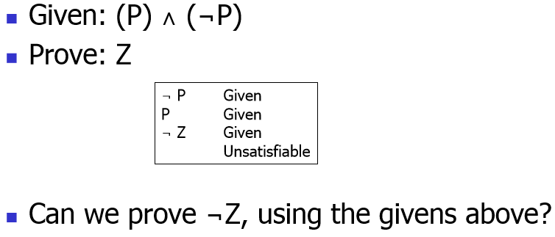
The power of false

Slide 38
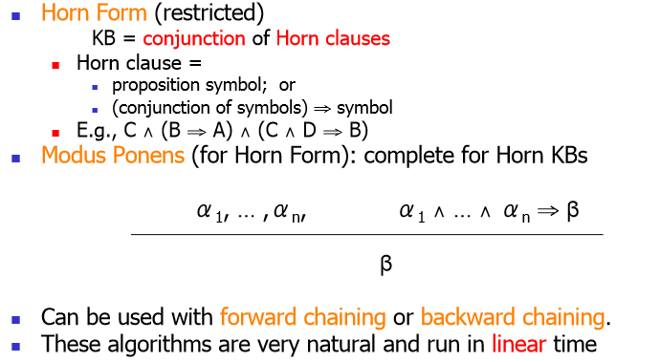
Forward and backward chaining

Slide 39
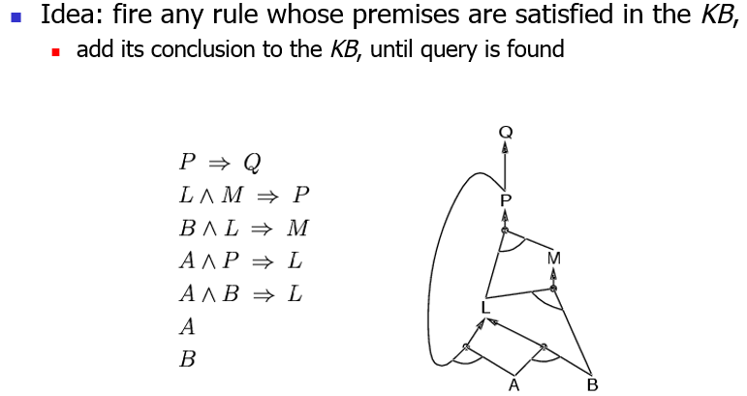
Forward chaining

Slide 40
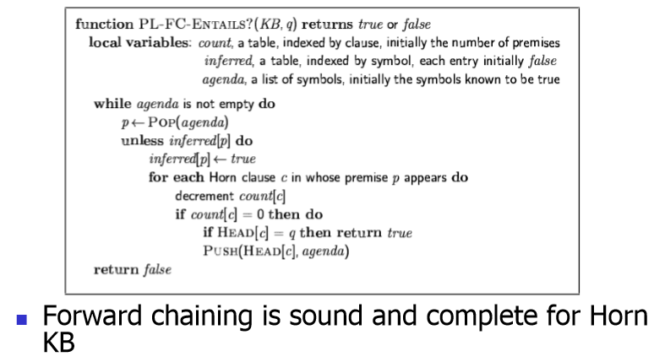
Forward chaining algorithm

Slide 41
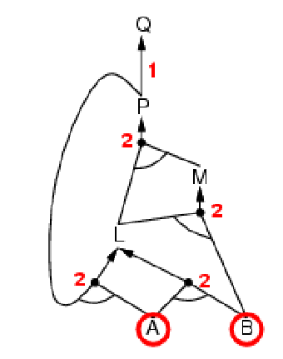
Forward chaining example

Slide 42
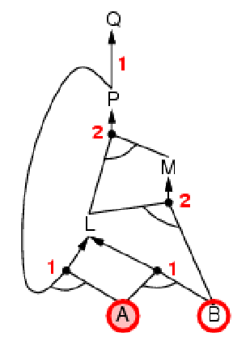
Forward chaining example

Slide 43
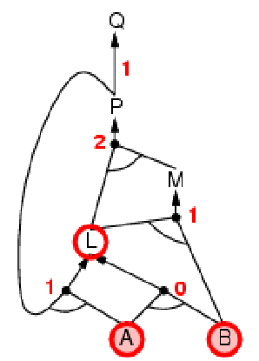
Forward chaining example

Slide 44
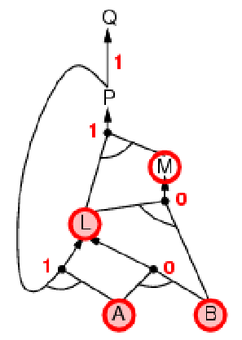
Forward chaining example

Slide 45
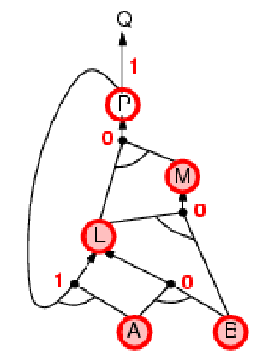
Forward chaining example

Slide 46
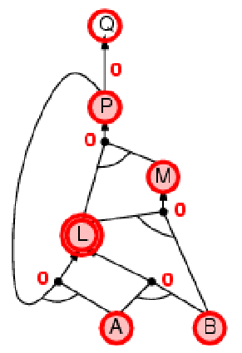
Forward chaining example

Slide 47
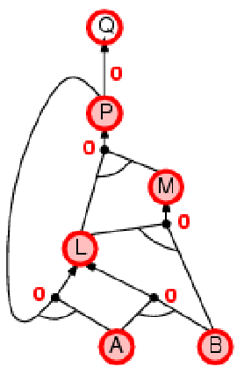
Forward chaining example

Slide 48
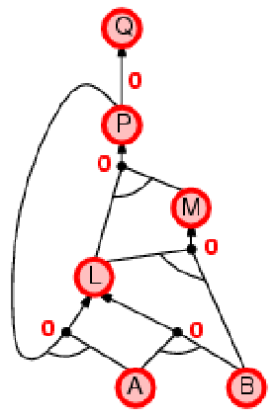
Forward chaining example

Slide 49
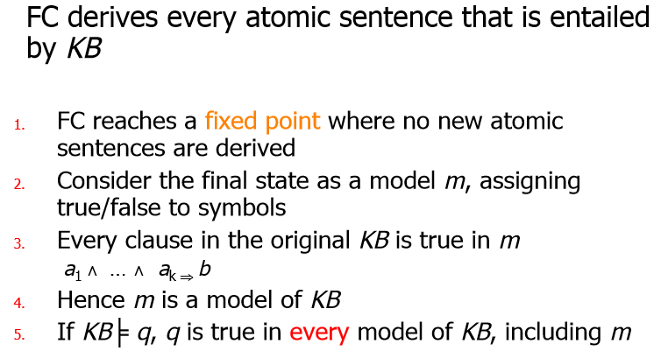
Proof of completeness

Slide 50
Backward chaining
Idea: work backwards from the query q :
to prove q by BC,
check if q is known already, or
prove by BC all premises of some rule concluding q
Avoid loops: check if new subgoal is already on the goal stack
Avoid repeated work: check if new subgoal
1. has already been proved true, or
2. has already failed

Slide 51
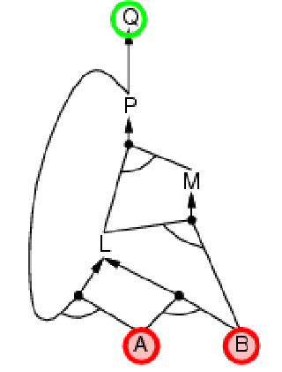
Backward chaining example

Slide 52
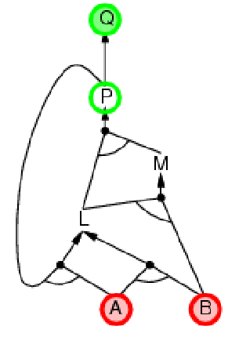
Backward chaining example

Slide 53
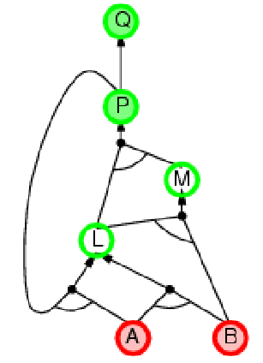
Backward chaining example

Slide 54
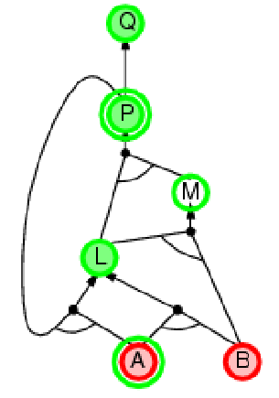
Backward chaining example

Slide 55
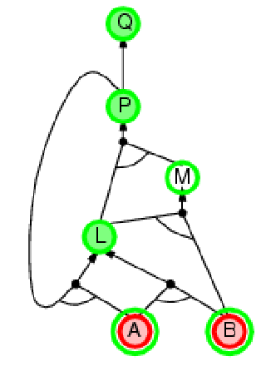
Backward chaining example

Slide 56
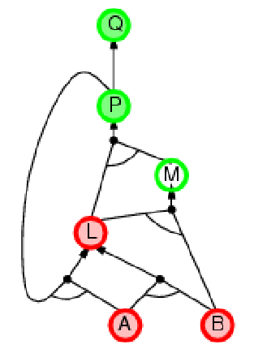
Backward chaining example

Slide 57
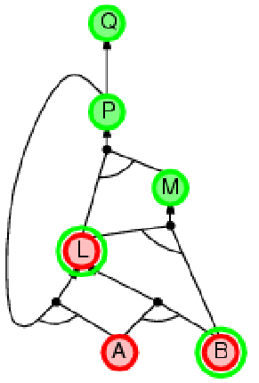
Backward chaining example

Slide 58
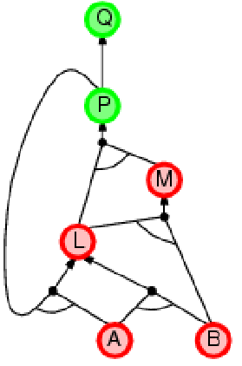
Backward chaining example

Slide 59

Backward chaining example

Slide 60

Backward chaining example

Slide 61
Forward vs. backward chaining
FC is data-driven, automatic, unconscious processing,
e.g., object recognition, routine decisions
May do lots of work that is irrelevant to the goal
BC is goal-driven, appropriate for problem-solving,
e.g., Where are my keys? How do I get into a PhD program?
Complexity of BC can be much less than linear in size of KB

Slide 62
Efficient propositional inference
Two families of efficient algorithms for propositional inference:
Complete backtracking search algorithms
DPLL algorithm (Davis, Putnam, Logemann, Loveland)
Incomplete local search algorithms  WalkSAT algorithm

Slide 63

The DPLL algorithm

Slide 64

The DPLL algorithm

Slide 65
The WalkSAT algorithm
Incomplete, local search algorithm
Evaluation function: The min-conflict heuristic of minimizing the number of unsatisfied clauses
Balance between greediness and randomness

Slide 66

The WalkSAT algorithm

Slide 67
Hard satisfiability problems
Consider random 3-CNF sentences. e.g.,
(¬D ∨ ¬B ∨ C) ∧ (B ∨ ¬A ∨ ¬C) ∧ (¬C ∨ ¬B ∨ E) ∧ (E ∨ ¬D ∨ B) ∧ (B ∨ E ∨ ¬C)
m = number of clauses
n = number of symbols
Hard problems seem to cluster near m/n = 4.3 (critical point)

Slide 68

Hard satisfiability problems

Slide 69

Hard satisfiability problems

Slide 70

Inference-based agents in the wumpus world

Slide 71

Expressiveness limitation of propositional logic

Slide 72
Summary
Logical agents apply inference to a knowledge base to derive new information and make decisions
Basic concepts of logic:
syntax: formal structure of sentences
semantics: truth of sentences w.r.t. models
entailment: necessary truth of one sentence given another
inference: deriving sentences from other sentences
soundness: derivations produce only entailed sentences
completeness: derivations can produce all entailed sentences
The wumpus world requires the ability to represent partial and negated information, reason by cases, etc.
Resolution is complete for propositional logic Forward, backward chaining are linear-time, complete for Horn clauses
Propositional logic lacks expressive power

