Slide 1
State Space Search
Review #1

Slide 2
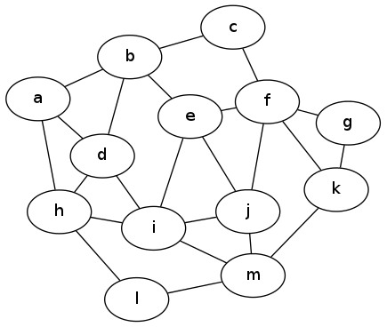
Graph 1

Slide 3
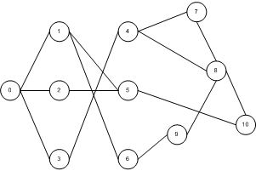
Graph 2

Slide 4
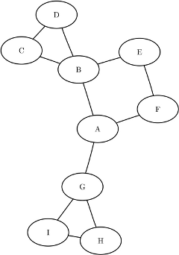
Graph 3

