Slide 1
Chapter 2
Data Encryption Algorithms
J. Wang and Z. Kissel. Introduction to Network Security: Theory and Practice. Wiley and HEP, 2015

Slide 2
Chapter 2 outline
2.1 Data Encryption Algorithm Design Criteria
2.2 Data Encryption Standard
2.3 Multiple DES
2.4 Advanced Encryption Standard
2.5 Standard Block-Cipher Modes of Operations
2.6 Stream Ciphers
2.7 Key Generations
J. Wang and Z. Kissel. Introduction to Network Security: Theory and Practice. Wiley and HEP, 2015

Slide 3
Things to know
Any message written over a fixed set of symbols can be represented as a binary string (a sequence of 0's and 1's)
Binary digits 0 and 1 are called bits
To reduce computation overhead, encryption algorithms should only use operations that are easy to implement
J. Wang and Z. Kissel. Introduction to Network Security: Theory and Practice. Wiley and HEP, 2015

Slide 4

For a binary string X:
  The length of X, denoted by |X|, is the number of bits in X
  If |X| = l, X is an l-bit binary string
  Let a be a binary bit and k a non-negative integer. Denote by a^{k} a string consisting of k copies of a
  Denote the concatenation of X and Y by XY or X||Y
J. Wang and Z. Kissel. Introduction to Network Security: Theory and Practice. Wiley and HEP, 2015

Slide 5
What is Encryption?
There are two approaches to network security
  Crypto based: cryptographic algorithms and security protocols
  System based: non-crypto
  Combination of both forms a standard security structure
Encryption
  Make plain text messages unintelligible
  The unintelligible text can be converted back to its original form
J. Wang and Z. Kissel. Introduction to Network Security: Theory and Practice. Wiley and HEP, 2015

Slide 6
Common encryption methods
Common encryption methods use secret keys and algorithms
  Conventional encryption algorithms (a.k.a. symmetric-key encryption algorithms): Same key for encryption and decryption
  Public-key encryption algorithms (a.k.a. asymmetric-key encryption algorithms): Different keys for encryption and decryption
J. Wang and Z. Kissel. Introduction to Network Security: Theory and Practice. Wiley and HEP, 2015

Slide 7
Example: Substitution
A one-to-one mapping of characters; e.g.
substitute a with d, b with z, c with t, etc
Unreadable to untrained eyes, this method maintains the statistical structure of the underlying language (e.g. character frequency)
In English, the letter “e” appears most frequently of all single letters
The letter with the highest frequency in the unintelligible text is likely the letter “e”
The method can be applied to other letters and letter sequences to find the original message
J. Wang and Z. Kissel. Introduction to Network Security: Theory and Practice. Wiley and HEP, 2015

Slide 8
ASCII Code
7-bit binary strings
  first and last 32 codes are control codes
  32 to 126 encode capital and lower-case English letters, decimal digits, punctuation marks, and arithmetic operation notations
We often add an extra bit in front, making each character a byte
  This allows us to either represent 128 extra characters, or have a parity bit for error detection
The length of any binary string in ASCII is therefore divisible by 8
The length of codes in other code sets, e.g. the Unicode, is divisible by 16
Without loss of generality, assume the length of any plaintext string in binary is divisible by 8
J. Wang and Z. Kissel. Introduction to Network Security: Theory and Practice. Wiley and HEP, 2015

Slide 9
XOR Encryption
The exclusive-OR operation, denoted by ⊕ or XOR, is a simple binary operation used in encryption
XOR encryption: Divide a string into blocks of equal length and encrypt each block with a secrete key of the same size of the block
J. Wang and Z. Kissel. Introduction to Network Security: Theory and Practice. Wiley and HEP, 2015

Slide 10
XOR Encryption Example
Block size of 8 (1 byte), on a two character (2 byte) string M
An 8-bit Encryption key (such as: 1100 1010) on M twice:
M: 1111 1111 0000 0000
K: ⊕ 1100 1010 1100 1010
C: 0011 0101 1100 1010
We can decrypt C using the same key; i.e., we simply XOR C with K to get M:
C: 0011 0101 1100 1010
K: ⊕ 1100 1010 1100 1010
M: 1111 1111 0000 0000
This is simple and easy to implement
But it is not secure, for knowing any one pair (M_{i},C_{i}) will reveal K:
M_{i} ⊕ C_{i} = M_{i} ⊕ (M_{i} ⊕ K) = K
J. Wang and Z. Kissel. Introduction to Network Security: Theory and Practice. Wiley and HEP, 2015

Slide 11
Criteria of Data Encryptions
XOR encryption is secure if a key is only used once, but it’s unpractical
How about keeping encryption algorithms private?
To study the security of encryption algorithms, we assume that everything except the encryption keys are publicly disclosed, and the keys are reusable
Good encryption algorithms must satisfy the following criteria:
-Efficiency
-Resistance to Statistical Analysis
-Resistance to Brute-Force Attacks
-Resistance to Mathematical Analysis Attacks
J. Wang and Z. Kissel. Introduction to Network Security: Theory and Practice. Wiley and HEP, 2015

Slide 12
Efficiency
Operations used in the algorithms must be easy to implement on hardware and software
Execution of the algorithms should consume only moderate resources
Time complexity and space complexity must be kept within a small constant factor of the input size
Common operations:
  XOR
  Permutations: one-to-one mapping
  Substitution: many-to-one mapping
  Circular shift: a special form of permutation
  Operations on finite fields
J. Wang and Z. Kissel. Introduction to Network Security: Theory and Practice. Wiley and HEP, 2015

Slide 13
Resistance to Statistical Analysis
Analyzing the frequencies of characters in C, one can find out the original characters in M they correspond to
Diffusion and confusion are standard methods to flatten statistical structure
  Diffusion: Each bit in C should depend on multiple bits (as evenly as possible) in M
    Diffusion can be obtained by executing a fixed sequence of operations for a fixed number of rounds on strings generated from the previous round
  Confusion: Each bit in C should depend on multiple bits (as evenly as possible) in the secrete key K
    Confusion can be obtained by generating sub-keys from K and using different sub-keys in different rounds
J. Wang and Z. Kissel. Introduction to Network Security: Theory and Practice. Wiley and HEP, 2015

Slide 14
Resistance to Brute-Force Attacks
The strength of an encryption algorithm depends on its operations and the key length
Suppose the encryption key is l-bit long, with 2^{l} possible keys
If Eve the eavesdropper attains a ciphertext message C and knows the algorithm used to encrypt it, she can try all keys one at a time until she decrypts the message into something makes sense
Thus, the time complexity of a brute-force attack is in the order of 2^{l}
Under current technologies, it is believed that l = 128 would be sufficient
The time complexity of a brute-force attack is often used as the benchmark for other cryptanalysis attacks: If an attack with a time complexity substantially less than 2^{l} is found, the attack is considered useful
J. Wang and Z. Kissel. Introduction to Network Security: Theory and Practice. Wiley and HEP, 2015

Slide 15
Resistance to Other Attacks
Other common attacks: chosen-plaintext attacks and mathematical attacks
Chosen-plaintext Attacks:
  Obtain a specific M encrypted to C
  Use this pair (M, C) to find out the key used
  Example: XOR encryption
  If Eve knows (M, C) she can find K easily:
  C = (M ⊕ K)
  M ⊕ C = M ⊕ (M ⊕ K)
  M ⊕ C = K!
Mathematical Attacks:
  Use mathematical methods to decipher encrypted messages
    Differential Cryptanalysis, Linear Cryptanalysis, Algebraic Cryptanalysis.
    Require sophisticated mathematics
J. Wang and Z. Kissel. Introduction to Network Security: Theory and Practice. Wiley and HEP, 2015

Slide 16
Implementation Criteria
Implementations of encryption algorithms must resist side channel attacks (SCA)
SCA explores loopholes in the implementation environments
  Timing Attacks: Attacker analyzes the computing time of certain operations
  Useful if the run-time of certain operations varies when the key has different bit values
Combating Timing Attacks:
  Flatten computation time differences by adding redundant operations on instructions that take less time to execute
J. Wang and Z. Kissel. Introduction to Network Security: Theory and Practice. Wiley and HEP, 2015

Slide 17
Chapter 2 Outline
2.1 Data Encryption Algorithm Design Criteria
2.2 Data Encryption Standard
2.3 Multiple DES
2.4 Advanced Encryption Standard
2.5 Standard Block-Cipher Modes of Operations
2.6 Stream Ciphers
2.7 Key Generations
J. Wang and Z. Kissel. Introduction to Network Security: Theory and Practice. Wiley and HEP, 2015

Slide 18
Data Encryption Standard (DES)
Published by the US National Bureau of Standards (NBS) in 1977
A concrete implementation of the Feistel Cipher Scheme (FCS), invented by Horst Feistel
Symmetrical encryption and decryption structures
Use four basic operations: XOR, permutations, substitution, and circular shift
Widely used from mid-70’s to early-2000’s.
Phased out by AES and other better encryption algorithms
J. Wang and Z. Kissel. Introduction to Network Security: Theory and Practice. Wiley and HEP, 2015

Slide 19
The Feistel Cipher Scheme (FCS)
Divide M into blocks of 2l-bits long (pad the last block if needed)
Use only the XOR and Substitution operations
Generate n sub-keys of a fixed length from the encryption key K: K₁,…,K_{n}
Divide a 2l-bit block input into two parts: L₀ and R₀, both of size l (the suffix and prefix of the block, respectively)
Perform a substitution function F on an l-bit input string and a sub-key to produce an l-bit output
Encryption and decryption each executes n rounds of the same sequence of operations
J. Wang and Z. Kissel. Introduction to Network Security: Theory and Practice. Wiley and HEP, 2015

Slide 20
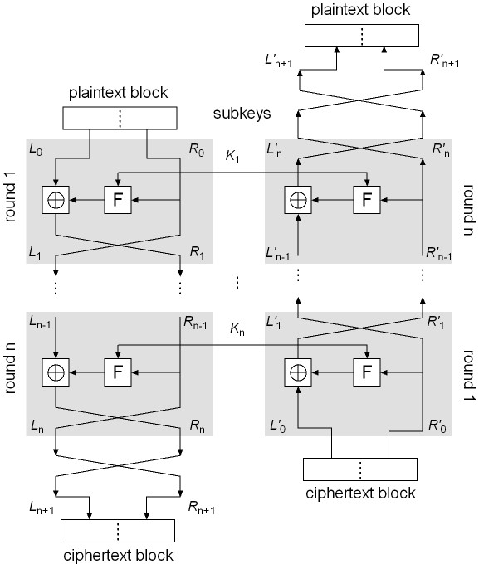
FCS Encryption and Decryption
FCS Encryption
Let M = L₀R₀; execute the following operations in round i, i = 1, …, n:
L_{i} = R_{i–1}
R_{i} = L_{i–1} ⊕ F(R_{i–1}, K_{i})
Let L_{n+1} = R_{n}, R_{n+1} = L_{n} and C = L_{n+1}R_{n+1}
FCS Decryption
Symmetrical to encryption, with sub-keys in reverse order
Rewrite C as C = L’₀R’₀
Execute the following in round i (i = 1, …, n):
L’_{i} = R’_{i–1}
R’_{i} = L’_{i–1} ⊕ F(R’_{i–1}, K’_{n–i+1})
Let L’_{n+1} = R’_{n}, R’_{n+1} = L’_{n}
We will show that M = L’_{n+1}R’_{n+1}
Encryption
Start
Decryption
Start
J. Wang and Z. Kissel. Introduction to Network Security: Theory and Practice. Wiley and HEP, 2015

Slide 21
Proof of FCS decryption
Will show that C = L_{n+1}R_{n+1} = L’₀R’₀ is transformed back to M = L₀R₀ by the FCS Decryption algorithm
Prove by induction the following equalities:
(1) L’_{i} = R_{n–i} (2) R’_{i} = L_{n–i}
Basis: L₀’ = L_{n+1} = R_{n}, R₀’ = R_{n+1} = L_{n}; (1) and (2) hold
Hypothesis: Assume when i ≤ n:
L_{i–1}’ = R_{n–(i–1)} R_{i–1}’ = L_{n–(i–1)}
Induction step:
  L’_{i} = R’_{i–1} (by decrypt. alg.) = L_{n–i+1} (by hypothesis) = R_{n–i} (by encrypt. alg.)
  Hence (1) is true
R’_{i} = L’_{i–1} ⊕ F(R’_{i–1}, K_{n–i+1})
= R_{n–(i+1)} ⊕ F(L_{n–(i+1)}, K_{n–i+1})
= [L_{n–i} ⊕ F(R_{n–i}, K_{n–i+1})] ⊕ F(R_{n–i}, K_{n–i+1})
= L_{n–i}
  Hence (2) true
J. Wang and Z. Kissel. Introduction to Network Security: Theory and Practice. Wiley and HEP, 2015

Slide 22
DES Sub-Key Generation
The block size of DES is 64 bits and the encryption key is 56 bits, which is represented as a 64-bit string K = k₁ k₂ … k₆₄
DES uses 16 rounds of iterations with 16 sub-keys
Sub-key generation:
  Remove the 8i-th bit (i = 1, 2, …, 8) from K
  Perform an initial permutation on the remaining 56 bits of K, denoted by IP_{key}(K)
  Split this 56-bit key into two pieces: U₀V₀, both with 28 bits
  Perform Left Circular Shift on U₀ and V₀ a defined number of times, producing U_{i}V_{i}:
  U_{i} = LS_{z(i)} (U_{i–1}), V_{i} = LS_{z(i)} (V_{i–1})
  Permute the resulting U_{i}V_{i} using a defined compress permutation, resulting in a 48-bit string as a sub-key, denoted by K_{i}
  K_{i} = P_{key} (U_{i} V_{i} )
J. Wang and Z. Kissel. Introduction to Network Security: Theory and Practice. Wiley and HEP, 2015

Slide 23
DES Substitution Boxes
The DES substitution function F is defined below:
F(R_{i–1}, K_{i}) = P(S(EP(R_{i–1}) ⊕ K_{i})), i = 1,…,16
First, permute R_{i} using EP(R_{i}) to produce a 48-bit string x
Next, XOR x with the 48-bit sub key K_{i} to produce a 48-bit string y
Function S turns y into a 32-bits string z, using eight 4x16 special matrices, called S-boxes
  Each entry in an S-box is a 4-bit string
  Break y into 8 blocks, each with 6-bits
  Use the i^{th} matrix on the i^{th} block b₁b₂b₃b₄b₅b₆
  Let b₁b₆ be the row number, and b₂b₃b₄b₅ the column number, and return the corresponding entry
  Each 6-bit block is turned to a 4-bit string, resulting in a 32-bit string z
Finally, permute z using P to produce the result of DES’s F function
This result, XOR’d with L_{i–1}, is R_{i}
J. Wang and Z. Kissel. Introduction to Network Security: Theory and Practice. Wiley and HEP, 2015

Slide 24
DES encryption steps
Rewrite IP(M) = L₀R₀, where |L₀| = |R₀| =32
For i = 1, 2, …, 16, execute the following operations in order:
L_{i} = R_{i-1}
R_{i} = L_{i-1} ⊕ F(R_{i-1}, K_{i})
Let C = IP⁻¹(R₁₆L₁₆).
J. Wang and Z. Kissel. Introduction to Network Security: Theory and Practice. Wiley and HEP, 2015

Slide 25
Is DES good enough?
Security strength of DES
  Number of rounds
  Length of encryption key
  Construction of the substitute function
DES was used up to the 1990’s.
People began to take on the DES Challenges to crack DES
Only uses 56-bit keys = 2⁵⁶ ~ 7.2× 10¹⁶ keys
Brute-force will work with current technology
  In 1997 on Internet in a few months
  In 1998 on dedicated h/w (EFF) in a few days
  In 1999 above combined in 22 hours
J. Wang and Z. Kissel. Introduction to Network Security: Theory and Practice. Wiley and HEP, 2015

Slide 26
What to Do Next?
Start over
New standards begin to be looked into
On the other hand, can we extend the use of DES?
J. Wang and Z. Kissel. Introduction to Network Security: Theory and Practice. Wiley and HEP, 2015

Slide 27
Chapter 2: roadmap
2.1 Data Encryption Algorithm Design Criteria
2.2 Data Encryption Standard
2.3 Multiple DES
2.4 Advanced Encryption Standard
2.5 Standard Block-Cipher Modes of Operations
2.6 Stream Ciphers
2.7 Key Generations
J. Wang and Z. Kissel. Introduction to Network Security: Theory and Practice. Wiley and HEP, 2015

Slide 28
3DES/2, 2DES and 3DES/3
DES is not a group!
  No two encryptions are the same as a single one: E_{K}(M) != E_{K1}(E_{K2}(M)
We can use Multiple DES
  Take X keys and apply DES Y times to get YDES/X
  We have, e.g., 2DES/2, 3DES/2, 3DES/3
  Can effectively extend the length of encryption keys using existing DES
  Can resist brute-force attacks
J. Wang and Z. Kissel. Introduction to Network Security: Theory and Practice. Wiley and HEP, 2015

Slide 29
Examples
3DES/2:
C = E_{K1}(D_{K2}(E_{K1}(M)))
M = D_{K1}(E_{K2}(D_{K1}(C)))
  Note: Other combinations of EEE and DDD etc are just as secure
  Using two keys to extend the key length to 112 bits, making DES much more secure against brute-force attacks
Notes on 2DES/2:
  2DES/2 uses just as many keys as 3DES/2, extending the key length to 112
  However, 2DES/2 is vulnerable to the meet-in-the-middle attack
J. Wang and Z. Kissel. Introduction to Network Security: Theory and Practice. Wiley and HEP, 2015

Slide 30
Meet-in-the-middle attacks on 2DES
A brute-force attack against 2DES/2 would need to test every combination of K₁ and K₂ to find the proper key (= 2⁵⁶ x 2⁵⁶ = 2¹¹²)
If the attacker gets two pairs (M₁, C₁) and (M₂, C₂) where C_{i} = E_{K2}(E_{K1}(M_{i}))
This means that D_{K2}(C_{i}) = X_{i} =E_{K1}(M_{i}) for both pairs
Make two tables, in one we decrypt C using all possible 56-bit keys, in the other we encrypt M, matching results are a potential match for K₁ and K₂. (We meet in the middle)
The number of pairs (K₁, K₂) that could possibly return equal results on both sides for a pair (M, C) is 2¹¹²/2⁶⁴ = 2⁴⁸.
The number of pairs that could return these results for two pairs M, C is 2⁴⁸/2⁶⁴ = 2⁻¹⁶.
Thus, the possibility of finding (K₁, K₂) is 1-2⁻¹⁶. Very high.
The time complexity is in the vicinity of 2(2⁵⁶ + 2⁴⁸) < 2⁵⁸. Much smaller than 2¹¹²
J. Wang and Z. Kissel. Introduction to Network Security: Theory and Practice. Wiley and HEP, 2015

Slide 31
Chapter 2 Outline
2.1 Data Encryption algorithm Design Criteria
2.2 Data Encryption Standard
2.3 Multiple DES
2.4 Advanced Encryption Standard
2.5 Standard Block-Cipher Modes of Operations
2.6 Stream Ciphers
2.7 Key Generations
J. Wang and Z. Kissel. Introduction to Network Security: Theory and Practice. Wiley and HEP, 2015

Slide 32
Advanced Encryption Standard competition began in 1997
Rijndael was selected to be the new AES in 2001
AES basic structures:
  block cipher, but not Feistel cipher
  encryption and decryption are similar, but not symmetrical
  basic unit: byte, not bit
  block size: 16-bytes (128 bits)
  three different key lengths: 128, 192, 256 bits
    AES-128, AES-192, AES-256
  each 16-byte block is represented as a 4 x 4 square matrix, called the state matrix
  the number of rounds depends on key lengths
  4 simple operations on the state matrix every round (except the last round)
J. Wang and Z. Kissel. Introduction to Network Security: Theory and Practice. Wiley and HEP, 2015

Slide 33
The Four Simple Operations
substitute-bytes (sub)
  Non-linear operation based on a defined substitution box
  Used to resist cryptanalysis and other mathematical attacks
shift-rows (shr)
  Linear operation for producing diffusion
mix-columns (mic)
  Elementary operation also for producing diffusion
add-round-key (ark)
  Simple set of XOR operations on state matrices
  Linear operation
  Produces confusion
J. Wang and Z. Kissel. Introduction to Network Security: Theory and Practice. Wiley and HEP, 2015

Slide 34
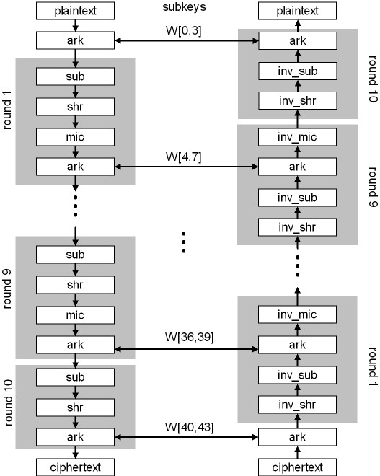
AES-128
J. Wang and Z. Kissel. Introduction to Network Security: Theory and Practice. Wiley and HEP, 2015

Slide 35
AES S-Box
S-box: a 16x16 matrix built from operations over finite field GF(2⁸)
  permute all 256 elements in GF(2⁸)
  each element and its index are represented by two hexadecimal digits
Let w = b₀ ... b₇ be a byte. Define a byte-substitution function S as follows:
Let i = b₀b₁b₂b₃, the binary representation of the row index
Let j = b₄b₅b₆b₇, the binary representation of the column index
Let S(w) = s_{ij,} S⁻¹(w) = s’_{ij}
We have S(S⁻¹(w)) = w and S⁻¹(S(w)) = w
J. Wang and Z. Kissel. Introduction to Network Security: Theory and Practice. Wiley and HEP, 2015

Slide 36
AES-128 Round Keys
Let K = K[0,31]K[32,63]K[64,95]K[96,127] be a 4-word encryption key
AES expands K into a 44-word array W[0,43]
Define a byte transformation function M as follows:
b₆b₅b₄b₃b₂b₁b₀0, if b₇ = 0,
M (b₇b₆b₅b₄b₃b₂b₁b₀) =
b₆b₅b₄b₃b₂b₁b₀0 ⊕ 00011011, if b₇ = 1
Next, let j be a non-negative number. Define m(j) as follows:
00000001, if j = 0
m(j) = 00000010, if j = 1
M (m(j–1)), if j > 1
Finally, define a word-substitution function T as follows, which transforms a 32-bit string into a 32-bit string, using parameter j and the AES S-Box:
T(w, j) = [(S(w₂) ⊕ m(j – 1)]S(w₃) S(w₄) S(w₁),
where w = w₁w₂w₃w₄ with each w_{i} being a byte
J. Wang and Z. Kissel. Introduction to Network Security: Theory and Practice. Wiley and HEP, 2015

Slide 37
Putting Things Together
Use all of these functions to create round keys of size 4 words (11 round keys are needed for AES-128; i.e. 44 words)
W[0] = K[0, 31]
W[1] = K[32, 63]
W[2] = K[64, 95]
W[3] = K[96, 127]
W[i–4] ⊕ T(W[i–1], i/4), if i is divisible by 4
W[i] =
W[i–4] ⊕ W[i–1], otherwise
i = 4, …, 43
11 round keys: For i = 0, …, 10:
K_{i} = W[4i, 4i + 3] = W[4i + 0] W[4i + 1] W[4i + 2] W[4i + 3]
J. Wang and Z. Kissel. Introduction to Network Security: Theory and Practice. Wiley and HEP, 2015

Slide 38
Add Round Keys (ark)
Rewrite K_{i} as a 4 x 4 matrix of bytes:
k_{0,0} k_{0,1} k_{0,2} k_{0,3}
K_{i} = k_{1,0} k_{1,1} k_{1,2} k_{1,3}
k_{2,0} k_{2,1} k_{2,2} k_{2,3}
k_{3,0} k_{3,1} k_{3,2} k_{3,3}
where each element is a byte and W[4i + j] = k_{0,j}k_{1,j}k_{2,j}k_{3,j}, j = 0, 1 , 2, 3
Initially, let a = M
k_{0,0}⊕ a_{0,0} k_{0,1}⊕ a_{0,1} k_{0,3} ⊕ a_{0,3} k_{0,4} ⊕ a_{0,4}
ark(a, K_{i}) = a ⊕ K_{i} = k_{1,0}⊕ a_{1,0} k_{1,1}⊕ a_{1,1} k_{1,2} ⊕ a_{1,2} k_{1,3} ⊕ a_{1,3} k_{2,0}⊕ a_{2,0} k_{2,1}⊕ a_{2,1} k_{2,2} ⊕ a_{2,2} k_{2,3} ⊕ a_{2,3} k_{3,0}⊕ a_{3,0} k_{3,1}⊕ a_{3,1} k_{3,2} ⊕ a_{3,2} k_{3,3} ⊕ a_{3,3}
Since this is a XOR operation, ark^{–1} is the same as ark. We have
ark(ark^{–1}(a, K_{i}), K_{i}) = ark^{–1}(ark(a, K_{i}), K_{i}) = a
J. Wang and Z. Kissel. Introduction to Network Security: Theory and Practice. Wiley and HEP, 2015

Slide 39
Substitute-Bytes (sub)
Recall that S is a substitution function that takes a byte as an input, uses its first four bits as the row index and the last four bits as the column index, and outputs a byte using a table-lookup at the S-box
Let A be a state matrix. Then
S(a_{0,0} ) S(a_{0,1} ) S(a_{0,2} ) S(a_{0,3} )
sub(A) = S(a_{1,0} ) S(a_{1,1} ) S(a_{1,2} ) S(a_{1,3} )
S(a_{2,0} ) S(a_{2,1} ) S(a_{2,2} ) S(a_{2,3} )
S(a_{3,0} ) S(a_{3,1} ) S(a_{3,2} ) S(a_{3,3} )
sub⁻¹(A) will just be the inverse substitution operation applied to the matrix
S⁻¹ (a_{0,0} ) S⁻¹ (a_{0,1} ) S⁻¹ (a_{0,2} ) S⁻¹ (a_{0,3} )
sub⁻¹ (A) = S⁻¹ (a_{1,0} ) S⁻¹ (a_{1,1} ) S⁻¹ (a_{1,2} ) S⁻¹ (a_{1,3} )
S⁻¹ (a_{2,0} ) S⁻¹ (a_{2,1} ) S⁻¹ (a_{2,2} ) S⁻¹ (a_{2,3} )
S⁻¹ (a_{3,0} ) S⁻¹ (a_{3,1} ) S⁻¹ (a_{3,2} ) S⁻¹ (a_{3,3} )
We have sub(sub⁻¹(A)) = sub⁻¹(sub(A)) = A
J. Wang and Z. Kissel. Introduction to Network Security: Theory and Practice. Wiley and HEP, 2015

Slide 40
Shift-Rows (shr)
shr(A) performs a left-circular-shift i – 1 times on the i-th row in the matrix A
a_{0,0} a_{0,1} a_{0,2} a_{0,3}
shr(A) = a_{1,1} a_{1,2} a_{1,3} a_{1,0}
a_{2,2} a_{2,3} a_{2,0} a_{2,1}
a_{3,3} a_{3,0} a_{3,1} a_{3,2}
shr⁻¹(A) performs a right-circular-shift i – 1 times on the i-th row in the matrix A
a_{0,0} a_{0,1} a_{0,2} a_{0,3}
shr⁻¹(A)= a_{1,3} a_{1,0} a_{1,1} a_{1,2}
a_{2,2} a_{2,3} a_{2,0} a_{2,1}
a_{3,1} a_{3,2} a_{3,3} a_{3,0}
We have shr(shr⁻¹(A)) = shr⁻¹(shr(A)) = A
J. Wang and Z. Kissel. Introduction to Network Security: Theory and Practice. Wiley and HEP, 2015

Slide 41
Mix-Columns (mic)
mic(A) = [a’_{ij}]_{4×4} is determined by the following operation (j = 0, 1, 2, 3):
a’_{0,j} = M (a_{0,j}) ⊕ [M (a_{1,j}) ⊕ a_{1,j}] ⊕ a_{2,j} ⊕ a_{3,j}
a’_{1,j} = a_{0,j} ⊕ M (a_{1,j}) ⊕ [M (a_{2,j} )⊕a_{2,j}] ⊕ a_{3,j}
a’_{2,j} = a_{0,j} ⊕ a_{1,j} ⊕ M (a_{2,j} ) ⊕ [M (a_{3,j} ) ⊕ a_{3,j}]
a’_{3,j} = [M (a_{0,j} )⊕ a_{0,j} ] ⊕ a_{1,j} ⊕ a_{2,j} ⊕ M (a_{3,j} )
mic⁻¹(A) is defined as follows:
  Let w be a byte and i a positive integer:
M ^{i}(w) = M (M ^{i-1}(w)) (i > 1), M ¹(w) = M (w)
  Let
M₁(w) = M³(w) ⊕ M²(w) ⊕ M(w)
M₂(w) = M³(w) ⊕ M(w) ⊕ w
M₃(w) = M³(w) ⊕ M²(w) ⊕ w
M₄(w) = M³(w) ⊕ w
mic⁻¹(A) = [a’’_{ij}]_{4×4} :
a’’_{0,j} = M₁(a_{0,j}) ⊕ M₂(a_{1,j}) ⊕ M₃(a_{2,j}) ⊕ M₄(a_{3,j})
a’’_{1,j} = M₄(a_{0,j}) ⊕ M₁(a_{1,j}) ⊕ M₂(a_{2,j}) ⊕ M₃(a_{3,j})
a’’_{2,j} = M₃(a_{0,j}) ⊕ M₄(a_{1,j}) ⊕ M₁(a_{2,j}) ⊕ M₂(a_{3,j})
a’’_{3,j} = M₂(a_{0,j}) ⊕ M₃(a_{1,j}) ⊕ M₄(a_{2,j}) ⊕ M₁(a_{3,j})
We have mic(mic⁻¹(A)) = mic⁻¹(mic(A)) = A
J. Wang and Z. Kissel. Introduction to Network Security: Theory and Practice. Wiley and HEP, 2015

Slide 42
AES-128 Encryption/Decryption
AES-128 encryption:
Let A_{i} (i = 0, …, 11) be a sequence of state matrices, where A₀ is the initial state matrix M, and A_{i} (i = 1, …, 10) represents the input state matrix at round i
A₁₁ is the cipher text block C, obtained as follows:
A₁ = ark(A₀, K₀)
A_{i+1} = ark(mic(shr(sub(A_{i}))), K_{i}), i = 1,…,9
A₁₁ = arc(shr(sub(A₁₀)), K₁₀))
AES-128 decryption:
Let C₀ = C = A₁₁, where C_{i} is the output state matrix from the previous round
C₁ = ark(C₀, K₁₀)
C_{i+1} = mic⁻¹(ark(sub ⁻¹(shr ⁻¹(C_{i})), K_{10-i})), i = 1,…,9
C₁₁ = ark(sub ⁻¹(shr ⁻¹(C₁₀)), K₀)
J. Wang and Z. Kissel. Introduction to Network Security: Theory and Practice. Wiley and HEP, 2015

Slide 43
Correctness Proof of Decryption
We now show that C₁₁ = A₀
We first show the following equality using mathematical induction:
C_{i} = shr(sub(A_{11-i})), i = 1, …, 10
For i = 1 we have
C₁ = ark(A₁₁, K₁₀)
= A₁₁ ⊕ K₁₀
= ark(shr(sub(A₁₀)), K₁₀) ⊕ K₁₀
= (shr(sub(A₁₀)) ⊕ K₁₀) ⊕ K₁₀
= shr(sub(A₁₀))
Assume that the equality holds for 1 ≤ i ≤ 10. We have
C_{i+1} = mic⁻¹(ark(sub ⁻¹(shr ⁻¹(C_{i})), K_{10-i}))
= mic⁻¹(ark(sub ⁻¹(shr ⁻¹(shr(sub(A_{11-i})))) ⊕ K_{10-i}))
= mic⁻¹(A_{11-i}⊕ K_{10-i})
= mic⁻¹(ark(mic(shr(sub(A_{10-i}))), K_{10-i}) ⊕ K_{10-i})
= mic⁻¹([mic(shr(sub(A_{10-i}))) ⊕ K_{10-i}] ⊕ K_{10-i})
= shr(sub(A_{10-i})
= shr(sub(A_{11-(i+1)}))
This completes the induction proof
J. Wang and Z. Kissel. Introduction to Network Security: Theory and Practice. Wiley and HEP, 2015

Slide 44
Finally, we have
C₁₁ = ark(sub⁻¹(shr⁻¹(C₁₀)), K₀)
= sub⁻¹(shr⁻¹(shr(sub(A₁)))) ⊕ K₀
= A₁ ⊕ K₀
= (A₀ ⊕ K₀) ⊕ K₀
= A₀
This completes the correctness proof of AES-128 Decryption
J. Wang and Z. Kissel. Introduction to Network Security: Theory and Practice. Wiley and HEP, 2015

Slide 45
Chapter 2 Outline
2.1 Data Encryption algorithm Design Criteria
2.2 Data Encryption Standard
2.3 Multiple DES
2.4 Advanced Encryption Standard
2.5 Standard Block-Cipher Modes of Operations
2.6 Stream Ciphers
2.7 Key Generations
J. Wang and Z. Kissel. Introduction to Network Security: Theory and Practice. Wiley and HEP, 2015

Slide 46
Modes of Operations
Let l be the block size of a given block cipher;
l = 64 in DES, l = 128 in AES
Let M be a plaintext string. Divide M into a sequence of blocks:
M = M₁M₂…M_{k},
such that the size of each block M_{i} is l (padding the last block if necessary)
There are several methods to encrypt M, where are referred to as block-cipher modes of operations
J. Wang and Z. Kissel. Introduction to Network Security: Theory and Practice. Wiley and HEP, 2015

Slide 47
Standard Modes of Opeations
Standard block-cipher modes of operations:
  electronic-codebook mode (ECB)
  cipher-block-chaining mode (CBC)
  cipher-feedback mode (CFB)
  output-feedback mode (OFB)
  counter mode (CTR)
J. Wang and Z. Kissel. Introduction to Network Security: Theory and Practice. Wiley and HEP, 2015

Slide 48
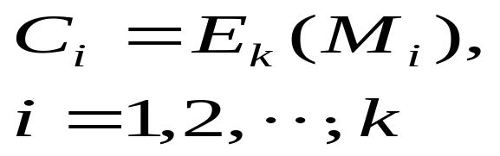
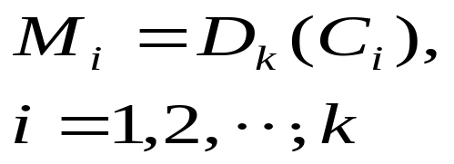
Electronic-Codebook Mode (ECB)
  ECB encrypts each plaintext block independently.
  Easy and straightforward. ECB is often used to encrypt short plaintext messages
  However, if we break up our string into blocks, there could be a chance that two different blocks are identical.
  This provides the attacker with some information about the original text
  Other Block-Cipher Modes deal with this in different ways
ECB Encryption Steps | ECB Decryption Steps
J. Wang and Z. Kissel. Introduction to Network Security: Theory and Practice. Wiley and HEP, 2015

Slide 49
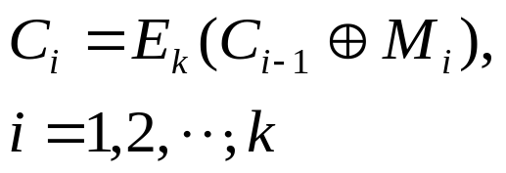
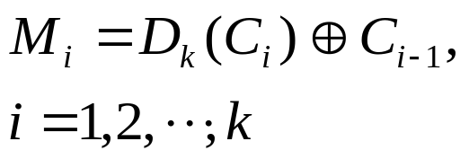
Cipher-Block-Chaining Mode (CBC)
When the plaintext message M is long, the possibility that some blocks may repeat will increase
CBC can overcome the weakness of ECB
In CBC, the previous ciphertext block is used to encrypt the current plaintext block
CBC uses an initial l-bit block C₀, referred to as initial vector
What if a bit error occurs in a ciphertext block during transmission?
  One bit change in C_{i} during transmission affects the decryption for M_{i} and M_{i+1}
CBC Encryption Steps | CBC Decryption Steps
J. Wang and Z. Kissel. Introduction to Network Security: Theory and Practice. Wiley and HEP, 2015

Slide 50
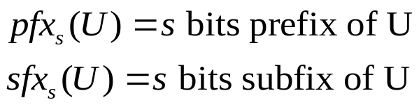
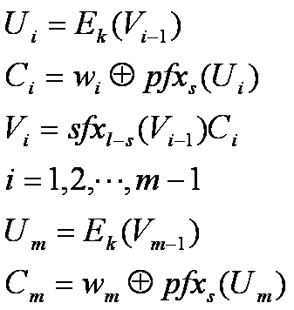
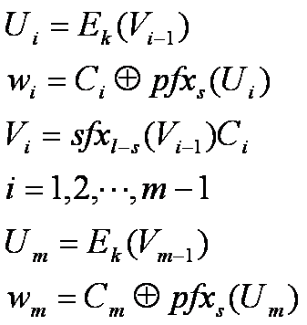
Cipher-Feedback Mode (CFB)
CFB turns block ciphers to stream ciphers
M = w₁w₂ … w_{m}, where w_{i} is s-bit long
Encrypts an s-bit block one at a time:
  s=8: stream cipher in ASCII
  s=16: unicode stream cipher
Also has an l-bit initial vector V₀
CFB Encryption Steps | CFB Decryption Steps
J. Wang and Z. Kissel. Introduction to Network Security: Theory and Practice. Wiley and HEP, 2015

Slide 51
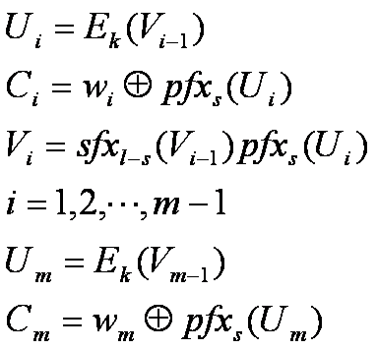
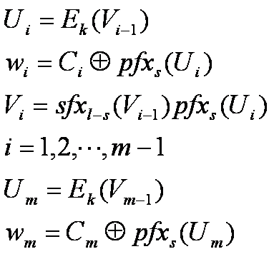
Output-Feedback Mode (OFB)
  OFB also turns block ciphers to stream ciphers
  The only difference between CFB and OFB is that OFB does not place C_{i} in V_{i} .
  Feedback is independent of the message
  Used in error-prone environment
OFB Encryption Steps | OFB Decryption Steps
J. Wang and Z. Kissel. Introduction to Network Security: Theory and Practice. Wiley and HEP, 2015

Slide 52
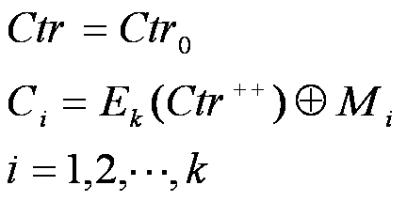
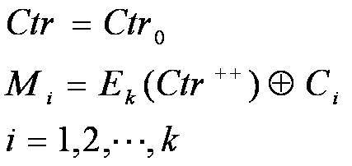
Counter Mode (CTR)
  CTR is block cipher mode.
  An l-bit counter Ctr, starting from an initial value and increases by 1 each time
  Used in applications requiring faster encryption speed
CTR Encryption Steps | CTR Decryption Steps
J. Wang and Z. Kissel. Introduction to Network Security: Theory and Practice. Wiley and HEP, 2015

Slide 53
Chapter 2 Outline
2.1 Data Encryption algorithm Design Criteria
2.2 Data Encryption Standard
2.3 Multiple DES
2.4 Advanced Encryption Standard
2.5 Standard Block-Cipher Modes of Operations
2.6 Stream Ciphers
2.7 Key Generations
J. Wang and Z. Kissel. Introduction to Network Security: Theory and Practice. Wiley and HEP, 2015

Slide 54
Stream Ciphers
Stream ciphers encrypts the message one byte (or other small blocks of bits) at a time
Any block ciphers can be converted into a stream cipher (using, e.g. CFB and OFB) with extra computation overhead
How to obtain light-weight stream ciphers?
J. Wang and Z. Kissel. Introduction to Network Security: Theory and Practice. Wiley and HEP, 2015

Slide 55
RC4
RC4, designed by Rivest for RSA Security, is a light-weight stream cipher
  It is a major component in WEP, part of the IEEE 802.11b standard.
  It has variable key length: ranging from 1 byte to 256 bytes
  It uses three operations: substitution, modular addition, and XORs.
J. Wang and Z. Kissel. Introduction to Network Security: Theory and Practice. Wiley and HEP, 2015

Slide 56
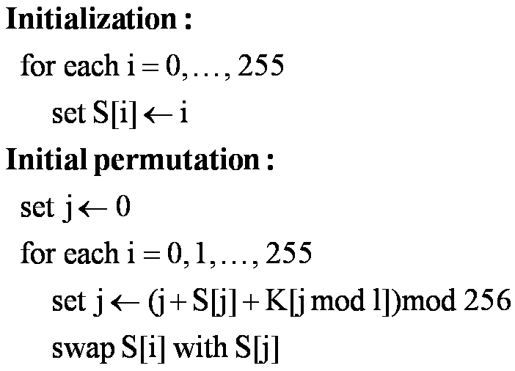
RC4 Subkey Generation
Let K be an encryption key:
K = K[0]K[1] … K[l–1],
where |K|=8l, 1≤ l ≤ 256
RC4 uses an array
S[0, 255] of 256 bytes to generate subkeys
Apply a new permutation of bytes in this array at each iteration to generate a subkey
Key Scheduling algorithm (KSA)
J. Wang and Z. Kissel. Introduction to Network Security: Theory and Practice. Wiley and HEP, 2015

Slide 57
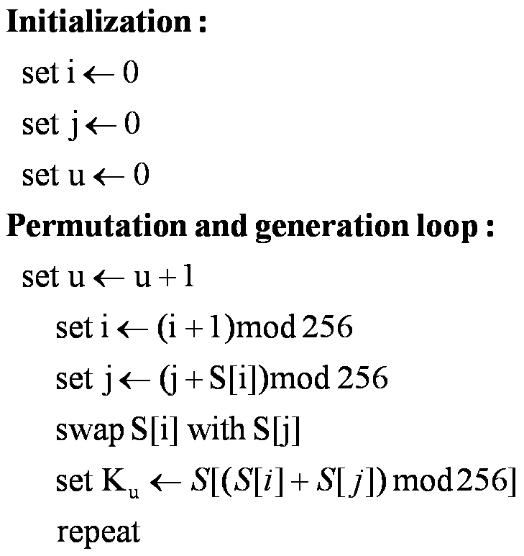
Subkey Generation Algorithm (SGA)
J. Wang and Z. Kissel. Introduction to Network Security: Theory and Practice. Wiley and HEP, 2015

Slide 58
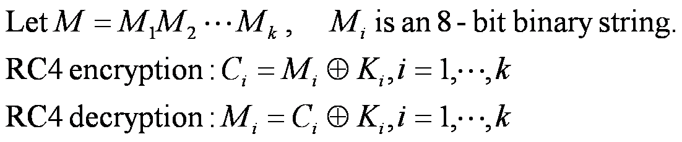
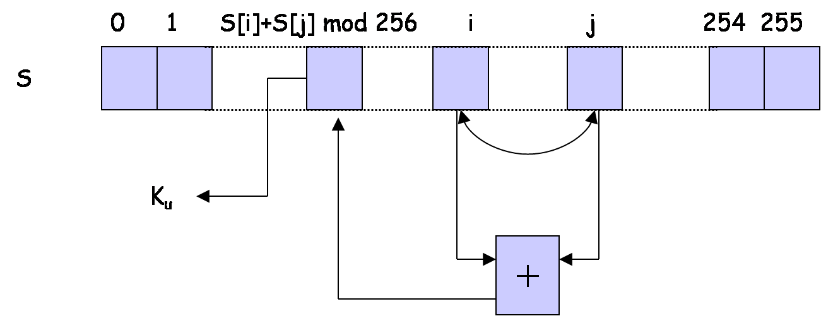
RC4 Encryption and Decryption
RC4 subkey generation after KSA is performed
J. Wang and Z. Kissel. Introduction to Network Security: Theory and Practice. Wiley and HEP, 2015

Slide 59
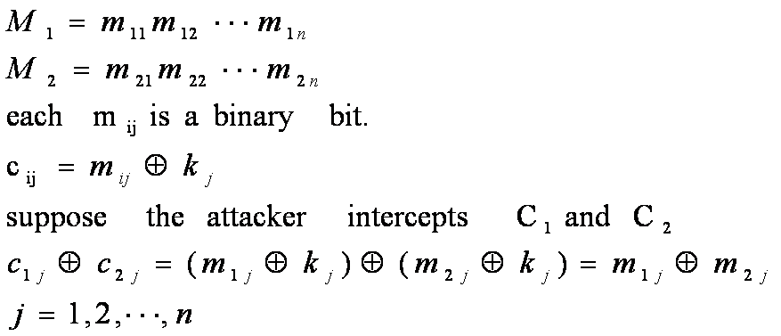
RC4 Security Weaknesses
Knowing the initial permutation of S generated in KSA is equivalent to breaking RC4 encryption
Weak keys: a small portion of the string could determine a large number of bits in the initial permutation, which helps reveal the secret encryption key
Reused keys:
  Known-plaintext attack: reveal the subkey stream for encryption
  Related-plaintext attack:
J. Wang and Z. Kissel. Introduction to Network Security: Theory and Practice. Wiley and HEP, 2015

Slide 60
Chapter 2 Outline
2.1 Data Encryption algorithm Design Criteria
2.2 Data Encryption Standard
2.3 Multiple DES
2.4 Advanced Encryption Standard
2.5 Standard Block-Cipher Modes of Operations
2.6 Stream Ciphers
2.7 Key Generations
J. Wang and Z. Kissel. Introduction to Network Security: Theory and Practice. Wiley and HEP, 2015

Slide 61
Key Generation
Secret keys are the most critical components of encryption algorithms
Best way: random generation
  Generate pseudorandom strings using deterministic algorithms (pseudorandom number generators “PRNG”); e.g.
    ANSI X9.17 PRNG
    BBS Pseudorandom Bit Generator
J. Wang and Z. Kissel. Introduction to Network Security: Theory and Practice. Wiley and HEP, 2015

Slide 62
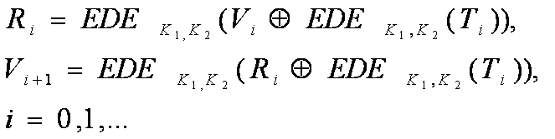
ANSI X9.17 PRNG
Published in 1985 by the American National Standard Institute (ANSI) for financial institution key management
Based on 3DES/2 with two initial keys K₁ and K₂, and an initial vector V₀
Two special 64-bit binary strings T_{i} and V_{i}:
  T_{i} represents the current date and time, updated before each round
  V_{i} is called a seed and determined as follows:
J. Wang and Z. Kissel. Introduction to Network Security: Theory and Practice. Wiley and HEP, 2015

Slide 63
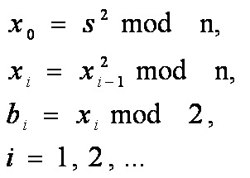
BBS Pseudorandom Bit Generator
It generates a pseudorandom bit in each round of computation.
Let p and q be two large prime numbers satisfying
p mod 4 = q mod 4 = 3
Let n = p X q and s be a positive number, where
  s and p are relatively prime; i.e. gcd(s,p) = 1
  s and q are relatively prime; i.e. gcd(s,q) = 1
BBS pseudorandom bit generation:
J. Wang and Z. Kissel. Introduction to Network Security: Theory and Practice. Wiley and HEP, 2015

Slide 64

How Good is BBS?
Predicting the (k+1)-th BBS bit b_{k+1} from the k previous BBS bits b₁, …, b_{k} depends on the difficulty of integer factorization
Integer factorization: for a given positive non-prime number n, find prime factors of n
  Best known algorithm requires computation time in the order of
If integer factorization cannot be solved in polynomial time, then a BBS pseudorandom bit cannot be distinguished from a true random bit in polynomial time
Integer factorization can be solved in polynomial time on a theoretical quantum computation model
J. Wang and Z. Kissel. Introduction to Network Security: Theory and Practice. Wiley and HEP, 2015

