Slide 1
Chapter 3
Public-Key Cryptography
and Key Management
J. Wang and Z. Kissel. Introduction to Network Security: Theory and Practice. Wiley and HEP, 2015

Slide 2
Why Public-Key Cryptography?
To use data encryption algorithms in network communications, all parities must first agree on using the same secret keys
  Rely on couriers
  Set up a meeting to determine a secret key
  Use postal service, email service, phone service
  …
  However, these conventional methods are inflexible for network communication applications
Public-key cryptography (PKC)
  Invented in the 1970’s
  Without the need of sharing prior secrets to distribute secret keys securely
  Can also be used for authentication
J. Wang and Z. Kissel. Introduction to Network Security: Theory and Practice. Wiley and HEP, 2015

Slide 3
Chapter 3 Outline
3.1 Concepts of Public-Key Cryptography
3.2 Elementary Concepts and Theorems in Number Theory
3.3 Diffie-Hellman Key Exchange
3.4 RSA Cryptosystem
3.5 Elliptic-Curve Cryptography
3.6 Key Distributions and Management
J. Wang and Z. Kissel. Introduction to Network Security: Theory and Practice. Wiley and HEP, 2015

Slide 4
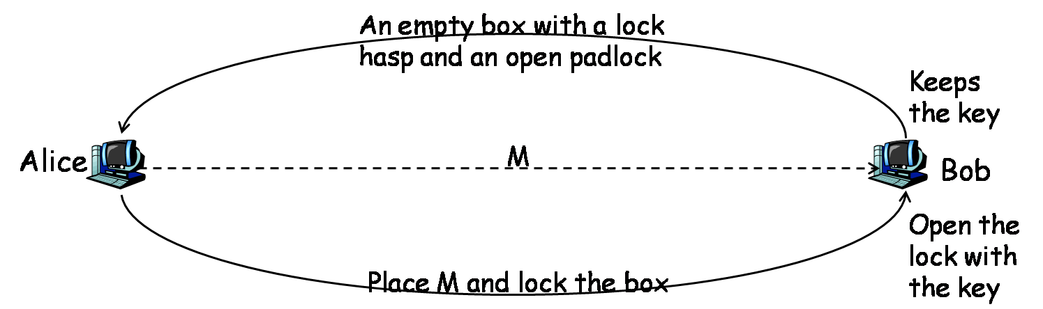
Basic Idea of PKC
Using conventional postal service, Bob can receive confidential message from Alice without sharing prior secrets
The open padlock and the box: public key (open to public)
The key Bob keeps: private key (to be kept private)
Q: How to realize this idea in a mathematical form?
J. Wang and Z. Kissel. Introduction to Network Security: Theory and Practice. Wiley and HEP, 2015

Slide 5
Another example
Suppose we have f₁(f₀(a, y), x) = f₁(f₀(a, x), y) and it is difficult to derive x from f₀(a, x) and a, which are publicly known
Alice does the following:
  Randomly selects a positive number x₁ (private key) and sends
  y₁ = f₀(a, x₁) to Bob
Bob does the same
  Randomly generates x₂ and sends y₂ = f₀(a, x₂) to Alice
Alice calculates K₂= f₁(y₁, x₂) and Bob calculates K₁= f₁(y₂, x₁) as their secret keys for a conventional encryption algorithm
Because f₁(y₂, x₁) = f₁(f₀(a, x₂), x₁) = f₁(f₀(a, x₁), x₂) = f₁(y₁, x₂),
they have K₁= K₂
Malice may eavesdrop y₁ and y₂, but still cannot find x₁ or x₂
Q: How to find such functions f₁ and f₂?
J. Wang and Z. Kissel. Introduction to Network Security: Theory and Practice. Wiley and HEP, 2015

Slide 6
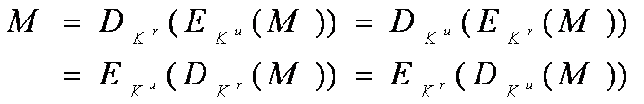
Criteria for PKC
Forward efficiency
  Computing encryption and decryption by legitimate parties must be easy
  Generating a new key pair (K^{u}, K^{r}) must be easy, where K^{u} is a public key and K^{r} the corresponding private key
Backward intractability
  Computing M from ciphertext C and the public key K^{u} must be computationally intractable
  In other words, K^{u} must not leak out any useful information of K^{r}
Commutability (optional)
  (K^{u}, K^{r}) must satisfy
  May be needed for data authentications; not needed for key exchange
J. Wang and Z. Kissel. Introduction to Network Security: Theory and Practice. Wiley and HEP, 2015

Slide 7
Chapter 3 Outline
3.1 Concepts of Public-Key Cryptography
3.2 Elementary Concepts and Theorems in Number Theory
3.3 Diffie-Hellman Key Exchange
3.4 RSA Cryptosystem
3.5 Elliptic-Curve Cryptography
3.6 Key Distributions and Management
J. Wang and Z. Kissel. Introduction to Network Security: Theory and Practice. Wiley and HEP, 2015

Slide 8
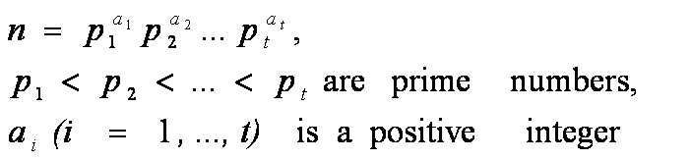

The Fundamental Theorem of Arithmetic
  Any integer greater than 1 is a product of prime numbers. Moreover, this product has a unique representation if prime numbers are listed in non-decreasing order.
Prime number theorem
  Let n be an integer greater than 1 and π(n) be the number of prime numbers that are less than n. Then π(n) ~ n/ln n
Modular arithmetic
  Let a and b be integers and m a positive integer
  (a + b) mod m = (a mod m + b mod m) mod m
  (a – b) mod m = (a mod m – b mod m) mod m
  (a × b) mod m = (a mod m× b mod m) mod m
Congruence relations
  a is congruent to b modulo m if a – b is divisible by m, denoted by
J. Wang and Z. Kissel. Introduction to Network Security: Theory and Practice. Wiley and HEP, 2015

Slide 9


Modular inverse:
  Let a and n be positive integers with a < n. If there is a positive integer b < n such that a•b ≡ 1 (mod n), then b is a’s inverse modulo n
  Finding modular inverse is a basic operation for the RSA public-key cryptosystem
  Note that modular inverse does not always exist
Euler’s totient function
  The number of positive integers that are less than n and relatively prime to n
Euler’s theorem:
  Let a be a positive integer and n an integer greater than 1 that is relatively prime to a, Then
Fermat’s little theorem:
  Let p be a prime number and a be a positive integer not divisible by p, then
J. Wang and Z. Kissel. Introduction to Network Security: Theory and Practice. Wiley and HEP, 2015

Slide 10

Primitive roots:
  If for any positive integer
    m < φ(n), then a is called a primitive root modulo n
  Not every integer n has a primitive root
Fast modular exponentiation:
  a^{x} mod n is a common operation in PKC
  Naïve method to calculate a^{x} mod n: First calculate a^{x}, then calculate modulo n. It incurs high time complexity!!!
  x is a positive integer. Let then
J. Wang and Z. Kissel. Introduction to Network Security: Theory and Practice. Wiley and HEP, 2015

Slide 11
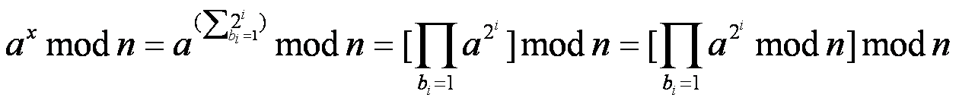
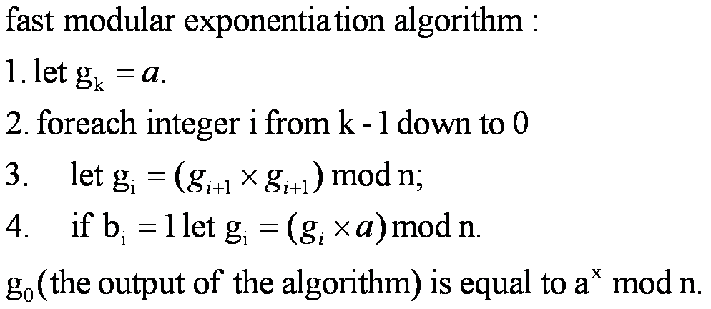
Thus,
An example in textbook on page 99
J. Wang and Z. Kissel. Introduction to Network Security: Theory and Practice. Wiley and HEP, 2015

Slide 12


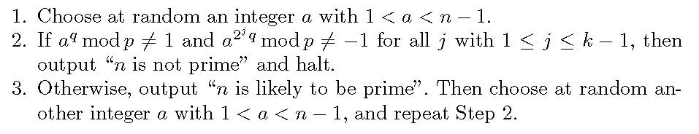
Finding Large Prime Numbers
How to efficiently determine whether a given odd number n is prime
  Check whether n has a factor x with
    Time complexity:
  Miller-Rabin’s primality test
    A probabilistic algorithm; the probability of returning false info is less than 2^{-2m}, where m is the number of iterations of the algorithm
    Let n be an odd integer > 1 and k a positive integer satisfying
    n – 1 = 2kq, where q is an odd integer
J. Wang and Z. Kissel. Introduction to Network Security: Theory and Practice. Wiley and HEP, 2015

Slide 13
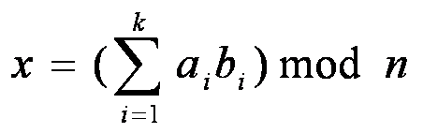
The Chinese Remainder Theorem
A solution to a set of simultaneous congruence equations
Let i be a positive integer, Z_{i} = {0, …, i-1}
Let n₁, n₂, …, n_{k} be positive integers pairwise relatively prime
Let n = n₁×n₂×…×n_{k}
For any given set of simultaneous congruence equations
x ≡ a_{i}(mod n_{j}), where i = 1, …, k,
it has the following unique solution in Z_{n}:
where b_{i} = m_{i} (m_{i}⁻¹ mod n_{i}) and m_{i} = n/n_{i}
J. Wang and Z. Kissel. Introduction to Network Security: Theory and Practice. Wiley and HEP, 2015

Slide 14
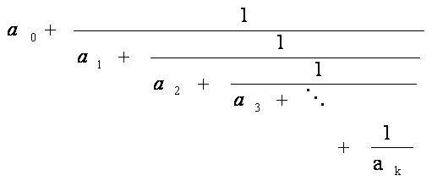
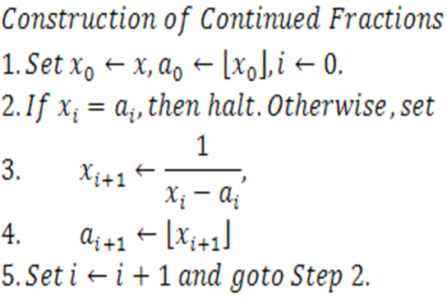
Finite Continued Fractions
Finite continued fractions are fractional numbers of the form:
where a₀ is an integer, and a₁ …, a_{k} are non-zero integers
Given a real number x, we can construct a continued fraction to represent x as follows:
J. Wang and Z. Kissel. Introduction to Network Security: Theory and Practice. Wiley and HEP, 2015

Slide 15
Chapter 3 Outline
3.1 Concepts of Public-Key Cryptography
3.2 Elementary Concepts and Theorems in Number Theory
3.3 Diffie-Hellman Key Exchange
3.4 RSA Cryptosystems
3.5 Elliptic-Curve Cryptography
3.6 Key Distributions and Management
J. Wang and Z. Kissel. Introduction to Network Security: Theory and Practice. Wiley and HEP, 2015

Slide 16
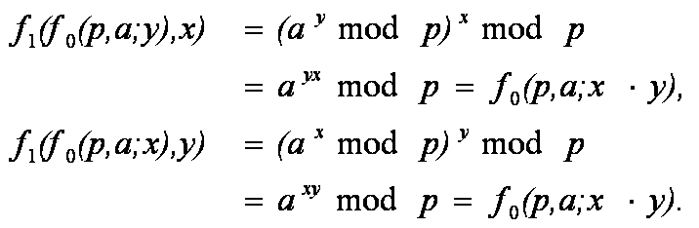
Diffie-Hellman Key Exchange
Diffie and Hellman provide a concrete construction of functions f₀ and f₁ as follows:
f₀(p, a; x) = a^{x} mod p,
f₁(x, b) = x^{b} mod p
where p is a large prime and a is a primitive root modulo p; public: (p, a); private: x
Thus, f₁(f₀(p, a; y), x) = f₁(f₀(p, a; x), y)
J. Wang and Z. Kissel. Introduction to Network Security: Theory and Practice. Wiley and HEP, 2015

Slide 17
D-H Key Exchange Protocol
Alice:
  Randomly selects a positive number X_{A} < p (private)
  Send Y_{A} = f₀(p, a; X_{A}) = a^{XA} mod p to Bob (public; a is also public)
  Compute K_{A}= f₁(Y_{B}, X_{A}) = Y_{B}^{XA} mod p as Alice’s secret key for a conventional encryption algorithm, where Y_{B} is a string sent from Bob
Bob: X_{B}; Y_{B} = f₀(p, a; X_{B}) = a^{XB} mod p; K_{B}= f₁(Y_{A}, X_{B}) = Y_{A}^{XB} mod p
Alice and Bob share the same secret key K = K_{A} = K_{B}
Forward efficiency: fast modular exponentiation
Backward intractability: relying on the difficulty of solving x from
y = a^{x} mod p with x < p (this is called the discrete logarithm problem)
  Believed to be unsolvable in poly-time on conventional computing devices
  When p is sufficiently large, D-H Key Exchange is considered secure
Malice can eavesdrop Y_{A} or Y_{B} , but has no ways to solve X_{A} or X_{B}; but it’s vulnerable to the man-in-the-middle attack
J. Wang and Z. Kissel. Introduction to Network Security: Theory and Practice. Wiley and HEP, 2015

Slide 18
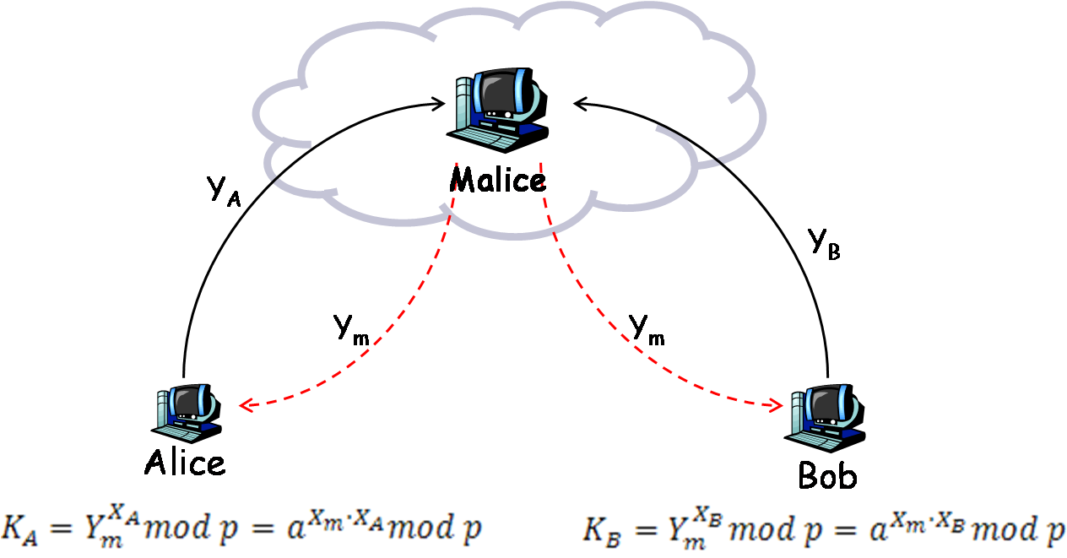
Man-in-the Middle Attacks
What Alice and Bob compute:
J. Wang and Z. Kissel. Introduction to Network Security: Theory and Practice. Wiley and HEP, 2015

Slide 19
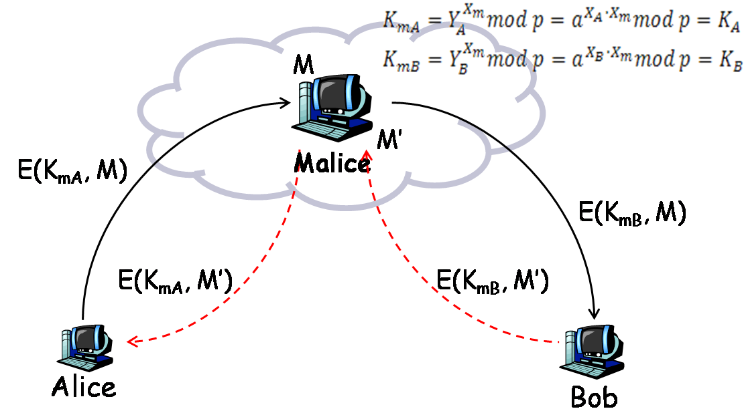
What Malice computes:
Alice and Malice have established a common secret key
Bob and Malice have established a common secret key
Alice and Bob have not established any common secret key
J. Wang and Z. Kissel. Introduction to Network Security: Theory and Practice. Wiley and HEP, 2015

Slide 20

Elgamal PKC
Devised in 1985 and based on the D-H key exchange protocol
Alice encrypts M as follows:
After receiving (C₁, C₂), Bob decrypts it by calculating
J. Wang and Z. Kissel. Introduction to Network Security: Theory and Practice. Wiley and HEP, 2015

Slide 21
Chapter 3 Outline
3.1 Concepts of Public-Key Cryptography
3.2 Elementary Concepts and Theorems in Number Theory
3.3 Diffie-Hellman Key Exchange
3.4 RSA Cryptosystem
3.5 Elliptic-Curve Cryptography
3.6 Key Distributions and Management
J. Wang and Z. Kissel. Introduction to Network Security: Theory and Practice. Wiley and HEP, 2015

Slide 22
RSA Keys, Encryption, Decryption
Basic operation: modular exponentiation
Select prime numbers p and q. Let n = p·q
Select a positive integer d with 1 < d < φ(n) and gcd(d, φ(n)) = 1
Compute e = d⁻¹ mod φ(n)
Public key: (e, n); private key: d
Encryption: C = Me mod n
Decryption: M = C^{d} mod n
Forward efficiency: fast modular exponentiation
Backward intractability: integer factorization
Commutability: also satisfied
easy
p, q
n=p× q
hard
J. Wang and Z. Kissel. Introduction to Network Security: Theory and Practice. Wiley and HEP, 2015

Slide 23
RSA Parameter Attacks
Attacks taking advantage of inappropriately chosen parameters
  Try all possible parameters d to decrypt an encrypted block
    Brute-force method, infeasible.
  Factor n
    Not known whether it is solvable in polynomial time on a conventional computer
  Use time analysis to find d
    Execution time of modular exponentiation differs greatly between 0 and 1 of the current bit in the exponent
  Derive RSA parameters from partial information of these parameters
J. Wang and Z. Kissel. Introduction to Network Security: Theory and Practice. Wiley and HEP, 2015

Slide 24

Small Exponent Attacks
Suppose Alice’s K_{A}^{u} = (e, n_{A}), Bob’s K_{B}^{u} = (e, n_{B}) and
gcd(n_{A}, n_{B}) = 1
Charlie sends M (M < min{n_{A}, n_{B}}) to Alice and Bob as follows:
  C_{A}= M² mod n_{A} to Alice
  C_{B}= M² mod n_{B} to Bob
Malice intercepts C_{A} and C_{B}. She can use the Chinese remainder theorem to solve the two simultaneous congruence relations:
  x ≡ C_{A}(mod n_{A})
  x ≡ C_{B}(mod n_{B})
Let x₀ ∈ Z_{n} be a solution, where n=n_{A}n_{B}. Then x₀ = M² mod n. Since M < √n, we have x₀ = M². Hence, M =
J. Wang and Z. Kissel. Introduction to Network Security: Theory and Practice. Wiley and HEP, 2015

Slide 25
Partial Information Attacks
Let m be the length of n in decimal representation
If the prefix (or suffix) m/4 bits of p (or q) leak out, then n (or d) can be factored efficiently
Suppose d is compromised. Generating a new pair of d and e using the original secret p and q can help to factor n
J. Wang and Z. Kissel. Introduction to Network Security: Theory and Practice. Wiley and HEP, 2015

Slide 26
Other Attacks
M should not contain the prime factor p or q
  n can be factored efficiently otherwise
If M is short and a product of two integers have close lengths, then Malice can use man-in-the-middle attack to compute M:
  M = m₁ · m₂ , |M| = l
  Malice intercepts C = Me mod n, computes, and sorts the following to arrays:
    For each positive integer x ≤ 2^{l/2+1}, compute Cx^{-e} (mod n)
    For each positive integer y ≤ 2^{l/2+1}, compute y^{e} (mod n)
  If there are integers x and y such that Cx^{-e} (mod n)= y^{e} (mod n), then C ≡ (xy)^{e} (mod n). Thus, M ≡ C^{-e} ≡ xy (mod n)
  Time complexity: O(2^{l/2})
  Defense: break up the product
J. Wang and Z. Kissel. Introduction to Network Security: Theory and Practice. Wiley and HEP, 2015

Slide 27
Chapter 3 Outline
3.1 Concepts of Public-Key Cryptography
3.2 Elementary Concepts and Theorems in Number Theory
3.3 Diffie-Hellman Key Exchange
3.4 RSA Cryptosystem
3.5 Elliptic-Curve Cryptography
3.6 Key Distributions and Management
J. Wang and Z. Kissel. Introduction to Network Security: Theory and Practice. Wiley and HEP, 2015

Slide 28
Key Distribution and Management
PKC takes more time to encrypt data than conventional encryption algorithms
  PKC is not suitable for encrypting long data
PKC is often used to encrypt secret keys for conventional encryption algorithms and other short messages for authentication
J. Wang and Z. Kissel. Introduction to Network Security: Theory and Practice. Wiley and HEP, 2015

Slide 29
Master Keys and Session Keys
Master keys (K_{m}): a secret key used to encrypt other secret keys during a certain period of time
  Reduce exposure of the master key
Session keys (K_{s}): a secret key for each new communication session and encrypted by the master key
  Encrypt a message or a packet in TCP
  Shorter lifetime than that of a master key
J. Wang and Z. Kissel. Introduction to Network Security: Theory and Practice. Wiley and HEP, 2015

Slide 30
Public-Key Certificates
To use PKC, users must get the other users’ public keys
  Published in a special Website or by emails
  Cannot ensure true ownership of a public key
Public-key certificates to authenticate public keys
  Issued by trusted organizations, certificate authorities (CAs)
  A CA uses PKC to authenticate certificates
    Publishes its public key on its Website
    Issues a certificate for each user
    Encrypts the certificate by CA’s private key for authentication
When Alice wants to use Bob’s public key:
  Asks Bob to send her his certificate
  Uses CA’s public key to verify it
  Gets Bob’s public key from his certificate
J. Wang and Z. Kissel. Introduction to Network Security: Theory and Practice. Wiley and HEP, 2015

Slide 31
CA Networks
A CA needs to keep track of which certificates are out of date and which have been canceled
CA(K_{X}^{u}): a certificate issued by CA to user X whose public key is K_{X}^{u}
Alice and Bob possess certificates from two different CAs. How to verify each other’s certificate?
  CAs should be able to authenticate each other’s public keys
J. Wang and Z. Kissel. Introduction to Network Security: Theory and Practice. Wiley and HEP, 2015

Slide 32
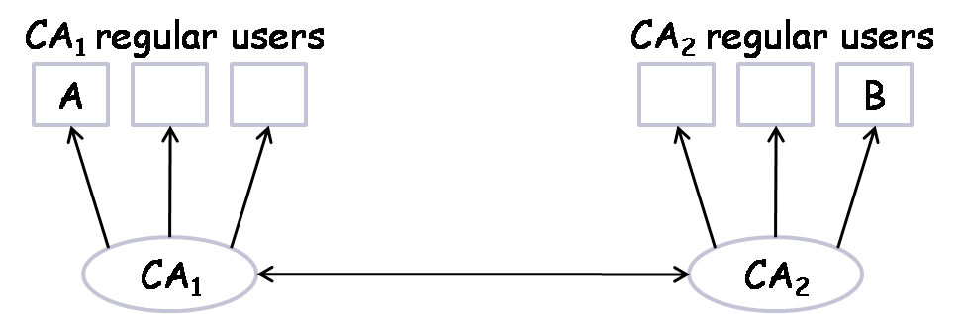
A CA network consisting of two CAs that can verify each other’s public key
Alice:
  Sends to Bob CA₁(K_{A}^{u}) and CA₂(K^{u}_{CA1})
Bob:
  Uses CA₂‘s public key to verify CA₁‘s public key
  Uses CA₁‘s public key to verify Alice’s public key
J. Wang and Z. Kissel. Introduction to Network Security: Theory and Practice. Wiley and HEP, 2015

Slide 33
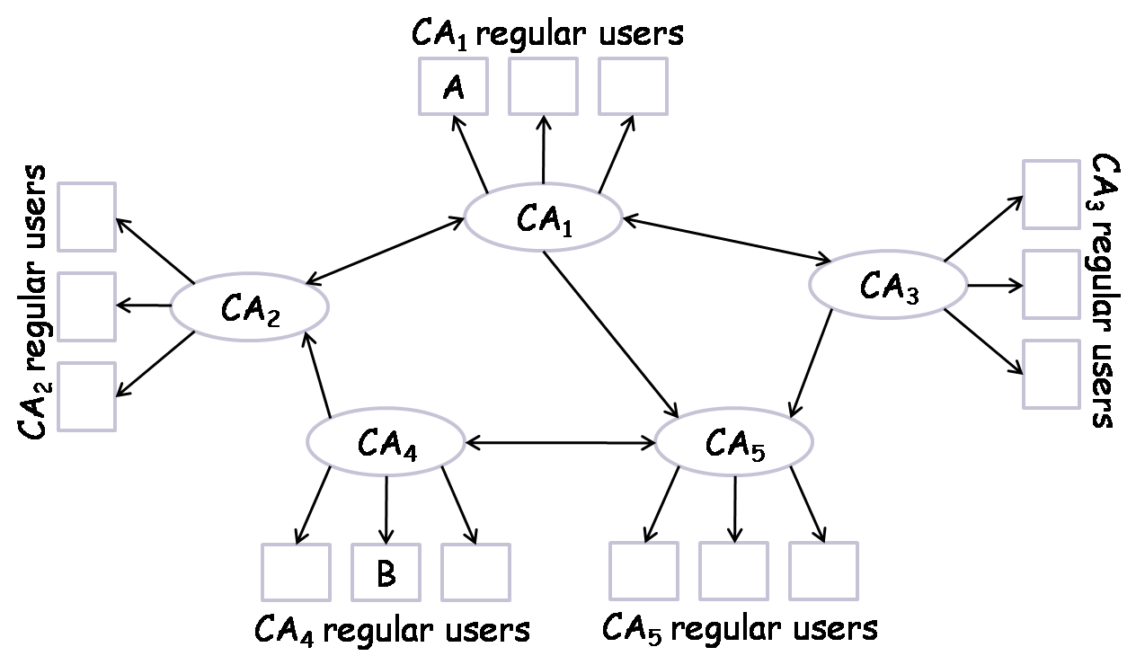
A CA network consisting more than two CAs
Path from Alice to Bob: CA₁→CA₅→CA₄ and CA₁→CA₃→CA₅→CA₄
Path from Bob to Alice: CA₄→CA₂→CA₁
J. Wang and Z. Kissel. Introduction to Network Security: Theory and Practice. Wiley and HEP, 2015

Slide 34
Key Rings
A system may have many different users
How to store and manage these public and private keys?
Private-key rings
  A table in which each row represents a record of a particular user: key ID, owner’s name, public key, encrypted private key, time stamp…
Public-key rings
  A table in which each row represents a record of a particular user: key ID, owner’s name, public key, CA name, CA trust, time stamp…
J. Wang and Z. Kissel. Introduction to Network Security: Theory and Practice. Wiley and HEP, 2015

