Slide 1
Chapter 4
Data Authentication
. Wang and Z. Kissel. Introduction to Network Security: Theory and Practice. Wiley and HEP, 2015

Slide 2
Why Data Authentication?
Certify the origin of the data
Convince the user that the data has not been modified or fabricated
A simple authentication scheme using prior shared secret:
  Alice sends M together with C = E_{k}(M) to Bob
  Bob receives the message and uses K to decrypt C to get M’
  If M’ = M Bob will be convinced that M came from Alice
PKC can authenticate data and provide data non-reputation
To authenticate a long data string M, it suffices to compute a short representation h of M and encrypt h
. Wang and Z. Kissel. Introduction to Network Security: Theory and Practice. Wiley and HEP, 2015

Slide 3
Digital Fingerprints
A short representation of M generated without using secret key is referred to as a digital digest or a digital fingerprint
Digital fingerprint can be obtained using a cryptographic hash function, also called one-way hash function
A short representation of M generated using a secret key is referred to as a message authentication code (MAC) or a tag
MAC can be obtained using an encrypted checksum algorithm
Keyed-hash message authentication code (HMAC) is the combination of cryptographic hash function and encrypted checksum algorithm
. Wang and Z. Kissel. Introduction to Network Security: Theory and Practice. Wiley and HEP, 2015

Slide 4
Chapter 4 Outline
4.1 Cryptographic Hash Functions
4.2 Cryptographic Checksums
4.3 HMAC
4.4 Birthday Attacks
4.5 Digital Signature Standard
4.6 Dual Signatures and Electronic Transactions
4.7 Blind Signatures and Electronic Cash
. Wang and Z. Kissel. Introduction to Network Security: Theory and Practice. Wiley and HEP, 2015

Slide 5
Cryptographic Hash Functions
A hash function takes a long string as input, breaks it into pieces, mixes them up, and produces a new shorter string
Not every hash function is suitable for generating a digital fingerprint. For example, let
M = M₁ M₂ … M_{k}
where M_{i} is a 16-bit binary string
Define a hash function H⊕ by
H⊕(M) = M₁ ⊕ M₂ ⊕ … ⊕ M_{k}
It is straightforward to find sentences with different meanings that have the same hash value under H⊕
  S₁: “He likes you but I hate you” and S₂: “He hates you but I like you”
  Encoding English letters using 8-bit ASCII codes and removing spaces between words, we get H⊕(S₁) = H⊕(S₂)
. Wang and Z. Kissel. Introduction to Network Security: Theory and Practice. Wiley and HEP, 2015

Slide 6
Design Criteria
Let H denote a hash function, Γ the upper bound of input length, and γ the fixed output length much less than Γ
One-Wayness: Computing a digital fingerprint for a given string is easy, but finding a string that has a given fingerprint is hard
  For any binary string x with |x| ≤ Γ, it is easy to compute H(x), but for any binary string h with |h| = γ, it is hard to find a binary string x such that h = H(x)
. Wang and Z. Kissel. Introduction to Network Security: Theory and Practice. Wiley and HEP, 2015

Slide 7
Design Criteria
Computational Uniqueness: It is computational difficult to find two different strings with the same fingerprint
  Collision Resistance – Given a string x with |x| ≤ Γ, it is intractable to find a different string y with |y| ≤ Γ such that
  H(x) = H(y) (Note that such strings y exist)
  Strong Collision Resistance – It is intractable to find two binary strings x and y with |x| ≤ Γ and |y| ≤ Γ such that
  H(x) = H(y)
Note that failing the strong collision resistance does not imply failing the collision resistance
. Wang and Z. Kissel. Introduction to Network Security: Theory and Practice. Wiley and HEP, 2015

Slide 8
Quest for One-Way Hash
Quest for Cryptographic Hash Functions
  Despite intensive effort, it is still not known whether cryptographic hash functions exist that are one-way and computationally unique
  Several hash functions that were believed to be cryptographically strong, including
  MD4, MD5, HACAL-128 and RIPEMD,
  fail the strong collision resistance
  Another commonly-used hash function SHA-1’s collision resistance was proven weaker than expected
  This section introduces two standard hash functions: SHA-512 and WHIRLPOOL
. Wang and Z. Kissel. Introduction to Network Security: Theory and Practice. Wiley and HEP, 2015

Slide 9
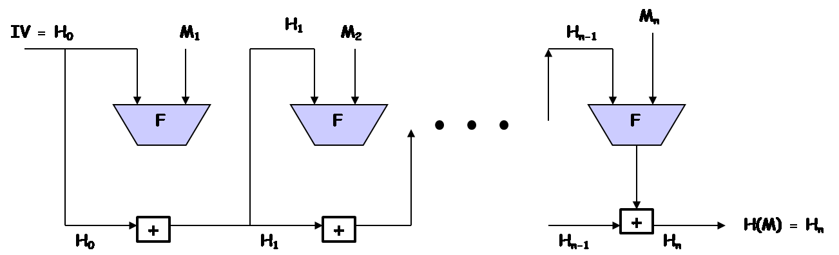
Basic Structure
SHA-1, SHA-2 (a series of hash functions), and WHIRLPOOL all have the same basic structure
The heart of this basic structure is a compression function F
  Different hash algorithms use different compression functions
  Use a CBC mode of repeated applications of F without using secret keys
M is a plaintext block, IV is an initial vector, F is a compression function, and “+” is some form of modular addition operation
. Wang and Z. Kissel. Introduction to Network Security: Theory and Practice. Wiley and HEP, 2015

Slide 10
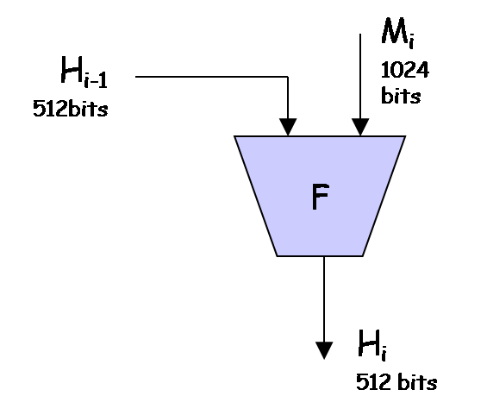
SHA-512 Initial Process (I)
  SHA-512 uses a 512-bit IV
  Let r₁, r₂, r₃, r₄, r₅, r₆, r_{7,} and r₈ be eight 64-bit registers
    Initially they are set to, respectively, the 64-bit binary string in the prefix of the fractional component of the square root of the first 8 prime numbers:
    √2, √3, √5, √7, √11, √13, √17, √19,
. Wang and Z. Kissel. Introduction to Network Security: Theory and Practice. Wiley and HEP, 2015

Slide 11
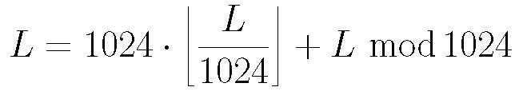
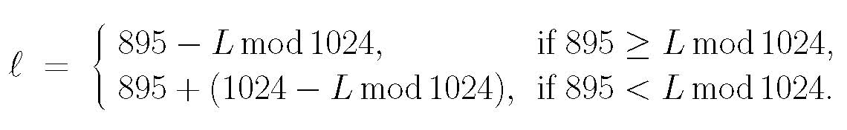
SHA-512 Initial Process (II)
Set Γ = 2¹²⁸ – 1 and γ = 512
M is a binary with |M| = L ≤ Γ
Represent L as a 128-bit binary string, denoted by b₁₂₈(L)
Pad M to produce a new binary string M’ as follows:
M’ = M || 10^{l} || b₁₂₈(L), l ≥ 0
such that |M’| (denoted by L’) is divisible by 1024. We have
L’ = L + (1 + l) + 128 = L + l + 129
L can be represented as
Hence, l can be determined as follows:
Thus, L’ is divisible by 1024. Let L’ = 1024N and write as a sequence of 1024-bit blocks: M’ = M₁M₂…M_{N}
. Wang and Z. Kissel. Introduction to Network Security: Theory and Practice. Wiley and HEP, 2015

Slide 12
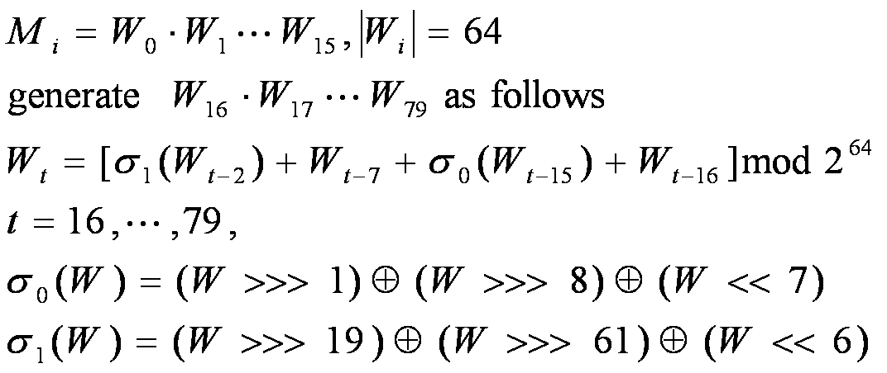
SHA-512 Compression Function (I)
Two inputs:
  a 1024-bit plaintext block M_{i}
  a 512-bit string H_{i-1}, where 1 ≤ i ≤ N and H_{i-1} is the current content in r₁r₂r₃r₄r₅r₆r₇r₈
W>>>n: circularly right shift W for n times
W<<n: linearly left shift W for n times (with the n-bit suffix of filled with 0’s)
. Wang and Z. Kissel. Introduction to Network Security: Theory and Practice. Wiley and HEP, 2015

Slide 13
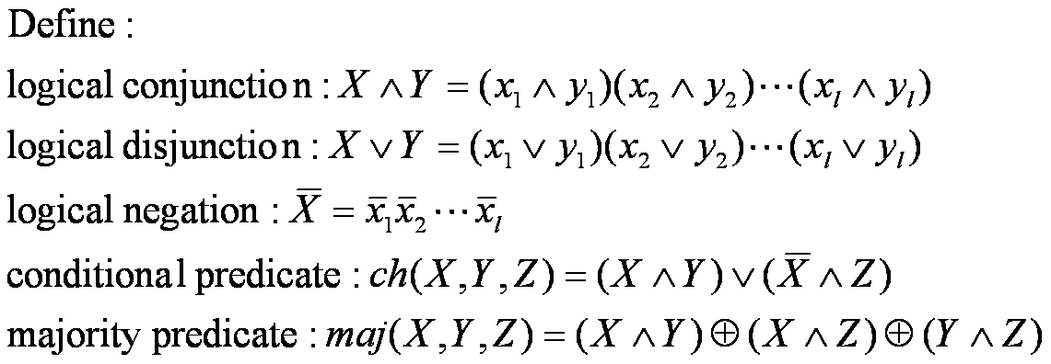
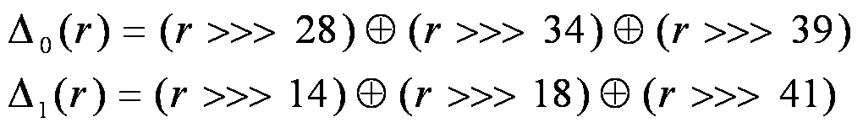
SHA-512 Compression Function (II)
Let K₀,K₁,…K₇₉ denote the sequence of SHA-512 constants, where each constant is a 64-bit binary string (see Appendix B). Let T₁ and T₂ denote temporary variables representing 64-bit binary strings. Let r denote a 64-bit register. Let
. Wang and Z. Kissel. Introduction to Network Security: Theory and Practice. Wiley and HEP, 2015

Slide 14
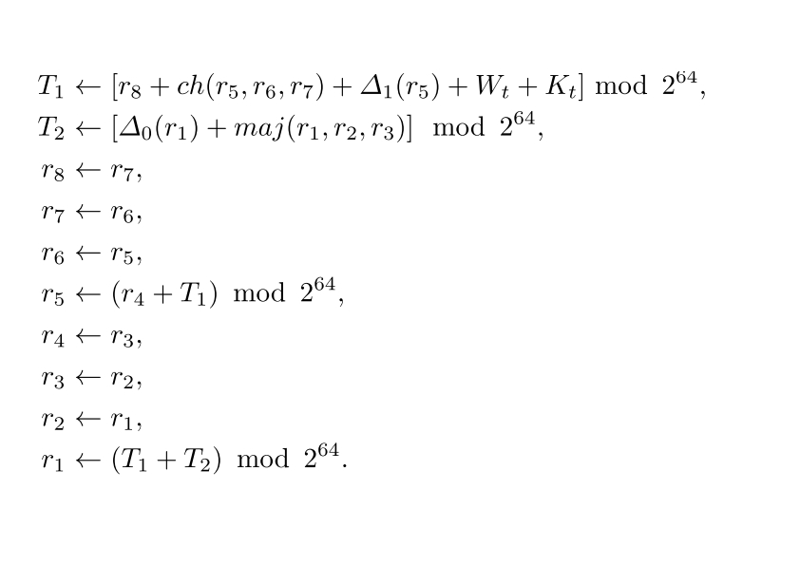
SHA-512 Compression Function (III)
For each i is executed 80 rounds of the same operations as following:
After 80 rounds of executions, the 512-bit string in r₁r₂r₃r₄r₅r₆r₇r₈ is the output of F(M_{i}, H_{i-1})
. Wang and Z. Kissel. Introduction to Network Security: Theory and Practice. Wiley and HEP, 2015

Slide 15
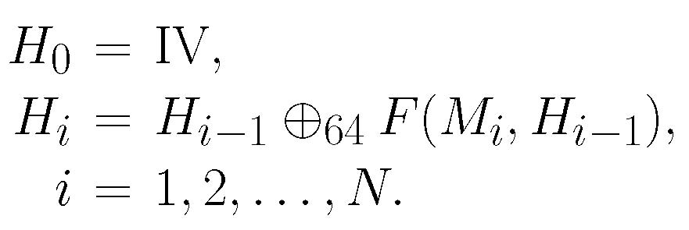
SHA-512 Algorithm
  Let X = X₁X₂…X_{k}, Y = Y₁Y₂…Y_{k} be binary strings, where each X_{i},Y_{i} is an l-bit binary string. Generalize the bitwise-XOR operation to an l-bitwise-XOR operation as follows:
  The M’s digital fingerprint is H(M) = H_{N}, where
. Wang and Z. Kissel. Introduction to Network Security: Theory and Practice. Wiley and HEP, 2015

Slide 16
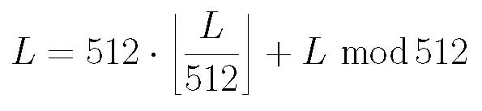
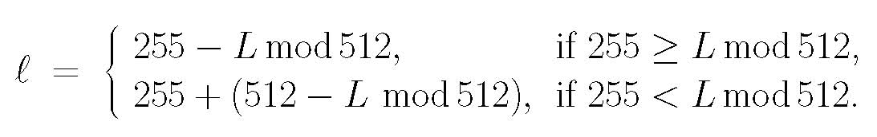
WHIRLPOOL Initial Process
In Whirlpool, Γ = 2²⁵⁶ – 1 and γ = 512
M is a binary with |M| = L ≤ Γ. Let L = |M|. Represent L as a 256-bit binary string, and denote it by b₂₅₆(L). Similar to SHA-512 pad M to produce a new binary string M’ as follows:
  M’ = M || 10^{l} || b₂₅₆(L), l ≥ 0
  such that the L’ = |M’| is divisible by 512. We have
  L’ = L + (1 + l) + 256 = L + l + 257
  L can be represented as
  Hence, we can determine l as follows:
  L’ is divisible by 512. That is, L’ = 512N. So we can write
  M’ = M₁M₂…M_{N}
  where each M_{i} is a 512-bit binary string
. Wang and Z. Kissel. Introduction to Network Security: Theory and Practice. Wiley and HEP, 2015

Slide 17

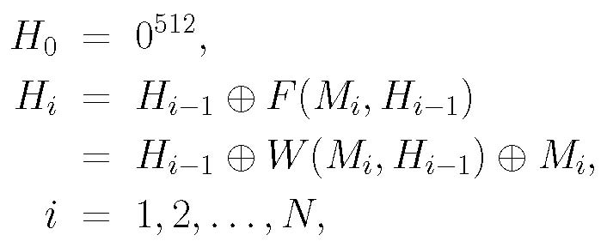
WHIRLPOOL Compression
  WHIRLPOOL’s compression function is defined as follows:
W(X, K) is an encryption algorithm similar to AES
    Input: a 512-bit plaintext block X and a 512-bit key K
    Output: a 512-bit output
  The M’s digital fingerprint is determined by H(M) = H_{N} and is obtained using a CBC mode on M_{i}:
. Wang and Z. Kissel. Introduction to Network Security: Theory and Practice. Wiley and HEP, 2015

Slide 18
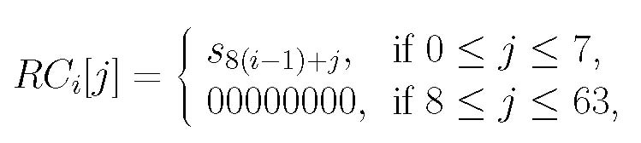
Construction of W(X, K)
A total of eleven 512-bit round keys are generated from K, denoted by K₀, K₁, …, K₁₀.
  K₀ = K
  K_{i} (1≤i ≤10) is generated using the same sequence of four basic operations on K_{i-1}
    substitute-byte (sub)
    shift-columns (shc)
    mix-rows (mir)
    add-round-constant (arc)
  K = arc(mir(shc(sub(K_{i-1}))), RC_{i})
  where RC_{i} is a 512-bit constant string obtained directly
  from WHIRLOOL’s S-Box:
  where i = 1, 2, …, 10
. Wang and Z. Kissel. Introduction to Network Security: Theory and Practice. Wiley and HEP, 2015

Slide 19

  Substitute Bytes (sub)
    WHIRLPOOL’s operation of substitute-bytes uses a 16ⅹ16 S-Box
    Let A = (a_{i,j}) _{8ⅹ8} be an 8ⅹ8 state matrix of bytes
    Let x = x₀x₁x₂x₃x₄x₅x₆x₇ be an 8-bit string, where each x_{i}∈{0,1}
    Let π₁(x) denote the decimal value of the binary string x₀x₁x₂x₃ and π₂(x) the decimal value of the binary string x₄x₅x₆x₇
    Define a substitution function S on x by
  where s_{u,v} is the byte at the u-th row and the v-th column in WHIRLPOOL’s S-Box and 0≤ u, v≤7
    WHIRLPOOL’s operation sub of substitute-bytes is defined as follows:
    sub(A) = (S(a_{i,j})) _{8ⅹ8}
  Shift Columns (shc)
    Similar to the shift-rows operation in AES, except that the columns rather than the rows are shifted. In particular, the j-th column is circularly shifted down j bytes, where j= 0, 1, …, 7.
. Wang and Z. Kissel. Introduction to Network Security: Theory and Practice. Wiley and HEP, 2015

Slide 20
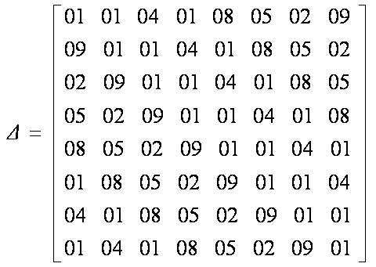
  Mix Rows (mir)
    Similar to the mix-columns operation in AES
    It uses the constant matrix, where each row, starting from the second row, is a circular right shift of the previous row.
    Then mir is defined by:
    mir(A) = A•△
  Add Round Constant (arc) and Add Round Key (ark)
    Same as the add-round-key operation in AES
    arc(A, RC_{i}) = A ⊕ RC_{i}
    ark(A, K_{i}) = A ⊕ K_{i}
. Wang and Z. Kissel. Introduction to Network Security: Theory and Practice. Wiley and HEP, 2015

Slide 21
Encryption Structure
  After the round keys are generated, the algorithm W writes the 64-byte string X in the form of a state matrix
  A = (a_{u,v}) _{8×8}, where
  a_{u,v} = x_{8u+v} and u,v = 0, 1, … ,7
  It then performs the add-round-key operation on A and K₀ to generate a new string A₀
  It repeats the same sequence of four operations for ten rounds. In particular, for each round i with 1≤i ≤10
    And W(X, K) = A₁₀
. Wang and Z. Kissel. Introduction to Network Security: Theory and Practice. Wiley and HEP, 2015

Slide 22
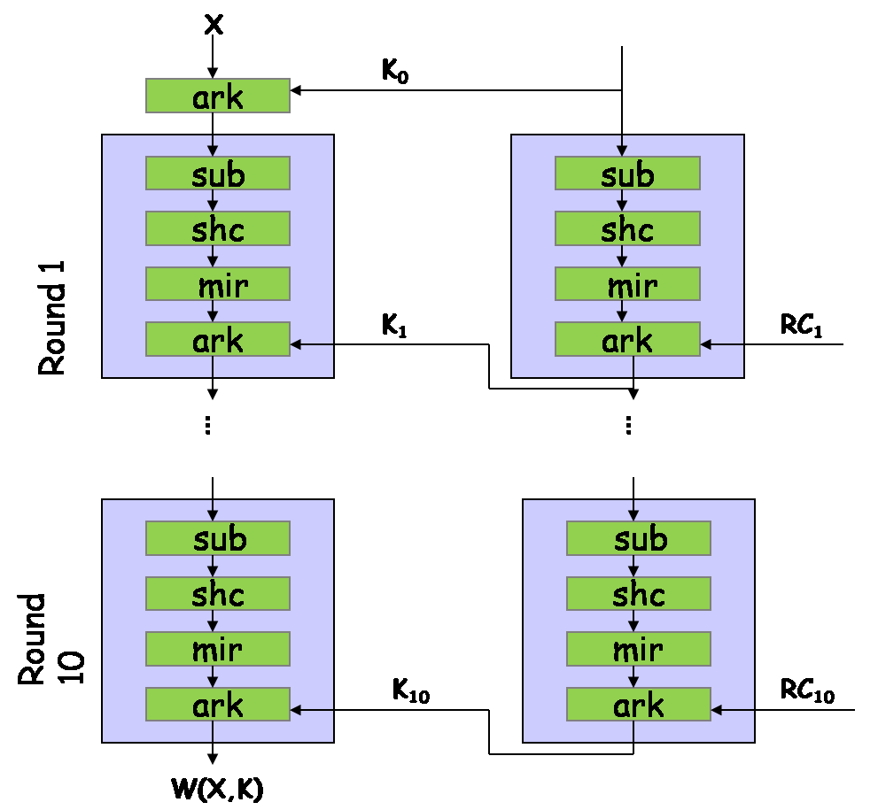
BLOCK diagram of W
. Wang and Z. Kissel. Introduction to Network Security: Theory and Practice. Wiley and HEP, 2015

Slide 23
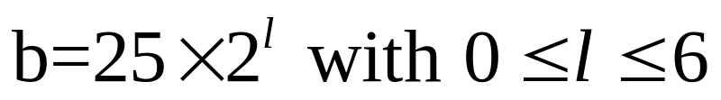
SHA-3
SHA-3 provides an alternative to SHA-2, and is drop-in compatible with any system using SHA-2
SHA-3 uses a sponge construction, instead of the CBC mode of repeated compressions used by SHA-1, SHA-2, and Whirlpool
Let M be the input string and γ the hash length. Write
Thus,
Write b = r + c, where c = 2γ
  r is called rate and c capacity
. Wang and Z. Kissel. Introduction to Network Security: Theory and Practice. Wiley and HEP, 2015

Slide 24
Example
Let γ = 512, then c = 1024. Choose b = 1600, then r = 576.
. Wang and Z. Kissel. Introduction to Network Security: Theory and Practice. Wiley and HEP, 2015

Slide 25
Setup
Pad M by appending 10*1 to produce M’ such that |M’| is divisible by r.
Divide M’ into N = |M’|/r blocks: M₁, …, M_{N}
Let A be a b-bit string and denote A as a 5X5 matrix
Let a_{i,j,k} denote the kth bit in a_{i,j}
Let f_{b} be a fixed-length permutation on b-bit inputs
Let p_{r} = pfx_{r}, s_{c} = sfx_{c}
. Wang and Z. Kissel. Introduction to Network Security: Theory and Practice. Wiley and HEP, 2015

Slide 26



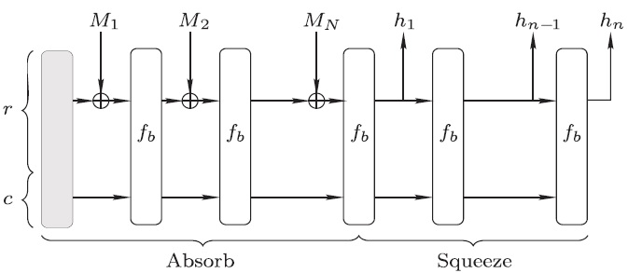
Absorb and Squeeze
Absorb:
Squeeze:
. Wang and Z. Kissel. Introduction to Network Security: Theory and Practice. Wiley and HEP, 2015

Slide 27
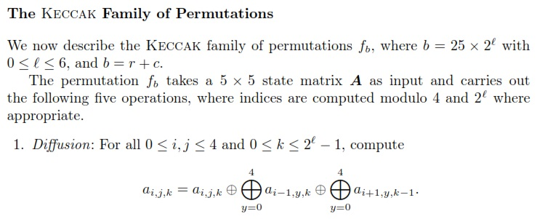
SHA-3 Hash
. Wang and Z. Kissel. Introduction to Network Security: Theory and Practice. Wiley and HEP, 2015

Slide 28
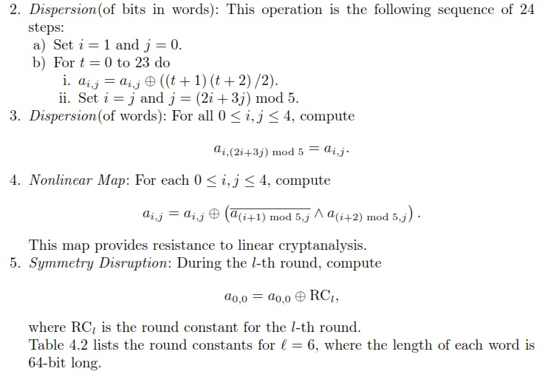
. Wang and Z. Kissel. Introduction to Network Security: Theory and Practice. Wiley and HEP, 2015

Slide 29
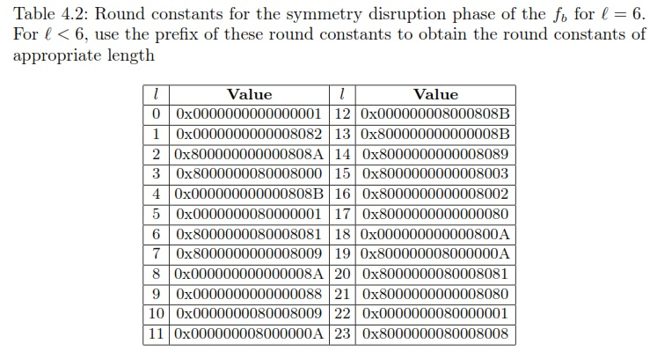
. Wang and Z. Kissel. Introduction to Network Security: Theory and Practice. Wiley and HEP, 2015

Slide 30
Chapter 4 Outline
4.1 Cryptographic Hash Functions
4.2 Cryptographic Checksums
4.3 HMAC
4.4 Birthday Attacks
4.5 Digital Signature Standard
4.6 Dual Signatures and Electronic Transactions
4.7 Blind Signatures and Electronic Cash
. Wang and Z. Kissel. Introduction to Network Security: Theory and Practice. Wiley and HEP, 2015

Slide 31
Cryptographic Checksums
Checksums are commonly used to detect transmission errors in network communications
  However, these checksums cannot be used to authenticate data or used as fingerprints, for it is easy to find a different string to have the same checksum as that of the given string
We can use symmetric-key encryption algorithms to generate cryptographic checksums to authenticate data
Cryptographic checksums are also called Message Authentication Codes (MAC)
. Wang and Z. Kissel. Introduction to Network Security: Theory and Practice. Wiley and HEP, 2015

Slide 32
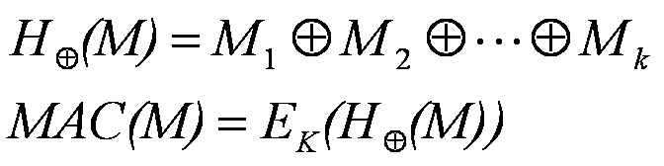
Exclusive-OR Cryptographic Checksums
Let E denote the AES-128 encryption algorithm and K an AES-128 secret key
This method is insecure. It is vulnerable to a man-in-middle attack.
For example, suppose Alice and Bob share the same AES-128 key K.
If Alice sends (M, E_{K}(H⊕(M))) to Bob to authenticate M and Malice intercepts it,
then Malice can use E_{K}(H⊕(M)) to impersonate Alice .
. Wang and Z. Kissel. Introduction to Network Security: Theory and Practice. Wiley and HEP, 2015

Slide 33
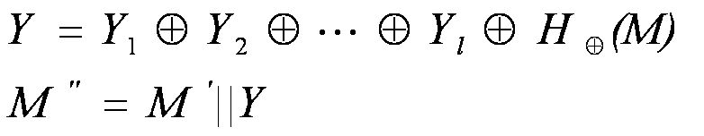
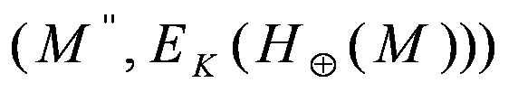


Man-in-the-middle Attack
Let M’ = Y₁Y₂…Y_{l} be an arbitrary message, where Y_{i} is a 128-bit binary string.
Malice sends to Bob:
Bob first computers
He then decrypts to get
So Bob would have to believe that M’’ comes from Alice.
. Wang and Z. Kissel. Introduction to Network Security: Theory and Practice. Wiley and HEP, 2015

Slide 34
Crypto-Checksums Design Criteria
Let MAC_{K}(M) denote M’s MAC code, where K is a secret key. We require that MAC_{K}(M) satisfy the following four criteria:
  Forward efficiency: Computing MAC_{K}(M) is easy and efficient
  Backward intractability: It is computationally difficult to compute M from MAC_{K}(M).
  Computational uniqueness: It is computationally difficult to find M’≠M from (M, MAC_{K}(M) ) such that MAC_{K}(M’) = MAC_{K}(M) .
  Uniform distribution: Let k be the length of the MAC code. Let M be a string selected uniformly at random. Let M’≠M be a string, where M’ is either selected at random independently of M or transformed from M’. Then the probability of MAC_{K}(M’) = MAC_{K}(M) is 2^{-k}
. Wang and Z. Kissel. Introduction to Network Security: Theory and Practice. Wiley and HEP, 2015

Slide 35
Constructions of Crypto-Checksums
There have been no known MAC algorithms proven to satisfy the four criteria
The common method to construct “crypto-checksums”:
  standard encryption algorithms + one-way hash functions
This method meets the need of practical applications
. Wang and Z. Kissel. Introduction to Network Security: Theory and Practice. Wiley and HEP, 2015

Slide 36
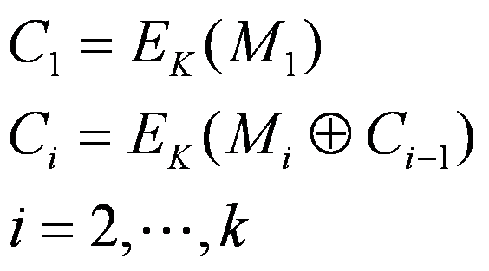
Data Authentication Algorithm
In 1985, the NIST established a data authentication code standard, called DAC, based on the DES under the CBC mode
Let M = M₁M₂…M_{K}, where each M_{i} is a 64-bit binary string. Let K be a DES key and E be a DES encryption algorithm. Let
Then DAC = C_{k}.
As DES is phasing out, DAC has been replaced with a new authentication scheme called Keyed-Hash Message Authentication Code (HMAC)
. Wang and Z. Kissel. Introduction to Network Security: Theory and Practice. Wiley and HEP, 2015

Slide 37
Chapter 4 Outline
4.1 Cryptographic Hash Functions
4.2 Cryptographic Checksums
4.3 HMAC
4.4 Birthday Attacks
4.5 Digital Signature Standard
4.6 Dual Signatures and Electronic Transactions
4.7 Blind Signatures and Electronic Cash
. Wang and Z. Kissel. Introduction to Network Security: Theory and Practice. Wiley and HEP, 2015

Slide 38
HMAC
HMAC is an algorithmic scheme
It uses a hash function and a symmetric-key encryption algorithm to generate authentication codes
Design Criteria of HMAC
    1. Any reasonable hash function can be deployed directly, i.e. without any modification, in HMAC
    2. Any cryptographic hash function deployed in HMAC should maintain its basic properties, including the one-wayness and computational uniqueness
    3. The use of secret keys is simple
    4. Analysis of the strength of a HMAC code can be obtained from analyzing the strength of the hash function deployed
. Wang and Z. Kissel. Introduction to Network Security: Theory and Practice. Wiley and HEP, 2015

Slide 39
HMAC Parameters
H: a hash function to be embedded (e.g., SHA-512 and WHIRLPOOL)
IV: the initial vector of H
M: the message to be authenticated
L: the number of blocks of M
l: the output length of H(M)
b: the number of bits in a block, which is divisible by 8. It is required that b≥l
K: the secret key with a length ≤b
K’: K’ = 0^{b-|K|} K is the prefix padding of K with |K’| = b
ipad: ipad = (00110110)^{b/8}
opad: opad = (01011100) ^{b/8}
K’₀: K’₀ = K’₀ ⊕ ipad. (K’₀ reverses one-half of the bits in K’)
K’₁: K’₁ = K’₁ ⊕ opad. (K’₁ reverses one-half of the bits in K’)
. Wang and Z. Kissel. Introduction to Network Security: Theory and Practice. Wiley and HEP, 2015

Slide 40
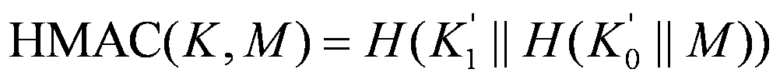
HMAC Algorithm
The HMAC algorithm is given by
. Wang and Z. Kissel. Introduction to Network Security: Theory and Practice. Wiley and HEP, 2015

Slide 41
Chapter 4 Outline
4.1 Cryptographic Hash Functions
4.2 Cryptographic Checksums
4.3 HMAC
4.4 Birthday Attacks
4.5 Digital Signature Standard
4.6 Dual Signatures and Electronic Transactions
4.7 Blind Signatures and Electronic Cash
. Wang and Z. Kissel. Introduction to Network Security: Theory and Practice. Wiley and HEP, 2015

Slide 42
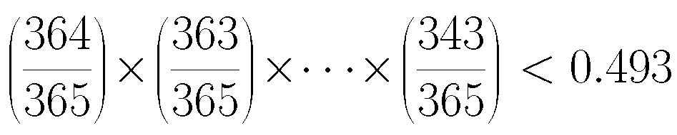
Birthday Attack Basics
In a group of 23 people, the probability that there are at least two persons on the same day in the same month is greater than 1/2
Proof. The probability that none of the 23 people has the same birthday is:
Thus, 1 – 0.493 > 1/2
. Wang and Z. Kissel. Introduction to Network Security: Theory and Practice. Wiley and HEP, 2015

Slide 43

Strong Collision Resistance Complexity Upper Bound
Complexity upper bound of breaking strong collision resistance
    Let H be a cryptographic hash function with output length l. Then H will only have at most n = 2^{l} different outputs
    Q: Is 2^{l} the complexity upper bound of breaking strong collision resistance?
    A: No. We can use birthday attack to reduce the complexity to 2^{l/2} with over 50% success rate
  Birthday Paradox:
    From a basket of n balls of different colors, pick k (k<n) balls uniformly and independently at random and record their colors. If
    then with probability at least 1/2 there is at least one ball that is picked more than once
  Complexity upper bound of SHA-1: 2^{160/2} = 2⁸⁰ ; SHA-512: 2^{512/2} = 2²⁵⁶
. Wang and Z. Kissel. Introduction to Network Security: Theory and Practice. Wiley and HEP, 2015

Slide 44
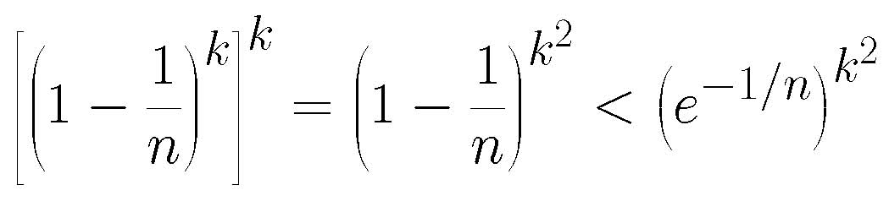
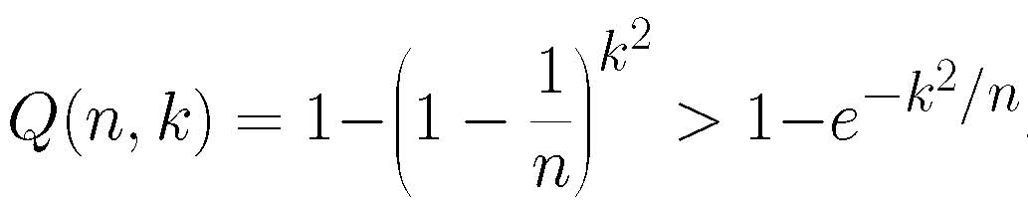
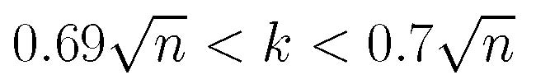

Set Intersection Attack
Select uniformly and independently at random two sets of integers from {1,2,…,n}, with k integers in each set, where k < n
What is the probability Q(n,k) that these two sets intersect?
  The probability that these two sets disjoin is equal to
  Thus,
  It can be shown that if then
. Wang and Z. Kissel. Introduction to Network Security: Theory and Practice. Wiley and HEP, 2015

Slide 45
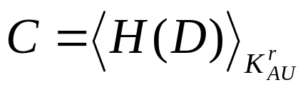
Set Intersection Attack Example
The set intersection attack is a form of birthday attacks
For example: Malice may fist use a legitimate document D to obtain the authority AU’s signature
Malice then produces a new document F that has different meanings from D such that H(F)=H(D) (Note that there are many tricks to find such an F)
Malice uses (F,C) to show that F is endorsed by AU
. Wang and Z. Kissel. Introduction to Network Security: Theory and Practice. Wiley and HEP, 2015

Slide 46
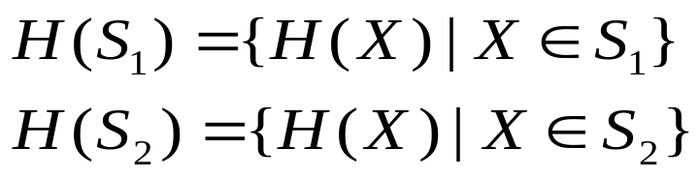
How to find Document F?
Malice prepares a set S₁ of 2^{l/2} different documents, all having the same meaning as D. Such documents can be obtained by
  replacing a word or a phrase in D
  rephrasing sentences in D
  using different punctuation
  reorganizing the structure of D
  changing passive tense to active, or active to passive
Malice prepares a set of S₂ of 2^{l/2} different documents, all having the same meaning of F, and computes
. Wang and Z. Kissel. Introduction to Network Security: Theory and Practice. Wiley and HEP, 2015

Slide 47
Chapter 4 Outline
4.1 Cryptographic Hash Functions
4.2 Cryptographic Checksums
4.3 HMAC
4.4 Birthday Attacks
4.5 Digital Signature Standard
4.6 Dual Signatures and Electronic Transactions
4.7 Blind Signatures and Electronic Cash
. Wang and Z. Kissel. Introduction to Network Security: Theory and Practice. Wiley and HEP, 2015

Slide 48
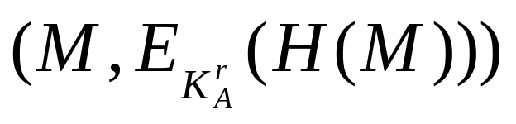
Digital Signature Standard (DSS)
Digital signature for a message M:
Public Key Cryptosystem
  The most effective mechanism to produce a digital signature for a given document
  RSA (patent protected until 2000)‏
DSS
  First published in 1991
  RSA and ECC were included in DSS after 2000
  Generate digital signatures only, not encrypt data
. Wang and Z. Kissel. Introduction to Network Security: Theory and Practice. Wiley and HEP, 2015

Slide 49
Construction of DSS
H: SHA-1 (160 bit)‏
L: 512 < L < 1024
Parameters:
P: prime number; 2^{L–1} < p < 2^{L}
q: a prime factor of p – 1; 2¹⁵⁹ < q < 2¹⁶⁰
g: g = h^{(p–1)/q} mod p; 1 < h < p – 1, g > 1
. Wang and Z. Kissel. Introduction to Network Security: Theory and Practice. Wiley and HEP, 2015

Slide 50
DSS Signing
Alice wants to sign a message M
Picks at random a private key, 0 < x_{A} < q
Computes public key: y_{A} = g^{xA} mod p
Picks at random an integer: 0 < k_{A} < q
r_{A} = (g^{kA} mod p) mod q
k_{A}^{–1} = k_{A}^{q–2} mod q
s_{A} = k_{A}^{–1}(H(M)+x_{A}r_{A}) mod q
M’s digital signature: (r_{A}, s_{A})
. Wang and Z. Kissel. Introduction to Network Security: Theory and Practice. Wiley and HEP, 2015

Slide 51
DSS Signature Verification
Bob gets (M', (r_{A}', S_{A}')‏) and CA[y_{A}]
Obtains Alice’s y_{A} using CA’s K_{CA}^{u} to decrypt CA[y_{A}]
Verifies Alice’s digital signature:
  w = (S_{A}')^{–1} mod q = (S_{A}')^{q–1} mod q
  u1 = (H(M') w) mod q
  u2 = (r_{A}' w) mod q
  v = [(g^{u1}y_{A}^{u2}) mod p] mod q
  If v = r_{A}' then the signature is verified
. Wang and Z. Kissel. Introduction to Network Security: Theory and Practice. Wiley and HEP, 2015

Slide 52
Security Strength of DSS
Rests on the strength of SHA-1 and the difficulty of solving discrete log
  The complexity of breaking the strong collision resistance of SHA-1 has recently been reduced from 2⁸⁰ to 2⁶³
  Breaking the collision resistance is harder
  Intractability of discrete log ensures that it is difficult to compute k_{A} or x_{A} from r_{A} and s_{A}
. Wang and Z. Kissel. Introduction to Network Security: Theory and Practice. Wiley and HEP, 2015

Slide 53
Chapter 4 Outline
4.1 Cryptographic Hash Functions
4.2 Cryptographic Checksums
4.3 HMAC
4.4 Birthday Attacks
4.5 Digital Signature Standard
4.6 Dual Signatures and Electronic Transactions
4.7 Blind Signatures and Electronic Cash
. Wang and Z. Kissel. Introduction to Network Security: Theory and Practice. Wiley and HEP, 2015

Slide 54
Dual Signatures and Electronic Transactions
Alice
(customer)‏
Bob
(merchant)‏
Alice wants bob to act on
Purchase Order ( I₁ )‏
Alice must send
payment information
to Charlie ( I₂ )‏
Bob will wait on
payment confirmation
from Charlie.
Charlie
(banker)‏
. Wang and Z. Kissel. Introduction to Network Security: Theory and Practice. Wiley and HEP, 2015

Slide 55
Dual Signatures
We don't want Bob to see I₂ and Charlie to see I₁ (for better privacy)
Charlie should not send I₂ to Bob before Bob gets I₁
I₁ and I₂ should be linked (this prevents separation of a payment from an order)
All messages must be authenticated and encrypted (No useful information is eavesdropped, modified, or fabricated)
. Wang and Z. Kissel. Introduction to Network Security: Theory and Practice. Wiley and HEP, 2015

Slide 56
Dual Signature
An interactive authentication protocol for electronic transactions
Provides security and privacy protections
Has been used in SET (Secure Electronic Transactions), designed by Visa and MasterCard in 1996 but has not been used in practice
Requires
  Alice, Bob, and Charlie agree on a hash function H and a PKC encryption algorithm E
  Each of Alice, Bob, and Charlie must each have an RSA key-pair: (K_{A}^{u}, K_{A}^{r}), (K_{B}^{u}, K_{B}^{r}), (K_{C}^{u}, K_{C}^{r})
. Wang and Z. Kissel. Introduction to Network Security: Theory and Practice. Wiley and HEP, 2015

Slide 57
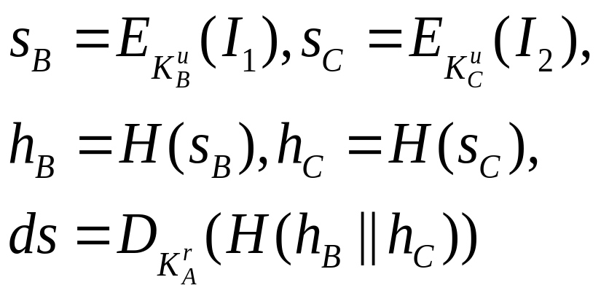
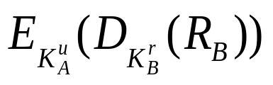
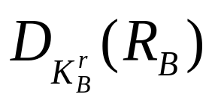
SET: Alice
Calculates the following values:
Sends (s_{B}, s_{C}, ds) to Bob.
Waits for a receipt R_{B} = from Bob
Decrypts R_{B} using K_{A}^{r} to get and verifies Bob’s signature using K_{B}^{u} to get R_{B}
. Wang and Z. Kissel. Introduction to Network Security: Theory and Practice. Wiley and HEP, 2015

Slide 58
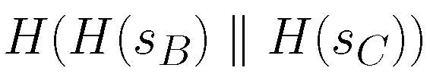
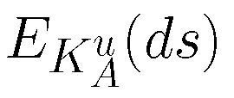
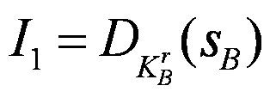



SET: Bob
Verifies Alice's signature; i.e.
Compares with
Decrypts
Forwards (s_{B}, s_{C}, ds) to Charlie
Waits for Charlie's receipt R_{C} = ‏
Decrypts R_{C} using K_{B}^{r} to get and verifies Charlie’s signature using K_{C}^{u} to get R_{C}
Sends a signed receipt R_{B} = to Alice
. Wang and Z. Kissel. Introduction to Network Security: Theory and Practice. Wiley and HEP, 2015

Slide 59
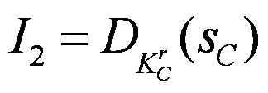

SET: Charlie
Verifies Alice's signature; i.e.
Compares with
Decrypts
If I₂ contains valid payment information, then execute the proper payment transaction and send a receipt R_{C} = to Bob
. Wang and Z. Kissel. Introduction to Network Security: Theory and Practice. Wiley and HEP, 2015

Slide 60
Chapter 4 Outline
4.1 Cryptographic Hash Functions
4.2 Cryptographic Checksums
4.3 HMAC
4.4 Birthday Attacks
4.5 Digital Signature Standard
4.6 Dual Signatures and Electronic Transactions
4.7 Blind Signatures and Electronic Cash
. Wang and Z. Kissel. Introduction to Network Security: Theory and Practice. Wiley and HEP, 2015

Slide 61
Blind Signatures
A technique to digitally sign a document without revealing the document to the signer
The document to be signed is combined with a blind factor, which prevents the signer from reading the document but can later be removed without damaging the signature
. Wang and Z. Kissel. Introduction to Network Security: Theory and Practice. Wiley and HEP, 2015

Slide 62
Blind Signatures with RSA
Randomly generate r < n (the blind factor) such that gcd(r, n) = 1
Let M_{r} = M r^{e} mod n
Signer signs M_{r} and obtains s_{r} = M_{r}^{d} mod n
The blind factor r can be removed as follows:
s_{M} = (s_{r} r^{–1}) mod n
= M^{d} mod n
. Wang and Z. Kissel. Introduction to Network Security: Theory and Practice. Wiley and HEP, 2015

Slide 63
Proof
The blind factor is removed as
s_{M} = (s_{r} r^{–1}) mod n
= (M^{d} r^{ed} r^{–1}) mod n
Since
ed ≡ 1 mod ф(n))
r^{ed} ≡ r mod n (Fermat’s little theorem)
We have
s_{M} = M^{d} mod n
. Wang and Z. Kissel. Introduction to Network Security: Theory and Practice. Wiley and HEP, 2015

Slide 64
Electronic Cash
Real cash has the following key properties:
  Anonymous
  Can change hands
  Can be divided into smaller values
  Hard to counterfeit
Can those properties be duplicated with some sort of electronic cash?
. Wang and Z. Kissel. Introduction to Network Security: Theory and Practice. Wiley and HEP, 2015

Slide 65
Ideal Electronic Cash Protocol
An ideal electronic cash protocol should have the following properties:
  Anonymous & Untraceable
  Secure: Can't be modified or fabricated
  Convenient: Allows off-line transactions
  Non-replicable: Can't be duplicated and reused
  Transferable: Can change hands
  Dividable: Can be divided into smaller values.
No such protocol have been found
. Wang and Z. Kissel. Introduction to Network Security: Theory and Practice. Wiley and HEP, 2015

Slide 66
eCash
Proposed in the 1980’s
A protocol that satisfies many of the most important properties for electronic cash
It uses Blind Signatures to ensure anonymousness and un-traceability
Let B denote a financial institution
Let B’s RSA parameters be (n, d, e)
. Wang and Z. Kissel. Introduction to Network Security: Theory and Practice. Wiley and HEP, 2015

Slide 67
Buying an eCash Dollar
To buy an eCash dollar, Alice does the following:
  Generates a sequence number m to represent the eCash dollar she is going to buy
  Generates a random number r < n (blind factor) and calculates x = mr^{e} mod n
  Sends x and her account number to her bank B
  B charges Alice’s account $1 and sends y = x^{d} mod n to Alice
  Alice computes z ≡ y r⁻¹ ≡ m^{d} mod n
  Alice gets her eCash dollar (m, z)
. Wang and Z. Kissel. Introduction to Network Security: Theory and Practice. Wiley and HEP, 2015

Slide 68
Redeeming an eCash Dollar
Bob has received an eCash dollar from Alice, and wants to redeem it
  He sends (m, z) and his account number to the bank B.
  If the signature is valid and no dollar with serial number m has been cashed previously, the bank records m and credits $1 to Bob's account
Problem: Since it is easy to duplicate (m, z), how can Bob stop someone else from redeeming that eCash dollar before he does?
. Wang and Z. Kissel. Introduction to Network Security: Theory and Practice. Wiley and HEP, 2015

Slide 69
Bitcoin
Bitcoin is a network protocol
It can be viewed as mining game, where players are rewarded for successes with prizes called Bitcoins
Unlike eCash, Bitcoin is a decentralized currency
Bitcoins use a group of cooperating players to form a P2P network called Bitcoin network
The Bitcoin network maintains a global distributed ledger (GDL) of transactions called block chain
Bitcoin signs individual transactions, instead of a particular Bitcoin
. Wang and Z. Kissel. Introduction to Network Security: Theory and Practice. Wiley and HEP, 2015

Slide 70
Bitcoin Transaction Signing
Suppose that Alice wants to pay Bob c BTC
  She collects transactions she owns from GDL that sum up to at least c BTC
  She signs a transaction, called a transaction record, which lists Bob (represented by his payment address) as the receiver of c BTC, and broadcasts it in the Bitcoin network
  The payment address is a function of Bob’s public key.
. Wang and Z. Kissel. Introduction to Network Security: Theory and Practice. Wiley and HEP, 2015

Slide 71
Transaction Record
The transaction record becomes a new item in the GDL, which consists of the following components:
  A list of transactions destined to Alice that sum to at least c. These transactions are lines in the GDL
  A hash of each transaction Alice is going to use for payment
  The payment address for Bob, with the amount of BTC to be paid to Bob
  The payment address for Alice, with how much change Alice should receive from the transaction
  The above items are hashed and signed with Alice’s private key
Bitcoin uses SHA-256 to hash
. Wang and Z. Kissel. Introduction to Network Security: Theory and Practice. Wiley and HEP, 2015

Slide 72
Bitcoin Mining
Mining is to collect a set of transactions, referred to as a block, from the Bitcoin network
A block consists of
  A list of verified transactions
  A hash of these transactions
  A link to the previous transaction in the block chain
  A proof that the transactions have been verified
Miner adds the new block to the block chain for a certain number of Bitcoins
Miner verifies the transactions in the new block by checking that the signatures work and no coins were spent twice. These transactions are combined into a single hash value using a Merkle tree
. Wang and Z. Kissel. Introduction to Network Security: Theory and Practice. Wiley and HEP, 2015

Slide 73
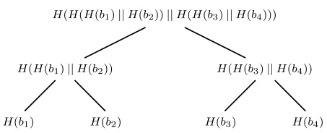
Merkle Tree
. Wang and Z. Kissel. Introduction to Network Security: Theory and Practice. Wiley and HEP, 2015

Slide 74
Proof of Work
To link the new block to the previous block in the block chain, the transaction must contain a reference called proof-of-work (POW) to the previous block
A POW is a value hard to generate to meet a certain requirement but easy to verify
This makes the process of acquiring Bitcoins from the Bitcoin network immensely difficult
  Some people are willing to pay real money to acquire Bitcoins from someone who own them
. Wang and Z. Kissel. Introduction to Network Security: Theory and Practice. Wiley and HEP, 2015

Slide 75
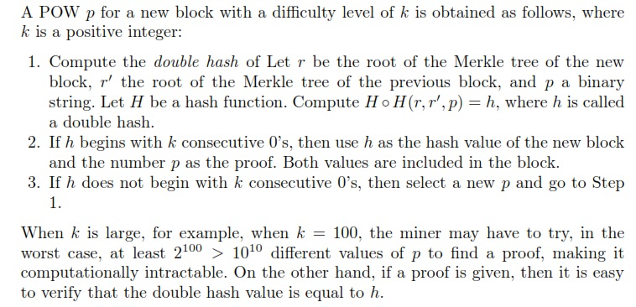
POW Details
. Wang and Z. Kissel. Introduction to Network Security: Theory and Practice. Wiley and HEP, 2015

Slide 76
Adding New Blocks
Miners add a new block by broadcasting it to the BN
When two miners each broadcast a new block and one block is a subset of the other, only the block with more transactions is kept
  When two blocks are identical (rare), the block is split temporarily in the block chain
  When one of the forked chains contains more transactions, this chain is kept
The Miner adds new blocks using a special transaction called a coinbase transaction, which lists the miner as the recipient of a certain amount of Bitcoins (i.e. 25 BTC)
. Wang and Z. Kissel. Introduction to Network Security: Theory and Practice. Wiley and HEP, 2015

