Slide 1
Chapter 5
Network Security Protocols in Practice
J. Wang and Z. Kissel. Introduction to Computer Network Security: Theory and Practice. Wiley 2015

Slide 2
Chapter 5 Outline
5.1 Crypto Placements in Networks
5.2 Public-Key Infrastructure
5.3 IPsec: A Security Protocol at the Network Layer
5.4 SSL/TLS: Security Protocols at the Transport Layer
5.5 PGP and S/MIME: Email Security Protocols
5.6 Kerberos: An Authentication Protocol
5.7 SSH: Security Protocols for Remote Logins
5.8 Electronic Voting Protocols
J. Wang and Z. Kissel. Introduction to Computer Network Security: Theory and Practice. Wiley 2015

Slide 3
Building Blocks for Network Security
Encryption and authentication algorithms are building blocks of secure network protocols
Deploying cryptographic algorithms at different layers have different security effects
Where should we put the security protocol in the network architecture?
J. Wang and Z. Kissel. Introduction to Computer Network Security: Theory and Practice. Wiley 2015

Slide 4
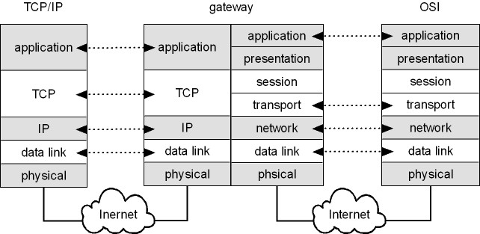
The TCP/IP and the OSI Models
J. Wang and Z. Kissel. Introduction to Computer Network Security: Theory and Practice. Wiley 2015

Slide 5
TCP/IP Protocol Layers
Logical (Software)‏
Physical (Hardware)‏
Application
  Web, Email
Transport Layer
  TCP, UDP
Network Layer
  IP
Data Link Layer
  Ethernet, 802.11
Physical Layer
J. Wang and Z. Kissel. Introduction to Computer Network Security: Theory and Practice. Wiley 2015

Slide 6
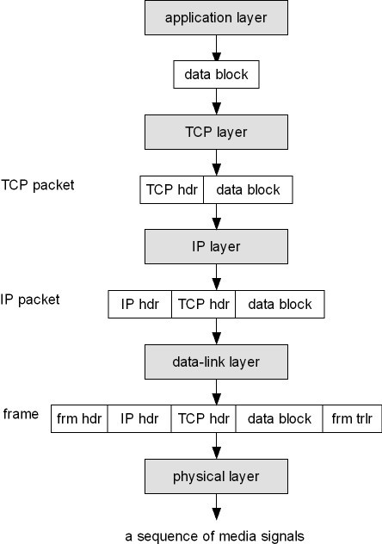
TCP/IP Packet
Generation
J. Wang and Z. Kissel. Introduction to Computer Network Security: Theory and Practice. Wiley 2015

Slide 7
What Are the Pros and Cons?
Application Layer
  Provides end-to-end security protection
  No need to decrypt data or check for signatures
  Attackers may analyze traffic and modify headers
Transport Layer
  Provides security protections for TCP packets
  No need to modify any application programs
  Attackers may analyze traffic via IP headers
J. Wang and Z. Kissel. Introduction to Computer Network Security: Theory and Practice. Wiley 2015

Slide 8
Network Layer
  Provides link-to-link security protection
    Transport mode: Encrypt payload only
    Tunnel mode: Encrypt both header & payload; need a gateway
  No need to modify any application programs
Data-link Layer
  Provides security protections for frames
  No need to modify any application programs
  Traffic analysis would not yield much info
J. Wang and Z. Kissel. Introduction to Computer Network Security: Theory and Practice. Wiley 2015

Slide 9
Chapter 5 Outline
5.1 Crypto Placements in Networks
5.2 Public-Key Infrastructure
5.3 IPsec: A Security Protocol at the Network Layer
5.4 SSL/TLS: Security Protocols at the Transport Layer
5.5 PGP and S/MIME: Email Security Protocols
5.6 Kerberos: An Authentication Protocol
5.7 SSH: Security Protocols for Remote Logins
5.8 Electronic Voting Protocols
J. Wang and Z. Kissel. Introduction to Computer Network Security: Theory and Practice. Wiley 2015

Slide 10
PKI
PKI is a mechanism for using PKC
PKI issues and manages subscribers’ public-key certificates and CA networks:
  Determine users’ legitimacy
  Issue public-key certificates upon users’ requests
  Extend public-key certificates’ valid time upon users’ requests
  Revoke public-key certificates upon users’ requests or when the corresponding private keys are compromised
  Store and manage public-key certificates
  Prevent digital signature singers from denying their signatures
  Support CA networks to allow different CAs to authenticate public-key certificates issued by other CAs
J. Wang and Z. Kissel. Introduction to Computer Network Security: Theory and Practice. Wiley 2015

Slide 11
X.509 PKI (PKIX)
Recommended by IETF
Four basic components:
    end entity
    certificate authority (CA)
    registration authority (RA)
    repository
J. Wang and Z. Kissel. Introduction to Computer Network Security: Theory and Practice. Wiley 2015

Slide 12
X.509 PKI (PKIX)
Main functionalities:
  CA is responsible of issuing and revoking public-key certificates
  RA is responsible of verifying identities of owners of public-key certificates
  Repository is responsible of storing and managing public-key certificates and certificate revocation lists (CRLs)
J. Wang and Z. Kissel. Introduction to Computer Network Security: Theory and Practice. Wiley 2015

Slide 13
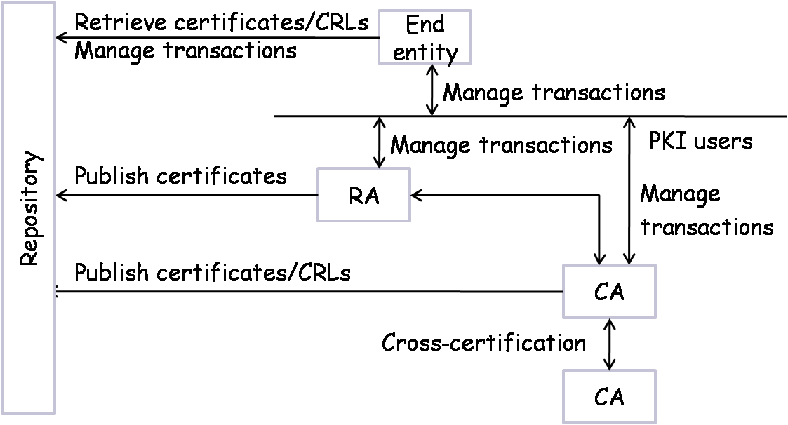
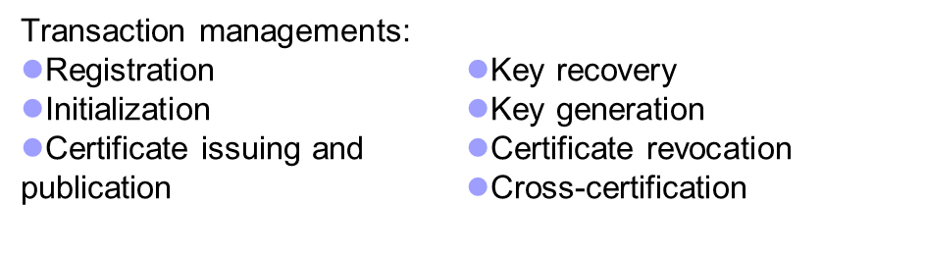
PKIX Architecture
J. Wang and Z. Kissel. Introduction to Computer Network Security: Theory and Practice. Wiley 2015

Slide 14
X.509 Certificate Formats
Version: which version the certificate is using
Serial number: a unique # assigned to the certificate within the same CA
Algorithm: name of the hash function and the public-key encryption algorithm
Issuer: name of the issuer
Validity period: time interval when the certificate is valid
Subject: name of the certificate owner
Public key: subject’s public-key and parameter info.
Extension: other information (only available in version 3)
Properties: encrypted hash value of the certificate using K_{CA}^{r}
J. Wang and Z. Kissel. Introduction to Computer Network Security: Theory and Practice. Wiley 2015

Slide 15
Chapter 5 Outline
5.1 Crypto Placements in Networks
5.2 Public-Key Infrastructure
5.3 IPsec: A Security Protocol at the Network Layer
5.4 SSL/TLS: Security Protocols at the Transport Layer
5.5 PGP and S/MIME: Email Security Protocols
5.6 Kerberos: An Authentication Protocol
5.7 SSH: Security Protocols for Remote Logins
5.8 Electronic Voting Protocols
J. Wang and Z. Kissel. Introduction to Computer Network Security: Theory and Practice. Wiley 2015

Slide 16
IPsec: Network-Layer Protocol
IPsec encrypts and/or authenticates IP packets
It consists of three protocols:
  Authentication header (AH)
    To authenticate the origin of the IP packet and ensure its integrity
    To detect message replays using sliding window
  Encapsulating security payload (ESP)
    Encrypt and/or authenticate IP packets
  Internet key exchange (IKE)
    Establish secret keys for the sender and the receiver
Runs in one of two modes:
  Transport Mode
  Tunnel Mode (requires gateway)‏
J. Wang and Z. Kissel. Introduction to Computer Network Security: Theory and Practice. Wiley 2015

Slide 17
IPsec Security Associations
Alice
Bob
SA
If Alice wants to establish an IPsec connection with Bob, the two parties must first negotiate a set of keys and algorithms
The concept of security association (SA) is a mechanism for this purpose
An SA is formed between an initiator and a responder, and lasts for one session
An SA is for encryption or authentication, but not both.
If a connection needs both, it must create two SAs, one for encryption and one for authentication
J. Wang and Z. Kissel. Introduction to Computer Network Security: Theory and Practice. Wiley 2015

Slide 18
SA Components
Three parameters:
  Security parameters index (SPI)
  IP destination address
  Security protocol identifier
Security Association Database (SAD)
  Stores active SAs used by the local machine
Security Policy Database (SPD)
  A set of rules to select packets for encryption / authentication
SA Selectors (SAS)
  A set of rules specifying which SA(s) to use for which packets
J. Wang and Z. Kissel. Introduction to Computer Network Security: Theory and Practice. Wiley 2015

Slide 19
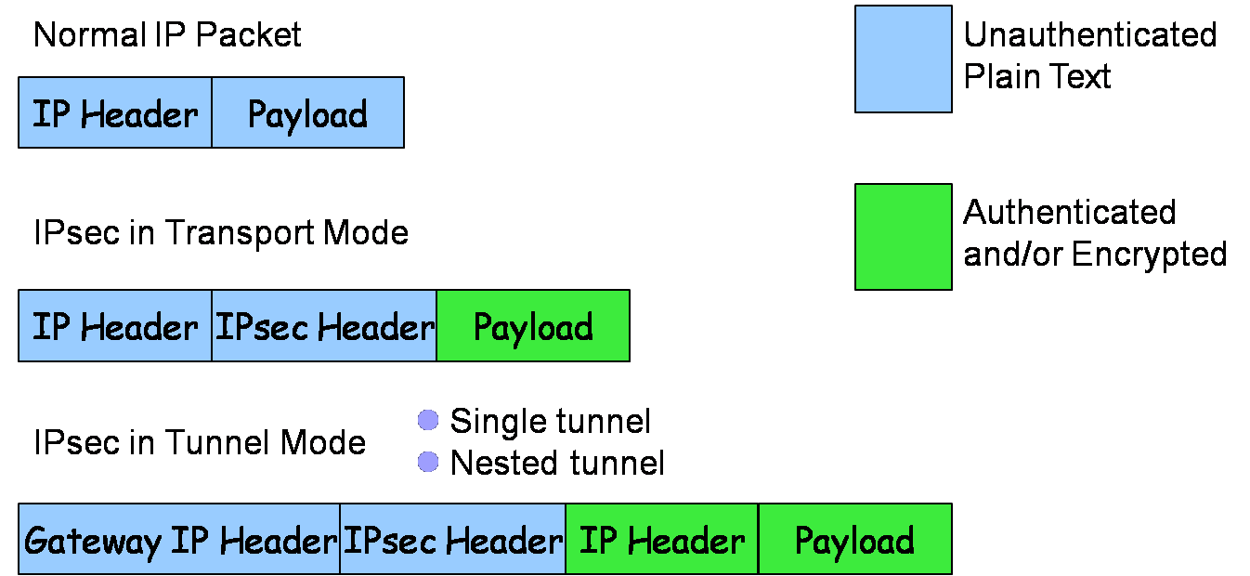
IPsec Packet Layout
J. Wang and Z. Kissel. Introduction to Computer Network Security: Theory and Practice. Wiley 2015

Slide 20
IPsec Header
IPsec Header
Authentication
Header (AH)‏
Encapsulated Security
Payload (ESP)‏
Authentication and Encryption use
separate SAs
J. Wang and Z. Kissel. Introduction to Computer Network Security: Theory and Practice. Wiley 2015

Slide 21
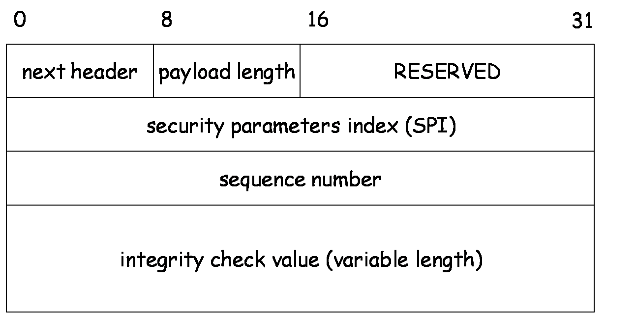
Authentication Header
J. Wang and Z. Kissel. Introduction to Computer Network Security: Theory and Practice. Wiley 2015

Slide 22
Resist Message Replay Attack
Sequence number is used with a sliding window
to thwart message replay attacks
A
B
C
Given an incoming packet with sequence # s, either
s in A – It's too old, and can be discarded
s in B – It's in the window. Check if it's been seen before
s in C – Shift the window and act like case B
J. Wang and Z. Kissel. Introduction to Computer Network Security: Theory and Practice. Wiley 2015

Slide 23
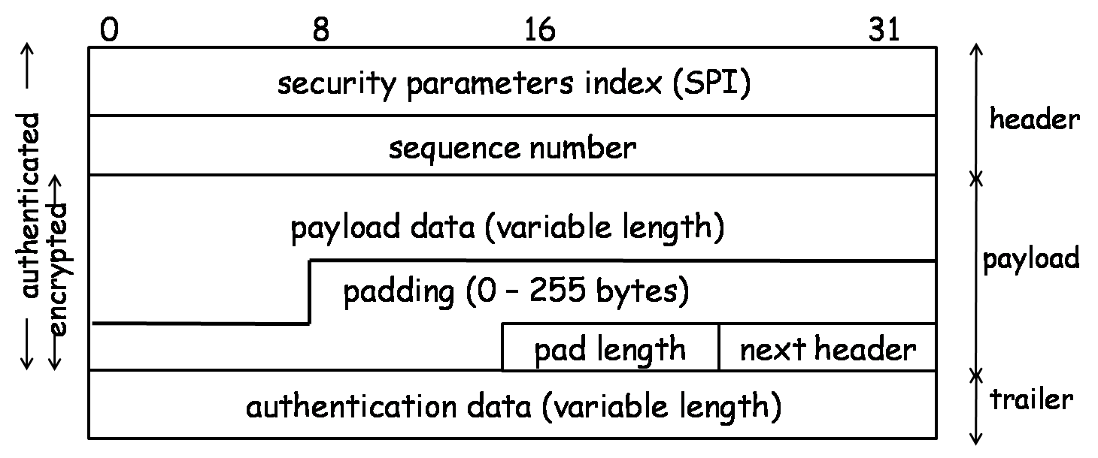
Encapsulated Security Payload
J. Wang and Z. Kissel. Introduction to Computer Network Security: Theory and Practice. Wiley 2015

Slide 24
Key Determination and Distribution
Oakley key determination protocol (KDP)
  Diffie-Hellman Key Exchange
  + authentication & cookies
  Authentication helps resist man-in-the-middle attacks
  Cookies help resist clogging attacks
  Nonce helps resist message replay attacks
J. Wang and Z. Kissel. Introduction to Computer Network Security: Theory and Practice. Wiley 2015

Slide 25
Clogging Attacks
A form of denial of service attacks
Attacker sends a large number of public key Y_{i} in crafted IP packets, forcing the victim’s computer to compute secret keys K_{i} = Y_{i}^{X} mod p over and over again
  Diffie-Hellman is computationally intensive because of modular exponentiations
Cookies help
  Before doing computation, recipient sends a cookie (a random number) back to source and waits for a confirmation including that cookie
  This prevents attackers from making DH requests using crafted packets with crafted source addresses
J. Wang and Z. Kissel. Introduction to Computer Network Security: Theory and Practice. Wiley 2015

Slide 26
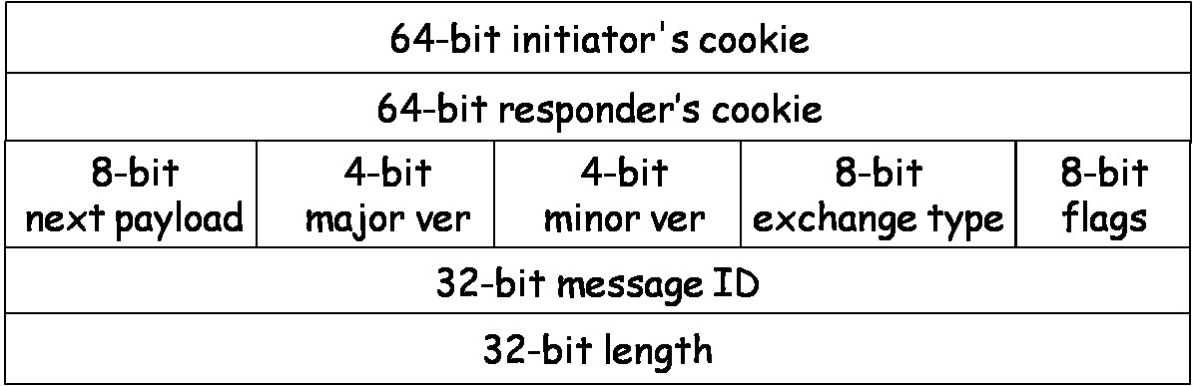
ISAKMP
ISAKMP: Internet Security Association and Key Management Protocol
  Specifies key exchange formats
  Each type of payload has the same form of a payload header
ISAKMP header
J. Wang and Z. Kissel. Introduction to Computer Network Security: Theory and Practice. Wiley 2015

Slide 27
ISAKMP Payload Types
SA: for establishing a security association
Proposal: for negotiating an SA
Transform: for specifying encryption and authentication algorithms
Key-exchange: for specifying a key-exchange algorithm
Identification: for carrying info and identifying peers
Certificate-request: for requesting a public-key certificate
Certificate: contain a public-key certificate
Hash: contain the hash value of a hash function
Signature: contain the output of a digital signature function
Nonce: contain a nonce
Notification: notify the status of the other types of payloads
Delete: notify the receiver that the sender has deleted an SA or SAs
8-bit
Next payload
8-bit
Reserved
16-bit
Payload length
J. Wang and Z. Kissel. Introduction to Computer Network Security: Theory and Practice. Wiley 2015

Slide 28
Chapter 5 Outline
5.1 Crypto Placements in Networks
5.2 Public-Key Infrastructure
5.3 IPsec: A Security Protocol at the Network Layer
5.4 SSL/TLS: Security Protocols at the Transport Layer
5.5 PGP and S/MIME: Email Security Protocols
5.6 Kerberos: An Authentication Protocol
5.7 SSH: Security Protocols for Remote Logins
5.8 Electronic Voting Protocols
J. Wang. Computer Network Security Theory and Practice. Springer 2008

Slide 29
SSL/TLS
Secure Socket Layer Protocol (SSL)
  Designed by Netscape in 1994
  To protect WWW applications and electronic transactions
  Transport layer security protocol (TLS)
    A revised version of SSLv3
  Two major components:
    Record protocol, on top of transport-layer protocols
    Handshake protocol, change-cipher-spec protocol, and alert protocol; they reside between application-layer protocols and the record protocol
J. Wang. Computer Network Security Theory and Practice. Springer 2008

Slide 30
SSL Example
Hyper Text Transmission Protocol over SSL (https)
  Implemented in the application layer of OSI model
  Uses SSL to
    Encrypt HTTP packets
    Authentication between server & client
J. Wang. Computer Network Security Theory and Practice. Springer 2008

Slide 31
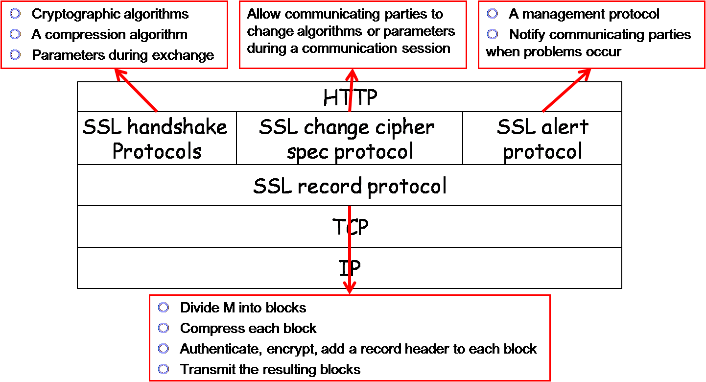
SSL Structure
J. Wang. Computer Network Security Theory and Practice. Springer 2008

Slide 32
SSL Handshake Protocol
Allows the client and the server to negotiate and select cryptographic algorithms and to exchange keys
Allows authentication to each other
Four phases:
  Select cryptographic algorithms
    Client Hello Message
    Server Hello Message
  Authenticate Server and Exchange Key
  Authenticate Client and Exchange Key
  Complete Handshake
J. Wang. Computer Network Security Theory and Practice. Springer 2008

Slide 33
Phase 1a: Client Hello Message
The client’s hello message contains the following information:
Version number, VC:
  Highest SSL version installed on the client machine
  Ex. V_{C} = 3
Pseudo Random string, RC
  32-byte string
    4 byte time stamp
    28 byte nonce
Session ID, S_{C}
  If S_{c}=0 then a new SSL connection on a new session
  If S_{c}!= 0 then a new SSL connection on existing session, or update parameters of the current SSL connection
Cipher suite: (PKE, SKA, Hash)
  Ex. <RSA, ECC, Elgamal,AES-128, 3DES, Whirlpool, SHA-384, SHA-1>
  Lists public key encryption algorithms, symmetric key encryption algorithms and hash functions supported by the client
Compression Method
  Ex. <WINZIP, ZIP, PKZIP>
  Lists compression methods supported by the client
J. Wang. Computer Network Security Theory and Practice. Springer 2008

Slide 34
Phase 1b: Server Hello Message
The server’s hello message contains the following information:
Version number, V_{S}:
  V_{S} = min {V_{Client},V}
  Highest SSL version installed at server-side
Pseudo Random string, R_{s}
  32-byte string
    4 byte time stamp
    28 byte nonce
Session ID, S_{S}
  If S_{c}=0 then S_{s} = new session ID
  If S_{c}!= 0 then S_{s}=S_{c}
Cipher suite: (PKE, SKA, Hash)
  Ex. <RSA,AES-128,Whirpool>
  Lists public key encryption algorithm, symmetric key encryption algorithm and hash function supported by the server
Compression Method
  Ex. <WINZIP>
  Compression method that the server selected from the client’s list.
J. Wang. Computer Network Security Theory and Practice. Springer 2008

Slide 35
Phase 2
Server sends the following information to the client:
  Server’s public-key certificate
  Server’s key-exchange information
  Server’s request of client’s public-key certificate
  Server’s closing statement of server_hello message
Note: The authentication part is often not implemented
J. Wang. Computer Network Security Theory and Practice. Springer 2008

Slide 36
Phase 3
Client responds the following information to the server:
  Client’s public-key certificate
  Client’s key-exchange information
  Client’s integrity check value of its public-key certificate
The key-exchange information is used to generate a master key
i.e., if in Phase 1, the server chooses RSA to exchange secret keys, then the client generates and exchanges a secret key as follows:
  Verifies the signature of the server’s public-key certificate
  Gets server’s public key K_{s}^{u}
  Generates a 48-byte pseudorandom string s_{pm} (pre-master secret)
  Encrypts s_{pm} with K_{s}^{u} using RSA and sends the ciphertext as key-exchange information to the server
J. Wang. Computer Network Security Theory and Practice. Springer 2008

Slide 37
Phase 3 (cont.)
After phase 3 both sides now have r_{c}, r_{s}, s_{pm}, then both the client & the server will calculate the shared master secret s_{m}:
s_{m} = H₁(s_{pm} || H₂ (‘A’ || s_{pm} || r_{c} || r_{s})) ||
H₁(s_{pm} || H₂ (‘BB’ || s_{pm} || r_{c} || r_{s})) ||
H₁(s_{pm} || H₂ (‘CCC’ || s_{pm} || r_{c} || r_{s}))
J. Wang. Computer Network Security Theory and Practice. Springer 2008

Slide 38
Phase 4
Client & Server send each other a change_cipher_spec message and a finish message to close the handshake protocol.
Now both sides calculate secret-key block K_{b} using same method as we did to calculate the master secret except we use S_{m} instead of S_{pm}
K_{b} = H₁(S_{m} || H₂ (‘A’ || S_{m} || R_{c} || R_{s})) ||
H₁(S_{m} || H₂ (‘BB’ || S_{m} || R_{c} || R_{s})) ||
H₁(S_{m} || H₂ (‘CCC’ || S_{m} || R_{c} || R_{s}))
…
K_{b} is divided into six blocks, each of which forms a secret key
K_{b} = K_{c1} || K_{c2} || K_{c3} || K_{s1} || K_{s2} || K_{s3} || Z (where Z is remaining substring)
Put the secret keys into two groups:
  Group I: (K_{c1}, K_{c2}, K_{c3}) = (K_{c,HMAC}, K_{c,E}, IV_{c}) (protect packets from client to server)
  Group II: (K_{s1}, K_{s2}, K_{s3}) = (K_{s,HMAC}, K_{s,E}, IV_{s}) (protect packets from server to client)
J. Wang. Computer Network Security Theory and Practice. Springer 2008

Slide 39
SSL Record Protocol
After establishing a secure communication session, both the client and the server will use the SSL record protocol to protect their communications
The client does the following:
  Divide M into a sequence of data blocks M₁, M₂, …, M_{k}
  Compress M_{i} to get M_{i}’ = cx(M_{i})
  Authenticate M_{i}’ to get M_{i}” = M_{i}’ || H_{Kc,HMAC}(M_{i}’)
  Encrypt M_{i}” to get C_{i} = E_{Kc,HMAC}(M_{i}”)
  Encapsulate C_{i} to get P_{i} = [SSL record header] || C_{i}
  Transmit P_{i} to the server
J. Wang. Computer Network Security Theory and Practice. Springer 2008

Slide 40
SSL Record Protocol
The server does the following:
  Extracts C_{i} from P_{i}
  Decrypts C_{i} to get M_{i}”
  Extracts M_{i}’ and H_{Kc,HMAC}(M_{i}’)
  Verifies the authentication code
  Decompress M_{i}’ to get M_{i}
J. Wang. Computer Network Security Theory and Practice. Springer 2008

Slide 41
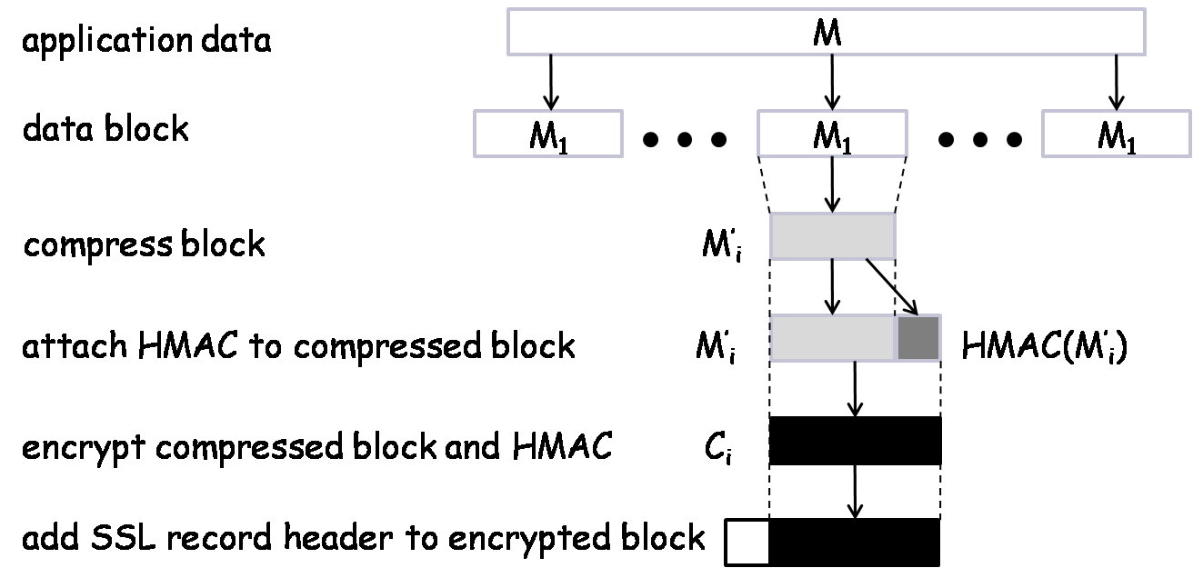
SSL Record Protocol Diagram
SSL record protocol
J. Wang. Computer Network Security Theory and Practice. Springer 2008

Slide 42
Chapter 5 Outline
5.1 Crypto Placements in Networks
5.2 Public-Key Infrastructure
5.3 IPsec: A Security Protocol at the Network Layer
5.4 SSL/TLS: Security Protocols at the Transport Layer
5.5 PGP and S/MIME: Email Security Protocols
5.6 Kerberos: An Authentication Protocol
5.7 SSH: Security Protocols for Remote Logins
5.8 Electronic Voting Protcols
J. Wang. Computer Network Security Theory and Practice. Springer 2008

Slide 43





Basic Email Security Mechanisms
Should Alice want to prove to Bob that M is from her
  Send to Bob for authentication, where denotes public-key encryption (to distinguish conventional encryption E)
Should Alice want M to remain confidential during transmission
  Send to Bob
  After getting this string, Bob first decrypts to get K_{A}
  Bob then decrypt using K_{A} to obtain M
J. Wang. Computer Network Security Theory and Practice. Springer 2008

Slide 44
PGP
Pretty Good Privacy
  Implements all major cryptographic algorithms, the ZIP compression algorithms, and the Base64 encoding algorithm
  Can be used to authenticate or encrypt a message, or both
  General format:
    Authentication
    ZIP compression
    Encryption
    Base64 encoding (for SMTP transmission)
J. Wang. Computer Network Security Theory and Practice. Springer 2008

Slide 45
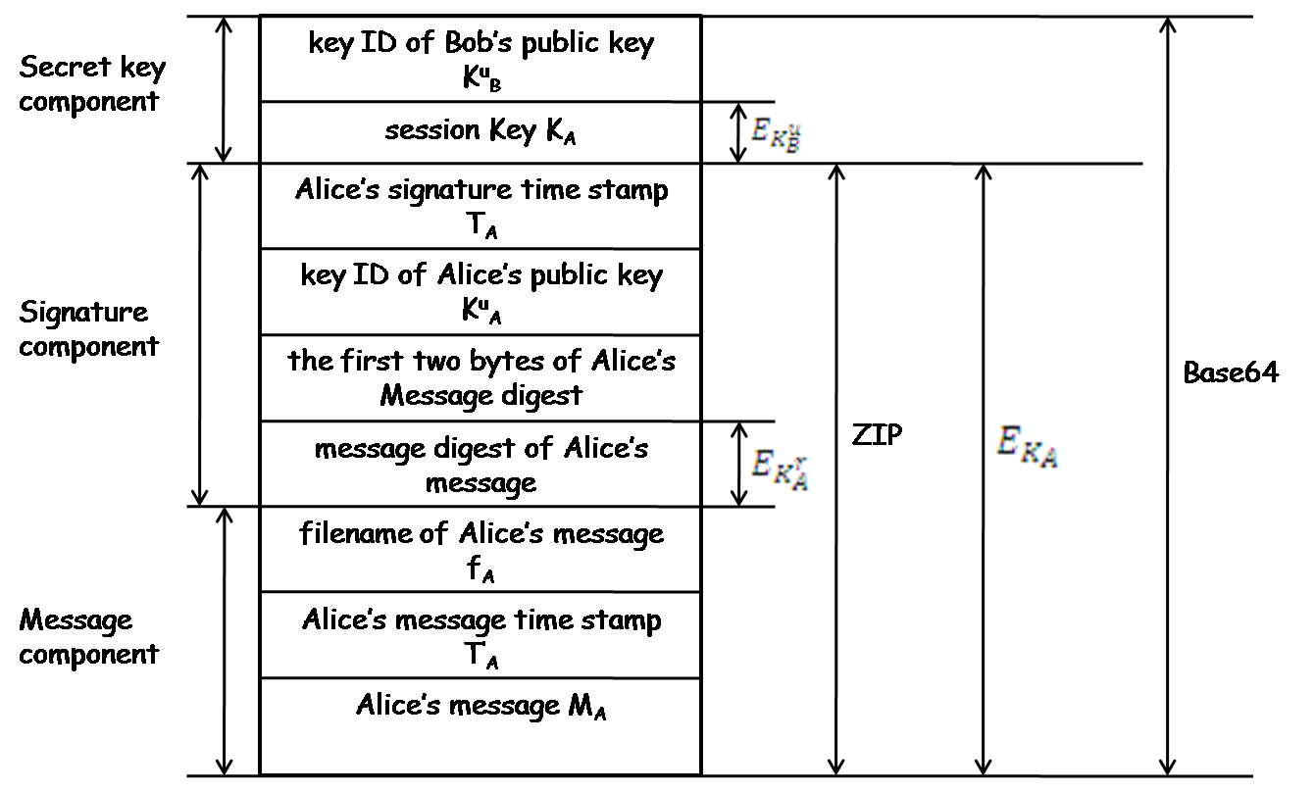
PGP Message Format
Sender: Alice; Receiver: Bob
J. Wang. Computer Network Security Theory and Practice. Springer 2008

Slide 46
S/MIME
Secure Multipurpose Internet Mail Extension
Created to deal with short comings of PGP
  Support for multiple formats in a message, not just ASCII text
  Support for IMAP (Internet Mail Access Protocol)
  Support for multimedia
Similar to PGP, can also do authentication, encryption, or both
Use X.509 PKI and public-key certificates
Also support standard symmetric-key encryption, public-key encryption, digital signature algorithms, hash functions, and compression functions
J. Wang. Computer Network Security Theory and Practice. Springer 2008

Slide 47
Chapter 5 Outline
5.1 Crypto Placements in Networks
5.2 Public-Key Infrastructure
5.3 IPsec: A Security Protocol at the Network Layer
5.4 SSL/TLS: Security Protocols at the Transport Layer
5.5 PGP and S/MIME: Email Security Protocols
5.6 Kerberos: An Authentication Protocol
5.7 SSH: Security Protocols for Remote Logins
5.8 Electronic Voting Protocols
J. Wang. Computer Network Security Theory and Practice. Springer 2008

Slide 48
Kerberos Basics
Goals:
  Authenticate users on a local-area network without PKI
  Allow users to access to services without re-entering password for each service
It uses symmetric-key encryption and electronic passes called tickets
It uses two different types of tickets:
  TGS-ticket: issued to the user by AS
  V-ticket (server ticket): issued to the user by TGS
J. Wang. Computer Network Security Theory and Practice. Springer 2008

Slide 49
Kerberos Servers
Requires two special servers to issue tickets to users:
  AS: Authentication Server. AS manages users and user authentication
  TGS: Ticket Granting Server. TGS manages servers
Two Kerberos Protocols (single network vs. multiple)
  Single-Realm Kerberos
  Multi-Realm Kerberos
J. Wang. Computer Network Security Theory and Practice. Springer 2008

Slide 50
How Does Kerberos Work?
  At first logon, the user provides username and password to AS
  AS then authenticates the user and provides a TGS ticket to the user
  When the user wants to access a service provided by server V, the user provides the TGS its TGS-ticket
  The TGS then authenticates the user’s TGS-ticket and issues a V-ticket (server ticket) to the user
  The user provides the V-ticket to server V to obtain service
J. Wang. Computer Network Security Theory and Practice. Springer 2008

Slide 51
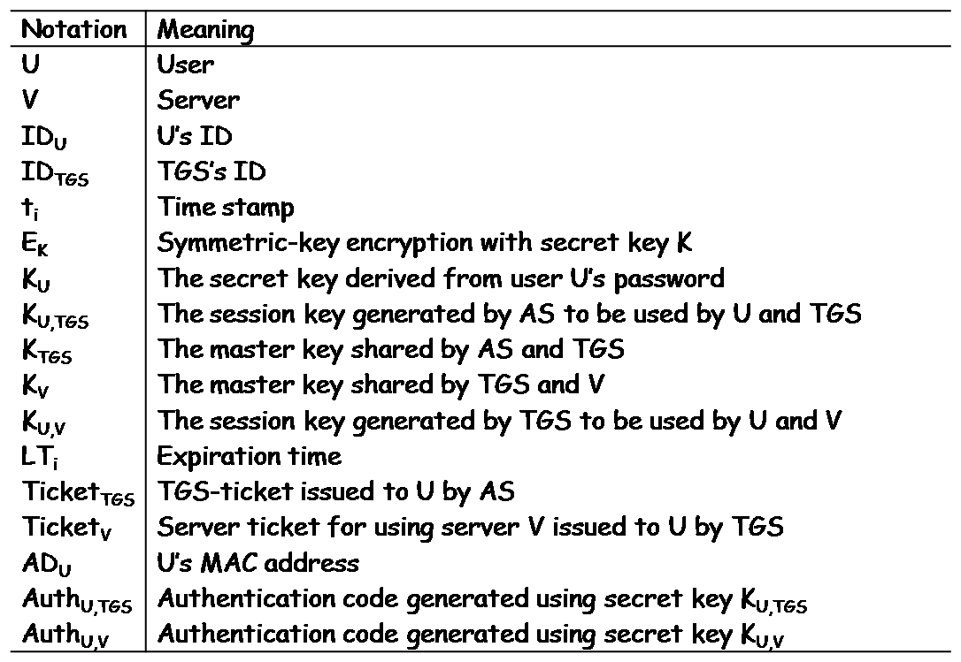
Kerberos Notations
J. Wang. Computer Network Security Theory and Practice. Springer 2008

Slide 52
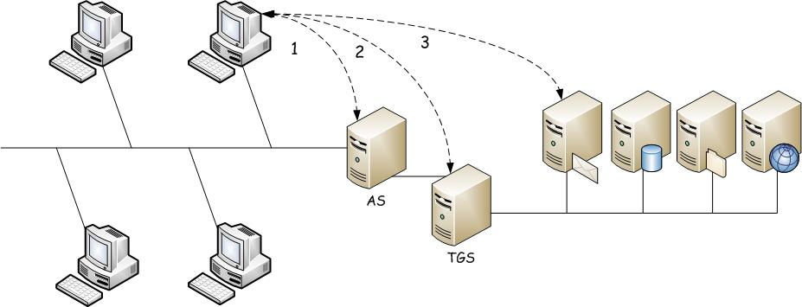
Single-Realm Kerberos
J. Wang. Computer Network Security Theory and Practice. Springer 2008

Slide 53
Three Phases in Single-Realm Kerberos
Phase 1: AS Issues a TGS-Ticket to User
  1. U → AS: ID_{U} || ID_{TGS} || t₁
  2. AS → U: E_{KU}(K_{U,TGS} || ID_{TGS} || t₂ || LT₂ || Ticket_{TGS})
  Ticket_{TGS} = E_{KTGS}(K_{U,TGS} || ID_{U} || AD_{U} || ID_{TGS} || t₂ || LT₂)
Phase 2: TGS Issues a Server Ticket to User
  3. U → TGS: ID_{V} || Ticket_{TGS} || Auth_{U,TGS}
  Auth_{U,TGS} = E_{KU,TGS}(ID_{U} || AD_{U} || t₃)
  4.TGS → U: E_{KU,TGS}(K_{U,V} || ID_{V} || t₄ || Ticket_{V})
  Ticket_{V} = E_{Kv}(K_{U,V} || ID_{U} || AD_{U} || ID_{V} || t₄ || LT₄)
Phase 3: User Requests Service from Sever
5. U → V: Ticket_{V} || Auth_{U,V}
Auth_{U,V} = E_{KU,V}(ID_{U} || AD_{U} || t₅)
6. V → E_{KU,V}(t₅+1)
J. Wang. Computer Network Security Theory and Practice. Springer 2008

Slide 54
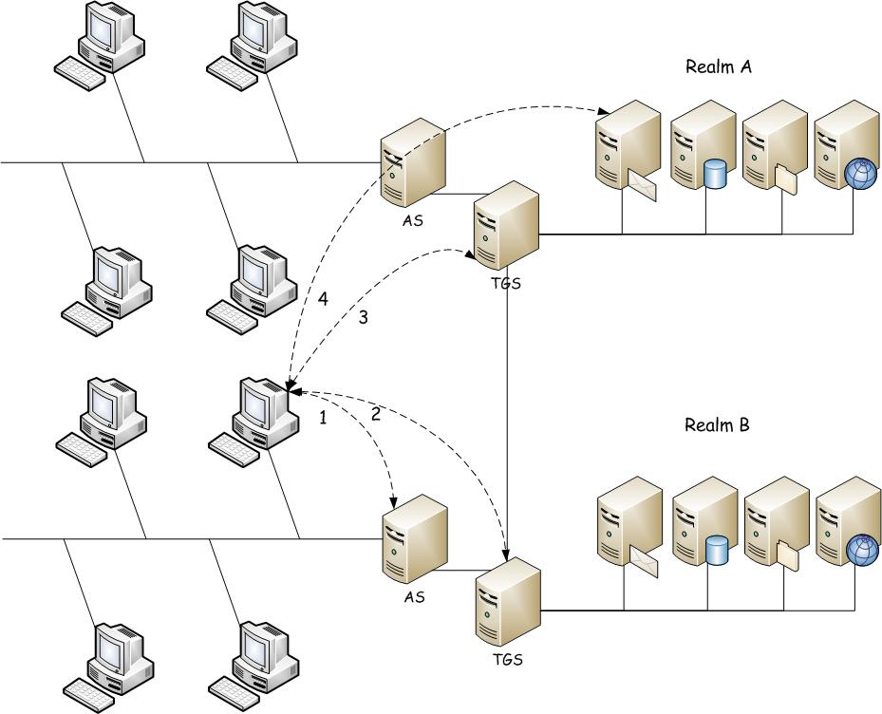
Multi-Realm Kerberos
J. Wang. Computer Network Security Theory and Practice. Springer 2008

Slide 55
Four Phases in Multi-Realm Kerberos
Phase 1: Local AS Issues a Local TGS-Ticket to User
  1. U → AS: ID_{U} || ID_{TGS} || t₁
  2. AS → U:
  EK_{U}(K_{U,TGS} || ID_{TGS} || t₂ || LT₂ || Ticket_{TGS})
  Ticket_{TGS} = E_{KTGS}(K_{U,TGS} || ID_{U} || AD_{U} || ID_{TGS} || t₂ LT₂)
Phase 2: Local TGS Issues a Neighbor TGS-Ticket to User
  3. U → TGS: ID_{V} || Ticket_{TGS} || Auth_{U,TGS}
  Auth_{U,TGS} = E_{KU,TGS}(ID_{U} || AD_{U} || t₃)
  4.TGS → U:
  E_{KU,TGS}(K_{U,TGS’} || ID_{TGS’} || t₄ || Ticket_{TGS’})
  Ticket_{TGS’} = E_{KTGS’}(K_{U,TGS’} || ID_{U} || AD_{U} || ID_{TGS’} || t₄ || LT₄)
Phase 3: Neighbor TGS’ Issues a Server Ticket to User
5. U → TGS’:
ID_{V} || Ticket_{TGS’} || Auth_{U,TGS’}
Auth_{U,TGS’} = E_{KU,TGS’}(ID_{U} || AD_{U} || t₅)
6. TGS’ → U:
E_{KU,TGS’}(K_{U,V} || ID_{V} || t₆ || Ticket_{V})
Ticket_{V} = E_{KV}(K_{U,V} || ID_{U} || AD_{U} || ID_{V} || t₆ || LT₆)
Phase 4: User Requests Service from Neighbor Server
7. U → V:
Tickey_{V} || Auth_{U,V}
Auth_{U,V} = E_{KU,V}(ID_{U} || AD_{U} || t₇)
8. V → U: E_{KU,V}(t₇ + 1)
J. Wang. Computer Network Security Theory and Practice. Springer 2008

Slide 56
Chapter 5 Outline
5.1 Crypto Placements in Networks
5.2 Public-Key Infrastructure
5.3 IPsec: A Security Protocol at the Network Layer
5.4 SSL/TLS: Security Protocols at the Transport Layer
5.5 PGP and S/MIME: Email Security Protocols
5.6 Kerberos: An Authentication Protocol
5.7 SSH: Security Protocols for Remote Logins
5.8 Electronic Voting Protocols
J. Wang. Computer Network Security Theory and Practice. Springer 2008

Slide 57
Overview of SSH
SSH: Secure Shell
Used to replace non-secure login utilities such as RCP, FTP, RSH, Telnet, rlogin
Creates a secure connection between two computers using authentication and encryption algorithms
Supports data compression
Provides security protection for file transfers (SFTP) and file copy (SCP)
SSH protocol is broken up into 3 components
J. Wang. Computer Network Security Theory and Practice. Springer 2008

Slide 58
3 Layers of SSH
SSH Connection:
  Sets up multiple channels for different applications in a single SSH connection
SSH User Authentication:
  Authenticate user to server
  Using password or PKC
SSH Transport
  Handles initial setup: server authentication, and key exchange
  Set up encryption and compression algorithms
SSH Connection
SSH User Authentication
Application Layer
SSH Transport
TCP
IP
Data Link
Physical
SSH architecture
J. Wang. Computer Network Security Theory and Practice. Springer 2008

Slide 59
Chapter 5 Outline
5.1 Crypto Placements in Networks
5.2 Public-Key Infrastructure
5.3 IPsec: A Security Protocol at the Network Layer
5.4 SSL/TLS: Security Protocols at the Transport Layer
5.5 PGP and S/MIME: Email Security Protocols
5.6 Kerberos: An Authentication Protocol
5.7 SSH: Security Protocols for Remote Logins
5.8 Electronic Voting Protocols
J. Wang. Computer Network Security Theory and Practice. Springer 2008

Slide 60
5.8 Electronic Voting Protocols
EVP seeks the following guarantees:
  Ballot casting assurance: Each voter gains personal assurance that their ballots are correctly cast
  Universal verifiability: Any observer can verify that all ballots are properly tallied
J. Wang and Z. Kissel. Introduction to Computer Network Security: Theory and Practice. Wiley 2015

Slide 61
Two Phases
Ballot preparation
  A voter prepares an encrypted ballot for his choice
Ballot tallying
  The set of encrypted ballots is processed to produce a tally and a proof of correctness
J. Wang and Z. Kissel. Introduction to Computer Network Security: Theory and Practice. Wiley 2015

Slide 62
EVP Primitives
Interactive proofs
  Peggy possesses secret and Victor wants to be convinced
  Peggy does not want to reveal her secret
  Peggy and Victor engage an interactive proof
Re-encryption schemes
  Create a new ciphertext whose plaintext is equivalent to an existing ciphertext’s plaintext
Threshold cryptography
  Multiple parties must cooperate to decrypt a ciphertext
J. Wang and Z. Kissel. Introduction to Computer Network Security: Theory and Practice. Wiley 2015

Slide 63
Interactive Proofs
Graph isomorphism problem
  Suppose that Peggy knows that G1 is isomorphic to G2 under a particular bijection f
  To convince Victor that G1 is isomorphic to G2
    (Setup) She constructs H such that H is isomorphic to G1 with a bijection f’. She sends H to Victor, and constructs two maps: f0 = f’ and f1 = f’○f⁻¹
    (Selection) Victor flips a fair coin and sends the reading to Peggy
    (Verification) Peggy sends to Victor f0 or f1 based on the coin flipping result i she receives. Victor then verifies that G_{i+1} is isomorphic to H
J. Wang and Z. Kissel. Introduction to Computer Network Security: Theory and Practice. Wiley 2015

Slide 64
Re-encryption
Re-encryption allows users to create a new ciphertext so that its plaintext is equivalent to an existing ciphertext’s plaintext, without knowing the plaintext
Re-encryption can be constructed using Elgamal (omitted; details can be found on pages 199-200)
J. Wang and Z. Kissel. Introduction to Computer Network Security: Theory and Practice. Wiley 2015

Slide 65
Threshold Cryptography
Threshold cryptography is a form of PKC, where a predetermined number of parties must cooperate to decrypt a ciphertext
  Each party begins by generating and publishing an encryption key, which will be aggregated to form a public key
  It needs a notion of secret sharing scheme
J. Wang and Z. Kissel. Introduction to Computer Network Security: Theory and Practice. Wiley 2015

Slide 66
A Secret Sharing Scheme
Let s be a secret to be shared by n parties
A special party, called the dealer, construct an (m-1)-degree polynomial p with s being the constant term
  The dealer provides a point on the polynomial curve. E.g., Party 3 may be given the point (3,p(3))
  The dealer destroys p after each party gets a point
To recover s, at least m parties must cooperate to reconstruct p
J. Wang and Z. Kissel. Introduction to Computer Network Security: Theory and Practice. Wiley 2015

Slide 67
The Helios Voting Protocol
Vote phase: Alice casts an encrypted ballot using threshold Elgamal, and authenticates herself to the system
Publish phase: The system posts Alice’s encrypted ballot along with her name (a proof that Alice did vote)
Shuffle phase: The system decouples the votes from the names and mixes the votes using a mix network
  Each server takes in a set of ballots, re-encrypts each ballot, mixes (permutes) the set, and passes it to the next server
  Every mix server proves that its resulting mix is genuine using interactive proof
J. Wang and Z. Kissel. Introduction to Computer Network Security: Theory and Practice. Wiley 2015

Slide 68
Tally and Vote
Tally phase: The system first tallies the votes in the public view (e.g., on the bulletin board) and then destroys the votes
Audit phase: Any auditor may choose to download all the election data and verify the correctness of the shuffle and tally phases
J. Wang and Z. Kissel. Introduction to Computer Network Security: Theory and Practice. Wiley 2015

