Slide 1
Chapter 6
Wireless Network Security
J. Wang and Z. Kissel. Introduction to Computer Network Security: Theory and Practice. Wiley 2015

Slide 2
Chapter 6 Outline
6.1 Wireless Communications and 802.11 WLAN Standards
6.2 WEP: Wired Equivalent Privacy
6.3 WPA: Wi-Fi Protected Access
6.4 IEEE 802.11i/WPA2
6.5 Bluetooth Security
6.6 Zigbee Security
6.7 Wireless Mesh Network Security
J. Wang and Z. Kissel. Introduction to Computer Network Security: Theory and Practice. Wiley 2015

Slide 3
Overview
Radio based communication, open air
The attacker, having a radio transmitter and receiver with the same radio frequency of the underlying wireless network, can easily:
  Intercept wireless data
  Connect his computing devices to a nearby wireless network
  Inject new packets to an existing wireless network
  Jam a particular wireless channel using a jamming device
Security measures
  Implement encryption algorithms, authentication algorithms, and integrity-check algorithms at the data-link layer
  Provide network access with wired equivalent privacy
  Higher-layer protocols and applications can be used without any modification
J. Wang and Z. Kissel. Introduction to Computer Network Security: Theory and Practice. Wiley 2015

Slide 4
WLAN Architecture
Two types of architecture
  Infrastructure: Attach to a wired infrastructure
  Ad hoc (peer-to-peer): not attach to any fixed infrastructure
Mobile station is referred to as STA
  Each STA in the IEEE 802.11 standard is identified by a 48-bit MAC address
Wireless access point (WAP)
  One end: a wired link connected to a wired LAN
  The other end: a radio transmitter and receiver to establish radio connections between the AP and STAs
  Each AP is associated with a Service Set Identifier (SSID)
J. Wang and Z. Kissel. Introduction to Computer Network Security: Theory and Practice. Wiley 2015

Slide 5
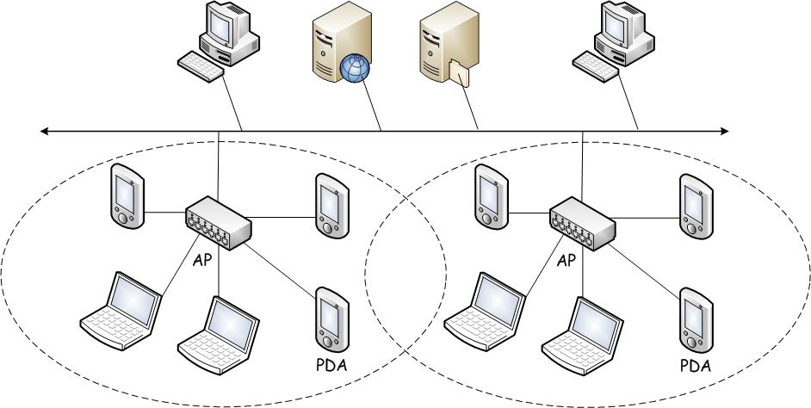
Infrastructure WLANs
Beaconing: AP announces regularly its SSID and other info for an STA to connect to it
Scanning: STA waits for a beacon and joins a WLAN by sending a request to the corresponding AP with the AP’s SSID
J. Wang and Z. Kissel. Introduction to Computer Network Security: Theory and Practice. Wiley 2015
Notes:
Figure 6.1

Slide 6
Ad Hoc WLANs
Formed without wired infrastructure
Doesn’t use APs
An STA may communicate with another STA directly within communication range
Can use multiple STA’s to extend communication range
J. Wang and Z. Kissel. Introduction to Computer Network Security: Theory and Practice. Wiley 2015

Slide 7
802.11 Essentials
802.11 is the wireless counterpart of 802.3 (Ethernet) & 802.5 (Token Ring)
It specifies communications and security mechanisms for WLAN at the MAC sublayer and at the physical layer
Commonly-used sub protocols:
  802.11a: 5 Ghz
  802.11b: 2.4 Ghz, 11Mbps, 35m indoor, 110m outdoor, WEP
  802.11g: 2.4 Ghz, 54Mbps
  802.11i: WPA2
  802.11n: supports MIMO
J. Wang and Z. Kissel. Introduction to Computer Network Security: Theory and Practice. Wiley 2015

Slide 8
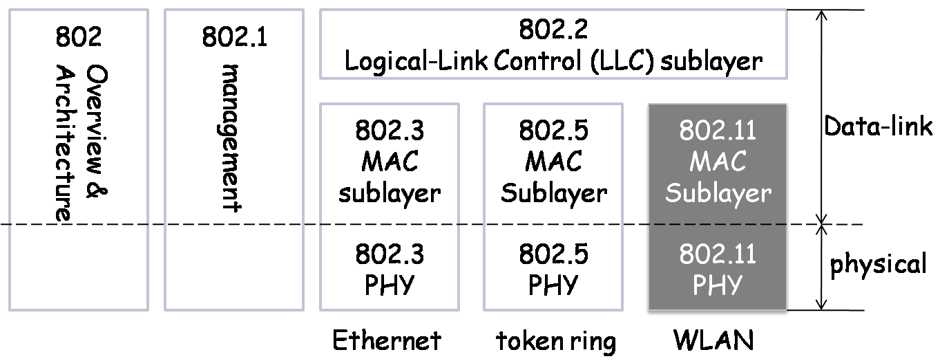
Schematic of the 802 Suite
A schematic of the IEEE 802 family
J. Wang and Z. Kissel. Introduction to Computer Network Security: Theory and Practice. Wiley 2015

Slide 9
Wireless Communication Weaknesses
Wireless communications could be easily sniffed
Radio signals could be easily disturbed or injected to the network
Wireless hand-held computing devices and embedded systems may not have sufficient computing resources or power supply to carry out complex computations
J. Wang and Z. Kissel. Introduction to Computer Network Security: Theory and Practice. Wiley 2015

Slide 10
Wireless Security Vulnerabilities
Eavesdropping attack
Denial-of-service attack
Message-reply attack
STA-spoofing attack
AP-spoofing attack
J. Wang and Z. Kissel. Introduction to Computer Network Security: Theory and Practice. Wiley 2015

Slide 11
Chapter 6 Outline
6.1 Wireless Communications and 802.11 WLAN Standards
6.2 WEP: Wired Equivalent Privacy
6.3 WPA: Wi-Fi Protected Access
6.4 IEEE 802.11i/WPA2
6.5 Bluetooth Security
6.6 Zigbee Security
6.7 Wireless Mesh Network Security
J. Wang and Z. Kissel. Introduction to Computer Network Security: Theory and Practice. Wiley 2015

Slide 12
WEP Overview
Published in 1999, WEP is the security component at the data-link layer of 802.11b
Requirements: All STA’s and AP’s in the same WLAN have to share the same secret key K (called the WEP key)
WEP Key:
  40-bit, 104-bit (most common), 232-bit
  WLAN devices may share multiple WEP keys, identified by a one-byte key ID (keyID)
  WEP keys are often selected by administrator
  Once installed, WEP keys will not change
J. Wang and Z. Kissel. Introduction to Computer Network Security: Theory and Practice. Wiley 2015

Slide 13
Device Authentication and Access Control
WEP uses a simple challenge-response authentication
To get access to an AP, an STA does the following:
  Request: STA sends a request for connection to the AP
  Challenge: AP generates 128-bit pseudorandom string cha and sends it to STA
  cha = a₁a₂…a₁₆ (where each a_{i} is an 8-bit string)
  Response: STA generates a 24-bit IV V and encrypts cha using RC4 with key V||K and sends res to AP
  r_{i} = a_{i} ⊕ k_{i,} for i = 1,2,…,16
  res = V || r₁r₂…r₁₆
  Verification: AP applies RC4 on V||K to generate the same sub keys, computes a_{i}’=r_{i} ⊕ k_{i} and verifies a_{i}’ = a_{i} for i = 1,2,…,16, and grants connection if true
J. Wang and Z. Kissel. Introduction to Computer Network Security: Theory and Practice. Wiley 2015

Slide 14
Data Integrity Check
Goal: to ensure that packets are not modified or injected by non-legitimate STAs
WEP uses the CRC-32 value of M as its ICV
  CRC-32 is common network technique to detect transmission errors
Simple Algorithm for CRC is ⊕ and bit shifting
  Can be easily implemented on a chip
To get a k-bit CRC value:
  M: an n-bit binary string
  P: a binary polynomial of degree k, yielding a (k+1)-bit binary string
  Divide M0^{k} by P to obtain a k-bit remainder CRC_{k}(M)
If M||CRC_{k}(M) is not divisible by P, it implies that M has been modified
J. Wang and Z. Kissel. Introduction to Computer Network Security: Theory and Practice. Wiley 2015

Slide 15
LLC Frame Encryption
Encryption done at MAC layer encrypting LLC frames, 3 step process
  Let M be a LLC frame:
  M || CRC₃₂(M) = m₁m₂….m_{l}
  Sender first generates a 24-bit initialization vector V, then uses RC4 on input V||K to generate a sequence of 8-bit sub-keys:
  c_{i} = m_{i} ⊕ k_{i}
  Sender’s MAC sublayer adds a header to the payload
  V || KeyID || c₁c₂…c_{l}
  General form of this encryption:
  C = ((M || CRC₃₂(M)) ⊕ RC4(V||K))
802.11b hdr
IV
keyID
data
ICV
RC4 encrypted
J. Wang and Z. Kissel. Introduction to Computer Network Security: Theory and Practice. Wiley 2015

Slide 16
Security Flaws of WEP
Authentication Flaws:
The challenge-response authentication scheme is vulnerable to the known-plaintext attack because of the exclusive-or operation
Example:
  Malice can intercept the challenge response pair (cha, res) between AP & a legitimate STA.
  She calculates k_{i}=c_{i} ⊕ r_{i} for i=1,2,…,16
  She sends a request to the AP and waits for challenge string cha’
  She then generates the response message res’ using the keys calculated above and sends res’ and the previously captured IV V to AP
  According to the WEP protocol, AP applies RC4 to V||K, generates the same sub-key stream k₁, k₂, k₃,… k₁₆, verifies k_{i} ⊕ res’ = cha’, and authenticates Malice’s device
J. Wang and Z. Kissel. Introduction to Computer Network Security: Theory and Practice. Wiley 2015

Slide 17
Security Flaws of WEP
Integrity Check Flaws:
CRC weaknesses
  CRC is linear: CRC (x ⊕ y) = CRC(x) ⊕ CRC(y)
  The linearity allows the attacker to modify a message without changing its CRC
  CRC does not use secret keys, which allows the attacker to inject new messages
    Message Tempering
    Message injections
    Fragmentation attacks
J. Wang and Z. Kissel. Introduction to Computer Network Security: Theory and Practice. Wiley 2015

Slide 18
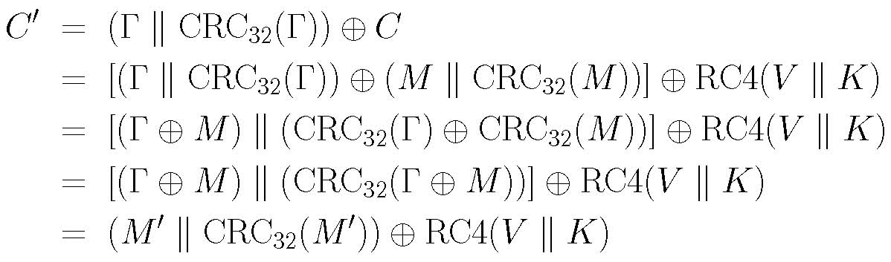
Security Flaws of WEP
Message Tampering:
Alice sends to Bob: C = (M|| CRC₃₂(M)) ⊕ RC4(V||K)
Malice intercepts and modifies C as follows, with a desired new string Γ:
C’ = (Γ || CRC₃₂(Γ) ⊕ C
Bob receives a new message M’ = Γ ⊕M with the correct ICV of CRC₃₂(M’):
J. Wang and Z. Kissel. Introduction to Computer Network Security: Theory and Practice. Wiley 2015

Slide 19
Security Flaws of WEP
Message Injection:
Suppose (M,C) is known and V is the initialization vector for generating C
Then (M ⊕ C) yields the key stream for encrypting M (i.e., sub-keys generated from RC4(V||K))
Let Θ be any message Malice wants to inject to the network
Note that V is transmitted in plaintext
Malice computes CRC₃₂(Θ) and injects
V||(Θ|| CRC₃₂(Θ)) ⊕ RC4(V||K)
if V is reused, the message above can be authenticated
J. Wang and Z. Kissel. Introduction to Computer Network Security: Theory and Practice. Wiley 2015

Slide 20
Security Flaws of WEP
Fragmentation Attacks:
Take advantage of LLC frame header to inject new messages
  LLC frame Has eight fixed values
  Attacker obtains eight sub keys using XOR
Attacker’s tricks:
  Inject 64-byte LLC by segmenting the LLC frame up to 16 segments into 4-byte fragment
  Use V and the sub-key stream k₁, k₂, …, k₈ to encrypt 4 byte fragments and the 4-byte integrity check value
  Put it to a MAC frame and inject it to network
J. Wang and Z. Kissel. Introduction to Computer Network Security: Theory and Practice. Wiley 2015

Slide 21
Security Flaws of WEP
Confidentiality flaws
Repeating Initialization Vectors
  A 24-bit IV allows 16,777,216 different sub-key streams
  However, it follows from the Birthday Paradox that repetition occurs with probability > ½ in 1.24 √2²⁴ = 5102 frames
RC4 weak keys
  WEP keys can often be learned from weak V’s
  A number of WEP cracking software tools based on the FMS attack
J. Wang and Z. Kissel. Introduction to Computer Network Security: Theory and Practice. Wiley 2015

Slide 22
Chapter 6 Outline
6.1 Wireless Communications and 802.11 WLAN Standards
6.2 WEP: Wired Equivalent Privacy
6.3 WPA: Wi-Fi Protected Access
6.4 IEEE 802.11i/WPA2
6.5 Bluetooth Security
6.6 Zigbee Security
6.7 Wireless Mesh Network Security
J. Wang and Z. Kissel. Introduction to Computer Network Security: Theory and Practice. Wiley 2015

Slide 23
WPA Overview
Published in 2003 by the Wi-Fi Alliance
Based on an early version (draft 3) of the IEEE 802.11i standard
Three major objectives:
  Correct all the security flaws in WEP
  Make existing WEP hardware also support WPA
  Ensure WPA is compatible with the 802.11i standard
Use 802.1X for authentication
Temporal Key Integrity Protocol (TKIP):
  Use Michael Algorithm, a specifically designed integrity check algorithm
  Use a new key structure to prevent message replays and de-correlate public initialization vectors from weak RC4 keys
J. Wang and Z. Kissel. Introduction to Computer Network Security: Theory and Practice. Wiley 2015

Slide 24
Device Authentication and Access Control
Home-and-small-office WPA:
  For home and small office
  Use WEP’s preset secret key
Enterprise WPA:
  Secure corporate WLANs
  Uses Authentication Server (AS)
  Different user has different pre-shared secret key with the AS
  Pre shared secrets are presented in the form of passwords
  Adopts 802.1X Port Based Network Access Control protocol to authenticate STAs
J. Wang and Z. Kissel. Introduction to Computer Network Security: Theory and Practice. Wiley 2015

Slide 25
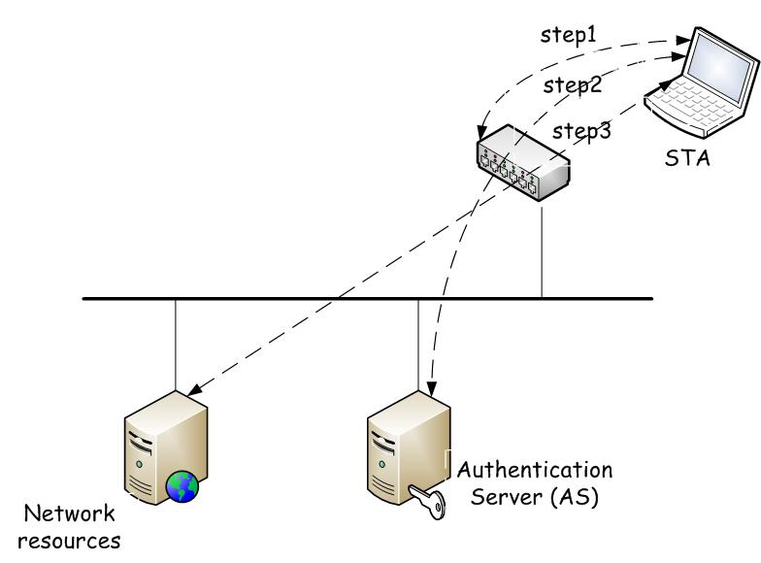
802.1X in a Nutshell
STA sends a request to AP. AP asks for the identity of STA.
STA sends AP its identity and signature using the master key shared with the AS. AS verifies STA and passes decision to AP. AP then informs STA about AS’s decision.
STA is granted access to WLAN.
J. Wang and Z. Kissel. Introduction to Computer Network Security: Theory and Practice. Wiley 2015

Slide 26
TKIP Key Generation
AS first generates a 256-bit pairwise master key (PMK)
  AS sends PMK to AP using pre-shared secret key between AS and AP
  AP sends PMK to STA using pre-shared secret key between AP and STA
For each new session, based on PMK and other info, TKIP generates four 128-bit secret pairwise transient keys (PTK):
  Data Encryption Key: for data encryption
  Data MIC key: for data integrity checks
  EAPoL key: for Extensible Authentication Protocol Over LAN (EAPoL) encryption
  EAPoL MIC key: for EAPoL integrity checks
J. Wang and Z. Kissel. Introduction to Computer Network Security: Theory and Practice. Wiley 2015

Slide 27
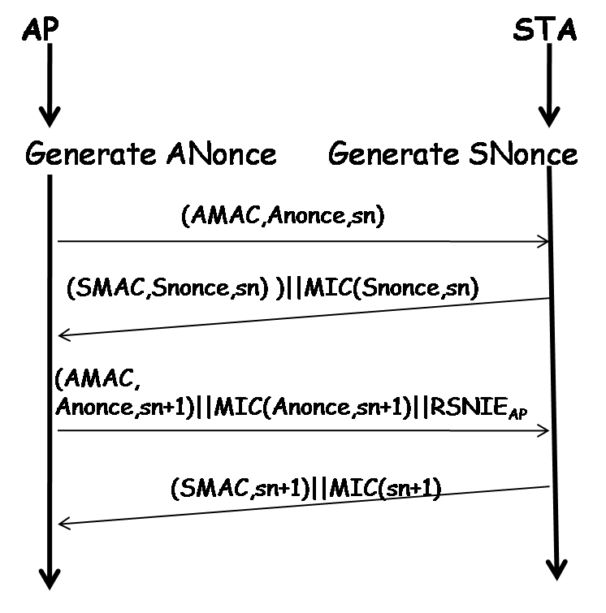
4 Ways Handshakes
TKIP uses 4 ways handshakes to exchange Pairwise Transient Keys (PTK).
  AP sends ANonce to STA
  Message₁ = (AMAC, Anonce, sn)
  STA sends SNonce to AP
Message₂ = (SMAC,Snonce,sn) || MIC(Snonce,sn) || RSNIE_{STA}
  AP acknowledges STA.
  Message₃ = (AMAC, Anonce,sn+1) || MIC(Anonce,sn+1) || RSNIE_{AP}
  STA acknowledges AP
  Message₄ = (SMAC,sn+1) || MIC(sn+1)
J. Wang and Z. Kissel. Introduction to Computer Network Security: Theory and Practice. Wiley 2015

Slide 28
TKIP Message Integrity Code
It uses the Michael algorithm to generate Message Integrity Code (MIC)
Creates a 64-bit message authentication code using a 64-bit secret key K
K: a 64-bit secret key divided into two halves K₀ and K₁ of equal length
Michael Algorithm generates MIC for M using K as follow:
(L₁,R₁) = (K₀,K₁),
(L_{i+1},R_{i+1}) = F(L_{i} XOR M_{i}, R_{i}) i = 1,2,…,n
MIC = L_{n+1}R_{n+1}
Where F is Feistel type of substitution
Then F(l,r) is defined as follow:
r₀ = r.
l₀ = l,
r₁ = r₀ xor (l₀ <<< 17)
l₁ = l₀ xor₃₂ r₁,
r₂ = r₁ xor XSWAP( l₁ ),
l₂ = l₁ xor₃₂ r₂,
r₃ = r₂ xor ( l₂ <<< 3),
l₃ = l₂ xor₃₂ r₃,
r₄ = r₃ xor ( l₂ >>> 2),
l₄ = l₃ xor₃₂ r₄,
F(l, r) = (l₄, r₄ )
XSWAP(l) swaps the left-half of l with the right-half of l
More secure than CRC₃₂
J. Wang and Z. Kissel. Introduction to Computer Network Security: Theory and Practice. Wiley 2015

Slide 29
Michael Algorithm Vulnerability
Attacker creates a message and attaches a 64-bit binary string as a MIC and tries to find the correct MIC without knowing the secret key
  Tries all 2⁶⁴ to find the correct MIC
  Uses a differential cryptanalysis attack which requires 2²⁹ tries
Solution to the problem:
  STA deletes its keys and disengages with AP when two failed forgeries are detected within a second
J. Wang and Z. Kissel. Introduction to Computer Network Security: Theory and Practice. Wiley 2015

Slide 30
TKIP Key Mixing
Generates a per-frame key using a key mixing algorithm for each frame.
  Uses a 48-bit IV V divided into three 16-bit blocks V₂, V₁, V₀
  Consist of two mixing phases
pk₁ = mix₁ (a^{t}, V₂ V₁, k^{t} ),
pk₂ = mix₂ (pk₁, V₀, k^{t} ),
Where a^{t} is the 48-bit MAC address of the transmitter
k^{t} is the 128-bit data encryption of the transmitter
pk₂ is a 128-bit per-frame key for RC4
  Uses Two S-boxes S0 and S1 to substitute a 16-bit string with a 16-bit string.
S(X) = S₁(X₁) S₀(X₀)
Where X = X₁X₀
J. Wang and Z. Kissel. Introduction to Computer Network Security: Theory and Practice. Wiley 2015

Slide 31
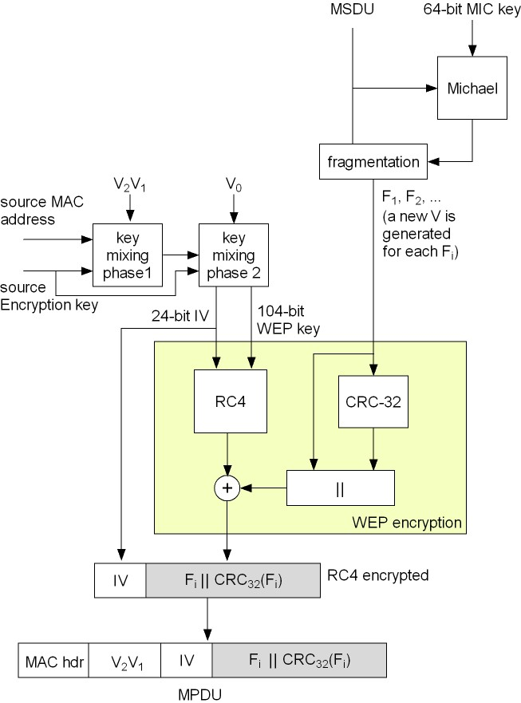
WPA
Encryption
J. Wang and Z. Kissel. Introduction to Computer Network Security: Theory and Practice. Wiley 2015

Slide 32
WPA Security Strength and Weakness
Superior to WEP
Vulnerable to DoS attack:
  After computing MIC of M, WPA encrypts fragments of M || ICV(M) to F₁, F₂, …
  For each F_{i}, WPA generates a 48-bit IV V_{i} to create a WEP IV and WEP key
  IV is transmitted in plaintext, the attack may intercept an MAC frame and replace the IV with a larger value.
  The encrypted frame will be discarded for incorrect decryption
  A legitimate MAC frame arrives later will be rejected for the IV has been used
J. Wang and Z. Kissel. Introduction to Computer Network Security: Theory and Practice. Wiley 2015

Slide 33
Chapter 6 Outline
6.1 Wireless Communications and 802.11 WLAN Standards
6.2 WEP: Wired Equivalent Privacy
6.3 WPA: Wi-Fi Protected Access
6.4 IEEE 802.11i/WPA2
6.5 Bluetooth Security
6.6 Zigbee Security
6.7 Wireless Mesh Network Security
J. Wang and Z. Kissel. Introduction to Computer Network Security: Theory and Practice. Wiley 2015

Slide 34
WPA 2 Overview
WPA:
  A rush solution to the security problems of WEP
WPA2:
  Based on 802.11i (official version)
    Encrypt and authenticate MSDUs: counter mode-CBC MAC protocol with AES-128
    Authenticate STAs: 802.1X
  Initialization vectors transmitted in plaintext are no longer needed to generate per-frame keys
  But most of the existing Wi-Fi WPA cards cannot be upgraded to support 802.11i
J. Wang and Z. Kissel. Introduction to Computer Network Security: Theory and Practice. Wiley 2015

Slide 35
Key Generation
Same key hierarchy as WPA
  256-bit pairwise master key (PMK)
  Four 128-bit pairwise transient keys (PTKs)
  384-bit temporal key for CCMP in each session
    Pseudorandom number generated based on SMAC, SNonce, AMAC, Anonce
    Exchanged following the 4-way handshake protocol
    Divided into three 128-bit transient keys:
      Two for connection between STA and AP
      One as a session key for AES-128
J. Wang and Z. Kissel. Introduction to Computer Network Security: Theory and Practice. Wiley 2015

Slide 36
CCMP Encryption and MIC
Encryption:
Ctr = Ctr₀
C_{i} = AES-128_{K} (Ctr + 1) ⊕ M_{i}
i = 1, 2, …, k
Authentication and integrity check:
C_{i} = 0¹²⁸
C_{i} = AES-128_{K} (C_{i–1} ⊕ M_{i})
i = 1, 2, …, k
J. Wang and Z. Kissel. Introduction to Computer Network Security: Theory and Practice. Wiley 2015

Slide 37
802.11i Security Strength and Weakness
Cryptographic algorithms and security mechanism are superior to WPA and WEP
However, still vulnerable to DoS attacks:
  Rollback Attacks
    RSN devices can communicate with pre-RSN devices
    Attacker tricks an RSN device to roll back to WEP
    Let RSN APs decline WEP or WPA connections???
J. Wang and Z. Kissel. Introduction to Computer Network Security: Theory and Practice. Wiley 2015

Slide 38
802.11i Security Weakness
  RSN IE Poisoning Attacks
    Against 4-way handshake protocol
    Attacker can forge message with wrong RSN IE and disconnects STA from AP
  De-Association Attacks
    Break an existing connection between an STA and an AP using forged MAC-layer management frames
J. Wang and Z. Kissel. Introduction to Computer Network Security: Theory and Practice. Wiley 2015

Slide 39
Chapter 6 Outline
6.1 Wireless Communications and 802.11 WLAN Standards
6.2 WEP
6.3 WPA
6.4 IEEE 802.11i/WPA2
6.5 Bluetooth Security
6.6 Zigbee Security
6.7 Wireless Mesh Network Security
J. Wang and Z. Kissel. Introduction to Computer Network Security: Theory and Practice. Wiley 2015

Slide 40
Overview
Proposed in 1998 as an industrial standard
For building ad hoc wireless personal area networks (WPANs)
IEEE 802.15 standard is based on Bluetooth
Wireless devices supported:
  Different platforms by different vendors can communicate with each other
  Low power, limited computing capabilities and power supplies
Implemented on Piconets
J. Wang and Z. Kissel. Introduction to Computer Network Security: Theory and Practice. Wiley 2015

Slide 41
Bluetooth: Piconets
Self-configured and self-organized ad-hoc wireless networks
Dynamically allow new devices to join in and leave ad-hoc network
  Up to 8 active devices are allowed to use the same physical channel
  All devices in piconet are peers
  One peer is designated as master node for synchronization
  The rest are slave nodes
  MAX 255 devices connected in a piconet
  Node’s state: parked, active, and standby
  A device an only belong to one piconet at a time
J. Wang and Z. Kissel. Introduction to Computer Network Security: Theory and Practice. Wiley 2015

Slide 42
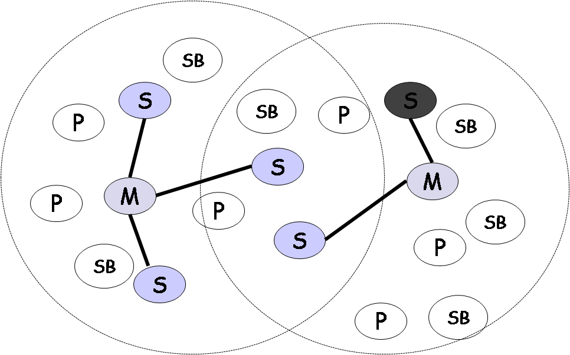
Scatternets: Overlapped Piconets
Scatternet schematic
J. Wang and Z. Kissel. Introduction to Computer Network Security: Theory and Practice. Wiley 2015

Slide 43
Secure Pairings
Nodes in the same piconet share the same personal identification number (PIN)
Nodes generate share secret key for authentication
  Generates a 128-bit initialization key based on the PIN
  Generates a 128-bit link key (combination key) to authenticate and create encryption key
Uses a stream cipher E₀ to encrypt payload
Uses a block cipher SAFER+ to construct three algorithms E₁, E₂₁, and E₂₂ for generating subkeys and authenticating devices
J. Wang and Z. Kissel. Introduction to Computer Network Security: Theory and Practice. Wiley 2015

Slide 44
SAFER+ Block Ciphers
To Authenticate Bluetooth device
An enhancement of SAFER (Secure And Fast Encryption Routine)
A Fiestel cipher with a 128-bit block size
Two components:
  Key scheduling component
  Encryption component
    Eight identical rounds (two subkeys for each round)
    An output transformation (one subkey)
J. Wang and Z. Kissel. Introduction to Computer Network Security: Theory and Practice. Wiley 2015

Slide 45
SAFER+ Subkeys
K = k₀ k₁ …k₁₅, a 128-bit encryption key.
k₁₆ = k₀ ⊕ k₁ ⊕ … ⊕ k₁₅
17 128-bit subkeys K₁, K₂, …, K₁₇:
K₁ ← k₀k₂k₃…k₁₅
for j = 0,1,…,16 do
k_{j} <- LS₃ (k_{j})
K₂ ← k₁k₂k₃…k₁₆ xor₈ B₂
for i = 3, 4, …, 17 do
for j = 0,1,…,16 do
k_{j} ← LS₃ (k_{j})
K_{i} ← k_{i-1} k_{i} k_{i+1}…k₁₆ k₀ k₁…k_{i-3} xor₈ B_{i-3}
B_{i}: a bias vector
B_{i} [j] = (45 ^{45 17i+j+i mode 257}) mod 257) mod 256
j = 0,1,….,15,
B_{i} = B_{i}[0] B_{i}[1] … B_{i}[15]
i = 2,3,….17,
J. Wang and Z. Kissel. Introduction to Computer Network Security: Theory and Practice. Wiley 2015

Slide 46
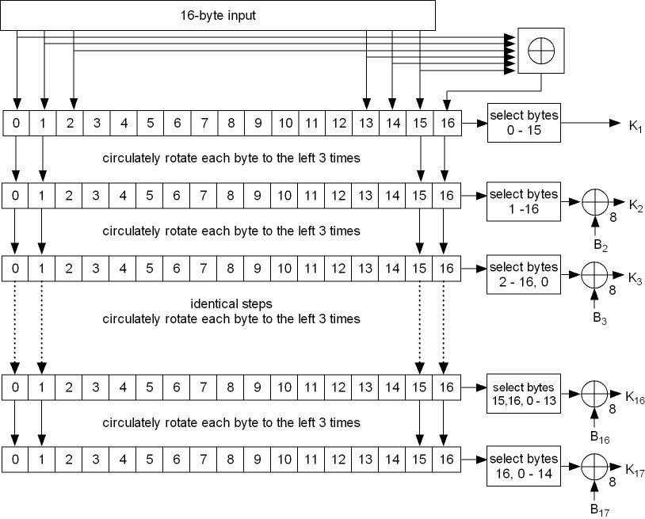
Schematic of SAFER+ subkey generation
J. Wang and Z. Kissel. Introduction to Computer Network Security: Theory and Practice. Wiley 2015

Slide 47
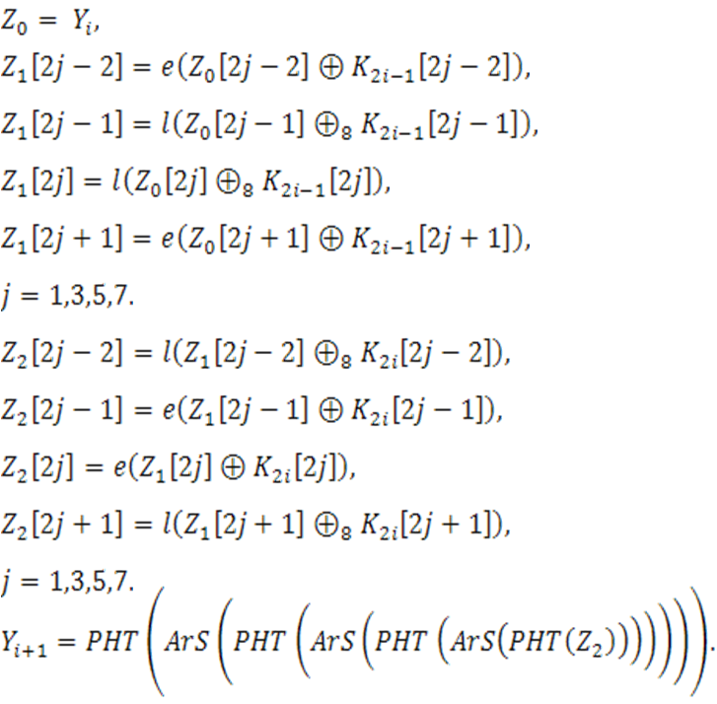
SAFER+ Encryption
Encryption Rounds
Let X = x₁x₂…x_{2k-1}x_{2k}, where x_{i} is a byte
Pseudo Hadamard Transform (PHT):
PHT(X) = PHT(x_{1,}x₂)||…||PHT(x_{2k-1,} x_{2k})
PHT(x,y) = (2x+y) mod 2⁸ || (x+y) mod 2⁸
Armenian Shuffles (ArS):
ArS (X) = x₈x₁₁x₁₂x₁₅x₂x₁x₆x₅x₁₀x₉x₁₄x₁₃x₀x₇x₄x₃
where X is a 16-byte string
  Table look up on two S-boxes for e and l:
e(x) = (45^{x} mod (2⁸ + 1)) mod 2⁸
l is e⁻¹: l(y) = x if e(x) = y
  ⊕ and ⊕₈ with two subkeys
  The i-th round in SAFER+:
J. Wang and Z. Kissel. Introduction to Computer Network Security: Theory and Practice. Wiley 2015

Slide 48
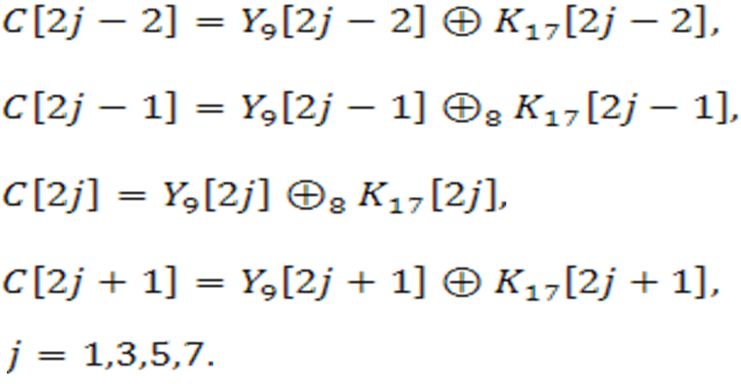
Output Transformation:
  After eight rounds, the output transformation component applies K₁₇ and Y₉ as applying K_{2i-1} to Y_{i} without using S-box and generate ciphertext block C.
J. Wang and Z. Kissel. Introduction to Computer Network Security: Theory and Practice. Wiley 2015

Slide 49


Bluetooth Algorithm E₁
E₁ takes the following parameters as input:
  K: 128-bit key
  ρ: 128-bit random string
  α: 48-bit address
and outputs a 128-bit string:
A_{r} is original SAFER+
is modified SAFER+, which combines the input of round 1 to the input of round 3 to make the algorithm non-invertible
is obtained from K using ⊕ and ⊕₈ (see p. 238)
E(α) = α || α || α[0:3]
J. Wang and Z. Kissel. Introduction to Computer Network Security: Theory and Practice. Wiley 2015

Slide 50
Bluetooth Algorithm E21
E₂₁ takes ρ and α as input:
E₂₁ (ρ, α) = A’_{r} (ρ’, E(α))
ρ’= ρ[0:14]|| (ρ[15] ⊕ 00000110)
J. Wang and Z. Kissel. Introduction to Computer Network Security: Theory and Practice. Wiley 2015

Slide 51
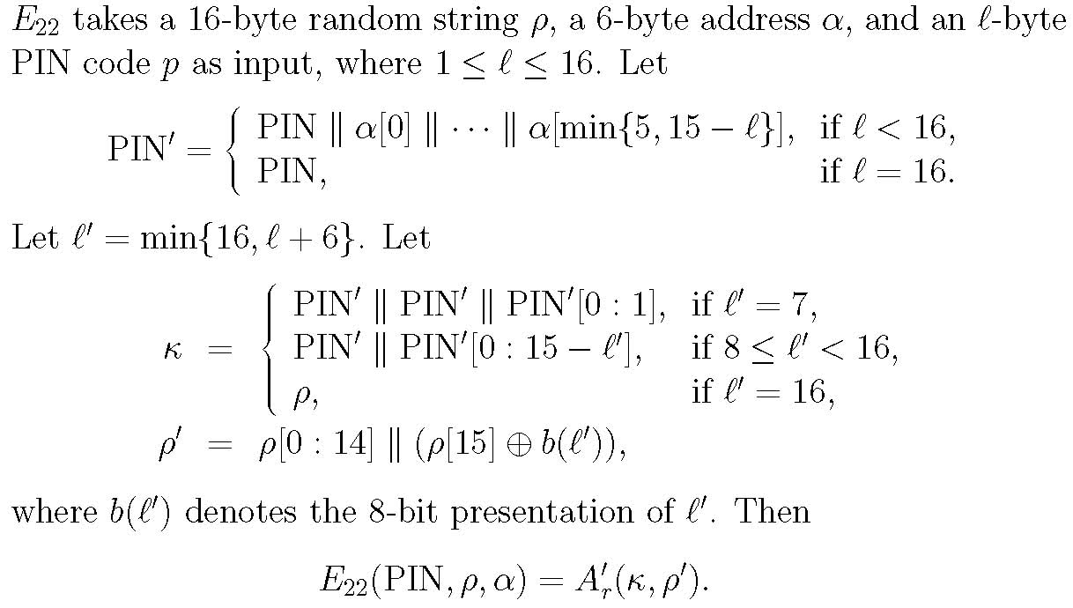
Bluetooth Algorithm E22
J. Wang and Z. Kissel. Introduction to Computer Network Security: Theory and Practice. Wiley 2015

Slide 52
Bluetooth Authentication
Initialize Key:
K_{init} = E₂₂ (PIN, In_RAND_{A}, BD_ADDR_{B})
D_{A} and D_{B} create link key:
D_{A} sends (LK_RAND_{A} ⊕ K_{init} ) to D_{B}
D_{B} sends (LK_RAND_{B} ⊕ K_{init} ) to D_{A}
K_{AB} = E₂₁(LK_RAND_{A} , BD_ADDR_{A}) ⊕ E₂₁(LK_RAND_{B} , BD_ADDR_{B})
D_{A} authenticates D_{B}:
D_{A} sends AU_RAND_{A} to D_{B}
D_{B} sends SRES_{A} to D_{A} where
SRES_{A} = E(K_{AB} , AU_RAND_{A}, BD_ADDR_{B}) [0:3]
D_{A} verifies SRES_{A}
J. Wang and Z. Kissel. Introduction to Computer Network Security: Theory and Practice. Wiley 2015

Slide 53
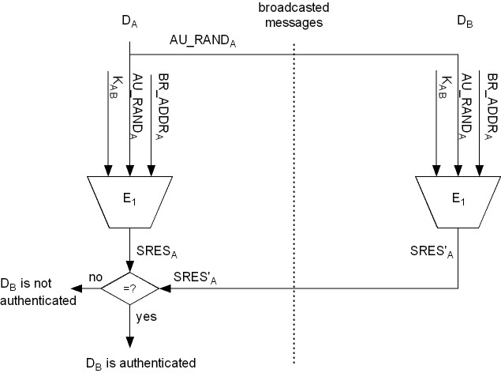
Bluetooth Authentication Diagram
J. Wang and Z. Kissel. Introduction to Computer Network Security: Theory and Practice. Wiley 2015

Slide 54
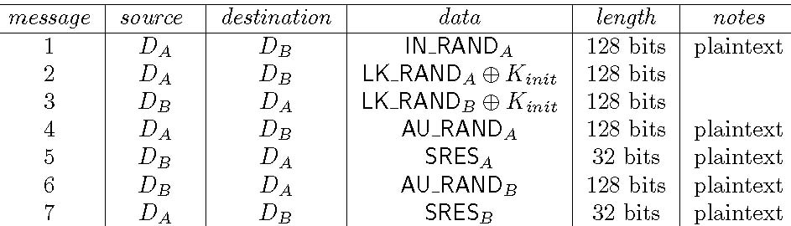
PIN Cracking Attack
Malice intercepts an entire pairing and authentication session between devices D_{A} and D_{B}
J. Wang and Z. Kissel. Introduction to Computer Network Security: Theory and Practice. Wiley 2015

Slide 55
PIN Cracking Attack
Malice cracks the PIN by brute force:
Enumerate all 2⁴⁸ possible values of PIN
Use IN_RAND_{A} from Message 1 and BD_ADDR_{B} to compute a candidate:
K’_{init}= E₂₂ (PIN’, In_RAND_{A}, BD_ADDR_{B})
Use K’_{init} to XOR Message 2 and Message 3 to obtain LK_RAND’_{A} and LK_RAND’_{B}. Then compute
K’_{AB} = E₂₁(LK_RAND’_{A} , BD_ADDR_{A}) ⊕ E₂₁ (LK_RAND’_{B} , BD_ADDR_{B})
Use AU_RAND_{A} from Message 4, K’_{AB}, and BD_ADDR_{B} to compute
SRES’_{A} = E₁(AU_RAND_{A}, K’_{AB}, BD_ADDR_{B}) [0:3]
Verify if SRES’_{A} = SRES_{A} using Message 5
May use Messages 6 and 7 to confirm the PIN code
J. Wang and Z. Kissel. Introduction to Computer Network Security: Theory and Practice. Wiley 2015

Slide 56
Bluetooth Secure Simple Pairing
A new pairing protocol to improve Bluetooth security
Secure simple pairing (SSP) protocol:
  Use elliptic-curve Diffie-Hellman (ECDH) key exchange algorithm to replace PIN
    To resist PIN cracking attack
  Use public key certificates for authentication.
    To prevent man-in-the-middle attack.
J. Wang and Z. Kissel. Introduction to Computer Network Security: Theory and Practice. Wiley 2015

Slide 57
Chapter 6 Outline
6.1 Wireless Communications and 802.11 WLAN Standards
6.2 WEP
6.3 WPA
6.4 IEEE 802.11i/WPA2
6.5 Bluetooth Security
6.6 Zigbee Security
6.7 Wireless Mesh Network Security
J. Wang and Z. Kissel. Introduction to Computer Network Security: Theory and Practice. Wiley 2015

Slide 58
ZigBee Security
IEEE 802.15.4 standard for low-power WPANs similar to Bluetooth
  Wildly used in health monitoring devices, home security systems, home automation systems, sensor networks
Four layers: physical; medium access control; network; application
Network topology: star, tree, mesh
ZigBee coordinator node (aka trust center)
  Sends network key in plaintext to new nodes
Similar to Bluetooth piconet, ZigBee can join (paring), authenticate, and secure communications
J. Wang and Z. Kissel. Introduction to Computer Network Security: Theory and Practice. Wiley 2015

Slide 59
ZeeBee Authentication
Challenge-Response using network keys
  A to B: Alice sends Bob a random string as the challenge, C_{A}
  B to A: Bob sends Alice a random string C_{B}, also called challenge, with a MAC using the network key on (02)¹⁶||A||B||C_{A}||C_{B}
  A to B: Alice sends Bob a MAC using the network key on (03)¹⁶||A||B||C_{A}||C_{B}
J. Wang and Z. Kissel. Introduction to Computer Network Security: Theory and Practice. Wiley 2015

Slide 60
Key Establishment
Link keys for communication, generated by (1) pre-installation (2) transport (using a trusted 3rd party) or establishment
Alice and Bob carry out authentication using a key MK provided by the trusted party, called the master key
Both generate a link key L = MAC_{MK}(A||B||C_{A}||C_{B})
J. Wang and Z. Kissel. Introduction to Computer Network Security: Theory and Practice. Wiley 2015

Slide 61
ZigBee Communication Security
Can be secured at network or application layers using AES-128 with the link key and CCM* mode of operation, which could also produce hash
The hash is the first M bytes of X_{n}
  X_{i} = AES(K, X_{i-1} xor b_{i-1}), b₁, b₂, …, b_{n} are 16-byte blocks (padding if necessary) of the message to be encrypted,
Encrypt the message by a stream cipher:
  s_{i} = AES(K, Flag||Nonce||i)
  c_{i} = b_{i} xor s_{i}
J. Wang and Z. Kissel. Introduction to Computer Network Security: Theory and Practice. Wiley 2015

Slide 62
Chapter 6 Outline
6.1 Wireless Communications and 802.11 WLAN Standards
6.2 WEP
6.3 WPA
6.4 IEEE 802.11i/WPA2
6.5 Bluetooth Security
6.6 Zigbee Security
6.7 Wireless Mesh Network Security
A||B||C_{A}||C_{B}
J. Wang and Z. Kissel. Introduction to Computer Network Security: Theory and Practice. Wiley 2015

Slide 63
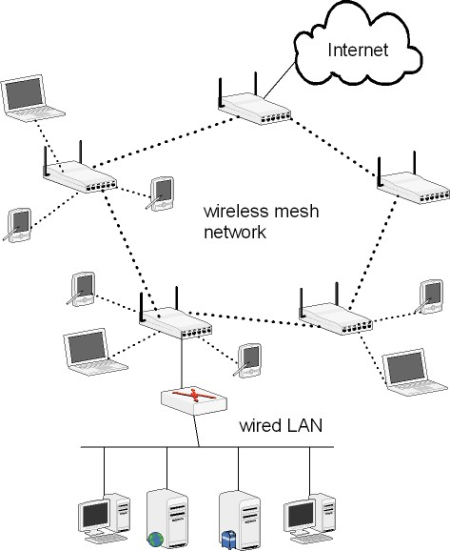
Wireless Mesh Network (WMN)
An AP may or may not connect to a wired network infrastructure
Each STA is connected to one AP
WMNs vs. WLANs:
  WLANs: star networks
  WMNs: multi-hop networks
A region:
  An AP and all the STAs connected to it
  Can be viewed as a WLAN
  Can apply the 802.11i/WPA2 security standard
J. Wang and Z. Kissel. Introduction to Computer Network Security: Theory and Practice. Wiley 2015

Slide 64
Security Holes in WMNs
Blackhole Attack.
  Impersonate a legitimate router and drop packet instead of forwarding it
  Coax users to use his router
Wormhole Attack
  Reroute packets from one region to another
Rushing Attacks
  Target at on-demand routing protocols:
    Router must forward the 1st route request packet and drop the subsequent packets from the same source to reduce clutter
  Rush an impersonated route request before the legitimate one arrives
Router-Error-Injection Attacks
  Injecting certain forged route-error packets to break normal communication
J. Wang and Z. Kissel. Introduction to Computer Network Security: Theory and Practice. Wiley 2015

