Slide 1
Chapter 7
Cloud Security
J. Wang and Z. Kissel. Introduction to Computer Network Security: Theory and Practice. Wiley 2015

Slide 2
Chapter 7 Outline
7.1 The Cloud Service Models
7.2 Cloud Security Models
7.3 Multiple Tenancy
7.4 Access Control
7.5 Coping with Untrusted Clouds
7.6 Searchable Encryption*
J. Wang and Z. Kissel. Introduction to Computer Network Security: Theory and Practice. Wiley 2015

Slide 3
The Cloud Service Models
Four service models
  Software-as-a-service (SaaS) Clouds
  Platform-as-a-service (PaaS) Clouds
  Infrastructure-as-a-service (IaaS) Clouds
  Storage-as-a-service (STaaS) clouds
The REST architecture
  Representational State Transfer (REST)
J. Wang and Z. Kissel. Introduction to Computer Network Security: Theory and Practice. Wiley 2015

Slide 4
The REST architecture
Use uniform resource identifier (URI) and the HTTP functions of PUT, POST, and GET to provide interface
  URI represents actions that web servers should perform
  HTML, XML, JSON (JavaScript Object Notation)
  Example: to determine CPU time consumed on a cloud, the cloud provider may indicate that the URI of our CPU time is
  http://sky.cloud/user/jwang/usage
  Using GET to obtain the CPU time in JSON format
J. Wang and Z. Kissel. Introduction to Computer Network Security: Theory and Practice. Wiley 2015

Slide 5
Software-as-a-Service
Users of SaaS clouds can only use cloud-provided applications
Maintained solely by the cloud provider
  Cheaper to users
Example:
  Gmail users are interacting with the SaaS for Gmail
  Yahoo! Mail users are interacting with the SaaS for Yahoo! mail
  Online social networks (OSNs): Facebook, Twitter, and Google+
J. Wang and Z. Kissel. Introduction to Computer Network Security: Theory and Practice. Wiley 2015

Slide 6
Platform-as-a-Service
PaaS allows users to deploy their own applications in clouds
The cloud maintains control and manages the entire cloud infrastructure
Example:
  Google AppEngine
  A subset of Amazon Web Services (AWS)
J. Wang and Z. Kissel. Introduction to Computer Network Security: Theory and Practice. Wiley 2015

Slide 7
Infrastructure-as-a-Service
William Bauldry
IaaS allows users to deploy their own OS
The cloud provider maintains the hardware, but won’t provide support for the OS and applications the users deploy
Example:
  Amazon Elastic Compute Cloud (EC2)
J. Wang and Z. Kissel. Introduction to Computer Network Security: Theory and Practice. Wiley 2015

Slide 8
Storage-as-a-Service
STaaS is a cloud architecture that allows the cloud provider to maintain a collection of bulk storage
  Accessible through REST protocol
Examples
  Amazon S3
  Dropbox
  Google Drive
  OneDrive
J. Wang and Z. Kissel. Introduction to Computer Network Security: Theory and Practice. Wiley 2015

Slide 9

STaaS Security
Cloud storage is inherently insecure
  Data for different parties coexist on the same hardware, segregated by the service provider
  Data not necessarily stored in an encrypted form
  Must implicitly trust the service provider
J. Wang and Z. Kissel. Introduction to Computer Network Security: Theory and Practice. Wiley 2015

Slide 10
Chapter 7 Outline
7.1 The Cloud Service Models
7.2 Cloud Security Models
7.3 Multiple Tenancy
7.4 Access Control
7.5 Coping with Untrusted Clouds
7.6 Searchable Encryption*
J. Wang and Z. Kissel. Introduction to Computer Network Security: Theory and Practice. Wiley 2015

Slide 11
Who Are We Protect Against?
In cloud computing, the cloud provider (CP) is the adversary
CP as a trusted-third party
  Users must completely trust the CP
    Backed by the service-level agreements (SLA) or brand recognition of CP
  No protection against the individuals who manage the clouds or the perpetrators who hack in the clouds
J. Wang and Z. Kissel. Introduction to Computer Network Security: Theory and Practice. Wiley 2015

Slide 12
Honest-but-Curious
The cloud will
  honestly store the data
  Honestly execute the protocols
  But try to learn as much info as possible from computations and interactions with the users
J. Wang and Z. Kissel. Introduction to Computer Network Security: Theory and Practice. Wiley 2015

Slide 13
Semi-Honest-but-Curious
Honestly store the data
Honestly execute requested operations or a fraction of them
Return a nonzero fraction of the results
Try to learn as much info as possible from executing user programs and interacting with them
J. Wang and Z. Kissel. Introduction to Computer Network Security: Theory and Practice. Wiley 2015

Slide 14
Chapter 7 Outline
7.1 The Cloud Service Models
7.2 Cloud Security Models
7.3 Multiple Tenancy
7.4 Access Control
7.5 Coping with Untrusted Clouds
7.6 Searchable Encryption*
J. Wang and Z. Kissel. Introduction to Computer Network Security: Theory and Practice. Wiley 2015

Slide 15
Virtualization
Used in IaaS clouds, it is a technology supporting software-based emulation or provisioning of computer hardware resources
Virtual machines (VMs) are enabled at a special layer called the hypervisor
  Provide access to resources according to how resources are provisioned to the virtual machine
  Logical—actual physical resources are shared among multiple VMs
  Physical---actual physical resources are completely control by the VM
Examples: Amazon EC2
J. Wang and Z. Kissel. Introduction to Computer Network Security: Theory and Practice. Wiley 2015

Slide 16
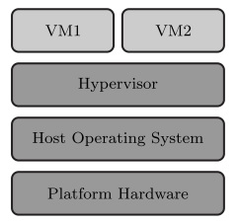
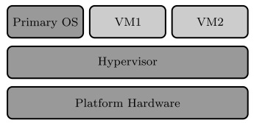
Virtualization Approaches
Software-based
Hardware-Assisted
Hypervisor runs as firmware
Primary OS provides the management interface to hypervisor
Examples:
  Oracle VM Server for SPARC
Hypervisor runs on top of true OS, called the host OS
Examples:
  Oracle Virtual Box
  VMWare
J. Wang and Z. Kissel. Introduction to Computer Network Security: Theory and Practice. Wiley 2015

Slide 17
Hypervisor Security
Multitennancy: different clients have data or applications on the same hardware
Most hypervisors only offers coarse-grained-level security protections
  For example, what disks are accessed by the VM and when
Introspection: A recent technology for finer-grained security
  Monitor network traffic, memory usage, process status
  Allow hypervisor to enforce security policies
  Perform firewalls and IDS
  Enable better separations between multiple tenants
J. Wang and Z. Kissel. Introduction to Computer Network Security: Theory and Practice. Wiley 2015

Slide 18
Attacks on Clouds
Side-channel Attacks
  Try to learn information leaked from normal operations
    Heavy network activities destined to a VM would indicate the importance of the VM
Co-residency Attacks
  Create a new VM to co-reside on the same physical hardware with the VM to be attacked
    Exploit software bugs or exhaustively spin up a VM
  Then use side-channel attacks
J. Wang and Z. Kissel. Introduction to Computer Network Security: Theory and Practice. Wiley 2015

Slide 19
Chapter 7 Outline
7.1 The Cloud Service Models
7.2 Cloud Security Models
7.3 Multiple Tenancy
7.4 Access Control
7.5 Coping with Untrusted Clouds
7.6 Searchable Encryption*
J. Wang and Z. Kissel. Introduction to Computer Network Security: Theory and Practice. Wiley 2015

Slide 20
Access Control
Control users how to access hardware resources
Discretionary access control
  Users are given privileges (by the cloud) and the ability to grant privileges to other users
Mandatory access control
  Set up a policy for all resources
  Only the policy manager can grant and revoke privileges
  A typical computer system uses password-based authentication with the OS to provide access control to user files
  Cloud system is similar in trusted clouds
J. Wang and Z. Kissel. Introduction to Computer Network Security: Theory and Practice. Wiley 2015

Slide 21
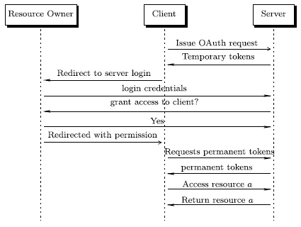
OAuth--the Open Authentication Protocol
On top of HTTP, Oauth offers discretionary access control
  Users can delegate access to protected resources they control without releasing their credentials
J. Wang and Z. Kissel. Introduction to Computer Network Security: Theory and Practice. Wiley 2015

Slide 22
Access Control in Untrusted Clouds
Authentication and access control must be managed without cloud’s involvement.
Proxy re-encryption (PRE)
  Allow an HBC proxy to convert a piece of ciphertext decryptable by Alice to a piece of ciphertext decryptable by Bob without revealing the contents to the proxy
J. Wang and Z. Kissel. Introduction to Computer Network Security: Theory and Practice. Wiley 2015

Slide 23
BBS Proxy Re-Encryption
(not the same BBS in the BBS pseudorandom bit generator)
The proxy is trusted to carry out the operations according to protocol, but it may also perform other things, such as trying to learn the contents
The proxy should not be able to recover the private key of Alice or Bob from performing the re-encryption.
Bob should not be able to recover Alice’s private key
Alice acts like a delegator, and Bob a delegatee
Unidirectional PRE
  The generation of a re-encryption key from Alice to Bob does not imply a re-encryption key from Bob to Alice
Bidirectional PRE
BBS PRE is bidirectional, based on the Elgamal PKC
J. Wang and Z. Kissel. Introduction to Computer Network Security: Theory and Practice. Wiley 2015

Slide 24
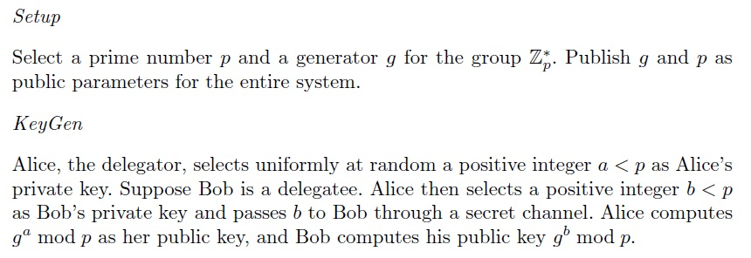
BBS PRE
J. Wang and Z. Kissel. Introduction to Computer Network Security: Theory and Practice. Wiley 2015

Slide 25
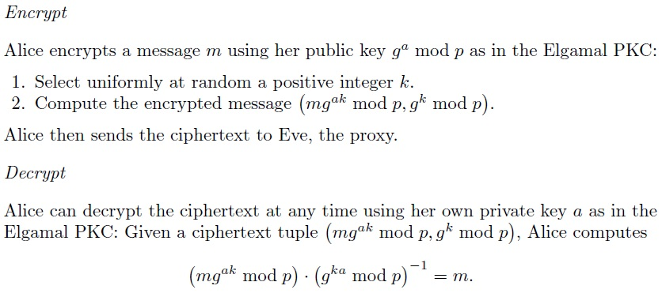
BBS PRE
J. Wang and Z. Kissel. Introduction to Computer Network Security: Theory and Practice. Wiley 2015

Slide 26
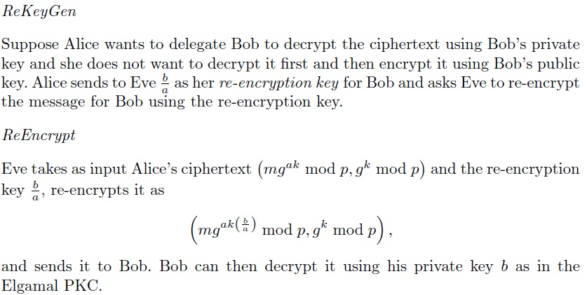
BBS PRE
J. Wang and Z. Kissel. Introduction to Computer Network Security: Theory and Practice. Wiley 2015

Slide 27
BBS PRE Weakness
Should Alice and Bob collude, then they can discover Alice’s private key
Improved PRE (unidirectional) can be constructed using computationally expensive pairing function
  Hinder its practical usage
J. Wang and Z. Kissel. Introduction to Computer Network Security: Theory and Practice. Wiley 2015

Slide 28
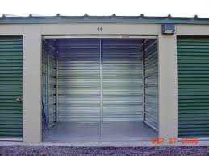
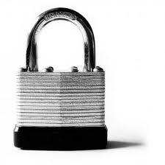
Using PRE for Access Control
How does Alice secure her storage bay?
Use a padlock
J. Wang and Z. Kissel. Introduction to Computer Network Security: Theory and Practice. Wiley 2015

Slide 29
Alice wants to give Bob access to her storage bay
She wants to change the key inside the lockbox at her convenience without needing to tell Bob
But she doesn’t want any of the followings:
  unlock the lock herself to let Bob in (she may not be available)
  give the combination to a designated third party to unlock the lock (it’s hard to completely trust a third party)
  give the combination to Bob (Bob make give this combination to other people)
J. Wang and Z. Kissel. Introduction to Computer Network Security: Theory and Practice. Wiley 2015

Slide 30
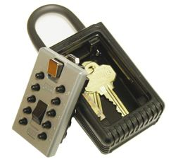
What can she do?
Construct a unique keysafe
J. Wang and Z. Kissel. Introduction to Computer Network Security: Theory and Practice. Wiley 2015

Slide 31

The keysafe has a unique key mechanism
3 types of cylinders
Original (OC)
Unlockable (ULC)
User (UC)
Alice's special lock
Swap key
(Eve holds this)
User Key
J. Wang and Z. Kissel. Introduction to Computer Network Security: Theory and Practice. Wiley 2015

Slide 32
Removable Cylinders
Alice can unlock the lock through the OC in the lock with her own private key (K_{A})
She can use K_{A} to swap the OC with the ULC; the lock with the ULC cannot be unlocked with any key
The ULC can be swapped with the OC or a UC using a swap key
Bob can unlock the lock through his UC (UC_{B}) in the lock with his user key (K_{B})
Bob can only swap UC_{B} in the lock with the ULC using K_{B} (he cannot swap UC_{B} with Eric’s UC or other cylinders)
J. Wang and Z. Kissel. Introduction to Computer Network Security: Theory and Practice. Wiley 2015

Slide 33
Alice’s Solution
Construct UC_{B} and K_{B}, and sends K_{B} to Bob
Ask Charlie, a trusted mutual friend of Alice and Bob, to verify the cylinders are swappable
Charlie engraves the swap key UC_{B}, and gives them to Jane (the storage owner)
Lock her storage bay with the padlock using the OC, then swap the OC with the ULC
To access Alice’s storage bay, Bob asks Eve for the swap key and UC_{B}
After verifying Charlie’s engraving, Bob swaps the ULC with UC_{B} and unlocks the lock with K_{B}
When finished, Bob locks the storage bay and swaps UC_{B} with the ULC
J. Wang and Z. Kissel. Introduction to Computer Network Security: Theory and Practice. Wiley 2015

Slide 34
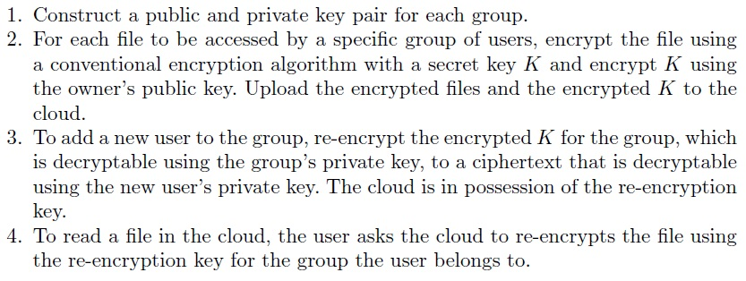
Realizing keysafe using PRE for UNIX-like group-level access control
Data owner provides group-level access control to different groups as follows:
J. Wang and Z. Kissel. Introduction to Computer Network Security: Theory and Practice. Wiley 2015

Slide 35
Chapter 7 Outline
7.1 The Cloud Service Models
7.2 Cloud Security Models
7.3 Multiple Tenancy
7.4 Access Control
7.5 Coping with Untrusted Clouds
7.6 Searchable Encryption*
J. Wang and Z. Kissel. Introduction to Computer Network Security: Theory and Practice. Wiley 2015

Slide 36
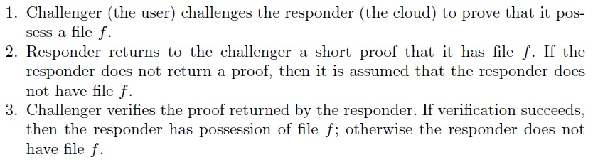
Proof of Storage (POS)
Want STaaS clouds to provide an uncorruptable and unforgeable proof guaranteeing the storage of data
Use the challenge-response scheme as follows:
J. Wang and Z. Kissel. Introduction to Computer Network Security: Theory and Practice. Wiley 2015

Slide 37
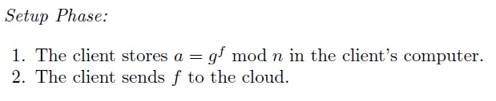
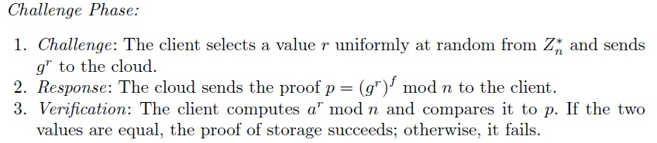
A POS Protocol
Using Diffie-Hellman Key Exchange (g, n)
  Represent file f as an integer
J. Wang and Z. Kissel. Introduction to Computer Network Security: Theory and Practice. Wiley 2015

Slide 38
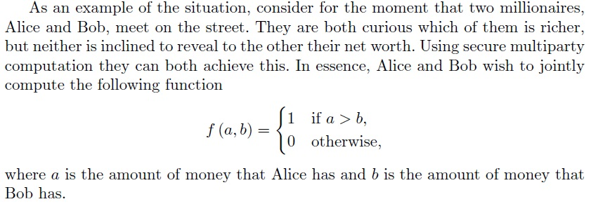
Secure Multiparty Computation
Allow multiple untrusting party to jointly compute a function of shared data, without revealing their individual inputs, and allow them to see the result
J. Wang and Z. Kissel. Introduction to Computer Network Security: Theory and Practice. Wiley 2015

Slide 39

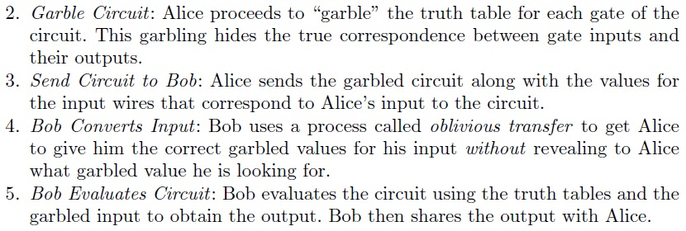
Garbled Circuits
J. Wang and Z. Kissel. Introduction to Computer Network Security: Theory and Practice. Wiley 2015

Slide 40
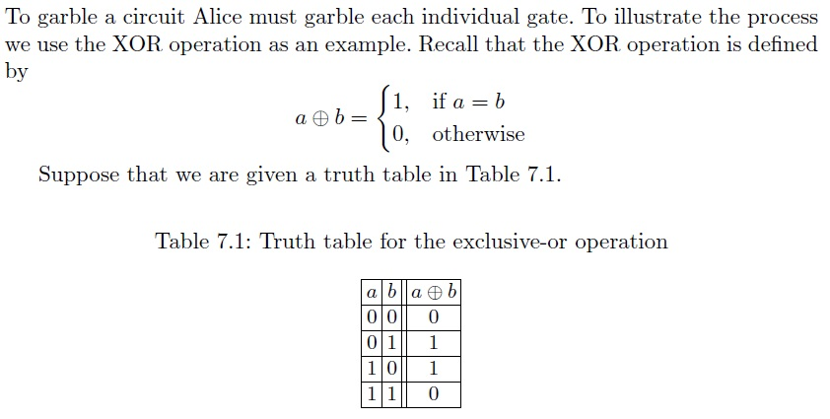
Garbled Circuit Example
J. Wang and Z. Kissel. Introduction to Computer Network Security: Theory and Practice. Wiley 2015

Slide 41
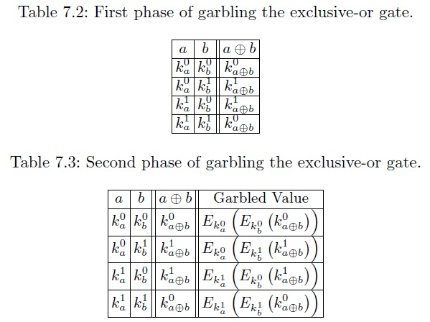
Key Generation for SKE and Garbling
Alice choses an SKE and generates for keys, where each key represents one possible input value for a and b
J. Wang and Z. Kissel. Introduction to Computer Network Security: Theory and Practice. Wiley 2015

Slide 42
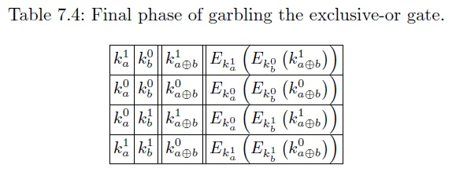
Garbling
To garble one gate, remove all the headers and permute the orders of rows to prevent leakage
To garble additional gates, use the keys for outputs to hook the output of the gate to the input of a subsequent gate
J. Wang and Z. Kissel. Introduction to Computer Network Security: Theory and Practice. Wiley 2015

Slide 43
Garbling continues
Alice must maintain
  The mapping between the keys of the outputs and the values they represent
  The mapping between the keys of the inputs and the values they represent
To allow Bob to learn the result of the computation, Alice may send Bob the mapping between the keys of the outputs and the values (this is optional)
J. Wang and Z. Kissel. Introduction to Computer Network Security: Theory and Practice. Wiley 2015

Slide 44
Oblivious Transfer (OT)
To obtain the correct garbled inputs, Bob must ask Alice which key represents 0 and which represents 1
Alice does not want to give what Bob asks
Bob does not want to reveal the value he is looking for
This can be solved using oblivious transfer
J. Wang and Z. Kissel. Introduction to Computer Network Security: Theory and Practice. Wiley 2015

Slide 45

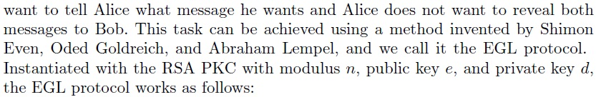
1-out-of-2 OT
J. Wang and Z. Kissel. Introduction to Computer Network Security: Theory and Practice. Wiley 2015

Slide 46
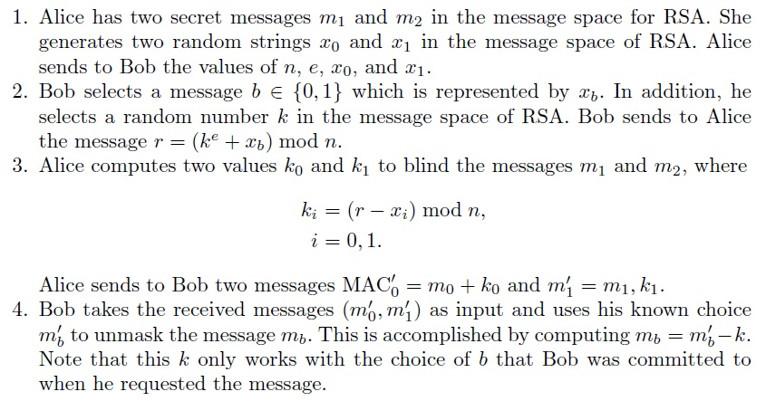
1-out-of-2 OT Steps
J. Wang and Z. Kissel. Introduction to Computer Network Security: Theory and Practice. Wiley 2015

Slide 47
Garbled Circuit Evaluation
Bob evaluates the GC using the input values for a gate to decrypt the output values for a gate
  Through a series of decryptions following the structure of the circuit
  For each gate, all Bob knows is a set of ciphertexts in a random order
  Bob must attempt to decrypt all ciphertexts to learn the key for the gate’s output wire
J. Wang and Z. Kissel. Introduction to Computer Network Security: Theory and Practice. Wiley 2015

Slide 48
Oblivious RAM (ORAM)
Computations in the RAM model leak the location in the memory that the algorithm is using
  Access pattern: the sequence of memory locations read from and written to by an algorithm
  Observing the access pattern of an algorithm, one can easily deduce what operations are performed and what values are valuable
Need to hide access pattern in untrusted clouds
  The most naïve solution is to, for each access request, make each cell both read-from and written-to.
  ORAM is a RAM that reveals no info about an algorithm’s inputs
  ORAM needs to simulate RAM efficiently
J. Wang and Z. Kissel. Introduction to Computer Network Security: Theory and Practice. Wiley 2015

Slide 49
Generic ORAM Simulation: “Square Root” Simulation
Virtual memory access is a memory request
In the “Square Root” simulation, the virtual memory access pattern is completely hidden
  Requires m+2sqrt(m) cells of memory in ORAM, where m is the total number of memory cells in PRAM (probabilistic RAM)
  ORAM divides the memory into 3 chunks:
    Main section
    Dummy section
    Shelter section
J. Wang and Z. Kissel. Introduction to Computer Network Security: Theory and Practice. Wiley 2015

Slide 50
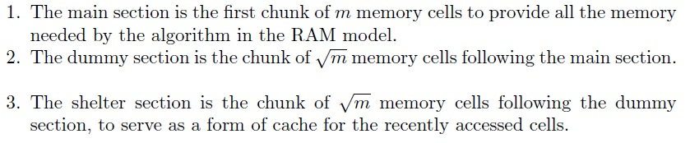
ORAM Memory Layout
J. Wang and Z. Kissel. Introduction to Computer Network Security: Theory and Practice. Wiley 2015

Slide 51
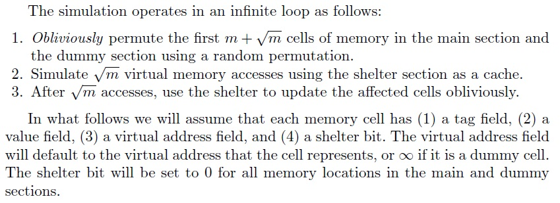
ORAM Simulation
J. Wang and Z. Kissel. Introduction to Computer Network Security: Theory and Practice. Wiley 2015

Slide 52
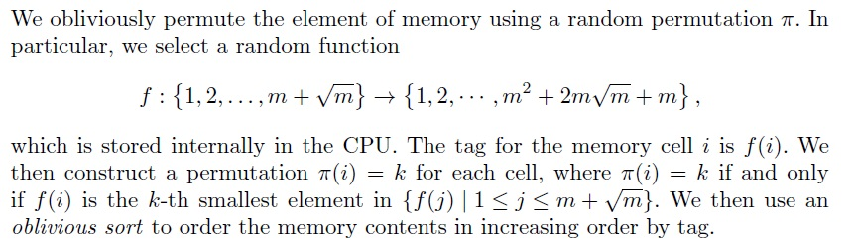
Oblivious Permutation
J. Wang and Z. Kissel. Introduction to Computer Network Security: Theory and Practice. Wiley 2015

Slide 53
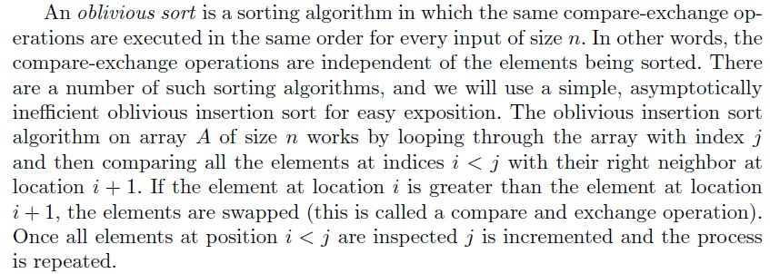
Oblivious Sort
J. Wang and Z. Kissel. Introduction to Computer Network Security: Theory and Practice. Wiley 2015

Slide 54

Simulate sqrt(m) Memory Accesses
J. Wang and Z. Kissel. Introduction to Computer Network Security: Theory and Practice. Wiley 2015

Slide 55
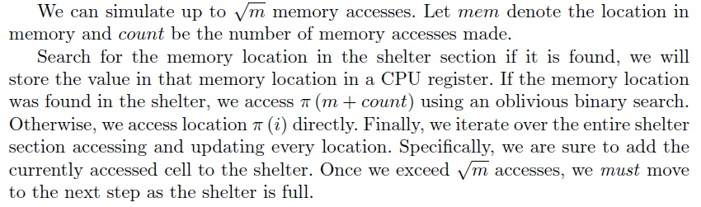
Memory Access Simulation
J. Wang and Z. Kissel. Introduction to Computer Network Security: Theory and Practice. Wiley 2015

Slide 56
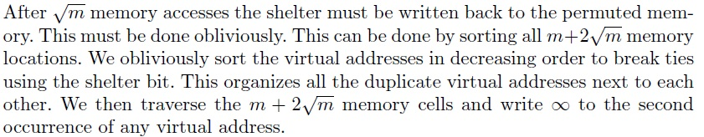
Update Permuted Memory
J. Wang and Z. Kissel. Introduction to Computer Network Security: Theory and Practice. Wiley 2015

