Slide 1
Chapter 8
Network Perimeter Security
J. Wang and Z. Kissel. Introduction to Computer Network Security: Theory and Practice. Wiley 2015

Slide 2
Chapter 8 Outline
8.1 General Framework
8.2 Packet Filters
8.3 Circuit Gateways
8.4 Application Gateways
8.5 Trusted Systems and Bastion Hosts
8.6 Firewall Configuration
8.7 Network Address Translations
8.8 Setting Up Firewalls
J. Wang and Z. Kissel. Introduction to Computer Network Security: Theory and Practice. Wiley 2015

Slide 3
Overview
LANs, WANs, WLANs are known as edge networks
  May be contained within businesses or homes
  Needs to be protected from the rest of the Internet!
Why firewall?
  Encryption?
    Cannot stop malicious packets from getting into an edge network
  Authentication?
    Can determine whether an incoming IP packet comes from a trusted user
    However, not all host computers have resources to run authentication algorithms
  Host computers managed by different users with different skill levels.
J. Wang and Z. Kissel. Introduction to Computer Network Security: Theory and Practice. Wiley 2015

Slide 4
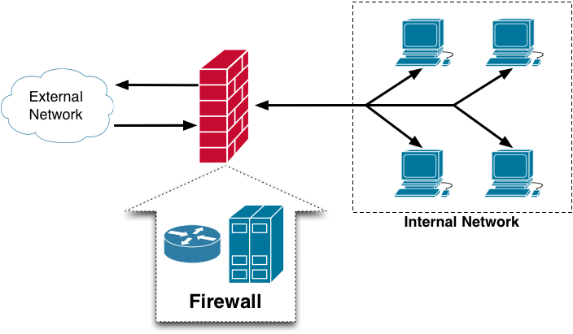
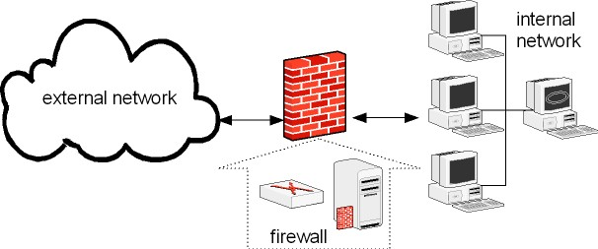
General Framework
J. Wang and Z. Kissel. Introduction to Computer Network Security: Theory and Practice. Wiley 2015

Slide 5
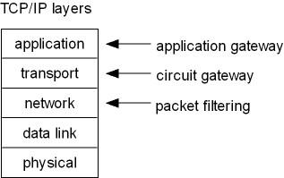
General Framework
What is a firewall?
  A hardware device, a software package, or a combination of both
  A barrier between the Internet and an edge network (internal network)
  A mechanism to filter Incoming (ingress) and outgoing (egress) packets.
  May be hardware and/or software
    Hardware is faster but can be difficult to update
    Software is slower but easier to update
Firewall placement
J. Wang and Z. Kissel. Introduction to Computer Network Security: Theory and Practice. Wiley 2015

Slide 6
Chapter 8 Outline
8.1 General Framework
8.2 Packet Filters
8.3 Circuit Gateways
8.4 Application Gateways
8.5 Trusted Systems and Bastion Hosts
8.6 Firewall Configuration
8.7 Network Address Translations
8.8 Setting Up Firewalls
J. Wang and Z. Kissel. Introduction to Computer Network Security: Theory and Practice. Wiley 2015

Slide 7
Packet Filters
Perform ingress (incoming) and egress (outgoing) filtering on packets
Only inspect IP and TCP/UDP headers, not the payloads
Can perform either stateless or stateful filtering
  Stateless filtering: easy to implement but very simple
  Stateful filtering: harder to implement but more powerful
J. Wang and Z. Kissel. Introduction to Computer Network Security: Theory and Practice. Wiley 2015

Slide 8
Stateless Filters
Perform “dumb” filtering
  Apply a set of static rules to inspect every packet
  Do not keep results from previous packets
A set of rules used is referred to as an Access Control List (ACL)
  Rules are checked from top to bottom and the first rule found is applied
  If no rules match, the packet is blocked by default
J. Wang and Z. Kissel. Introduction to Computer Network Security: Theory and Practice. Wiley 2015

Slide 9
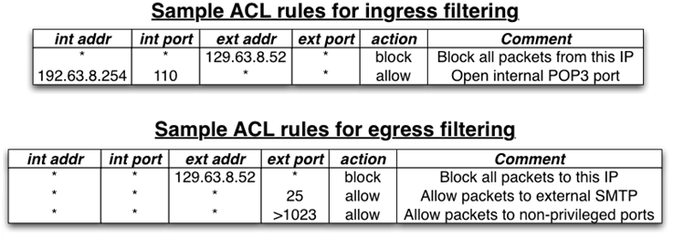
ACL Example
    Blocks egress/ingress packets from certain IP address or port
    Monitors an ingress packet with an internal address as the source IP address for possible crafted packet
    Identifies Packets that specifies certain router for possible bypassing firewall
    Watches for packets with small payload for possible fragmentation attack
    Blocks control packets from going outside
J. Wang and Z. Kissel. Introduction to Computer Network Security: Theory and Practice. Wiley 2015

Slide 10
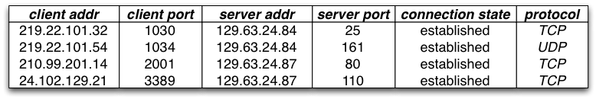
Stateful Filters
Smarter than a stateless filter
  Keep track of connection states between internal and external hosts
Will only accept/reject based on the connection state
  Usually combined with a stateless filter
Must pay attention to memory and CPU time requirements; connection tracking can be expensive!
Connection state table example
J. Wang and Z. Kissel. Introduction to Computer Network Security: Theory and Practice. Wiley 2015

Slide 11
Chapter 8 Outline
8.1 General Framework
8.2 Packet Filters
8.3 Circuit Gateways
8.4 Application Gateways
8.5 Trusted Systems and Bastion Hosts
8.6 Firewall Configuration
8.7 Network Address Translations
8.8 Setting Up Firewalls
J. Wang and Z. Kissel. Introduction to Computer Network Security: Theory and Practice. Wiley 2015

Slide 12
Circuit Gateways
Operate at the transport layer
Examine information of IP addresses and port numbers in TCP/UDP headers to determine if a connection is allowed
Usually combined with a packet filter to form a dynamic packet filter
Basic structure:
  Relay a TCP connection between an internal and external host
  Disallow direct connection between the external and the internal networks
  Maintain a table for valid connection and check incoming packet against the table
J. Wang and Z. Kissel. Introduction to Computer Network Security: Theory and Practice. Wiley 2015

Slide 13
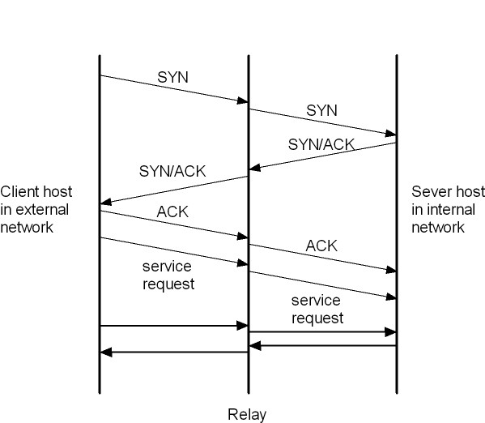
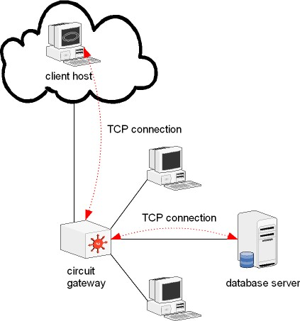
Examples
J. Wang and Z. Kissel. Introduction to Computer Network Security: Theory and Practice. Wiley 2015

Slide 14
SOCKetS (SOCKS)
A network protocol for implementing circuit gateway
Consists of three components:
  SOCKS server
    Run on a packet filtering firewall through port 1080
  SOCKS client
    Run on an external client host
  SOCKS client library
    Run on an internal host
Verifies information for authentication and decides establishing connection upon the information
  Provides an authenticated relay for a remote network
J. Wang and Z. Kissel. Introduction to Computer Network Security: Theory and Practice. Wiley 2015

Slide 15
Chapter 8 Outline
8.1 General Framework
8.2 Packet Filters
8.3 Circuit Gateways
8.4 Application Gateways
8.5 Trusted Systems and Bastion Hosts
8.6 Firewall Configuration
8.7 Network Address Translations
8.8 Setting Up Firewalls
J. Wang and Z. Kissel. Introduction to Computer Network Security: Theory and Practice. Wiley 2015

Slide 16
Application Gateways
Also called application-level gateway or proxy server
Act like a proxy for internal hosts, processing service request from external clients.
Perform deep packet inspection on all packet
  Inspect application program formats
  Apply rules based on the payload
  Have the ability to detect malicious and suspicious packets
Extremely resource intensive
J. Wang and Z. Kissel. Introduction to Computer Network Security: Theory and Practice. Wiley 2015

Slide 17
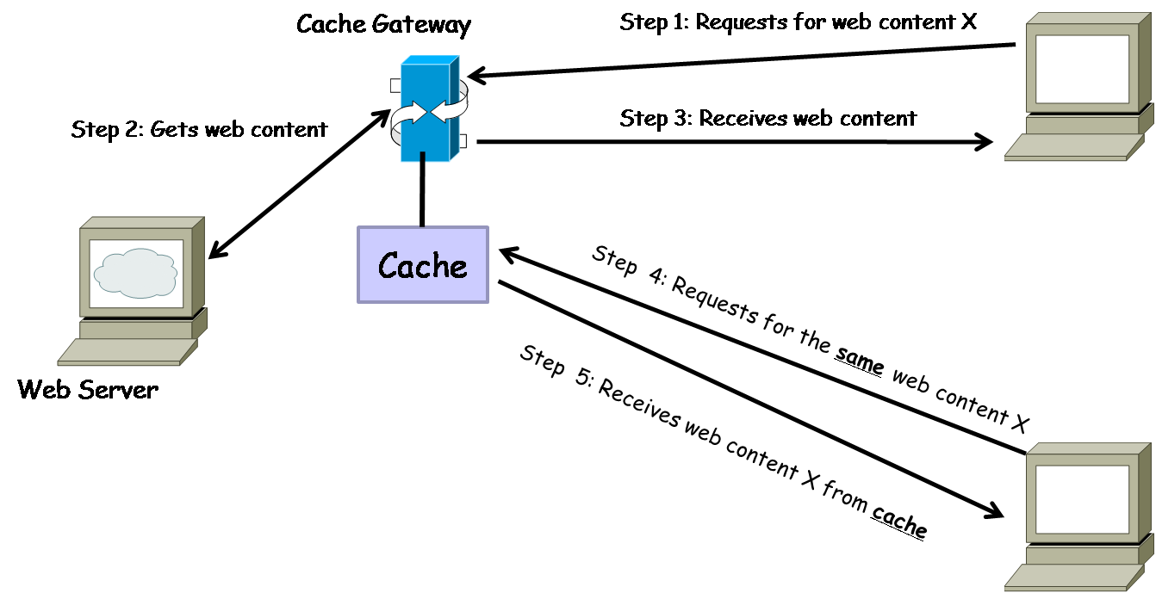
Cache Gateway
J. Wang and Z. Kissel. Introduction to Computer Network Security: Theory and Practice. Wiley 2015

Slide 18
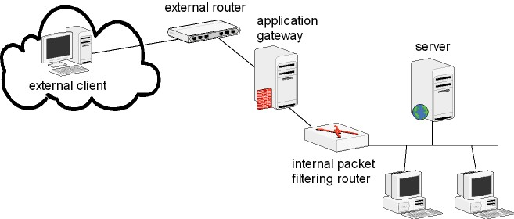
Application Gateways
Place a router behind the gateway to protect connections between the gateway and the internal hosts
J. Wang and Z. Kissel. Introduction to Computer Network Security: Theory and Practice. Wiley 2015

Slide 19
Stateful Packet Inspection
Application-level extension of stateful packet filtering
  Support scanning packet payloads
  Will drop packets that do not match the expected connection state or data type for protocol
J. Wang and Z. Kissel. Introduction to Computer Network Security: Theory and Practice. Wiley 2015

Slide 20
Chapter 8 Outline
8.1 General Framework
8.2 Packet Filters
8.3 Circuit Gateways
8.4 Application Gateways
8.5 Trusted Systems and Bastion Hosts
8.6 Firewall Configuration
8.7 Network Address Translations
8.8 Setting Up Firewalls
J. Wang and Z. Kissel. Introduction to Computer Network Security: Theory and Practice. Wiley 2015

Slide 21
Trusted Systems and Bastion Hosts
Application gateways are placed between the external and the internal networks
  Exposed to attacks from the external network
Need to have strong security protections
  Trusted operating system
  Bastion hosts
J. Wang and Z. Kissel. Introduction to Computer Network Security: Theory and Practice. Wiley 2015

Slide 22
Trusted Operating Systems
An operating system that meets a particular set of security requirements
  System design contains no defects
  System software contains no loopholes
  System is configured properly
  System management is appropriate
May have users at different levels of security clearance
Must follow strict rules regarding permissions
J. Wang and Z. Kissel. Introduction to Computer Network Security: Theory and Practice. Wiley 2015

Slide 23
Access Rights
No read-up
  Users of a lower level of clearance cannot execute programs of a higher level of secrecy
  Programs of a lower level of secrecy cannot read files of higher level of secrecy
No write-down
  Users of a higher level of clearance cannot use programs of lower level of secrecy to write data to a file
  Programs of a higher level of secrecy cannot write data into files of a lower level of secrecy
J. Wang and Z. Kissel. Introduction to Computer Network Security: Theory and Practice. Wiley 2015

Slide 24
Bastion Hosts
Systems with strong defensive mechanisms
Serves as hosts computers for implementing:
  Gateways
  Circuit gateways
  Other types of firewall
Operated on a trusted operating system
  Must not have any unnecessary functionality!
Keeps the system simple to reduce error probabilities
J. Wang and Z. Kissel. Introduction to Computer Network Security: Theory and Practice. Wiley 2015

Slide 25
Requirements
Gateway software should be written using only small modules
May provide user authentication at the network level
Should be connected to the smallest possible number of internal hosts
Extensive logs should be kept of all activity passing through the system
If they are running on a single host, multiple gateways must operate independently
Hosts should avoid writing data to their hard disks
Gateways running on bastion hosts should not be given administration rights
J. Wang and Z. Kissel. Introduction to Computer Network Security: Theory and Practice. Wiley 2015

Slide 26
Chapter 8 Outline
8.1 General Framework
8.2 Packet Filters
8.3 Circuit Gateways
8.4 Application Gateways
8.5 Trusted Systems and Bastion Hosts
8.6 Firewall Configuration
8.7 Network Address Translations
8.8 Setting Up Firewalls
J. Wang and Z. Kissel. Introduction to Computer Network Security: Theory and Practice. Wiley 2015

Slide 27
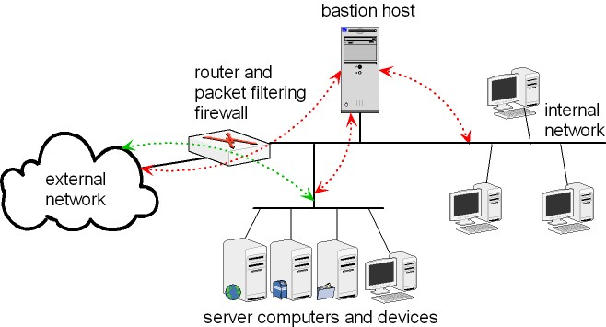
Single-Homed Bastion System
Consists of a packet-filtering router and a bastion host
  Router connects internal network to external network
  Bastion host is inside the internal network
PF firewall inspects each egress and blocks it if its source address is not the IP address of bastion host
If the PF router is compromised, the attacker can modify the ACLs and bypass the bastion host
J. Wang and Z. Kissel. Introduction to Computer Network Security: Theory and Practice. Wiley 2015

Slide 28
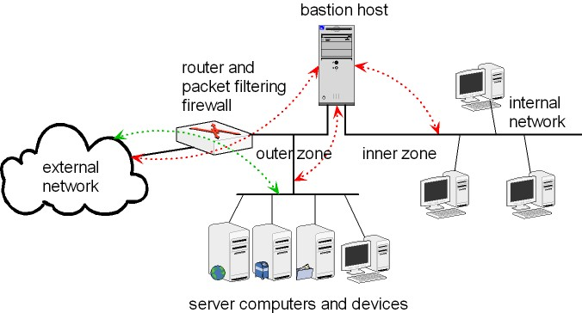
Dual-Homed Bastion System
Two zones in the internal network:
  Inner zone: hosts are unreachable from external
  Outer zone: hosts may be reached from Internet
Hosts in inner zone are protected by both bastion host and PF router
Servers in outer zone protected by PF router
Prevents access to the internal network even if the PF router is compromised
J. Wang and Z. Kissel. Introduction to Computer Network Security: Theory and Practice. Wiley 2015

Slide 29
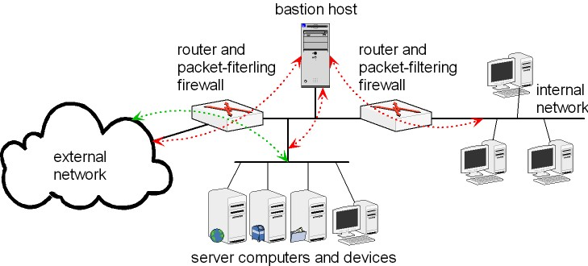
Screened Subnets
A SHBH network paired with a second PF router for the internal network
Area between the two PF routers is called a screened subnet
Hides the internal network structure from external hosts
J. Wang and Z. Kissel. Introduction to Computer Network Security: Theory and Practice. Wiley 2015

Slide 30
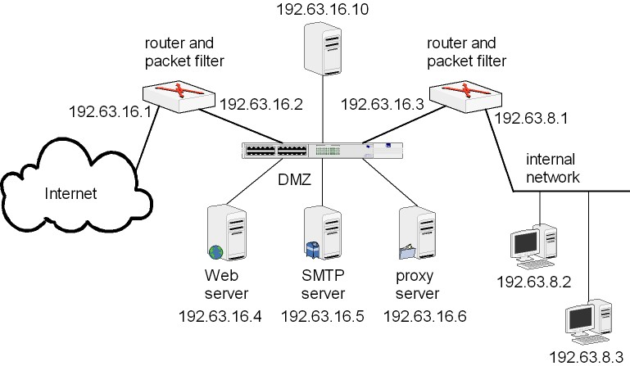
Demilitarized Zones (DMZ)
A subnet between two firewalls in an internal network
  External firewall protects DMZ from external threats
  Internal firewall protects internal network from DMZ
DMZs can be implemented in a hierarchal structure
J. Wang and Z. Kissel. Introduction to Computer Network Security: Theory and Practice. Wiley 2015

Slide 31
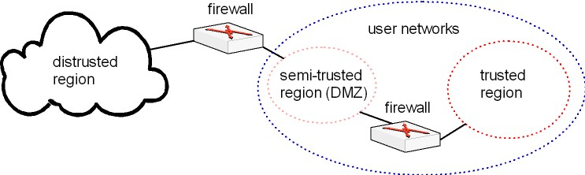
Network Security Topology
Firewalls divide networks into three areas:
  Distrusted region
  Semi-trusted region
  Trusted region
J. Wang and Z. Kissel. Introduction to Computer Network Security: Theory and Practice. Wiley 2015

Slide 32
Chapter 8 Outline
8.1 General Framework
8.2 Packet Filters
8.3 Circuit Gateways
8.4 Application Gateways
8.5 Trusted Systems and Bastion Hosts
8.6 Firewall Configuration
8.7 Network Address Translations
8.8 Setting Up Firewalls
J. Wang and Z. Kissel. Introduction to Computer Network Security: Theory and Practice. Wiley 2015

Slide 33
Network Address Translations (NAT)
Divides IP addresses into public and private (non-routable) groups
  IANA has 3 IP blocks designated as private
    10.0.0.0/8
    172.16.0.0/12
    192.168.0.0/16
Many private IP addresses can connect to Internet via a few public IP addresses
  Overcomes the 2³² address limit in IPv4
J. Wang and Z. Kissel. Introduction to Computer Network Security: Theory and Practice. Wiley 2015

Slide 34
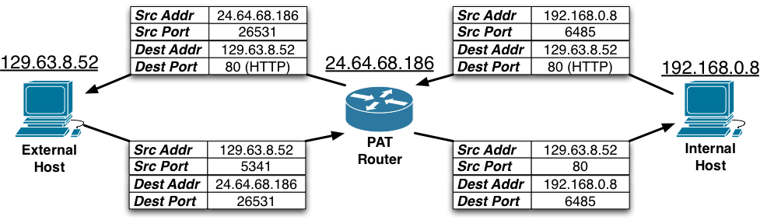
Dynamic NAT
Dynamically assigns a small number of public IPs to a large number of private IPs
Port Address Translation (PAT), a variant of NAT
  Allows one or more private networks to share a single public IP
  Commonly used for homes and small businesses
  Works by remapping the source and destination addresses and ports of packets
J. Wang and Z. Kissel. Introduction to Computer Network Security: Theory and Practice. Wiley 2015

Slide 35
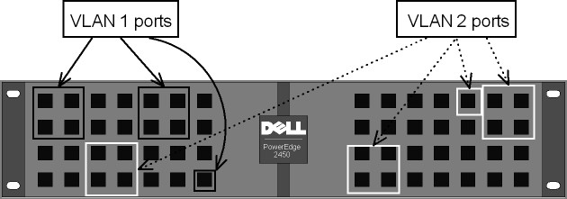
Virtual Local-Area Networks (VLAN)
A technology for creating several independent logical LANs over the same physical network
VLANs can be created using software
VLAN switches: A VLAN switch can be configured to several logical groupings of switch ports for creating independent VLANs:
J. Wang and Z. Kissel. Introduction to Computer Network Security: Theory and Practice. Wiley 2015

Slide 36
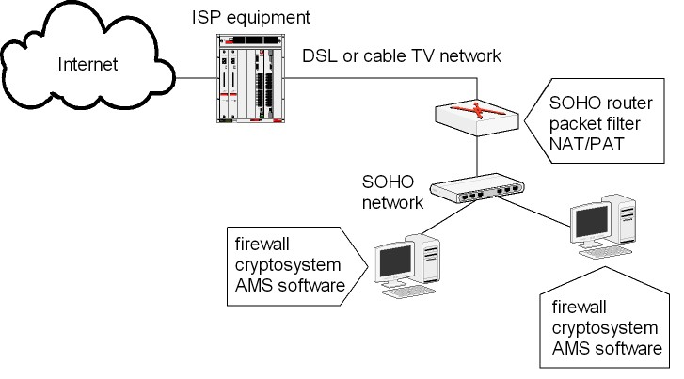
Small Office and Home Office Firewalls (SOHO)
J. Wang and Z. Kissel. Introduction to Computer Network Security: Theory and Practice. Wiley 2015

Slide 37
Chapter 8 Outline
8.1 General Framework
8.2 Packet Filters
8.3 Circuit Gateways
8.4 Application Gateways
8.5 Trusted Systems and Bastion Hosts
8.6 Firewall Configuration
8.7 Network Address Translations
8.8 Setting Up Firewalls
J. Wang and Z. Kissel. Introduction to Computer Network Security: Theory and Practice. Wiley 2015

Slide 38
Setting Up Firewalls
Windows Systems:
  Built-in firewalls under Control Panel
Linux
  Use the iptables program:
  iptables <option> <chain> <matching criteria> <target>
  Example:
  iptables –A INPUT –p TCP –s 129.63.8.109 –j ACCEPT
  iptables –A INPUT –p TCP ! –syn –d 129.63.8.109 –j ACCEPT
  iptables –A INPUT –p TCP –d 129.63.8.109 telnet –j DROP
FreeBSD UNIX
  Use the ipf program
J. Wang and Z. Kissel. Introduction to Computer Network Security: Theory and Practice. Wiley 2015

