Slide 1
Chapter 9
The Art of Intrusion Detection
J. Wang and Z. Kissel. Introduction to Computer Network Security: Theory and Practice. Wiley 2015

Slide 2
Chapter 9 Outline
9.1 Basic Ideas of Intrusion Detection
9.2 Network-Based and Host-Based Detections
9.3 Signature Detections
9.4 Statistical Analysis
9.5 Behavioral Data Forensics
9.6 Honeypots
J. Wang and Z. Kissel. Introduction to Computer Network Security: Theory and Practice. Wiley 2015

Slide 3

Basic Ideas of Intrusion Detection
What is Intrusion?
E.g. Malice gets Alice’s user name & password and impersonates Alice
Intruders are attackers who obtain login information of legitimate users and impersonate them
J. Wang and Z. Kissel. Introduction to Computer Network Security: Theory and Practice. Wiley 2015

Slide 4
Basic Ideas of Intrusion Detection
Observation! (Back to mid-1980’s)
  Intruder’s behavior is likely to be substantially different from the impersonated users
  The behavior differences can be “measured” to allow quantitative analysis
Intrusion detection:
  Identify as quick as possible intrusion activities occurred or are occurring inside an internal network
  Trace intruders and collect evidence to indict the criminals
  Common approach: Identify abnormal events
How about building an automated tool to detect these behaviors? → Intrusion Detection System (IDS)
J. Wang and Z. Kissel. Introduction to Computer Network Security: Theory and Practice. Wiley 2015

Slide 5
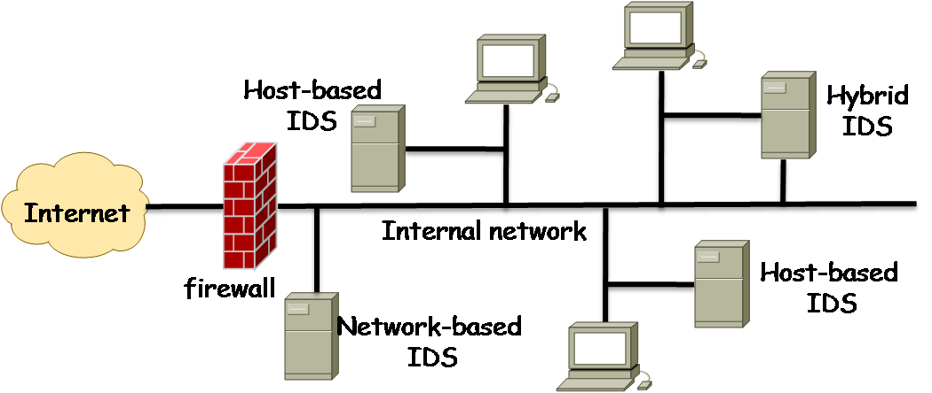
Basic Methodology
Log system events and analyze them
  Can be done manually if log file is small. But a log file could be big… need sophisticated tools
  Can be generated to keep track of network-based activities and host based activities
    Network-based detection (NBD)
    Host-based detection (HBD)
    Both (hybrid detection)
J. Wang and Z. Kissel. Introduction to Computer Network Security: Theory and Practice. Wiley 2015

Slide 6
Basic Methodology
Auditing
  Analyzing logs is often referred to as auditing
  Two kinds of audits
    Security profiles: static configuration information
    Dynamic events: dynamic user events
 | Parameters | Values
Password | Minimum length (bytes) Lifetime (days) Expiration warning (days) | 8 90 14
Login session | Maximum number of unsuccessful attempts allowed Delay between delays (seconds) Time an accounts is allowed to remain idle (hours) | 3 20 12
subject | action | object | exception condition | resource usage | time stamp
Alice Alice Alice | executes opens writes | cp ./myprog etc/myprog | none none write fails | CPU:00001 byte-r: 0 byte-w: 0 | Tue 11/06/07 20:18:33 EST Tue 11/06/07 20:18:33 EST Tue 11/06/07 20:18:34 EST
J. Wang and Z. Kissel. Introduction to Computer Network Security: Theory and Practice. Wiley 2015

Slide 7
IDS Components
Three components:
  Assessment
    Evaluate security needs of a system and produce a security profile for the target system
  Detection
    Collect system usage events and analyze them to detect intrusion activities
      User profile, acceptable variation
  Alarm
    Alarm the user or the system administrator
    Classify alarms and specify how system should respond
J. Wang and Z. Kissel. Introduction to Computer Network Security: Theory and Practice. Wiley 2015

Slide 8
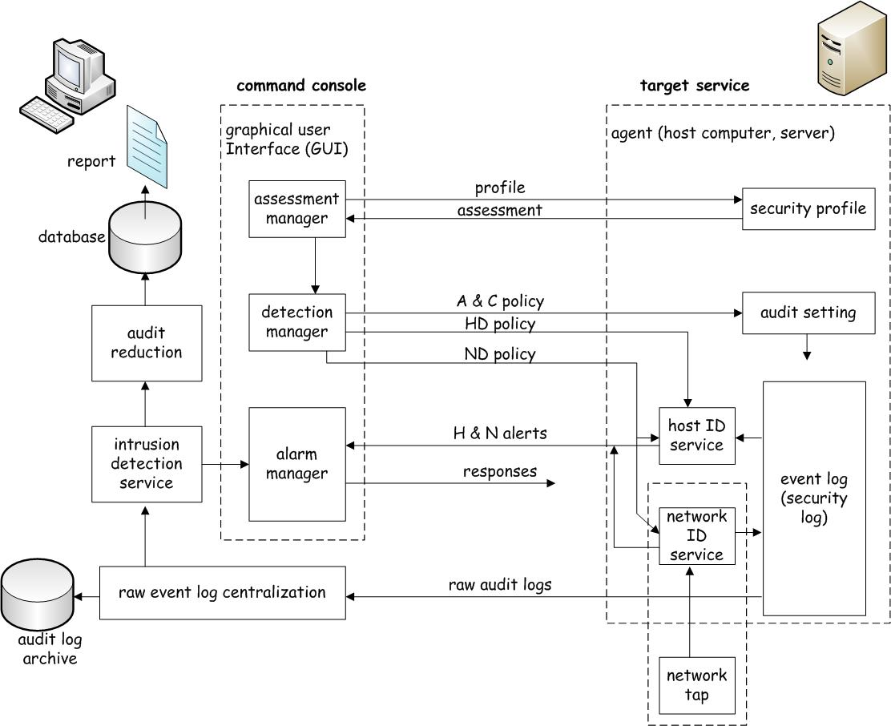
IDS Architecture
Command console
  Control and manage the target systems
  Unreachable from external networks
Target service
  Detect intrusions on devices
J. Wang and Z. Kissel. Introduction to Computer Network Security: Theory and Practice. Wiley 2015

Slide 9
Intrusion Detection Policies
IDP are used to identify intrusion activities
Specify what data must be protected and how well they should be protected
Specify what activities are intrusions and how to respond when they are identified
  False Positives vs. False Negatives
  Behavior Classifications
    Green-light behavior: a normal behavior acceptable
    Red-light behavior: an abnormal behavior must be rejected
    Yellow-light behavior: cannot determine with current information
    Reactions to red-light and yellow-light behavior detections:
      Collect more info for better determination, if yellow-light behavior
      Terminate user login session, if red-light behavior
      Disconnect network, if red-light behavior
      Shut down computer
J. Wang and Z. Kissel. Introduction to Computer Network Security: Theory and Practice. Wiley 2015

Slide 10
Unacceptable Behaviors
Behavior:
  A sequence of events or a collection of several sequences of events
Acceptable behavior:
  A sequence of events that follow the system security policy
Unacceptable behavior:
  A sequence of events that violate the system security policy
Challenging issues:
  How to define what behaviors are acceptable or unacceptable?
  How to model and analyze behaviors using quantitative methods
J. Wang and Z. Kissel. Introduction to Computer Network Security: Theory and Practice. Wiley 2015

Slide 11
Chapter 9 Outline
9.1 Basic Ideas of Intrusion Detection
9.2 Network-Based and Host-Based Detections
9.3 Signature Detections
9.4 Statistical Analysis
9.5 Behavioral Data Forensics
9.6 Honeypots
J. Wang and Z. Kissel. Introduction to Computer Network Security: Theory and Practice. Wiley 2015

Slide 12
Network-Based Detections (NBD)
  NBD analyzes network packets
  NBD:
    Identify yellow-light behaviors, red-light behaviors
    Send warning messages to alarm manager in command console
    Log packets in event log for future analysis
  Two major components:
    Network tap:
      tap network at selected points to gather information
    Detection engine:
      Analyze packets and send warning messages
J. Wang and Z. Kissel. Introduction to Computer Network Security: Theory and Practice. Wiley 2015

Slide 13
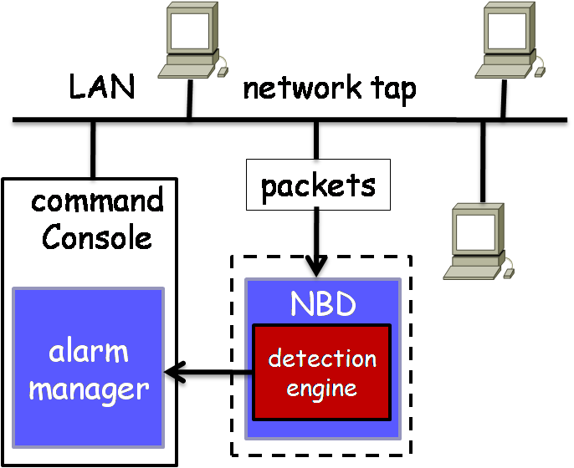
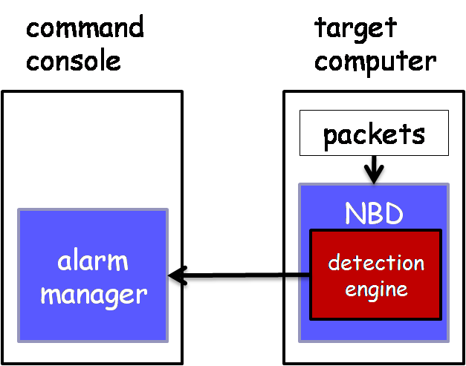
NBD Architecture
Network-Node Detections
  Inside a target computer
Network-Sensor Detections
  At a selected point of network
  Need a network tap
J. Wang and Z. Kissel. Introduction to Computer Network Security: Theory and Practice. Wiley 2015

Slide 14
NBD Pros and Cons
Advantages:
  Low cost
  No interference
  Intrusion resistant
Disadvantages:
  May not be able to analyze encrypted packets
  Hard to handle large volume of traffics in time
  Some intrusion activities are hard to identify
  Hard to determine whether the intrusion has been successfully carried out
J. Wang and Z. Kissel. Introduction to Computer Network Security: Theory and Practice. Wiley 2015

Slide 15
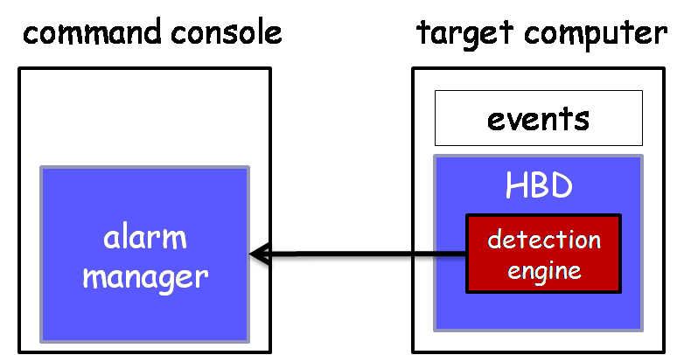
Host-Based Detections (HBD)
HBD analyzes system events and user behaviors and alert the alarm manager
  Check an event log to identify suspicious behavior
  Check system logs, keep record of system files
  Check system configurations
  Keep a copy of the event log in case an intruder modifies it
J. Wang and Z. Kissel. Introduction to Computer Network Security: Theory and Practice. Wiley 2015

Slide 16
HBD Pros and Cons
Advantages:
  Can detect data encrypted during transmissions
  Detect intrusions that cannot be detected by NBD
  Do not need special hardware devices
  Check system logs, more accurate
Disadvantages:
  Require extra system managing
  Consume extra computing resources
  May be affected if host computers or servers affected
  Cannot be installed in routers or switches
J. Wang and Z. Kissel. Introduction to Computer Network Security: Theory and Practice. Wiley 2015

Slide 17
Chapter 9 Outline
9.1 Basic Ideas of Intrusion Detection
9.2 Network-Based and Host-Based Detections
9.3 Signature Detections
9.4 Statistical Analysis
9.5 Behavioral Data Forensics
9.6 Honeypots
J. Wang and Z. Kissel. Introduction to Computer Network Security: Theory and Practice. Wiley 2015

Slide 18
Signature Detection
Also referred to as operational detections or rule-based detections
Inspect current events and decide whether they are acceptable
Two types of signature detections:
  Network signatures
    Analyze packet behaviors
  Host-based signatures
    Analyze event behaviors
A set of behavior rules:
  System files should not be copied by users
  Users should not access disks directly
  Users should not probe other users’ personal directories
  Users should not keep on trying to log on their accounts if three attempts have failed
  …
J. Wang and Z. Kissel. Introduction to Computer Network Security: Theory and Practice. Wiley 2015

Slide 19
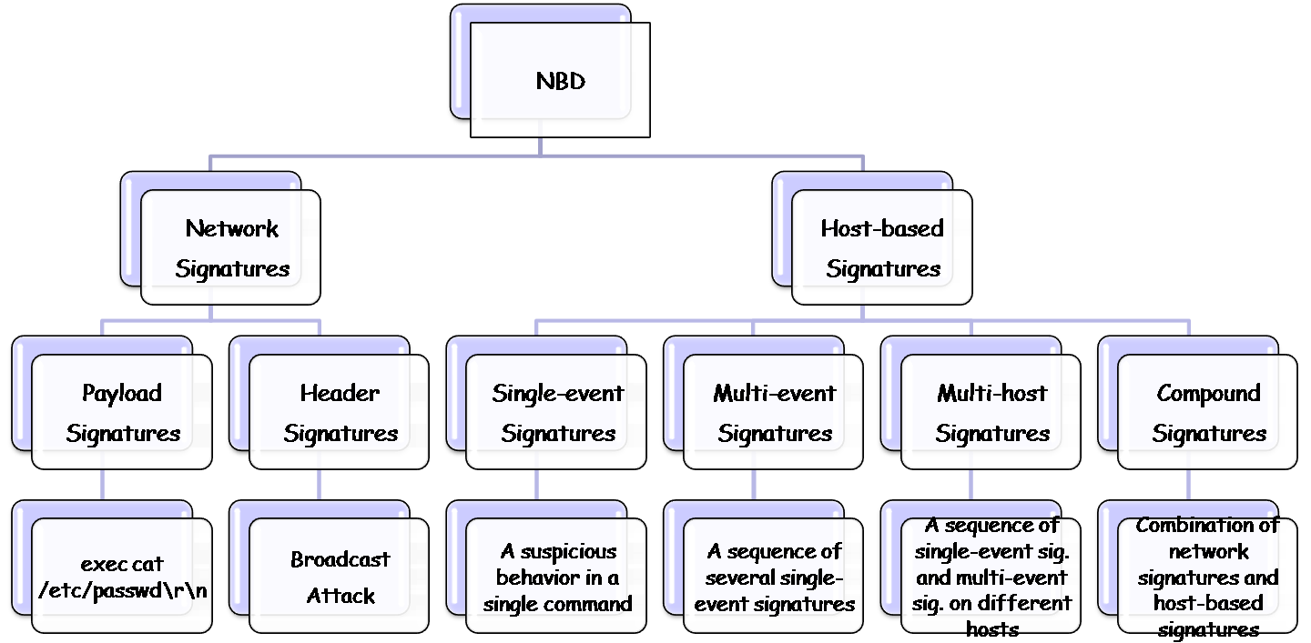
Signature Classification
J. Wang and Z. Kissel. Introduction to Computer Network Security: Theory and Practice. Wiley 2015

Slide 20
Compound Signature Examples
Network-based activities | Host-based activities | Compound signatures
a user uses FTP to log on to the system and uses cd and ls commands | a user browses the etc directory and read the passwd file | a user browses system files from a remote computer
a user uses FTP to log on to the system and uses the put command | the files uploaded to the system have virus and Trojan horse signatures | a user uploads malicious software to the system from a remote computer
a user uses FTP to log on to the system and uses the put command | a user modifies system files and registry entities | a user modifies system files from a remote computer
a certain Web attack | read system executable files | a Web attack is successful
Examples of compound signatures
J. Wang and Z. Kissel. Introduction to Computer Network Security: Theory and Practice. Wiley 2015

Slide 21
Outsider behaviors and insider misuses
Insider: A person with authenticated access to a system
Outsider: A person without authenticated access to a system
Use outsider behaviors to detect intrusion:
  Attacker may plant a Trojan horse, hijack a TCP connection, or try a sweeping attack
Use insider misuses to detect intrusion:
  Attacker may do things legitimate users would not normally do
J. Wang and Z. Kissel. Introduction to Computer Network Security: Theory and Practice. Wiley 2015

Slide 22
Signature Detection System
Build-in System
  Store detection rules inside the system
  Provide an IDS editor to user
  User can select rules based on their needs
Programming System
  Has default rules and a programming language
  Allow users to select rules and define their own rules
Expert System
  More specific and comprehensive
  Require domain experts
J. Wang and Z. Kissel. Introduction to Computer Network Security: Theory and Practice. Wiley 2015

Slide 23
Chapter 9 Outline
9.1 Basic Ideas of Intrusion Detection
9.2 Network-Based and Host-Based Detections
9.3 Signature Detections
9.4 Statistical Analysis
9.5 Behavioral Data Forensics
9.6 Honeypots
J. Wang and Z. Kissel. Introduction to Computer Network Security: Theory and Practice. Wiley 2015

Slide 24
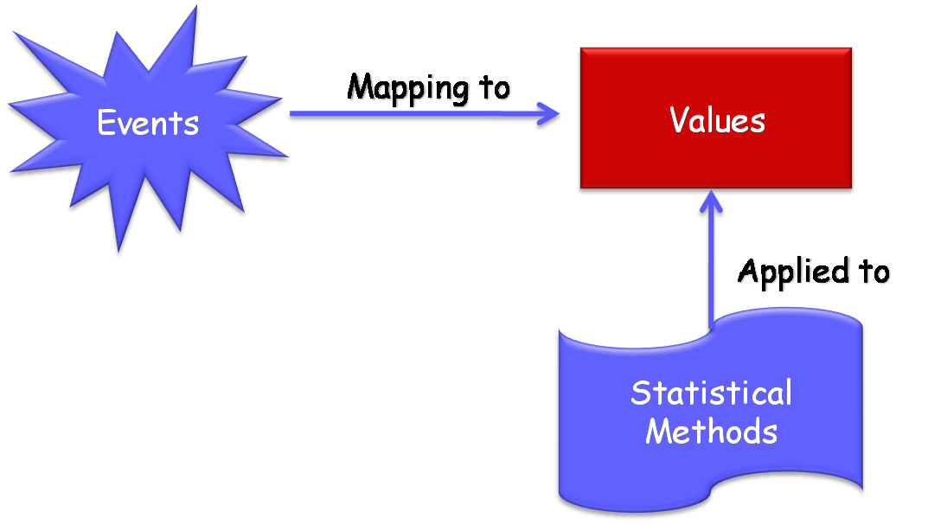
J. Wang and Z. Kissel. Introduction to Computer Network Security: Theory and Practice. Wiley 2015

Slide 25
Common Approaches
Two common approaches to identifying unacceptable events based on quantified event measures:
  Threshold values of certain measures
    Simple but inaccurate
    Count No. of occurrences of certain events during a period of time
  User profile
    More accurate
    Collect past events of a user to create user profiles based on certain quantified measures
J. Wang and Z. Kissel. Introduction to Computer Network Security: Theory and Practice. Wiley 2015

Slide 26
Quantifiable Events
Examples:
  The time a particular event occurs
  The number of times a particular event occurs in a period of time
  The current values of system variables
  The utilization rate of system resources
J. Wang and Z. Kissel. Introduction to Computer Network Security: Theory and Practice. Wiley 2015

Slide 27
Events Measures
Event Counter
  An integer variable for each type of events to record the total number of times this type of events occurs in a fixed period of time
Event Gauge
  An integer variable for each measurable object in the system to denote the current value of the object
Event Timer
  An integer variable for two related events in the system to denote the time difference of the occurrences of the first event and the second event
Resource Utilization
  A variable for each resource in the system to record the utilization of the resource during a fixed period of time
J. Wang and Z. Kissel. Introduction to Computer Network Security: Theory and Practice. Wiley 2015

Slide 28
Statistical Techniques
  The mean and standard deviation
    Compare with the normal values
  Multivariate analysis
    Analyze two or more related variables at the same time to identify anomalies
  Markov process
    Calculate the probability the system changes from one state to another
  Time series analysis
    Study event sequences to find out anomalies
J. Wang and Z. Kissel. Introduction to Computer Network Security: Theory and Practice. Wiley 2015

Slide 29
Chapter 9 Outline
9.1 Basic Ideas of Intrusion Detection
9.2 Network-Based and Host-Based Detections
9.3 Signature Detections
9.4 Statistical Analysis
9.5 Behavioral Data Forensics
9.6 Honeypots
J. Wang and Z. Kissel. Introduction to Computer Network Security: Theory and Practice. Wiley 2015

Slide 30
Behavioral Data Forensics
Behavioral data forensics studies how to use data mining techniques to analyze event logs and search for useful information
Data Mining Techniques
  Data Refinement
  Contextual Interpretation
  Source Combination
  Out-of-Band Data
  Drill Down
A behavioral data forensic example (pp.339)
J. Wang and Z. Kissel. Introduction to Computer Network Security: Theory and Practice. Wiley 2015

Slide 31
Chapter 9 Outline
9.1 Basic Ideas of Intrusion Detection
9.2 Network-Based and Host-Based Detections
9.3 Signature Detections
9.4 Statistical Analysis
9.5 Behavioral Data Forensics
9.6 Honeypots
J. Wang and Z. Kissel. Introduction to Computer Network Security: Theory and Practice. Wiley 2015

Slide 32


Honeypots
Definition:
  Any device, system, directory, or file used as a decoy to lure attackers away from important assets and to collect intrusion behaviors
Mission
  Help its owner to know the enemies
  Sacrifice itself to save the other assets
IDS = Guard
Decoy System = Honeypot
J. Wang and Z. Kissel. Introduction to Computer Network Security: Theory and Practice. Wiley 2015

Slide 33
Types of Honeypots
Physical system, developed in 1990
  Host computers connected to unprotected LANs with real IP addresses
  Require high-level interactions and substantial efforts to maintain it
Software techniques, late 1990’s
  Easy to deploy
  Require low-level interactions
  Honeyd, KFSensor, CyberCop Sting …
J. Wang and Z. Kissel. Introduction to Computer Network Security: Theory and Practice. Wiley 2015

Slide 34
Interaction Levels
Low interaction:
  Daemon only writes to the hard disk of the local host
Mid interaction:
  Daemon reads from and writes to the hard disk of the local host
High interaction
  Daemon interacts with OS, and through OS interacts with hard disk and other resources
J. Wang and Z. Kissel. Introduction to Computer Network Security: Theory and Practice. Wiley 2015

Slide 35
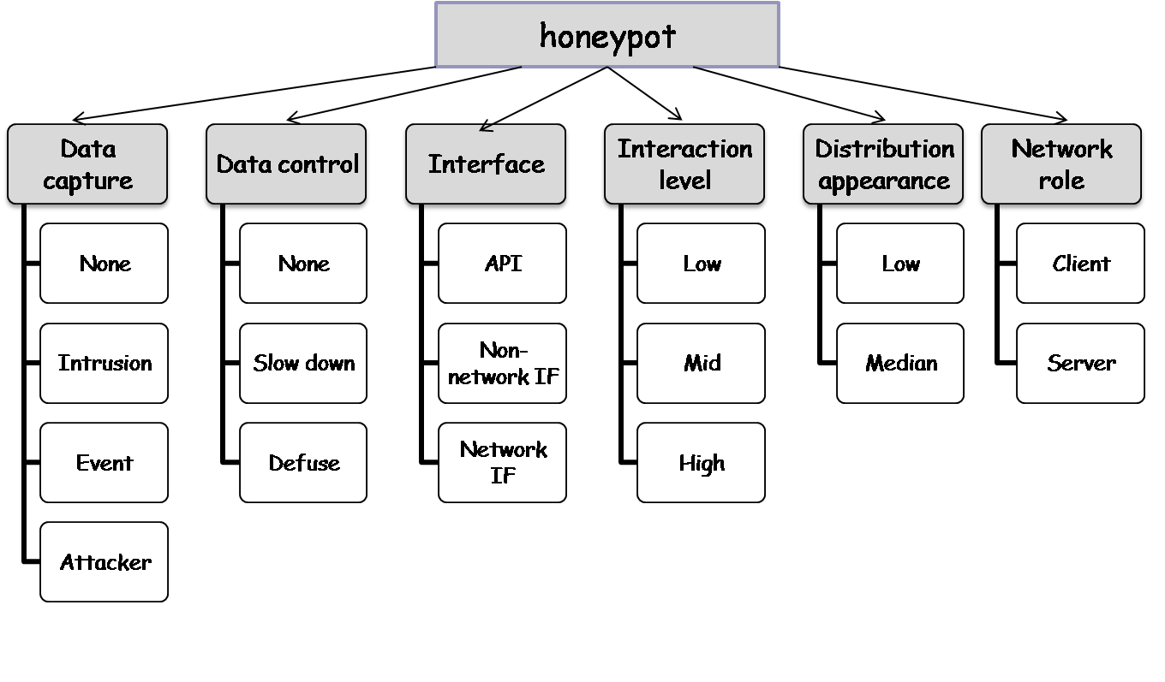
Honeypot functionalities and characterizations
J. Wang and Z. Kissel. Introduction to Computer Network Security: Theory and Practice. Wiley 2015

Slide 36
Honeyd
An engine for running virtual IP protocol stacks in parallel
A lightweight framework for constructing virtual honeypots at the network level
Can simulate standard network services running different OS on different virtual hosts simultaneously
Can detect and disable worms, distract intruders and prevent spread of spam mails
J. Wang and Z. Kissel. Introduction to Computer Network Security: Theory and Practice. Wiley 2015

Slide 37
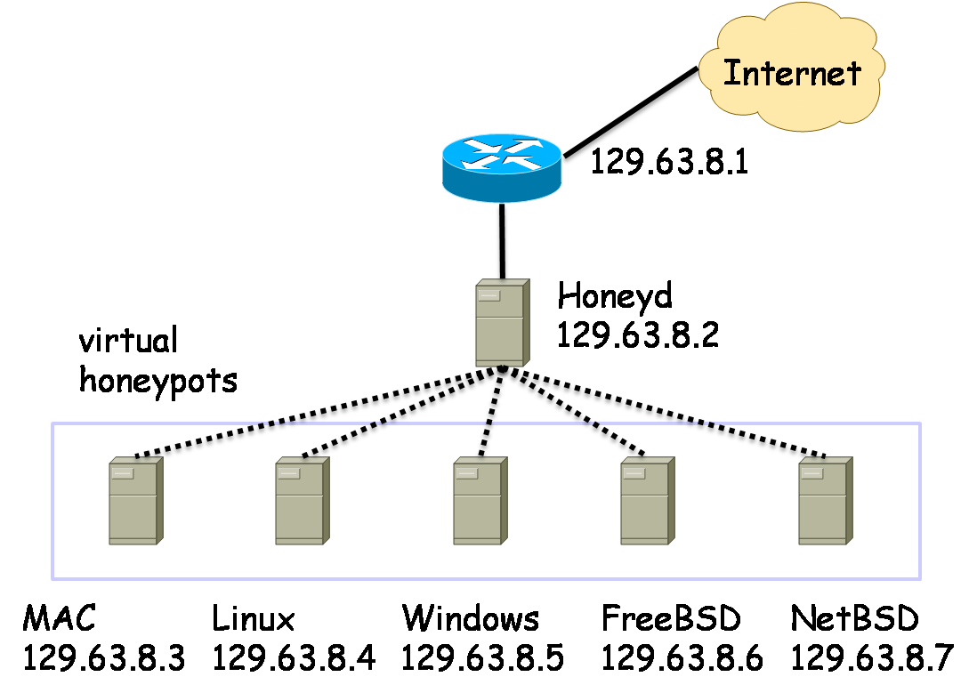
Honeyd Virtual Framework
J. Wang and Z. Kissel. Introduction to Computer Network Security: Theory and Practice. Wiley 2015

Slide 38
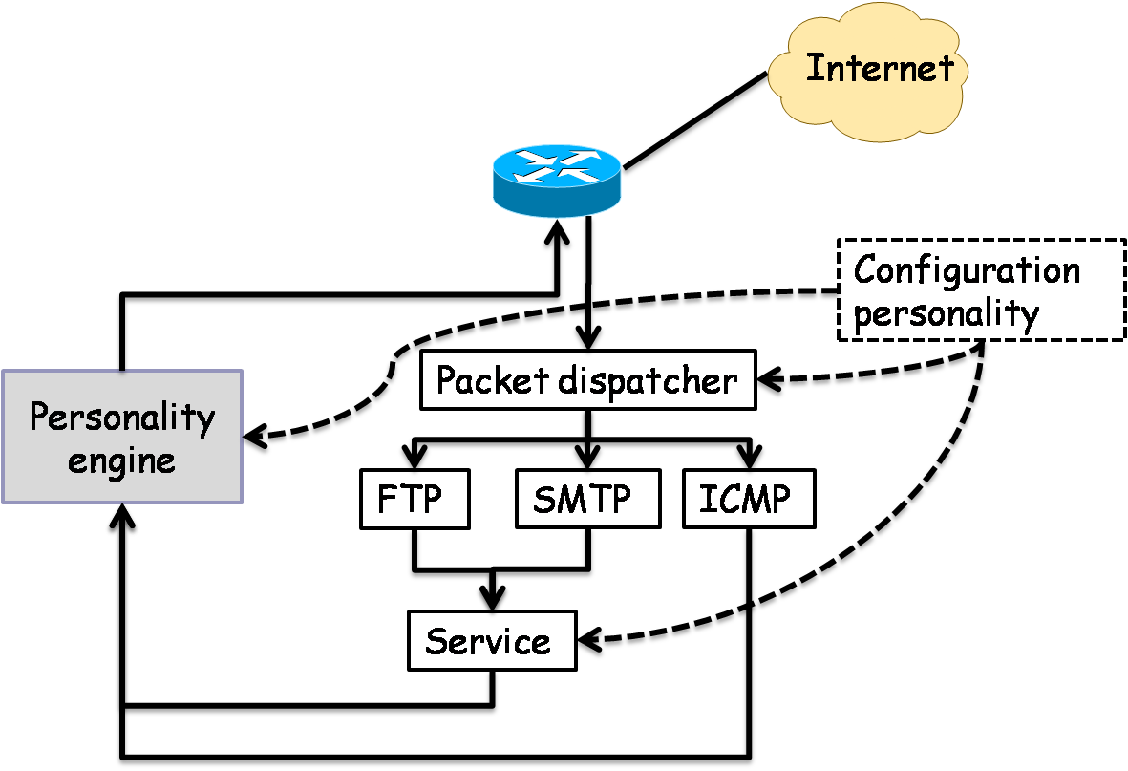
Honeyd Personality Engines
A block diagram of Honeyd architecture
J. Wang and Z. Kissel. Introduction to Computer Network Security: Theory and Practice. Wiley 2015

Slide 39
Other Systems
MWCollect Projects
Honeynet Projects
  Honeywall CDROM
  Sebek
  High Interaction Honeypot Analysis Toolkit (HIHAT)
  HoneyBow
J. Wang and Z. Kissel. Introduction to Computer Network Security: Theory and Practice. Wiley 2015

