Slide 1
Mining Frequent Patterns Without Candidate Generation
Apriori-like algorithm suffers from long patterns or quite low minimum support thresholds.
Two nontrivial costs:
  To handle a huge number of candidate sets.
  To repeatedly scan the database and match patterns.

Slide 2
Mining Frequent Patterns Without Candidate Generation
A novel data structure, frequent pattern tree(FP-tree), is used to prevent generating a large amount of candidate sets.
A compact data structure based on the following observations.
  Perform one scan of DB to identify the set of frequent items.
  Store the set of frequent items of each transaction in some compact structure.

Slide 3
Definition of FP-tree
A frequent pattern tree is defined below.
  It consists of one root labeled as “null”, a set of item prefix subtrees as the children of the root, and a frequent-item header table.
  Each node in the item prefix subtree consists of three fields: item-name, count, and node-link.
  Each entry in the frequent-item header table consists of two fields, (1) item-name and (2) head of node-link.

Slide 4
Algorithm of FP-tree construction
Input: A transaction database DB and a minimum support threshold ξ.
Output: Its frequent pattern tree, FP-tree.
Method:
Scan the DB once. Collect the set of frequent items F and their supports. Sort F in support descending order as L, the list of frequent items.

Slide 5
Algorithm of FP-tree construction
Create the root of an FP-tree, T, and label it as “null”. For each transaction in DB do the following.
  Select and sort the frequent items in transaction according to the order of L. Call insert_tree([p|P],T).
    [p|P] is the sorted frequent item list, where p is the first element and P is the remaining list.

Slide 6
Algorithm of FP-tree construction
The function insert_tree([p|P],T) is performed as follows.
  If T has a child N such that N.item-name=p.item-name, then increment N’s count by 1;
  else create a new node N, and let its count be 1, its parent link be linked to T, and its node-link be linked to the nodes with the same item-name via the node-link structure.
  If P is nonempty, call insert_tree(P,N) recursively.

Slide 7
Analysis of FP-tree construction
Analysis:
  Need only two scans of DB.
  Cost of inserting a transaction into the FP-tree is O(|Trans|).

Slide 8
Frequent Pattern Tree
Lemma 1:
  Given a transaction database DB and a support threshold ξ, its corresponding FP-tree contains the complete information of DB in relevance to frequent pattern mining.
Lemma 2:
  Without considering the (null) root, the size of an FP-tree is bounded by the overall occurrences of the frequent items in the database, and the height of the tree is bounded by the maximal number of frequent items in any transaction in the database.

Slide 9
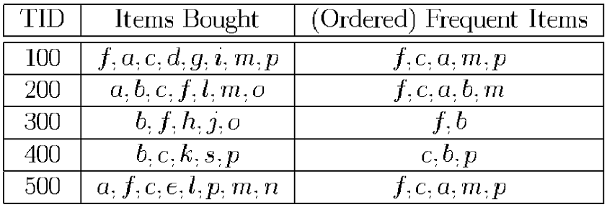
Frequent Pattern Tree — Example
Let Min_Sup = 3. The first scan of DB derives a list of frequent items in frequency descending order: < (f:4), (c:4), (a:3), (b:3), (m:3), (p:3)>.

Slide 10
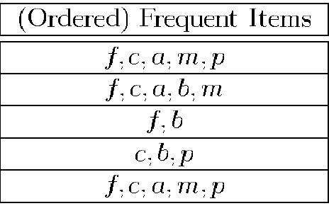
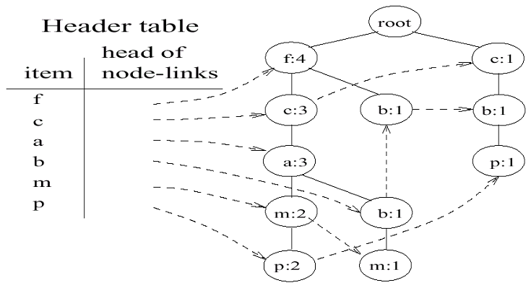
Frequent Pattern Tree — Example
Scan the DB the second time to construct the FP-tree.

Slide 11
Compare Apriori-like method to FP-tree
Apriori-like method may generate an exponential number of candidates in the worst case.
FP-tree does not generate an exponential number of nodes.
The items ordered in the support-descending order indicate that FP-tree structure is usually highly compact.

Slide 12
Mining Frequent Patterns using FP-tree
Property 1 (Node-link property):
  For any frequent item a_{i}, all the possible frequent patterns that contain a_{i} can be obtained by following a_{i}’s node-links, starting from a_{i}’s head in the FP-tree header.

Slide 13
Mining Frequent Patterns using FP-tree
Property 2 (Prefix path property):
  To calculate the frequent patterns for a node a_{i} in a path P, only the prefix subpath of node a_{i} in P need to be accumulated, and the frequent count of every node in the prefix path should carry the same count as node a_{i}.

Slide 14
Mining Frequent Patterns using FP-tree
Lemma 3 (Fragment growth):
  Let α be an itemset in DB, B be α’s conditional pattern base, and β be an itemset in B. Then the support of α∪β in DB is equivalent to the support of β in B.

Slide 15
Mining Frequent Patterns using FP-tree
Corollary 1 (Pattern growth):
  Let α be a frequent itemset in DB, B be α’s conditional pattern base, and β be an itemset in B. Then α∪β is frequent in DB if and only if β is frequent in B.

Slide 16
Mining Frequent Patterns using FP-tree
Lemma 4 (Single FP-tree path pattern generation):
  Suppose an FP-tree T has a single path P. The complete set of the frequent patterns of T can be generated by the enumeration of all the combinations of the subpaths of P with the support being the minimum support of the items contained in the subpath.

Slide 17
Algorithm of FP-growth
Algorithm 2 (FP-growth: Mining frequent patterns with FP-tree by pattern fragment growth):
  Input: FP-tree constructed based on Algorithm 1, using DB and a minimum support threshold ξ.
  Output: The complete set of frequent patterns.
  Method: Call FP-growth(FP-tree, null).

Slide 18
Algorithm of FP-growth
Procedure FP-growth(Tree, α)
{
(1) if Tree contains a single path P then
(2) for each combination (denoted as β) of the nodes in the path P do
(3) generate pattern β∪α with support = minimum support of nodes in β;
(4) else
(5) for each a_{i} in the header of Tree
(6) generate pattern β = a_{i}∪α with support = a_{i}.support;
(7) construct β’s conditional pattern base and then β’s conditional FP-tree Tree_{β};
(8) if Tree_{β} ≠ ∅ then
(9) call FP-growth(Tree_{β}, β)
}

Slide 19
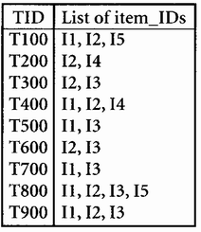
Construct FP-tree from a Transaction Database
Let the minimum support be 20%
  Scan DB once, find frequent 1-itemset (single item pattern)
  Sort frequent items in frequency descending order, f-list
  Scan DB again, construct FP-tree
Frequent 1-itemset | Support Count
I1 | 6
I2 | 7
I3 | 6
I4 | 2
I5 | 2

Slide 20
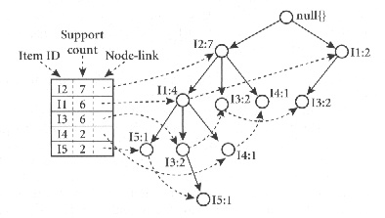
Construct FP-tree from a Transaction Database
TID Items bought (ordered) frequent items
T100 {I1, I2, I5} {I2, I1, I5}
T200 {I2, I4} {I2, I4}
T300 {I2, I3} {I2, I3}
T400 {I1, I2, I4} {I2, I1, I4}
T500 {I1, I3} {I1, I3}
T600 {I2, I3} {I2, I3}
T700 {I1,I3} {I1,I3}
T800 {I1, I2, I3, I5} {I2, I1, I3, I5}
T900 {I1, I2, I5} {I2, I1, I5}

Slide 21
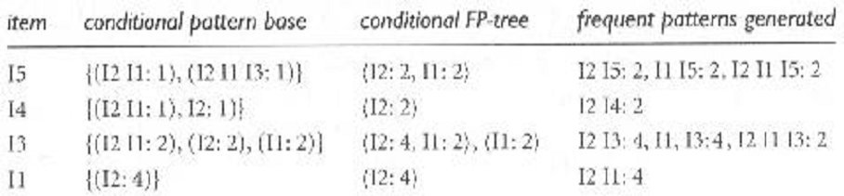
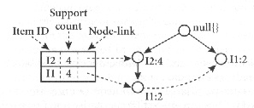
Construct FP-tree from a Transaction Database

Slide 22
Benefits of the FP-tree Structure
Completeness
  Preserve complete information for frequent pattern mining
  Never break a long pattern of any transaction
Compactness
  Reduce irrelevant info—infrequent items are gone
  Items in frequency descending order: the more frequently occurring, the more likely to be shared
  Never be larger than the original database (not count node-links and the count field)
  For Connect-4 DB, compression ratio could be over 100

Slide 23
Construct FP-tree from a Transaction Database

Slide 24
From Conditional Pattern-bases to Conditional FP-trees
Suppose a (conditional) FP-tree T has a shared single prefix-path P
Mining can be decomposed into two parts
  Reduction of the single prefix path into one node
  Concatenation of the mining results of the two parts
{}
a₁:n₁
a₂:n₂
a₃:n₃
{}
r₁
a₁:n₁
+
b₁:m₁
C₁:k₁

r₁
=
b₁:m₁
C₁:k₁
a₂:n₂
C₂:k₂
C₃:k₃
a₃:n₃
C₂:k₂
C₃:k₃

Slide 25
Mining Frequent Patterns With FP-trees
Idea: Frequent pattern growth
  Recursively grow frequent patterns by pattern and database partition
Method
  For each frequent item, construct its conditional pattern-base, and then its conditional FP-tree
  Repeat the process on each newly created conditional FP-tree
  Until the resulting FP-tree is empty, or it contains only one path—single path will generate all the combinations of its sub-paths, each of which is a frequent pattern

Slide 26
Why Is FP-Growth the Winner?
Divide-and-conquer:
  decompose both the mining task and DB according to the frequent patterns obtained so far
  leads to focused search of smaller databases
Other factors
  no candidate generation, no candidate test
  compressed database: FP-tree structure
  no repeated scan of entire database
  basic operations—counting local frequent items and building sub FP-tree, no pattern search and matching

Slide 27
Mining Association Rules in Large Databases
Association rule mining
Algorithms for scalable mining of (single-dimensional Boolean) association rules in transactional databases
Mining various kinds of association/correlation rules
Constraint-based association mining
Sequential pattern mining
Applications/extensions of frequent pattern mining
Summary

Slide 28
Mining Various Kinds of Rules or Regularities
Multi-level, quantitative association rules, correlation and causality, ratio rules, sequential patterns, emerging patterns, temporal associations, partial periodicity
Classification, clustering, iceberg cubes, etc.

Slide 29
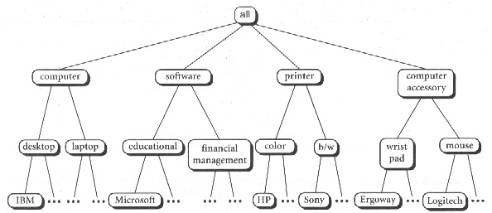
Multiple-level Association Rules
Items often form hierarchy (concept hierarchy)

Slide 30
Multiple-level Association Rules
If an itemset i in the ancestor level is infrequent, the descendent itemsets of i are all infrequent.
Flexible support settings: Items at the lower level are expected to have lower support.
uniform support
reduced support
Level 1
min_sup = 5%
Level 1
min_sup = 5%
Milk
[support = 10%]
Level 2
min_sup = 5%
2% Milk
[support = 6%]
Skim Milk
[support = 4%]
Level 2
min_sup = 3%

Slide 31
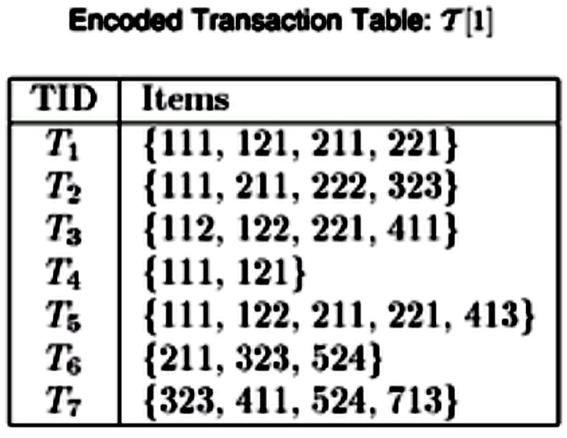
Multiple-level Association Rules
Transaction database can be encoded based on dimensions and levels.
For example, {112}, the first ’1’ represents the “milk” in the first level, the second ’1’ represents the “2%milk” in the second level, and ’2’ represents the brand “NESTLE” in the third level.

Slide 32
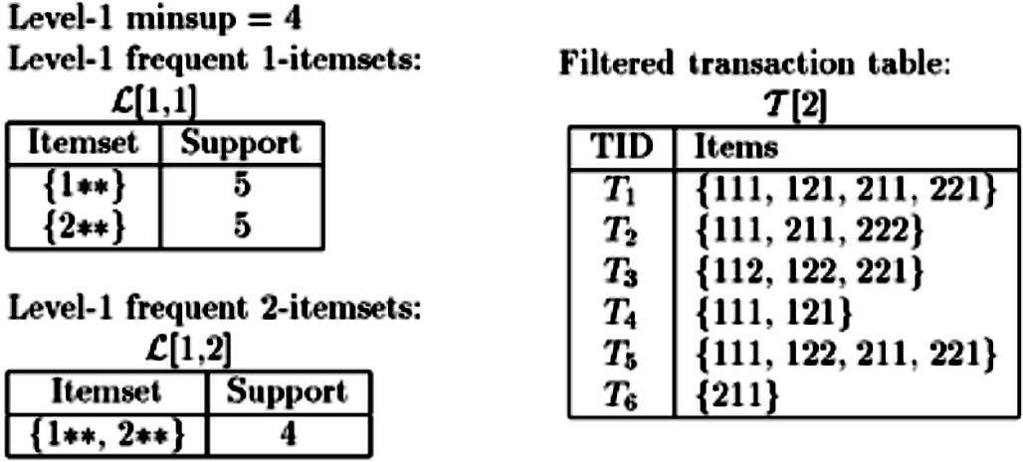
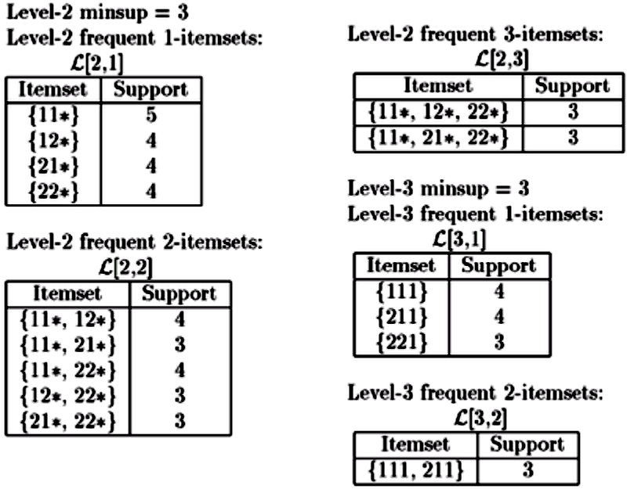
Multiple-level Association Rules

Slide 33
Multi-level Association: Redundancy Filtering
Some rules may be redundant due to “ancestor” relationships between items.
Example
  milk ⇒ bread [support = 8%, confidence = 70%]
  2% milk ⇒ bread [support = 2%, confidence = 72%]
We say the first rule is an ancestor of the second rule.
A rule is redundant if its support is close to the “expected” value, based on the rule’s ancestor.

