Slide 1
Classification and Prediction
Classification:
  predicts categorical class labels (discrete or nominal)
  classifies data (constructs a model) based on the training set and the values in a classifying attribute and uses it in classifying new data
Prediction:
  models continuous-valued functions, i.e., predicts unknown or missing values
Typical Applications
  credit approval
  target marketing
  medical diagnosis
  treatment effectiveness analysis

Slide 2
Classification—A Two-Step Process
Model construction and model usage
Model construction: describing a set of predetermined classes
  Each tuple/sample is assumed to belong to a predefined class, as determined by the class label attribute
  The set of tuples used for model construction is training set
  The model is represented as classification rules, decision trees, or mathematical formulas

Slide 3
Classification—A Two-Step Process
Model usage: for classifying future or unknown objects
  Estimate accuracy of the model
    The known label of test sample is compared with the classified result from the model
    Accuracy rate is the percentage of test set samples that are correctly classified by the model
    Test set is independent of training set
  If the accuracy is acceptable, use the model to classify data tuples whose class labels are not known

Slide 4
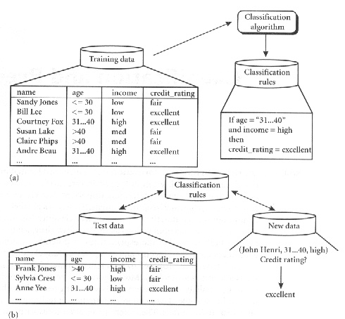
Classification Process: Model Construction and Use the Model in Prediction

Slide 5



Classification Process (1): Model Construction
Classification
Algorithms
Training
Data
Classifier
(Model)
IF rank = ‘professor’
OR years > 6
THEN tenured = ‘yes’

Slide 6




Classification Process (2): Use the Model in Prediction
Classifier
Test
Data
New Data
(Jeff, Professor, 4)
Tenured?

Slide 7
Supervised vs. Unsupervised Learning
Supervised learning (classification)
  Supervision: The training data (observations, measurements, etc.) are accompanied by labels indicating the class of the observations
  New data is classified based on the training set
Unsupervised learning (clustering)
  The class labels of training data is unknown
  Given a set of measurements, observations, etc. with the aim of establishing the existence of classes or clusters in the data

Slide 8
Issues Regarding Classification and Prediction: Data Preparation
Data cleaning
  Preprocess data in order to reduce noise and handle missing values
Relevance analysis (feature selection)
  Remove the irrelevant or redundant attributes
Data transformation
  Generalize and/or normalize data

Slide 9
Issues Regarding Classification and Prediction: Evaluating Classification Methods
Predictive accuracy
Speed and scalability
  time to construct the model
  time to use the model
Robustness
  handling noise and missing values
Scalability
  efficiency in disk-resident databases
Interpretability:
  understanding and insight provided by the model
Goodness of rules
  decision tree size
  compactness of classification rules

Slide 10
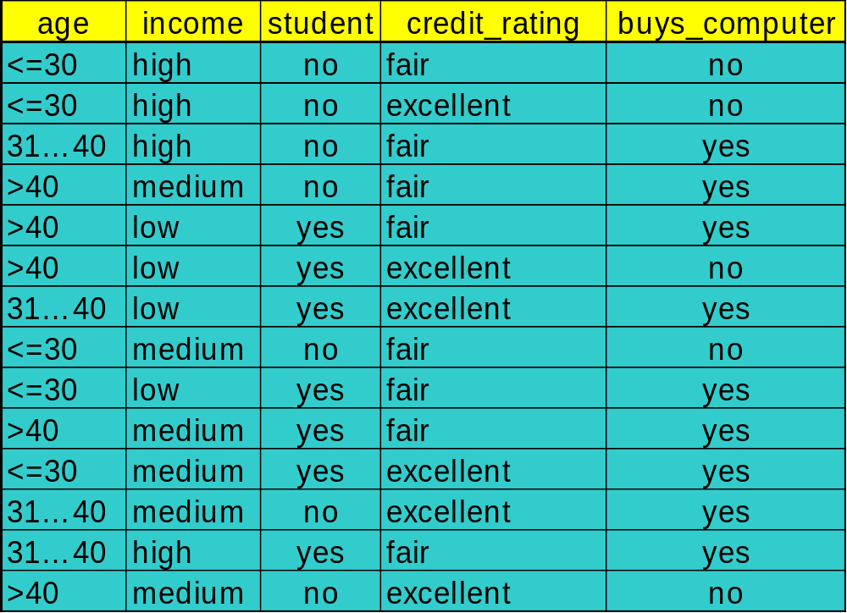
Training Dataset

Slide 11
Output: A Decision Tree for “buys_computer”
age?
<=30
overcast
>40
30..40
student?
yes
credit rating?
no
yes
excellent
fair
no
yes
no
yes

Slide 12
Algorithm for Decision Tree Induction
Basic algorithm (a greedy algorithm)
  Tree is constructed in a top-down recursive divide-and-conquer manner
  At start, all the training examples are at the root
  Attributes are categorical (if continuous-valued, they are discretized in advance)
  Examples are partitioned recursively based on selected attributes
  Test attributes are selected on the basis of a heuristic or statistical measure (e.g., information gain)

Slide 13
Algorithm for Decision Tree Induction
Conditions for stopping partitioning
  All samples for a given node belong to the same class
  There are no remaining attributes for further partitioning
  There are no samples left

Slide 14
Decision-Tree Classification
(1) create a node N;
(2) if samples are of the same class, C, then
(3) return N as a leaf node labeled with the class C;
(4) if attribute-list is empty then
(5) return N as a leaf node labeled with the most common class in samples;
(6) select test-attribute, the attribute among attribute-list with the highest information gain;
(7) label node N with test-attribute;

Slide 15
Decision-Tree Classification
(8) for each known value a_{i} of test-attribute
(9) grow a branch from node N for the condition test-attribute=a_{i};
(10) let s_{i} be the set of samples in samples for which testattribute=a_{i};// a partition
(11) if s_{i} is empty then
(12) attach a leaf labeled with the most common class in samples;
(13) else attach the node returned by Generate_decision_tree(s_{i}, attribute-list-best-attribute);

Slide 16
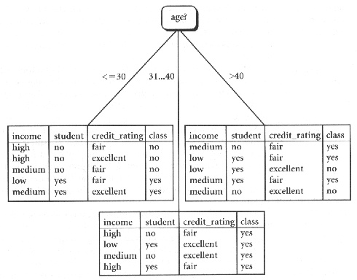
Decision-Tree Classification

Slide 17
Choose Split Attribute
The attribute selection measure is also called Goodness function
Different algorithms may use different goodness functions:
  – information gain
  – gini index
  – inference power

Slide 18
Primary Issues in Tree Construction
Branching scheme:
  Determining the tree branch to which a sample belongs
When to stop the further splitting of a node
Labeling rule: a node is labeled as the class to which most samples at the node belongs

Slide 19
How to Use a Tree?
Directly
  test the attribute value of unknown sample against the tree.
  A path is traced from root to a leaf which holds the label
Indirectly
  decision tree is converted to classification rules
  one rule is created for each path from the root to a leaf
  IF-THEN is easier for humans to understand

Slide 20
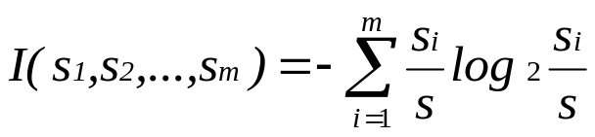
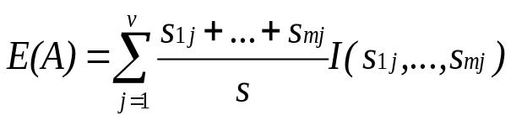

Information Gain
Select the attribute with the highest information gain
S contains s_{i} tuples of class C_{i} for i = {1, …, m}
information measures information required to classify any arbitrary tuple
entropy of attribute A with values {a₁,a₂,…,a_{v}}
information gained by branching on attribute A

Slide 21
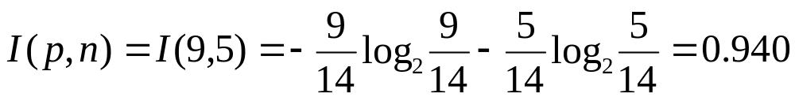
Attribute Selection by Information Gain Computation
Class P: buys_computer = “yes”
Class N: buys_computer = “no”
Information

Slide 22

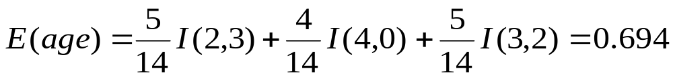
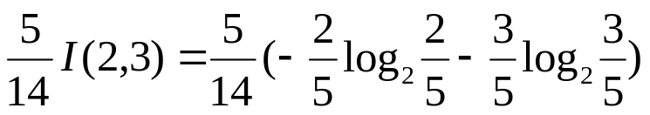

Attribute Selection by Information Gain Computation
Compute the entropy for age:
Where means “age <=30” has 5 out of 14 samples, with 2 yes’es and 3 no’s.
Hence
Similarly,

Slide 23
Attribute Selection by Information Gain Computation
age?
<=30
overcast
>40
30..40
student?
yes
credit rating?
no
yes
excellent
fair
no
yes
no
yes

