Slide 1
Gini Index (IBM IntelligentMiner)
Gini index
  All attributes are assumed continuous-valued
  Assume there exist several possible split values for each attribute
  May need other tools, such as clustering, to get the possible split values
  Can be modified for categorical attributes

Slide 2
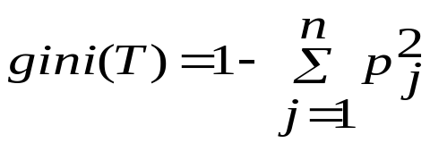
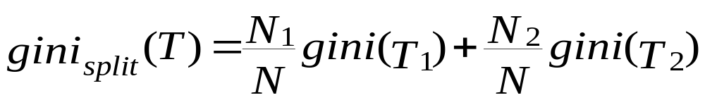
Gini Index (IBM IntelligentMiner)
If a data set T contains examples from n classes, gini index, gini(T) is defined as
where p_{j} is the relative frequency of class j in T.
If a data set T is split into two subsets T₁ and T₂ with sizes N₁ and N₂ respectively, the gini index of the split data contains examples from n classes, the gini index gini(T) is defined as
The attribute provides the smallest gini_{split}(T) is chosen to split the node (need to enumerate all possible splitting points for each attribute).

Slide 3
Example for gini Index
Suppose there two attributes: age and income, and the class label is buy and not buy.
There are three possible split values for age: 30, 40, 50.
There are two possible split values for income: 30K, 40K
We need to calculate the following gini Index
  gini_{age=30}(T), gini_{age=40}(T), gini_{age=50}(T),
  gini_{income=30k}(T), gini_{income=40k}(T)
choose the minimal one as the split attribute

Slide 4
Inference Power of an Attribute
A feature that is useful in inferring the group identity of a data tuple is said to have a good inference power to that group identity.
In the following table, given attributes (features) “Gender”, “Beverage”, “State”, try to find their inference power to “Group id”

Slide 5
Inference Power of an Attribute
Label | Gender | Beverage | State | Group id
1 | M | water | CA | I
2 | F | juice | NY | I
3 | M | water | NY | I
4 | F | milk | TX | I
5 | M | water | NY | I
6 | M | juice | CA | I
7 | M | water | TX | III
8 | F | juice | CA | II
9 | F | juice | NY | II
10 | F | milk | CA | I
11 | M | milk | TX | II
12 | M | milk | TX | II
13 | F | milk | TX | II
14 | F | water | NY | III
15 | F | water | CA | III

Slide 6
Inference Power of an Attribute
Distribution when the profile is classified by gender.
Gender | I | II | III | (max, group)
Male | 4 | 2 | 1 | (4, I)
Female | 3 | 3 | 2 | (3, I)
Hit ratio: 7/15

Slide 7
Inference Power of an Attribute
Distribution when the profile is classified by state.
State | I | II | III | (max, group)
CA | 3 | 1 | 1 | (3, I)
NY | 3 | 1 | 1 | (3, I)
TX | 1 | 3 | 2 | (3, II)
Hit ratio: 9/15

Slide 8
Inference Power of an Attribute
Distribution when the profile is classified by beverage.
beverage | I | II | III | (max, group)
Juice | 2 | 2 | 0 | (2, I)
Water | 3 | 0 | 3 | (3, I)
Milk | 2 | 3 | 0 | (3, II)
Hit ratio: 8/15

Slide 9
Inference Power of an Attribute
The “state” attribute is found to have the largest inference power
The procedure continues similarly after the first level tree expanding

Slide 10
Inference Power of Multiple Attributes
It is noted that in some cases,
  the group identity is not so dependent on the value of a single attribute
  but instead, it is dependent upon the combined values of a set of attributes

Slide 11
Inference Power of Multiple Attributes
In the following table , “a male of low income and a female with high income” drive car
  neither gender nor income has good inference power
Label | Gender | Income | Vehicle
1 | M | low | car
2 | M | low | car
3 | F | high | car
4 | F | high | car
5 | M | high | bike
6 | M | high | bike
7 | F | low | bike
8 | F | low | bike

Slide 12
Algorithm for Inference Power Mining
Feature extraction phase:
  To learn useful features, which have good inference powers to group identities, from a subset of the training database.
Feature combination phase:
  To evaluate extracted features based on the entire training database and form multi-attribute predicates with good inference powers.

Slide 13
Remarks
Note that for the example profile
  “state” is the attribute with the largest inference power
  “beverage” is the attribute with the highest information gain
  Information gain considers the cost of the whole process; hit ratio corresponds to a one-step optimization

Slide 14
Extracting Classification Rules from Trees
Represent the knowledge in the form of IF-THEN rules
One rule is created for each path from the root to a leaf
Each attribute-value pair along a path forms a conjunction
The leaf node holds the class prediction
Rules are easier for humans to understand

Slide 15
Extracting Classification Rules from Trees
Example
  IF age = “<=30” AND student = “no” THEN buys_computer = “no”
  IF age = “<=30” AND student = “yes” THEN buys_computer = “yes”
  IF age = “31…40” THEN buys_computer = “yes”
  IF age = “>40” AND credit_rating = “excellent” THEN buys_computer = “yes”
  IF age = “<=30” AND credit_rating = “fair” THEN buys_computer = “no”

Slide 16
Classification in Large Databases
Scalability: Classifying data sets with millions of examples and hundreds of attributes with reasonable speed
Why decision tree induction in data mining?
  relatively faster learning speed (than other classification methods)
  convertible to simple and easy to understand classification rules
  comparable classification accuracy with other methods

Slide 17

Presentation of Classification Results

Slide 18

Visualization of a Decision Tree

Slide 19
Neural Networks
Analogy to Biological Systems
Massive Parallelism allowing for computational efficiency
The first learning algorithm came in 1959 (Rosenblatt) who suggested that if a target output value is provided for a single neuron with fixed inputs, one can incrementally change weights to learn to produce these outputs

Slide 20
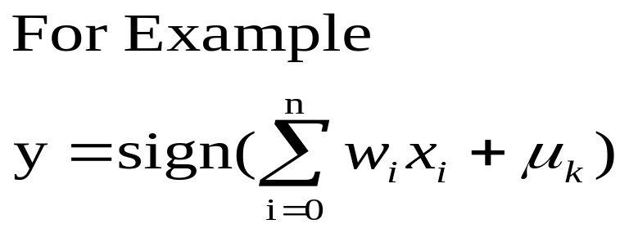
A Neuron
-
μ_{k}
x₀
w₀
x₁
w₁
∑
f
output y
x_{n}
w_{n}
Input
vector x
weight
vector w
weighted
sum
Activation
function
The n-dimensional input vector x is mapped into variable y by means of the scalar product and a nonlinear function mapping

Slide 21
Multi-Layer Feed-Forward Neural Network
Output vector
Output nodes
Hidden nodes
Input nodes
Input vector: x_{i}

Slide 22
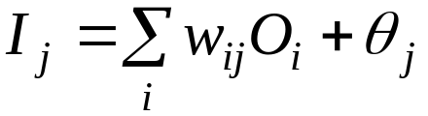
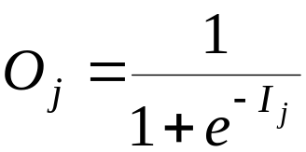


Multi-Layer Feed-Forward Neural Network
Given a unit j in a hidden or output layer, the net input, I_{j}, to unit j is
Given the net input I_{j} to unit j, then O_{j}, the output of unit j, is computed as
For a unit j in the output layer, the error Err_{j} is computed by
The error of a hidden layer unit j is

Slide 23


Multi-Layer Feed-Forward Neural Network
Weights are updated by
The biases are updated by the following equations

Slide 24
Network Training
The ultimate objective of training
  obtain a set of weights that makes almost all the tuples in the training data classified correctly
Steps
  Initialize weights with random values
  Feed the input tuples into the network one by one
  For each unit
    Compute the net input to the unit as a linear combination of all the inputs to the unit
    Compute the output value using the activation function
    Compute the error
    Update the weights and the bias

Slide 25
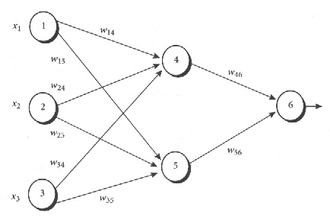
Multi-Layer Feed-Forward Neural Network – An Example

Slide 26
Multi-Layer Feed-Forward Neural Network – An Example
Initial input, weight, and bias values
The net input and output calculations
x₁ | x₂ | x₃ | w₁₄ | w₁₅ | w₂₄ | w₂₅ | w₃₄ | w₃₅ | w₄₆ | w₅₆ | θ₄ | θ₅ | θ₆
1 | 0 | 1 | 0.2 | -0.3 | 0.4 | 0.1 | -0.5 | 0.2 | -0.3 | -0.2 | -0.4 | 0.2 | 0.1
Unit j | Net input, I_{j} | Output, O_{j}
4 | 0.2+0-0.5-0.4=-0.7 | 1/(1+e^{0.7})=0.332
5 | -0.3+0+0.2+0.2=0.1 | 1/(1+e^{-0.1})=0.525
6 | (-0.3)(0.332)-(0.2)(0.525)+0.1=-0.105 | 1/(1+e^{0.105})=0.474

Slide 27
Multi-Layer Feed-Forward Neural Network – An Example
Calculation of the error at each node
Unit j | Err_{j}
6 | (0.474)(1-0.474)(1-0.474)=0.1311
5 | (0.525)(1-0.525)(0.1311)(-0.2)=-0.0065
4 | (0.332)(1-0.332)(0.1311)(-0.3)=-0.0087

Slide 28
Multi-Layer Feed-Forward Neural Network – An Example
Calculations for weight and bias updating
Weight or bias | New value
W₄₆ | -0.3+(0.9)(0.1311)(0.332)=-0.261
W₅₆ | -0.2+(0.9)(0.1311)(0.525)=-0.138
W₁₄ | 0.2+(0.9)(-0.0087)(1)=0.192
W₁₅ | -0.3+(0.9)(-0.0065)(1)=-0.306
W₂₄ | 0.4+(0.9)(-0.0087)(0)=0.4
W₂₅ | 0.1+(0.9)(-0.0065)(0)=0.1
W₃₄ | -0.5+(0.9)(-0.0087)(1)=-0.508
W₃₅ | 0.2+(0.9)(-0.0065)(1)=0.194
θ₆ | 0.1+(0.9)(0.1311)=0.218
θ₅ | 0.2+(0.9)(-0.0065)=0.194
θ₄ | -0.4+(0.9)(-0.0087)=-0.408

Slide 29
What Is Prediction?
Prediction is similar to classification
  First, construct a model
  Second, use model to predict unknown value
    Major method for prediction is regression
      Linear and multiple regression
      Non-linear regression
Prediction is different from classification
  Classification refers to predict categorical class label
  Prediction models continuous-valued functions

Slide 30
Predictive Modeling in Databases
Predictive modeling: Predict data values or construct generalized linear models based on the database data.
Method outline:
  Attribute relevance analysis
  Generalized linear model construction
  Prediction
Determine the major factors which influence the prediction
  Data relevance analysis: uncertainty measurement, entropy analysis, expert judgment, etc.

Slide 31
Regress Analysis and Log-Linear Models in Prediction
Linear regression: Y = α + β X
  Two parameters , α and β specify the line and are to be estimated by using the data at hand.
  using the least squares criterion to the known values of Y1, Y2, …, X1, X2, ….
Multiple regression: Y = α + β₁X₁ + β₂X₂
  Many nonlinear functions can be transformed into the above.
Log-linear models: Y = α + β₁X + β₂X² + β₃X³
  Polynomial regression

Slide 32
Summary
Classification is an extensively studied problem (mainly in statistics, machine learning & neural networks)
Classification is probably one of the most widely used data mining techniques with a lot of extensions
Scalability is still an important issue for database applications: thus combining classification with database techniques should be a promising topic
Research directions: classification of non-relational data, e.g., text, spatial, multimedia, etc..

